Slide 1

Advance Python Course
Trainer: Fawad Bahadur Marwat

Slide 2
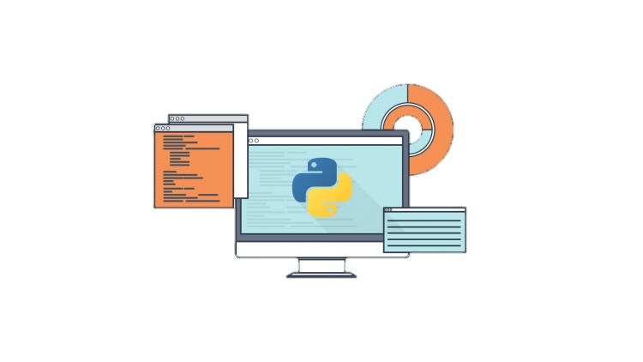

Introduction to Python
High-level, interpreted, general-purpose programming language.
Known for its clear syntax, readability, and simplicity.
What Is Python?
Python is a high-level, interpreted, general-purpose programming language.
Known for its clear syntax, readability, and simplicity.
Used by beginners and experts alike due to its versatility.
Why Learn Python?
Beginner-friendly yet powerful for complex applications.
Widely adopted by Google, NASA, Netflix, and more.

Slide 3


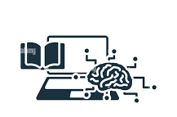
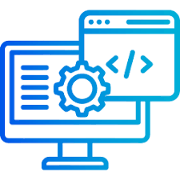

Conti…
Key Features
Easy to Learn & Write – Minimalistic syntax, resembles English.
Rich Standard Library – Pre-built modules for faster develop
Strong Community Support – Active forums, tutorials, and open-source contributions.
Versatile – Used in:
Web Development (Django, Flask)
Data Science & AI (Pandas, TensorFlow)
Automation & Scripting
Game Development (Pygame)

Slide 4
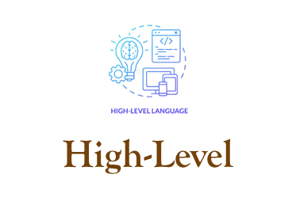
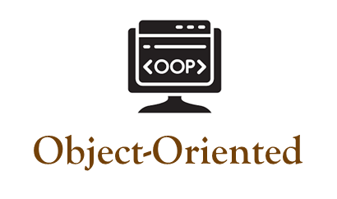
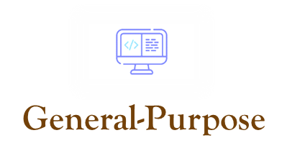
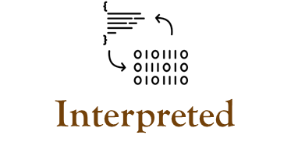
Key characteristics
Simple, abstracted coding
Classes, objects support
Versatile, multi-domain use
Runs without compilation

Slide 5
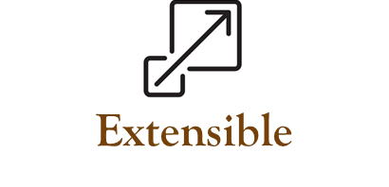
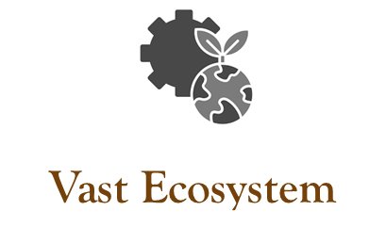
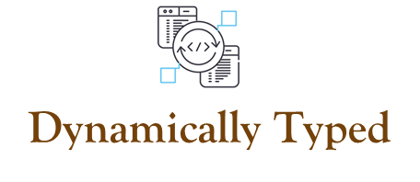
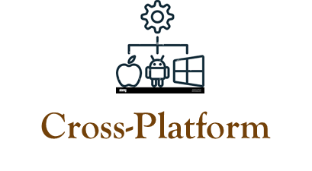
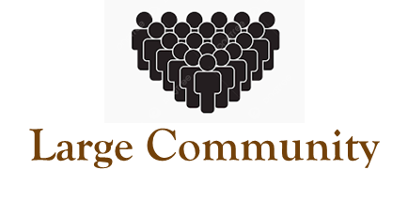
Conti…
Integrates external code
Rich libraries, tools
Flexible variable types
Runs on all OS
Active, supportive network

Slide 6

Python Programming
Applications
Web Development
Data Science
Data Analytics
Machine Learning & AI
Automation and Scripting
Software Development and Prototyping
Desktop GUI applications
Scientific and Numeric Computing
Game Development
Education and Research

Slide 7
THANK YOU

