Slide 1

Advance Python Course
Trainer: Fawad Bahadur Marwat

Slide 2
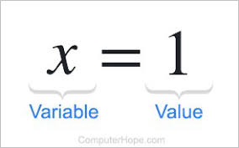

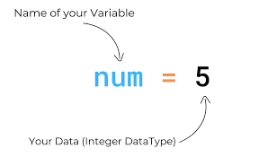

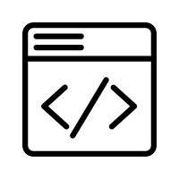
Variables in Python
What is a Variable?
A named container to store data in memory.
Holds values that can be changed during program execution.
No need to declare type
Key Rules
Names are case-sensitive (x ≠ X).
Can include letters, digits, _ (no spaces).
Cannot start with a digit.
Avoid Python keywords (if, for, etc.).
Syntax
Example
variable_name = value
age = 25
name = "Alice"
Trainer: Fawad Bahadur Marwat

Slide 3
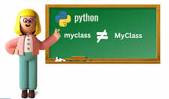
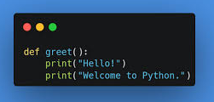
Python Syntax & Structure
Indentation matters (no braces)
✅Case-sensitive
✅ Indentation matters (no braces)
✅ Comments: # single-line, ''' multi-line '‘’
✅ Statement ends by newline (no semicolon needed)
Trainer: Fawad Bahadur Marwat

Slide 4


Comments in Python
Explain complex logic.
Describe functions or modules.
Help others understand your code.
Explain complex logic.
Describe functions or modules.
Help others understand your code.
Definition
Comments are used to explain code and make it more readable.
They are ignored by the Python interpreter and do not affect the program’s execution.
Why Use ?
Example
Explain complex logic.
Describe functions or modules.
Help others understand your code.
# This is a comment

Slide 5
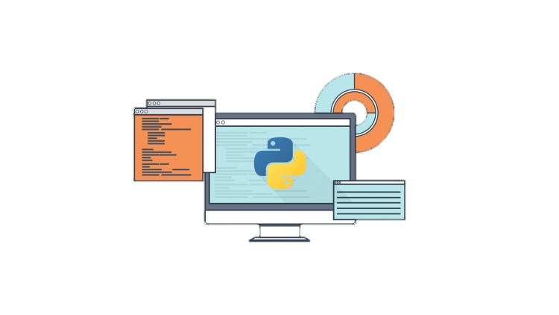
Types of Comments
1. Single-line Comment
This is a single-line comment
print("Hello, Python!")
2. Multi-line Comment / Docstring
'''
This is a multi-line comment.
It can span multiple lines.
'''
print("Hello, Python!")

Slide 6
Data Types
What is Data type?
Building Blocks of Python Programs
1. Numeric Types
Int, Float, Complex
2. Sequence Types
Str, list, tuple
3. Mapping Types
dict
4. Set Types
Set
5. Boolean Types
bool
6. None Types
None
Dict
int
str
bool
list
tuple
float

Slide 7
THANK YOU

