Slide 1

Advance Python Course
Trainer: Fawad Bahadur Marwat

Slide 2




Integers in Python
What is a Integers?
Syntax
A whole number (positive, negative, or zero) without decimals of unlimited length.
Used for counting, indexing, and mathematical operations.
variable_name = integer_value
Integers
Example
age = 30
temperature = -10
count = 0
Key Properties
Immutable: Cannot be changed after creation
(a new object is created on modification).
Unlimited Size: Python handles large numbers seamlessly.
Trainer: Fawad Bahadur Marwat

Slide 3
Floating-Point Numbers (Floats) in Python
What is a Floats?
Syntax
Represents real numbers (with decimal points or scientific notation).
Used for measurements, scientific calculations, and fractional values.
variable_name = float_value
Float
Example
pi = 3.14159
temperature = -12.5
scientific_notation = 2.5e3 # 2500.0
Key Properties
Precision: Limited by hardware (64-bit double-precision).
Immutable: Like integers, floats are immutable objects.
Trainer: Fawad Bahadur Marwat

Slide 4
Strings in Python
What is a String?
Syntax
A sequence of characters enclosed in quotes (' ' or " ").
Used to represent text data in Python.
string_name = "text" # or 'text'
String
Example
name = "Alice"
greeting = 'Hello, World!'
multiline = """This is a
multi-line string"""
Key Properties
Immutable: Cannot be changed after creation.
Indexed: Access characters using indices (starts at 0).
Iterable: Can loop through characters.
Trainer: Fawad Bahadur Marwat

Slide 5


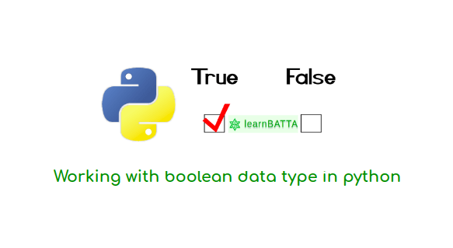
Boolean (bool) in Python
Definition
Represent True or False values.
Example
is_logged_in = True
if is_logged_in:
print("User is logged in")
# Output: User is logged in
Key Uses:
Control flow in if and while statements.
Result of logical operations (e.g., 5 > 3 → True).
Represent states (e.g., on/off, open/closed).
Bool
Conversions:
bool(0) → False,
bool(1) → True.
Trainer: Fawad Bahadur Marwat

Slide 6
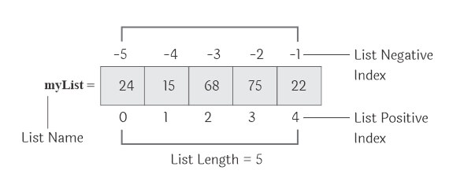
List in Python
Definition
Ordered, mutable collections of items.
Key Features
Can store mixed data types (e.g., integers, strings, lists).
Indexed from 0.
Supports operations: .append(), .remove(), .sort().
Use Cases
Store sequences (e.g., names, numbers, objects).
Example
fruits = ["apple", "banana", "cherry"]
fruits.append("orange")
print(fruits)
# Output: ['apple', 'banana', 'cherry', 'orange']
LIST
Trainer: Fawad Bahadur Marwat

Slide 7
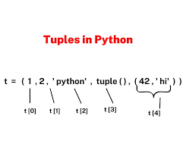
Tuple in Python
Definition
Ordered, immutable collections of items.
Key Features
Values cannot be changed after creation.
Indexed from 0, like lists.
Can store mixed data types (e.g., integers, strings, tuples).
Use Cases
Fixed data sets (e.g., coordinates, color values).
Unpacking: x, y = (10, 20).
Example
coordinates = (34.0522, -118.2437)
print(coordinates[0]) # Output: 34.0522
Tuple
Trainer: Fawad Bahadur Marwat

Slide 8
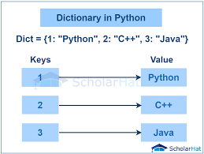
Dictionary in Python
Definition
Stores data in key-value pairs for fast lookups.
Keys: Unique, immutable (e.g., strings, numbers, tuples).
Values: Any data type, mutable.
Use Cases: Structured data (e.g., user profiles, settings, JSON).
Example
student = {"name": "Alice", "age": 22}
print(student["name"]) # Output: Alice
Dict
Key Operations
Add: dict['key'] = value
Remove: del dict['key']
Advantage: Fast key-based access via hashing.
Trainer: Fawad Bahadur Marwat

Slide 9

Set in Python
Definition
Stores unique, unordered elements..
Keys: Unique, immutable (e.g., strings, numbers, tuples).
Values: Elements must be immutable (e.g., strings, numbers, tuples).
Use Cases:
Membership testing, removing duplicates, mathematical set operations (union, intersection, difference).
Example
numbers = {1, 2, 3, 3, 4}
print(numbers)
# Output: {1, 2, 3, 4} (order may vary)
print(2 in numbers)
# Output: True
Set
Key Operations
Add: set.add(element)
Remove: set.remove(element)
Advantage: Fast membership testing via hashing; automatic duplicate removal.
Trainer: Fawad Bahadur Marwat

Slide 10
Comparison of Mutability and Use Case
Data Type | Example | Mutable | Use Case
Int | x = 5 | - | Whole numbers
Float | y = 3.24 | - | Decimals
Str | s = ‘text’ | ❌ | Text
Bool | Flag = True | - | True/False
List | [1,2,3] | ✅ | Modifiable collection
Tuple | (1,2) | ❌ | Fixed Collection
Dict | {“key” : “value” | ✅ | Key-Value Pairs
Set | {1,2,3} | ✅ | Unique elements
Trainer: Fawad Bahadur Marwat

Slide 11
THANK YOU

