Slide 1
THEPETSVault
AI-Powered Pet Care &
Marketplace Ecosystem
Buy & sell pets • Pet sitting • Vet care • Food & accessories
ONE PET PROFILE
FOUR CONNECTED PILLARS
PRACTICUM-I MID EVALUATION
Trust • Care • Continuity
Syed Rafay Hasan | Hammad Farman | Ghazi Abid | Laiba Mumtaz
Supervisor: Muhammad Kamran
MS in Software Project Management • FAST-NUCES Karachi • Fall 2026

Slide 2
Executive summary
One trusted place for the pet-owner journey
THE PROBLEM
Pet services, records and supplies are fragmented.
THE PRODUCT
Four pillars connected through one pet profile.
THE PLAN
12-month roadmap; Practicum-I M1–M6, Practicum-II M7–M12.
THE ASK
Review scope, plan, budget and risk baseline.
• 11 epics and 29 user stories in the current backlog
• PKR 4.8M planning baseline across 12 months
• Karachi pilot planned for Month 9
• Current stage and actual completion must be reported using evidence
THEPETSVault | Practicum-I Mid Evaluation
2
2

Slide 3
Problem & opportunity
The project problem hypothesis to validate through user and supply-side research
Fragmented buying & selling
Social channels can lack consistent verification, payment protection and accountability.
Scattered health records
Vaccination history may sit on paper, in chats or separate clinic systems.
Hard to find safe care
Owners may rely on personal contacts for sitting, without standard care instructions or emergency workflows.
Disconnected supplies
Food and accessories are purchased separately from health records and care advice.
Opportunity: move from passive classifieds to a trusted service marketplace built around one portable pet profile.
THEPETSVault | Practicum-I Mid Evaluation
3
3

Slide 4
Project objectives & success criteria
FUNCTIONAL
Deliver approved Must-have scope across listings, sitting, vet care, records, store and admin.
TRUST & SAFETY
Verification, moderation, dispute workflows, consent and approved payment provider.
AI
Measured discovery, grounded support and triage routing; no diagnosis or prescriptions.
TECHNICAL
Modular APIs, RBAC, secure cloud, CI/CD and replaceable provider adapters.
BUSINESS
Validate multi-stream model and Karachi-first supply onboarding.
ACADEMIC
Maintain scope, WBS, schedule, risk, budget, EVM and quality evidence.
THEPETSVault | Practicum-I Mid Evaluation
4
4

Slide 5
The solution: four pillars, one pet profile
Think of a pet marketplace connected to ongoing care services
BUY & SELL
Verified sellers • listings • search • messaging • provider-mediated protected payment
PET SITTING
Verified sitters • availability • bookings • care instructions • emergency contact • ratings
VET CARE
Licence checks • appointments • video consults • consultation notes • vaccination records
FOOD & ACCESSORIES
Vendor catalogue • inventory • cart/checkout • order tracking • reviews
UNIFIED PET PROFILE
Identity • vaccination & health records • bookings • purchases
Trust layer: verified onboarding, ratings, moderation, consent and audit trail. AI is decision support, never a diagnosis.
THEPETSVault | Practicum-I Mid Evaluation
5
5

Slide 6
Scope baseline
Clear boundaries prevent scope creep
IN SCOPE (MVP)
• Registration, verification and roles
• Pet profiles and health records
• Pet listings, search and messaging
• Sitting bookings and care instructions
• Vet slots, video consults and notes
• Product catalogue and checkout
• Refunds, disputes, audit trail and admin
• Notifications and three AI capabilities
• Controlled Karachi pilot
OUT OF SCOPE
• AI diagnosis or AI-written prescriptions
• Building own payment gateway or holding regulated funds
• Direct NADRA integration
• Own boarding facilities, warehouse or delivery fleet
• Insurance/claims platform
• Protected wildlife or illegal species trading
• Nationwide rollout before Karachi pilot
• Image-based disease prediction
PENDING DECISIONS
• Supplier payout after commission
• Sitting incident/emergency reporting
• AI listing-risk scoring
• AI sitter ranking
Change control: supervisor approval for changes affecting scope, cost >5%, schedule >1 week, privacy duties or AI medical boundaries.
THEPETSVault | Practicum-I Mid Evaluation
6
6

Slide 7
Users & key journey
Six actors have distinct goals and permissions
Pet owner / buyer
Manage pet, find services, track vaccinations and purchases
Seller
Publish verified listings, message buyers and receive provider-held payment
Pet sitter
Set availability, accept bookings, post check-ins and earn ratings
Veterinarian
Prove licence, set slots, consult and update records
Product vendor
Manage catalogue/inventory and fulfil orders
Platform admin
Review verification, moderate listings and resolve disputes
Example journey: Register & verify → seller lists pet → admin moderates → buyer searches/messages → payment provider holds funds → handover confirmed → pet profile and vet booking.
THEPETSVault | Practicum-I Mid Evaluation
7
7

Slide 8
Requirements analysis: functional vs non-functional
Functional = what the system does | Non-functional = how well and safely it does it
FUNCTIONAL REQUIREMENTS (FRs)
• Register and verify users; apply roles
• Create pet profiles and vaccination records
• Search/filter listings, message and report
• Book sitters and veterinarians
• Manage products, cart, checkout and tracking
• Moderate listings; handle refunds/disputes
• Send reminders and provide AI decision support
NON-FUNCTIONAL REQUIREMENTS (NFRs)
• Performance
• AI response
• Security
• Privacy
• Reliability
• Usability
• Quality
THEPETSVault | Practicum-I Mid Evaluation
8
8

Slide 9
Product backlog: 11 epics, 29 user stories
1. Identity, Auth & Verified Onboarding
4 stories
2. Unified Pet Profile & Health Records
3 stories
3. Pet Marketplace (Buy/Sell)
4 stories
4. Pet Sitting / Boarding
3 stories
5. Veterinary Care & Health Records
4 stories
6. Food & Accessories Commerce
3 stories
7. Trust, Payment & Moderation
3 stories
8. AI Recommendation & Discovery
1 story
9. AI Support & Vet Triage
2 stories
10. Notifications & Reminders
1 story
11. Admin Dashboard & Analytics
1 story
THEPETSVault | Practicum-I Mid Evaluation
12
12

Slide 10
Prototype & demonstration plan
1. Pet profile
Owner creates profile and adds vaccination with next-due badge
2. Marketplace
Seller lists pet; buyer searches/messages; payment provider sandbox/mock holds funds
3. Vet care
Owner books licensed vet slot; consultation note is saved to pet record
4. Pet sitting
Owner books sitter with care instructions and emergency contact
5. AI triage
Red-flag symptom routes to emergency care without diagnosis
THEPETSVault | Practicum-I Mid Evaluation
13
13

Slide 11
Solution architecture & technology
Layered, modular architecture with replaceable provider adapters
EXPERIENCE
Flutter mobile app • Vet portal • Vendor portal • Admin dashboard
API & SECURITY
REST API • Authentication/RBAC • Rate limiting • Audit logging • Notifications
CORE DOMAIN SERVICES
Pet profile & health • Marketplace • Sitting/booking • Vet care/video • Commerce • Payments
ISOLATED AI SERVICES
Recommendation • RAG support/triage assistant • Analytics • Safe fallback
DATA & EXTERNAL ADAPTERS
PostgreSQL • Redis • Object storage • Payment/KYC/video adapters • Maps • SMS/email
Proposed technology choices: Flutter • Node.js/NestJS-style REST API • PostgreSQL • Python/FastAPI • commercial video SDK • approved payment/KYC provider
THEPETSVault | Practicum-I Mid Evaluation
14
14

Slide 12
Responsible AI: decision support, not authority
Targets in the plan require offline evaluation and veterinary review
PERSONALISED DISCOVERY
Rules + content-based similarity
Target: Precision@5 ≥70% on curated test set; fallback to normal search.
GROUNDED SUPPORT CHATBOT
RAG over reviewed knowledge
Target: answers cite approved source; graceful fallback.
VET TRIAGE & ROUTING
Deterministic red-flag rules + RAG
Target: ≥90% correct routing; zero diagnosis claims; human override.
• Vet-reviewed, version-controlled knowledge base
• Red flags trigger escalation to licensed care
• No AI-generated diagnosis, prescription or “medically safe” claim
THEPETSVault | Practicum-I Mid Evaluation
15
15

Slide 13
Innovation & problem-solving
The differentiator is connected trust and continuity—not simply four features
ONE PET PROFILE
Health records, bookings and purchases stay connected.
TRUST BUILT IN
Verified actors, licensed vets, protected-provider payments and audit trail.
PROACTIVE HEALTH
Next-due vaccination reminders, not just passive record storage.
DELIVERY CHALLENGE
Four pillars are broad for one semester. Use MoSCoW, a controlled pilot and formal change control.
RISK-BASED DESIGN
Provider adapters and mock/sandbox fallback; deterministic triage if AI is unsafe or unavailable.
Competitive claims in the source deck should be backed by dated desk research; avoid absolute claims without evidence.
THEPETSVault | Practicum-I Mid Evaluation
16
16

Slide 14

PRODUCT ROADMAP
SIX STOPS FROM FOUNDATION TO GO-LIVE
FOUNDATION
TRUST
MARKETPLACE
1
2
3
M1-M3 Validated plan & design
Requirements baseline, UX prototype, architecture, cloud & CI/CD base
M3-M5 Verified users & pet profiles
Sign-up, roles & KYC; pet profile, vaccination records, document access
M4-M6 Safe pet buying & selling
Listings & search, messaging, protected payment, refunds, disputes & audit
P-I GATE: M6
4
5
6
M5-M7 Sitting & vet care
Sitter booking & ratings; vet licence, slots, video consults; reminders
M6-M8 Store, AI & admin
Food store, personalised discovery, support chatbot, vet triage, admin dashboard
M9-M12 Test, pilot & go-live
UAT & security tests, Karachi pilot, hardening, privacy controls, deployment
CARE
SHOP & SMART
LAUNCH
Stops overlap. Months are project months (M1 = start of Fall 2026). Practicum-I covers M1-M6, Practicum-II covers M7-M12.
Notes:
Walk the road once: foundation, trust, marketplace (Practicum-I gate at Month 6), care, shop and smart, launch. Every one of the 29 user stories sits on one of these stops (see Appendix A4). Timings are mapped from the WBS and overlap by design.

Slide 15
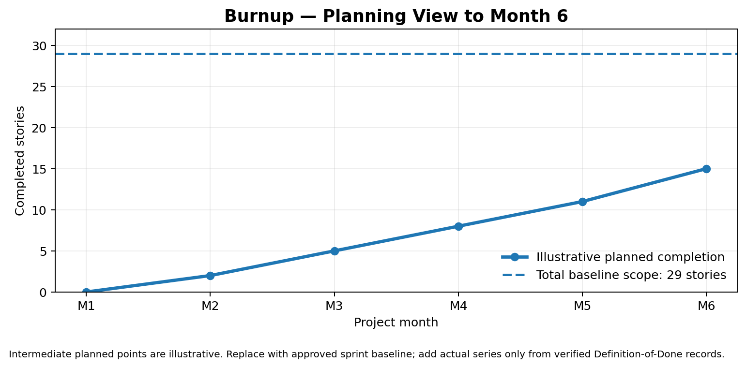
Progress tracking: burnup chart
Burnup shows completed stories against total scope; actual progress must be evidence-based
• Source plan: about 15 of 29 stories by M6
• Approx. 14 stories remain at that planned gate
• Actual line is intentionally not shown until real data is entered
• Count a story only when it meets Definition of Done
• Remaining = current scope − completed stories
THEPETSVault | Practicum-I Mid Evaluation
20
20

Slide 16
Budget & earned value management
PKR 4.80M planning baseline across 12 months
BUDGET CATEGORIES (PKR 000s)
• Software development: 1,400
• Project management / product: 500
• AI engineering: 500
• Cloud, APIs, video, SMS: 350
• QA & testing: 300
• Pilot marketing: 260
• UI/UX: 250
• Security / VAPT: 250
• Business onboarding: 250
• Contingency: 200
• DevOps: 180
• Legal & compliance: 180
• Veterinary SME: 180
EARNED VALUE BASICS
PV = planned value
EV = earned value of completed work
AC = actual cost
CONTROL INDICATORS
CPI = EV / AC
SPI = EV / PV
EAC = BAC / CPI
Below 0.90 triggers corrective action in the current plan.
THEPETSVault | Practicum-I Mid Evaluation
21
21

Slide 17
Top risks & responses
Risk response should be tied to a trigger and an accountable owner
R2 — Low pilot supply
Onboard early; set minimum quotas. If below quota two weeks before launch, consider launching with 1–2 strongest pillars.
R8 — Payment/KYC provider delay
Start approvals early; use adapters and sandbox/mock in practicum; production remains blocked until approvals.
R6 — Unsafe AI guidance
Vet-reviewed knowledge, red-flag rules, human override; switch to deterministic routing if unsafe output is found.
R1 — Scope creep
MoSCoW prioritisation and formal change requests.
R10 — Team bottleneck
Cross-training, schedule buffer and priority control.
Fraud / misleading listings
KYC gate, moderation queue, user reporting and prohibited-species rules.
THEPETSVault | Practicum-I Mid Evaluation
22
22

Slide 18
Quality management & Definition of Done
No gate should pass without evidence
DEFINITION OF DONE
• Acceptance criteria met
• Peer-reviewed code merged
• Automated and functional tests pass
• Security/privacy checks completed
• Sandbox integrations and failure paths tested
• AI benchmark and safety checks completed
• No unresolved critical/high defect
• Documentation updated
• Deployed to staging and demonstrated
TEST STRATEGY
• Functional: trace acceptance criteria to tests
• Integration: payment, KYC, video, notifications and AI
• Performance: API p95 ≤2.0 s; AI median ≤2.5 s
• Security: VAPT, access-control and OWASP checks
• UAT: all four pillar flows with users and vet expert
• Pilot go/no-go: security, privacy, quality and supervisor sign-off
THEPETSVault | Practicum-I Mid Evaluation
23
23

Slide 19
Next steps & what we need from the panel
The review should help us reduce the highest risks before Practicum-II
TEAM NEXT STEPS
• Nominate veterinary and architecture/SPM experts
• Run persona and supply-side interviews
• Request payment/KYC sandbox access early
• Complete UX and architecture approval
• Stand up cloud, CI/CD, authentication and RBAC
• Build core prototype and AI proof-of-concept
REQUESTED PANEL INPUT
• Review scope, success criteria and budget baseline
• Challenge AI safety boundaries
• Advise Karachi pilot supply strategy
• Confirm Month 6 gate evidence
• Prioritise supplier payouts, incident reporting and AI fraud scoring decisions
Our priority is to validate the riskiest assumptions early and proceed only when the gate evidence is ready.
THEPETSVault | Practicum-I Mid Evaluation
25
25

Slide 20
Thank you
Questions, feedback and recommendations from the evaluation panel are welcome.
ThePetsVault | A trusted pet ecosystem
Syed Rafay Hasan • Hammad Farman • Ghazi Abid • Laiba Mumtaz

