Slide 1

Week 1 (lecture 1 & 2 )

Slide 2
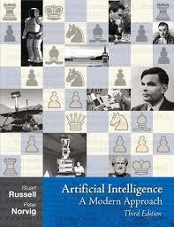
Artificial Intelligence
A Modern Approach
Stuart J. Russell and Peter Norvig

Slide 3
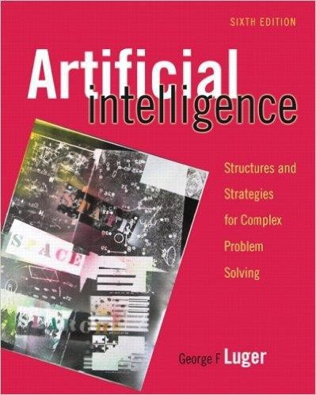
Artificial Intelligence
George F. Luger

Slide 4

Artificial Intelligence
Foundation of Computational Agents
David L. Poole
Alan K. Mackworth

Slide 5


Slide 6

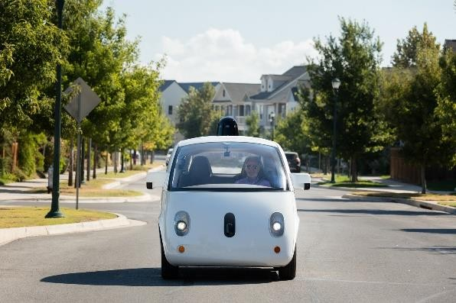
Self-drive Cars:
In 2005, a driverless robotic car named STANLEY sped through the rough terrain of the Mojave dessert at 22 mph, finishing the 132-mile.
Google self-driving car project WAYMO, stands for a new way forward in mobility.
Dr. Hashim Yasin
11

Slide 7
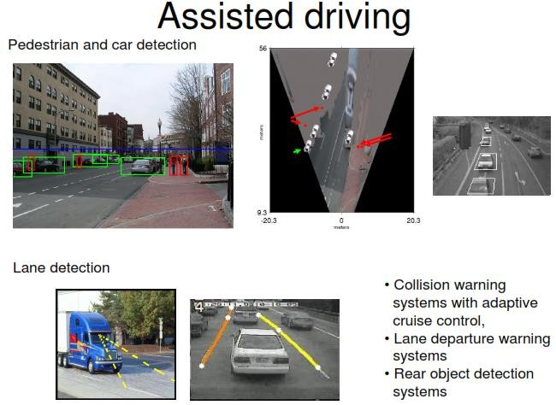

Slide 8
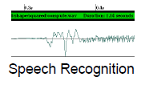
Speech recognition:
A traveler calling United Airlines to book a flight can have the entire conversation guided by an automated speech recognition and dialog management system.

Slide 9
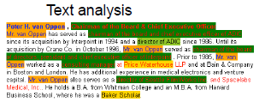
Autonomous Planning and Scheduling:
NASA’s Remote Agent program became the first on-board autonomous planning program to control the scheduling of operations for a spacecraft.
Text Analysis and NLP
A computer program automatically translates from Arabic to
English.
A program analysis the text and execute the summary of the text.

Slide 10
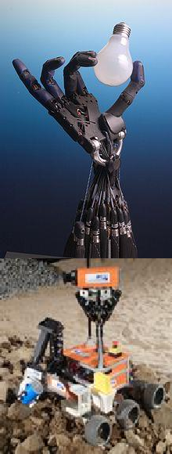
Robotics:
PackBot it is used to handle hazardous materials, clear explosives, and identify the location of snipers.
Spam Detection
Various AI anti-spam techniques
Each day, learning algorithms classify over a billion messages as spam, saving the recipient from having to waste time deleting
For many users, could comprise 80% or 90% of all messages, if not classified away by algorithms.

Slide 11
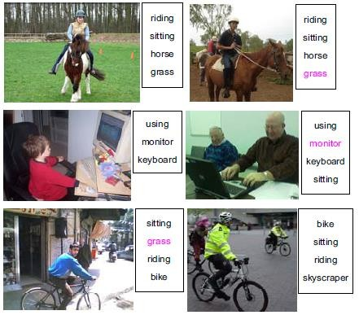
Computer Vision
Action Recognition

Slide 12
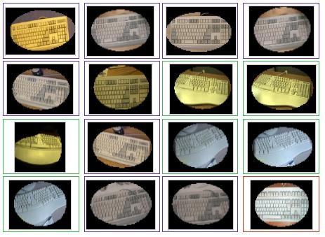
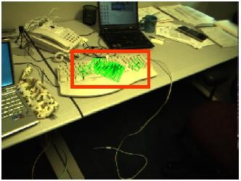
Computer Vision
Object detection

Slide 14
“The ability to learn or understand things or to deal
with new or difficult situations.” (Merriam Webster)
“The ability to learn, understand and make judgments or have opinions that are based on reason.” (Cambridge Advance Learner’s Dictionary, 2006)
“The ability to acquire and apply knowledge and skills.”
(Compact Oxford Dictionary, 2006)

Slide 15
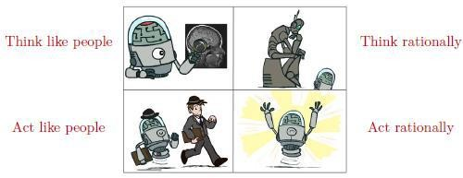
AI can be defined with four different perspectives
Systems that think like humans
Systems that act like humans
Systems that think rationally
Systems that act rationally

Slide 16
Systems that think like humans
"The exciting new effort to make computers think . . . machines with minds, in the full and literal sense." (Haugeland, 1985)
Systems that act like humans
“The art of creating machines that perform functions that require intelligence when performed by people” (Kurzweil, 1990).

Slide 17
Systems that think rationally
“The study of the computations that make it possible to perceive, reason, and act.” (Winston, 1992)
Systems that act rationally
"Computational Intelligence is the study of the design of intelligent agents." (Poole et al., 1998)

Slide 18

These definitions --- two main dimensions
thought processes and reasoning,
behaviour.

Slide 19
"Can machines think?"
"Can machines behave intelligently?"
Turing Test (1950)
proposed by Alan Turing
🞂​An attempt to provide a satisfactory operational test for intelligent behavior

Slide 20
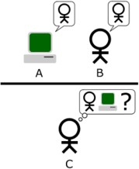
Turing Test --- An Imitation Game
A (Human) judge communicates with a human and a machine over text-only channel,
Both human and machine try to act like a human,
Judge tries to tell which is which.
Predicted that by 2000, a machine might have a 30% chance of fooling a lay person for 5 minutes.

Slide 21
Turing Test --- An Imitation Game
Natural Language Processing
To recognize language
Knowledge representation
To store knowledge
Automated reasoning
To give answer

Slide 22
Turing Test --- An Imitation Game
Machine learning
adapt to new circumstances
Computer vision
perceive objects
Robotics
manipulate objects

Slide 23
Turing Test --- An Imitation Game
Is Turing Test the right goal?
Aeronautical engineering texts do not define the goal of their field as: making machines that fly so exactly like pigeons that they can fool even other pigeons. [Russell and Norvig]

Slide 24

Cognitive Science:
🞂​It brings together computer models from Artificial Intelligence and experimental techniques from Psychology
to construct precise and testable theories of the workings of the human mind.

Slide 25
The “Laws of Thought” approach
🞂​Aristotle was one of the first to attempt to codify “right thinking”
Initiated the field called logic
Socrates is a man; all men are mortal; therefore, Socrates is mortal.

Slide 26

🞂​Act rationally/like a human presumably requires (some sort of) thinking rationally/like a human
Humans much more rational in complex domains

Slide 27
The rational agent approach
Rational behavior: doing the right thing
System is rational if it does the right thing.
The right thing
to maximize goal achievement, given the available information
Doesn't necessarily involve thinking – but thinking should be in the service of rational action

Slide 28


Slide 29

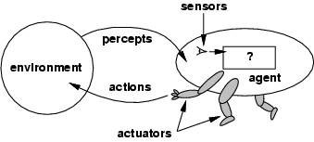
An Agent is an entity which
perceives its environment through sensors and
acts upon that environment through actuators
Assumption: Every agent can perceive its own actions (but not always the effects)

Slide 30
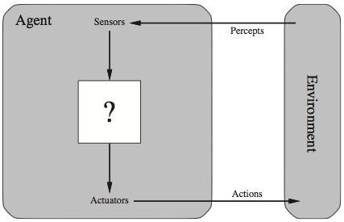
Agent with an Environment

Slide 31
🞂​Abstractly, an agent is a function which maps percept histories to actions:
[f: P* → A]
🞂​Internally, the agent function will be implemented by an agent program which runs on the physical architecture to produce f
agent = architecture + program

Slide 32

Agent Examples:
Human agent:
Sensors --- eyes, ears, and other organs
Actuators --– hands, legs, mouth, and other body parts
Robotic agent:
Sensors --- cameras and infrared range finders
Actuators --– various motors for actuators
A software agent:
🞂 Sensors --- Keystrokes, file contents, received network packages
🞂​Actuators --– Displays on the screen, files, sent network packets

Slide 33


Slide 34
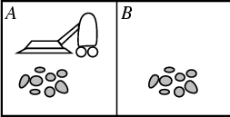
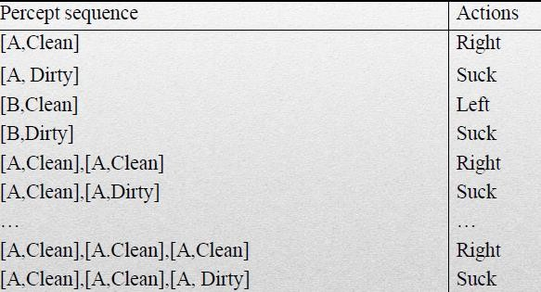
Two locations: A and B
Precepts
location
contents [A, Dirty]
Actions
Left
Right
Suck
NoOp

Slide 35
Rationality
What is rational at any given time?
🞂​Environment are essentially the "problems" to which rational agents are the "solutions".
It depends on four things:
🞂​The performance measure that defines the criterion of success.
The agent's prior knowledge of the environment.
The actions that the agent can perform.
The agent's percept sequence to date.

Slide 36
In designing an agent, must
the first step
always be to specify the task environment (PEAS) as fully as possible.
PEAS:
Performance measure
Environment
Actuators
Sensors

Slide 37
PEAS for an automated taxi-driving
🞂​Performance measure: Safe, fast, legal, comfortable trip, maximize profits, etc.
🞂​Environment: Roads, other traffic, pedestrians, customers, etc.
🞂​Actuators: Steering wheel, accelerator, brakes, signal, horn, etc.
🞂​Sensors: Cameras, speedometer, GPS, odometer, engine sensors, keyboard, etc.

Slide 38
PEAS for medical diagnosis system
🞂​Performance measure: Healthy patient, minimize costs etc.
Environment: Patient, hospital, staff etc.
🞂​Actuators: Screen display (questions, tests, diagnoses, treatments, referrals)
🞂​Sensors: Keyboard (entry of symptoms, findings, patient's answers)

Slide 39
PEAS for Interactive English tutor
Performance measure: Maximize student's score on test
Environment: Set of students
Actuators: Screen display (exercises, suggestions, corrections)
Sensors: Keyboard

Slide 40
Class Task
Design an AI Agent for any 1 of the following:
A student
A doctor
A farmer
A traffic police officer
You must identify:
Environment
Sensors (inputs)
Actions (outputs)
Goal

Slide 41

Artificial Intelligence, A Modern Approach Stuart J. Russell and Peter Norvig
Chapter 1 & 2.

