Slide 1
Examples of subcelluar structures in confocal images
2018/11/27
Claire

Slide 2
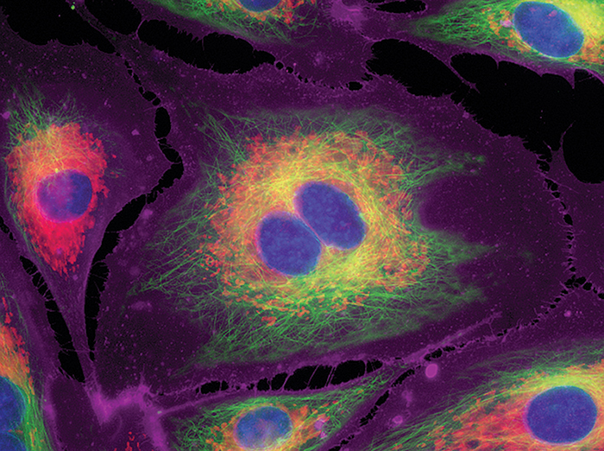
21. Plasmic membrane
1. Nuclear membrane
1. Nuclear membrane
23. mitochondria
0. Nucleoplasm
4. Cytosol
14. microtubules

Slide 3
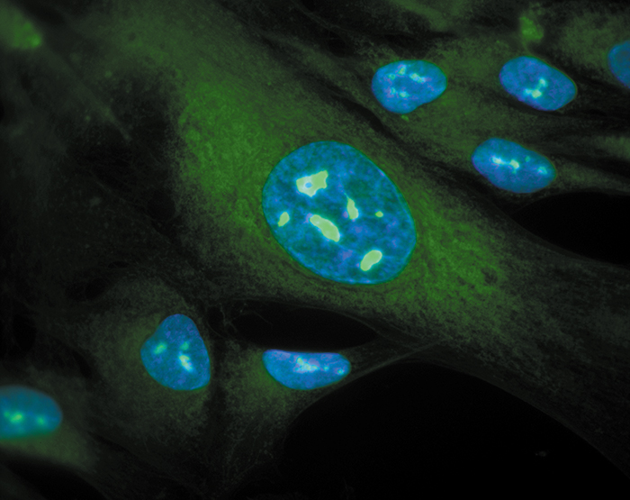
https://www.thermofisher.com/hk/en/home/life-science/cell-analysis/cell-structure/nucleus-and-nucleoli.html

Slide 4
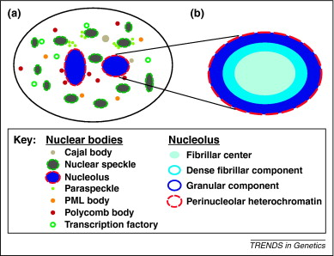

Slide 5
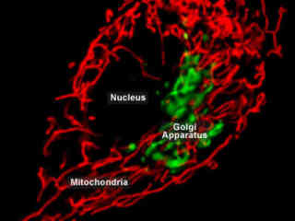

Slide 6
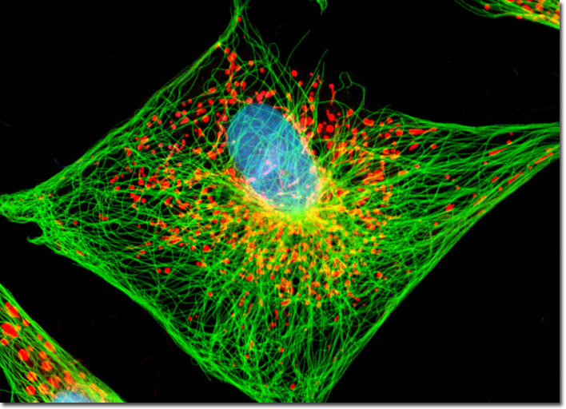
23. mitochondria

Slide 7
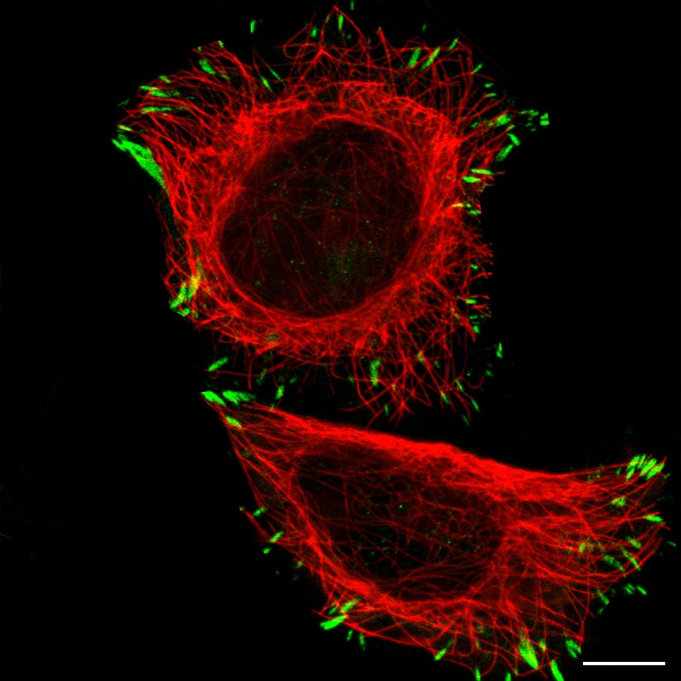
13. Focal adhesion point

