Slide 1



DID THE ONGOING BOYCOTT IMPACT STARBUCK’S STOCKS

Slide 2


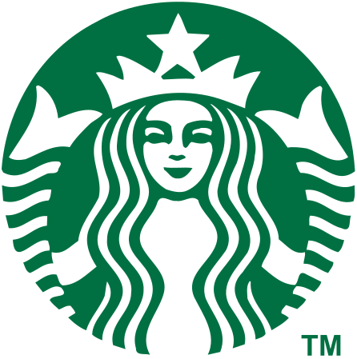

Global markets are influenced by political and social trends, impacting companies like Starbucks. Boycotts, social movements, and the COVID-19 pandemic present challenges and opportunities. This analysis provides insights into key trends shaping Starbucks' market performance.

Slide 3



In October 2023, a significant boycott campaign targeted Starbucks over perceived political stances. This boycott, amplified by social media, aimed to pressure the company by encouraging consumers to avoid its products.

Slide 4
Social media platforms like Twitter and Instagram saw hashtags urging customers to boycott Starbucks, which quickly gained traction. Influencers and celebrities joined the movement, further increasing its visibility.

Slide 5
Such events can dramatically impact stock performance by altering consumer behavior and investor sentiment, providing a unique opportunity to study the effects of political activism on market trends.

Slide 6


Historically, Starbucks has faced similar challenges but has managed to navigate through by making strategic changes, such as altering their policies or launching new marketing campaigns to regain consumer trust.

Slide 7
This situation presents a fascinating case study of how external sociopolitical factors can influence market dynamics and corporate strategies.

Slide 8

Analyze the impact of the 2023 boycott on Starbucks' stock prices and trading volumes.
Compare the financial performance of Starbucks before and after the boycott.
Goals
Understand the broader implications of sociopolitical events on market trends.
Provide insights for investors and stakeholders on how to navigate similar challenges.

Slide 9
Methodology
Data Collection
Data Analysis
Hypothesis Testing:
Comparative Analysis:
Obtain historical stock price and trading volume data for Starbucks from June 26, 1992, to May 23, 2024.
Focus on two key periods: October 2022 to May 2023 and October 2023 to May 2024.
Calculate descriptive statistics for both periods, including mean, standard deviation, and interquartile range (IQR) for closing prices and trading volumes.
Create visualizations such as scatter plots and violin plots to compare trends and distributions across the two periods.
Conduct hypothesis tests to determine if there are significant differences in mean closing prices and trading volumes between the two periods.
Use ANOVA tests to calculate p-values and assess statistical significance.
Compare Starbucks' performance with a major competitor, Costa Coffee, to identify industry-wide trends and isolate the effects of the boycott.
Analyze any other external factors that may have influenced the observed changes in stock performance.

Slide 10
Our analysis shows that Starbucks' stock prices and trading volumes were significantly impacted by the boycott in October 2023. Before the boycott, trading was steady and prices were higher.

Slide 11
After the boycott, trading became more volatile and prices dropped. This indicates that the boycott negatively affected market sentiment and investor behavior, leading to increased trading activity and lower stock prices.

Slide 12
These findings highlight how political and social events can influence a company's financial performance.

Slide 13
In our study, we found that Starbucks' stock performance was significantly affected during the time period of the boycott starting October 2023. We compared the periods from October 2022 to May 2023 and October 2023 to May 2024.
The data showed a clear decrease in average closing prices and an increase in trading volume after the boycott. This suggests that the boycott had a substantial impact on investor behavior and market sentiment.
Conclusion
While the boycott is a likely explanation for these changes, other factors might also have contributed to the observed trends.

Slide 14
Thank You!
-IRIS

