Slide 1
Android devices benchmark
Prepared by Lai Ka Yee, Kelly

Slide 2
Most popular tools are evaluated
AnTuTu Benchmark
Quadrant Standard Edition
Vellamo Mobile Web Benchmark
GlBenchmark
SD Tool
CF-Bench
Linpack for Android
CPU Benchmark
RealPi
NenaMark2
Neocore

Slide 3
3 of them are selected
AnTuTu Benchmark
Vellamo Mobile Web Benchmark
3. GlBenchmark (for additional information)

Slide 4

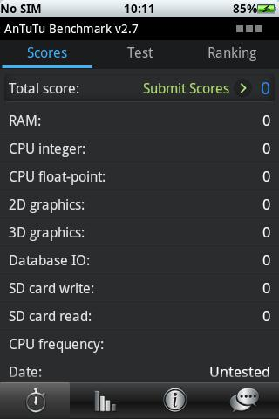
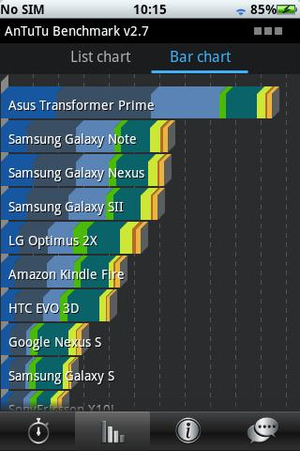
1. AnTuTu Benchmark
Measure almost every aspects of performance on the device
Runs tests on the following parts
Memory Performance
CPU Integer Performance
CPU Floating point Performance
2D Graphics Performance
3D Graphics Performance
SD card reading/writing speed
Database IO performance testing

Slide 5
AnTuTu Benchmark VS Quadrant
Quadrant is a popular android application similar to AnTuTu Benchmark, it also performs tests on CPU, Memory, I/O and 2D and 3D graphics performance
AnTuTu Benchmark allows both full benchmark test and custom benchmark test, that is user can choose to test on certain parts of the device.
Quadrant Standard Edition only allows full benchmark test, custom test is only avaiable in the advanced edition
AnTuTu can finish the full benchmark test within 5 minutes

Slide 6

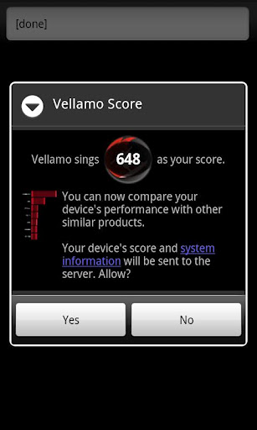
2. Vellamo Mobile Web Benchmark
Measures the following things
the browser’s use of the HTML5 display processing subsystem
overall speed and efficiency of the JavaScript virtual machine
the efficiency between this engine and the core browser
responsiveness of panning, zooming, and scrolling of text, images, and standard web page objects
the performance of the browser’s HTTP and IP networking stack
Can be used to benchmark different android device if the same browser is being used on each
Reasons for choosing this application instead of other browser benchmark:
High user rating in google play store
(average rating : 4.3 / 5)

Slide 7

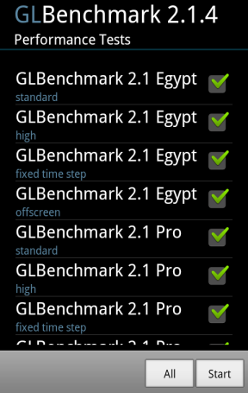
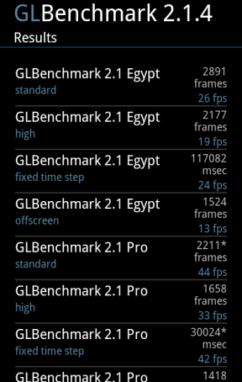
3. GlBenchmark
gives more accurate 3D Graphics Performance measurement, it contains testing with high level 3D animation
can test screen capabilities of device at HD resolutions
Reasons for choosing this application:
Contains many different performance tests on graphic (33 different tests)
Flexible selection of test

Slide 8
Compound index is recommended
To rank devices using the above applications mentioned, we calculate the overall score for the devices using the following formula
overall score of the AnTuTu Benchmark * 80 % +
overall score of Vellamo Mobile Web Benchmark * 5 * 20%
(Since AnTuTu Benchmark has already measured the 3D Graphic performance, GlBenchmark score is used as an additional information for ranking when the overall scores of two devices are close to each other)

Slide 9
Samples
Model Number | Android Version | Kernel Version | Build number | AnTuTu Benchmark | Vellamo Mobile Web Benchmark | Overall Score | Rank
Samsung Galaxy S3 | 4.0.3 | - | - | 11871 | 1995 | 11491.8 | 1
HTC One X | 4.0.3 | - | - | 10597 | 1650 | 10127.6 | 2
PI7000 | 3.2.1 | 2.6.35.7+ | T8.C.01.02.09 | 2380 | 444 | 2348 | 3
Tablet_7_LC_C | 4.0.3 | 3.0.8 | T7.C.02.02.10 | 2143 | 423 | 2137.4 | 4
Table_7_HD_C | 4.0.3 | 3.0.8 | T7.C.00.03.10 | 2030 | 421 | 2045 | 5

Slide 10
Brief for other candidates and their major weakness

Slide 11

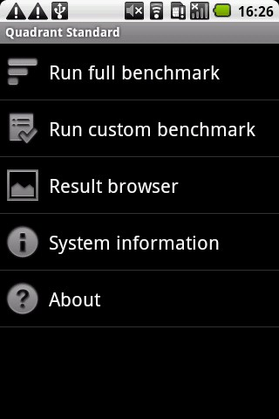
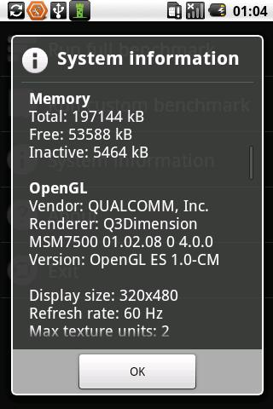
Quadrant Standard Edition
Runs tests on the following parts
CPU - arithmetic operations, XML parsing, multimedia decoding
Memory throughput
I/O – file system access and database operations
2D graphics
3D graphics - OpenGL single-pass and multi-pass rendering with stencil buffers

Slide 12

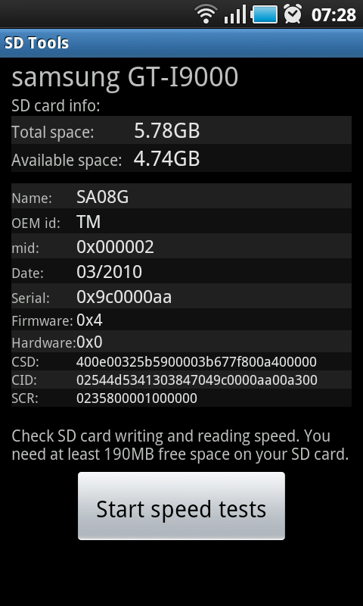
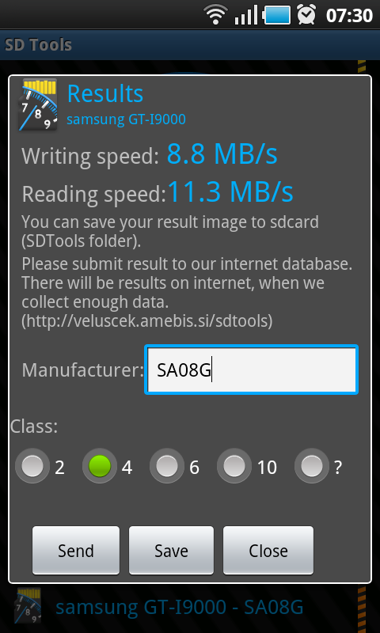
SD Tool
benchmark SD card writing and reading speeds
Reason for not choosing:
Tests on SD writing and reading are already included in the testing done by AnTuTu Benchmark

Slide 13

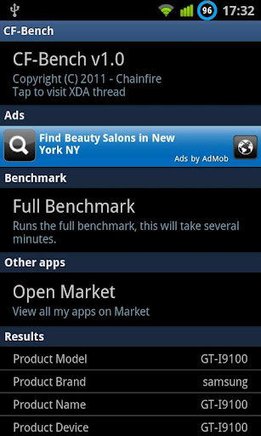
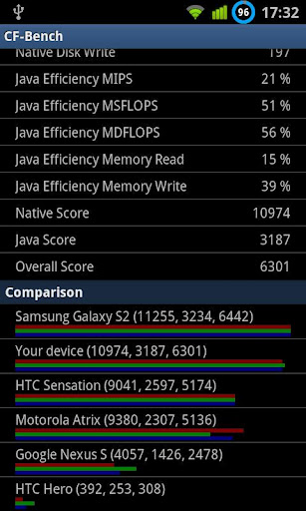
CF-Bench
CPU and memory benchmark tool
Supports multi-core devices
test both native and Java code
Only full benchmark test is available
Reason for not choosing:
CPU and memory performance tests are included in the testing done by Antutu Benchmark

Slide 14

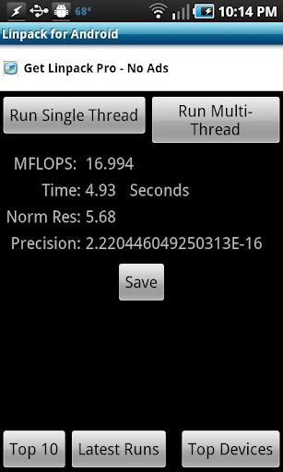
Linpack for Android
Measures CPU performance
Measures system’s floating point computing power
Result presented in millions of floating point operations per second
Reason for not choosing:
CPU Performance Test is included in the testing done by AnTuTu Benchmark

Slide 15

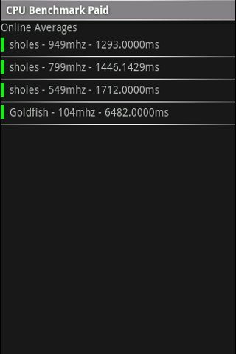
CPU Benchmark
CPU Benchmarking tool for android
Simple test on the speed of CPU
Reason for not choosing:
CPU Performance Test is included in the testing done by AnTuTu Benchmark

Slide 16

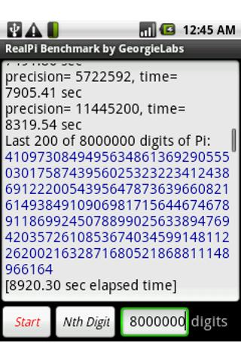
RealPi
tests on CPU and memory performance
Using tests on calculating the value of Pi to many decimal places
Reason for not choosing:
CPU and memory performance tests are included in the testing done by Antutu Benchmark

Slide 17

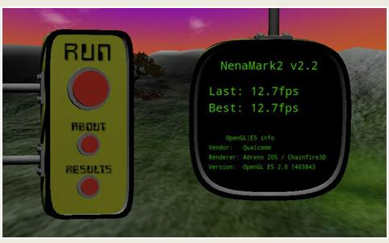

NenaMark2
Graphics performance benchmark application
Test on the performance of GPU
measures performance using realistic scenes that could be taken from a typical game
result presented in frames per second
Reason for not choosing:
Graphics performance are being tested by AnTuTu Benchmark
Some review say that fps score is meaningless due to low resolution scene can always give high fps

Slide 18


Neocore
graphics performance benchmark
result presented in frames per second
Reason for not choosing:
Graphics performance are being tested by AnTuTu Benchmark
Some review say that fps score is meaningless due to low resolution scene can always give high fps

