Slide 1
A Proposal to benchmark android devices
Prepared by Lai Ka Yee, Kelly

Slide 2
Proposed Apps used for benchmarking android device
AnTuTu Benchmark
Vellamo Mobile Web Benchmark
GlBenchmark (for additional information)

Slide 3

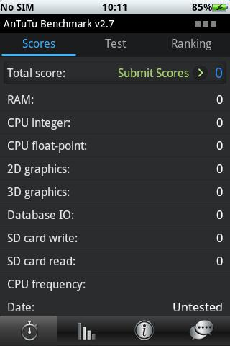
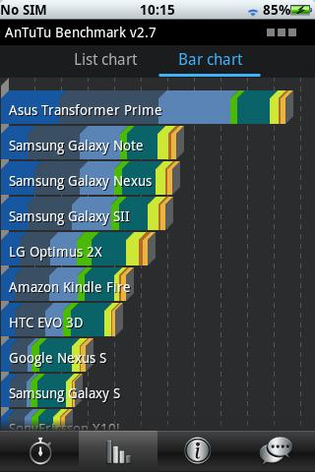
AnTuTu Benchmark
Runs tests on the following parts
Memory Performance
CPU Integer Performance
CPU Floating point Performance
2D Graphics Performance
3D Graphics Performance
SD card reading/writing speed
Database IO performance testing

Slide 4
AnTuTu Benchmark VS Quadrant Standard
Quadrant standard is a popular android application similar to AnTuTu Benchmark, it also performs tests on CPU, Memory, I/O and 2D and 3D graphics performance
AnTuTu Benchmark allows both full benchmark test and custom benchmark test, that is user can choose to test on certain parts of the device
Quadrant standard only allows full benchmark test
AnTuTu can finish the full benchmark test within 5 minutes

Slide 5

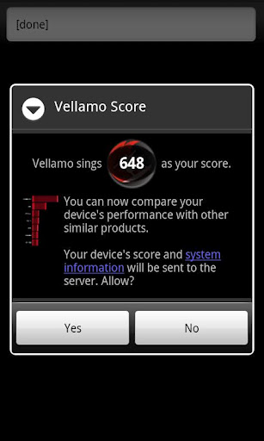
Vellamo Mobile Web Benchmark
Measures the following things
the browser’s use of the HTML5 display processing subsystem
overall speed and efficiency of the JavaScript virtual machine
the efficiency between this engine and the core browser
responsiveness of panning, zooming, and scrolling of text, images, and standard web page objects
the performance of the browser’s HTTP and IP networking stack
Reasons for choosing this application:
High user rating in google play store
(average rating : 4.3 / 5)

Slide 6

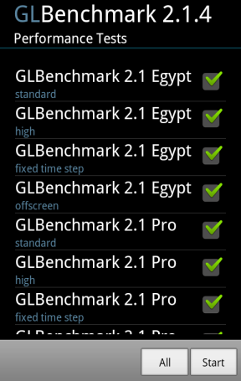
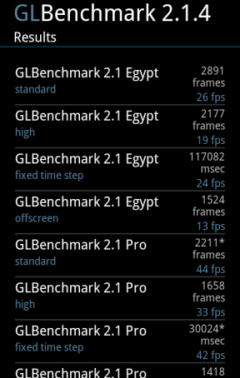
GlBenchmark
gives more accurate 3D Graphics Performance measurement, it contains testing with high level 3D animation.
Reasons for choosing this
application:
Contains many different
performance tests on graphics
(33 different tests)
Flexible selection of test

Slide 7
Overall Score
To rank devices using the above applications mentioned, we calculate the overall score for the devices using the following formula
overall score of the Antutu Benchmark * 80 % +
overall score of Vellamo Mobile Web Benchmark * 5 * 20%
(Since AnTuTu Benchmark has already measured the 3D Graphic performance, GlBenchmark score is used as an additional information for ranking when the overall scores of two devices are close to each other)

Slide 8
Samples
Model Number | Android Version | Kernel Version | Build number | AnTuTu Benchmark | Vellamo Mobile Web Benchmark | Overall Score | Rank
Samsung Galaxy S3 | 4.0.3 | - | - | 11871 | 1995 | 11491.8 | 1
HTC One X | 4.0.3 | - | - | 10597 | 1650 | 10127.6 | 2
PI7000 | 3.2.1 | 2.6.35.7+ | T8.C.01.02.09 | 2380 | 444 | 2348 | 3
Tablet_7_LC_C | 4.0.3 | 3.0.8 | T7.C.02.02.10 | 2143 | 423 | 2137.4 | 4
Table_7_HD_C | 4.0.3 | 3.0.8 | T7.C.00.03.10 | 2030 | 421 | 2045 | 5

