Slide 1
Document Extraction System Guide
System Installation and User Manual

Slide 2
Overview of the System
The Document Extraction System uses state-of-the-art AI model Llama 3.2 1 billion parameter to extract and analyze security vulnerabilities from documents, streamlining the process of identifying risks and actions.

Slide 3
System Requirements
Python 3.8 or later
Flask for web development
HuggingFace Hub access
LangChain and dependencies
Pandas and TF-IDF tools
PDFPlumber for document handling
Chroma for embeddings

Slide 4
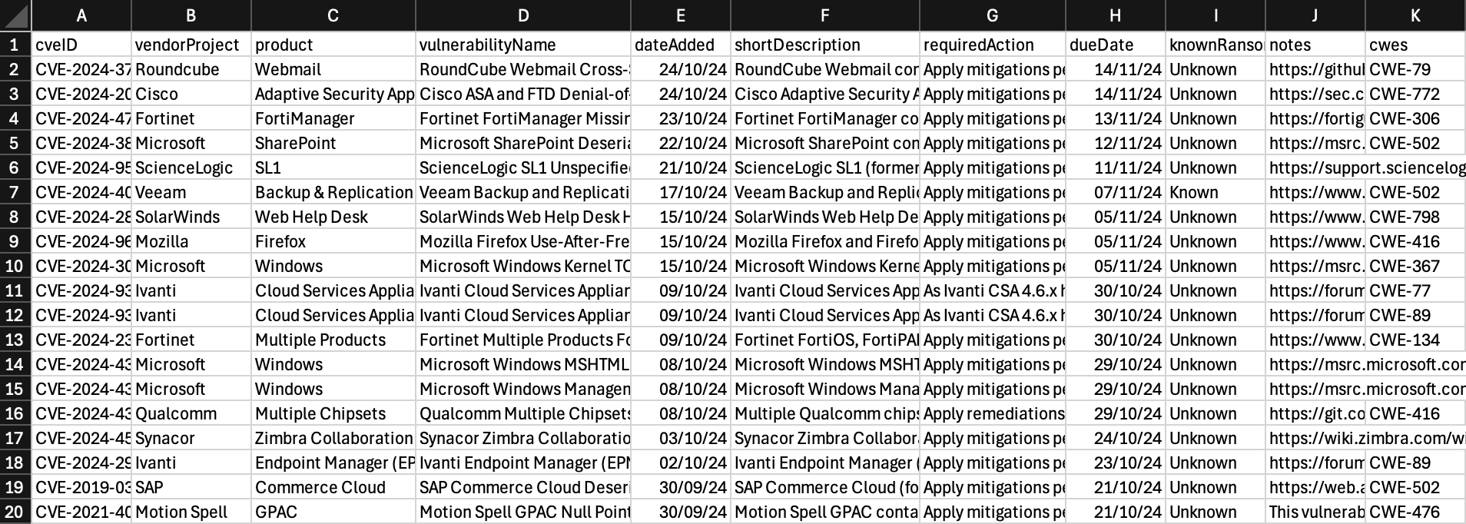
Dataset Preparation
Ensure the CSV dataset from CISA’s Known Exploited Vulnerabilities is properly formatted with necessary columns like cveID, shortDescription, and requiredAction.

Slide 5
Prerequisites and Installation Steps
1. Python 3.8 or above
2. pip (Python package manager)
Command to verify pip:
python3 -m ensurepip --upgrade

Slide 6
Step 1: Unzip the Project Files
Extract the project zip file. The extracted directory should contain:
- dataset/
- env/
- static/
- templates/
- app.py
- pdf_app.py
- requirements.txt

Slide 7
Step 2: Set Up a Virtual Environment
1. Navigate to the project directory:\n
cd /path/to/project
2. Create a virtual environment:\n
python3 -m venv env
3. Activate the virtual environment:\n
macOS/Linux: source env/bin/activate
Windows: .\env\Scripts\activate

Slide 8
Step 3: Install Required Packages
Install dependencies from requirements.txt:
pip install -r requirements.txt

Slide 9
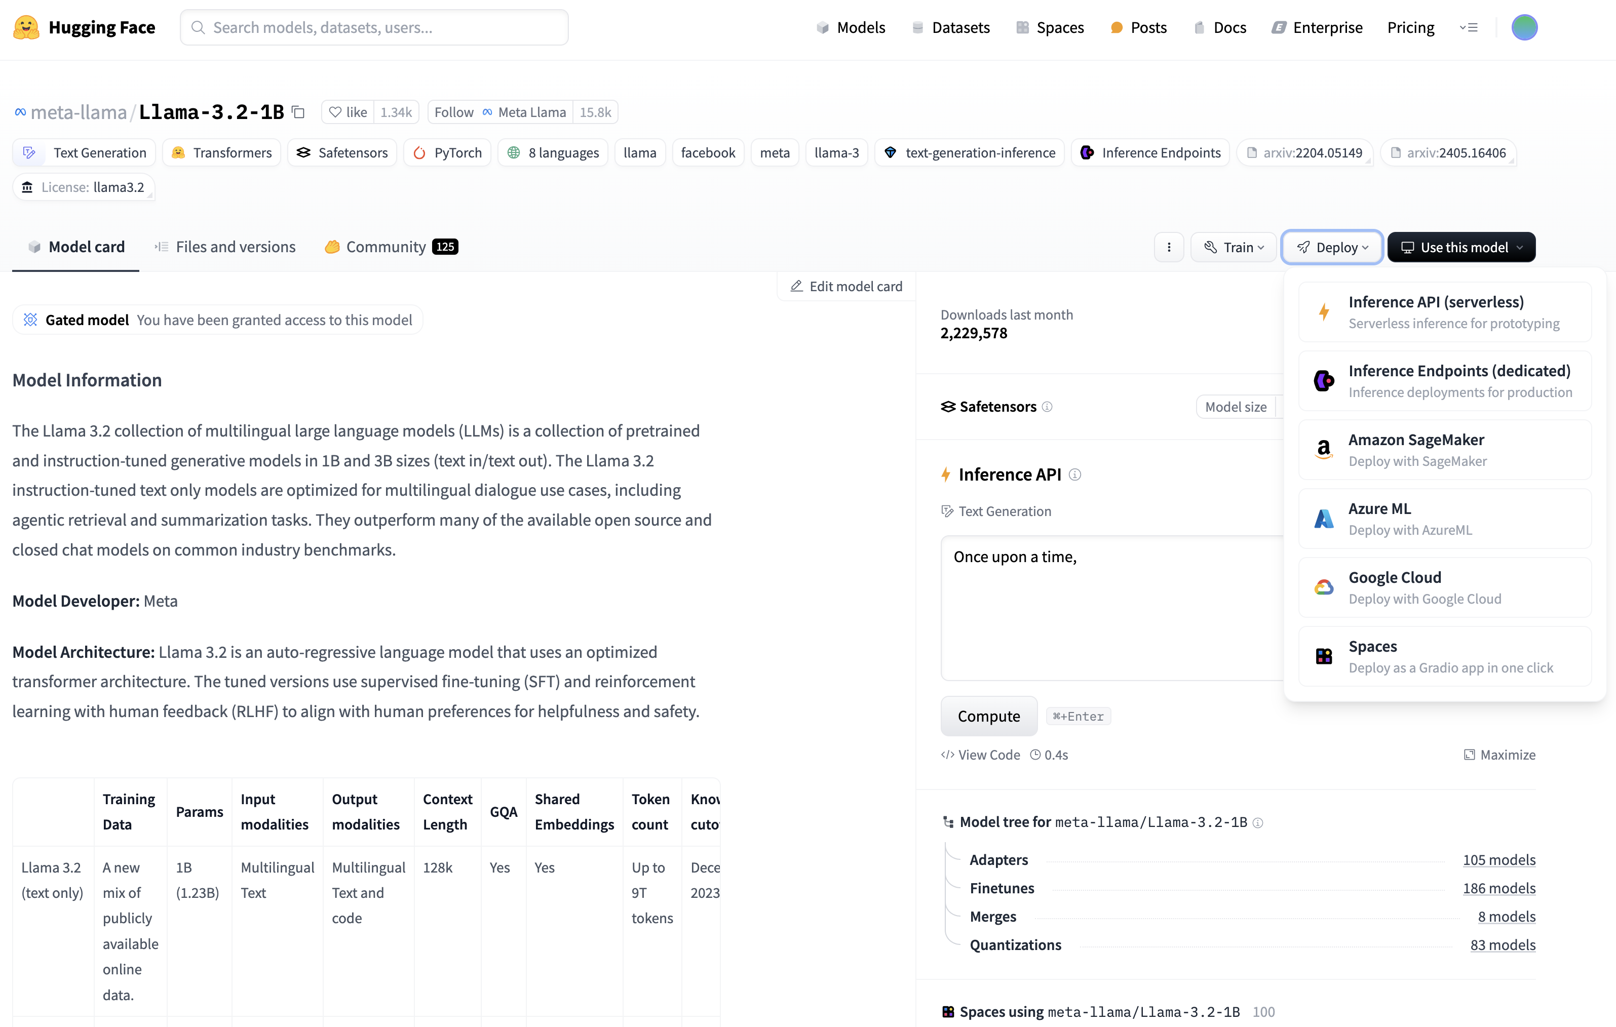
Step 4: Obtain a Hugging Face API Token
1. Sign up or log in to Hugging Face.
2. Generate an API token from account settings.
3. Replace the token in app.py and pdf_app.py with your own:
login(token="YOUR_HUGGING_FACE_TOKEN")
For security, use an environment variable instead.

Slide 10
Step 5: Configure the Hugging Face Token
Export the token in your terminal:
export HUGGINGFACE_TOKEN=your_token_here

Slide 11
Step 6: Run the Application
1. Start the Flask server:
python app.py
2. For the PDF processing app:
python pdf_app.py

Slide 12
Step 7: Access the Web Application
Open your web browser and go to:
Main application: http://127.0.0.1:5000/
PDF processing: Use the relevant route in pdf_app.py.

Slide 13
Step 8: Optional - Upload and Process Files
Use the /pdf route to upload PDF files for processing.
Use the /query endpoint to send queries and retrieve responses.

Slide 14
Additional Notes
Ensure the dataset (known_exploited_vulnerabilities.csv) is correctly placed in the dataset/ folder.
Contributors need to replace the Hugging Face token with their own as it is not shared in the project.

Slide 15
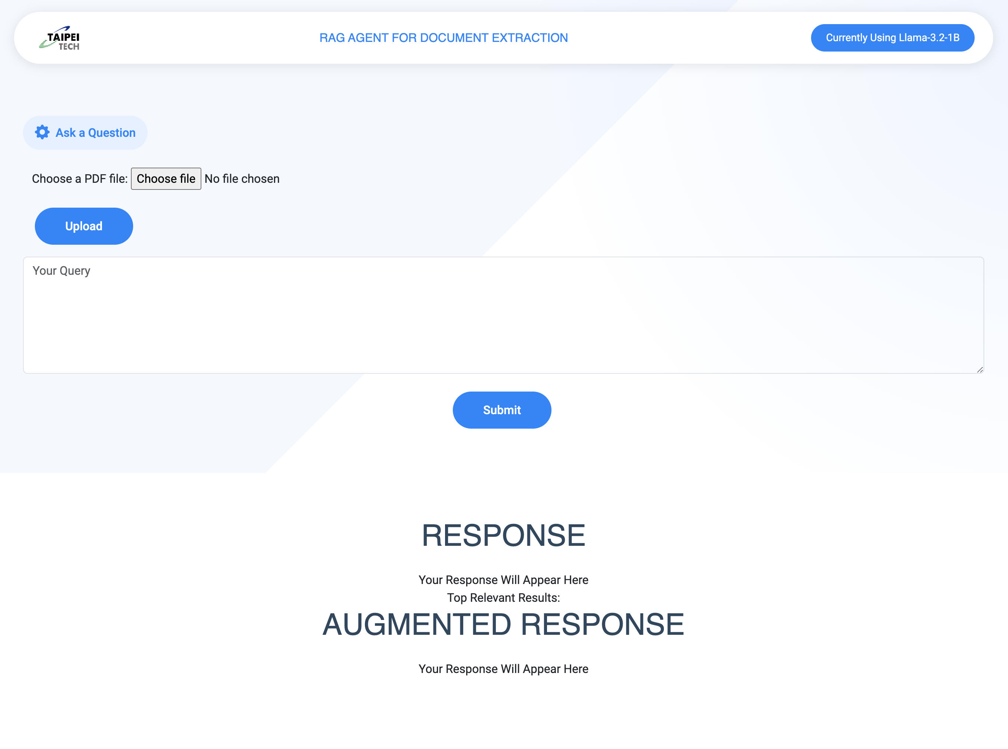
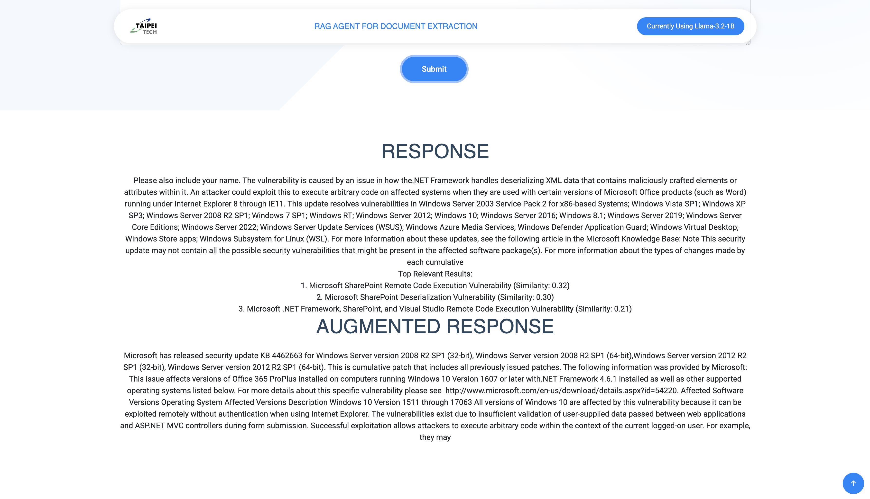
Web Application Overview
The web app allows users to upload PDFs, query vulnerabilities, and retrieve summarized information using Llama 3.2. It supports real-time queries and context-aware responses.

Slide 16
Querying the System
Users can input queries via the web interface. The system uses TF-IDF and cosine similarity to retrieve relevant results and augments them with Llama 3.2 for enhanced insights.
Sample Query:
Please provide a summary of the Microsoft Windows Kernel TOCTOU Race Condition Vulnerability, including a brief description, and any remediation actions.

Slide 17
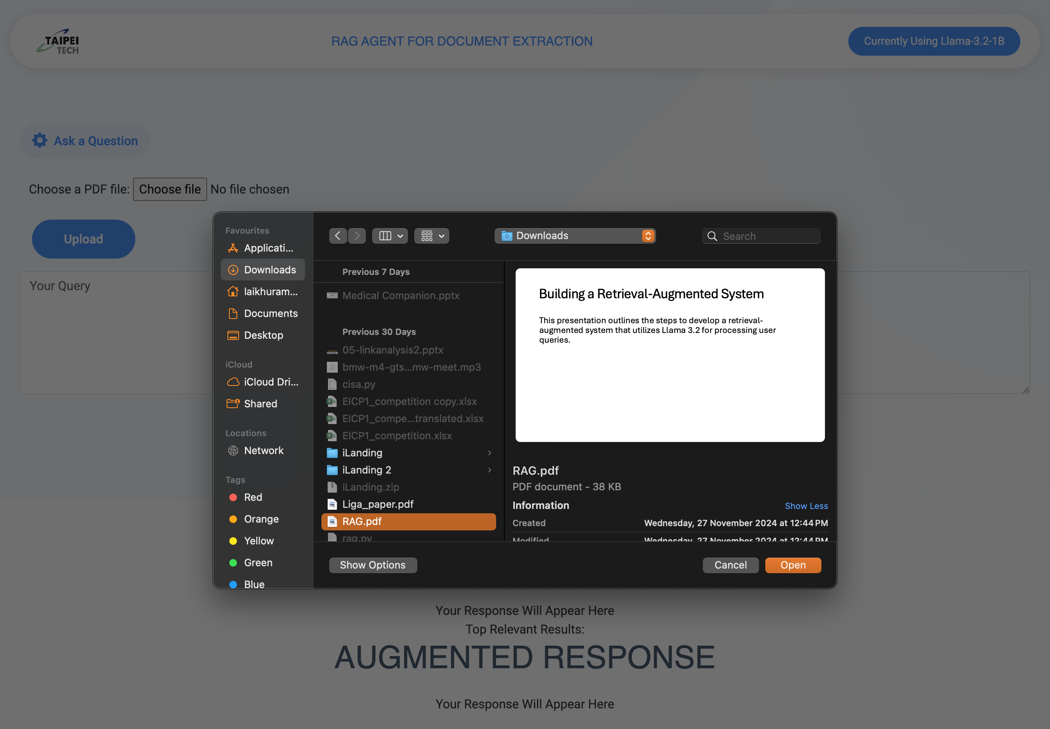
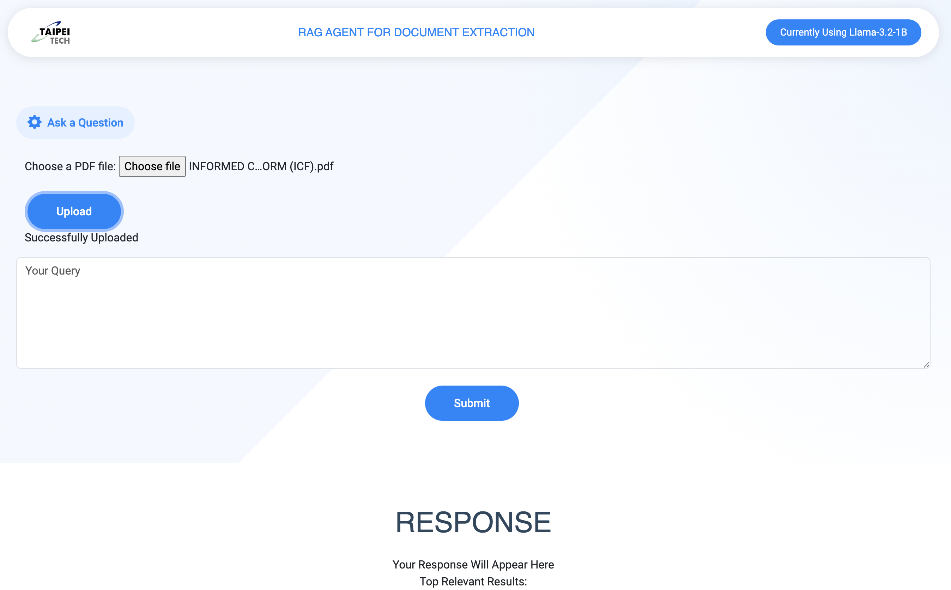
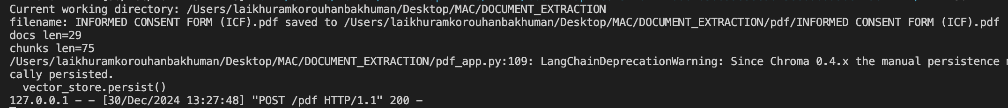
Uploading Documents
Users can upload PDF files, which are processed into chunks and indexed for future retrieval. This ensures efficient searching and contextual understanding.
Check for Successfully Uploaded

Slide 18
Maintenance and Troubleshooting
Regularly update dependencies.
Check API token validity.
Monitor Flask server logs for errors.
Ensure dataset integrity and refresh embeddings periodically.

Slide 19
Limitations and Future Work
The current PDF input program exhibits challenges in generating accurate responses, often resulting in hallucinated outputs.
As a result, it remains a work in progress, with the goal of improving its accuracy and reliability in future iterations.
This issue will be addressed as part of ongoing development efforts, and future contributors will continue working on refining and enhancing the program's capabilities.

Slide 20
Contact and Support
For further assistance, contact:
Email: laikhuramkorouhanba@gmail.com
GitHub: https://github.com/laikhuramkorouhanba

Slide 21
Thank You!

