Slide 1
Customer Segmentation using RFM Analysis
An RFM-based approach for customer classification
By - Laikhuram Korouhanba Khuman Student ID: 113012040 Computer Science and Information Engineering

Slide 2
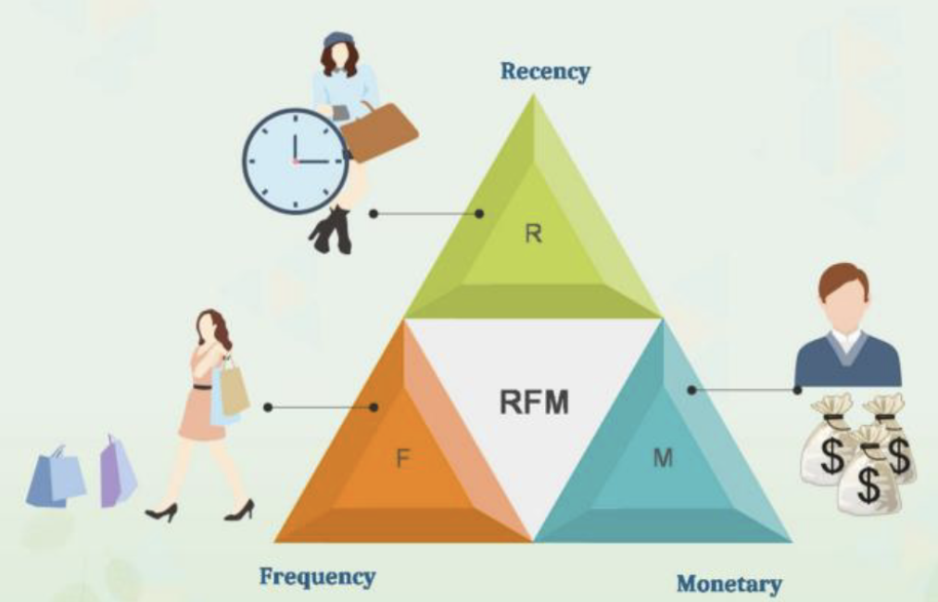
Introduction
RFM analysis is a marketing technique used to segment customers based on three factors:
Recency: Time since the last purchase Frequency: Number of purchases Monetary: Total amount spent

Slide 3
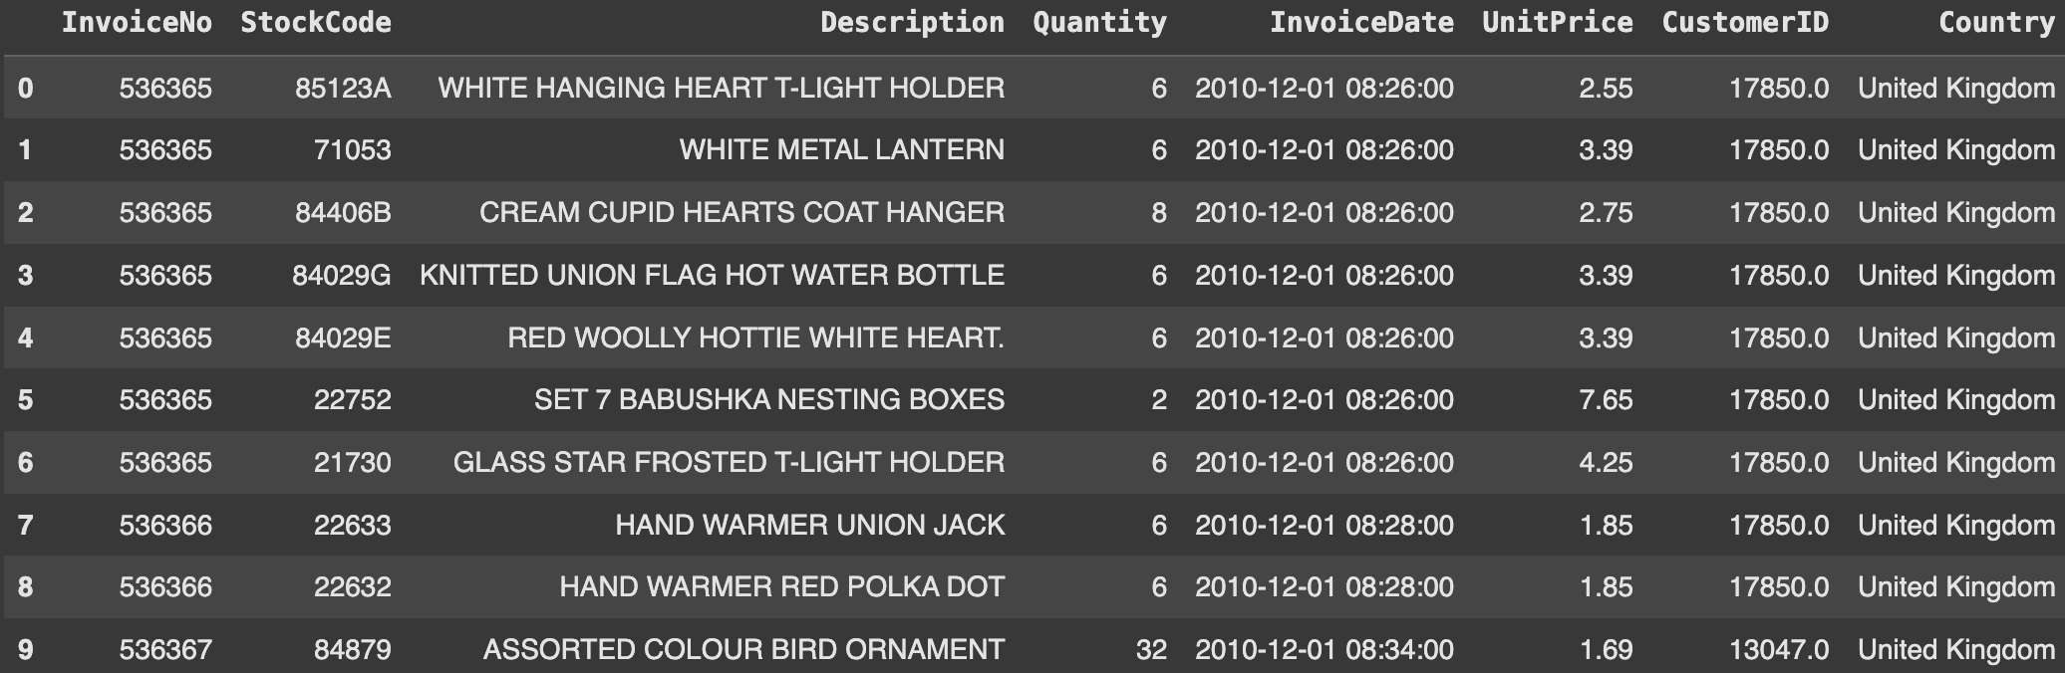
Data Preparation
Dataset used: Using open datasets from Kaggle - Online Retail Data Set (dataset contains all purchases made for an online retail company based in the UK during 2010 - 2011 )
Number of rows: 541909 Number of columns: 8 Data size: 168.526 MB

Slide 4
Packages used
Pandas
NumPy
Matplotlib
Seaborn
Sklearn

Slide 5
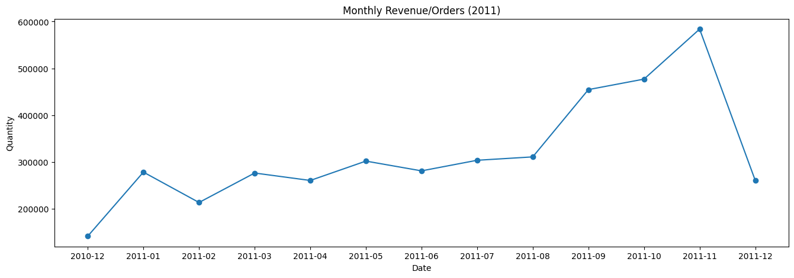
Exploratory Data Analysis
Revenue in November has highest amount that has 13,41% revenue from total revenue along 1 year. Therefore the business team can replicate the success of sales strategies in November to be implemented in other months

Slide 6
RFM Calculation
1. Calculated Recency as the difference between the last purchase date and the reference date
2. Computed Frequency as the total number of purchases per customer
3. Measured Monetary value as the total spending per customer

Slide 7
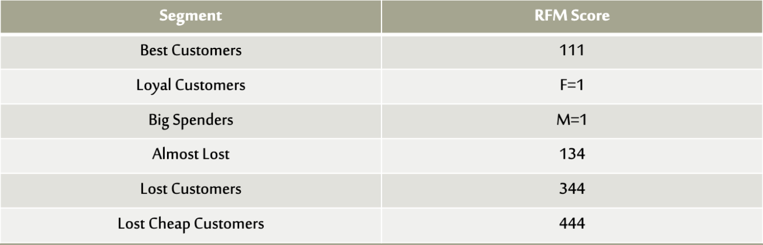
Modeling RFM Quantiles
We split the metrics into segments using quantiles.
We will assign a score from 1 to 4 to each Recency, Frequency and Monetary respectively.
1 is the highest value, and 4 is the lowest value.
A final RFM score (Overall Value) is calculated simply by combining individual RFM score numbers.

Slide 8
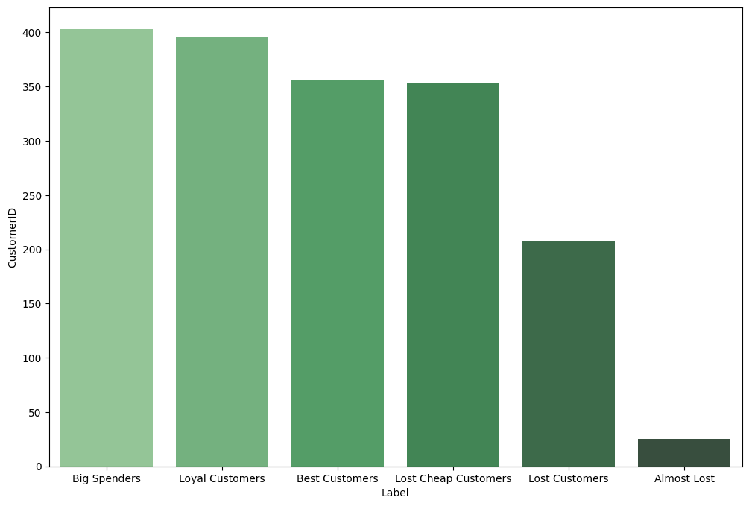
Modeling RFM Quantiles

Slide 9
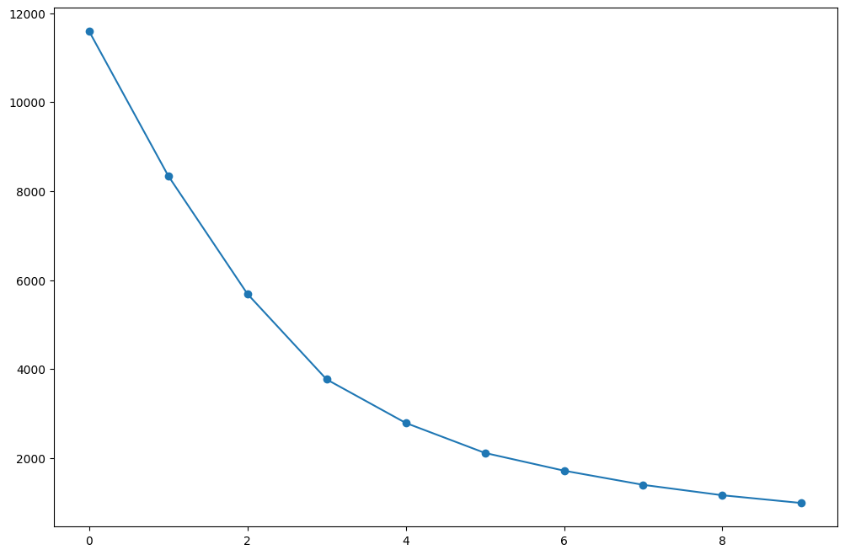
Clustering using K-Means
Finding the optimal number of clusters (k) using elbow method

Slide 10
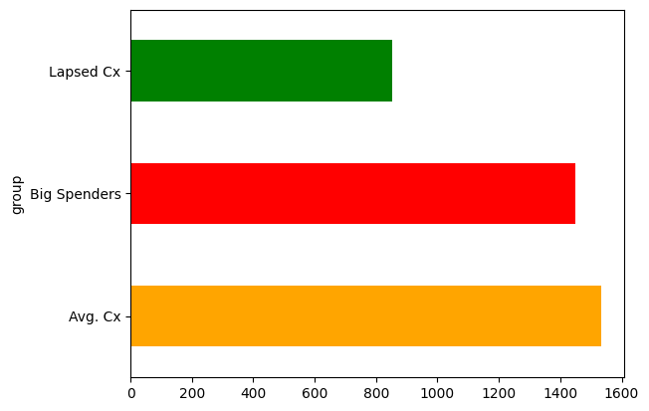
Clustering using K-Means

Slide 11
Cluster Insights
Cluster characteristics:
• Whales: High monetary value, frequent purchases, recent buyers
• Lapsed Customers: Low frequency, long time since last purchase
• Average Customers: Moderate values across all metrics

Slide 12
Conclusion
RFM analysis helps businesses understand customer behavior and target them effectively. By segmenting customers, companies can allocate resources efficiently and maximize ROI.

