Slide 1
Inqaz AI: Emergency Rescue System
Computer Vision & Image Processing Final Project
Shorouk Academy (SUT)

Slide 2
Project Overview
Objective: Build an end-to-end Computer Vision pipeline to automatically detect car crashes from images.
Goal: Simulate automated emergency alerts to the Ministry of Interior (122) and Ambulance (123).
Requirements Met: Real dataset, full preprocessing, custom CNN, manual transfer learning, strict evaluation, and a working deployment.

Slide 3
Dataset Collection & Quality
Data Source: Kaggle (no built-in libraries used).
Size: 3,000 real images.
Classes: Crash (Class 0) vs Normal Traffic (Class 1).
Validation: Verified raw image integrity to ensure the model learns true features (crumpled metal, accidents) rather than dataset noise.

Slide 4
Preprocessing Pipeline
Resizing: Uniform 224x224 pixels for CNN and MobileNetV2 compatibility.
Normalization: Scaled pixel values to [-1.0, 1.0] using tf.keras.layers.Rescaling.
Augmentation: Applied Random Flip, 20% Rotation, and 20% Zoom to training data to prevent overfitting.
Splitting: 70% Train (2,100), 15% Val (450), 15% Test (450).

Slide 5
Model 1: Custom Scratch CNN
Architecture: 4 Convolutional Blocks (Conv2D -> BatchNorm -> ReLU -> MaxPooling).
Head: Flatten -> Dense(128) + Dropout -> Dense(1) Sigmoid.
Parameters: ~2.5 Million.
Performance: Struggled with the complexity of real-world dashcam images, achieving 63% accuracy.

Slide 6
Model 2: Transfer Learning (MobileNetV2)
Backbone: MobileNetV2 (ImageNet weights, include_top=False).
Architecture Upgrade: Replaced Flatten() with GlobalAveragePooling2D().
Impact: Reduced parameters from ~16 million to ~1,280, effectively preventing overfitting.
Custom Head: GlobalAveragePooling -> Dense(256) -> Dense(128) -> Sigmoid.
Training: 2-Phase Fine-Tuning (Frozen base -> Unfroze top 20 layers).

Slide 7
Evaluation & Comparison
Scratch CNN Test Accuracy: 63%
Transfer Learning Test Accuracy: 68%
Crash F1-Score: 0.62 (Scratch) vs 0.68 (Transfer Learning)
Conclusion: MobileNetV2 significantly outperformed the custom model due to its pre-trained feature extraction capabilities and optimized pooling layer.

Slide 8
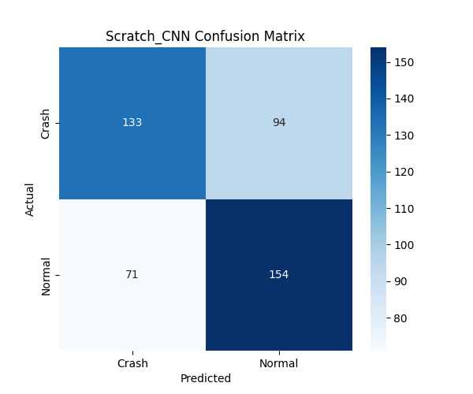
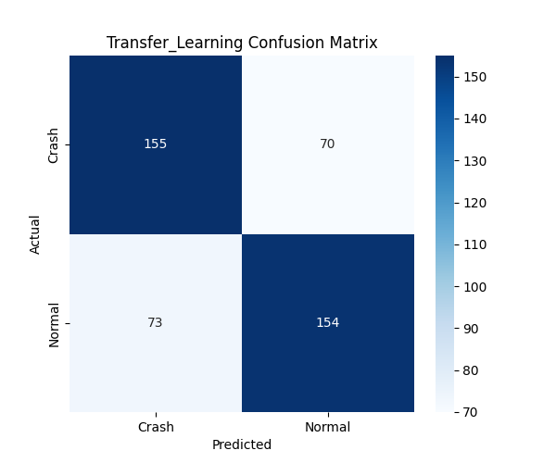
Confusion Matrices
Scratch CNN
Transfer Learning

Slide 9
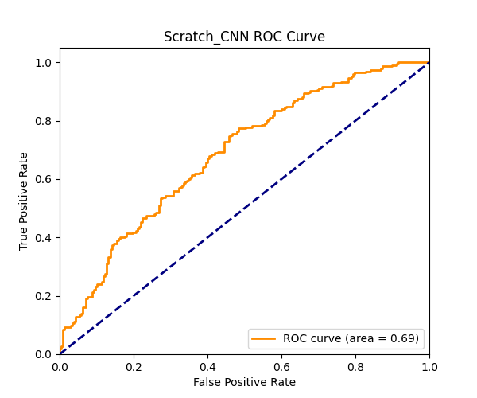
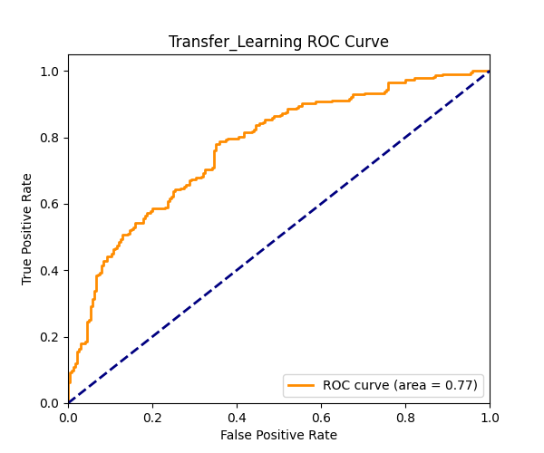
ROC & AUC Curves
Scratch CNN
Transfer Learning

Slide 10
Deployment (Bonus Phase)
Platform: Deployed as a web application using Streamlit.
Functionality: Accepts image uploads, applies exact [-1, 1] preprocessing, and runs inference.
Output: Displays crash confidence percentage and simulates emergency dispatches.
Status: Fully operational on localhost.

Slide 11
Thank You
Questions & Discussion

