Slide 1

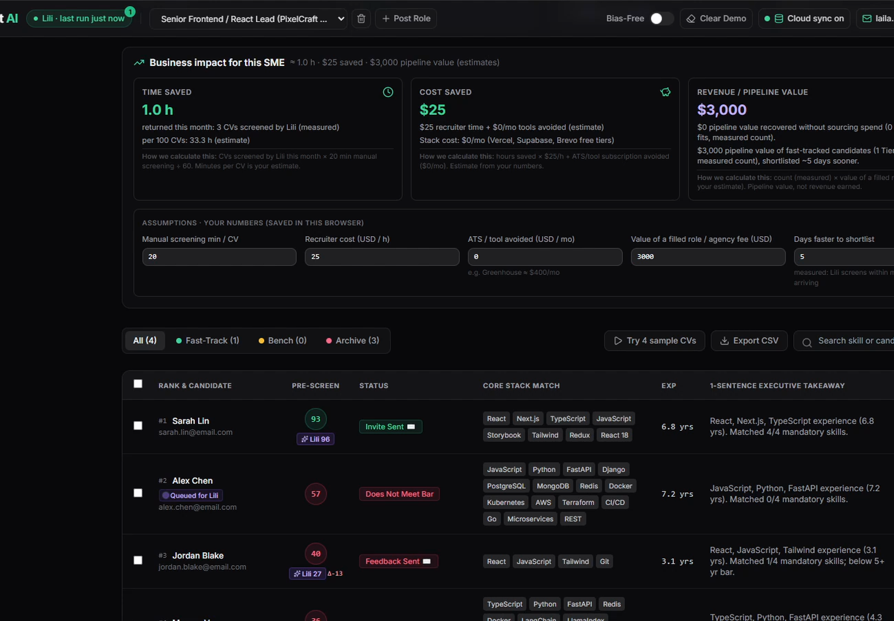
AUTONOMOUS TECHNICAL RECRUITER
TalentScout AI: Meet Lili
An AI agent that screens applicants, explains scores, and emails candidates for SMEs
auto_awesome
100% Applicant Screening
Instantly evaluates every resume against technical role requirements without manual labor.
fact_check
Explainable AI Scoring
Transparent ratings grounded directly in candidate evidence and verifiable skill metrics.
mark_email_read
Automated Candidate Outreach
Sends personal invites automatically; every rejection waits for one-click recruiter approval.
BUILT FOR GROWING TEAMS
$0 cost autonomous recruiter
Eliminates expensive ATS overhead while keeping high candidate engagement.
Agents at Work Hackathon · Laila Mohamed · lili-hr-agent.vercel.app

Slide 2
TARGET PROFILE & PAIN POINTS
The SME We Built For
High-Growth, Resource-Constrained
PRIMARY RECRUITING BOTTLENECKS
warning_amber
50–200 CVs Per Open Role
The overwhelming majority of resumes are never properly reviewed.
COMPANY SIZE
10–50 Employees
HIRING PACE
1–3 Engineers / mo
schedule
Communication Delays & Ghosting
Top talent waits days for responses; rejected candidates get no feedback.
Tech startups and boutique recruiting agencies operate without dedicated talent acquisition teams. Recruiting is handled entirely on top of primary duties by a single founder or office manager.
Enterprise ATS platforms like Greenhouse or Lever cost thousands of dollars annually—yet still demand human manual labor to screen each applicant.
"Good candidates wait days for a reply, while rejected ones are usually ghosted. Enterprise ATS tools still require a human to manually screen applicants."
Result: Severe recruiting bottlenecks that slow growth and damage candidate relations.
THE SME CANDIDATE DROP-OFF PROBLEM
Manual screening overhead creates critical hiring lag

Slide 3
TRADITIONAL WORKFLOW
Before: Manual & Inconsistent
TRANSFORMED WORKFLOW
After: Lili
1
Download CVs from Email
Manual extraction from inbox attachments.
Drop CVs & Instant Pre-Screen
Browser-based quick intake and automated initial screening.
1
2
Skim with Gut-Feel Bias
Inconsistent screening without standard criteria.
3
Track in Spreadsheet
Static data entry prone to error and delay.
Evidence-Cited Deep Evaluation
Objective scoring grounded directly in candidate evidence.
2
4
Write One-by-One Emails
Repetitive drafting of individual messages.
Live Ranked Pipeline
TIER 1 TIER 2 TIER 3
~20 min
PER CANDIDATE
High latency, inconsistent evaluation, and heavy recruiter effort.
3
Automated Outreach & Review
Invites go out automatically; constructive rejections wait for one-click approval.
4

Slide 4

AUTONOMOUS RECRUITMENT ENGINE
End-to-End Autonomous Candidate Pipeline
Lili operates on a zero-copy-paste continuous loop with automated scoring & reporting
01
02
03
04
05
06
Intake
Queue
Evaluate
Rules in DB
Act
Report
Parses up to 3 CVs simultaneously directly in the browser with zero copy-pasting.
Candidates enter the processing queue seamlessly via Wesam.ai ATS integration.
Scores candidates via weighted rubric:
< Min Exp:
Score Cap 69
Checks GitHub claims, sends invites via Brevo, and queues rejections for your approval.
Updates live dashboard instantly and generates shortlist reports for human review.
Tech: 40%
Experience: 25%
Missing Must-Haves:
Score Cap 74
Impact: 20%
Leadership: 15%
Tier 1 Standard:
Score ≥ 85
In-Browser Parsing
ATS API Sync
Brevo Messaging
Live Dashboard

Slide 5
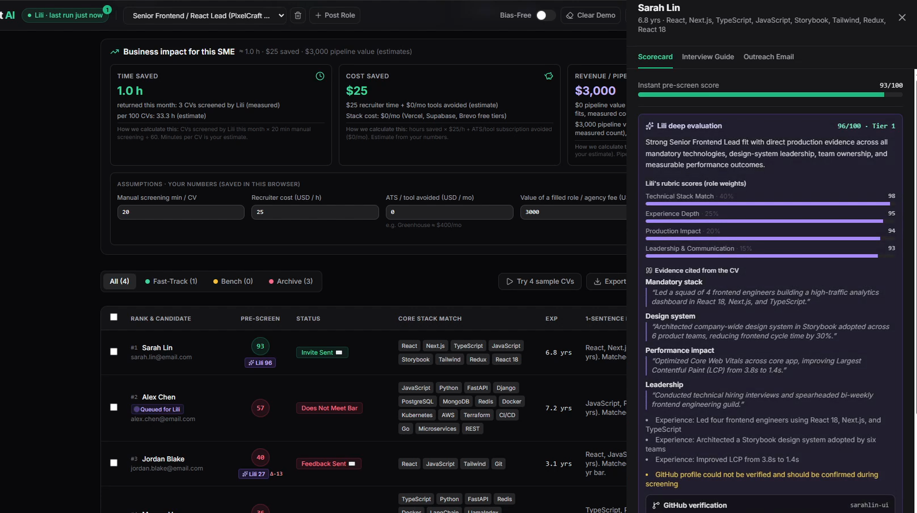
AUTONOMOUS SCREENING RUN
Real-World Execution: 4 CVs, 1 Instruction
Autonomous Screening: Lili screened all candidates without human intervention, citing specific evidence.
LIVE APPLICATION
lili-hr-agent.vercel.app
Live Integration: Invite sent via Brevo (demo mode delivers to the recruiter's inbox); rejections await approval.
SL
Sarah Lin
TIER 1
Score: 96/100
VERDICT EVIDENCE CITED:
• "Storybook design system adopted across 6 product teams"
• "Improved LCP from 3.8s to 1.4s"
OTHER CANDIDATES (3 APPLICANTS)
TIER 3
Candidate B
Applied Caps: Missing core tech stack depth; non-verifiable metrics.
Candidate C
Applied Caps: Insufficient experience duration for senior requirements.
Live Dashboard & Activity Log
The system automatically logs each evaluation step in real-time and issues email confirmation via Brevo instantly upon candidate ranking.
Candidate D
Applied Caps: Key domain skills absent in background review.

Slide 6

QUANTIFIABLE ROI & EFFICIENCY
Time Savings & Candidate Engagement Impact
66 Hours/Mo
Days → Minutes
Manual Screening Replaced Monthly
First Reply Velocity
2 open roles × ~100 CVs × 20 min each. About 60 hours return to the team after reviewing Lili's shortlist.
Time to first reply drops dramatically, ensuring top tier talent is immediately engaged before competitors.
CALCULATION CONTEXT & BENCHMARKS
~20 Minutes Saved Per Candidate
80 Recruiter-Minutes Saved Per Run
Lili automates initial candidate evaluation, freeing recruiters from repetitive manual screening tasks without sacrificing assessment depth.
In a single run of 4 candidates, Lili saves about 80 recruiter-minutes in batch processing, as detailed directly in Lili's performance report.
Works: live agent + 13 tests · Time: ~30 h saved per role · Cost: ~$750 per role, $0/mo stack · Revenue: more placements + rediscovery

Slide 7

COST ARCHITECTURE & ROI
Zero-Cost Tech Stack with High Financial Impact
Lili runs on a completely free tech stack totaling $0/month, utilizing generous free tiers and hackathon credits to replace expensive enterprise software.
TOTAL MONTHLY SAVINGS
$1,000–$1,650/mo
$0 / MO
Vercel — Dashboard hosting
Direct Labor Savings + ATS License
Replaces ~66 hours/month of manual screening valued at $15–$25/hour, plus any ATS subscription you no longer need.
$0 / MO
Supabase — Database & live sync
$0 / MO
Brevo — Delivery (up to 300 emails/day)
66 Hours Manual Labor Eliminated
Automates candidate screening, ranking, and notification delivery.
$0 / MO
Wesam.ai — Agent execution & credits

Slide 8
BUSINESS IMPACT
Faster, Fairer Hiring Generates Direct Revenue
AGENCY SCALE
SPEED TO HIRE
CANDIDATE EXPERIENCE
Recruiting Agencies
Tech Startups
Employer Brand
+1–2 Roles
per recruiter per month
Instant Replies
respond in minutes, not days
Zero Ghosting
respectful, specific feedback
~60 freed hours a month let the same recruiter take on 1–2 more roles.
+$6k–$8k per extra placement (15–20% fee on a $40k salary).
Replies in minutes win top candidates. Talent rediscovery re-matches past CVs to new roles at zero sourcing cost.
Directly prevents product roadmap delays caused by empty engineering seats.
Providing respectful, specific replies to every applicant completely eliminates candidate ghosting.
Significantly boosts employer reputation and drives higher organic candidate referrals.

Slide 9
TRUST & GOVERNANCE
Lili is Designed for Complete Trust
fact_check
1. Explainable
01
balance
2. Fair
02
Rubric breakdown, quoted CV evidence and the cap applied for every score. Lili scores blind; if she and the pre-screen would decide differently, a human reviews.
Bias-Free Mode hides names and emails; demographics and prestige are ignored. Prompt-injection tricks are flagged, and GitHub claims are verified.
touch_app
3. Human in the Loop
03
verified_user
4. Private by Design
04
Invites go out automatically. Every rejection waits for the recruiter's Approve & send, editable before sending. The rules live in the database.
Built with login authentication, row-level security, and owner-only database isolation so recruiters strictly access their own pipeline.

Slide 10


FUTURE ROADMAP & VISION
Autopilot Intake & Scheduling
Automated Gmail intake, calendar booking confirmations, and seamless interview scheduling.
"Lili turns 66 hours of manual screening into a few hours of review, on a $0/month stack."
Multi-Recruiter & Agency Portal
Expanding platform capabilities to support collaborative multi-recruiter teams and a dedicated agency client portal.
Wesam.ai Marketplace Listing
66 hrs
~6 h
Submitted to the Wesam.ai marketplace (in review) so any SME can hire Lili in one click.
Manual Effort Saved
Review per month
▶ Demo video · lili-hr-agent.vercel.app · github.com/laila2005/recruitment-agent-wesam

