Slide 1
Front-end Test
Convert into HTML5 this Template from AI
Requirement :
a. Responsive using Bootstrap and custom media query
b. W3C HTML Compliance
c. Validate and pass with SortSite
https://www.powermapper.com/products/sortsite/
d. Crossbrowser support (IE9/Chrome/Firefox/Safari)
3. Please see next slide for the feature and function of the template

Slide 2
TEMPLATE
Banner carousel using OwlCarousel
4 banner: 2 are videos and its autoplaying on the banner and auto off on slide to next slider. The other two are just images.

Slide 3
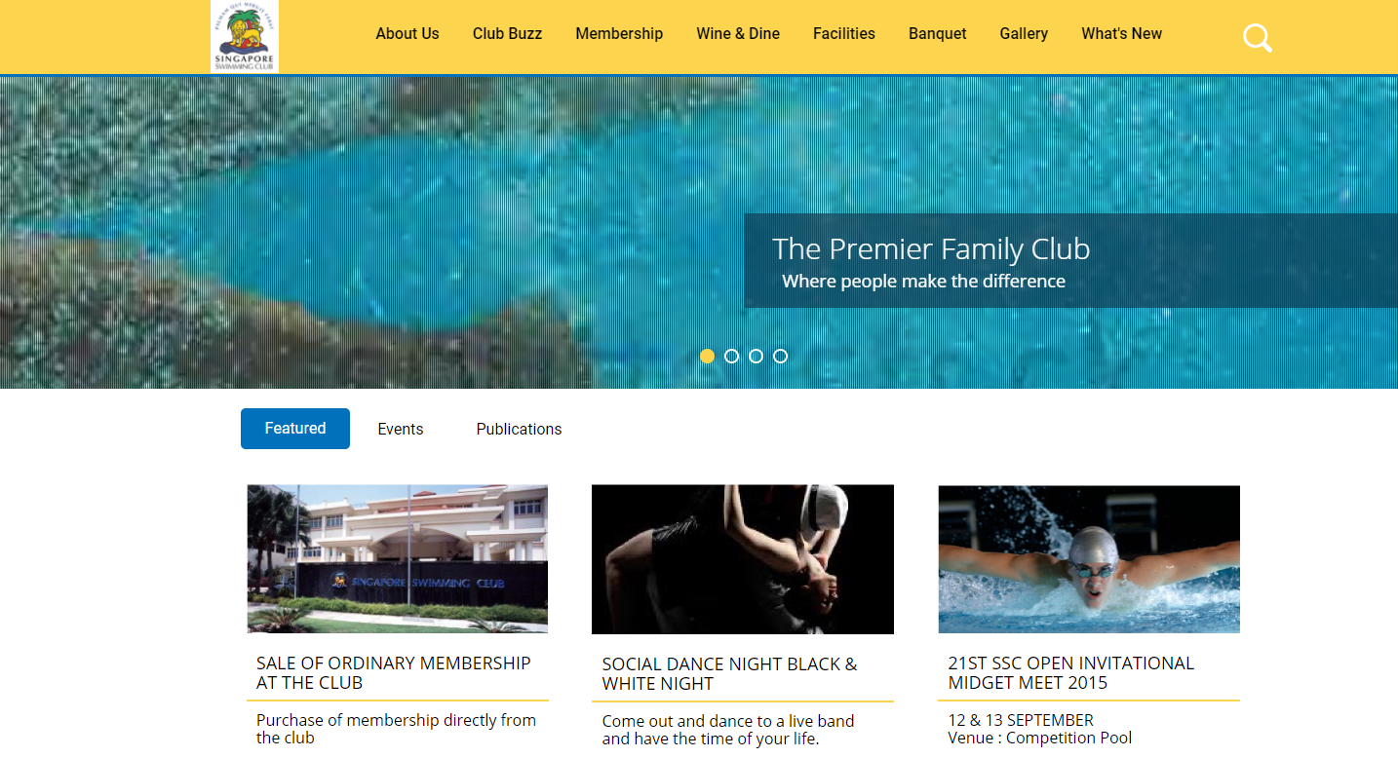
TEMPLATE
From box by default, become like this on scroll
3. The main menu, on scrolldown become sticky
These are tabs

Slide 4

TEMPLATE
Search button by default just icon, on click showing the field

Slide 5
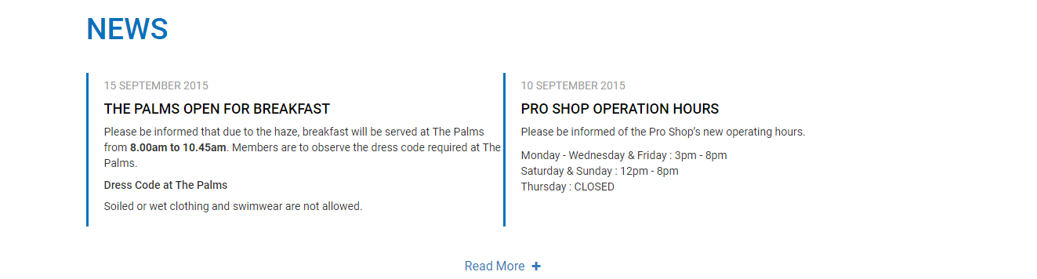
TEMPLATE
4. Please add this function
On click, will show the next same two columns, just use dummy text

Slide 6
TEMPLATE
5. For the responsive, there is no design for it. Please use your feeling and initiative how to display the clean and tidy layout when become to responsive.
6. Please learn to use SortSite or you may use HTML compliance from w3c validator

