Slide 1
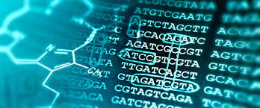
Natural Language Processing protein classification
Presenter: Laila Almajnuni
Instructor: Dr Mejdal Alqahtani

Slide 2
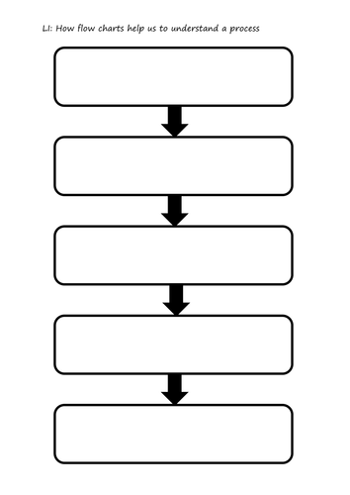
Project Workflow
Defining the Problem
Reading research papers
EDA and Preprocessing
Dimensionality Reduction
Modeling and Validation

Slide 3
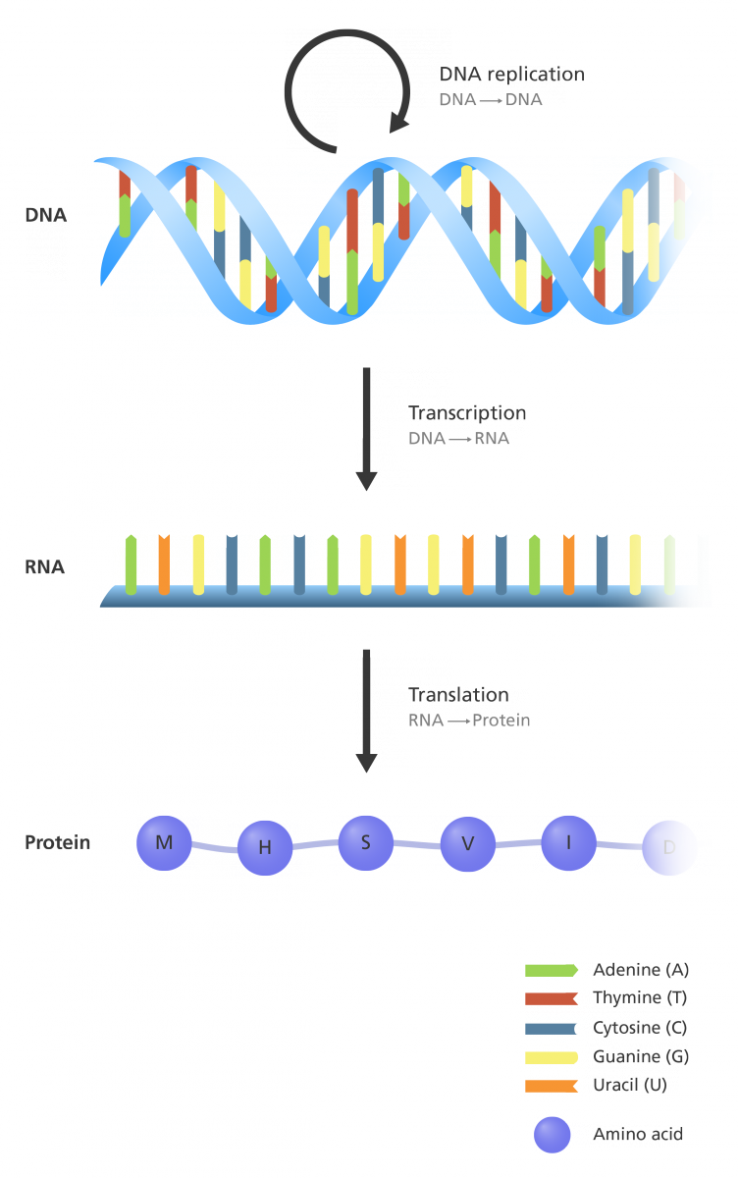
Quick Biological Overview:
DNA is the genetic martial of living cells.
mRNA copies the DNA sequence (transcription).
Amino acid chain forms by translation from mRNA (translation).

Slide 4
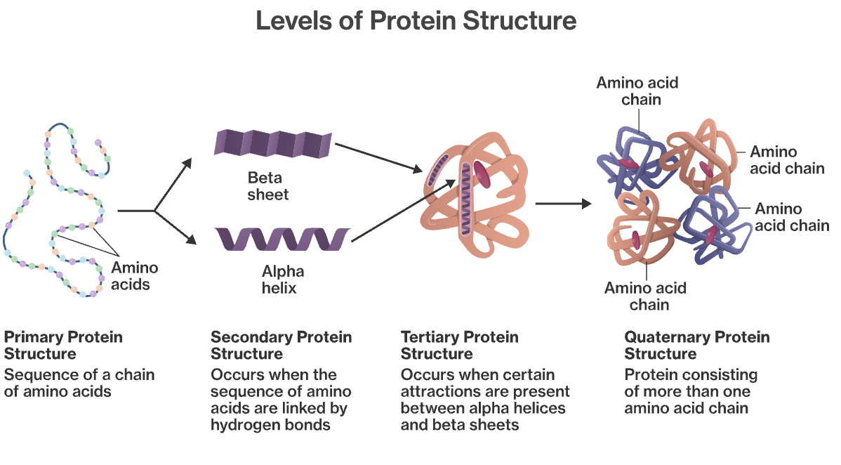
Why it is important?
1. The sequence of amino acids -> dictates the function of the protein.
2. Protein function -> helps making precise diagnostics.

Slide 5
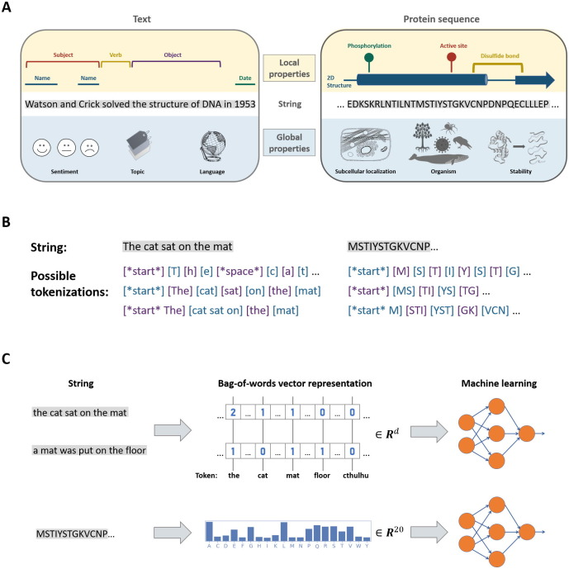
How Text and Protein Sequence are similar

Slide 6
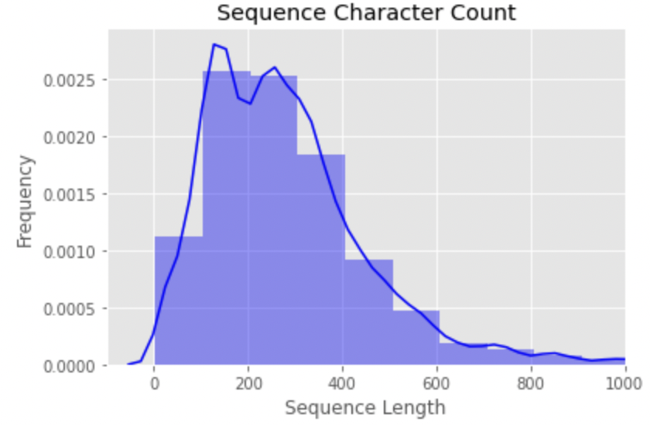
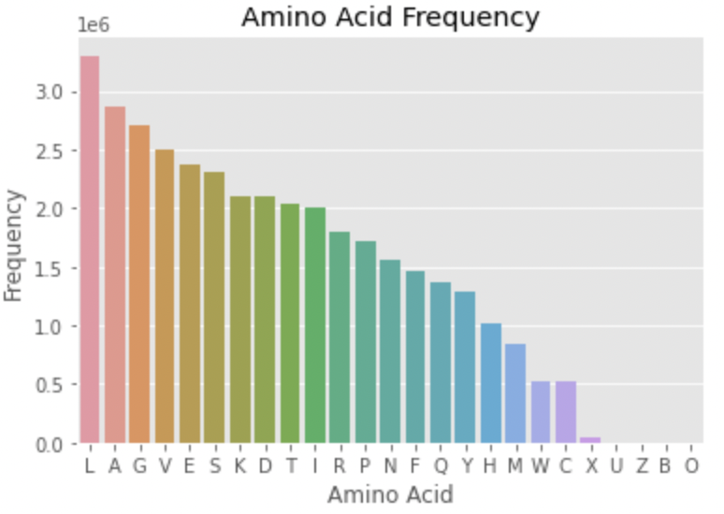
EDA AND Preprocessing
Only ‘Protein’
Sequence with length (<~400)
5 common families( ~3500)
Nulls/duplicates
Remove uncommon AA [*OUBXZ]
Tokenization: unigram, (3,5)

Slide 7
Tokenization (3,5)/(1,1) + K-means
Truncated SVD
Worse scenario:
The model was not able to cluster the data right
Cluster 0: | Cluster 1: | Cluster 2: | Cluster 3: | Cluster 4
AAAK | AAAA | AAAG | AAAM | AAAG
AALA | AAAG | AAAR | AAAH | AAAH
AALV | AAAH | AAAH | AAAL | AAAL
AALR | AAAL | AAAL | AAKA | AAAS
AAIA | AAAS | AAAM | AAGV | AAPT

Slide 8
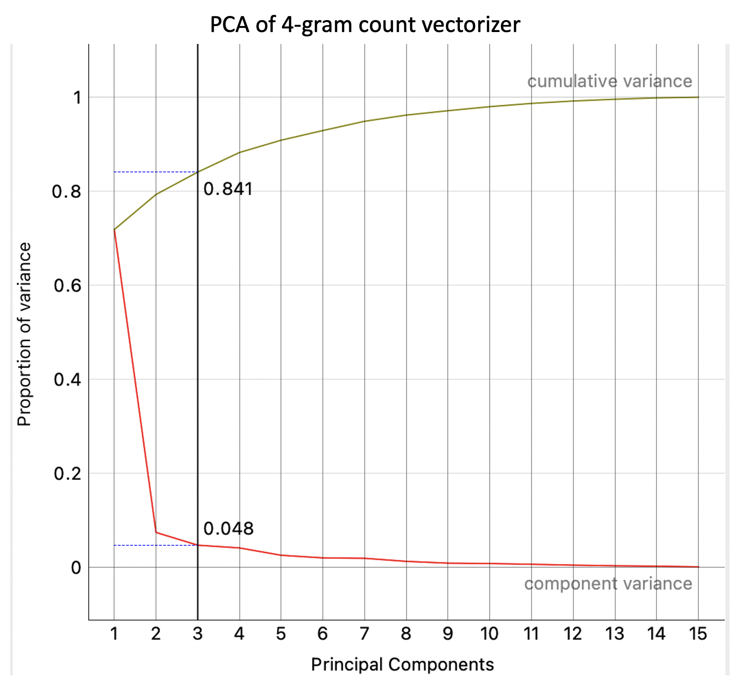
Classification
PCA on unigram verctorization
The (3,5) n-grams is better with accuracy of 88% and MSE 0.32.
PCA for deminsion reduction with ~ 80%.
High sparsity

Slide 9

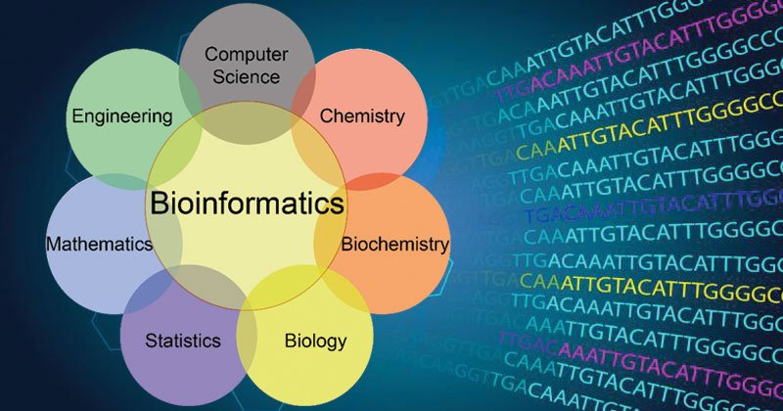
Future work
Use neural network to optimize the performance
Get into research field
Look for more challenging problems
Learn about the bioinformatics tools available

