Slide 1
AdGenie
A RAG-Based Multi-Agent System
for Social-Media Campaign Planning
Leila Mehbani | Nancy Nezzal
Seminar 1 • Problem framing, related work, and dataset analysis

Slide 2
02 | FRAMING CARD
Project Scope at a Glance
The seven required elements of the project framing card.
Task type
Generation and retrieval in a multi-agent workflow
Input → output
Product, platform, audience and goal → campaign strategy, content pillars, posting calendar, captions and CTA
Users & affected
Small-business owners, online stores and social-media managers; audiences receiving the generated content
Costlier error
Invented product facts can mislead audiences and damage brand trust; unmet requirements can make content unusable
Metric + threshold
Primary: Requirement Recall ≥ 0.90 (requirements met ÷ requirements in the brief). Guardrail: Fact Precision ≥ 0.95 (supported claims ÷ product claims). Must beat baseline by ≥ 15 points.
Baseline
Same Qwen2.5-1.5B-Instruct, used as-is (no fine-tuning), with the same request but without RAG or agent review
Test-set size
30 planned English client-brief prompts, shared across all system variants; descriptive pilot evaluation
02

Slide 3
2. What Will Be Compared?
A controlled comparison: add one component at a time.
Variant | Method | Purpose
A — Baseline | LLM generates from the client brief only | Reference point
B — RAG | LLM + retrieval of relevant marketing examples | Measure retrieval contribution
C — RAG + Agents | RAG + planning/content/evaluation workflow | Measure review and refinement contribution
Retrieval
Agent review
Find relevant examples from the dataset.
Check the plan against the client brief and improve it.
03

Slide 4
03 | LITERATURE REVIEW
Research Comparison (1/2)
The same seven fields are used for every study. N/A means the field does not apply to that study's contribution.
Research | Input | Output | Data | Embedding | Ranker | Reranker
MarketingFM Liu et al., 2025 | Search keyword + product/landing-page context | Keyword-specific ad headline and description | E-commerce product catalog/landing-page information; human and automated ad evaluations; online A/B test | Sentence encoder for semantic retrieval | Similarity score (e.g., dot product) ranks product candidates | No separate reranker stage identified in the described pipeline
Koo, 2025 Cross-lingual effects | 200 typical business issues; generated responses in English, Arabic and Chinese | 600 ChatGPT-4 business recommendations; human-written business emails in follow-up study | Study 1: 200 issues × 3 languages; Study 2: 480 participants (160 per language) | N/A — not an embedding/retrieval study | N/A | N/A
Lewis et al., 2020 Original RAG | Input query + retrieved passages | Generated answers/text conditioned on query and passages | Wikipedia index; evaluated on NQ, WebQuestions, CuratedTREC, TriviaQA, MS MARCO, Jeopardy question generation and FEVER | Dense Passage Retriever (DPR) query/document encoders | DPR retrieves top-K passages using maximum inner-product search | No distinct second-stage reranker in the original RAG architecture
Evidence note: ranker = first-stage candidate ordering; reranker = a separate second-stage reordering step.
04

Slide 5
04 | LITERATURE REVIEW
Research Comparison (2/2)
These studies support multilingual retrieval and multi-agent design, but they do not all propose a complete RAG pipeline.
Research | Input | Output | Data | Embedding | Ranker | Reranker
Multilingual E5 Wang et al., 2024 | Text/query to be represented for semantic retrieval | Vector embeddings; supports similarity search and retrieval, not ad copy generation | Training: about 1B multilingual text pairs; fine-tuning: about 1.6M labeled examples; evaluated on MTEB, MIRACL and bitext-mining benchmarks | Multilingual E5 (small/base/large; instruction-tuned variant also reported) | Similarity-based retrieval using embedding scores; benchmarked against BM25 and mDPR | No separate online reranker proposed as the core method; cross-encoder is used as a training/distillation teacher
Li et al., 2024 Multi-agent systems survey | Existing LLM-based multi-agent studies and system designs | A survey/framework of agent workflow, infrastructure, applications and challenges | Literature review of published systems; not one single task dataset or benchmark | N/A — not an embedding model paper | N/A | N/A
Important distinction: a cross-encoder used to train an embedding model is not automatically an online reranker.
05

Slide 6
05 | LITERATURE REVIEW
Coverage Matrix
✓ = directly relevant to this component; — = not the main focus of the paper.
Research | Marketing | RAG / retrieval | Multilingual | Multi-agent | Evaluation
MarketingFM | ✓ | ✓ | — | — | ✓
Koo (2025) | ✓ (business content) | — | ✓ | — | ✓
Lewis et al. (2020) | — | ✓ | — | — | ✓
Multilingual E5 | — | ✓ (embeddings) | ✓ | — | ✓
Li et al. (2024) | — | — | — | ✓ | ✓ (surveyed methods)
This matrix shows topic coverage; it does not claim every paper implements every component.
06

Slide 7
6. Research Gap & Proposed Contribution
Gap in the reviewed literature | AdGenie response
MarketingFM generates a single ad (headline + description), not a full campaign plan. | Generate strategy, content pillars, and a publishing calendar in one structured plan.
RAG and E5 are tested on QA/retrieval benchmarks; the agent paper is a survey, not a marketing pipeline. | Use retrieval as context, then review outputs against the brief.
Evaluation in the reviewed work targets ad quality, QA answers or retrieval benchmarks, not whether a plan meets every requirement of a client brief. | Score every plan against its brief with Requirement Recall and Fact Precision.
Gap: no reviewed study tests a retrieval + review workflow for full campaign plans, scored against explicit brief requirements. Contribution: a practical, testable workflow that does.
07

Slide 8
7. Dataset EDA — Key Numbers
Marketing-Instruct CSV audit
13,141
4
31.5%
0
rows
text columns
missing original_completion
fully duplicated rows
Column | Median characters | Use / note
enhanced_prompt | 662 | Candidate retrieval query / client brief
enhanced_completion | 1,341 | Candidate retrieved marketing example
original_completion | 699* | Missing in 4,136 rows
*Median among non-missing values. Dataset audit completed; model experiments have not been run.
08

Slide 9
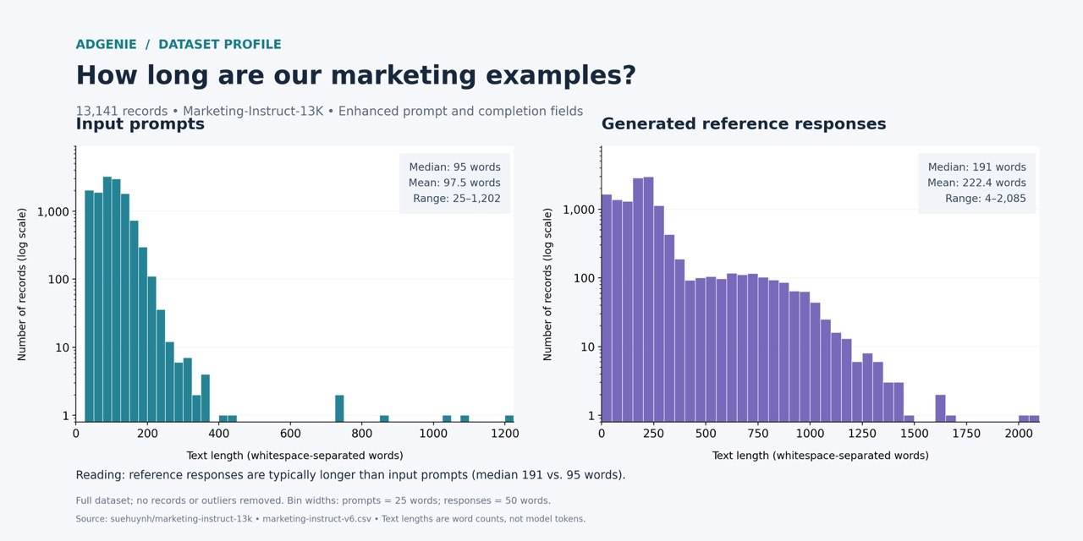
7. Dataset EDA — Text Length Distribution
Word counts of enhanced_prompt and enhanced_completion • 13,141 records
Implication: reference examples (median 191 words) are about 2× longer than prompts (median 95), so we plan to keep top-k small and cap example length in the context.
09

Slide 10
8. Dataset Fit & Limitations
What the current dataset can and cannot support.
Suitable for | Limitations to report | Planned handling
English marketing prompts and responses | English-only, so results do not transfer to other languages | Define the project scope as English and make no multilingual claims
Retrieval examples for copy and campaign ideas | No verified business outcome labels identified in this audit | Evaluate relevance and quality with a human rubric
Prompt → completion examples | 31.5% of original_completion is missing | Use enhanced fields for initial experiments; document filtering
Important: AdGenie is scoped to English; no claim is made about other languages.
10

Slide 11
9. Proposed System Workflow
The workflow focuses on planning and publishing cadence, not budget allocation.
1
2
3
4
5
6
Client brief
Retrieve
Plan
Create
Evaluate
Refine
Product • audience
platform • language
goal • duration
Find relevant
marketing examples
Strategy + content
pillars + calendar
Posts, stories,
CTA and hashtags
Check relevance,
consistency, brief fit
Improve weak parts
before final output
Final output: a structured campaign plan + a practical publishing calendar.
11

Slide 12
10. Proposed Tools
Each tool has one clear role; final choices depend on experiments.
Component | Candidate | Role
Language model | Qwen2.5-1.5B-Instruct (same model in all variants) | Generate the initial plan
Embeddings | multilingual-e5-base | Represent prompts/examples for retrieval
Vector store | ChromaDB | Store and search dataset examples
Workflow | LangGraph | Coordinate planning, content, and evaluation steps
Optional reranker | Cross-encoder | Reorder retrieved examples by relevance
Status: candidate stack only; not presented as implemented or experimentally validated.
12

Slide 13
11. References
Use the linked papers for the final verified literature review.
MarketingFM (2025)
amazon.science/publications/llms-for-customized-marketing-content-generation-and-evaluation-at-scale
Cross-lingual effects (Koo, 2025)
nature.com/articles/s41598-025-16650-w
RAG — Lewis et al. (2020)
arxiv.org/abs/2005.11401
Multi-agent survey — Li et al. (2024)
link.springer.com/article/10.1007/s44336-024-00009-2
Multilingual E5 — Wang et al. (2024)
microsoft.com/en-us/research/publication/multilingual-e5-text-embeddings-a-technical-report/
Dataset: Marketing-Instruct 13K
huggingface.co/datasets/suehuynh/marketing-instruct-13k
13

Slide 14
12. Seminar 1 Deliverables
A concise checklist aligned with the requested seminar structure.
Required item | Where it appears
Problem framing: inputs, outputs, research question | Slides 2–3
Baseline and comparison variants | Slides 2–3
Literature coverage and comparison tables | Slides 4–6
Research gap and proposed contribution | Slide 7
Dataset description and EDA numbers | Slides 8–10
Proposed system workflow | Slide 11
Tools and implementation candidates | Slide 12
Sources for the review | Slide 13
14

