Slide 1

M.Phil. Art and Design Education
Laila Noor
2022-2024
Supervisors:
Prof. Dr. Nusra Inayat
Ms. Mahrukh Malik

Slide 2
Significance of ‘Augmented Reality’ as a communication instrument for primary year students with hearing impairment and muteness to empower them with self-confidence and independence.

Slide 3
Hearing Impairment and Muteness
Augmented Reality
Hearing impairment and muteness are related conditions that can cause difficulty in communication.
Augmented Reality (AR) is a technology that overlays digital information, such as images, videos, or sounds, onto the real world through devices like smartphones, tablets, or AR glasses.

Slide 4
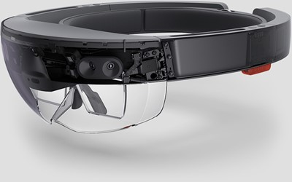
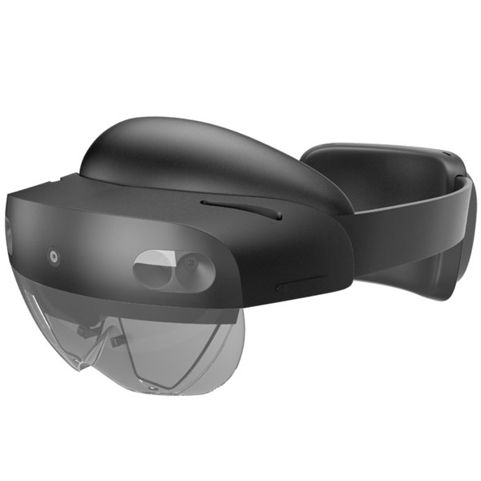
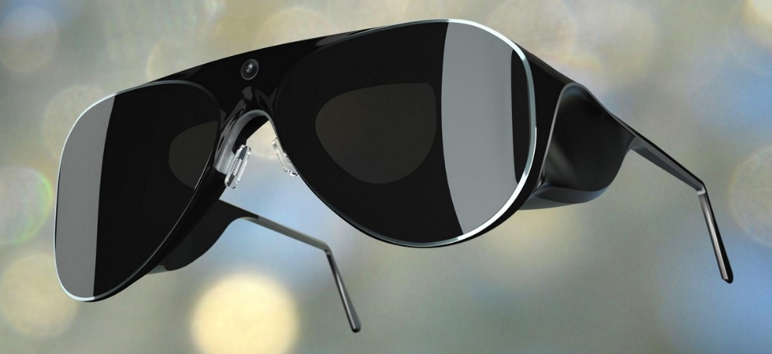
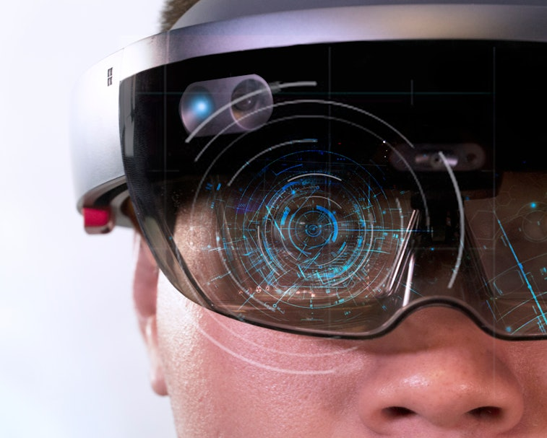
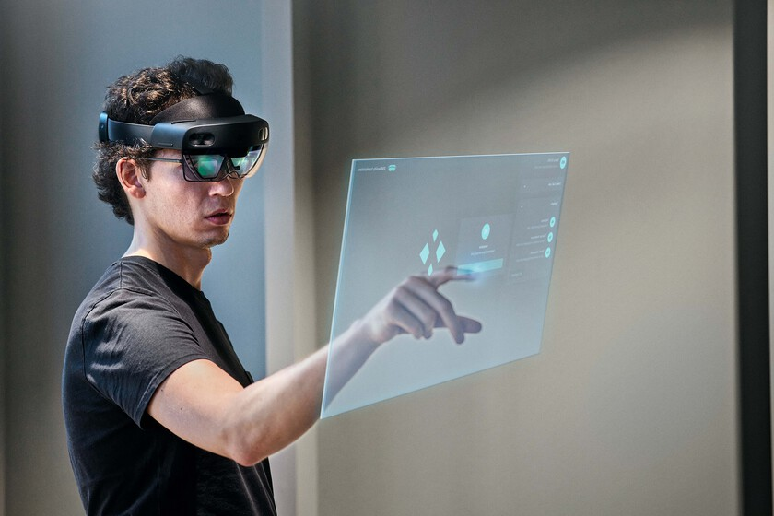
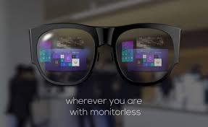
Example of Augmented Reality

Slide 5
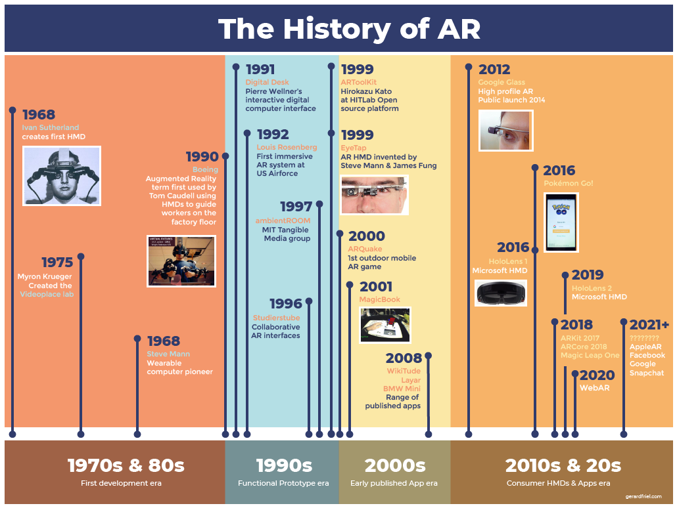

Slide 6
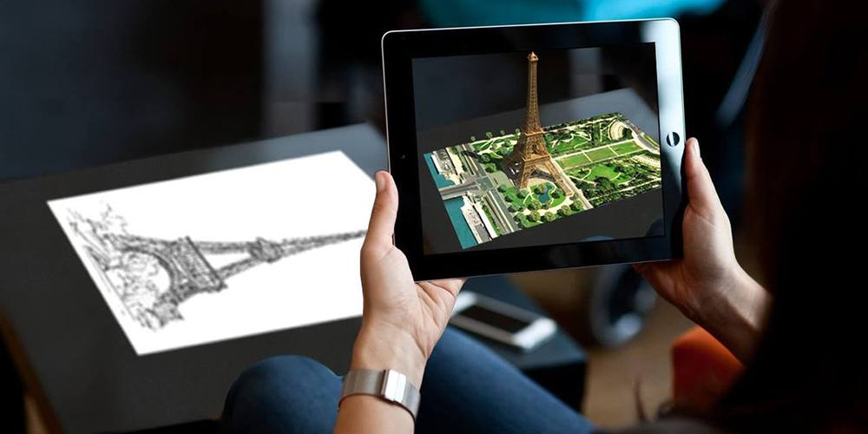
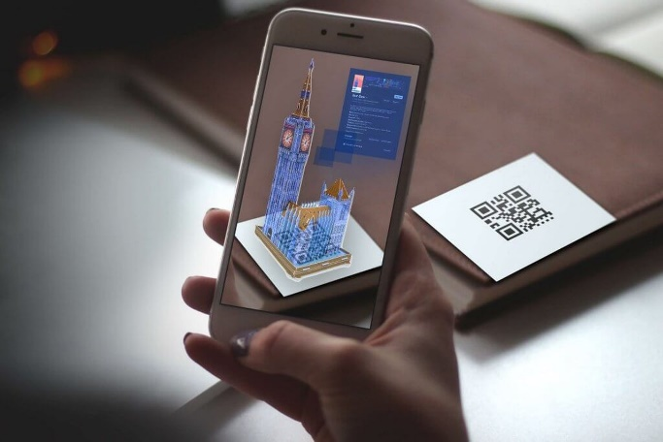
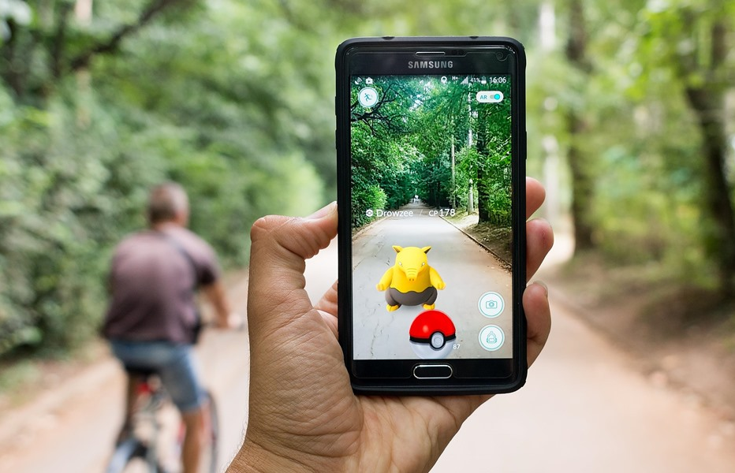
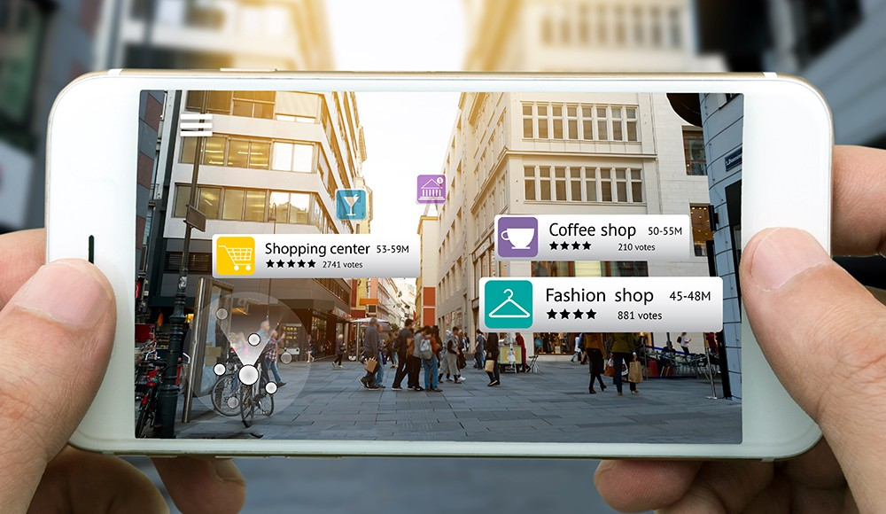
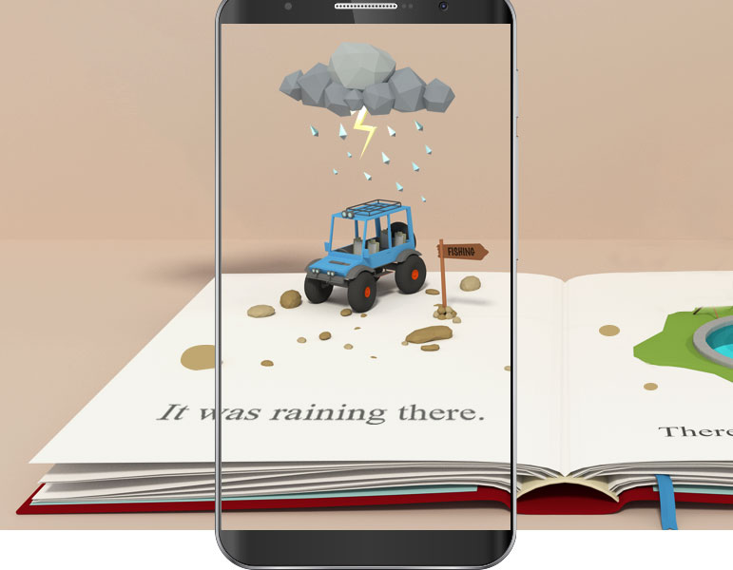
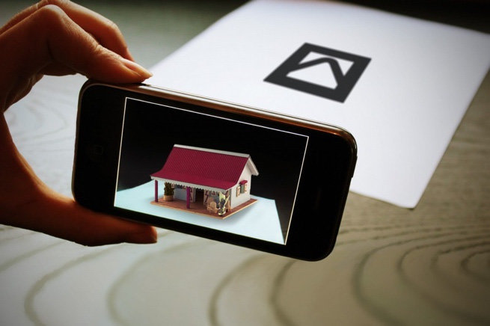
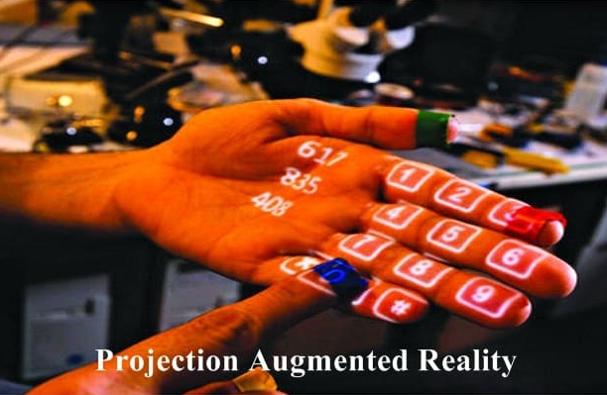
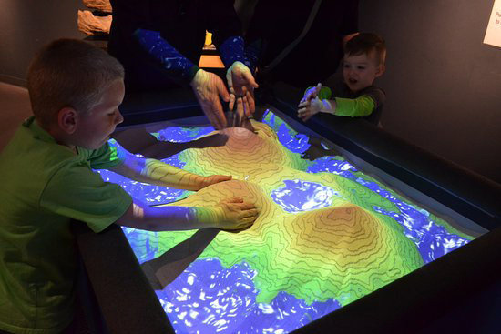
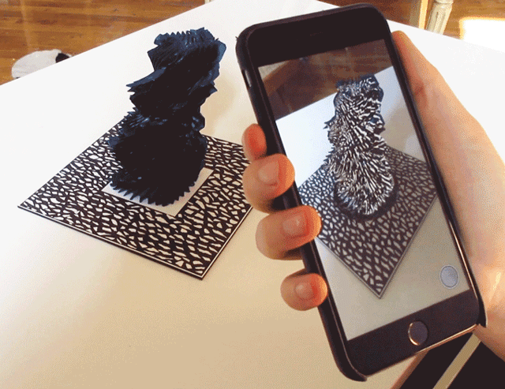
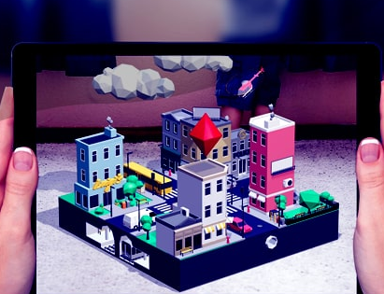
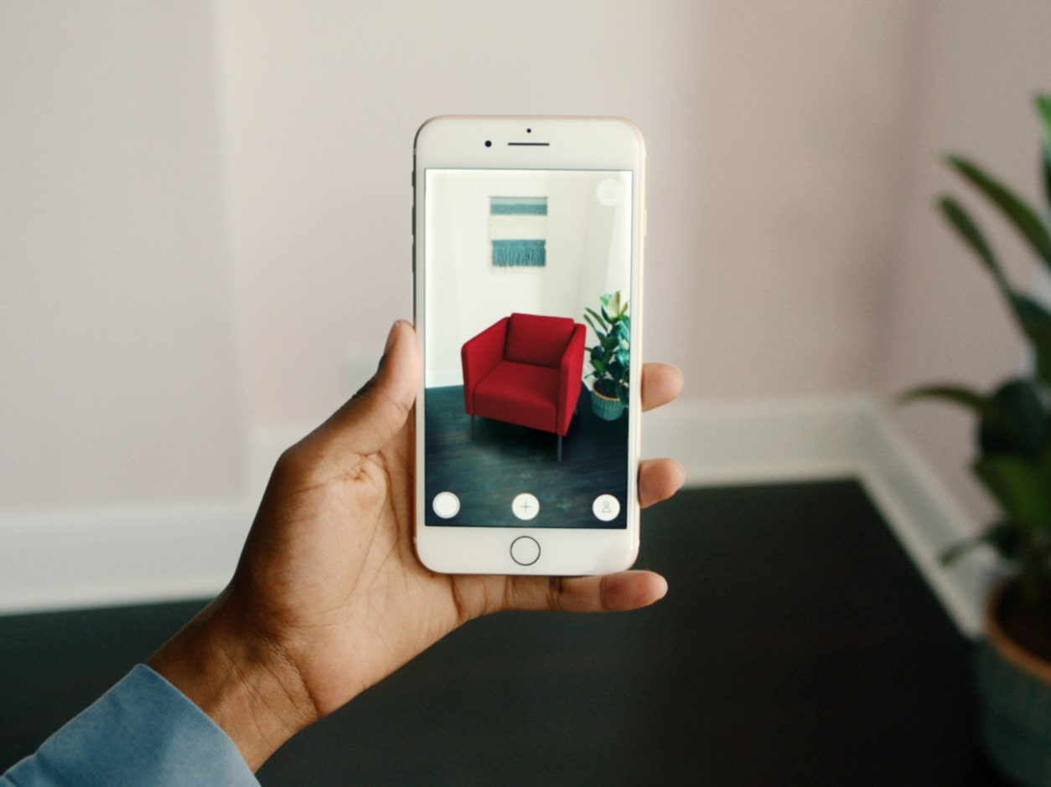
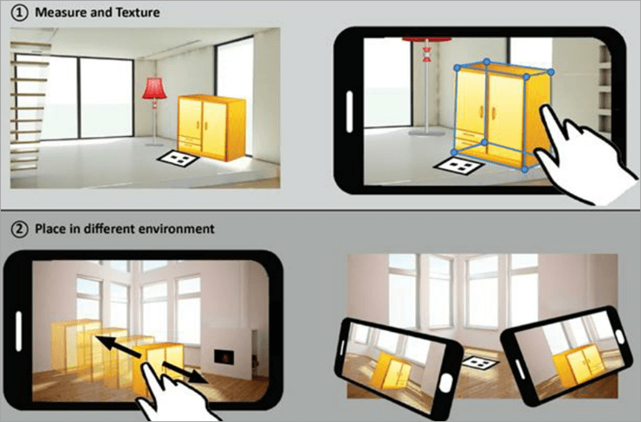
Markerbased/Image Recognition AR
Marker-less AR

Slide 7
Augmented Reality and Students with Hearing Impairment and Muteness
Augmented Reality (AR) can help students with hearing impairment and muteness to boost their confidence by allowing them to interact with the material in a more engaging and immersive way.
AR can provide visual cues to help them better understand the material, as well as provide interactive feedback and guidance.
Additionally, AR can provide visual support for activities such as sign language, allowing students with hearing impairment to better access the material and gain confidence in their own learning.
Augmented Reality (AR) can bring inclusion to a classroom by allowing students to learn and interact with each other and with their instructor in class.

Slide 8
Research Questions
How can Augmented Reality be used to bridge the communication gap between students with hearing impairments and muteness and their peers?
How can Augmented Reality be used to foster the social development of students with hearing impairments and muteness?
How can Augmented Reality be helpful for students with hearing impairment and muteness in bringing inclusion to a classroom?

Slide 9
Research Objectives
To examine the role of Augmented Reality in promoting the inclusion of students with hearing impairment and muteness.
To help students with hearing impairment and muteness improve their communication skills.
To help them enhance social interaction.
To help them build their self-confidence

Slide 10
Literature Review
Augmented Reality for Students with Hearing Impairment and Muteness
Augmented Reality in Education
Augmented Reality in Museums

Slide 11
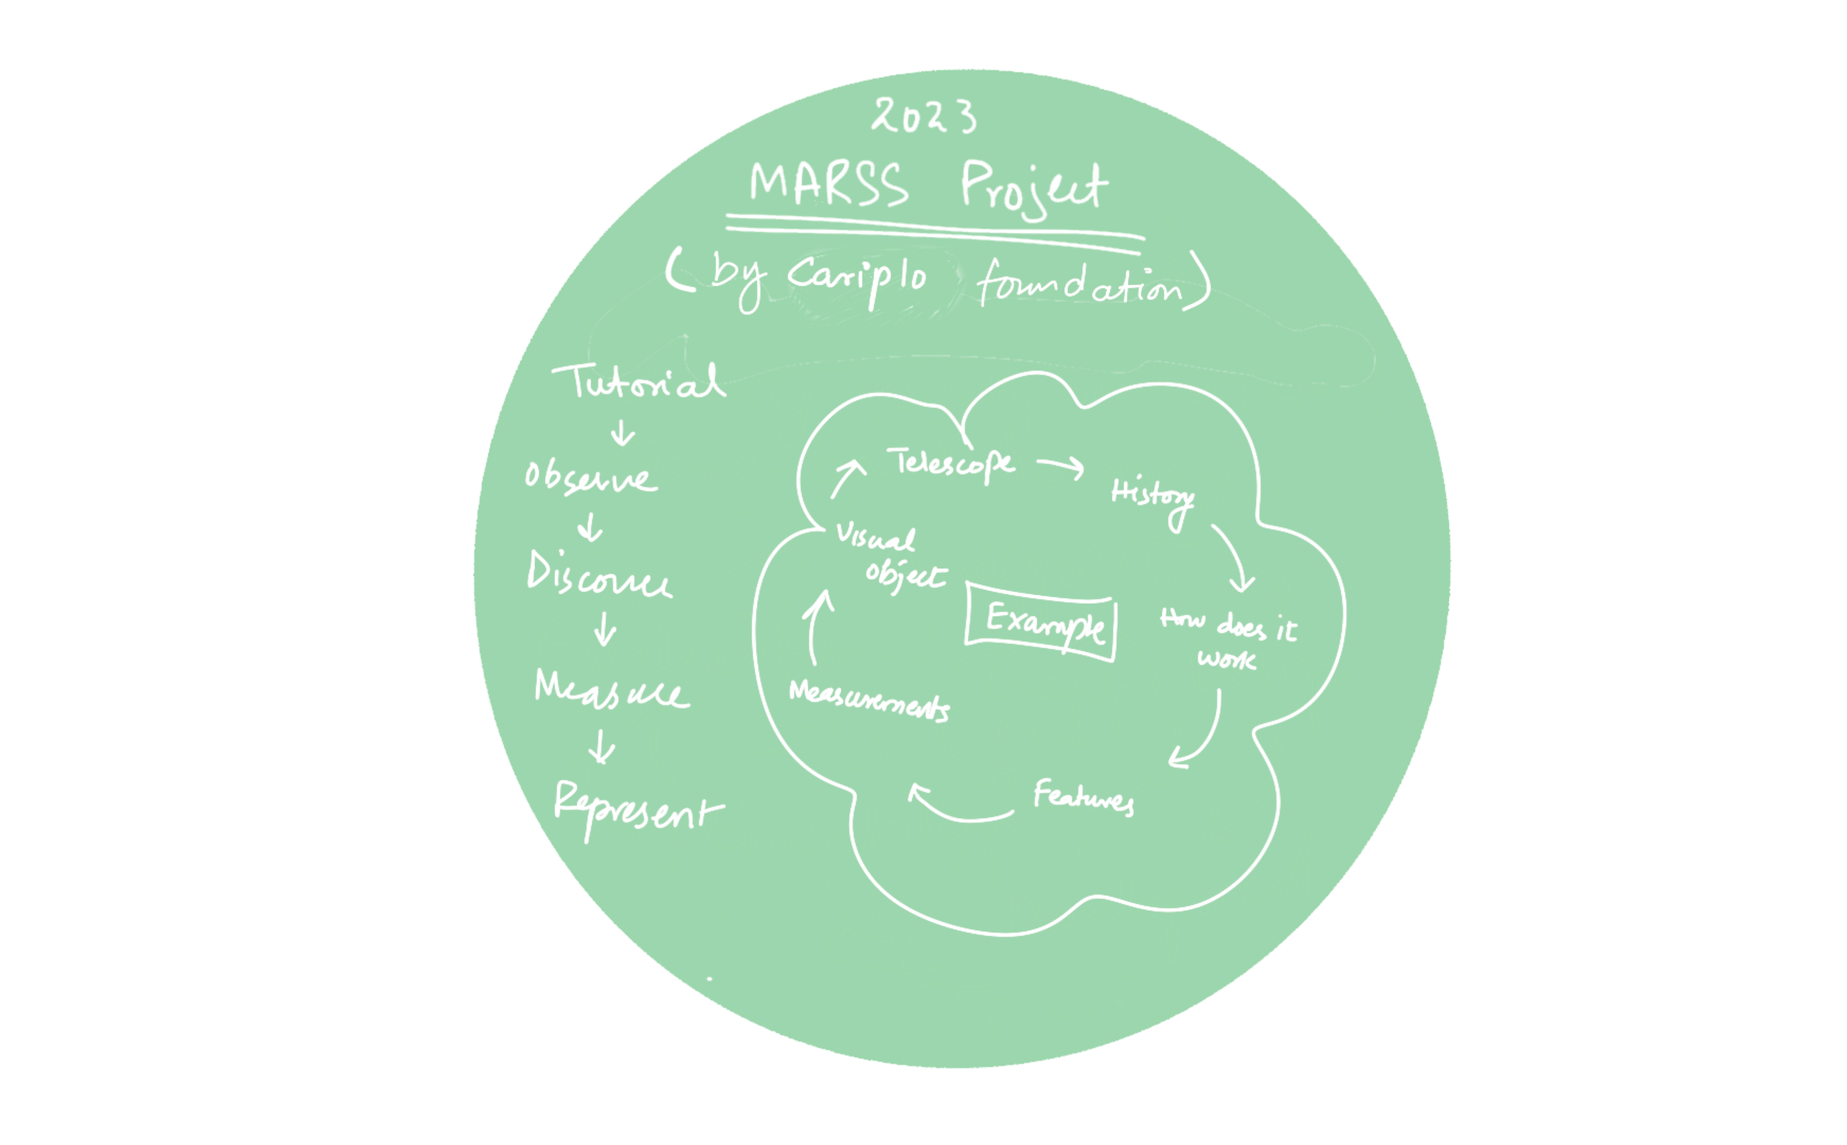
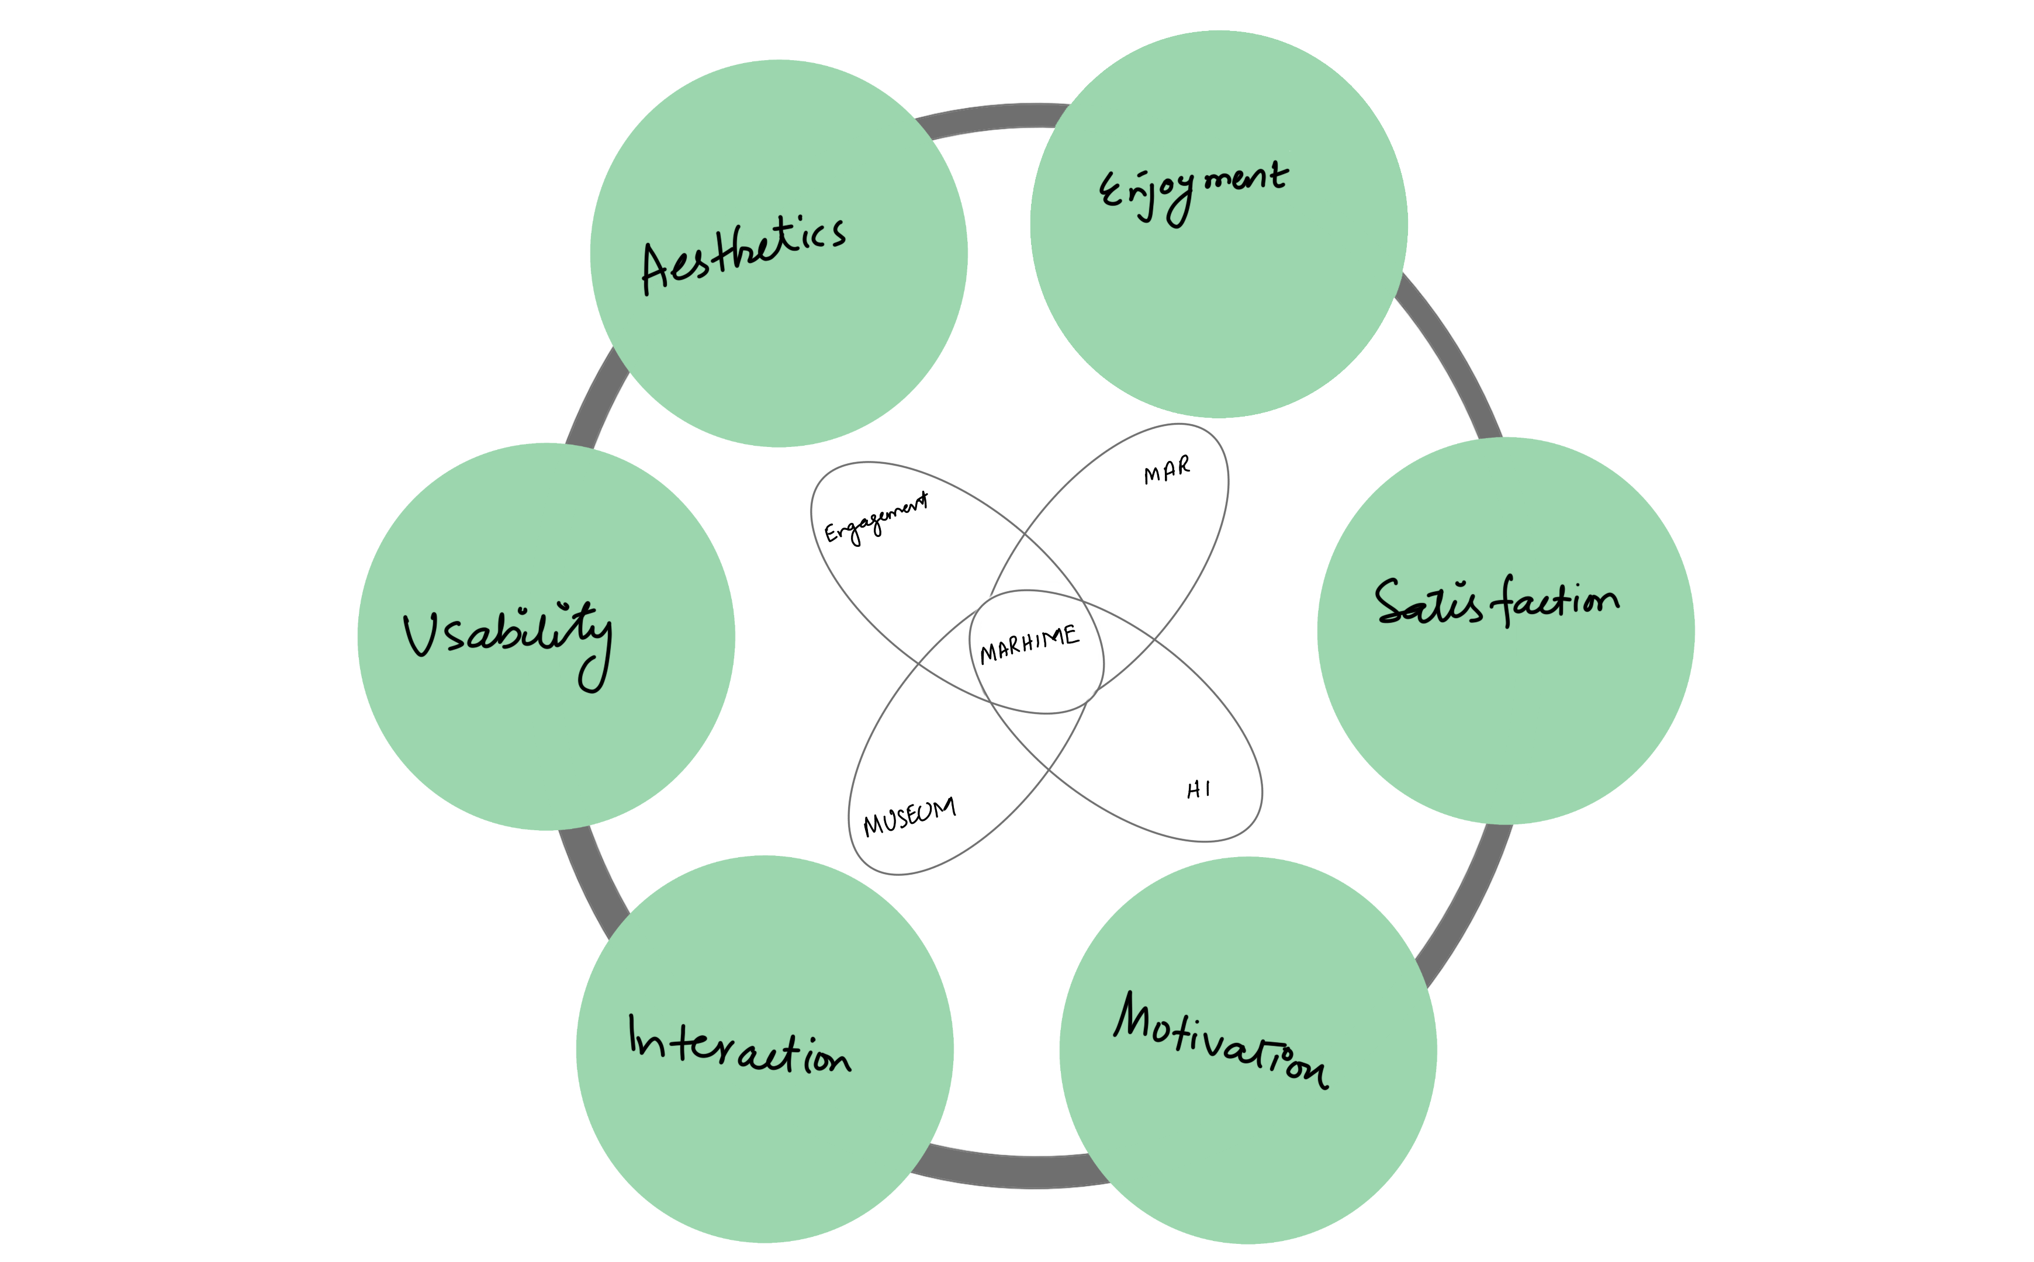
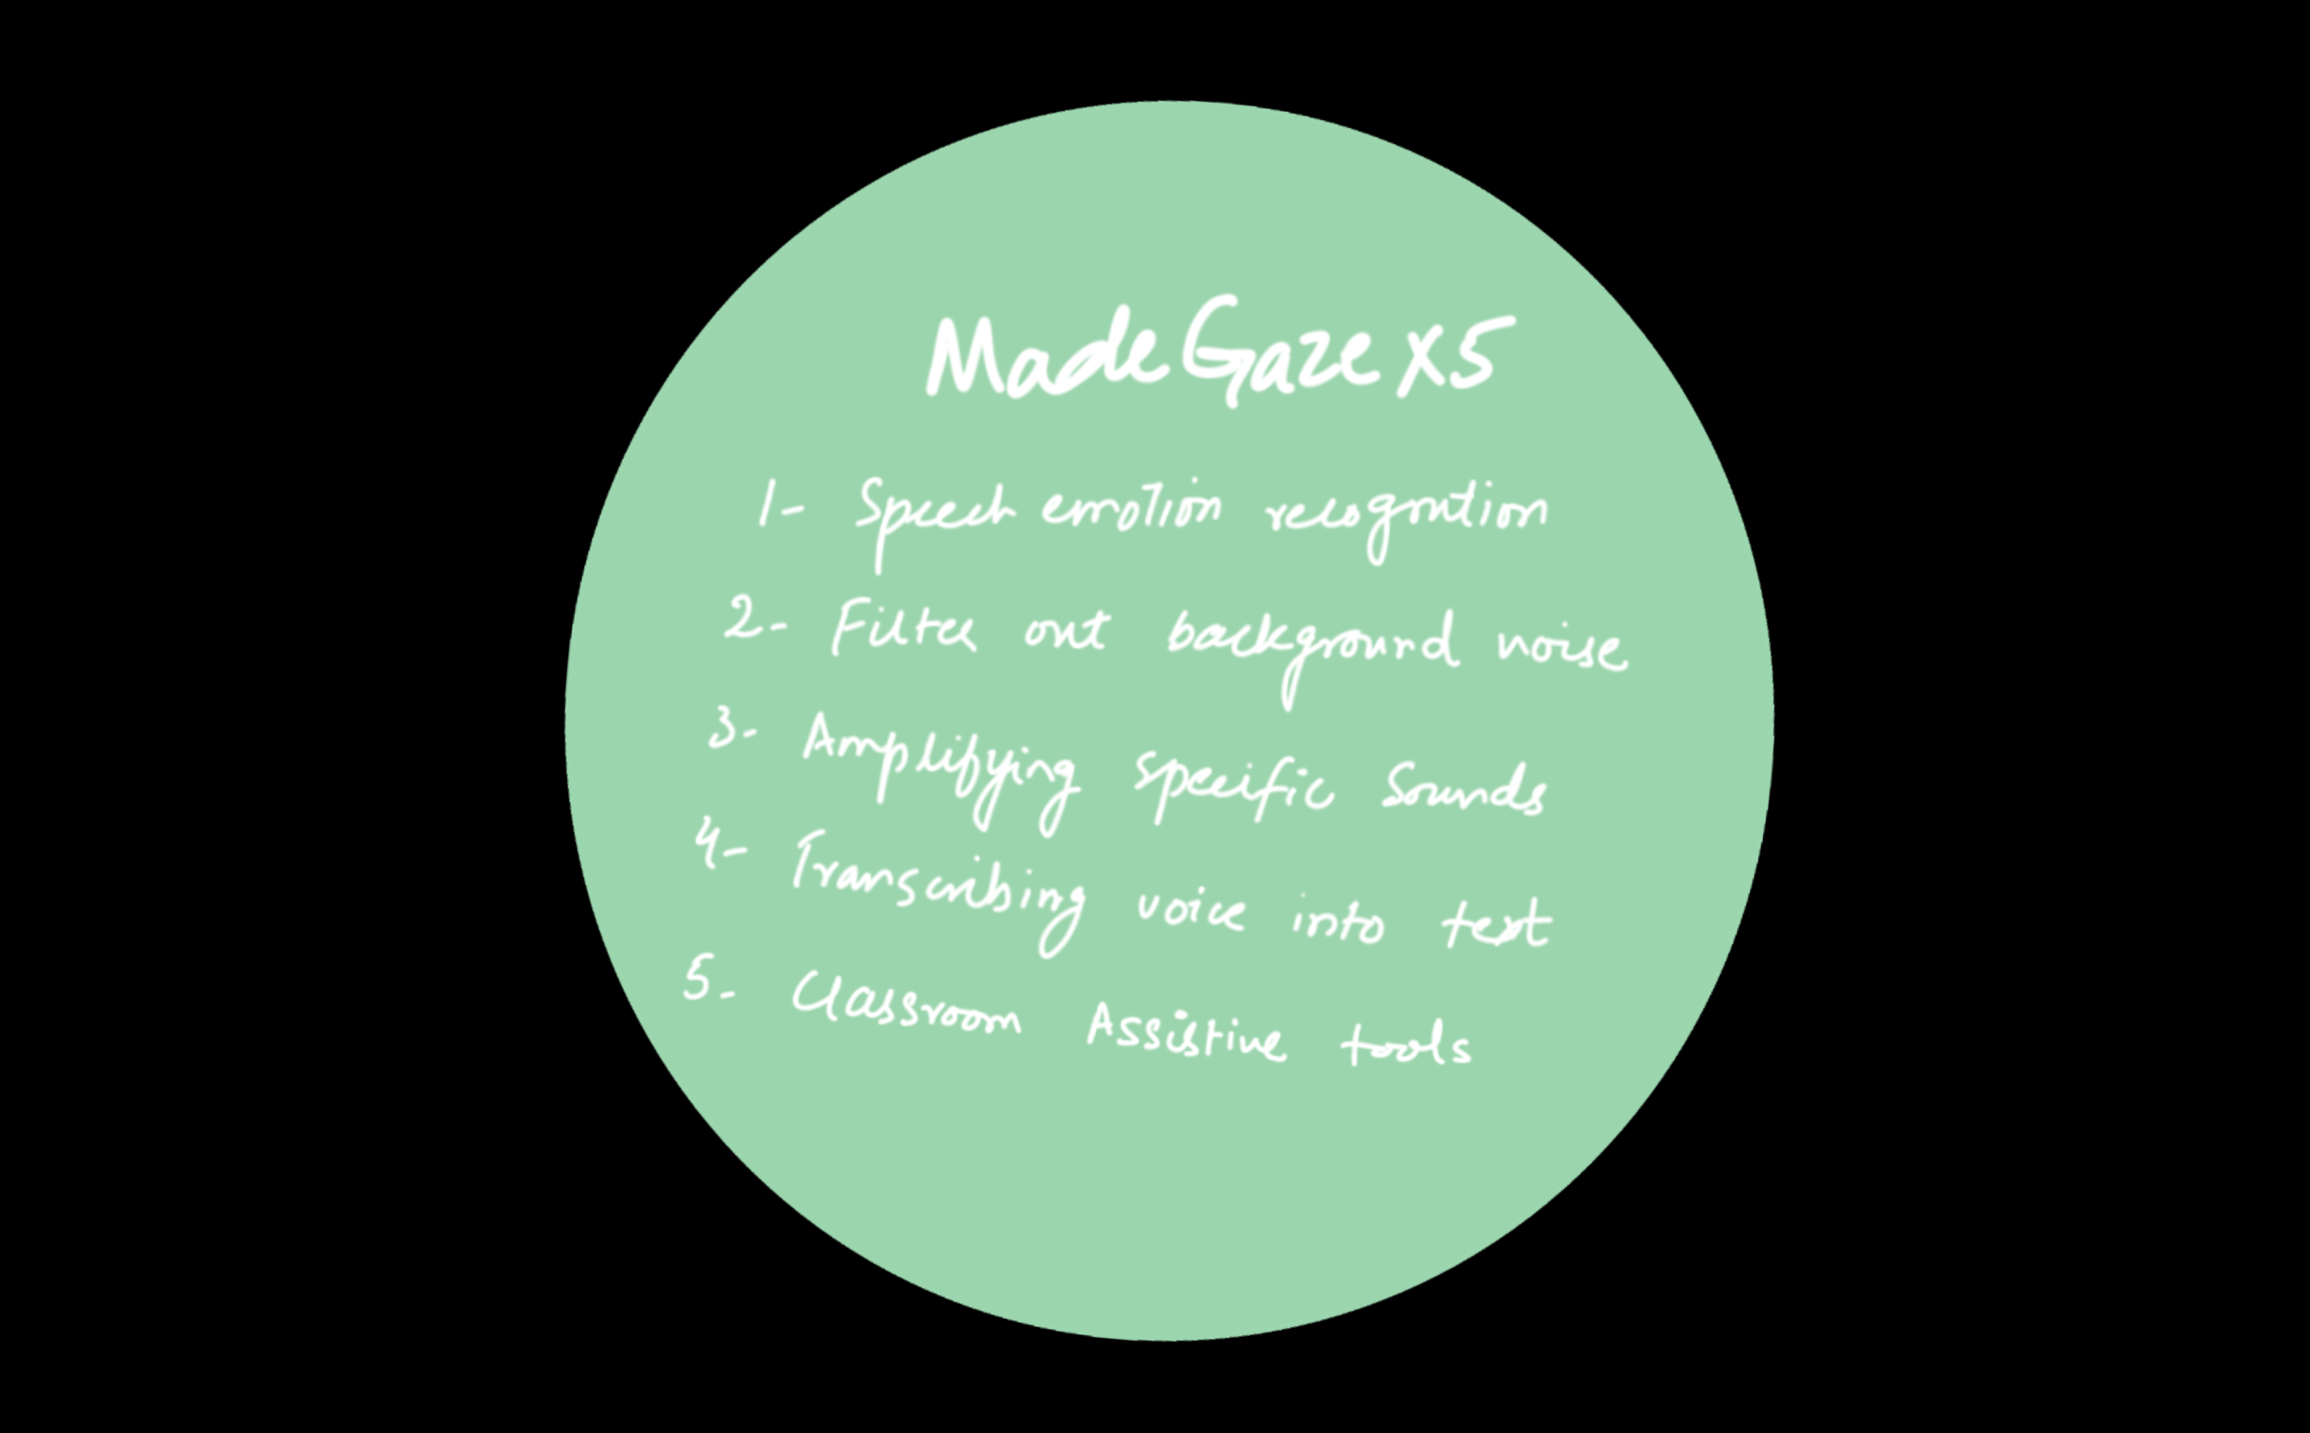
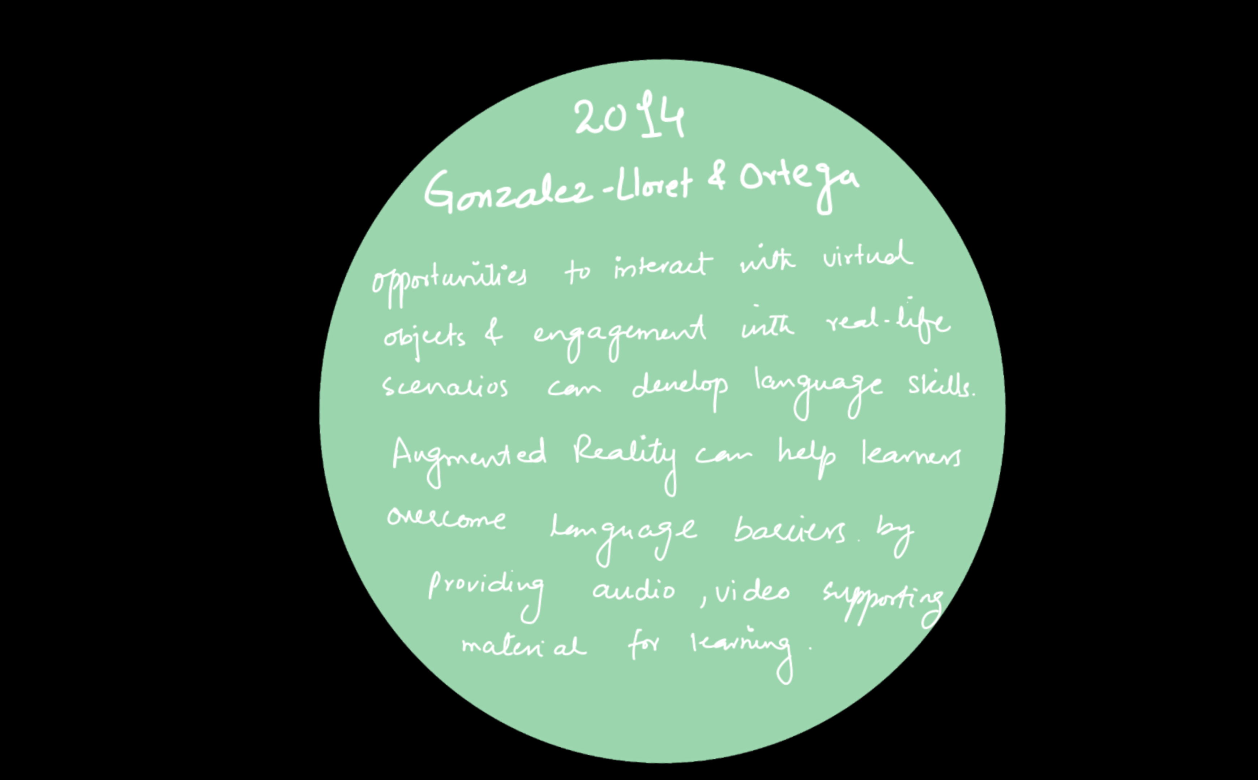
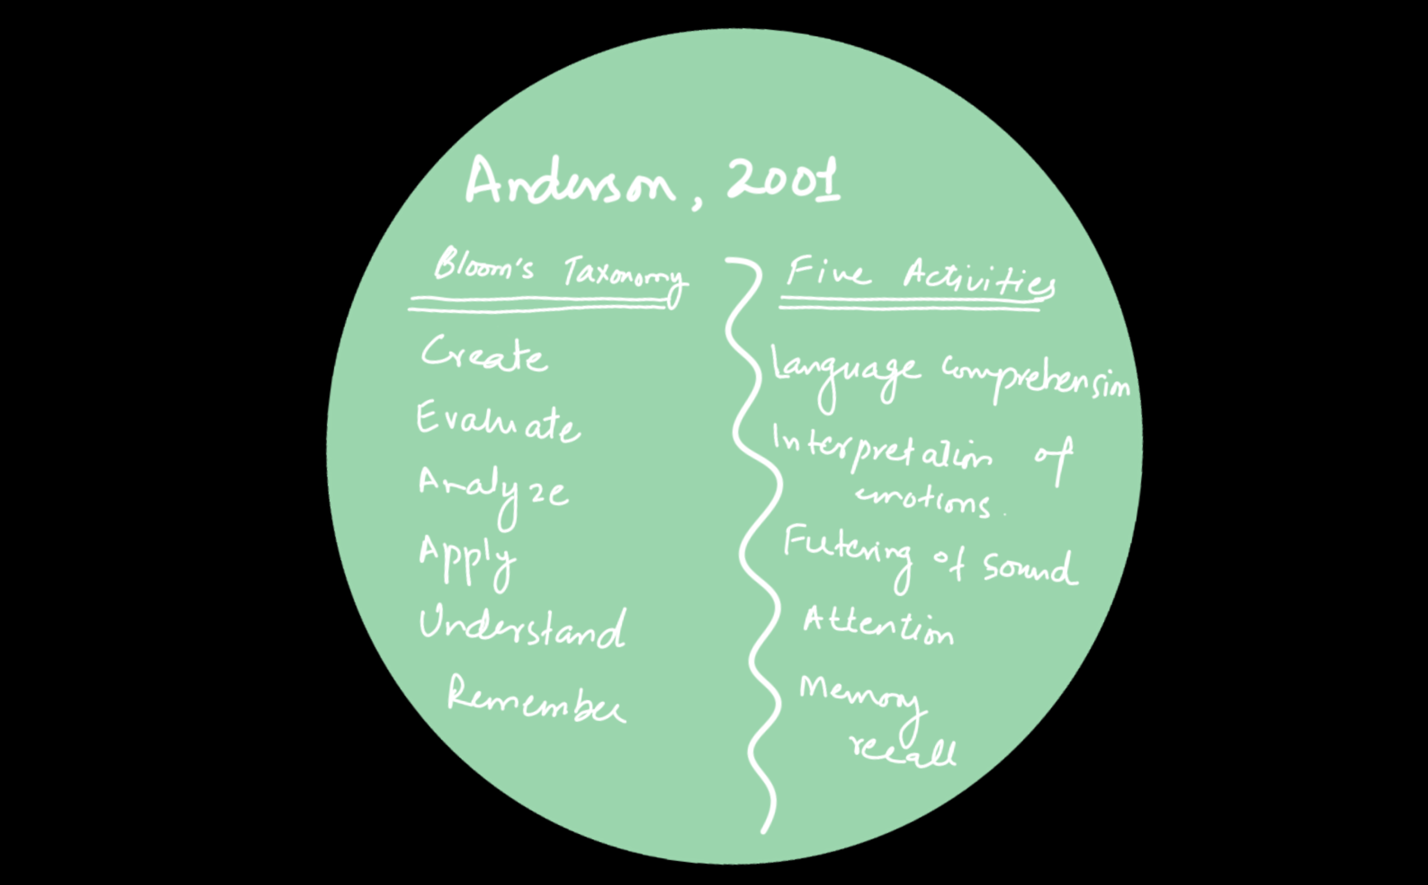

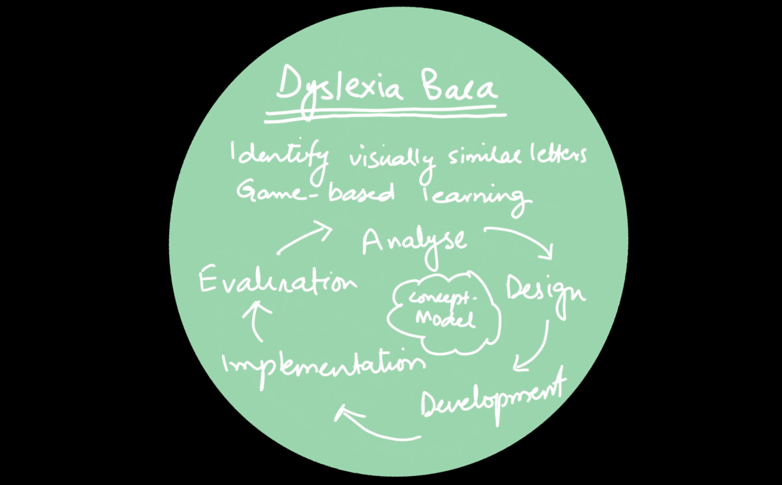
AR for students with Hearing Impairment
and Muteness
AR in Museums
AR in Education

Slide 12
Research Gap
The use of AR technology in special education is a relatively new area of research, and there is limited understanding of how this technology can be effectively integrated into the classroom to promote inclusion for students with hearing impairment and muteness. Therefore, this study aims to address this research gap by exploring the potential of AR technology in promoting inclusion for students with hearing impairment and muteness within Pakistan.

Slide 13
Research Methodology
Mixed Method Experimental Research

Slide 14
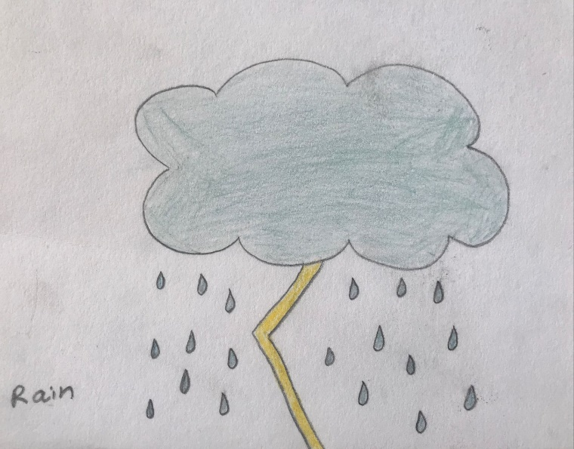


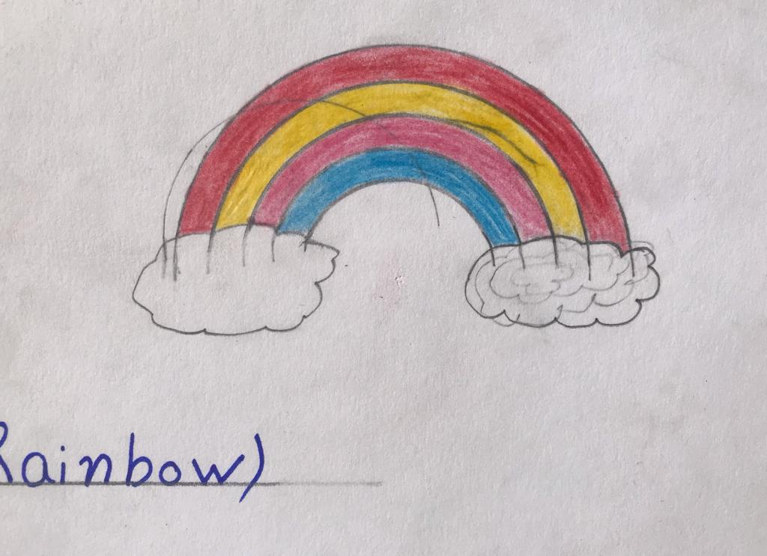


Activity No. 1, ‘Technology Integration into Arts’
Session | Tasks |  |  | Results
Session 1 | Group A Task 1 Scanning flashcards Task 2 Use sign language. | Group B Task 1 Guess the object. Task 2 Find the object | Group C Task 1 Match words Task 2 Complete a puzzle | The primary year students with hearing impairment and muteness displayed interest and participated joyfully in the activity. They expressed a desire to take more turns in scanning the flashcards. Several students found enjoyment in exploring mystery objects within their classroom environment and requested additional time to engage with the flashcards. Providing unexpected treats to students served as a powerful motivator, encouraging and inspiring them to sustain their engagement and enthusiasm for the activity. They were filled with excitement while actively engaging in drawing and coloring. They also showed excitement and positive responses while scanning their artwork through mobile augmented reality app.
Session 2 | No Groups Task 1: Watch the movie Task 2: Pick a noun Task 3: Drawing
Session 3 | No Groups Task 1: Display the artwork Task 2: Interact with the artwork Task 3: Feedback Questionnaire

Slide 15
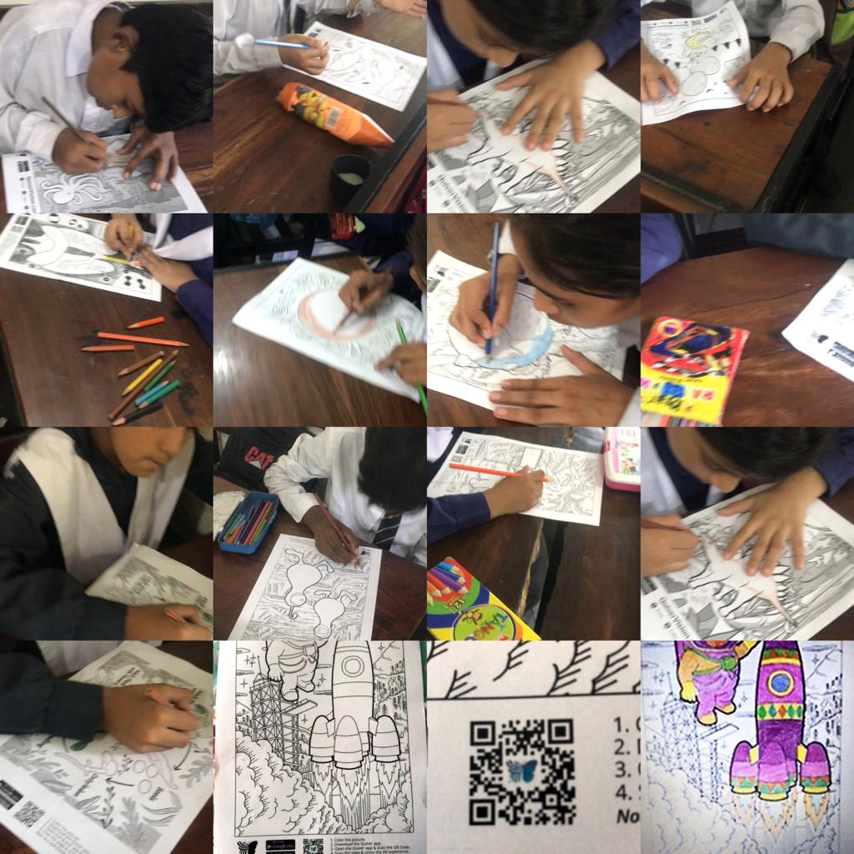
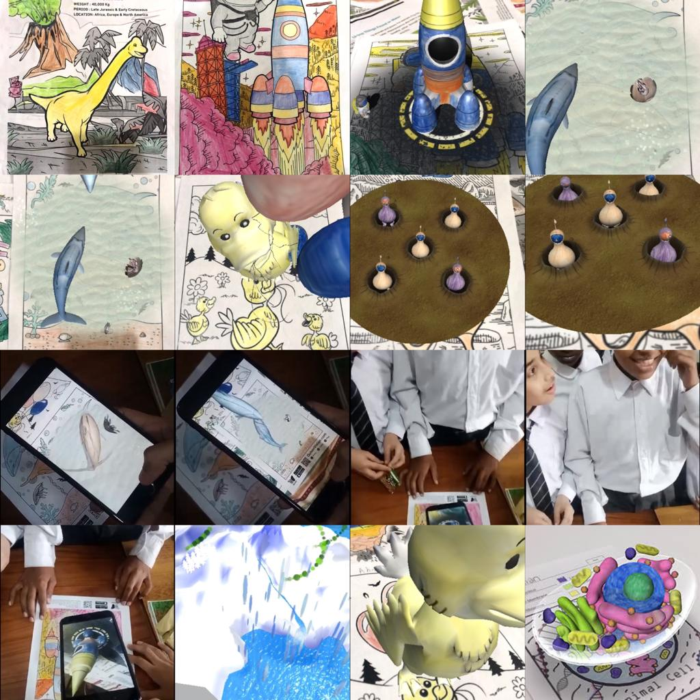
Activity No. 2, ‘Quiver Vision AR App’
Session | Tasks/Step
Session 1 | Task 1: Color the Quiver Coloring sheets
Session 2 | Step 1: Scan the QR code given on the color sheet to view the 3D design of the colored Quiver sheet. Learn about the objects in the colored sheets in 3D form. (Collaboratively)
Session 2 | Step 2: Collect feedback from students about the Quiver Vision Augmented Reality App

Slide 16
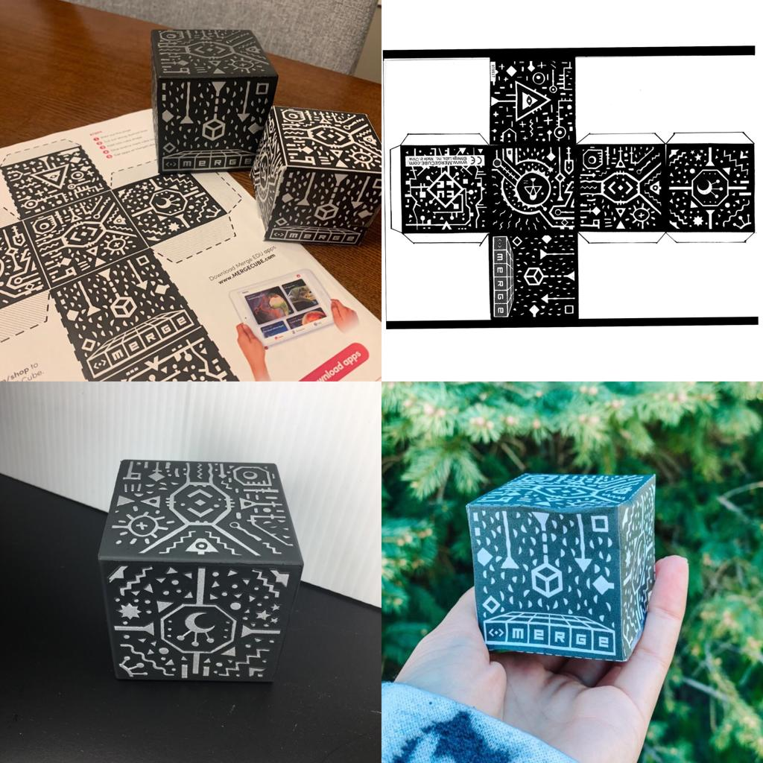
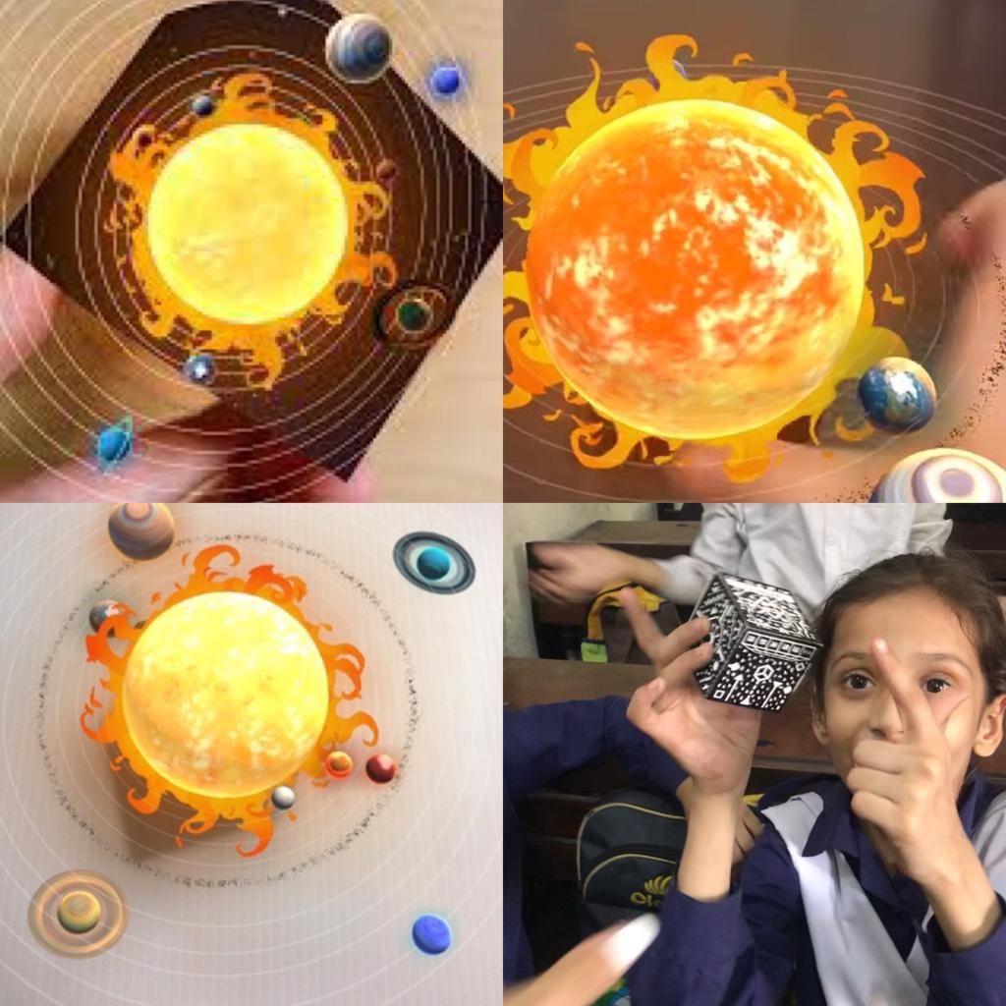
Activity No. 3, ‘Merge Cube – Merge Explorer App’
Session | Tasks
Session 1 | Pre-test 1 Day 1: Five written questions Day 2: Five written questions Day 3: Five written questions
Session 2 | Intervention Day 1: Game space cheat sheet with Merge Cube Day 2: Use Merge Cube (with instructor) Day 3: Merge Cube (collaboratively) Day 4: Merge Cube (Independently) Day 5: Merge Cube (Independently)
Session 3 | Post-test Day 1: Solar system MCQs (Pg.1) Day 2: Explore the Solar System (Pg. 2) Day 3: Solar System Worksheet (Pg. 3)

Slide 17
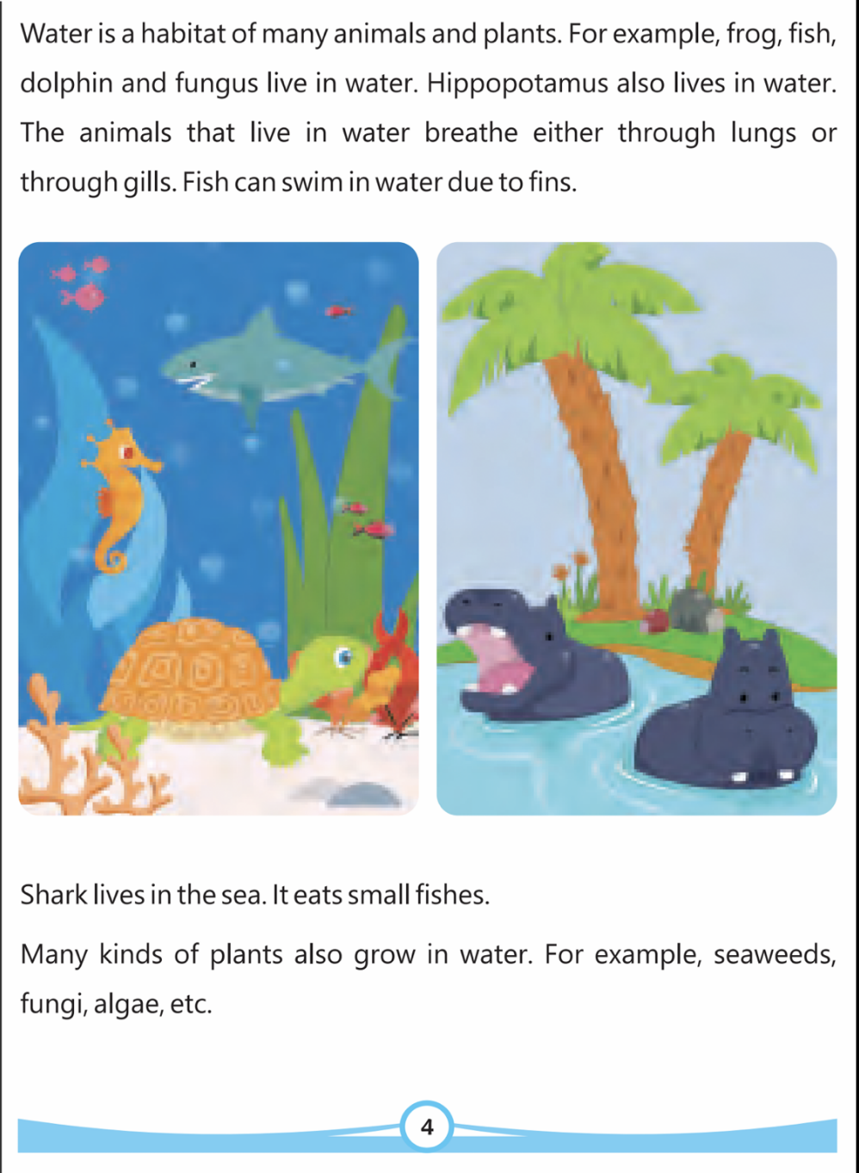
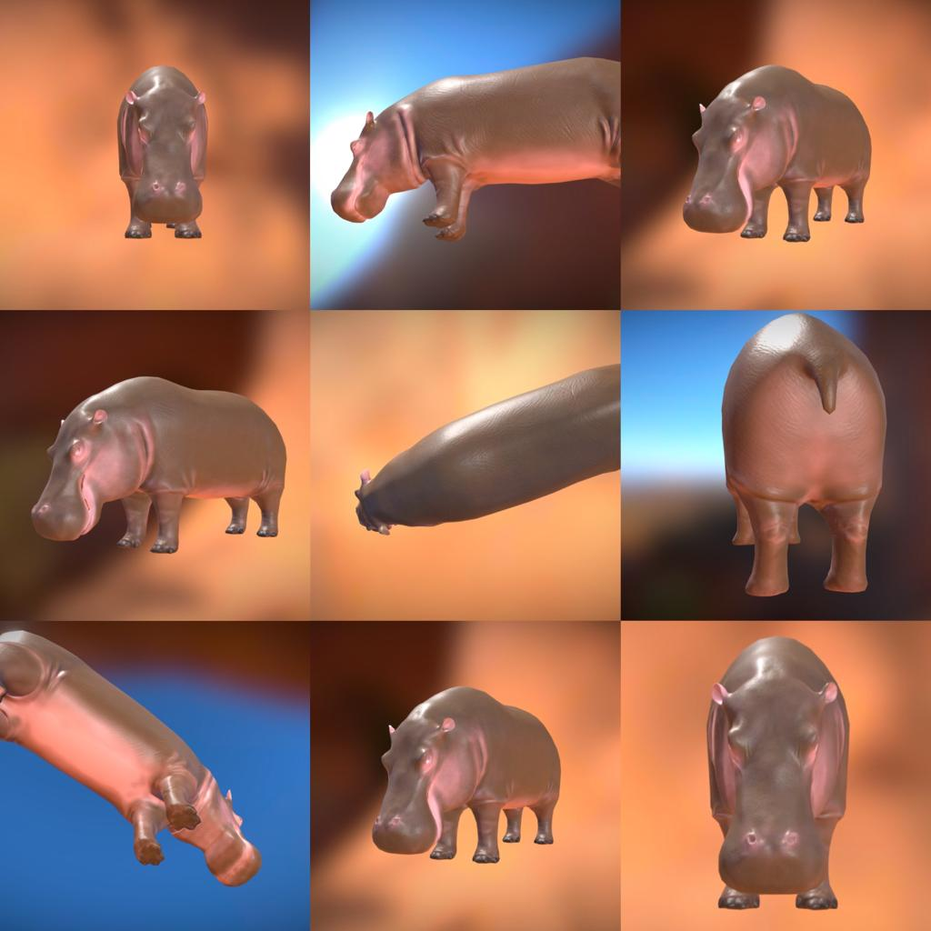
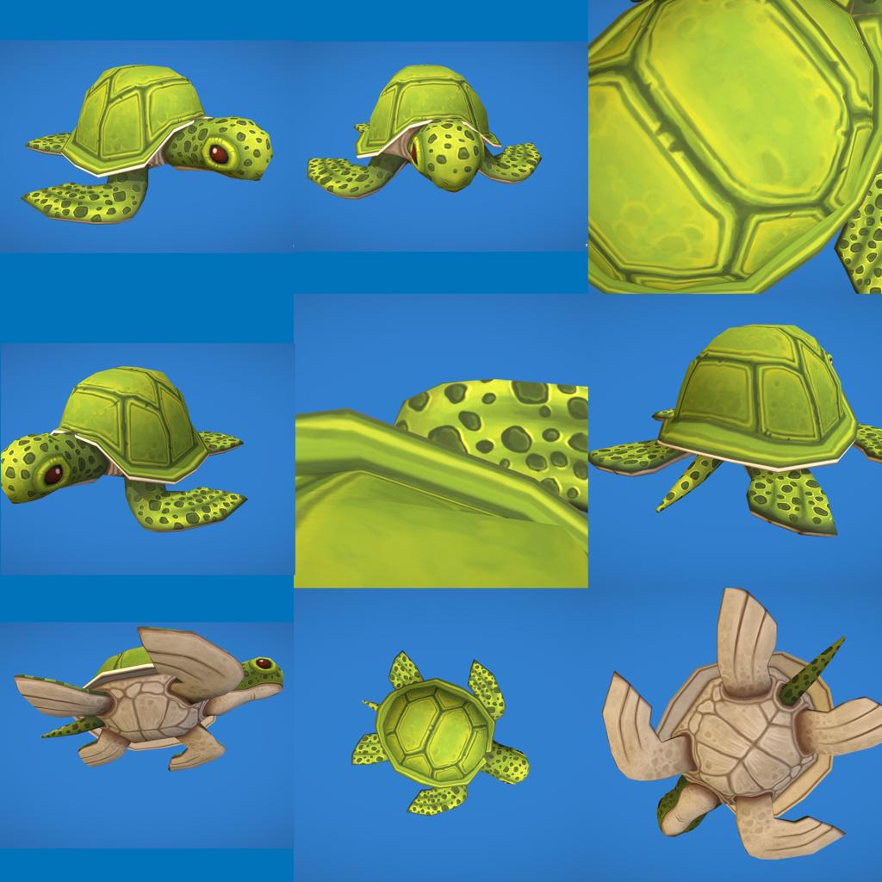
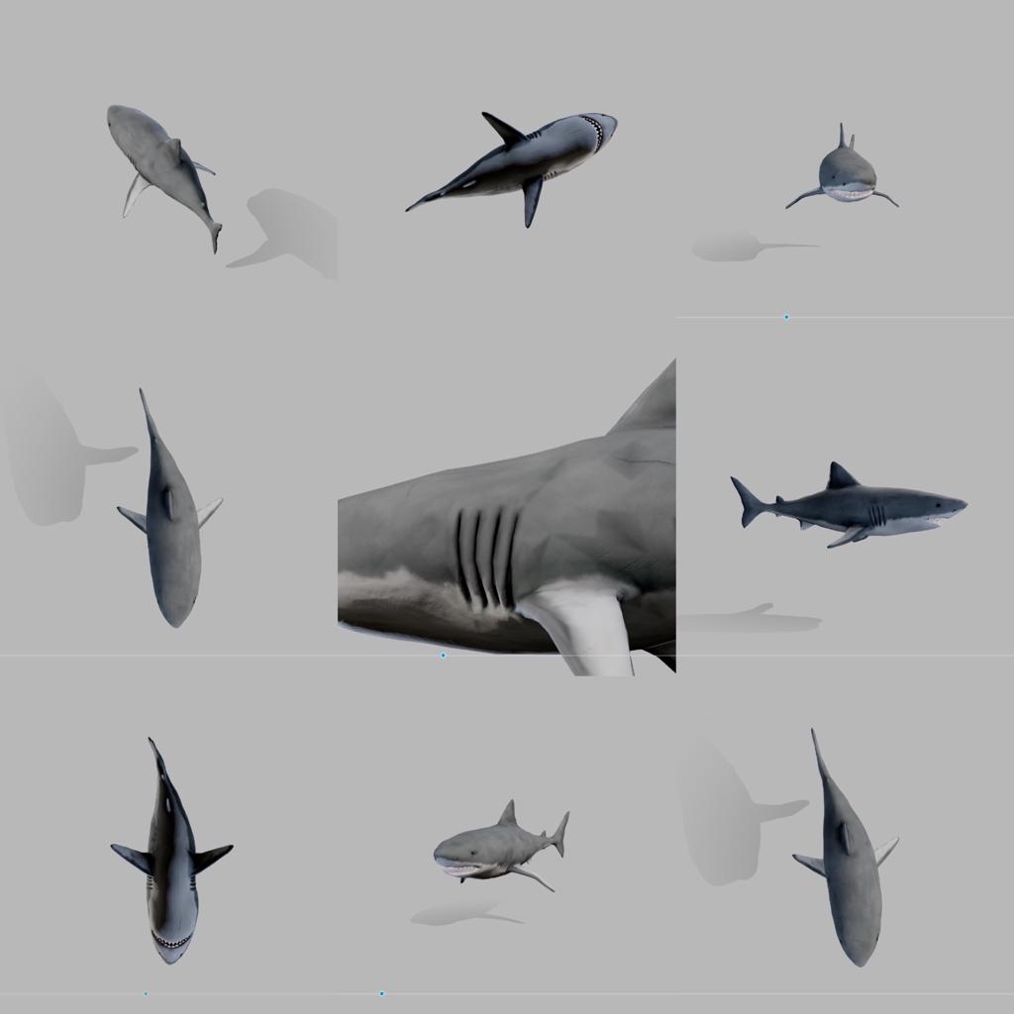
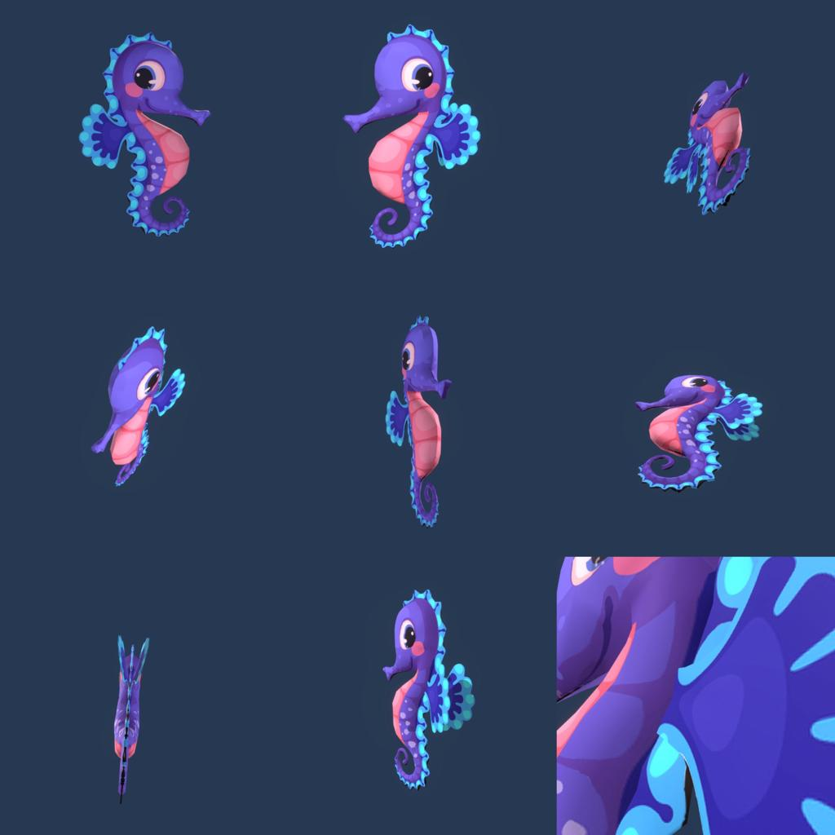
Proto AR App (HIARt)
Define Objectives
Choose Platform
(AR Kit, Unity Engine, Vuforia Engine)
Integrate AR SDK
Develop Marker
Recognition
Algorithm
Create 3D Models
(and digirtal content)
Integrate Markers
Images with content
Implement user Interactions
Optimise for performance
Testing
Deployment

Slide 18
Research Instruments
Interviews | Rubrics as an observational tool | Pre-posttests | Questionnaires
Teachers To gain initial insights, gather knowledge of teachers’ understanding of AR. | Students To assess and evaluate the performance of students in the designed activity performed in the classroom. A rubric scale was also used to evaluate the effectiveness of the performed activity. | Students To evaluate the effectiveness of AR before and after intervention. | Parents To assess the number of students exhibiting changes following the integration of Augmented Reality technology. Students (Feedback) To assess the students' ability to engage and interact with each other and how effectively they improved their communication skills through the use of Augmented Reality technology.

Slide 19
Population
Students with Hearing Impairment and Muteness
Sample
Ten (school) teachers were selected for interviews. The sample of this study was fifteen primary-year students with hearing impairment and muteness from Gung Mahal, Government College for Deaf and Dumb, Lahore. The same number of parents of students experiencing hearing impairment and muteness were given questionnaires to be filled out.
Sampling Technique
The purposive sampling technique was employed in this study because the selected students were easily accessible and relevant to the research objectives, producing valuable findings that were applicable to the selected population.

Slide 20
Data Analysis
Interview Questions | Codes | Categories | Themes
Are you using any technology as a teaching tool? If yes, what technology are you using as a teaching tool? | Smart tabs, Mobile Phones, Whatsapp, Flipped classroom, Netbooks, Projectors, online apps, Programs, Computer, Storyboards, word, PPT, Excel, DEV, C++, Multimedia, Laptop | Gadgets, Softwares, Applications, Multimedia | Teaching Tools
What is your understanding of Augmented Reality technology? | The use of graphic animation in real life or real world Combination of both physical presence and virtual art piece. Snapchat filter | Art, Technology, Fusion of art and life | Technology Integration
What are activities are you using as a tool to help boost the self-confidence of students with hearing impairment and muteness? | Express through Arts, Freedom of speech, MS Paint, 2D 3D form, Hands on experience, Interactive activity, VTR, group art, craft projects, teacher counseling, teacher resolve issues, out of box activities, practically, real life examples | Independence, Softwares, Art and craft, problem solving | Group Art Activities
What interactive art practices could be helpful to integrate with technology to teach students more effectively in classroom? | Computer technology, Arts, out of the box activities, replacement by technology, reshaping arts, Art Softwares, learn more | Combination of Arts and Technology, modern technology, effective learning | Augmented Reality Technology
How can arts be used to promote collaboration and teamwork among students with hearing impairment and muteness? | Learning through pictures, art projects, group work, exhibiting work is a result of collaboration, suggestions, help, communication through art, engagement, different point of views, respect each other viewpoint | Visual Aid, group work, empathy | Collective Learning

Slide 21
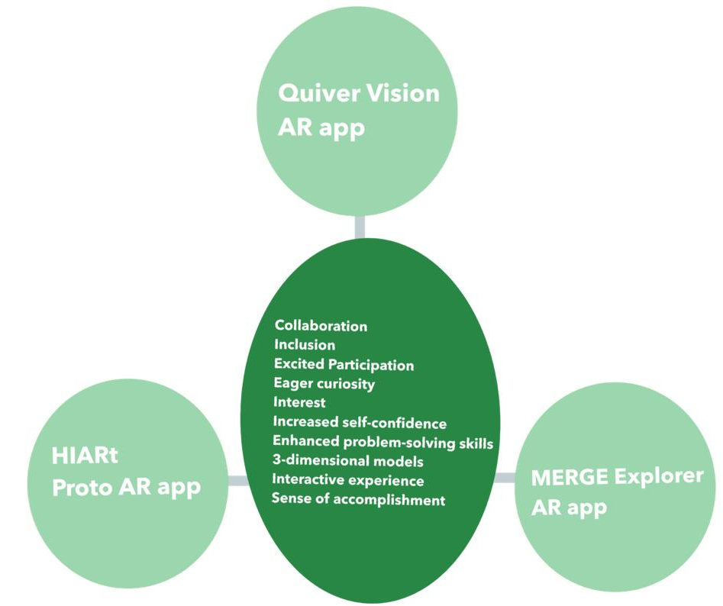
Data Analysis

Slide 22
Data Analysis
Respondent No. | Pre-test | Post-test
1 | 6 | 14.5
2 | 7 | 13.5
3 | 10 | 14.5
4 | 9 | 12
5 | 8 | 14.5
6 | 4 | 14.5
7 | 5 | 14
8 | 7 | 14
9 | 6 | 14
10 | 9 | 14
11 | 7 | 12.5
12 | 6 | 13
13 | 11 | 13.5
14 | 10 | 12
15 | 5 | 13

Slide 23
Feedback
Students
Their excitement, eagerness and commitment to future activities evidenced their interest in AR experiences.
Teachers
Their willingness to embrace the integration of AR technology both within the school environment and at home highlights a positive shift in their perception of innovative teaching methods.
Parents
Although the response was limited, but the feedback provided was helpful in determining that the students demonstrated positive behavioral changes.

Slide 24
Findings
Students and teachers are unfamiliar with Augmented Reality.
Shortage of resources
Scarcity of Multimedia tools
Lack of Visual aids
AR can help students accept diverse environment and promote inclusion

Slide 25
Discussion
How can ‘Augmented Reality’ be used to bridge the communication gap between students with hearing impairments and muteness and their peers?
How can ‘Augmented Reality’ be used to foster the social development of students with hearing impairments and muteness?
How can ‘Augmented Reality’ be helpful for students with hearing impairment and muteness in bringing inclusion to a classroom?
The teamwork and collaborative learning environment fostered by AR activities not only broke down communication barriers but also nurtured a sense of community among students. The personalized nature of AR catered to diverse learning needs, allowing students to engage with content at their own pace. Moreover, the positive impact on students' self-confidence was evident, as AR helped them be empowered to actively participate and express themselves, contributing to a truly comprehensive and transformative learning experience.
The shared experiences facilitated by AR activities not only built common ground for interaction but also contributed to the development of meaningful relationships among students and their instructors. Importantly, the increased level of confidence observed in students engaging with AR spilled over into their social interactions, underscoring the transformative impact of AR on the social development of students with hearing impairments and muteness.
AR provided accessible learning material, inclusive learning environments, individualized or personalized learning paths, collaborative engagement, and enhanced communications. Visual and interactive content presented through AR accommodated diverse learning needs, ensuring that students with hearing impairment and muteness had equal access to educational resources. Students, regardless of their communication abilities, could actively engage with the content.

Slide 26
Recommendations
Teacher and Educator Training (Educational researchers, institutions, and organizations)
User-Centered Design (Technology developers, designers, and researchers)
Collaboration with Technology Providers (Educational institutions, researchers, and developers specialized in educational technology)
Community Engagement and Awareness (Educational institutions, school administration, and advocacy organizations)
Integration of AR in Educational Curricula (Educational advocates, experts in special education, and organizations)
Scalability and Implementation in Developing Regions (Researchers, technology developers, and organizations focused on educational accessibility)
Long-term Research and Impact Assessment (Educational researchers, institutions, and organizations)

Slide 27
Thank you for your valuable time.

