Slide 1


DATA OPS CHALLENGE
Presented by Laima Ozola-Szoke

Slide 2




National Medicare Advantage Plan
food access program
DECREASE
DECREASE
increases prevalence of
FOOD INSECURITY
CHRONIC DISEASES
Hypertension,
Asthma,
Arthritis,
COPD,
Diabetes^{[9]}
13.5% (18 million)^{[5]}

Slide 3
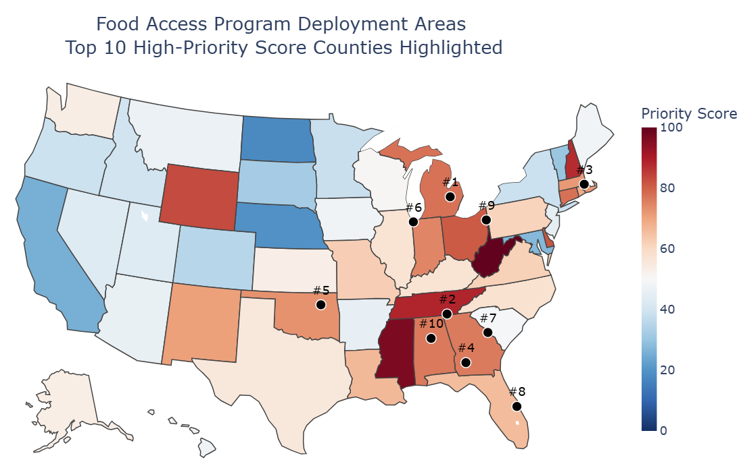
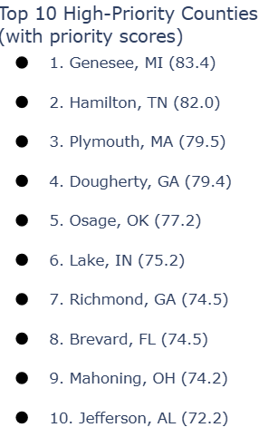
Where should we deploy a food access program?
Analytical Approach
Result
Step 1. Identify Where the Need Is
Target counties with low food access AND high chronic disease prevalence^{[1,4]}
Step 2. Calculate the Priority Score
Normalize general population food access and average chronic disease percentages (0–1 scale)
Average equally (50/50 weight)
Convert to a 0–100 priority score per county

Slide 4
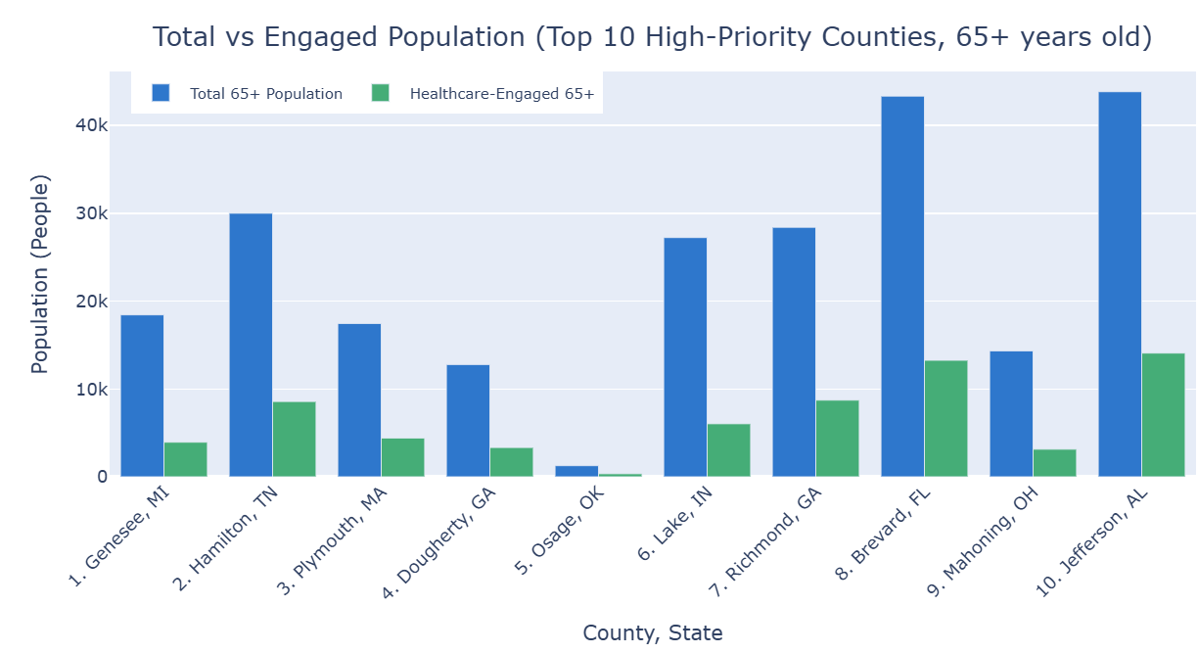
How many people will be included? How many will be successfully engaged?
Analytical Approach
Step 1. Identify the Included Population
Combine data from the County Demographics dataset^{[2]} with population census information^{[1]} to estimate total 65+ population (Medicare-eligible) in the top 10 high-priority counties
Step 2. Estimate Engaged Population
Use current healthcare engagement rates^{[4]} (65+ adults who are up-to-date on core clinical preventive services such as flu shots, mammogram screenings) to approximate reach for this program
Result
Total 65+ Population in Top 10 High-Priority Counties: 237,045
Total 65+ Population Engaged in Top 10 High-Priority Counties: 65,823

Slide 5
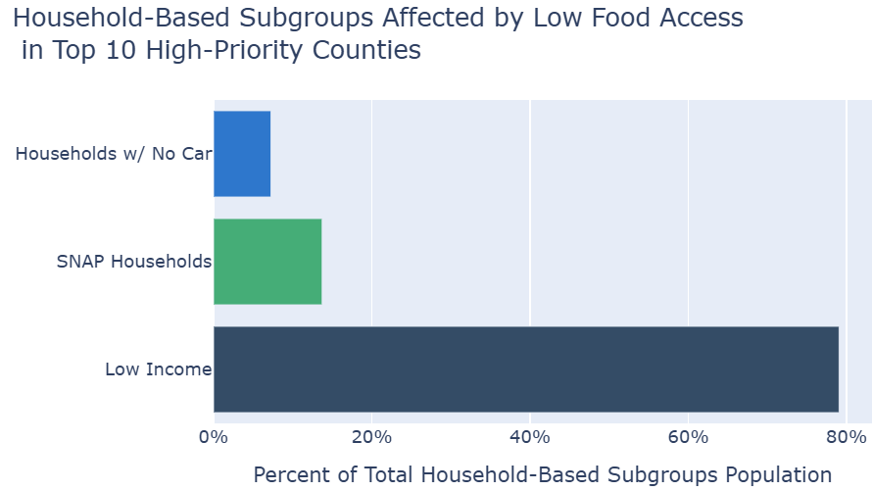
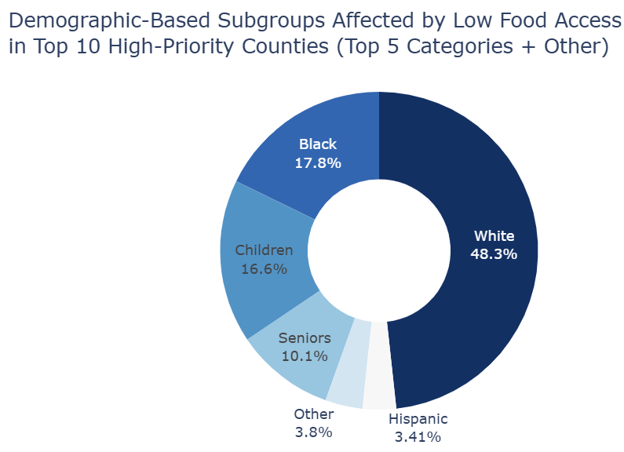
Which subgroup of the population might benefit the most from the program?
Analytical Approach
Step 1. Identify the Subgroups
Using the FDA Food Atlas dataset^{[4]}, we can find numerical data for how many people in various subgroups (household, demographic) have low access to food within the top 10 high-priority counties.
Step 2. Plan the Visualization
I split the visualizations into two based on their overarching subgroup from the dataset (household or demographic)^{[4]} for easier readability.
Result
Because many subgroups overlap (e.g., a low-income SNAP household may include seniors), their effects are not statistically independent. This overlap makes it difficult to conclude which subgroup benefits most given this data.

Slide 6
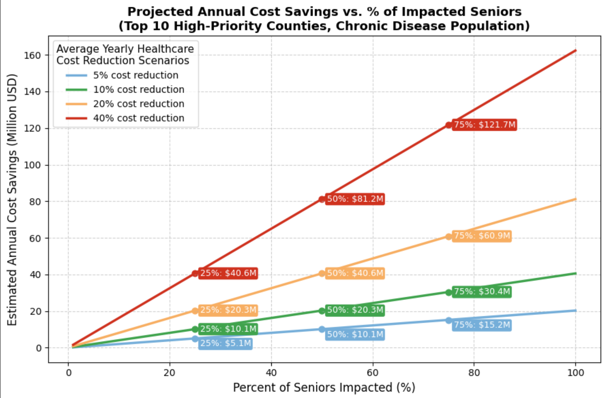
PROJECTED IMPACT
In the top 10 high-priority counties, the total 65+ Medicare-eligible population is 237,045 individuals^{[1,2,4]}
Calculated average low food-access affected chronic disease rate of 21.1% in the top 10 high-priority counties^{[1,4]}
Using this average, an estimated 49,977 of these individuals live with one or more cases of these 5 chronic diseases
Given statistics from studies about the per person, per year cost in the United States of these chronic diseases^{[3,6,7,8,10]}, we can estimate that the average healthcare-related cost for these diseases (per person, per year) is $8,120
Annual cost savings was calculated by the following:
(seniors affected by the 5 chronic diseases in the top 10 counties) * (cost reduction scenario percentage * average healthcare related cost for the diseases)
* (% of seniors impacted)

Slide 7
References
1. 500 Cities: Census Tract-Level Data (GIS Friendly Format), 2019 Release | Data | Centers for Disease Control and Prevention. https://chronicdata.cdc.gov/500-Cities-Places/500-Cities-Census-Tract-level-Data-GIS-Friendly-Fo/k86t-wghb/about_data.
2. CORGIS Datasets Project. https://corgis-edu.github.io/corgis/csv/county_demographics/.
3. “Cost of Asthma on Society.” Asthma & Allergy Foundation of America, https://aafa.org/advocacy/key-issues/access-to-health-care/cost-of-asthma-on-society/.
4. Food Environment Atlas | Economic Research Service. https://www.ers.usda.gov/data-products/food-environment-atlas
5. Food Security in the U.S. - Key Statistics & Graphics | Economic Research Service. https://www.ers.usda.gov/topics/food-nutrition-assistance/food-security-in-the-us/key-statistics-graphics.
6. Lo, Jessica, et al. “A Systematic Review of the Incidence, Prevalence, Costs, and Activity/Work Limitations of Amputation, Osteoarthritis, Rheumatoid Arthritis, Back Pain, Multiple Sclerosis, Spinal Cord Injury, Stroke, and Traumatic Brain Injury in the United States: A 2019 Update.” Archives of Physical Medicine and Rehabilitation, vol. 102, no. 1, Jan. 2021, pp. 115–31. PubMed Central, https://doi.org/10.1016/j.apmr.2020.04.001
7. Mannino, David M., et al. “National and Local Direct Medical Cost Burden of COPD in the United States From 2016 to 2019 and Projections Through 2029.” CHEST, vol. 165, no. 5, May 2024, pp. 1093–106. ScienceDirect, https://doi.org/10.1016/j.chest.2023.11.040.
8. Olga A. Khavjou, Minglu Sun, Sophia R. D’Angelo, Simon J. Neuwahl, Thomas J. Hoerger, Pyone Cho, Kristopher Myers, Ping Zhang; Economic Costs Attributed to Diagnosed Diabetes in Each U.S. State and the District of Columbia: 2021. Diabetes Care 20 June 2025; 48 (7): 1164–1171. https://doi.org/10.2337/dc24-0832
9. Predicted Prevalence of Five Chronic Diseases Increased as Household Food Security Worsened | Economic Research Service. https://www.ers.usda.gov/data-products/charts-of-note/chart-detail?chartId=108211.
10. Wang, Yu et al. “Health Care Expenditures and Use Associated with Hypertension Among U.S. Adults.” American journal of preventive medicine vol. 67,6 (2024): 820-831. doi:10.1016/j.amepre.2024.07.005.

