Slide 1


CARD MANAGEMENT SYSTEM
Integrated Banking System - Use Case - 5
Laima Singla
Pragya Goyal
Mohit Pursnani
Shubham Bhutada

Slide 2
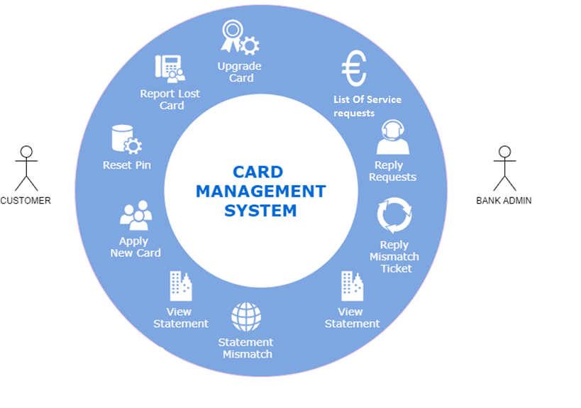
Customer Level Operations
a. Apply for a credit or a debit card (types like platinum/gold etc.).
b. Reset PIN
c. Report loss of card.
d. Apply for card up-gradation
e. Request card statement for a specific period.
f. Report statement mismatch.
Bank Level Operations
a. Approve or decline card request.
b. Activate or deactivate a card.
c. View card statement
d. View and reply for a statement mismatch ticket.

Slide 3

ROAD MAP:
3rd Sprint (22/10/2019)
-Collaboration for Transaction Table -Minor Validations(Card Pin)
2nd Sprint (09/10/2019)
-Card ”Block” & its functions -Tracking Service Request Status -Multiple Confirmations -Back Function
1st Sprint (27/09/2019)
-Service Request Table -Naming Conventions

Slide 4
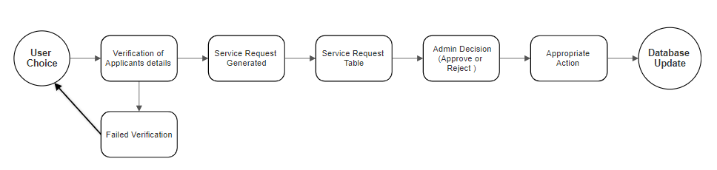
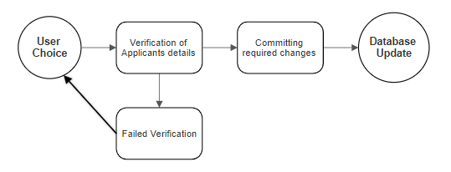
Flow of SERVICE REQUESTS
Approval Requests
Apply New Card
Upgrade Existing Card
Direct Requests
Reset Card Pin
View Card Statement

Slide 5
Apply New Card
You are applying for a new Debit Card To exit, press x
Enter Account Number you want to apply debit card for :
12345678910
We offer three kinds of Debit Cards:
.....................................
1 for Platinum 2 for Gold 3 for Silver
Choose between 1 to 3
3
You have applied for: Silver Application for new debit card success!! Your reference Id is ANDC19103112255113050
12345678911
Account Number does not exist
Enter Account Number you want to apply debit card for :
abcdefghijklm
Renter 11 digit account number
Enter Account Number you want to apply debit card for :
123456789
Incorrect length

Slide 6
Upgrade Card
Enter your Debit Card Number:
To exit, press x
5221562391012233
Choose 1 to upgrade to Gold
Choose 2 to upgrade to Platinum
2
You have applied for Platinum
Ticket Raised successfully . Your reference Id is XXXXXXXXXXXXXXXX
555555555555555
Incorrect length
5555555555555555
Debit Card Number does not exist
5234567891012131
You already have a Platinum Card

Slide 7
Reset Pin
Enter your Debit Card Number:
To exit, press x
5234567891012131
Enter your existing pin:
2131
Enter new pin
1111
Re-enter your new pin
1111
PIN CHANGED SUCCESSFULLY!!!
5234567891012131
Enter your existing pin:
1111
Enter new pin
9999
Re-enter your new pin
9998
PINS DO NOT MATCH...TRY AGAIN
5234567891012131
Enter your existing pin:
2131
You have entered wrong pin

Slide 8
View Statement
To exit, press x
Enter your Debit Card Number:
5234567891012131
enter days :
600
Transaction ID : XXXXX
UCI : XXXXXXXXXXXXXXX
Date of transaction : YYYY-MM-DD T hh:mm
Amount : XXX.00
Description : Supermarket
.......................................................
5234567891012131
enter days :
800
Enter days less than 730
enter days :
-100
Statement can not be generated for less than 1 day

Slide 9
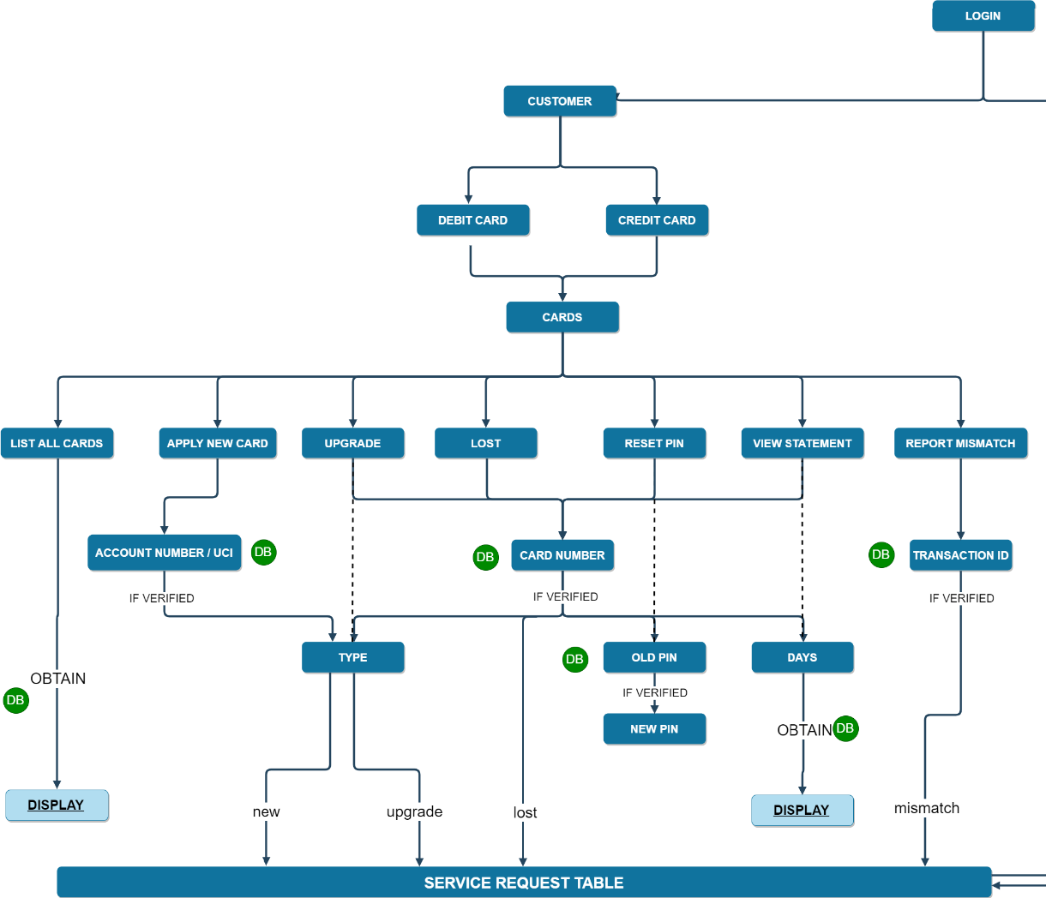
INTERNAL WORKING OF CUSTOMER FUNCTIONS
TO
B
A
N
K
A
D
M
I
N

Slide 10
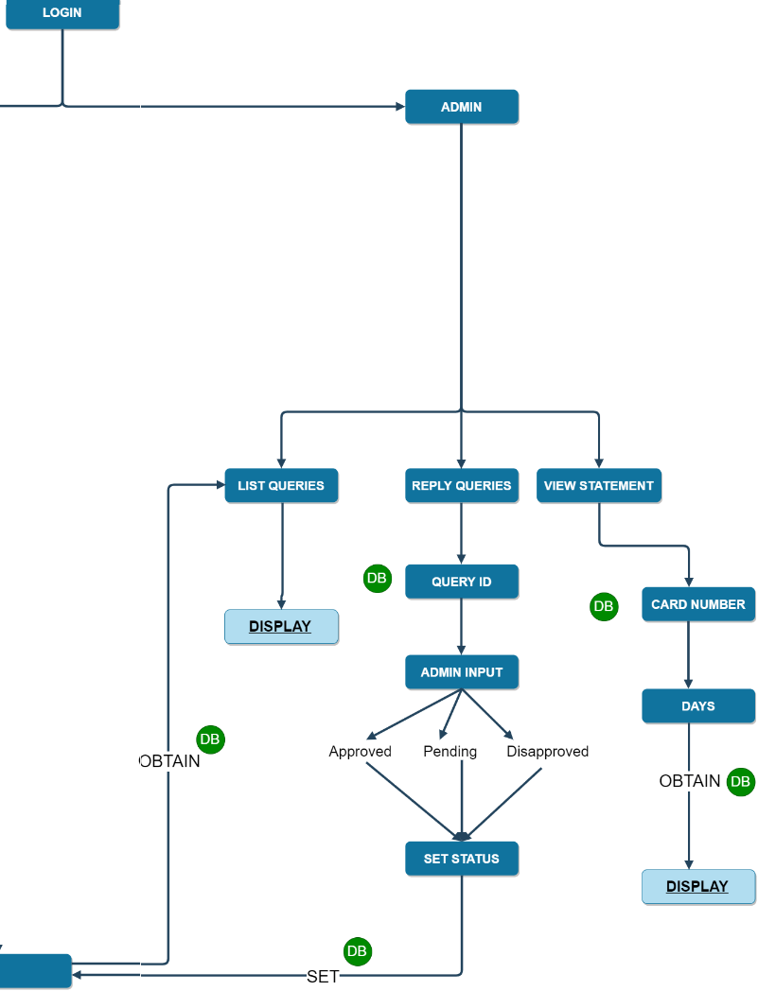
INTERNAL WORKING OF BANK FUNCTIONS
FROM
C
U
S
T
O
M
E
R

Slide 11
Reply Queries
ANCC191031124720483
Select new Status from the following list:
..........................................
1 for Approved......
2 for In Process.....
3 for Disapproved ...
4
Not a valid input
Select new Status from the following list:
..........................................
1 for Approved......
2 for In Process.....
3 for Disapproved ...
3
You have chosen Disapproved
To exit, press x
Enter your case ID:
RCCU191031124726858
Select new Status from the following list:
..........................................
1 for Approved......
2 for In Process.....
3 for Disapproved ...
1
You have chosen Approved
Appropriate Action

Slide 12
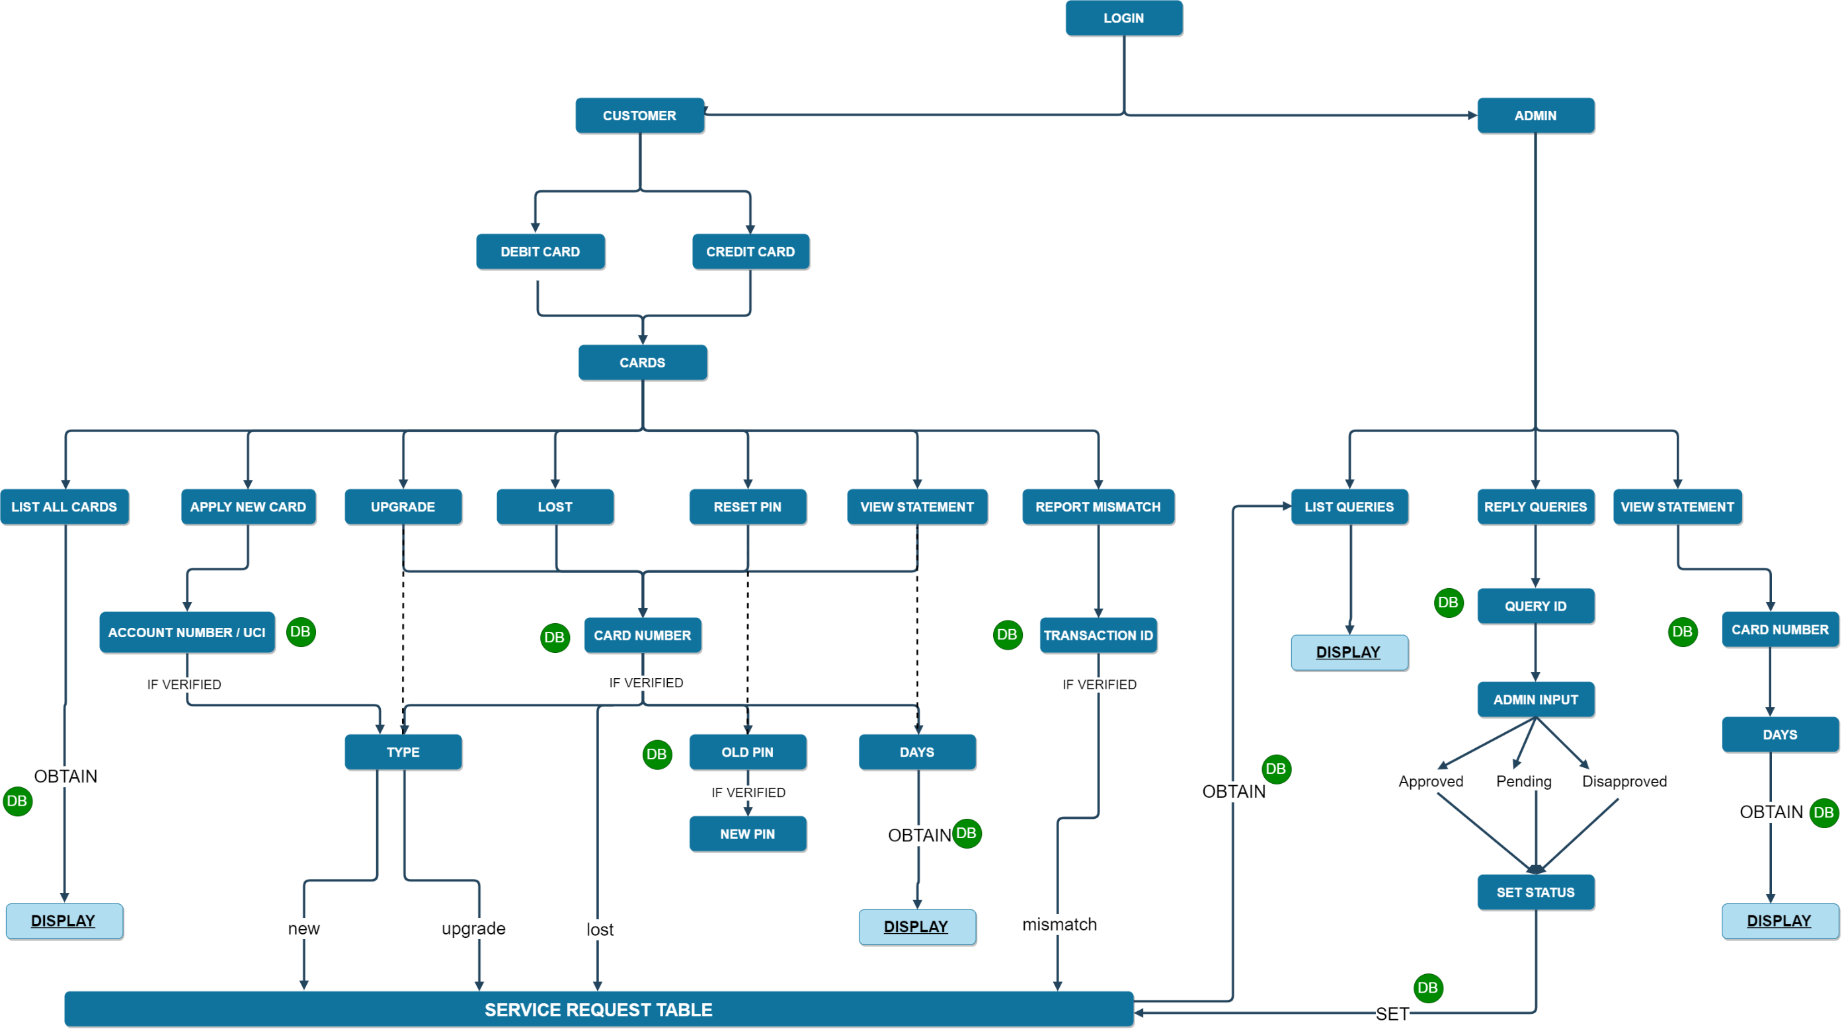
WORKING

Slide 13
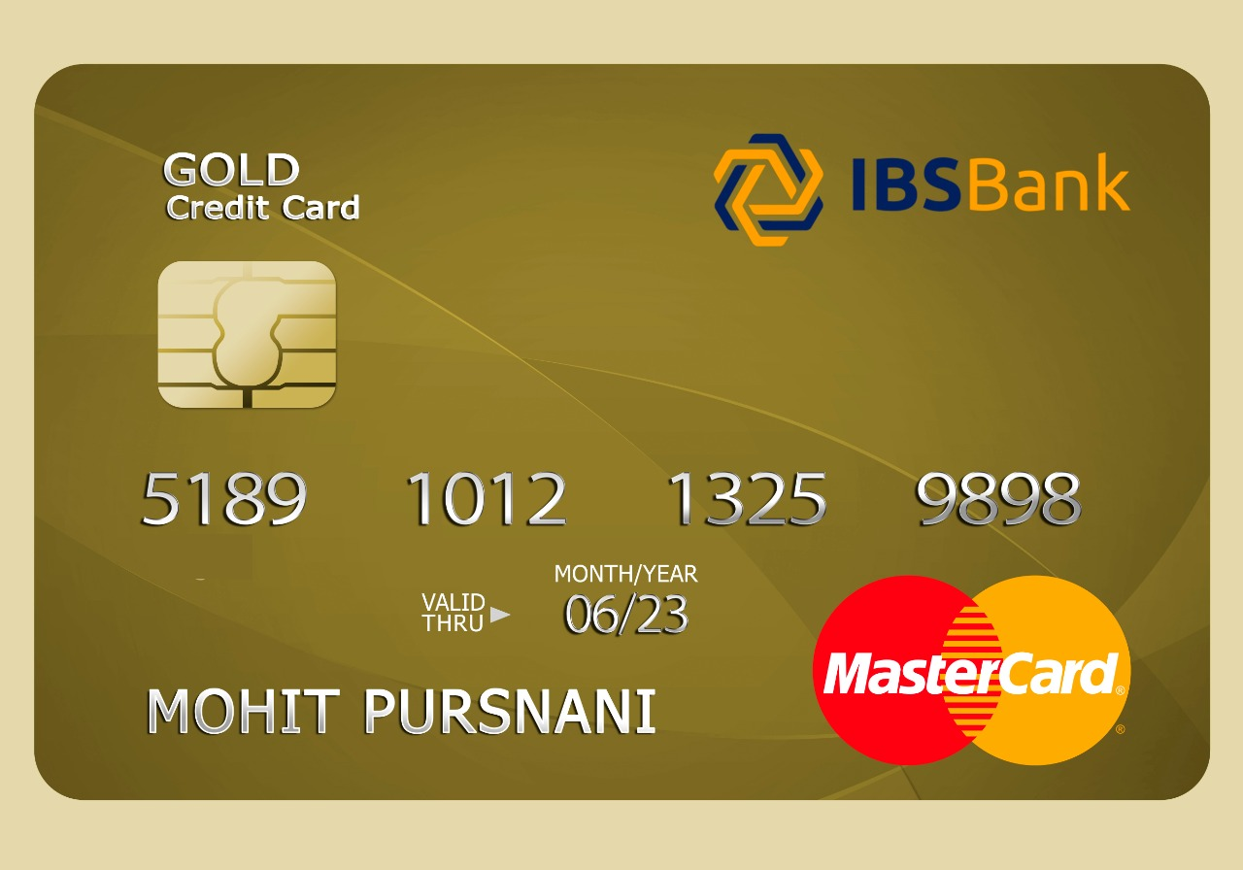
Peculiar Features – CARD GENERATION
Card Type
Provider
Card Number
MII
Card Name
Expiry Date
Payment Gateway

Slide 14

Peculiar Features – SERVICE REQUEST TABLE
Abbreviation | Description of the query
ANDC | Apply new debit card
ANCC | Apply new credit card
RDMT | Raise debit mismatch ticket
RCMT | Raise credit mismatch ticket
RDCU | Request debit card upgrade
RCCU | Request credit card upgrade
RDCL | Request debit card lost
RCCL | Request Credit card lost
CASE-ID-GENERATION
The CaseID generated has 16 digits.
Example: ‘ANDC19102212325302’
Stands for :
Apply New Debit Card_(22/10/2019)_(12:32:54)_(XX)

Slide 15
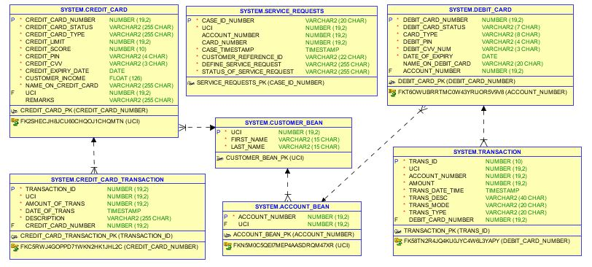
Database Schema

Slide 16
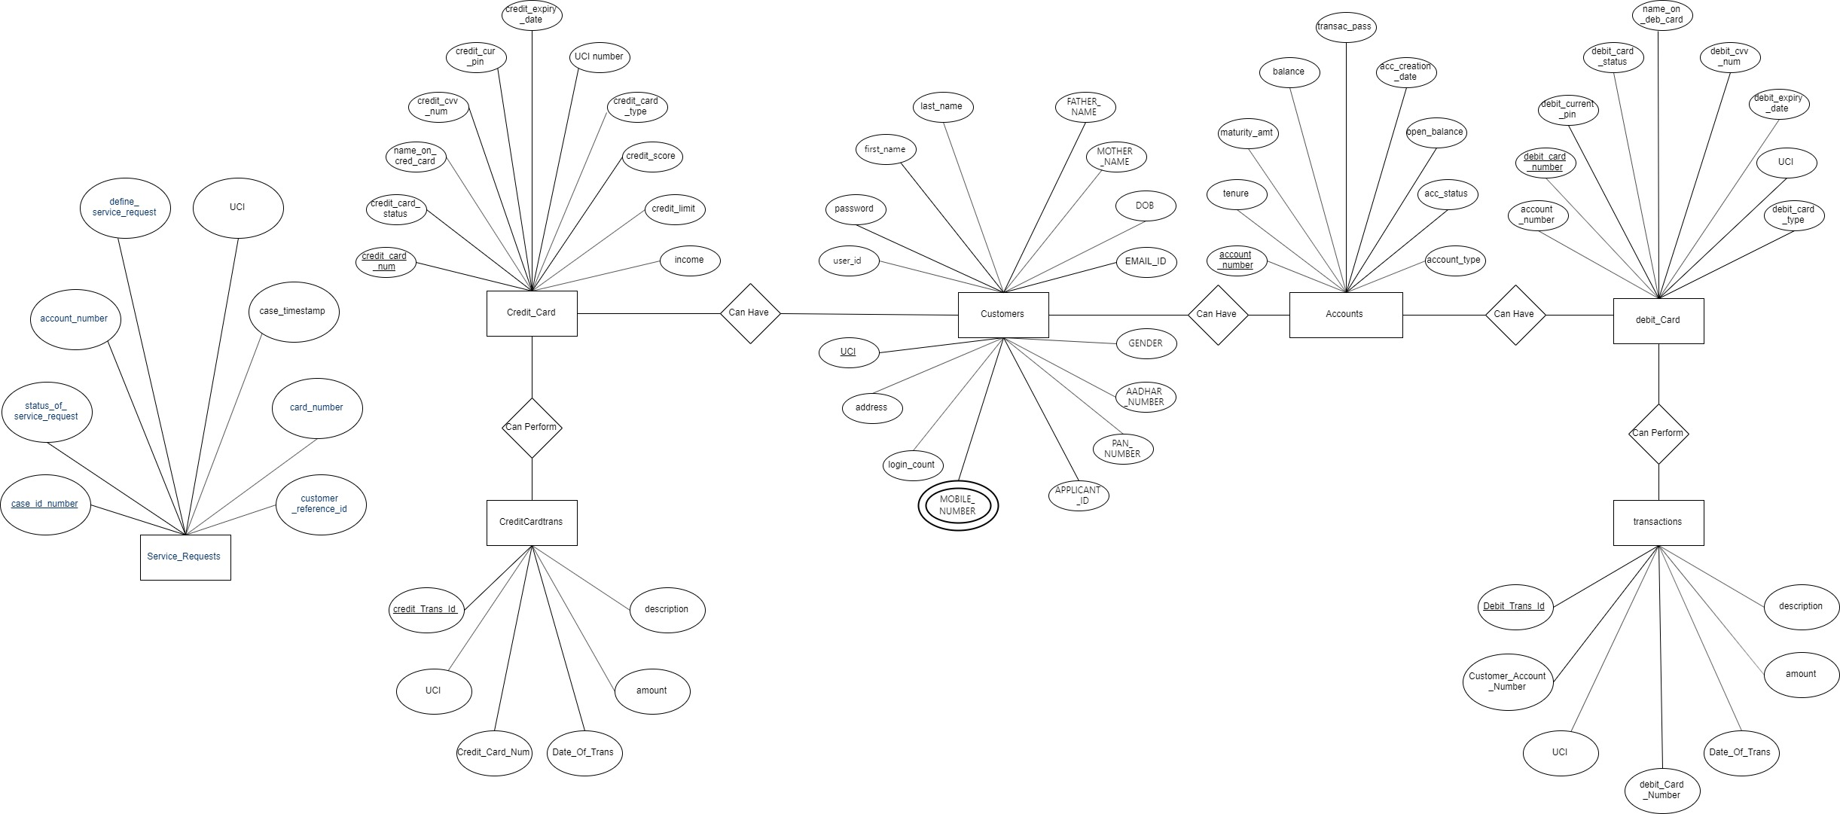
ER Diagram

Slide 17

Thank You!

