Slide 1
Real Estate Listing Web Application
SDK Project Presentation
Elaine li 02.08.2012

Slide 2
Overview
Problem Definition
Requirements
Application Architecture
Web interface and design
Form Validation
Demonstration

Slide 3
Problem definition
Build a real estate web application utilizing Java and web development coding to help end users look for listings and for real estate agents to add/modify listings

Slide 4
Requirements
Read listing data from an XML file
Display data in a well designed website
Implement ability to search and sort on listing for user
Implement ability to add and modify listings for user (with input validation)
Write data back to XML file

Slide 5
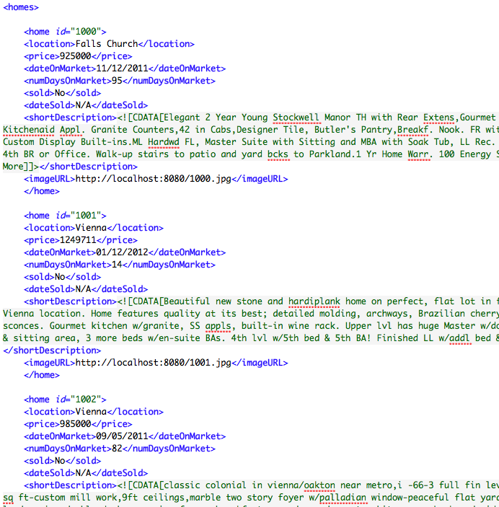
Requirements
Choice: NOVA Home Real Estates

Slide 6
Architecture
Server-side
Client-side
DOM
Parser
Send Data
JavaScript:
get data; sort, search listings
XML File
Main JSP
Web Browser: HTML/CSS
forms
Writer
JavaScript:
Send data/form validation
Validate input
getData()
updateData()
Send Request
modRecord()
addRecord()
getHomes()
outputListing()
searchBy()
sortData()
checkEntry();
formatEntry();

Slide 7
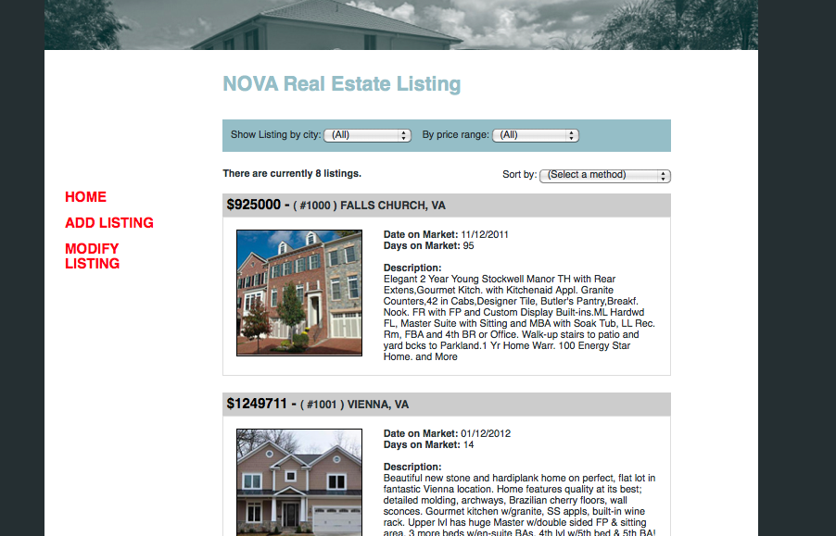
web interface
Menu bar
Searching and Sorting
Listing div
Notes:
For POC, users and real estate agents’ view are combined

Slide 8
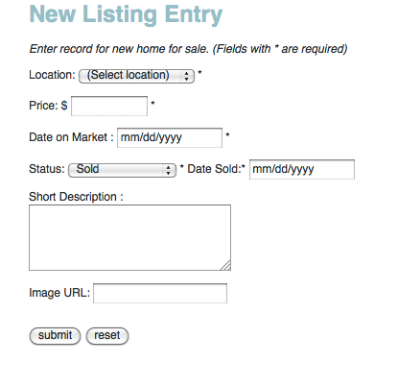
Form validation
Take out commas
Verify positive numbers
Verify format mm/dd/yyy
Verify valid date
Verify sold date is less than date on market
Set blank optional fields to “N/A”
Notes:
Use of regular expressions

Slide 9
Demo

