Slide 1
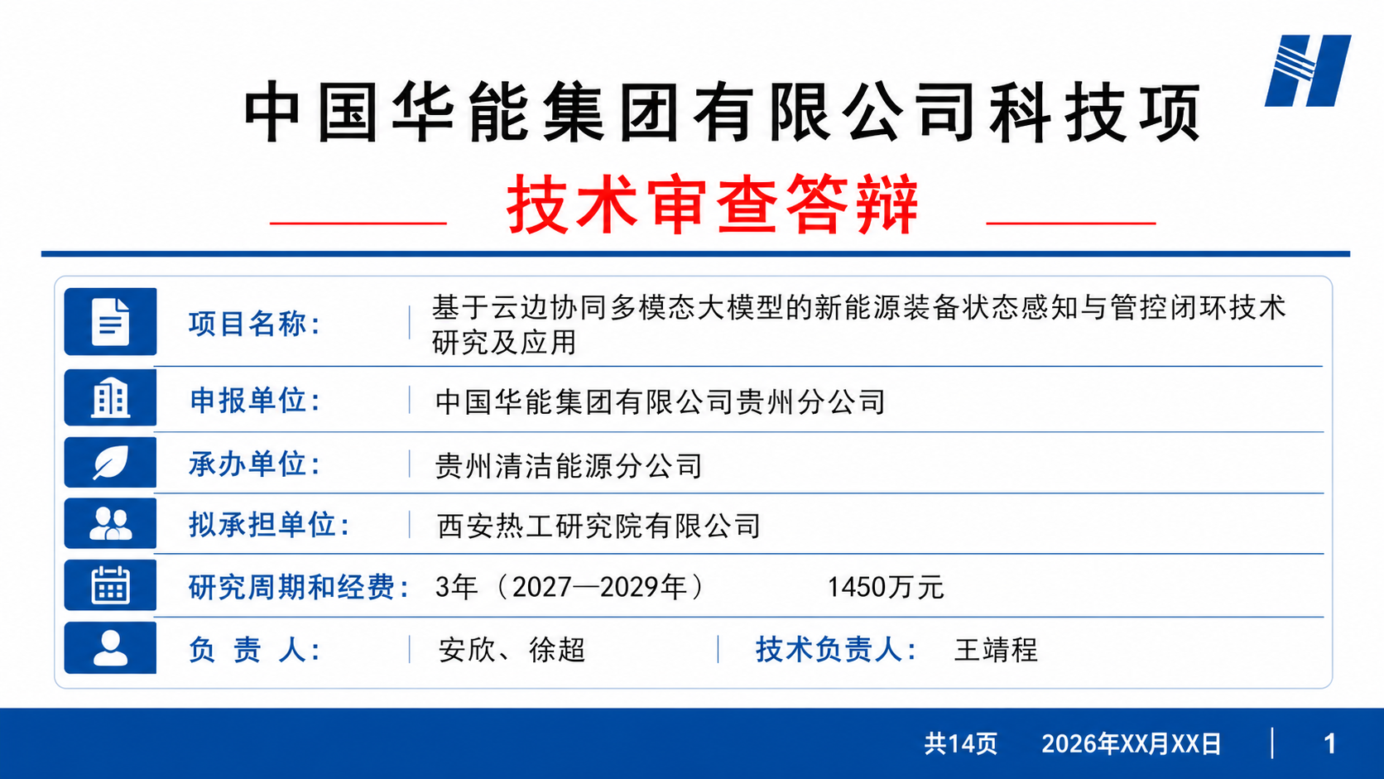
Notes:
[Sources]
- Generated preview asset: generated-previews/slide-01-preview.png
- Visual reference: source PPT slide 01
[/Sources]

Slide 2
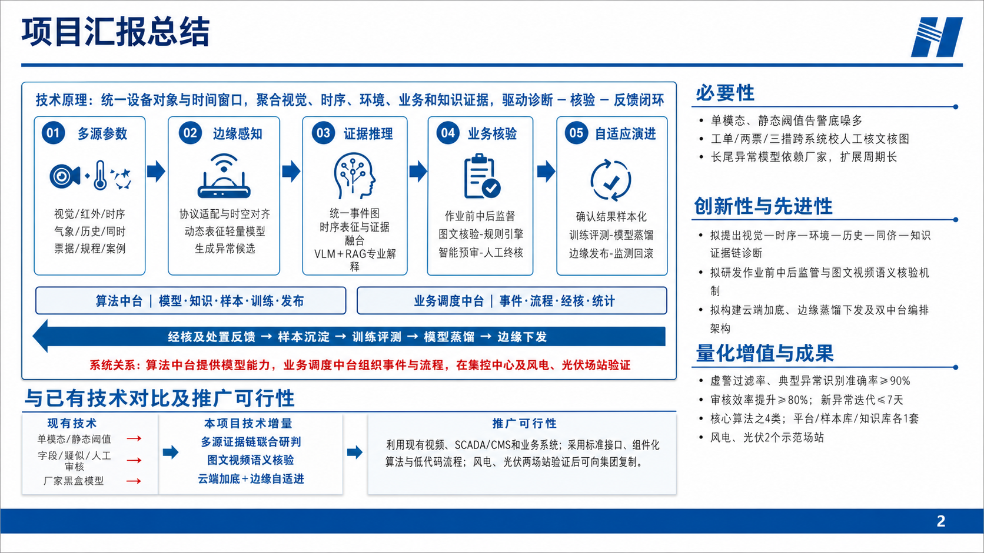
Notes:
[Sources]
- Generated preview asset: generated-previews/slide-02-preview.png
- Visual reference: source PPT slide 02
[/Sources]

Slide 3
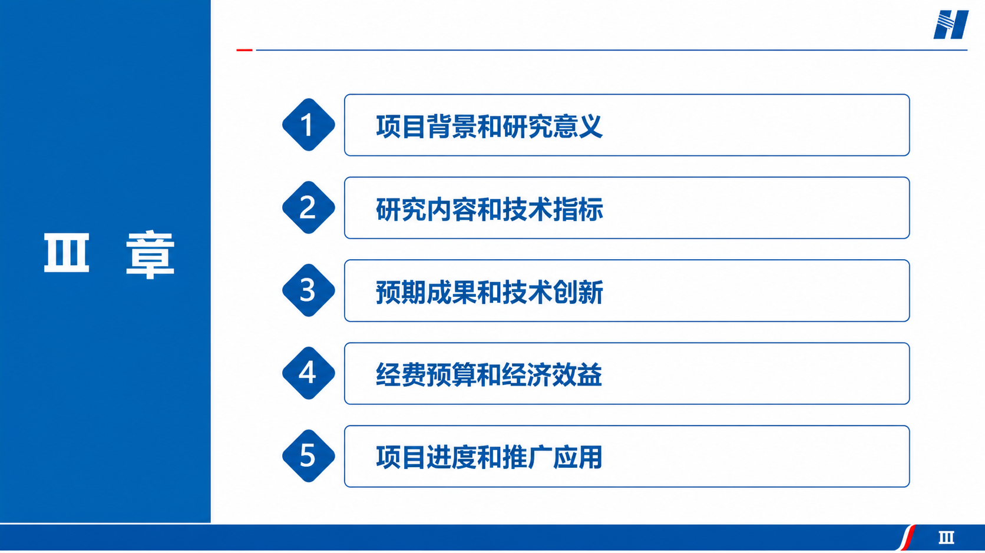
Notes:
[Sources]
- Generated preview asset: generated-previews/slide-03-preview.png
- Visual reference: source PPT slide 03
[/Sources]

Slide 4
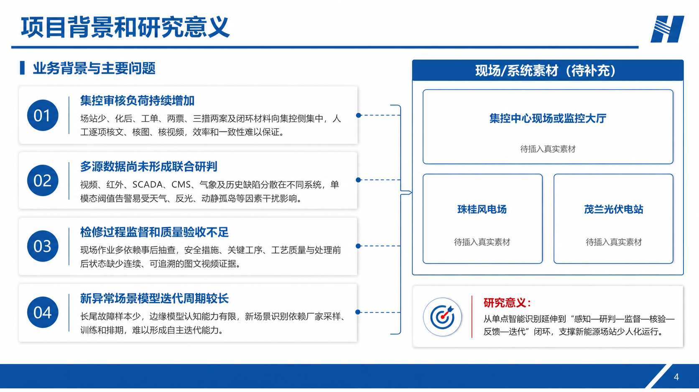
Notes:
[Sources]
- Generated preview asset: generated-previews/slide-04-preview.png
- Visual reference: source PPT slide 04
[/Sources]

Slide 5
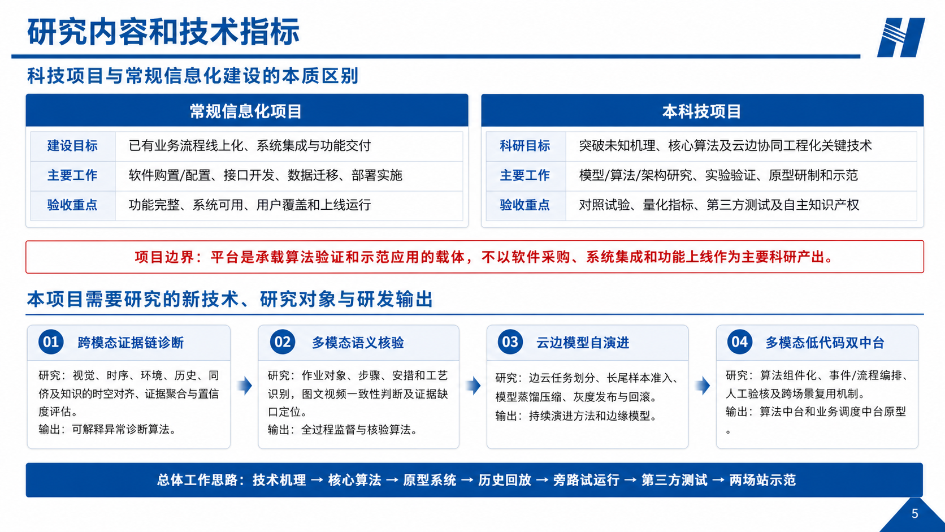
Notes:
[Sources]
- Generated preview asset: generated-previews/slide-05-preview.png
- Visual reference: source PPT slide 05
[/Sources]

Slide 6
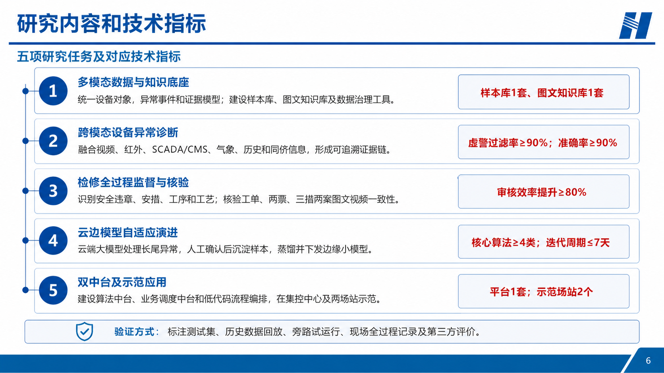
Notes:
[Sources]
- Generated preview asset: generated-previews/slide-06-preview.png
- Visual reference: source PPT slide 06
[/Sources]

Slide 7
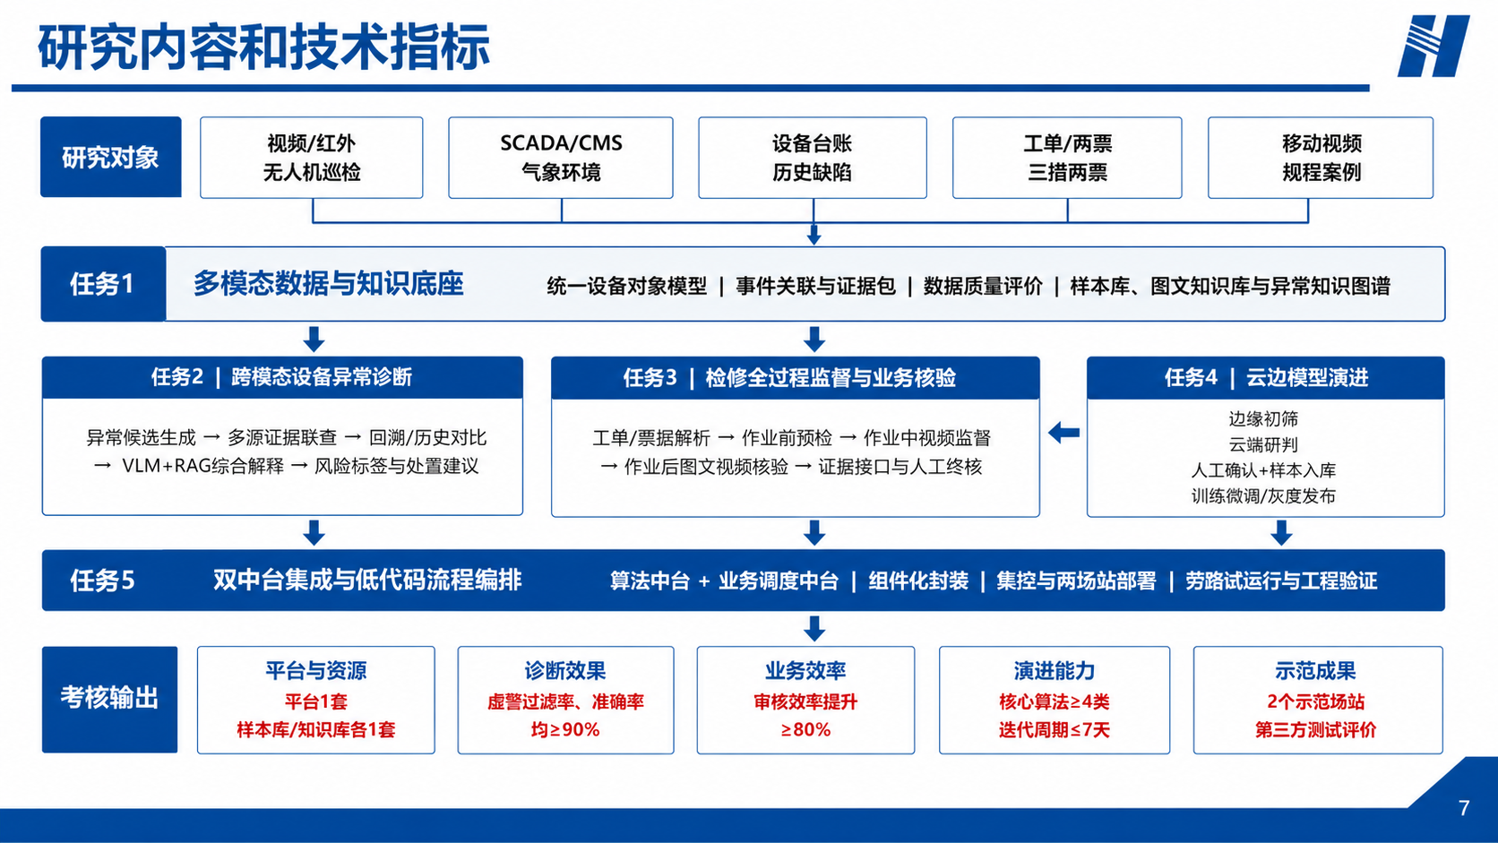
Notes:
[Sources]
- Generated preview asset: generated-previews/slide-07-preview.png
- Visual reference: source PPT slide 07
[/Sources]

Slide 8
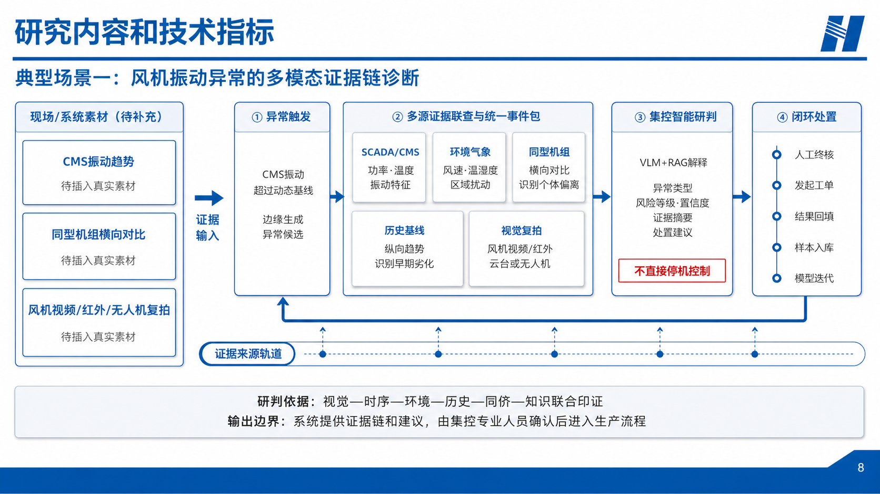
Notes:
[Sources]
- Generated preview asset: generated-previews/slide-08-preview.png
- Visual reference: source PPT slide 08
[/Sources]

Slide 9
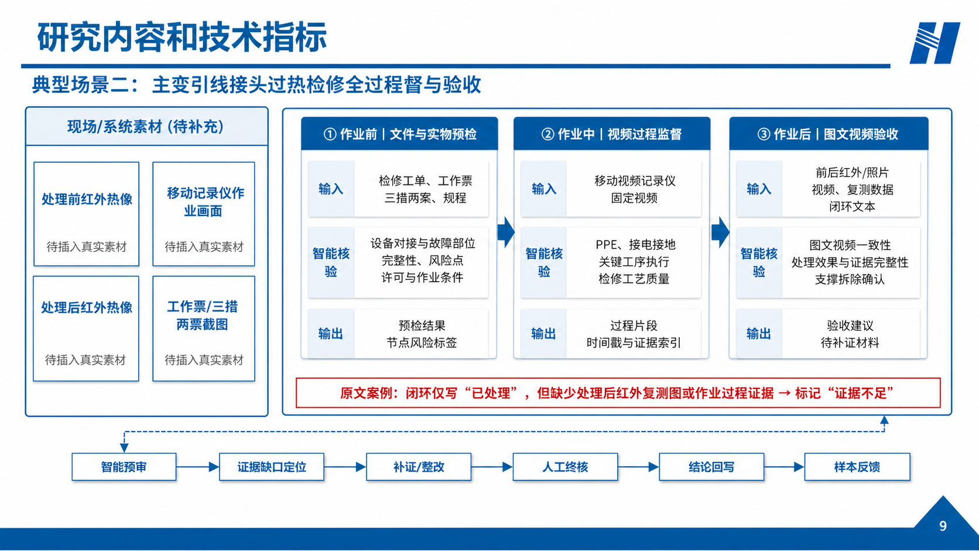
Notes:
[Sources]
- Generated preview asset: generated-previews/slide-09-preview.png
- Visual reference: source PPT slide 09
[/Sources]

Slide 10
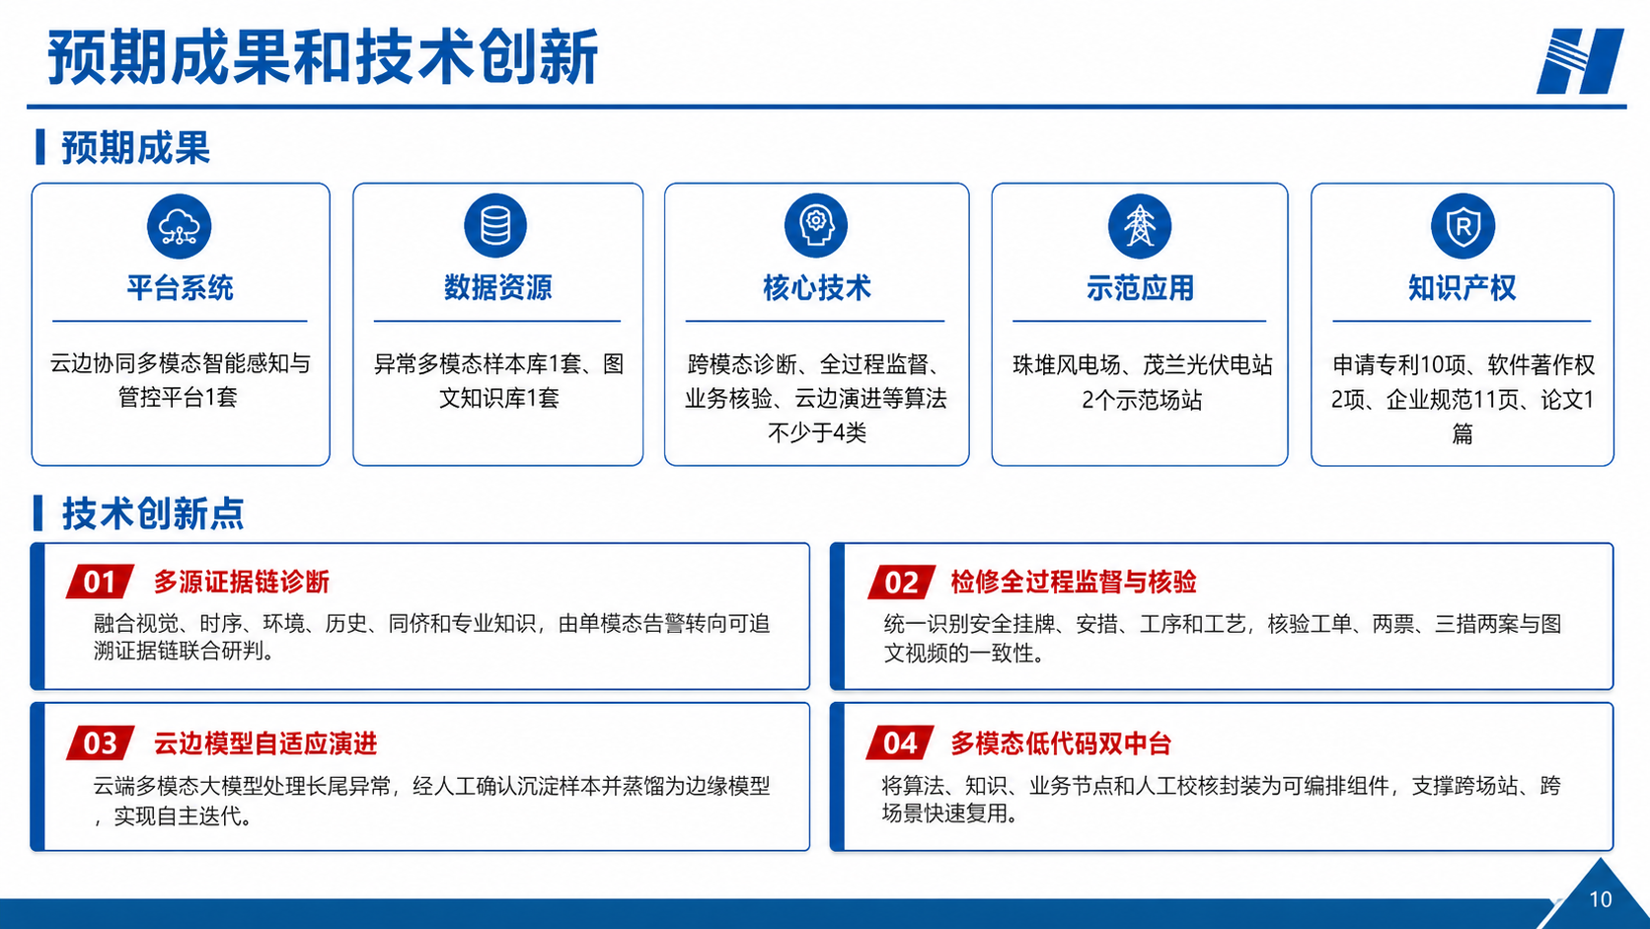
Notes:
[Sources]
- Generated preview asset: generated-previews/slide-10-preview.png
- Visual reference: source PPT slide 10
[/Sources]

Slide 11
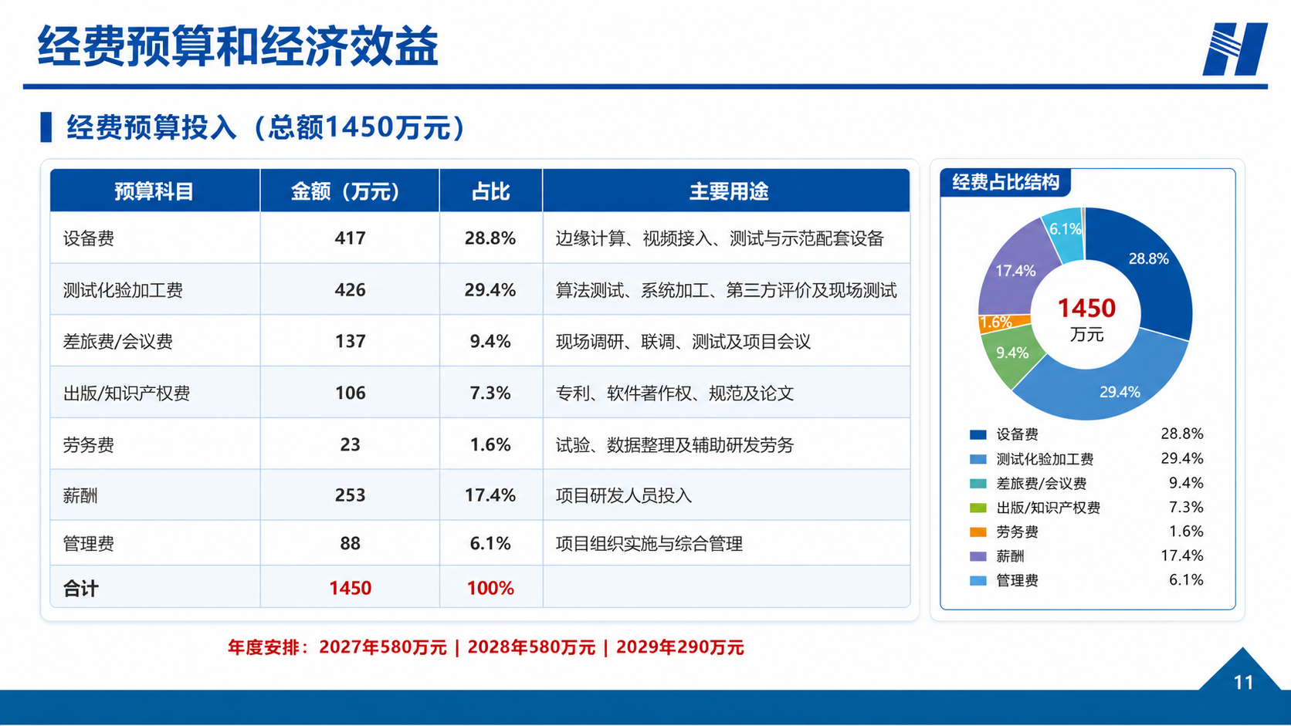
Notes:
[Sources]
- Generated preview asset: generated-previews/slide-11-preview.png
- Visual reference: source PPT slide 11
[/Sources]

Slide 12
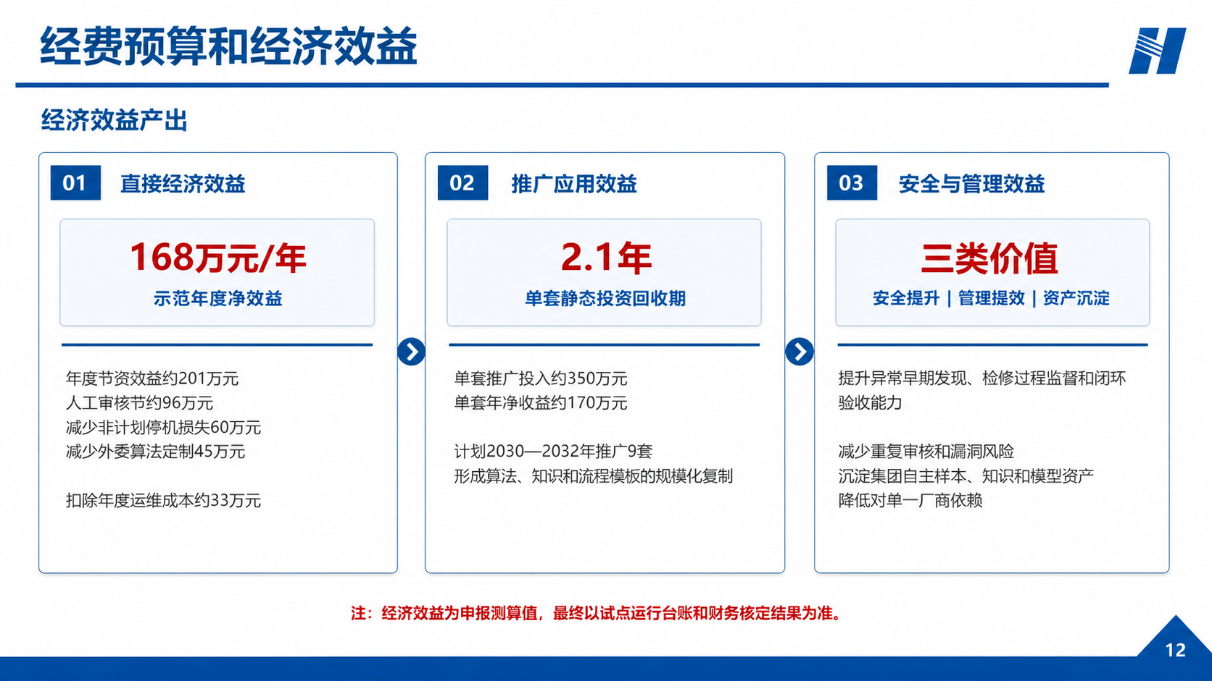
Notes:
[Sources]
- Generated preview asset: generated-previews/slide-12-preview.png
- Visual reference: source PPT slide 12
[/Sources]

Slide 13
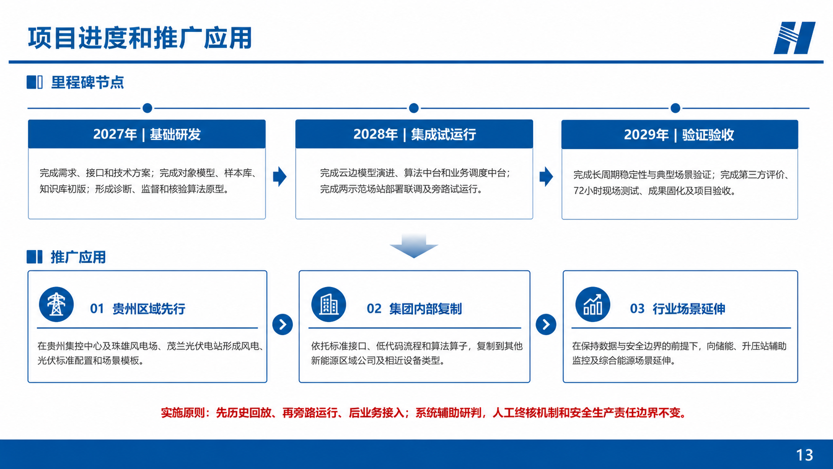
Notes:
[Sources]
- Generated preview asset: generated-previews/slide-13-preview.png
- Visual reference: source PPT slide 13
[/Sources]

Slide 14

Notes:
[Sources]
- Generated preview asset: generated-previews/slide-14-preview.png
- Visual reference: source PPT slide 14
[/Sources]

