Slide 1
MySQL & Django tutorial 2nd part, Assignment #2
2021, Fall
Pusan National University

Slide 2
Steps 1-13 are from first ppt

Slide 3
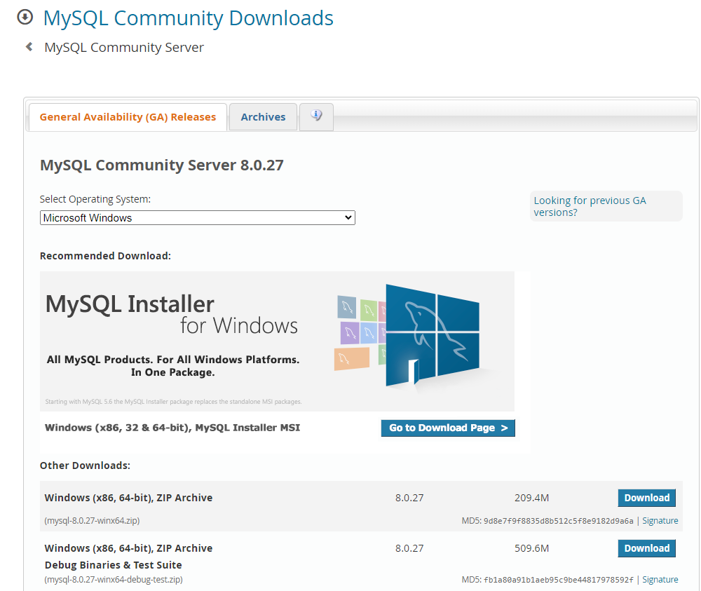
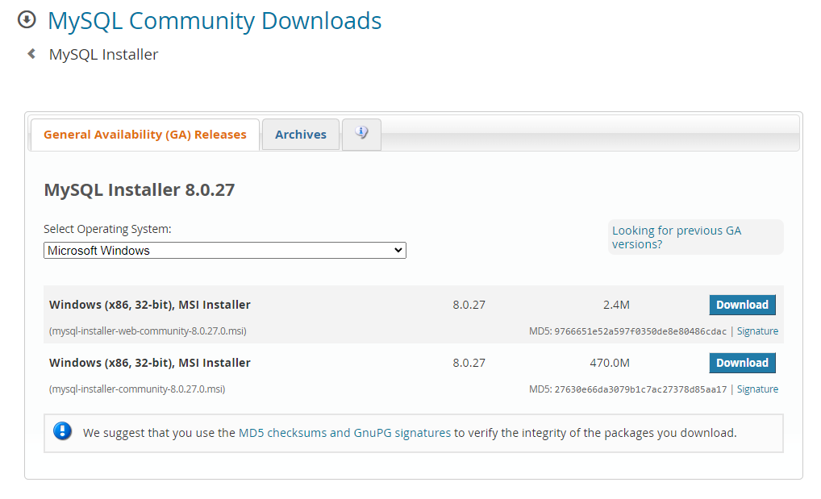
1) Download MySQL
Go to this URL -> https://dev.mysql.com/downloads/mysql/
Press “Go to download page” and download second installer

Slide 4
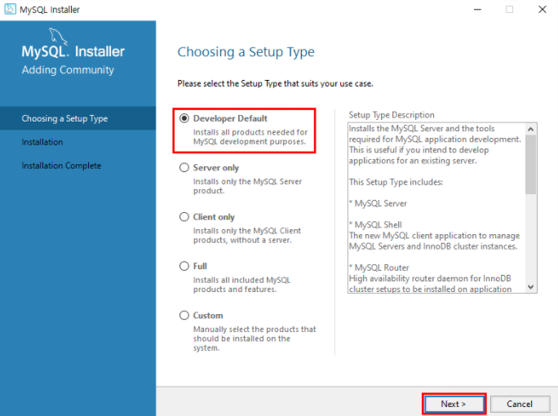
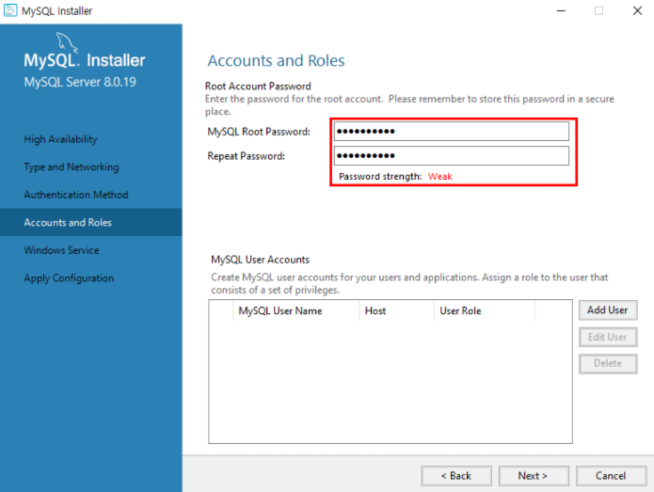
2) Install MySQL
Lunch downloaded file(mysql-installer-community-8.0.27.0.exe)
Key points:
While choosing the setup type, select the “Developer Default” option
Enter the MySQL Root password which will be strong and which you can remember

Slide 5
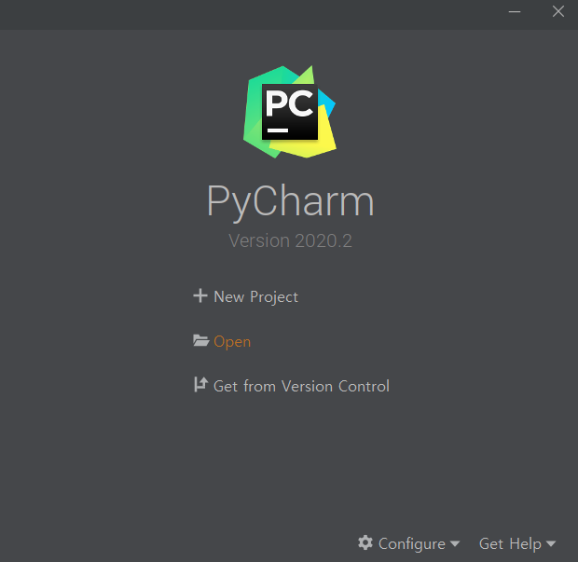

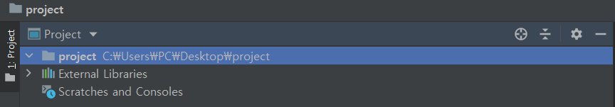
3) Initializing a new virtual environment
1) Create working directory
(in this example it is a folder called “project”)
2) Open the working directory from PyCharm

Slide 6


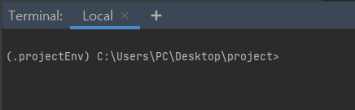
3) Initializing a new virtual environment (cont.)
python3 -m venv .projectEnv
3) Click on “Terminal” which is located at bottom left side in PyCharm
4) Create virtual environment called “projectEnv”
5) Activate the virtual environment
.projectEnv\Scripts\activate.bat

Slide 7


4) Installing Django and MySQL client
Install Django packages
2) Install MySQL client for python
pip install django
pip install mysqlclient

Slide 8
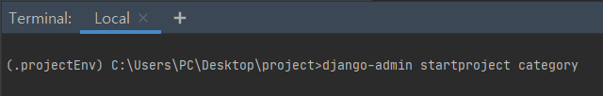
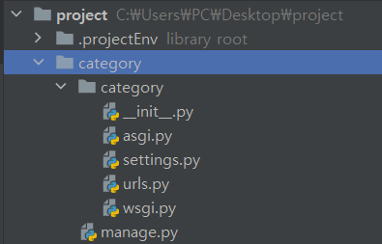
5) Create the new Django project
Start Django project called “category” using django-admin tool
django-admin startproject category
After that our current working directory should look like this:

Slide 9
6) About the files located in project folder
__init__.py is an empty file that tells Python to use this directory as a Python package.
asgi.py is a standard for Python asynchronous web app and server to communicate with each other.
settings.py contains all the website settings, database configuration details, etc.
The manage.py script is used to work with databases, create applications, and start the web server.
wsgi.py is used to help Django application communicate with the webserver.
urls.py defines the site URL-to-view mappings.

Slide 10
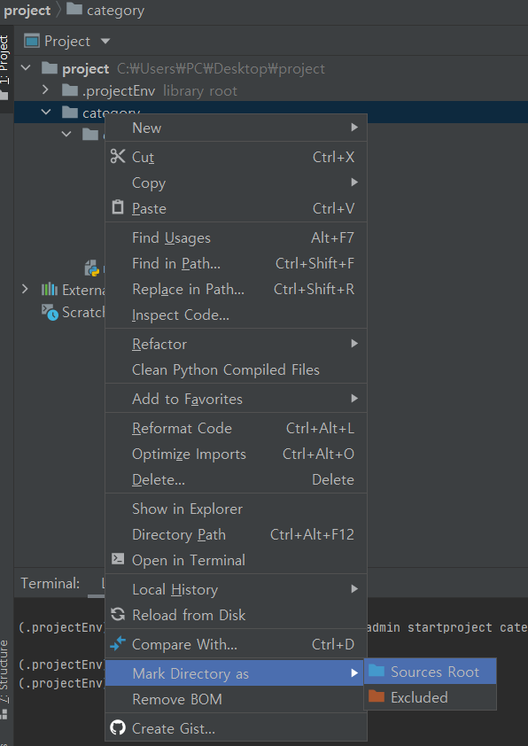
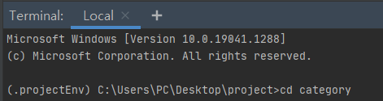
7) Change to project folder
Mark the project directory as root:
Right click on project folder → Mark Directory as
→ Sources Root
Change into project directory in terminal
cd category

Slide 11
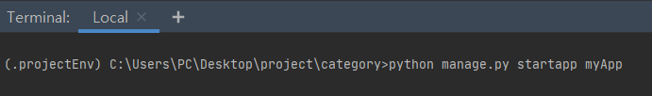
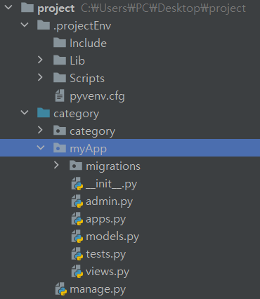
8) Create the new Django application
Create Django application called “myApp”
python manage.py startapp myApp
Then, our working directory will look like this:

Slide 12
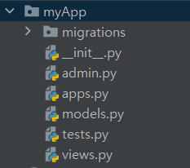
9) About the files located in myApp folder
migrations folder stores migrations files that make it possible to automatically update database as soon as models will be modified.
__init__.py is an empty file that tells Python to use this directory as a Python package.
admin.py contains administration site configurations.
views should be stored in views.py.
tests.py contains tests.
The apps.py stores application registration.
models.py stores models.

Slide 13
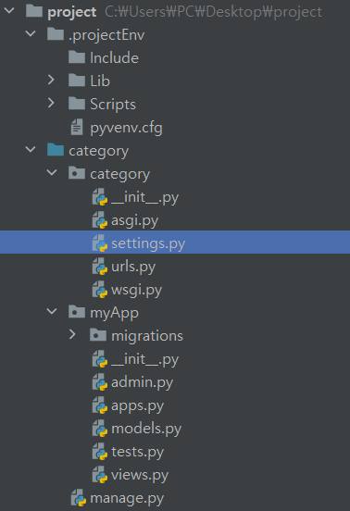
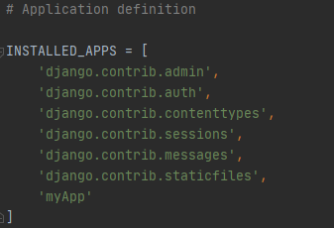
10) Registering myApp application
Open settings.py file add the new created application myApp to INSTALLED_APPS

Slide 14
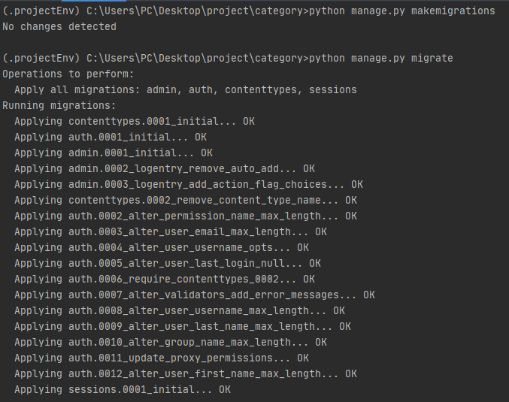

11) Testing the website framework
Running database migrations:
python manage.py makemigrations
python manage.py migrate
Running the server:
python manage.py runserver

Slide 15
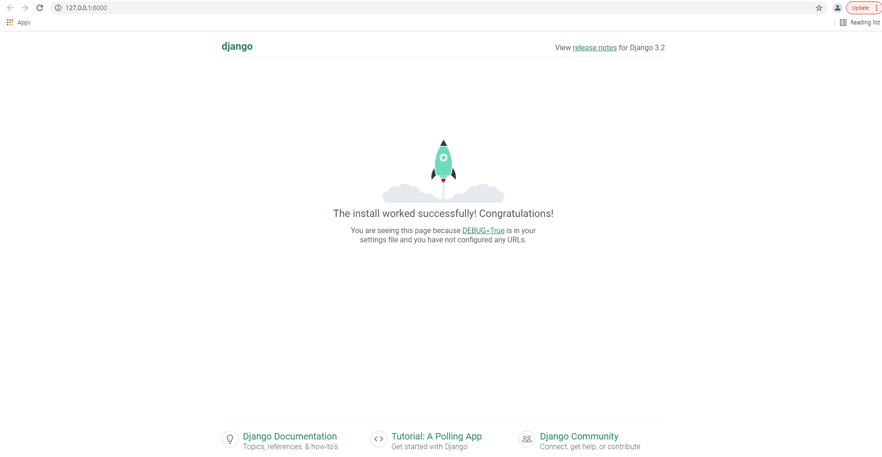
11) Testing the website framework (cont.)
The development server can be accessed at
http://127.0.0.1:8000/
Here we can see that website framework was set up successfully

Slide 16

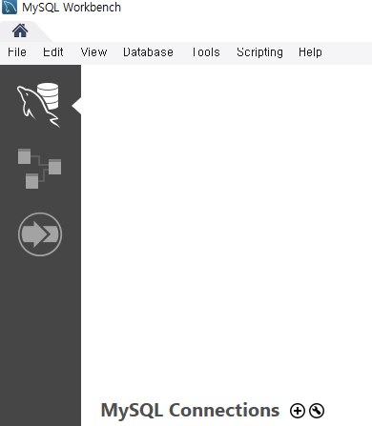
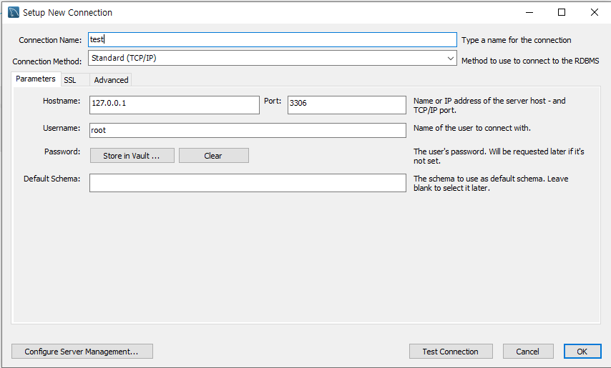
12) Creating MySQL Database
1) Open the MySQL Workbench
and click on ⊕ button
2) Set up the connection name(here the name is “test”) and press ok

Slide 17
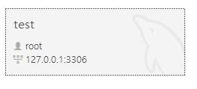
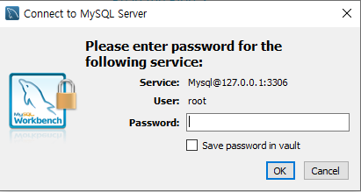

12) Creating MySQL Database (cont.)
3) Double click on created connection “test”
4) Enter the password of the root and click “OK”
5) Create database called “categoryDB” and press the
button
create database categoryDB;

Slide 18
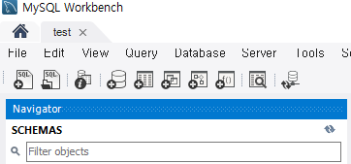


12) Creating MySQL Database (cont.)
6) By clicking on update button we can see the new created database “categoryDB”
7) Double click on “categoryDB”

Slide 19
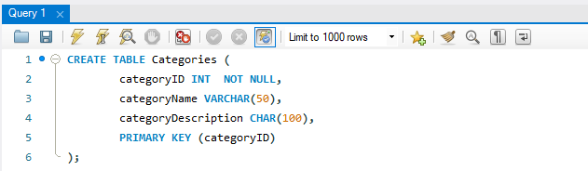
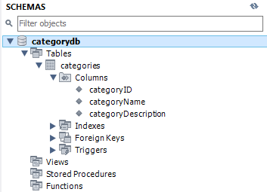
12) Creating MySQL Database (cont.)
CREATE TABLE Categories ( categoryID INT NOT NULL, categoryName VARCHAR(50), categoryDescription CHAR(100), PRIMARY KEY (categoryID)
);
8) Create table called “Categories” and press the
button
9) By pressing update button we can see that our table “Categories” is created

Slide 20
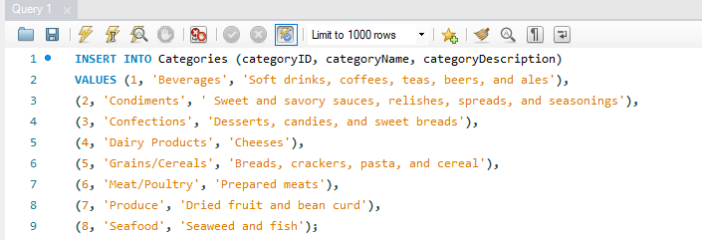
12) Creating MySQL Database (cont.)
10) Add records “Categories” table
INSERT INTO Categories (categoryID, categoryName,categoryDescription)
VALUES (1, 'Beverages', 'Soft drinks, coffees, teas, beers, and ales'), (2, 'Condiments', 'Sweet and savory sauces, relishes, spreads, and seasonings'), (3, 'Confections', 'Desserts, candies, and sweet breads'),(4, 'Dairy Products', 'Cheeses'),(5, 'Grains/Cereals', 'Breads, crackers, pasta, and cereal'),(6, 'Meat/Poultry', 'Prepared meats'),(7, 'Produce', 'Dried fruit and bean curd'),(8, 'Seafood', 'Seaweed and fish');

Slide 21
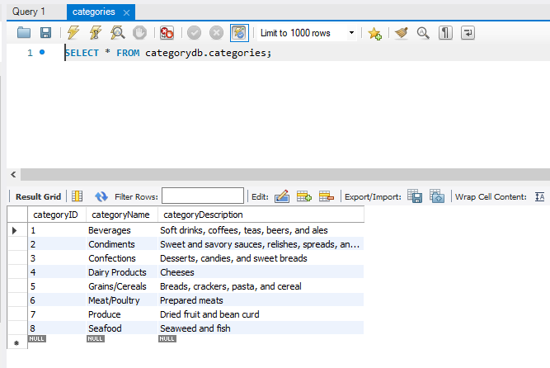
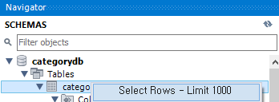
12) Creating MySQL Database (cont.)
11) In order to see the records in the table:
Right click on category->SelectRows

Slide 22
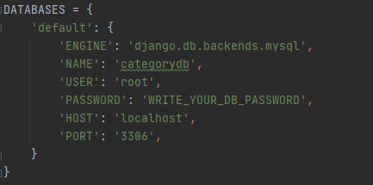
13) Connecting MySQL database to Django project
Open settings.py file and set up configurations of mySQL database “categoryDB”
Run database migrations:
python manage.py migrate

Slide 23
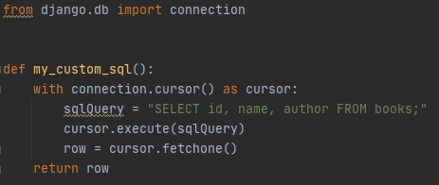
Executing custom SQL directly
Django.db.connection defines the default database connection. If we want to use the database connection, we need to call connection.cursor() to get a cursor object.
cursor.execute(sql, [params]) to execute the SQL
cursor.fetchone() or cursor.fetchall() to return the resulting rows

Slide 24

Example of using custom SQL in Django
For example we have following tasks:
Show the Categories table
Show the CategoryName and CategoryDescription of the record(s) where the categoryID is equal to 7

Slide 25
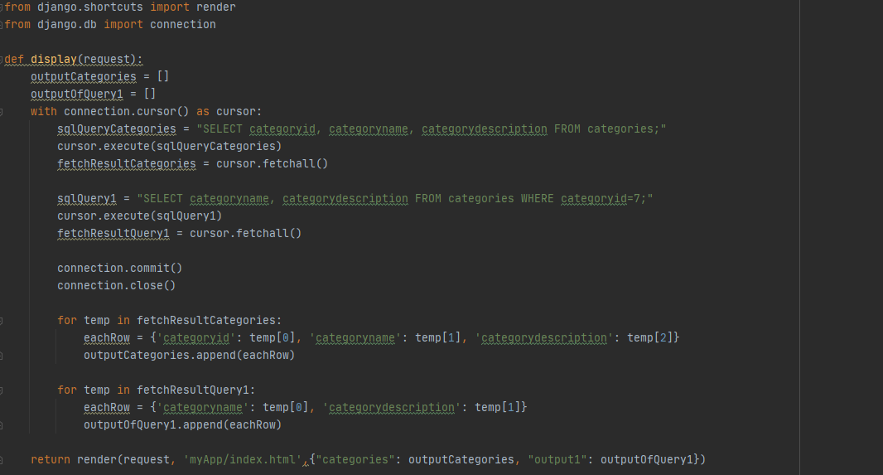
14) Defining custom SQL queries in views
First, we need to set up the views.py.
Define the function “display” as following:
views.py

Slide 26
14) Defining custom SQL queries in views (cont.)
First, we need to set up the views.py.
Define the function “display” as following:
views.py
from django.shortcuts import render
from django.db import connection
def display(request):
outputCategories = []
outputOfQuery1 = []
with connection.cursor() as cursor:
sqlQueryCategories = "SELECT categoryid, categoryname, categorydescription FROM categories;"
cursor.execute(sqlQueryCategories)
fetchResultCategories = cursor.fetchall()
sqlQuery1 = "SELECT categoryname, categorydescription FROM categories WHERE categoryid=7;"
cursor.execute(sqlQuery1)
fetchResultQuery1 = cursor.fetchall()
connection.commit()
connection.close()
for temp in fetchResultCategories:
eachRow = {'categoryid': temp[0], 'categoryname': temp[1], 'categorydescription': temp[2]}
outputCategories.append(eachRow)
for temp in fetchResultQuery1:
eachRow = {'categoryname': temp[0], 'categorydescription': temp[1]}
outputOfQuery1.append(eachRow)
return render(request, 'myApp/index.html',{"categories": outputCategories, "output1": outputOfQuery1})

Slide 27
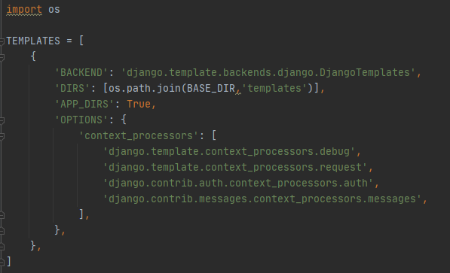
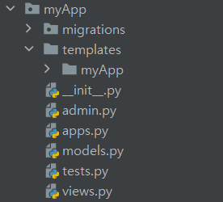
15) Creating templates
1) In settings.py add path to “templates” which will store the templates used by application
2) In the myApp directory, create templates directory and inside of it create another directory which will have same name as the application

Slide 28
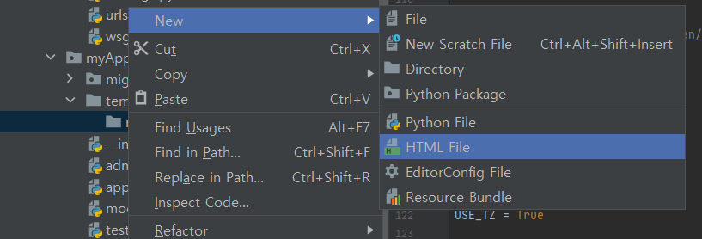

15) Creating templates (cont.)
3) Then right click on new created directory “myApp”-> Press New->HTML File
4) Name it as “index” and press enter

Slide 29
15) Creating templates (cont.)
index.html
<!DOCTYPE html>
<html>
<head>
<meta charset="UTF-8">
<title>Categories Database:</title>
</head>
<body>
<h2>Categories table</h2>
<table>
<thead>
<tr>
<th>category id</th>
<th>category name</th>
<th>category description</th>
</tr>
</thead>
{% for category in categories %}
<tr>
<td>{{ category.categoryid }}</td>
<td>{{ category.categoryname }}</td>
<td>{{ category.categorydescription }}</td>
</tr>
{% endfor %}
</table>
<br>
<br>
<h2>Example query result:</h2>
<table>
<thead>
<tr>
<th>category name</th>
<th>category description</th>
</tr>
</thead>
{% for i in output1 %}
<tr>
<td>{{ i.categoryname }}</td>
<td>{{ i.categorydescription }}</td>
</tr>
{% endfor %}
</table>
</body>
</html>
5) Add the following to index.html

Slide 30
16) Creating URLs
After that,we need to create urls in urls.py to have access to views.
Update the urls.py file as following:
urls.py
from django.urls import path
from myApp import views
urlpatterns = [
path('', views.display, name='index'),
]

Slide 31
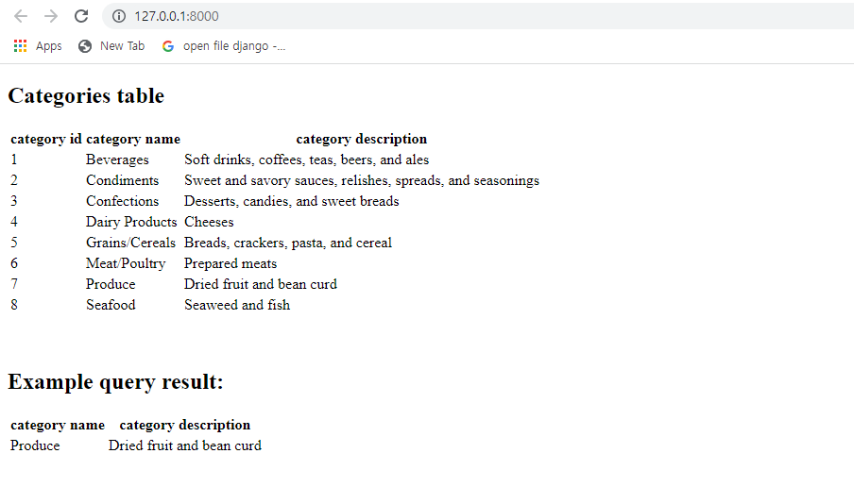
17) Run the development server
Running the server:
python manage.py runserver
We should get following output:

Slide 32
Assignment #2
Web application and server to handle the given queries where the schemas are as below;
Students(studentID, name, score, county)
Professors(facultyID, name, age, county)
Counties(countyName, population, city)
COVID(patientID, city)
where the types of attributes are all CHAR(30) except score, age, and population, whose types are REAL, INTEGER, and INTEGER respectively. And four CSV files will be given for each table.

Slide 33
Assignment #2 (cont.)
The web application provides the following functions with proper GUI;
1. Build the database with four tables by reading each line from the given CSV file and inserting it into the proper table.
2. Query type 1: List the pairs (countyName, averageScore) where averageScore is the average score of each county.
3. Query type 2: List the pairs (cityName, averageScore) where averageScore is the average score of each city.
4. Query type 3: List the pairs (professorName, studentName) where the student has the highest score in her/his county, the professor is the eldest in her/his county, and they live in the same county.

Slide 34
Assignment #2 (cont.)
5. Query type 4: List the pairs (professorName, studentName) where the student has the highest score in her/his city, the professor is the eldest in her/his city, and they live in the same city.
6. Query type 5: List the pairs (studentName, cityName) where the ratio of COVID patients is in top 3 cities.
We will measure the execution time of Query type 5 and give 50%, 30%, 20% of bonus over the assignment score (#1 and #2) to the fastest, second fastest, and third fastest submissions, respectively.

Slide 35
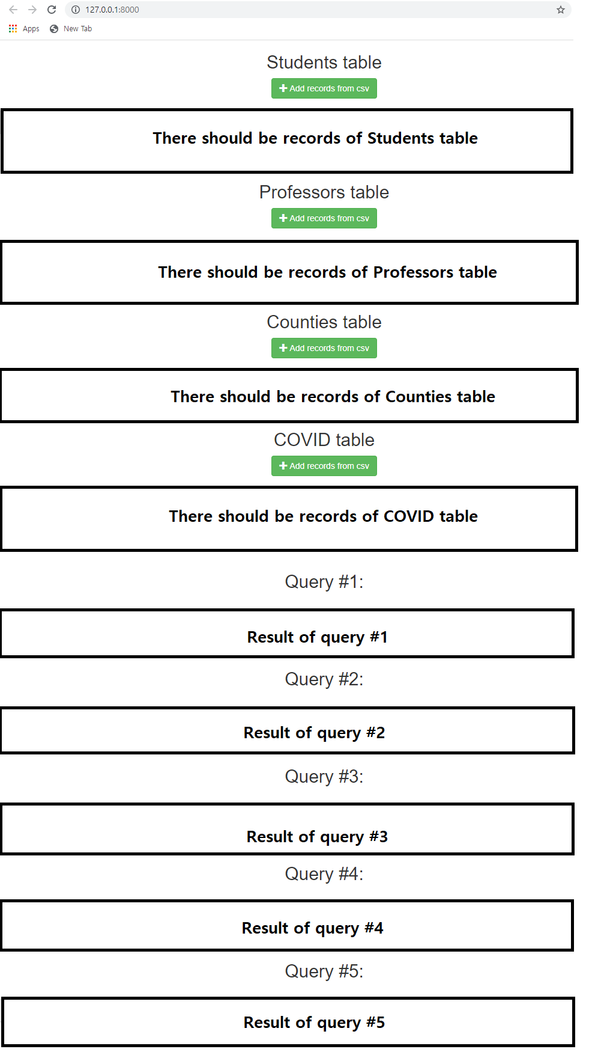
Assignment #2 (cont.)
Initially, all tables should be empty
When pressing “Add records from csv” button the respective csv file should be read and records should be add to respective table
Store csv files in ~templates/myApp/ folder (here myApp is the name of Django application)

Slide 36
Assignment #2 (cont.)
Important notice:
Use only connection and cursor with sql query while
inserting records into tables
showing the tables and query results
Don’t use Manager.raw(), select_related, prefetch_related and other methods or functions while working with sql.
Don’t use Django models and models.py should be empty
If you solved your homework by using other methods and functions not by connection and cursor when working with sql tables and queries, you will get 0 points for the Assignment #2.

Slide 37
Assignment #2 (cont.)
Submission:
you have to submit project file and every necessary files to run your program to plato portal.
due: Dec. 22 18:00, 2021
Oral test: Dec. 27 and 28, 2021 (detail schedule will be announced)

