Slide 1

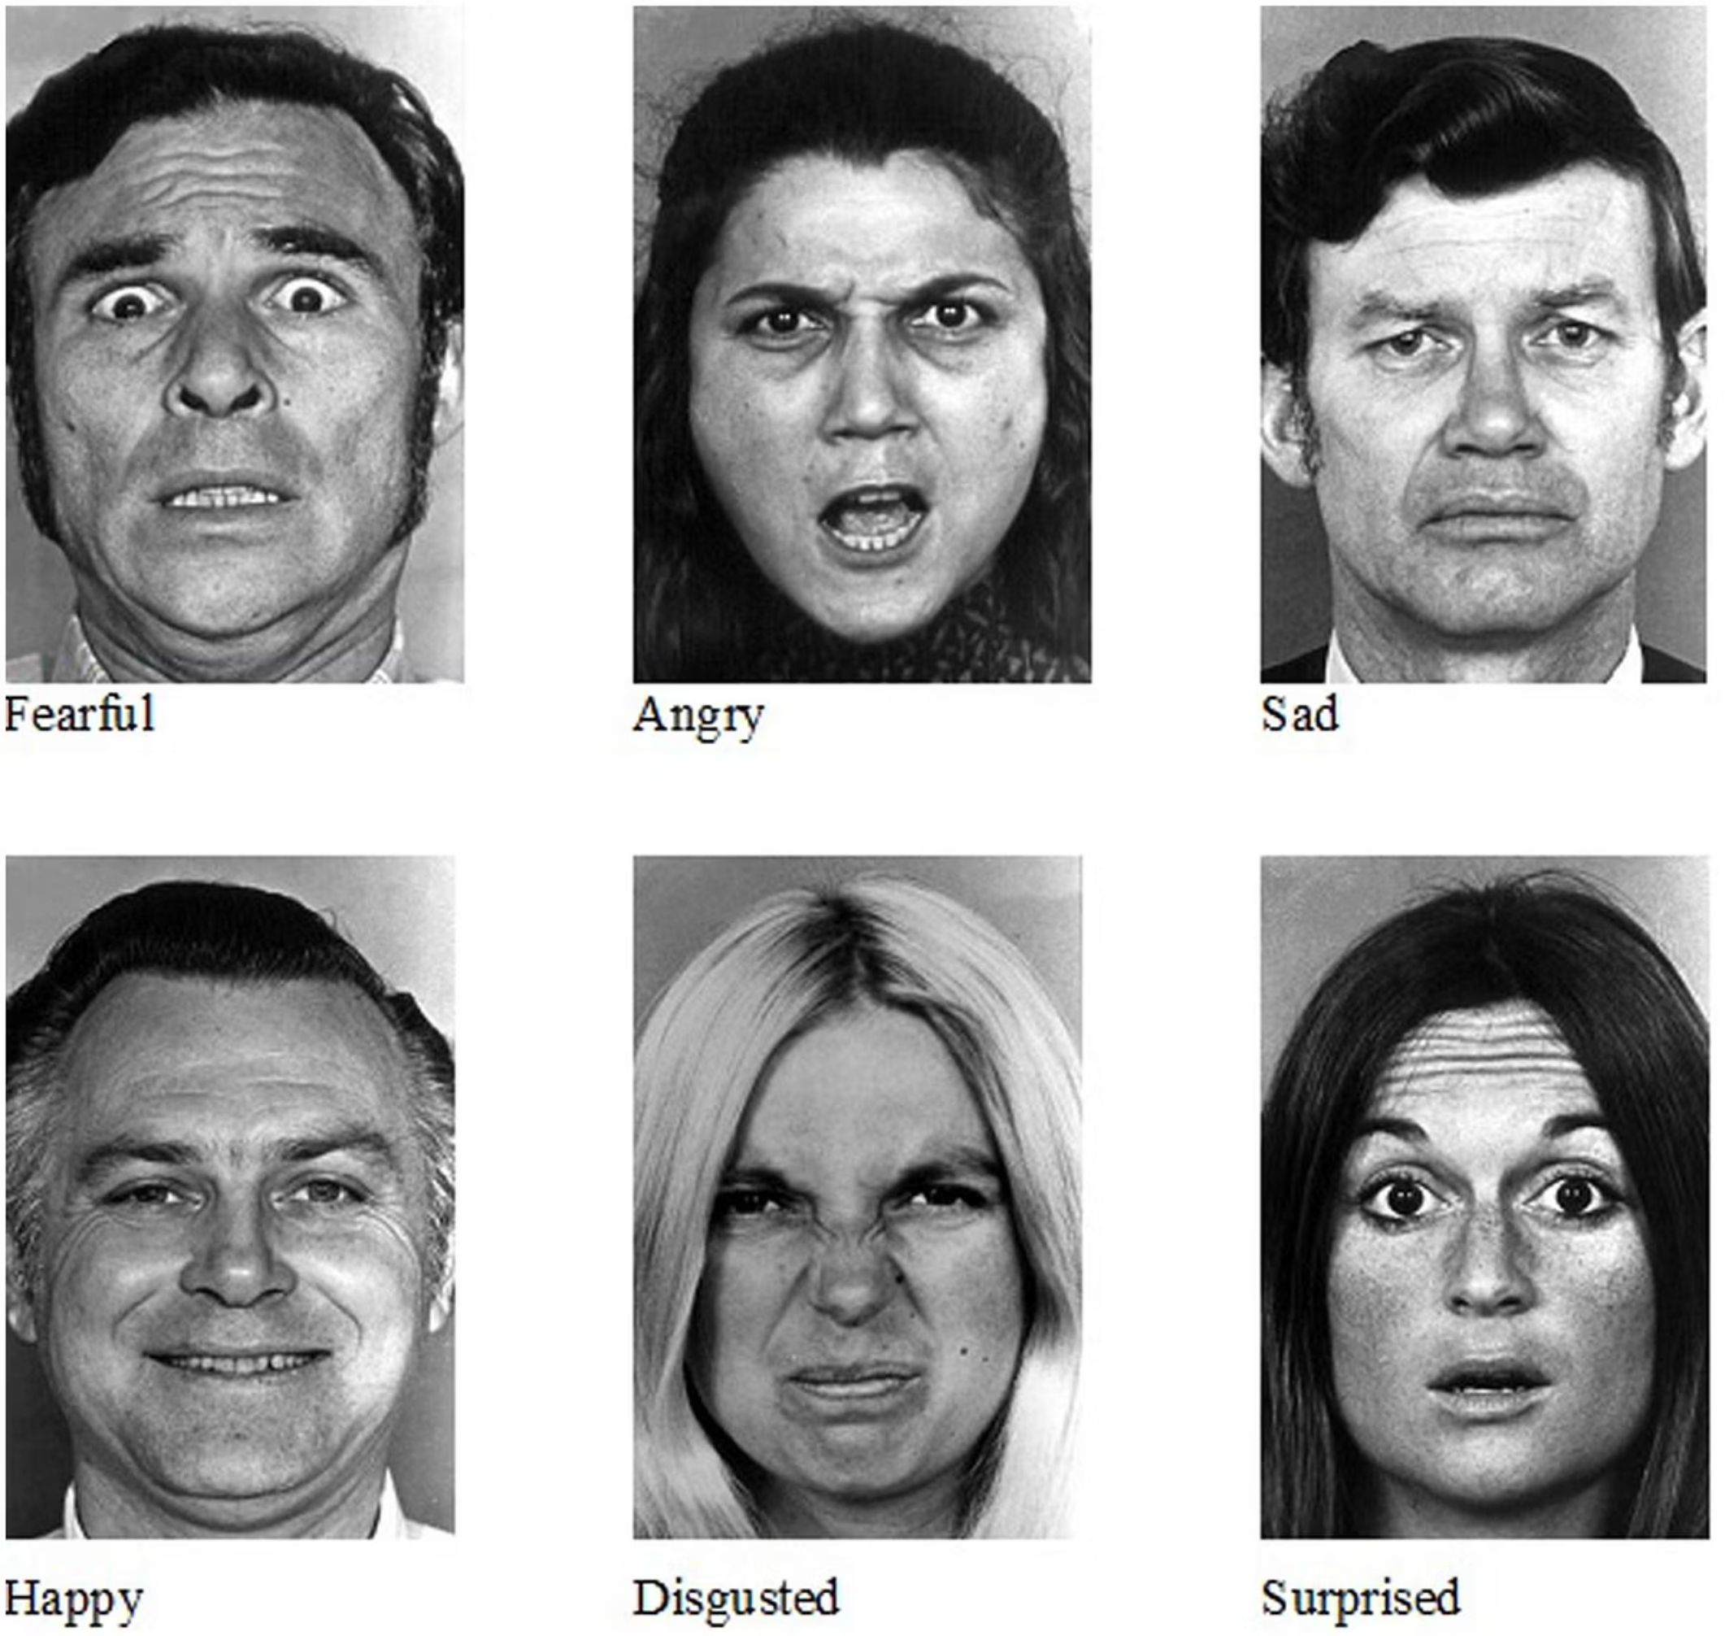
Emotion Recognition using CNN (FER2013)
Problem Statement
Facial emotion recognition aims to identify human emotions from facial images. This is a challenging real-world image processing problem due to subtle expressions, low image quality, and facial variations.

Slide 2
Algorithm Used – Convolutional Neural Network (CNN)
Why CNN?
How CNN Works (3 Stages)
Images are made of pixels, not simple numbers
01
CNNs are designed specifically for image data
Feature Detection
They automatically learn important visual features
02
Feature Reduction
03
Classification

Slide 3

Dataset Used – FER2013
FER2013 Dataset
Public facial emotion dataset
48×48 grayscale images
7 emotion classes
Collected from real-world conditions
Expected Accuracy
Emotion recognition is a difficult task
50–60% accuracy is considered reasonable for FER2013

Slide 4
Methodology & Key Learnings
Methodology
Key Learnings
Image preprocessing and normalization
How CNNs process images step by step
Data augmentation to improve learning
Importance of data quality and preprocessing
CNN model training
Real-world image tasks are challenging
Emotion prediction on new images

