Slide 1
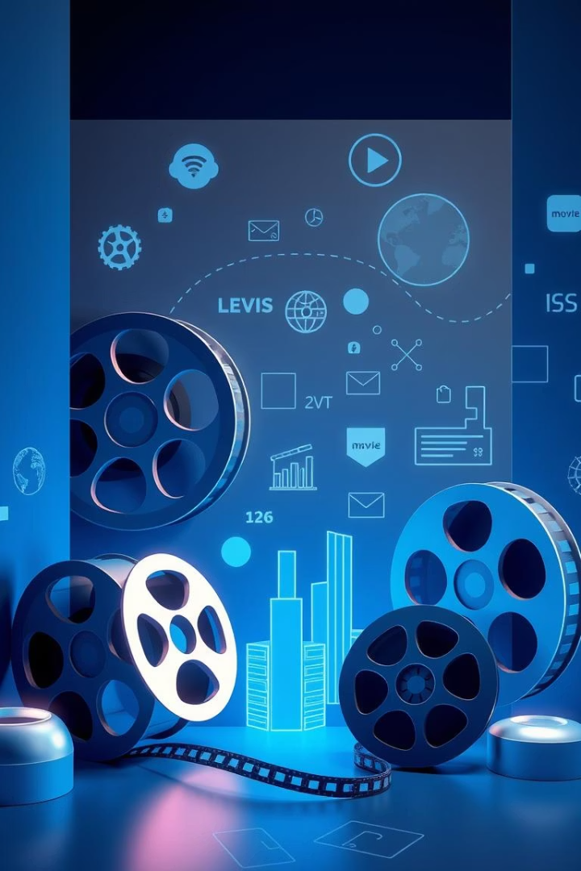
Movie Recommender System
Presented by:
Laiqa Tahir Khan (22-CP-02)
Muhammad Saffi Ul Haq (22-CP-78)
Presented to: Engr. Mona Waseem
Date: May 06, 2025
Notes:
1

Slide 2
Project Overview and Tools
Objective
Technologies
Suggest similar movies using content-based filtering
Python, Pandas, Scikit-learn, NLTK
Apply NLP on movie metadata
Streamlit for front-end
Deploy via Streamlit web app
TMDB 5000 Movies Dataset
Notes:
2

Slide 3
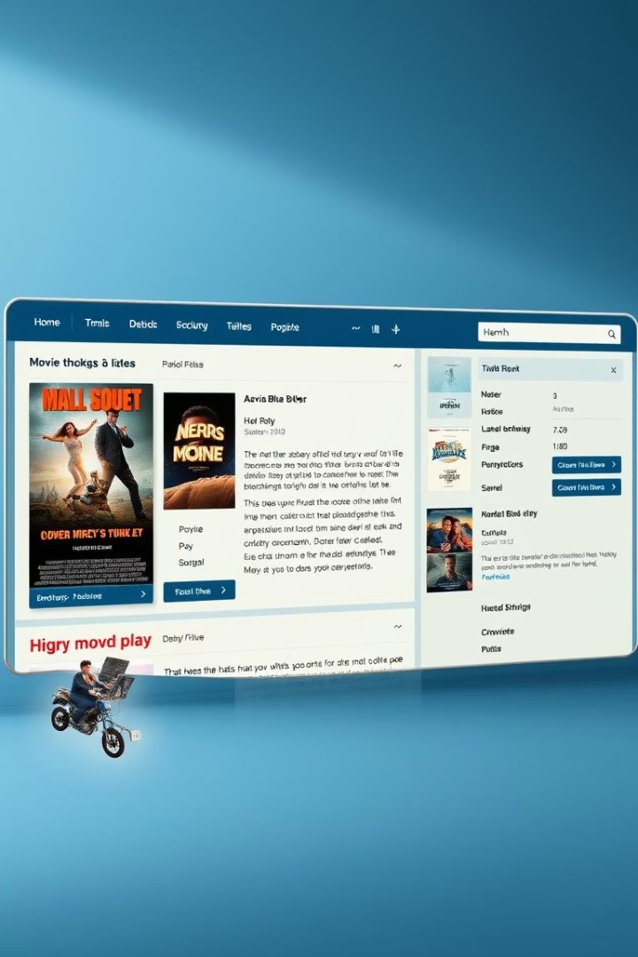



Dataset Description
Datasets
Key Features
tmdb_5000_movies.csv and tmdb_5000_credits.csv
Plot summary (Overview)
Genres and keywords
Top 3 cast actors
Director (Crew)
Selection Reason
Best represent movie content for recommendations
Notes:
3

Slide 4
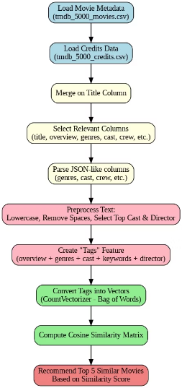
Project Flowchart
Visual representation of project steps and data flow
Notes:
4

Slide 5
Model Pipeline
Similarity Computation
Text Vectorization
Preprocessing & Feature Engineering
CountVectorizer with max 5000 features, exclude stopwords
Cosine similarity to find top 5 movie matches
Data Merging & Cleaning
Parse JSON, remove spaces, apply stemming, combine tags
Combine datasets, select relevant columns
Notes:
5

Slide 6

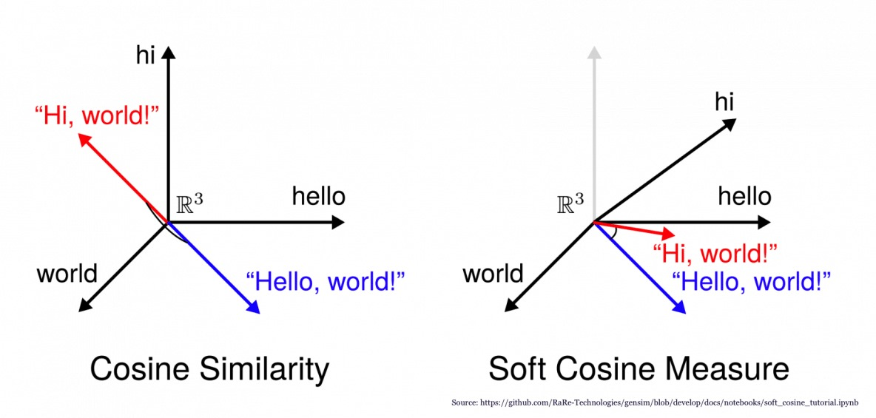


Cosine Similarity Algorithm
Definition
Measures similarity between two vectors
Range
From 0 (no similarity) to 1 (identical)
Advantages
Works well on sparse text data
Ignores vector magnitude, compares direction
Notes:
6

Slide 7
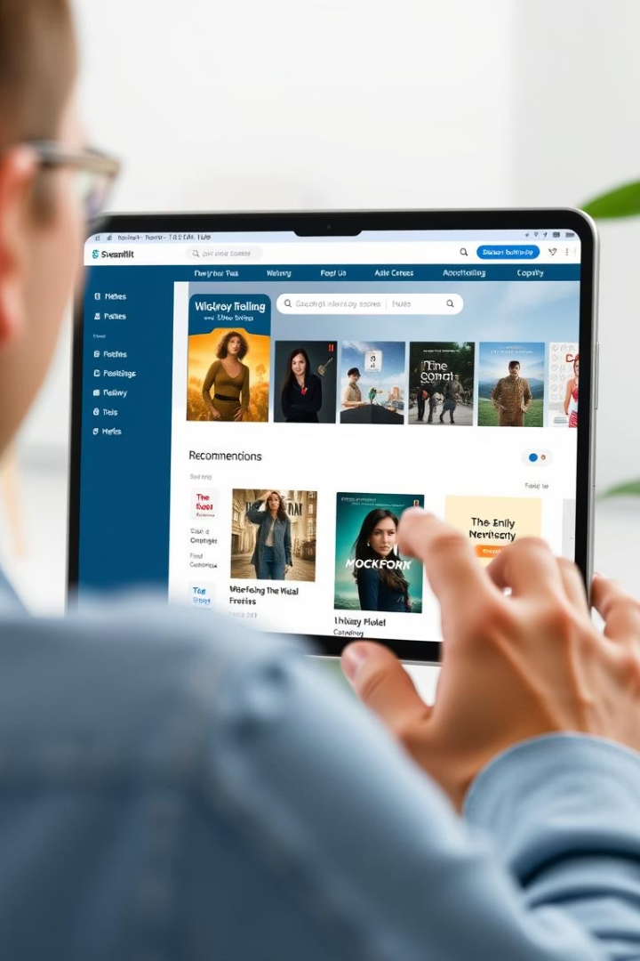
Web App Deployment - Streamlit
1
User Flow
Enter movie title
Receive top 5 similar movies
2
Implementation
Pickled model files for fast access
Simple, interactive interface
Notes:
7

Slide 8

Conclusion & Future Scope
Conclusion
Built effective content-based recommender
Applied NLP and cosine similarity successfully
Deployed with Streamlit UI
Future Improvements
Add collaborative filtering for personalization
Integrate user preferences
Incorporate advanced NLP models: TF-IDF, BERT
Notes:
8

