Slide 1
Topic Modeling NSF Proposals:
Results from the Enclave
David Newman
UC Irvine
September 23, 2010
David Newman - UC Irvine

Slide 2
Executive summary
Topic modeling is a mature technology to automatically learn categories to describe and quantify funding of scientific research
Methodology is simple (bag-of-words), robust (statistical), and could be used on all incoming proposals for improved understanding of research landscape and trends
Use topics to characterize
  Single proposal or set of proposals
  Principal Investigator or reviewer
  NSF Program or Program Manager
Summary text is good proxy for full text, but better to use full text when possible (as input to topic model)
Topic modeling is potential way to identify and quantify increasingly interdisciplinary nature of research
David Newman - UC Irvine

Slide 3
Topic model can answer these types of questions
How (topically) have the grants in SciSIP changed between 2007 and 2009?
What grants, for which I am not the program officer, are similar to my set of grants?
My program is Ion Channels. What topics are addressed by grants not in my program, but do mention Ion Channels?
What is the topical makeup of grants in Statistics that don't mention "Bayesian"?
What grants are related to Climate Change?
How much does NSF spend on nanotechnology and nanomaterials?
What topics do program (or program manager) X and Y have in common?
Are topics associated with EAGER and RAPID funding different from those with standard funding?
David Newman - UC Irvine

Slide 4
Topic model learns topics from co-occurring words
Automatically Learned Topics (10 of T):
…
t6. conflict violence war international military …
t7. model method data estimation variables …
t8. parameter method point local estimates …
t9. optimization uncertainty optimal stochastic …
t10. surface surfaces interfaces interface …
t11. speech sound acoustic recognition human …
t12. museum public exhibit center informal outreach
t13. particles particle colloidal granular material …
t14. ocean marine scientist cosee oceanography …
t15. atmospheric chemistry ozone air organic …
…
NSF proposals
Topic Model:
Use words from
(all) text
Learn T topics
t49
t18
t114
t305
Topic tags for each and every proposal
David Newman - UC Irvine

Slide 5
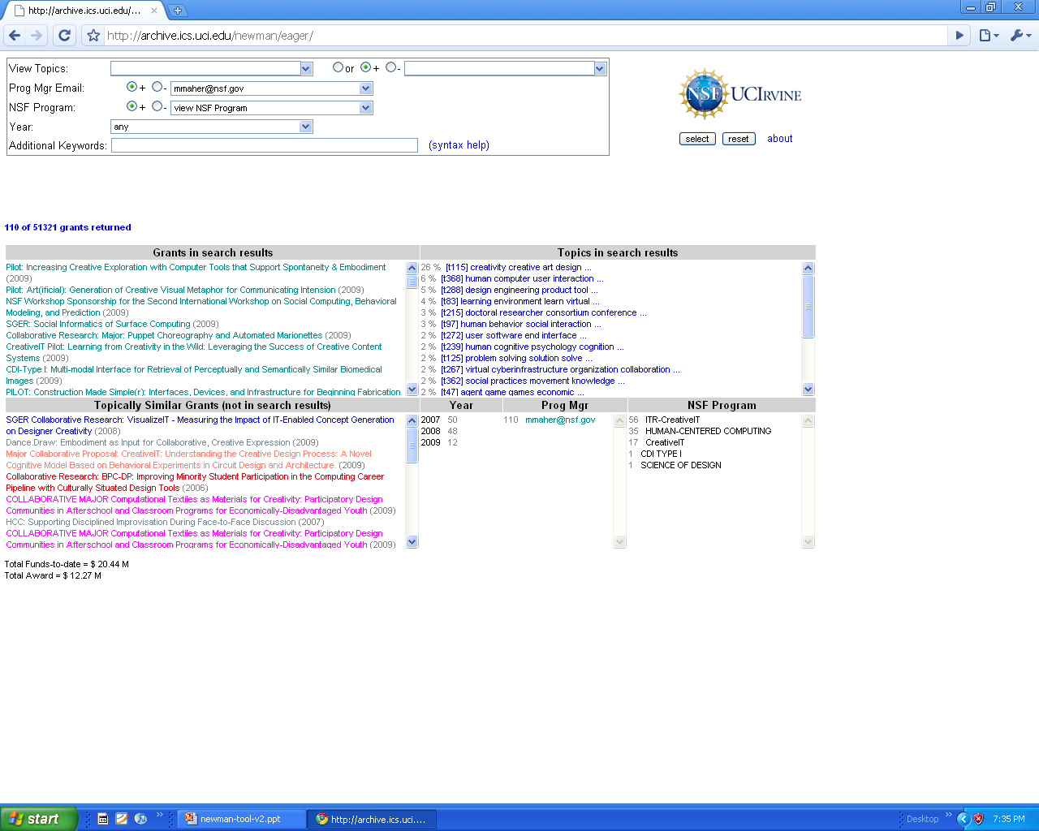
Grant-Set Analyzer – Screen 1 of 3 (search results)
Q: What topics belong to this program manager? (Could do same from NSF Program, etc)
David Newman - UC Irvine

Slide 6
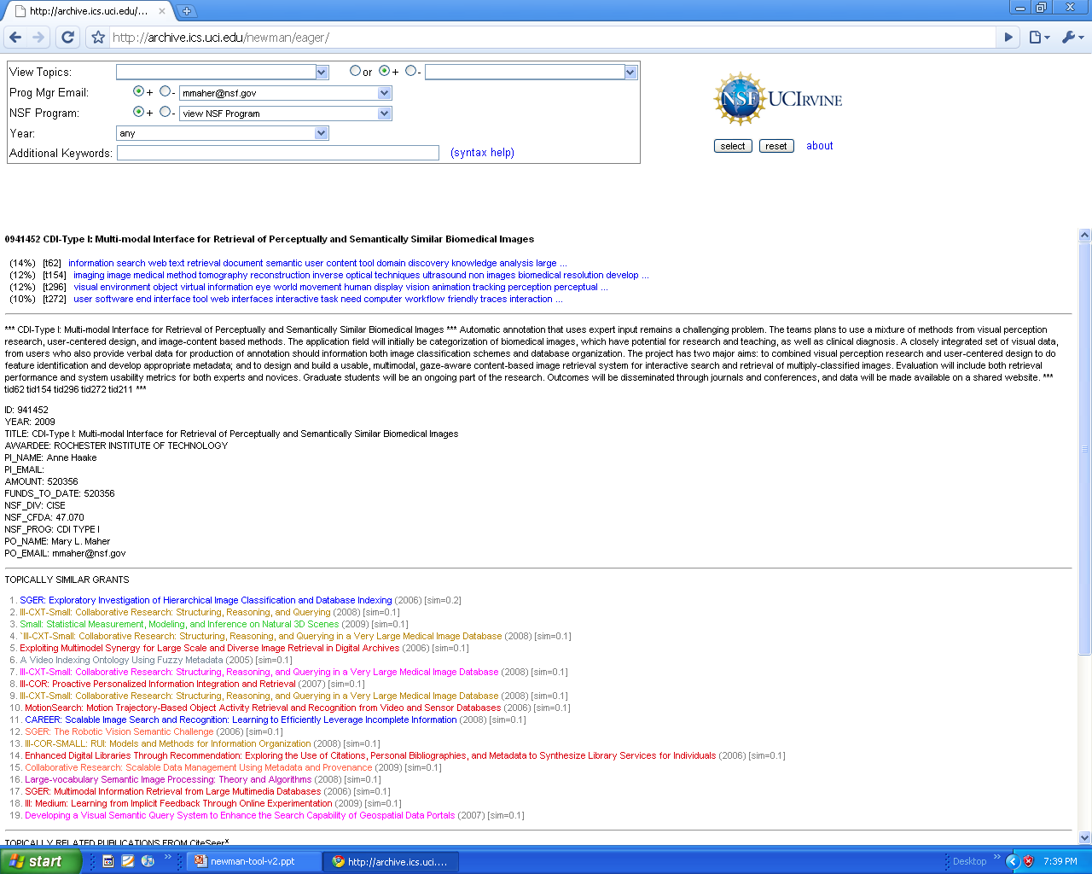
Grant-Set Analyzer – Screen 2 of 3 (grant detail)
Q: What topics are in this grant?
David Newman - UC Irvine

Slide 7
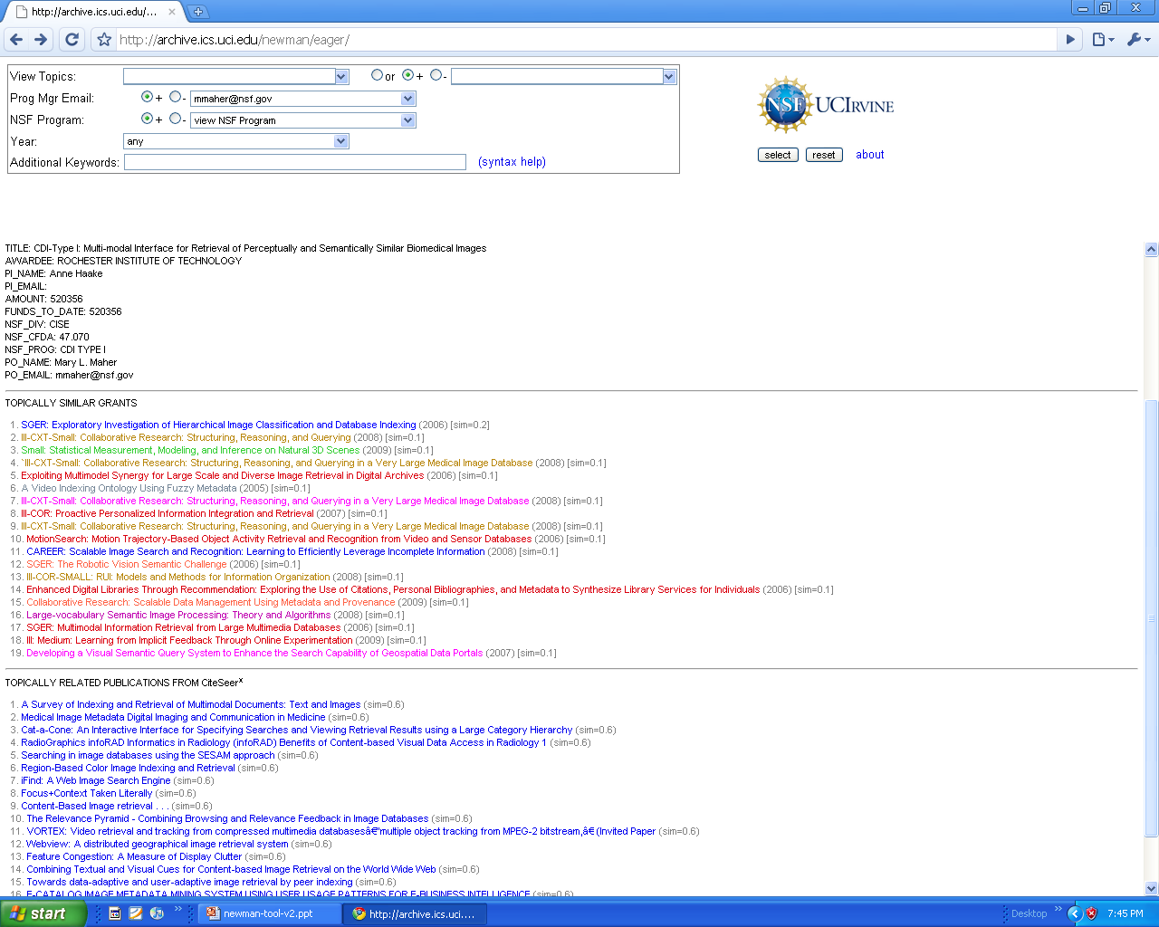
Grant-Set Analyzer – Screen 2 of 3 (grant detail … cont)
Q: What are topically-similar grants and publications?
David Newman - UC Irvine

Slide 8
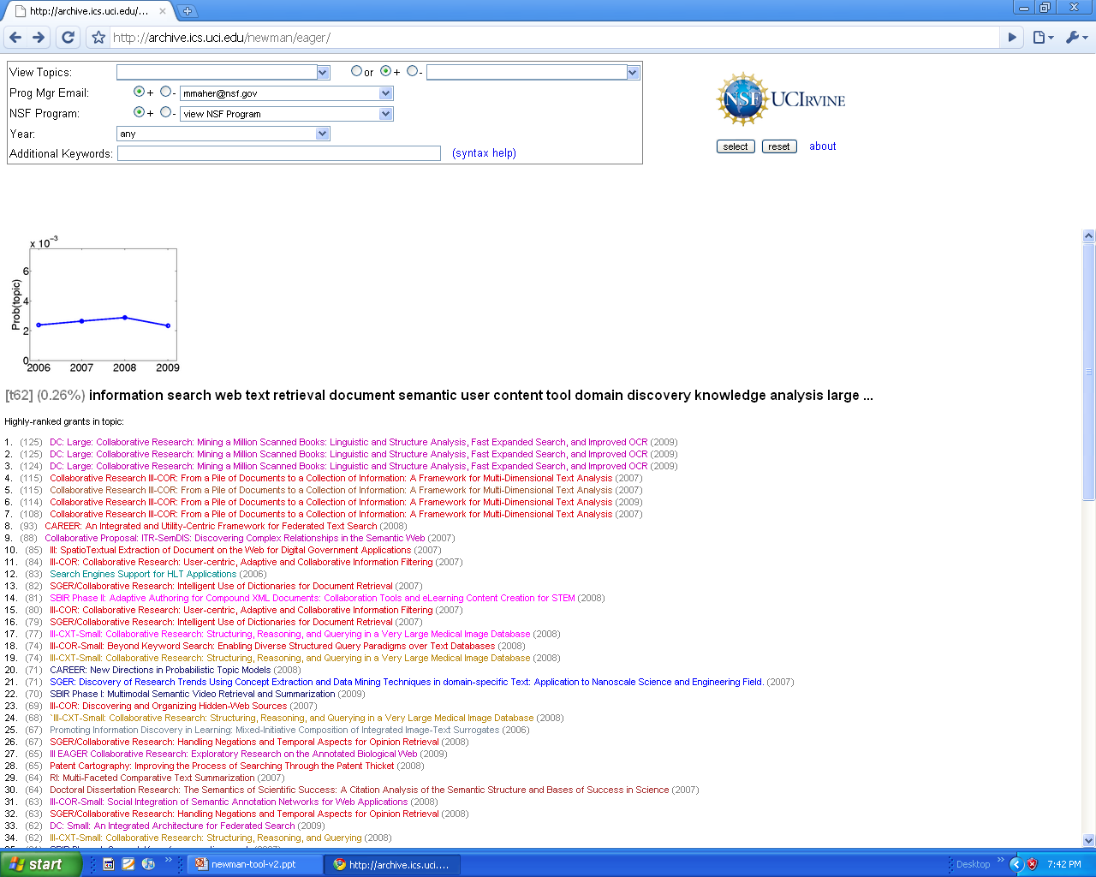
Grant-Set Analyzer – Screen 3 of 3 (topic detail)
Q: What are other grants related to this topic?
David Newman - UC Irvine

Slide 9
Enclave proposals used in topic modeling
 | Total | Awarded | % Awarded
2007 | 36,105 | 9,493 | 26%
2008 | 37,047 | 10,441 | 28%
2009 | 42,393 | 10,059 | 24%
Total | 115,545 | 29,993 | 26%
Note: Topic modeling is highly scalable, and can easily handle millions of full text proposals
* Only used proposals where Enclave had ProjSumm and ProjDesc, 2010 omitted because of largely incomplete data
David Newman - UC Irvine

Slide 10
Topic models learned from Enclave proposals
 | Summary | FullText
T=50 | X | X
T=200 | X | X
T=400 | X | X
T=800 | X | X
Learned eight topic models
  (T is number of topics)
Topic model output
  Topics (set of T lists of words)
  Topics in each document for d=1:D (D=115,545)
Can partition/aggregate results by year and funding decision (or other metadata: NSF Program, Program Manager, PI, etc.)
 | Awarded | All Proposals
2007 | X | X
2008 | X | X
2009 | X | X
David Newman - UC Irvine

Slide 11
[t14] (3.0%) student learning teacher education teaching mathematic stem classroom ...
[t12] (2.9%) social policy political public economic cultural practice organization ...
[t46] (2.9%) student undergraduate graduate group underrepresented training publication journal ...
[t47] (2.8%) team interdisciplinary field scientist knowledge collaboration challenge researcher ...
[t26] (2.8%) engineering student undergraduate education course educational design graduate ...
[t32] (2.7%) decision individual behavior social effect children factor test ...
[t10] (2.7%) model modeling simulation computational dynamic analysis data develop ...
[t6] (2.7%) student stem college career high faculty increase community ...
[t5] (2.6%) material device film electronic high nanoscale properties structure ...
[t42] (2.6%) protein cell dna molecular function structure binding biology ...
[t37] (2.4%) center education community national institution resource partner partnership ...
[t2] (2.3%) software computing system computer performance parallel resource computational ...
[t24] (2.2%) gene plant expression genome genetic genomic sequence biology ...
[t20] (2.2%) data information analysis tool database web knowledge collection ...
[t31] (2.2%) student undergraduate graduate summer reu experience site minority ...
[t48] (2.2%) system control design dynamic complex physical agent real ...
[t43] (2.2%) chemistry reaction chemical metal organic synthesis catalyst compound ...
[t33] (2.1%) ecosystem species plant ecological forest change soil community ...
[t21] (2.1%) conference workshop international meeting researcher participant student scientist ...
[t44] (2.1%) algorithm equation solution analysis theory nonlinear mathematical optimization ...
[t50] (2.0%) instrument student instrumentation chemistry facility department laboratory equipment ...
[t23] (2.0%) network communication wireless mobile protocol node design networking ...
[t38] (2.0%) technology phase cost product market innovation industry manufacturing ...
[t49] (2.0%) polymer surface material nanoparticle properties molecular membrane structure ...
[t30] (2.0%) flow fluid particle transport surface heat experimental dynamic ...
[t40] (2.0%) species evolution genetic evolutionary population diversity phylogenetic molecular ...
[t25] (2.0%) human image learning computer visual object information task ...
[t15] (1.9%) physic quantum magnetic system experiment field spin experimental ...
[t29] (1.9%) cell brain neural mechanism function system neuron activity ...
[t35] (1.9%) virtual public game media web digital content online ...
[t41] (1.8%) material mechanical properties composite structure high fiber structural ...
[t11] (1.8%) energy fuel cell power solar efficiency high gas ...
[t45] (1.7%) optical laser imaging light high resolution optic photonic ...
[t8] (1.7%) region site local human collection data land cultural ...
[t3] (1.7%) population behavior host female animal species male human ...
[t19] (1.6%) ocean marine ice sea arctic water coastal carbon ...
[t34] (1.6%) security service information system user internet attack privacy ...
[t39] (1.6%) risk building infrastructure decision structure design management structural ...
[t1] (1.6%) change climate model global atmospheric data variability scale ...
[t4] (1.6%) sensor detection sensing monitoring system technology measurement high ...
[t17] (1.5%) design power device system circuit high performance chip ...
[t18] (1.5%) theory group geometry space mathematic geometric structure field ...
[t9] (1.5%) cell tissue health medical drug patient cancer treatment ...
[t7] (1.4%) star formation observation astronomy cluster mass data galaxies ...
[t16] (1.4%) data mantle fault zone earth seismic earthquake rock ...
[t22] (1.4%) water environmental environment soil stream quality river urban ...
[t36] (1.4%) record isotope sediment sample core earth isotopic trace ...
[t27] (1.3%) microbial production bacteria enzyme bacterial metabolic acid food ...
[t13] (1.3%) wave wind plasma field space solar model turbulence ...
[t28] (0.8%) language east linguistic asia speech context word help ...
Summary Text
(T=50 topics)
% is percent of all words assigned to that topic (i.e. prevalence of that topic across the entire corpus)
Topics are good way of measuring slice of pie (e.g. 1.6% on ocean sciences)
David Newman - UC Irvine

Slide 12
[t14] (4.8%) student engineering faculty college stem undergraduate graduate career ...
[t5] (4.0%) student teacher learning education teaching course assessment curriculum ...
[t50] (2.8%) material film device layer substrate high structure surface ...
[t10] (2.7%) workshop conference meeting international center scientist participant collaboration ...
[t23] (2.6%) social policy economic political public interview data local ...
[t35] (2.5%) model data distribution function parameter variable probability algorithm ...
[t37] (2.5%) network node wireless communication security channel protocol information ...
[t39] (2.5%) model simulation modeling system dynamic scale computational structure ...
[t21] (2.4%) design team knowledge environment information game engineering decision ...
[t20] (2.4%) data user information web system service database tool ...
[t25] (2.3%) student laboratory instrument undergraduate system lab department chemistry ...
[t11] (2.3%) species soil change forest ecosystem site land environmental ...
[t7] (2.3%) group social individual participant effect behavior measure children ...
[t29] (2.2%) cell protein expression gene mutant function signaling role ...
[t47] (2.2%) protein binding structure dna enzyme peptide interaction site ...
[t31] (2.1%) technology phase product cost market industry business innovation ...
[t46] (2.1%) system performance computing data memory core resource architecture ...
[t40] (2.1%) laser optical light beam high wavelength detector measurement ...
[t27] (2.0%) flow particle fluid surface pressure heat transport experiment ...
[t19] (2.0%) water change ocean ice climate sea data sediment ...
[t34] (2.0%) equation solution function numerical system nonlinear linear order ...
[t13] (2.0%) material mechanical properties stress composite strain fiber surface ...
[t28] (2.0%) polymer nanoparticle particle material surface properties size solution ...
[t18] (1.9%) system software code tool design analysis language techniques ...
[t36] (1.9%) power design system device signal circuit frequency energy ...
[t45] (1.9%) energy quantum physic electron interaction experiment calculation atom ...
[t26] (1.9%) image object feature data spatial visual algorithm video ...
[t17] (1.8%) water microbial concentration environmental sample bacteria organic carbon ...
[t42] (1.8%) system sensor control robot sensing vehicle task environment ...
[t16] (1.8%) metal reaction surface chemical ion chemistry water oxide ...
[t48] (1.8%) theory group space graph theorem function manifold case ...
[t4] (1.7%) female male species behavior animal individual food size ...
[t32] (1.7%) language task word experiment learning cognitive speech subject ...
[t15] (1.7%) energy fuel gas production cell high carbon process ...
[t6] (1.6%) reaction synthesis group chemistry compound ligand organic scheme ...
[t12] (1.6%) gene sequence genome expression dna genomic analysis data ...
[t44] (1.6%) neuron brain neural activity experiment response effect change ...
[t41] (1.6%) membrane surface detection molecule probe sensor single lipid ...
[t30] (1.5%) cell tissue cellular culture growth biological bone scaffold ...
[t22] (1.5%) magnetic field phase material structure spin crystal properties ...
[t2] (1.5%) wind data model wave field plasma atmospheric observation ...
[t3] (1.5%) engineering building design system test structure risk construction ...
[t43] (1.5%) star mass data observation cluster line formation galaxies ...
[t49] (1.5%) species collection data specimen phylogenetic group taxa evolution ...
[t38] (1.5%) population genetic host selection species evolution variation gene ...
[t33] (1.4%) plant gene mutant root arabidopsis seed growth expression ...
[t24] (1.4%) data fault zone rock seismic earthquake mantle field ...
[t1] (1.3%) site history period analysis material human early region ...
[t8] (1.2%) sample isotope composition mineral element isotopic high trace ...
[t9] (1.1%) health medical human patient disease data drug treatment ...
FullText
(T=50 topics)
FullText topics similar to Summary topics
David Newman - UC Irvine

Slide 13
Topic model learns useful categories at different resolutions
[t166] (0.44%) ice arctic polar sea antarctic change alaska climate ...
T=200
T=400
T=800
[t190] (0.23%) arctic change alaska
ice snow climate polar region …
[t398] (0.21%) ice antarctic polar sheet
sea glacier antarctica change ...
[t63] (0.15%) arctic change
climate alaska region
polar permafrost ice …
[t563] (0.14%) ice sea
glacier sheet change
climate glacial greenland ...
[t331] (0.09%) antarctic
polar antarctica region
southern ross ipy ice ...
David Newman - UC Irvine

Slide 14
FullText vs. Summary
At T=50 topics, see much similarity between topics learned from FullText and Summary datasets … and see some slight differences
Nanoparticles
  FullText: [t28] (2.0%) polymer nanoparticle particle material surface properties size solution ...
  Summary: [t49] (2.0%) polymer surface material nanoparticle properties molecular membrane structure ...
Climate Change
  FullText: [t19] (2.0%) water change ocean ice climate sea data sediment ...
  Summary: [t1] (1.6%) change climate model global atmospheric data variability scale ...
Star Formation
  FullText: [t43] (1.5%) star mass data observation cluster line formation galaxies ...
  Summary: [t7] (1.4%) star formation observation astronomy cluster mass data galaxies ...
David Newman - UC Irvine

Slide 15
Topics in one proposal (did=111111)
Summary (T=200)
FullText (T=200)
(17%) [t166] ice arctic polar sea antarctic change alaska
(13%) [t145] island marine coral reef coastal pacific hawaii
(9%) [t4] population species conservation habitat
(8%) [t168] ocean marine water coastal sea carbon
(7%) [t23] species phylogenetic group evolution molecular
(20%) [t138] island marine coastal coral bay reef site sea
(15%) [t106] ocean water sea shelf deep depth current
(6%) [t132] population genetic selection evolution variation
(6%) [t69] ice arctic sea snow polar alaska antarctic change
(5%) [t200] species community diversity communities plant
Summary (T=800)
FullText (T=800)
(17%) [t126] coral reef marine caribbean sponge sea ecosystem
(12%) [t28] species population genetic pattern diversity
(7%) [t275] gradient cold winter spring season seasonal pool
(7%) [t654] web content site page information user internet
(6%) [t346] tropical conservation biodiversity costa peru region
(19%) [t690] coral reef dms sponge marine species dmsp
(5%) [t364] population genetic gene individual loci variation
(4%) [t509] ice glacier sea sheet greenland change data
(4%) [t158] ridge hydrothermal deep vent spreading seafloor
(4%) [t584] ocean water sea dissolved atlantic surface depth
Both found “coral reef”
FullText possibly better ... and T=800 more specific?
David Newman - UC Irvine

Slide 16
2007-2009 Growth topics (all proposals)
2007 2008 2009
0.14% 0.32% 0.46% [t374] student igert graduate faculty interdisciplinary phd training department ...
0.47% 0.49% 0.69% [t369] instrument instrumentation user acquisition equipment department facility
0.21% 0.35% 0.41% [t166] theory algebra representation algebraic algebras conjecture curve theor
0.24% 0.45% 0.42% [t381] college technology industry community education student workforce traini
0.31% 0.44% 0.45% [t85] stem student college discipline academic increase mathematics success ...
0.54% 0.66% 0.67% [t54] teacher student classroom professional teaching content education district
0.32% 0.49% 0.44% [t200] faculty institution department education minority universities institutional m
0.69% 0.77% 0.79% [t398] student education activities educational undergraduate outreach plan grad
0.15% 0.17% 0.25% [t142] biomass cellulose ethanol biofuel production lignin fuel fermentation ...
0.19% 0.26% 0.28% [t208] market financial labor price worker income asset household ...
0.43% 0.49% 0.52% [t236] student career mentor mentoring experience summer undergraduate grad
0.22% 0.28% 0.31% [t376] teacher education teaching mathematics district secondary noyce high ...
0.36% 0.46% 0.44% [t24] cultural interview social practice ethnographic participant observation migra
0.55% 0.61% 0.63% [t105] education learning curriculum skill evaluation student assessment educat
0.17% 0.20% 0.25% [t373] energy renewable efficiency consumption source harvesting system effic
0.20% 0.24% 0.28% [t112] environmental environment sustainability sustainable natural resource is
0.13% 0.14% 0.20% [t284] conflict violence military war international terrorist domestic terrorism ...
Which topics are researchers proposing more?
David Newman - UC Irvine

Slide 17
2007-2009 Growth topics (awarded)
2007 2008 2009
0.19% 0.34% 0.68% [t376] teacher education teaching mathematics district secondary noyce high ...
0.37% 0.51% 0.73% [t166] theory algebra representation algebraic algebras conjecture curve theorem ...
0.53% 0.57% 0.84% [t369] instrument instrumentation user acquisition equipment department facility trai
0.22% 0.52% 0.47% [t381] college technology industry community education student workforce training ...
0.16% 0.30% 0.36% [t374] student igert graduate faculty interdisciplinary phd training department ...
0.33% 0.40% 0.51% [t365] galaxies galaxy star formation mass redshift gas survey ...
0.41% 0.59% 0.56% [t200] faculty institution department education minority universities institutional memb
0.34% 0.36% 0.49% [t16] record climate change core sediment site variability proxy ...
0.29% 0.24% 0.44% [t38] ocean marine sea ship deep underwater data cruise ...
0.17% 0.17% 0.31% [t305] device gan growth layer high semiconductor gaas substrate ...
0.32% 0.40% 0.45% [t33] polynomial bound set theorem theory question finite proof ...
0.35% 0.35% 0.47% [t223] manifold metric geometric geometry space curvature point hyperbolic ...
0.80% 0.77% 0.91% [t73] conference meeting session speaker researcher symposium participant talk ...
0.71% 0.42% 0.82% [t247] phase technology market product commercial company cost technical ...
0.46% 0.43% 0.57% [t355] operator function theorem theory space case measure estimate ...
0.29% 0.25% 0.40% [t343] star planet disk mass observation stellar dwarf planetary ...
0.20% 0.20% 0.31% [t395] bridge concrete structural load building steel test earthquake ...
0.14% 0.17% 0.24% [t353] solar cell efficiency tio2 photovoltaic energy device organic ...
0.16% 0.19% 0.26% [t302] electron sem tem microscopy image resolution sample high ...
0.17% 0.26% 0.26% [t296] magnetic solar field mhd flux shock sun wind ...
0.20% 0.28% 0.28% [t208] market financial labor price worker income asset household ...
0.16% 0.18% 0.23% [t373] energy renewable efficiency consumption source harvesting system efficient ...
0.28% 0.35% 0.35% [t97] genome gene sequence genomic sequencing dna species read ...
Which topics are NSF awarding more?
David Newman - UC Irvine

Slide 18
2007-2009 Shrinking topics (all proposals)
2007 2008 2009
0.57% 0.60% 0.22% [t130] student reu summer participant undergraduate faculty site experience ...
0.45% 0.30% 0.28% [t338] tool resource web workflow service standard metadata access ...
0.48% 0.41% 0.32% [t160] reaction scheme chiral synthesis product group addition yield ...
0.26% 0.19% 0.11% [t152] ice sea polar arctic antarctic ocean antarctica shelf ...
0.34% 0.31% 0.23% [t1] rock tectonic fault basin zone mountain crustal deformation ...
0.38% 0.34% 0.27% [t248] model precipitation atmospheric climate weather forecast observation tropical ...
0.40% 0.37% 0.30% [t187] museum audience informal public exhibit education center visitor ...
0.37% 0.32% 0.28% [t145] ligand complexes metal complex chemistry bond coordination electron ...
0.27% 0.24% 0.18% [t48] bond energy vibrational electronic electron molecule excited transition ...
0.34% 0.33% 0.27% [t113] nutrient phytoplankton nitrogen production concentration water bloom diatom ...
0.41% 0.37% 0.33% [t328] protein binding structure folding conformational site conformation ligand ...
0.37% 0.34% 0.30% [t99] calculation atom potential energy computational atomic experimental dft ...
0.36% 0.26% 0.28% [t345] detection sensitivity biosensor binding analyte assay target concentration ...
0.58% 0.57% 0.51% [t271] evidence observed suggest case investigation likely difference present ...
0.24% 0.29% 0.17% [t125] physics matter particle energy neutrino experiment mass model ...
0.46% 0.45% 0.40% [t100] protein binding assay function cell purified complexes terminal ...
0.33% 0.30% 0.27% [t132] isotope organic isotopic sample carbon source stable matter ...
0.23% 0.21% 0.17% [t202] collection specimen museum database data herbarium plant natural ...
0.42% 0.40% 0.36% [t34] species phylogenetic lineage evolution taxa clade gene data ...
0.26% 0.25% 0.20% [t13] earthquake fault seismic slip zone event deformation gps ...
0.32% 0.31% 0.26% [t234] embryos expression cell zebrafish developmental signaling embryo stage ...
0.17% 0.14% 0.11% [t167] arctic alaska permafrost winter north northern russian region ...
0.31% 0.30% 0.26% [t192] ocean current mixing circulation vertical shelf water transport ...
David Newman - UC Irvine

Slide 19
2007-2009 Shrinking topics (awarded)
2007 2008 2009
0.79% 0.90% 0.24% [t130] student reu summer participant undergraduate faculty site experience ...
0.56% 0.53% 0.34% [t160] reaction scheme chiral synthesis product group addition yield ...
0.52% 0.31% 0.31% [t338] tool resource web workflow service standard metadata access ...
0.43% 0.53% 0.22% [t125] physic matter particle energy neutrino experiment mass model ...
0.51% 0.52% 0.36% [t248] model precipitation atmospheric climate weather forecast observation tropical ...
0.44% 0.36% 0.30% [t187] museum audience informal public exhibit education center visitor ...
0.62% 0.63% 0.48% [t115] student course courses teaching class curriculum undergraduate lecture ...
0.31% 0.28% 0.18% [t347] language speech speaker linguistic english word native spanish ...
0.24% 0.36% 0.11% [t202] collection specimen museum database data herbarium plant natural ...
0.43% 0.41% 0.30% [t145] ligand complexe metal complex chemistry bond coordination electron ...
0.28% 0.21% 0.15% [t181] key security secure protocol authentication scheme attack encryption ...
0.29% 0.26% 0.17% [t152] ice sea polar arctic antarctic ocean antarctica shelf ...
0.27% 0.20% 0.15% [t51] visual stimuli stimulus perception attention experiment perceptual trial ...
0.33% 0.32% 0.21% [t361] memory cognitive participant trial word condition item object ...
0.41% 0.33% 0.30% [t327] participant emotion negative individual measure positive emotional psychology .
0.49% 0.44% 0.38% [t254] student assessment learning question item instruction instructor skill ...
0.30% 0.26% 0.20% [t389] language word semantic sentence linguistic translation verb text ...
0.42% 0.42% 0.32% [t192] ocean current mixing circulation vertical shelf water transport ...
0.38% 0.36% 0.28% [t1] rock tectonic fault basin zone mountain crustal deformation ...
David Newman - UC Irvine

Slide 20
Topics overrepresented in awarded proposals
2.5x f=0.8% all=0.3% [t73] conference meeting session speaker researcher symposium participant ...
1.7x f=0.3% all=0.2% [t38] ocean marine sea ship deep underwater data cruise ...
1.7x f=0.4% all=0.2% [t125] physic matter particle energy neutrino experiment mass model ...
1.7x f=0.4% all=0.2% [t173] invariant theory knot manifold topology space topological homology ...
1.7x f=0.5% all=0.3% [t279] workshop participant discussion meeting session topic group issues ...
1.6x f=0.5% all=0.3% [t166] theory algebra representation algebraic algebras conjecture curve ...
1.6x f=0.3% all=0.2% [t217] hole black gravitational gravity ligo mass ray star ...
1.6x f=0.4% all=0.2% [t223] manifold metric geometric geometry space curvature point hyperbolic ...
1.6x f=0.5% all=0.3% [t355] operator function theorem theory space case measure estimate ...
1.6x f=0.3% all=0.2% [t339] telescope astronomy radio observation source sky observatory data ...
1.5x f=0.5% all=0.3% [t215] melt rock composition volcanic mineral mantle eruption magma ...
1.5x f=0.5% all=0.4% [t131] national report member board committee meeting director planning ...
1.5x f=0.4% all=0.3% [t376] teacher education teaching mathematics district secondary noyce high .
1.5x f=0.4% all=0.3% [t16] record climate change core sediment site variability proxy ...
1.5x f=0.3% all=0.2% [t67] data observation wind region latitude solar ionospheric electron ...
1.4x f=0.3% all=0.2% [t48] bond energy vibrational electronic electron molecule excited transition ...
1.4x f=0.3% all=0.2% [t13] earthquake fault seismic slip zone event deformation gps ...
1.4x f=0.6% all=0.4% [t130] student reu summer participant undergraduate faculty site experience ...
“Climate change” is discussed 1.5x more often in awarded proposals (0.4% of time in awarded proposals, compared to 0.3% overall)
David Newman - UC Irvine

Slide 21
Topics underrepresented in awarded proposals
0.5x f=0.1% all=0.2% [t224] channel ca2 calcium current release cam ion potential ...
0.6x f=0.1% all=0.2% [t47] fuel cell cathode anode proton electrode electrolyte electrochemical ...
0.6x f=0.1% all=0.2% [t233] immune mice mouse cell anti antigen cytokine antibody ...
0.6x f=0.2% all=0.3% [t227] signaling receptor activation pathway phosphorylation kinase activity signal ...
0.6x f=0.1% all=0.2% [t375] transport membrane transporter cell trafficking vesicle uptake secretion ...
0.7x f=0.1% all=0.2% [t142] biomass cellulose ethanol biofuel production lignin fuel fermentation ...
0.7x f=0.2% all=0.2% [t342] transcription promoter histone chromatin dna binding site factor ...
0.7x f=0.2% all=0.3% [t229] neuron synaptic neuronal activity neural recording spike axon ...
0.7x f=0.2% all=0.3% [t384] contaminant concentration environmental wastewater water toxicity chemical
0.7x f=0.2% all=0.3% [t353] solar cell efficiency tio2 photovoltaic energy device organic ...
0.7x f=0.1% all=0.1% [t307] eye cone retinal retina visual light eyes photoreceptor ...
0.7x f=0.1% all=0.2% [t46] vehicle transportation traffic driver safety road travel system ...
0.7x f=0.1% all=0.2% [t27] disease infection pathogen transmission parasite host human diseases ...
0.7x f=0.3% all=0.4% [t100] protein binding assay function cell purified complexe terminal ...
0.7x f=0.1% all=0.2% [t333] bone scaffold tissue collagen biomaterial properties mechanical engineering ...
0.7x f=0.2% all=0.2% [t258] bacteria bacterial strain coli biofilm antibiotic cell plasmid ...
0.7x f=0.1% all=0.2% [t194] fuel engine combustion flame emission diesel ignition gas ...
0.7x f=0.2% all=0.2% [t58] pathway metabolic glucose metabolite enzyme metabolism acid biosynthesis ...
0.7x f=0.1% all=0.2% [t22] nanotube carbon cnt swnt cnts properties tube swcnt ...
0.7x f=0.2% all=0.2% [t301] cell culture differentiation adhesion tissue factor ecm migration ...
“Ion Channels” is discussed half as much in awarded proposals (0.1% of awarded proposals, compared to 0.2% overall)
David Newman - UC Irvine

Slide 22
Learned topics can be mapped to existing ontologies
MeSH: Alcohol-Related-Disorders
(27%) [t26] drinking alcohol alcohol-use problem alcohol-related drinker
(11%) [t36] dependence use-disorder criteria dsm-iv symptom diagnostic
MeSH: Cocaine-Related-Disorders
(32%) [t114] cocaine user crack drug dependence abuse urine reported
(5%) [t66] drug drug-use substance-use substance substance-abuse
(4%) [t6] treatment outcome program client outpatient abuse-treatment follow-up
MeSH: Tobacco-Smoke-Pollution
(31%) [t98] passive air tobacco-smoke ets pollution environmental exposure
(10%) [t129] smoking smoker tobacco smoke consumption tobacco-use cigarette
(9%) [t70] exposure exposed effect level environmental chemical relationship
(8%) [t120] policies policy ban smoke-free workplace law public restaurant
Learned topics don’t replace existing categorization schemes – they are complementary
David Newman - UC Irvine

Slide 23
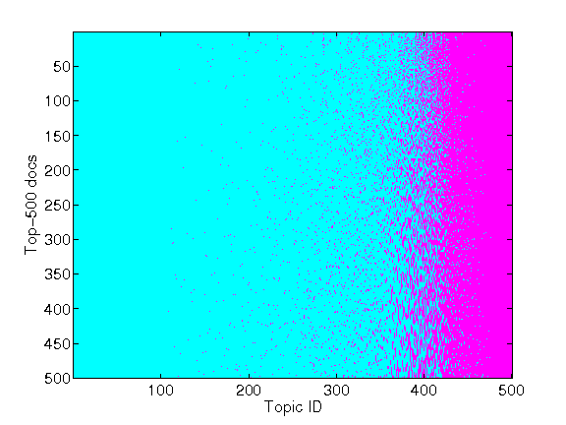
Topic model can learn unified categories
NIH-specific topics
NSF-specific topics
NIH grant
NSF grant
Topics relevant to both NIH and NSF
Topic modeling can learn categories that cut across federal funding agency boundaries
David Newman - UC Irvine

Slide 24
(51 nsf in top-500) [t90] motor movement control hand muscle task force limb pattern motion
(51 nsf in top-500) [t386] protein function modification expression target functional recombinant
(55 nsf in top-500) [t6] transfer electron heme reaction protein proton site redox mechanism
(55 nsf in top-500) [t291] children infant early age young developmental childhood adult month
(59 nsf in top-500) [t334] fluorescent cell fluorescence protein gfp imaging single microscopy
(59 nsf in top-500) [t397] protein folding structure conformational dynamic conformation
(66 nsf in top-500) [t175] african_american ethnic hispanic racial group population american
(79 nsf in top-500) [t288] genome genomic sequence sequencing dna human genomes
(82 nsf in top-500) [t274] nmr spectroscopy structure dynamic nuclear experiment magnetic_resonance
(85 nsf in top-500) [t312] human monkey primate model primates species animal rodent nonhuman
(87 nsf in top-500) [t483] visual object attention processing perception information task
(92 nsf in top-500) [t415] behavior factor behavioral relationship model individual influence
(108 nsf in top-500) [t37] health social neighborhood status family data individual level
(136 nsf in top-500) [t149] female sex male females males behavior gender differences sexual
(180 nsf in top-500) [t314] american native indian los angeles alaska tribal hawaii pacific
(183 nsf in top-500) [t180] phase commercial technology product sbir_phase market feasibility
(194 nsf in top-500) [t457] disaster safety worker emergency response transportation event
(197 nsf in top-500) [t448] language word speech linguistic reading english languages processing
(202 nsf in top-500) [t2] microscopy imaging microscope electron confocal scanning image cell
(229 nsf in top-500) [t38] evolution evolutionary genes organism species genome sequence
(266 nsf in top-500) [t259] model modeling dynamic simulation data mathematical experimental
(268 nsf in top-500) [t443] computational biological modeling system model biology experimental
(270 nsf in top-500) [t69] chemistry reaction synthesis organic catalyst metal compound chiral
(274 nsf in top-500) [t150] image images data algorithm reconstruction processing computer
(312 nsf in top-500) [t449] polymer material properties delivery release copolymer molecular
(320 nsf in top-500) [t404] software tool user data community infrastructure open system grid
(329 nsf in top-500) [t246] material composite fiber properties composites polymer strength
(342 nsf in top-500) [t349] model data statistical estimation statistic inference bayesian
(344 nsf in top-500) [t212] urban rural areas population household local migration city communities
(345 nsf in top-500) [t362] education learning curriculum educational material student evaluation
(396 nsf in top-500) [t302] particles size particle aerosol cloud distribution dust properties
(410 nsf in top-500) [t167] plasma field ion electron charge electric trap ions atom gas
(410 nsf in top-500) [t419] population genetic species variation selection natural evolution
(429 nsf in top-500) [t62] production process product chemical water processes environmental
(440 nsf in top-500) [t299] simulation computing cluster computer computational parallel system
(449 nsf in top-500) [t235] mechanical material deformation strain properties stress model
Top-500 grants relating to this “gene sequencing” topic include 79 NSF grants and 421 NIH grants
David Newman - UC Irvine

Slide 25
Ongoing research
Topic quality
  Interpretability
  Coherence
Labeling of topics
Evaluation
  Validation
  Accuracy
  Comparison against known categories
Finer-grained analysis
  Track innovation
  Identify interdisciplinary research
David Newman - UC Irvine

Slide 26
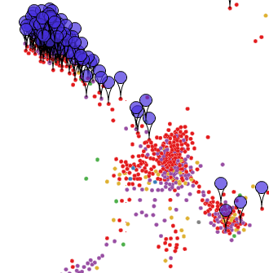
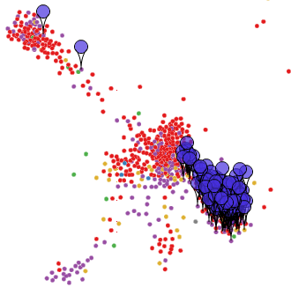
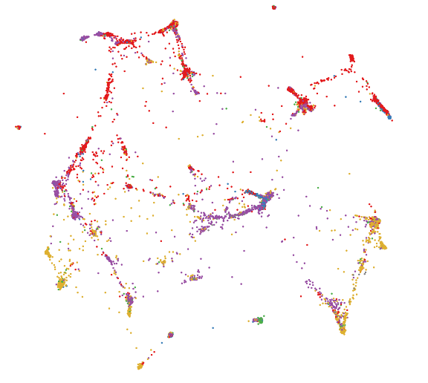
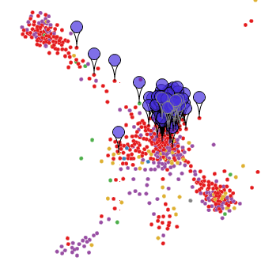
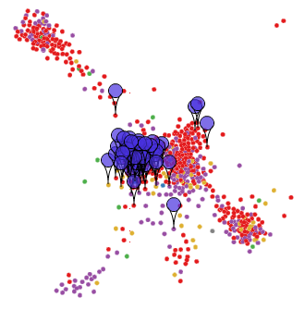
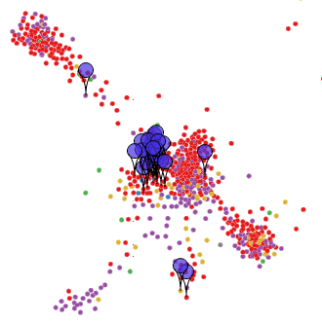
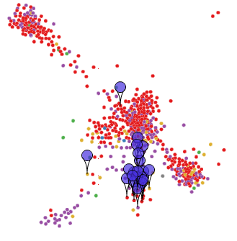
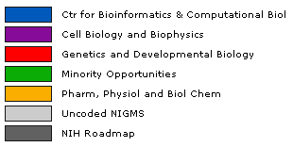
Topic models are the basis of topic maps
NIGMS Topic Map
DNA
Cell Division
Chromatin
Evolutionary Genetics
RNA
Ribosomes/tRNA
Development
Transcription
Actin Cytoskeleton
Biochemistry
Clinical Research
Membrane Cell Biology
Molecular Biophysics
Splicing
RNA Interference
Organic Chemistry
Research Training
NIGMS Program Divisions
Bioinformatics & Computational Biol
Cell Biology and Biophysics
Genetics and Developmental Biol
Minority Opportunities
Pharm, Physiol & Biol Chemistry
Micro RNA
Assay Devel
David Newman - UC Irvine

Slide 27
Conclusions
Topic models learn useful categories at multiple resolutions
Can quantify
  what was funded
  trends in funding
  provide rapid quantitative analysis
Topics learned from FullText data seem to be better than topics learned from Summary data
Recommendation: No reason not to topic model all proposals submitted to NSF
Resources (lists of learned topics)
  www.ics.uci.edu/~newman/enclave/
Grant set analyzer
  http://datalab-1.ics.uci.edu/newman/eager1/
David Newman - UC Irvine

Slide 28
Extra Slides
David Newman - UC Irvine

Slide 29
Source data in the Enclave
pdf files
  ProjSumm (1 page) approx 150,000 files
  ProjDesc (15 pages) approx 120,000 files
  CoverSheet (metadata) not used
2007, 2008, 2009, 2010
  2010 incomplete, not used in this analysis
awarded.txt list of NSF IDs that were awarded
David Newman - UC Irvine

Slide 30
Methodology
Input to topic model is bag-of-words
  convert pdf → plain txt (used linux’s pdftotext)
  apply simple tokenization (lowercase, remove punctuation, split on whitespace)
Create bag-of-words, for
  all ProjSumm files (1 page)
  all ProjDesc files (15 pages)
David Newman - UC Irvine

Slide 31
Vocabulary
Kept all term that occur > 50 times
Omitted standard stopwords (the, and, etc.)
Omitted topically-uninteresting terms from domain (study, proposal, result, intellectual, merit, broader, impact, etc.)
Produced vocabulary of 133,330 terms
David Newman - UC Irvine

Slide 32
Term frequencies
All Proposals Funded Proposals
ALL PROPOSALS AWARDED PROPOSALS
1 in 91 student | 1 in 95 student
1 in 147 system | 1 in 157 system
1 in 215 data | 1 in 207 data
1 in 218 model | 1 in 225 model
1 in 244 high | 1 in 253 high
1 in 261 undergraduate | 1 in 280 undergraduate
1 in 286 material | 1 in 302 field
1 in 309 engineering | 1 in 310 graduate
1 in 311 graduate | 1 in 312 material
1 in 326 field | 1 in 338 engineering
1 in 333 design | 1 in 340 group
1 in 349 education | 1 in 360 education
1 in 369 group | 1 in 368 design
1 in 370 develop | 1 in 407 develop
1 in 410 structure | 1 in 414 analysis
1 in 411 network | 1 in 418 network
1 in 415 information | 1 in 432 structure
1 in 429 analysis | 1 in 443 community
1 in 434 technology | 1 in 449 information
1 in 455 cell | 1 in 462 change
1 in 457 change | 1 in 475 technology
1 in 486 learning | 1 in 504 large
1 in 488 community | 1 in 540 interaction
1 in 521 large | 1 in 544 tool
1 in 523 interaction | 1 in 544 training
1 in 525 tool | 1 in 551 learning
1 in 533 training | 1 in 556 scale
1 in 535 knowledge | 1 in 559 researcher
1 in 547 experience | 1 in 560 experience
1 in 552 techniques | 1 in 568 dynamic
1 in 554 dynamic | 1 in 580 techniques
1 in 555 energy | 1 in 583 theory
1 in 556 scale | 1 in 585 activities
1 in 568 environment | 1 in 599 effort
1 in 573 effect | 1 in 601 cell
1 in 590 activities | 1 in 620 knowledge
1 in 595 control | 1 in 630 processes
David Newman - UC Irvine

Slide 33
Two representations of collection of proposals
Summary
  Collection of 115,545 proposals created from ProjSumm
  Nd = 270 words per doc avg*
  31M words total
FullText
  Collection of 115,545 proposals created by combining ProjSumm + half the words in ProjDesc (for computational efficiency)
  Nd = 1632 words per doc avg*
  189M words total
* Average words per document excludes all stopwords, numbers, etc.
David Newman - UC Irvine

Slide 34
Review of topic modeling
Topic model
  Each document is about a small number of topics (topics are like tags or subject headings)
  Topics are distributions over words that focus on a theme
    e.g. gene sequence genome expression dna genomic analysis...
Topic model is a Bayesian explanation of the text data in a collection of documents ... learned from patterns of words that tend to co-occur
David Newman - UC Irvine

Slide 35
How many topics?
Topic model was run at multiple resolutions
  T=50
  T=200
  T=400
  T=800
Note: T=50 is NOT first 50 topics of T=200 model. T=200 model has finer resolution ... different to Latent Semantic Analysis
David Newman - UC Irvine

Slide 36
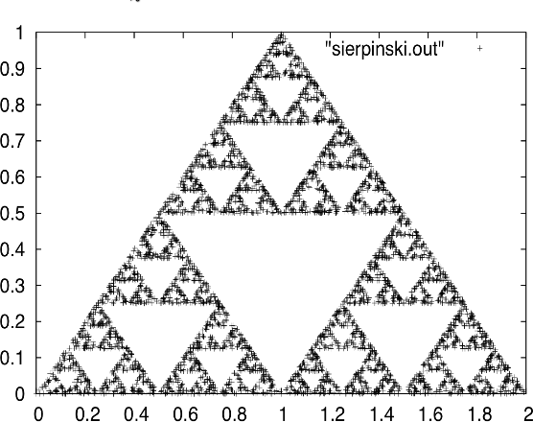
How many topics?
How many clusters?
(from: C. Faloutsos)
David Newman - UC Irvine

Slide 37
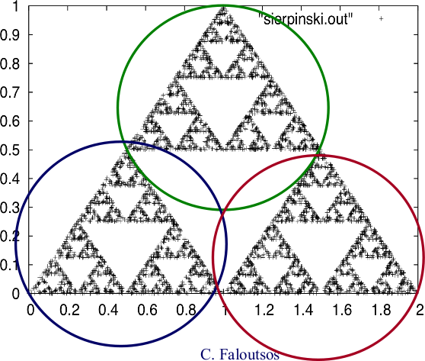
How many topics?
How many clusters?
Are there 3 clusters?
David Newman - UC Irvine

Slide 38
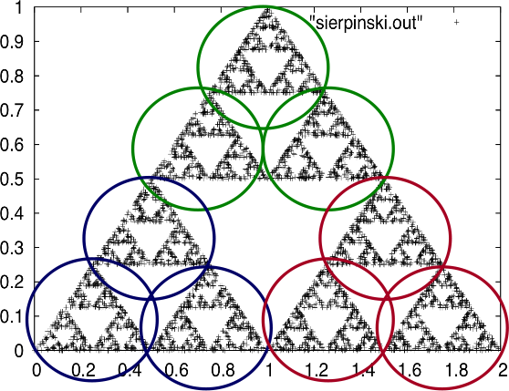
How many topics?
How many clusters?
Are there 3 clusters?
Are there 9 clusters?
David Newman - UC Irvine

Slide 39
Multi-resolution categories (Summary)
T=50
T=200
T=400
T=800
[t49] (2.02%) polymer surface material nanoparticle properties molecular membrane structure ...
[t81] (0.39%) nanoparticle particle size surface properties shell colloidal gold ...
[t203] (0.24%) nanoparticle nanomaterial size particle properties surface shell synthesis ...
[t118] (0.14%) nanoparticle particle size surface gold nps metal nanomaterial ...
David Newman - UC Irvine

Slide 40
Multi-resolution categories (FullText)
T=50
T=200
T=400
T=800
[t28] (1.99%) polymer nanoparticle particle material surface properties size solution ...
[t199] (0.50%) nanoparticle nanotechnology size nano surface nanostructure nanomaterial synthesis ...
[t222] (0.25%) nanoparticle size gold surface particle nps nanomaterial solution ...
[t650] (0.16%) nanoparticle gold size particle surface silver nanomaterial solution ...
David Newman - UC Irvine

Slide 41
Topics in one proposal (did=10101)
Summary (T=200)
FullText (T=200)
(23%) [t52] cell cellular differentiation biology culture actin
(17%) [t100] tissue bone delivery engineering drug
(8%) [t179] mechanical material mechanic properties
(8%) [t122] student graduate undergraduate training group
(8%) [t189] structure structural function properties
(19%) [t181] tissue bone scaffold collagen blood tissues
(11%) [t34] cell cellular culture differentiation adhesion type
(10%) [t150] cell actin filament microtubule protein function
(8%) [t52] strain stress mechanical deformation shear elastic
(6%) [t50] polymer chain copolymer polymerization molecular
Summary (T=800)
FullText (T=800)
(22%) [t316] tissue scaffold engineering cell biomaterial
(10%) [t102] mechanical mechanic properties elastic material
(9%) [t39] cell cellular biology culture type single intracellular
(8%) [t637] properties structure physical property relationship
(6%) [t169] cell actin filament microtubule protein cytoskeleton
(18%) [t231] scaffold hydrogel biomaterial gel tissue engineering
(11%) [t416] actin adhesion filament cell myosin cytoskeleton
(7%) [t212] mechanical elastic deformation mechanic properties
(5%) [t644] collagen tissue ecm cartilage matrix tissues fibril
(4%) [t789] cell cellular type single division intracellular living
General agreement at T=800
FullText possibly better
David Newman - UC Irvine

Slide 42
Grant-Set Analyzer
David Newman
UC Irvine
June 2010
David Newman - UC Irvine

Slide 43
Grant-Set Analyzer …
http://datalab-1.ics.uci.edu/newman/eager1/
David Newman - UC Irvine

Slide 44
… can answer these questions
How (topically) have the grants in SciSIP changed between 2007 and 2009?
What grants, for which I am not the program officer, are similar to my set of grants?
My program is Ion Channels. What topics are addressed by grants not in my program, but do mention Ion Channels?
What is the topical makeup of grants in Statistics that don't mention "Bayesian"?
What grants are related to Climate Change?
How much does NSF spend on nanotechnology and nanomaterials?
What topics do program (or program manager) X and Y have in common?
Are topics associated with EAGER and RAPID funding different from those with standard funding?
David Newman - UC Irvine

Slide 45
Topic modeling can relate and unify documents from different collections
NSF Proposals
Topic Model:
Automatically learns set of topics for any collection of documents
Labels each document with a few topics
Provides a way to relate documents from different collections
Reveals flow of ideas
Is mature technology and considered state-of-art
Is basis for this tool!
Published Scientific Literature
NSF Awards
Patents
David Newman - UC Irvine

Slide 46
Topic model learns topics from co-occurring words
Automatically Learned Topics (10 of 400):
…
t6. conflict violence war international military …
t7. model method data estimation variables …
t8. parameter method point local estimates …
t9. optimization uncertainty optimal stochastic …
t10. surface surfaces interfaces interface …
t11. speech sound acoustic recognition human …
t12. museum public exhibit center informal outreach
t13. particles particle colloidal granular material …
t14. ocean marine scientist cosee oceanography …
t15. atmospheric chemistry ozone air organic …
…
NSF Awards
(51,000)
Topic Model:
Use words from title
& abstract
Learn T=400 topics
t49
t18
t114
t305
Topic tags for each and every document
David Newman - UC Irvine

Slide 47
Topic model tags each document with a few topics
Blood flow in the microcirculation: model studies of the effect of drag-reducing additives
Many serious medical conditions, from hemorrhage to coronary artery disease to diabetes, are associated with disruptions in blood flow. It has been observed that dramatic beneficial effects on blood flow arise from addition to blood of low concentrations of very large polymer molecules known as drag-reducing additives. These polymers are so named because of their drag-reducing effects on turbulent flow, but since blood flow is not for the most part turbulent, the effects of these polymers on blood flow must have a separate origin from turbulent drag reduction. Through complementary experiments and simulations, the investigators aim to gain a fundamental understanding of the effects of polymer additives on blood flow in the microcirculation (i.e. the small blood vessels, including capillaries) …
[t49] flow fluid dynamic complex interaction experimental transport model shear hydrodynamic velocity particle …
[t18] polymer material properties chain molecular copolymer polymeric polymerization summary responsive block structure …
[t114] cell cellular biology differentiation tissue developmental organ molecular embryonic culture embryo tissues human …
[t305] medical patient health treatment care blood clinical device healthcare hospital medicine devices biomedical …
This grant has been tagged with these four topics
David Newman - UC Irvine

Slide 48
Grant-Set Analyzer is based on topics
Grant-Set Analyzer uses topics to answer:
  What topics are in this grant?
  What grants are in this topic?
  What topics are in this set of grants?
  What are similar grants?
  What are publications similar to this grant?
  …. and more …
David Newman - UC Irvine

Slide 49
Grant-Set Analyzer – Screen 1 of 3 (search results)
David Newman - UC Irvine

Slide 50
Grant-Set Analyzer – Screen 2 of 3 (grant detail)
David Newman - UC Irvine

Slide 51
Grant-Set Analyzer – Screen 2 of 3 (grant detail … cont)
David Newman - UC Irvine

Slide 52
Grant-Set Analyzer – Screen 3 of 3 (topic detail)
David Newman - UC Irvine

Slide 53
Topic models are the basis of topic maps
NIGMS Topic Map
DNA
Cell Division
Chromatin
Evolutionary Genetics
RNA
Ribosomes/tRNA
Development
Transcription
Actin Cytoskeleton
Biochemistry
Clinical Research
Membrane Cell Biology
Molecular Biophysics
Splicing
RNA Interference
Organic Chemistry
Research Training
NIGMS Program Divisions
Bioinformatics & Computational Biol
Cell Biology and Biophysics
Genetics and Developmental Biol
Minority Opportunities
Pharm, Physiol & Biol Chemistry
Micro RNA
Assay Devel
David Newman - UC Irvine

Slide 54
Questions – All feedback is welcome!
Search
  Which particular search functionalities were useful? What would you add?
Display
  What screens were the most useful?
  How would you use such a tool? What questions would you answer with such a tool?
  What (other) displays would be useful? What comparisons would be useful?
  Was the link to CiteSeer pubs useful?
Topics
  Were topics too fine? To broad?
  Do you trust the topics? Would you like the topics labeled?
  Do you understand what is being computed?
David Newman - UC Irvine

Slide 55
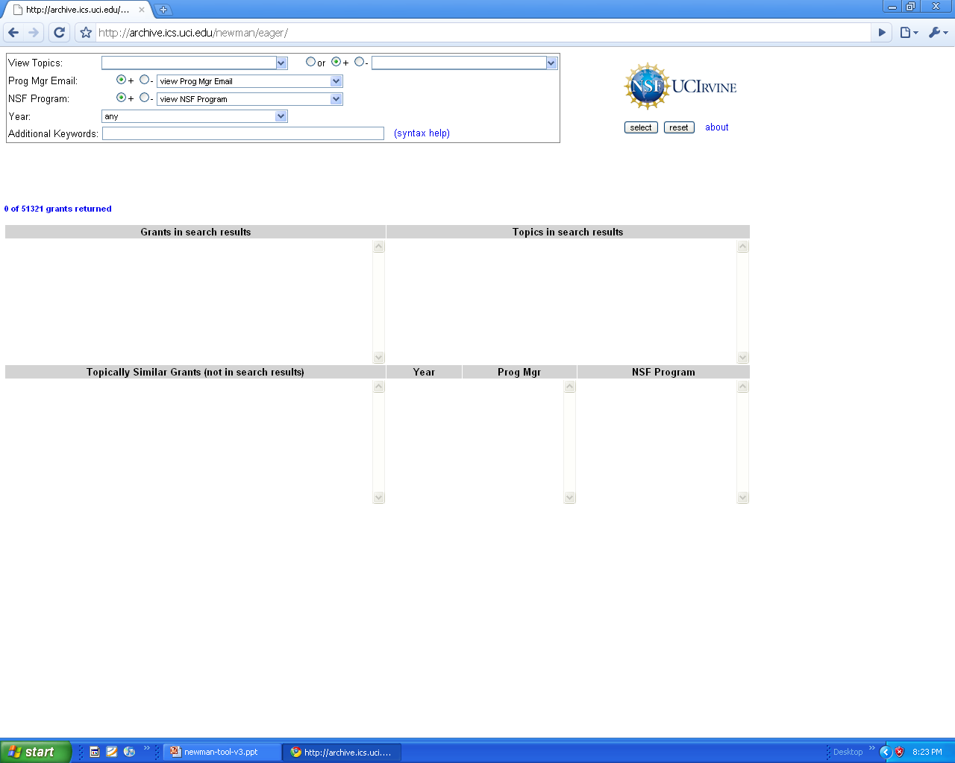
David Newman - UC Irvine

Slide 56
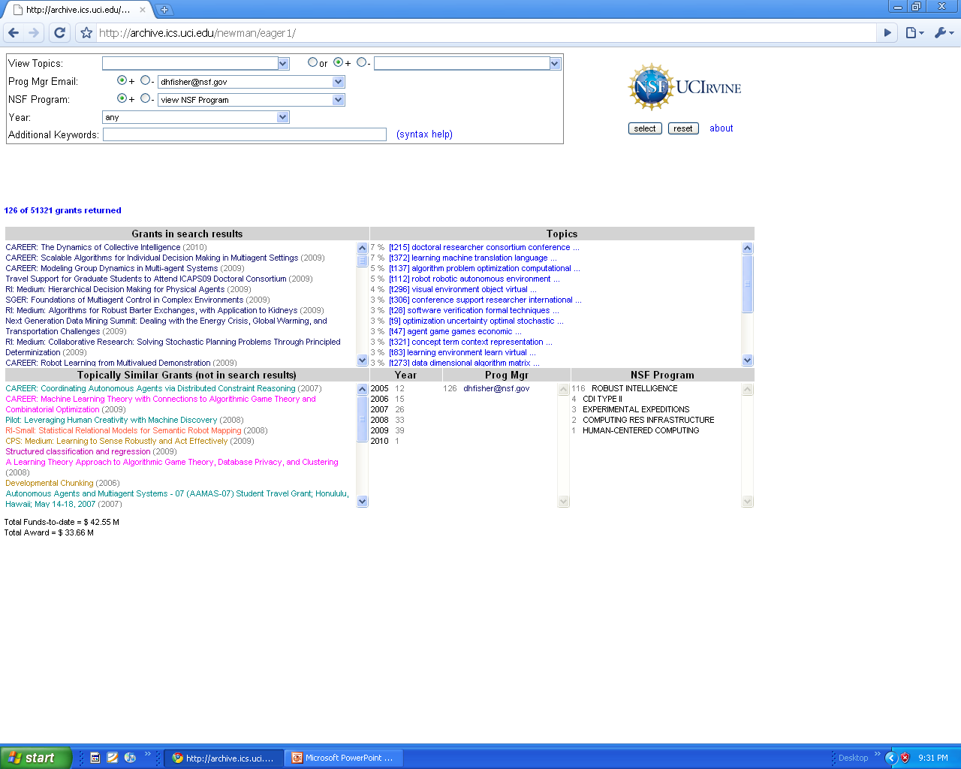
1. Select Prog Mgr
2. Grants in search results
3. Topics in search results
4. Grants NOT in search results, but topically related
David Newman - UC Irvine

Slide 57
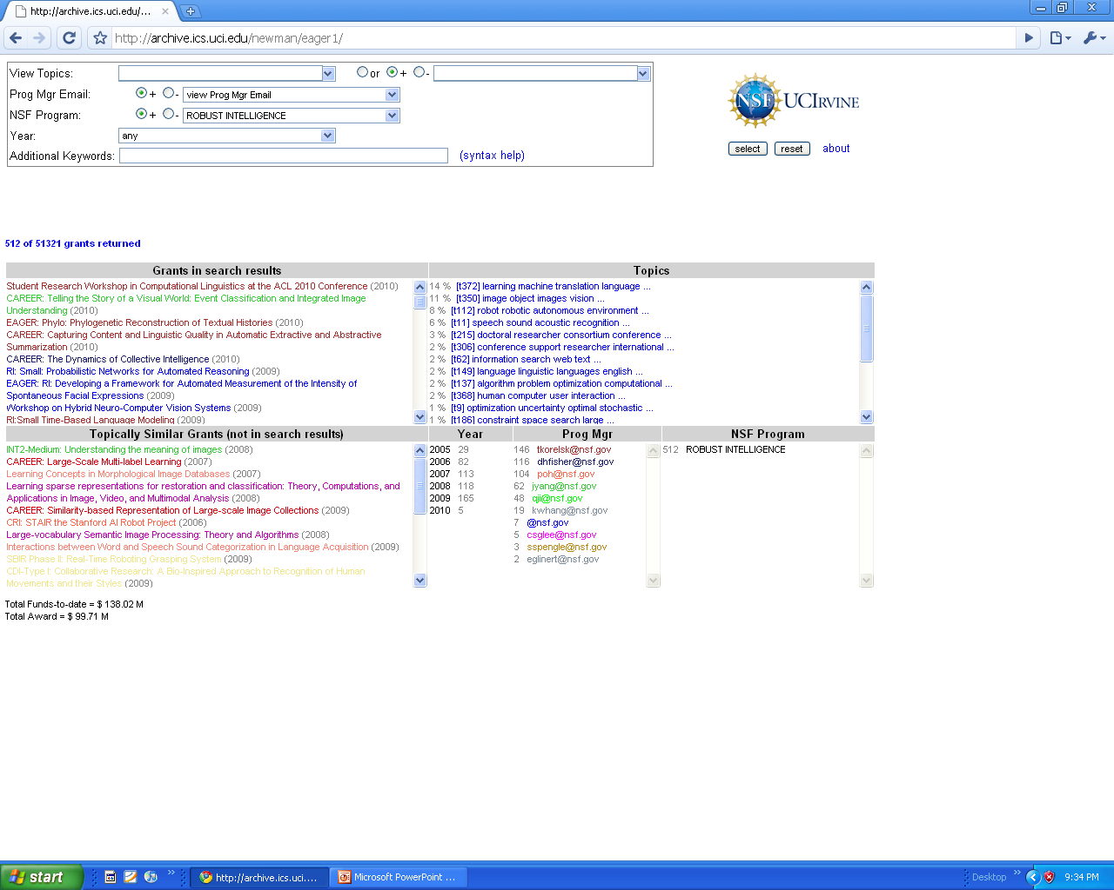
1. Select NSF Program
2. Click on grant
David Newman - UC Irvine

Slide 58
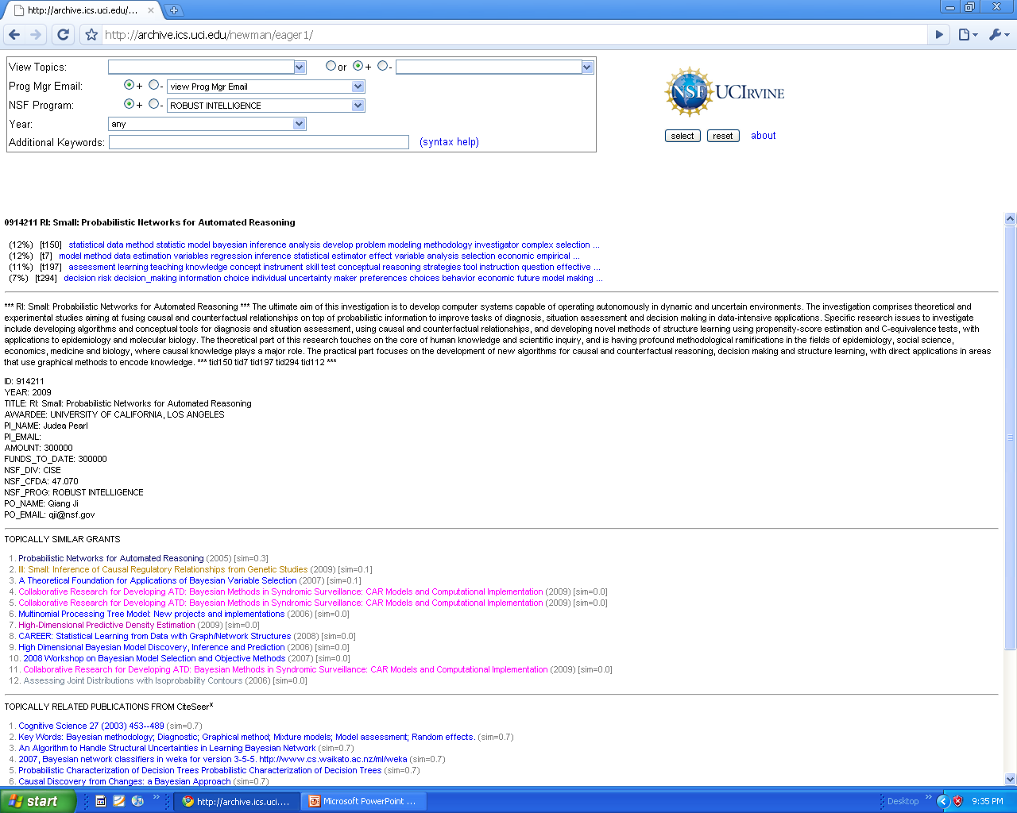
1. Topics in grant
David Newman - UC Irvine

Slide 59
2. Similar grants
3. Similar articles from CiteSeer^{x}
4. Click on topic
David Newman - UC Irvine

Slide 60
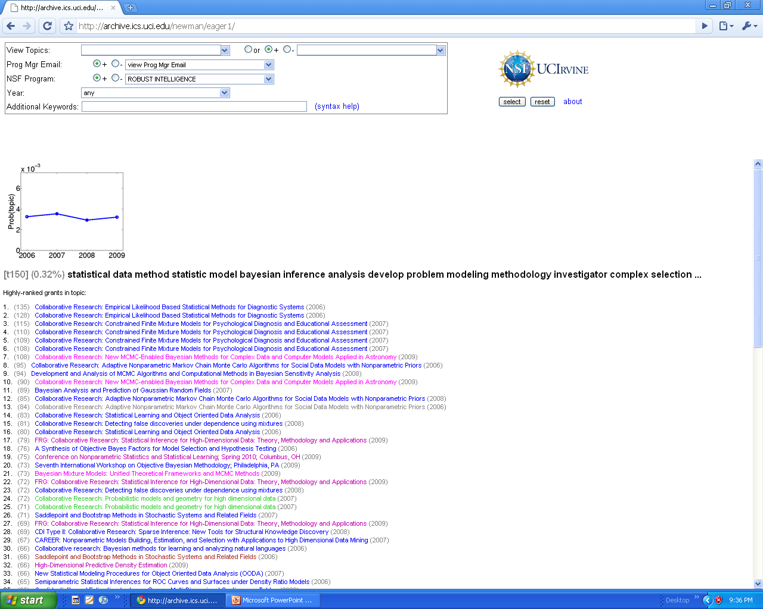
1. Topic trend
2. Top-ranked grants in topic
David Newman - UC Irvine

Slide 61
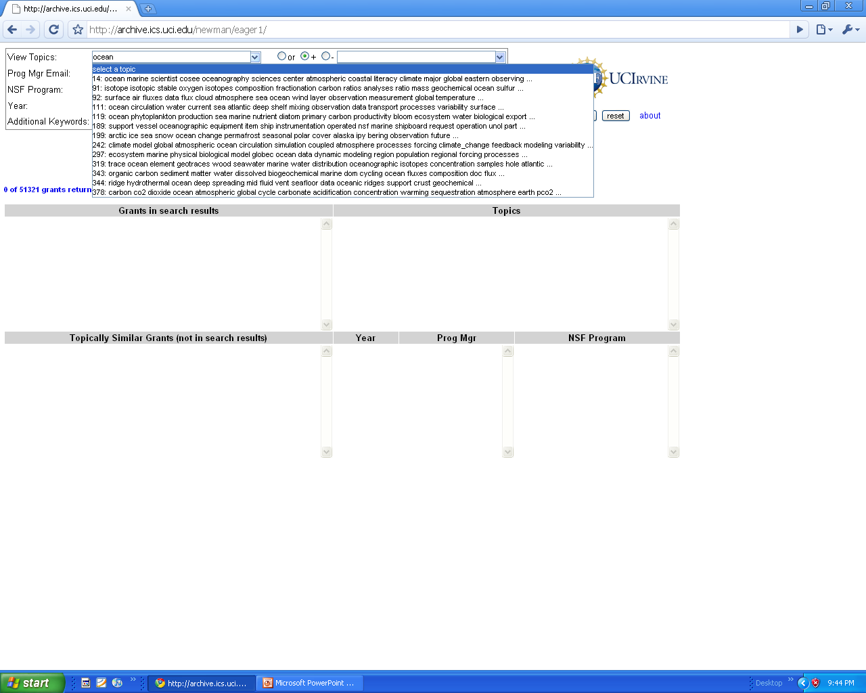
1. Type keyword to find topics that include keyword
David Newman - UC Irvine

Slide 62
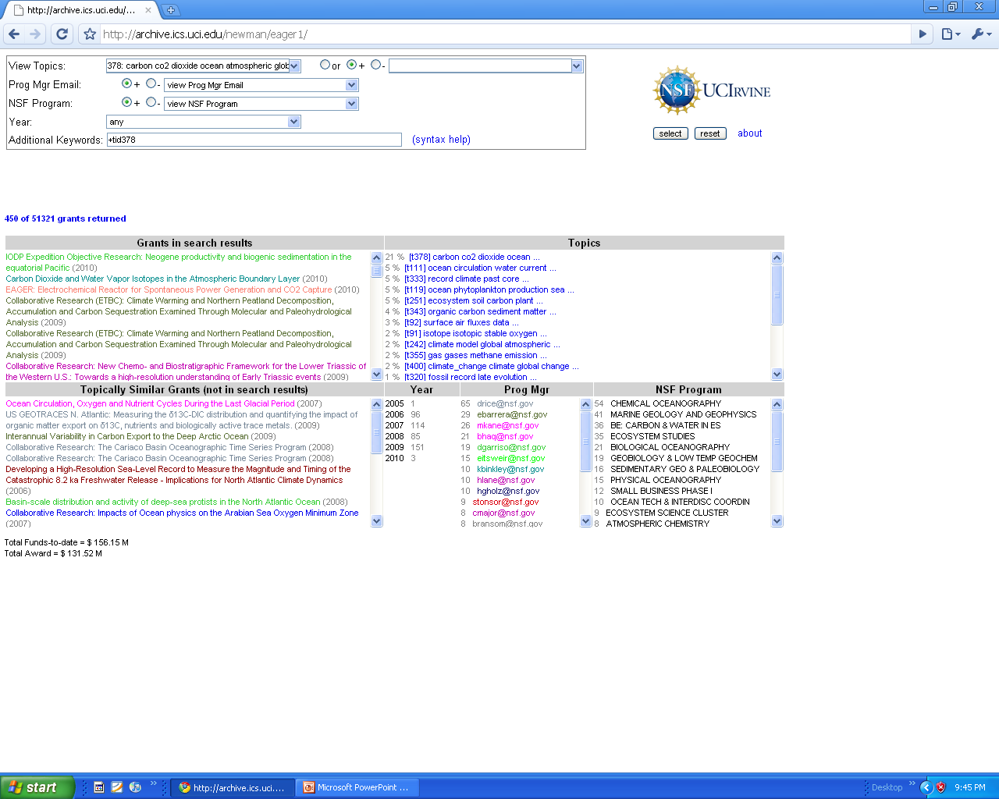
1. Select topic, show grants that have that topic
David Newman - UC Irvine

Slide 63
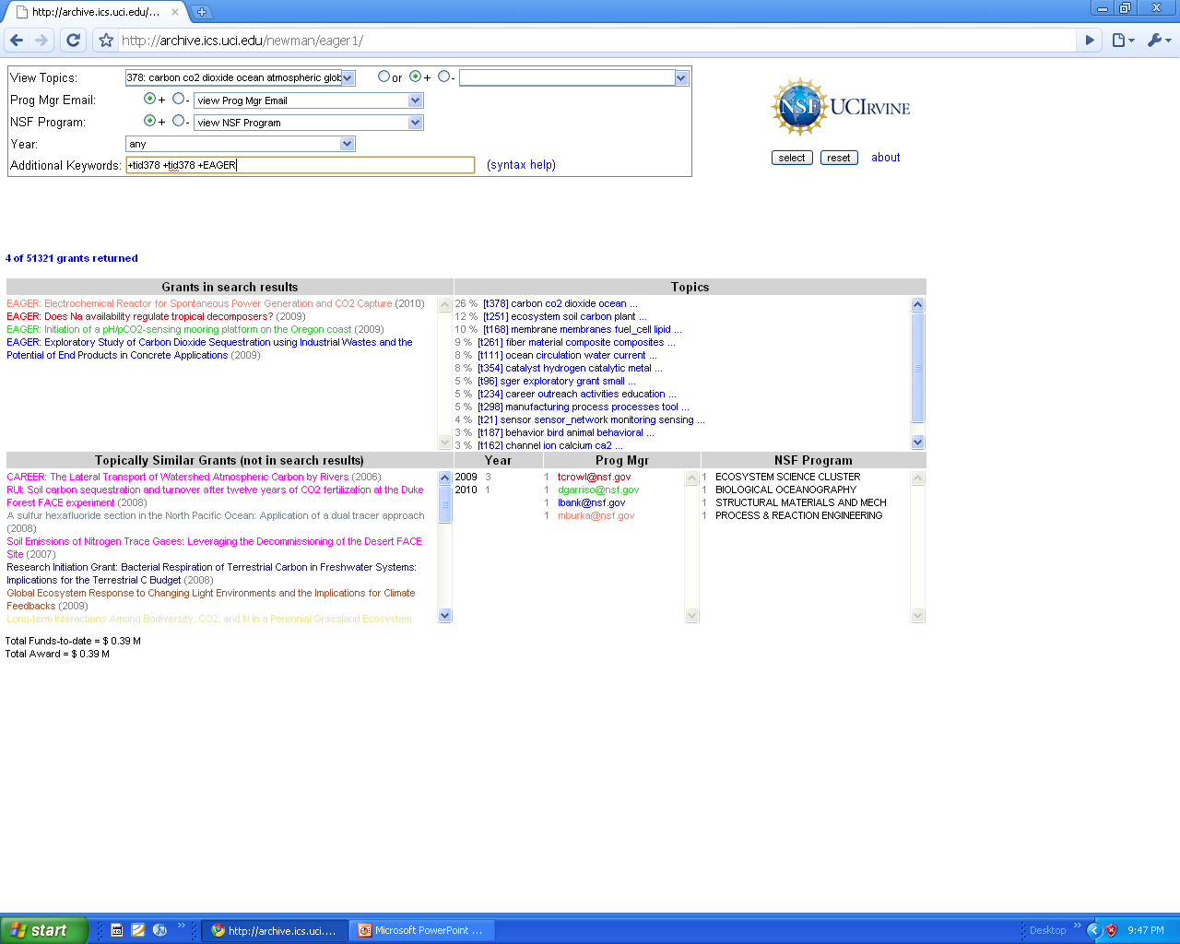
1. Of those grants, show ones that contain ‘EAGER’
David Newman - UC Irvine

Slide 64
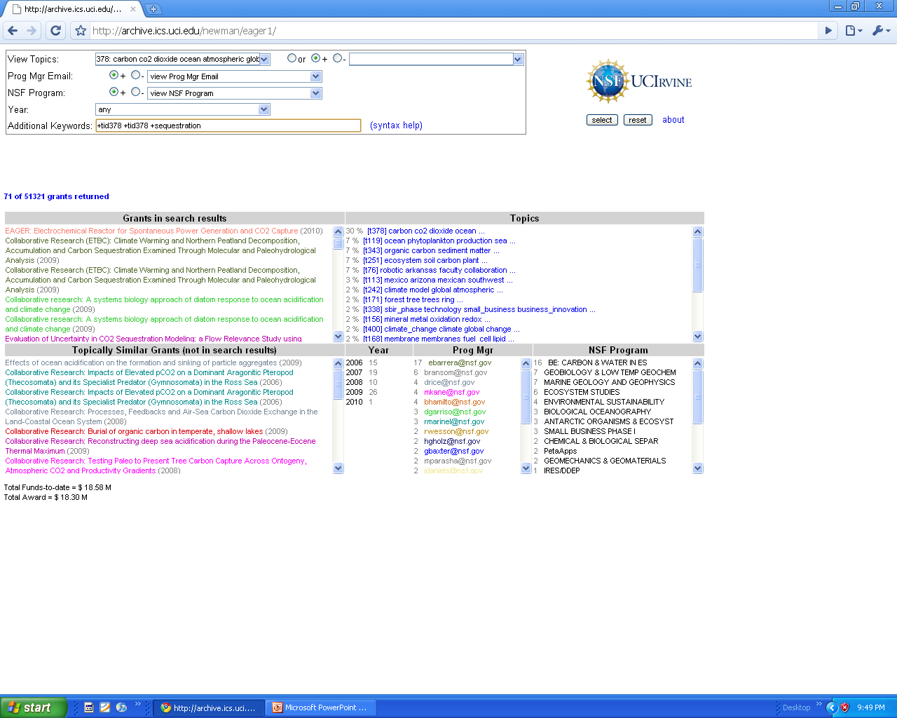
1. Of those grants, show ones that contain ‘sequestration’
David Newman - UC Irvine

