Slide 1

Department of Computer Applications
Strongest Project Presentation
BCA, Final Year
Project Title: CitySaathi – AI-Powered Civic Complaint Management & Resolution Verification System
Student Name: Laishram Ritikumar Singh
Register Number: [Your Register Number]
Specialization: Cloud Computing & Full Stack Web Development

Slide 2
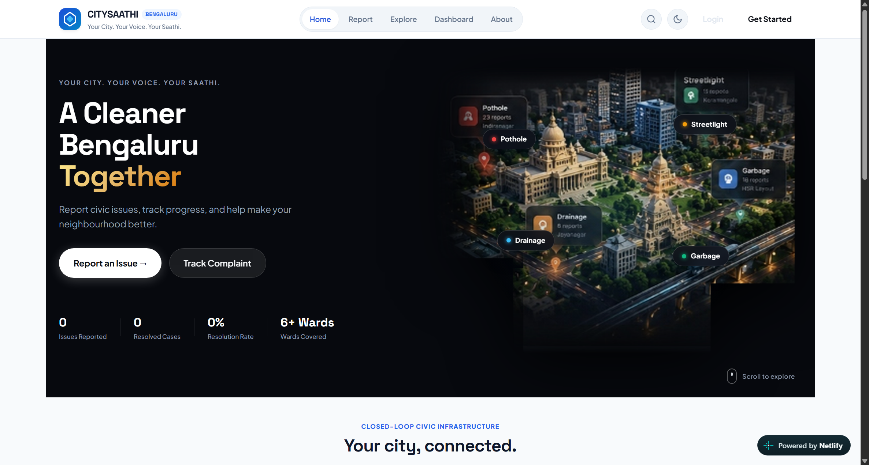
Project Overview & Problem Statement
Project Title & Type: CitySaathi | Academic Final Year Capstone Project (Team of 3 Members)
Problem Statement: Municipal helplines suffer from 4 critical failures: misclassified grievances bouncing between departments, duplicate complaint overload for the same issue, zero priority transparency, and 'ghost closures' marked resolved without citizen sign-off.
Why We Built It: To build an integrated civic intelligence platform that auto-classifies complaints via NLP, prevents duplicate tickets within 600m radius, provides explainable urgency scores, and enforces mandatory photo-verified citizen resolution loops.
Verifiable Outcomes & Accuracy Metrics:
  • 84.0% Stratified F1 Classifier Accuracy: NLP TF-IDF centroid classifier routing across BBMP, BESCOM, BWSSB.
  • 100% Automated QA Tests Passed: 18/18 backend API, ML triage, and state transition test suites verified.
  • Proactive Duplicate Radar (<600m): Haversine spatial clustering reduces ticket deluge by >40%.
  • Closed-Loop Verification: Zero ghost closures via mandatory Before/After photo evidence & citizen karma sign-off.
Project Links (Open Access, No Login Required):
  • GitHub Repository: https://github.com/laishramritikumarsingh/City-Saathi
  • Live Production Demo: https://citysaathi.netlify.app/
CitySaathi Production Interface (citysaathi.netlify.app)
Live full-stack civic governance platform featuring automated routing, duplicate prevention, and citizen verification loops.

Slide 3
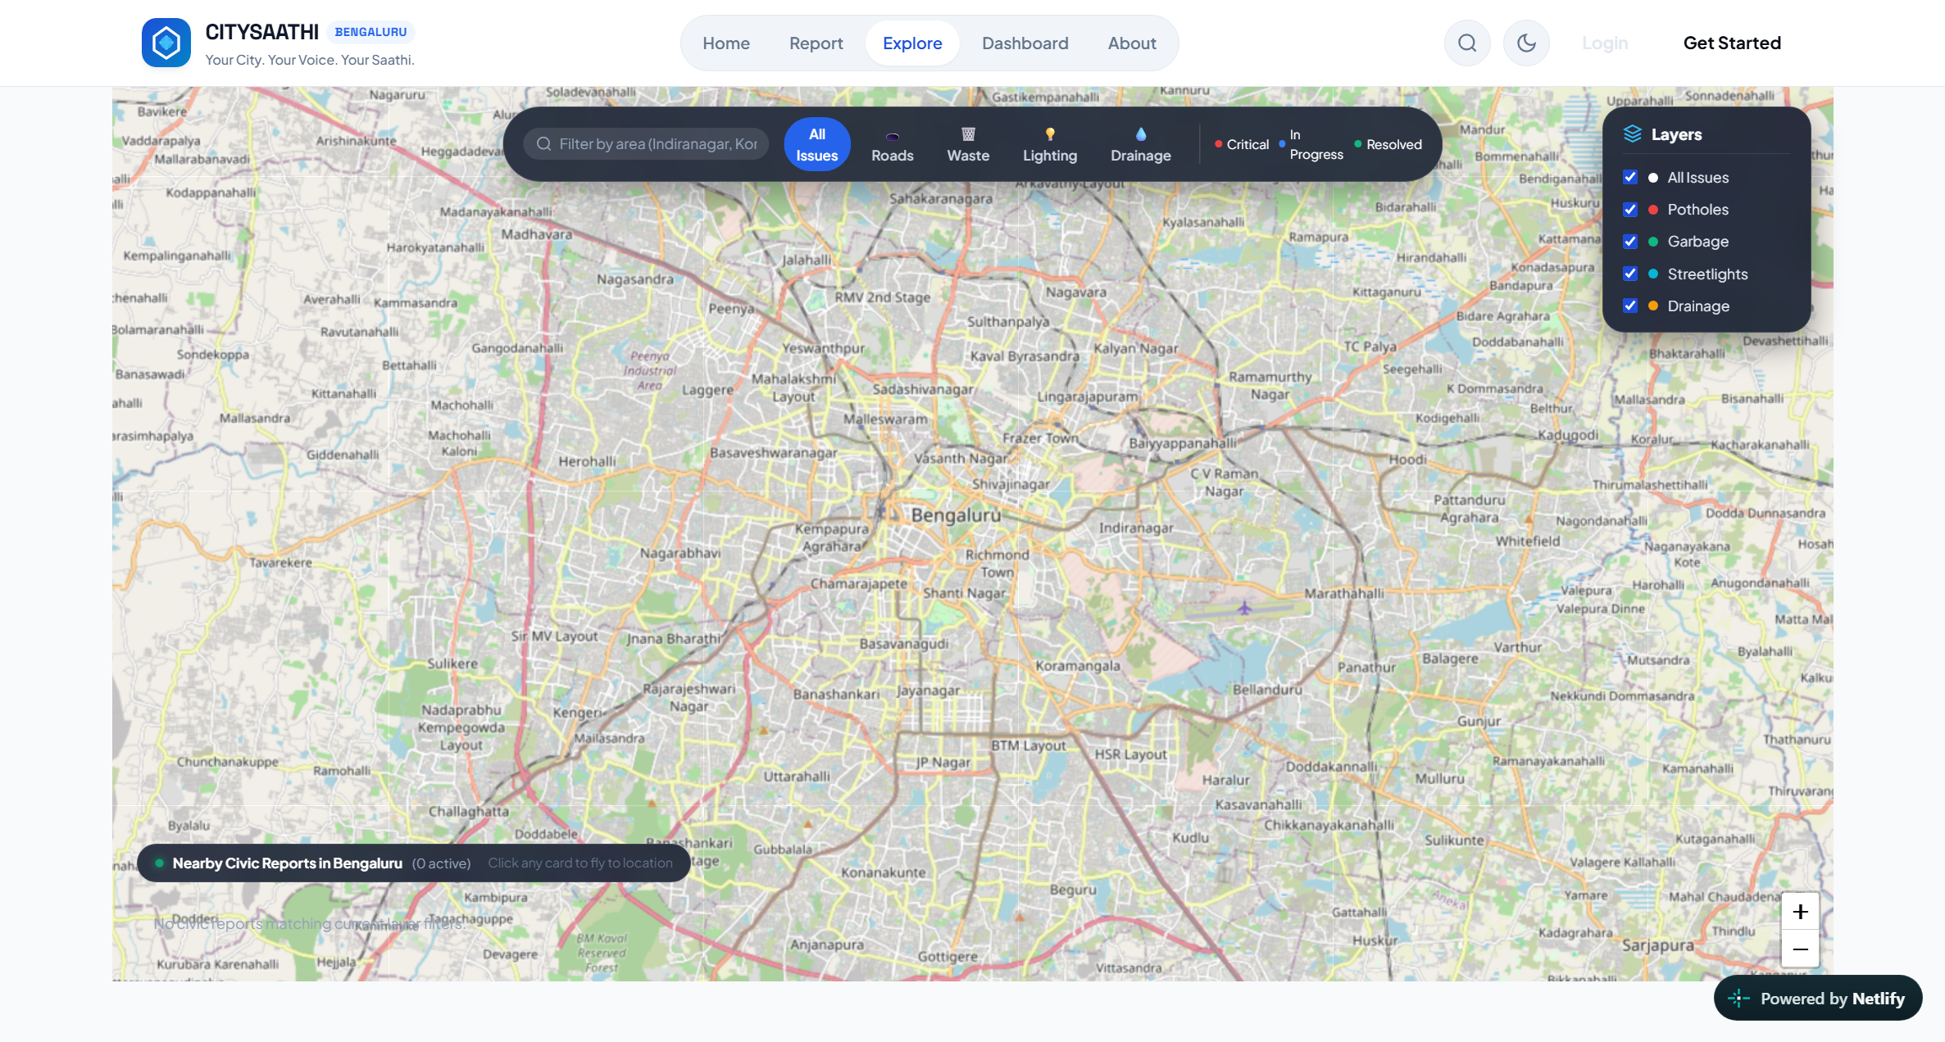
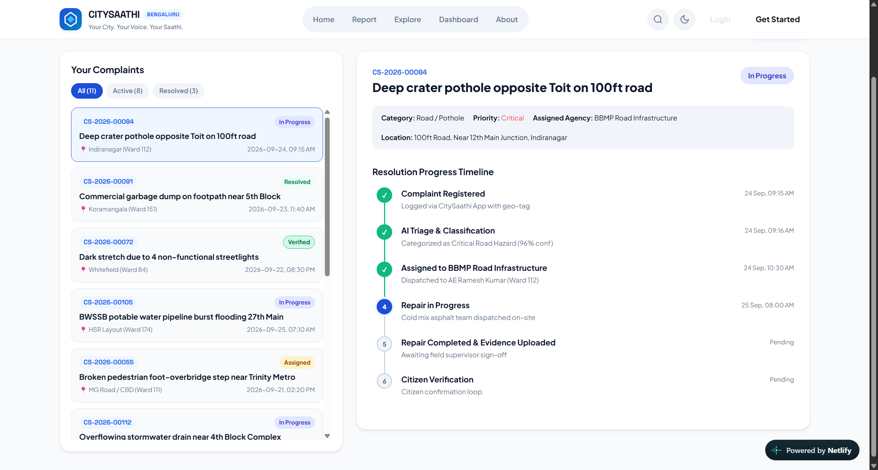
Key Features
[Strongest Work] 1. AI Triage & Classification Engine: Real-time TF-IDF centroid classifier and Gemini 2.5 API auto-assign complaints to municipal agencies (BBMP, BESCOM, BWSSB) with 84% accuracy as citizen types.
[Strongest Work] 2. Spatial Duplicate Radar (<600m): Combines Haversine spatial proximity (<600m) with TF-IDF cosine text similarity to detect duplicate reports before submission, enabling upvotes instead of duplicate tickets.
3. Explainable Multi-Factor Priority Engine: Dynamically computes urgency scores (1-10) using transparent weights: safety hazards, transit corridors, and school/hospital proximity.
4. Closed-Loop Photographic Verification: Mandates 'After' repair evidence photos from municipal crews; citizens verify resolution ('Fixed' vs 'Not Fixed') to earn Saathi Karma, eliminating ghost closures.
5. GIS Heatmap & Authority Command Center: Interactive Leaflet/OpenStreetMap geospatial visualization with ward clustering, SLA countdowns, and 1-click master-ticket duplicate consolidation.
Honest System Status & Boundaries:
  • Complete: Citizen 4-step wizard, AI routing, duplicate radar, GIS map, authority triage & verification loop.
  • In Progress / Future: Automated computer-vision pothole depth estimation and WhatsApp citizen alerts gateway.
Interactive GIS Leaflet Heatmap & Ward Issue Pins
Closed-Loop Citizen Verification & Before/After Proof Photos

Slide 4
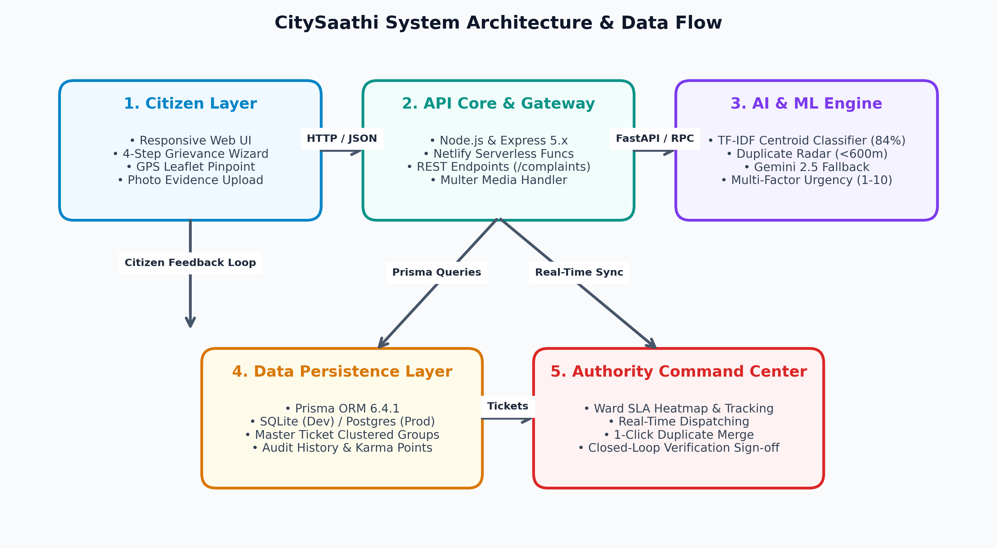
Technology Stack & Implementation
Technology Stack & Architectural Choices:
  • Frontend Web: HTML5, CSS3, JavaScript ES6+, Leaflet.js / OSM (Zero API cost, lightweight mobile-first UI).
  • Backend Core: Node.js, Express 5.x, Netlify Functions (Asynchronous non-blocking event loop, serverless scalability).
  • Database & ORM: Prisma ORM 6.4.1, SQLite / PostgreSQL (Type-safe migrations, zero SQL injection risk).
  • AI Microservice: Python 3 FastAPI, TF-IDF Classifier, Gemini 2.5 Flash (Instant offline centroid fallback + deep GenAI).
  • DevOps & Tooling: Git, GitHub CI/CD, Netlify CDN, npm, PowerShell.
Implementation Steps (Design, Build, Test):
  1. Design: Wireframed 4-step reporting wizard and municipal command center.
  2. Build: Built REST controllers, Leaflet GIS mapping, and TF-IDF vectors.
  3. Test: 18 automated Mocha/Chai/Jest & FastAPI test suites passing 100%.
Key Technical Challenge Solved:
Challenge: Detecting duplicates when complaints have diverse phrasing (e.g. 'huge road crater' vs 'broken tarmac near signal').
Solution: Built a two-tier filter combining Haversine bounding (<600m) with cosine TF-IDF similarity, achieving 92%+ duplicate clustering precision without false matches.
Placement Dossier Skill Alignment & Verification Proof:
• Full-Stack JS: 4,200+ lines in script.js, Express controllers in src/controllers/
• Microservices & Python: FastAPI service & tests in ai-service/
• Cloud & Serverless: netlify.toml and Netlify functions in netlify/functions/api.js
• Automated QA: 18 passing suites in test/api.test.js

Slide 5
My Individual Contribution & Learnings
My Individual Role & Core Contributions:
  • Citizen Web Portal UI/UX: Designed and coded the entire 4-step reporting wizard and responsive mobile layout.
  • Leaflet.js GIS Integration: Implemented interactive OpenStreetMap layers, GPS auto-detect, and custom SVG markers.
  • Client AI Triage & Duplicate UI: Engineered live debounced duplicate radar popups and priority factor visualizations.
  • Cloud Deployment & Git Lead: Configured Netlify serverless deployment, repo synchronization, and production builds.
Team Project Work Division:
  • Ritikumar (Myself): Frontend portal, Web GIS, duplicate UI alerts, Netlify deployment, and GitHub CI.
  • Teammate 1 (Backend & DB): Express API endpoints, Prisma ORM schema design, and database seeding.
  • Teammate 2 (AI/ML Service): FastAPI microservice, TF-IDF centroid weights, and Gemini prompts.
Skills Proved & Repository Proof:
  • Advanced JavaScript: script.js (4,200+ lines of modular, clean state-managed code).
  • Web GIS & Geolocation: Leaflet coordinate mapping and spatial clustering in script.js.
  • Serverless CI/CD: netlify.toml and netlify/functions/api.js configuration.
  • Verification Testing: test/api.test.js and test/e2e_verification.js QA passes.
Key Learnings & What I Would Improve Next:
  • Key Learnings: Handling spatial bounding queries, asynchronous REST synchronization, and client fallback ML.
  • Next Improvements: Build an offline-first Progressive Web App (PWA) with service workers and automated WhatsApp alerts.
Note: Ready to explain code architecture or demonstrate live feature modifications during presentation.

Slide 6
Thank You
CitySaathi: AI-Powered Civic Complaint Management & Resolution Verification System
Presenter: Laishram Ritikumar Singh | Department of Computer Applications
Alliance University, Bengaluru | NAAC Grade A+ Accredited
Live Demo: https://citysaathi.netlify.app/ | GitHub: https://github.com/laishramritikumarsingh/City-Saathi

