Slide 1
Tập 1: Tán tỉnh ng2
Cài đặt và chạy chương trình
Customize 1 chút

Slide 2

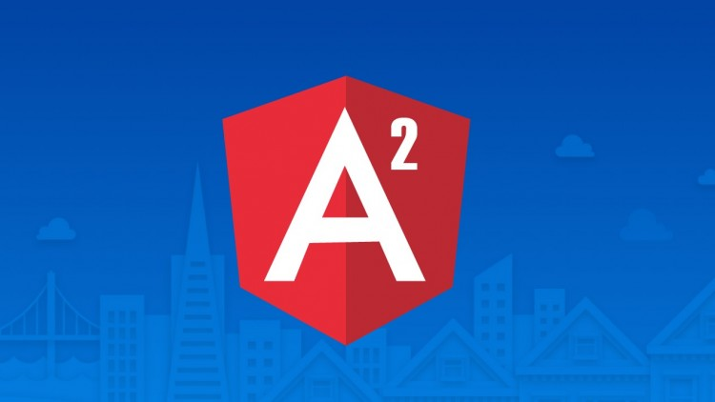


Why ng2 ?
Simplicity
Productivity
Separation of concerns
Use of TypeScript
DI
Reactive programming style
Open Source
Community
ES5
ES6
No Types
Types
http://angular.io

Slide 3
1. npm: node package manager 2. node: ~ browser (server) 3. VSCode: editor (Webstorm) 4. Typescript? Javascript type ~ java (int, long,String, ….) superset 5. ng2? SPA (single page app) ~ RIA 6. semver:

Slide 4
1. Module loader: SystemJS, AMD, UMD (define, require) 2. preboot vs fastboot (SPA) 3. Con duong: https://github.com/AngularClass/awesome-angular2

Slide 5
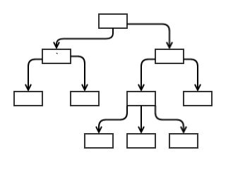
ng2 Component
One of Angular’s building blocks
Enables having reusable UI
Tree structure

Slide 6
for product of products (for index in products) pipeline? Avoid state change.

Slide 7
ng Module
@NgModule({
imports: [
BrowserModule,
HttpModule,
RouterModule.forRoot([
{ path: 'welcome', component: WelcomeComponent },
{ path: '', redirectTo: 'welcome', pathMatch: 'full' },
{ path: '**', redirectTo: 'welcome', pathMatch: 'full' }
]),
ProductModule
],
declarations: [
AppComponent,
WelcomeComponent
],
bootstrap: [ AppComponent ]
})
app.module.ts

Slide 8
ng Routing
<router-outlet></router-outlet>
app.component.html
import { provideRouter, RouterConfig } from '@angular/router';
const routes: RouterConfig = [ { path: 'login', component: LoginComponent }, { path: 'chat', component: ChatComponent }
];
export const appRouterProviders = [provideRouter(routes)];
app.routes.ts

Slide 9
Binding
Component
{{value}}
DOM
Template binding (one-way)
[property]=“value”
Event binding (one-way)
DOM
(event)=expression
Component
DOM
[prop]=expression
Component
Property binding (one-way)
Component
[(value)]* = “expression”
*[()] banana in a box
DOM
Two way binding

