Slide 1
Practical Java EE 5 Presentation Layer Technologies
Module 5: Apache Tomcat
Notes:
Module Duration: 2 hours and 10 minutes
(This time does not include the optional crossword activity of 10 minutes.)
Focus: Module 4: Java EE Presentation Layer Technologies
Content: N/A
Note to Instructor: N/A
Transition: Let’s look at the course map.

Slide 2
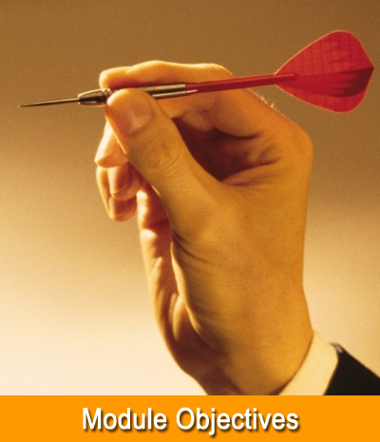
Objetivos do Módulo
Ao completar este módulo você saberá:
Entender o que é um Servidor de aplicações
Entender o que é um Servlet Container.
Instalar o Tomcat.
Notes:
Focus: Module Objectives
Content: N/A
Note to Instructor: Briefly review the module objectives with participants.
Transition: Let’s review the agenda for this module.

Slide 3

Agenda
Servidor de Aplicação
Servlet Container
Instalação do Tomcat
Integração do Tomcat com o Eclipse
Notes:
Topic Duration: 20 minutes
Focus: Agenda
Content: N/A
Note to Instructor: This is just a brief reminder of where you are in the module. It will help the participants to know what is coming up.
Transition: Let’s begin with the introduction to Java EE UI Technologies.

Slide 4
Servidor de Aplicação
Java EE é um grande conjunto de especificações
Para utilizar o JAVA EE é necessário usar uma implementação dessas especificações
O servidor de aplicação é uma implementação que tem papel de servir sua aplicação para auxiliá-la com serviços de infraestrutura
Servidores de aplicação implementam as especificações do java, como Java EE 5, Java EE 6, etc
Alguns softwares implementam apenas uma parte dessas especificações do Java EE, como por exemplo o Apache Tomcat
Notes:
Focus: Java EE UI Technologies – An Introduction
Content: N/A
Note to Instructor: N/A
Transition: Let’s look at the Application Client.

Slide 5
Servlet Container
Especificações Java EE para desenvolvimento WEB
Servlet
JSP
JSTL
JSF
Servlet Container é um servidor que suporta essas especificações, mas não necessariamente o Java EE completo
O Apache Tomcat é o servlet container mais famoso do mercado, ele não é um container EJB.
Notes:
Focus: Application Clients
Content: N/A
Note to Instructor: N/A
Transition: Let’s learn more about Application Client.

Slide 6
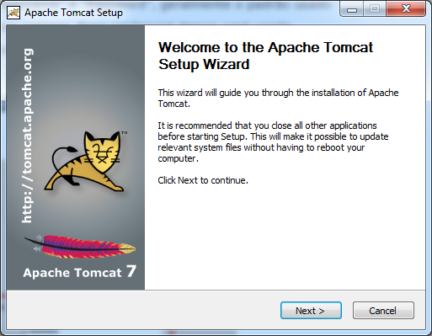
Instalação do Tomcat
Execute o apache-tomcat-7.0.59 que se encontra na pasta ambiente
Notes:
Focus: Examples of Application Clients
Content: N/A
Note to Instructor: N/A
Transition: Let’s now learn about the Web Client.

Slide 7
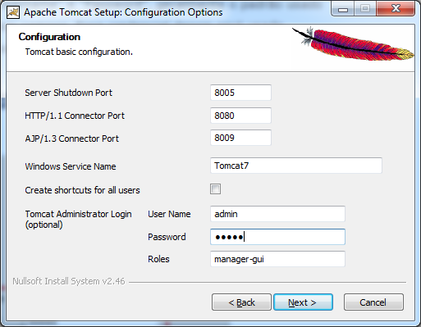
Instalação do Tomcat (Cont.)
Aperte next até chegar na tela abaixo
Aqui é configurado as portas de acesso, usuário e senha, a porta padrão é 8080, altere apenas o user name e password
Notes:
Focus: Web Clients
Content:
The Dynamic page is generated on the server-side in presentation tier.
The Generated page is rendered on the client-side by the Web browser.
Note to Instructor: N/A
Transition: Let’s look at the Java EE Web Application Model.
AFP-J Note:
Applet: Applet is java EE compliant.

Slide 8
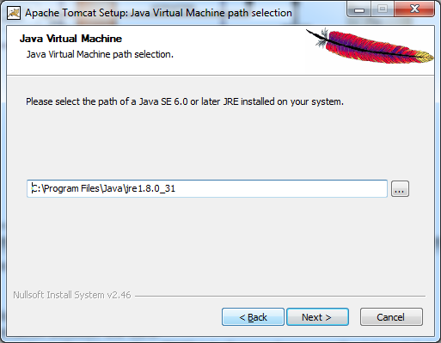
Instalação do Tomcat (Cont.)
Na tela abaixo, aponte para a instalação do java
Notes:
Focus: Java EE Web Application Model
Content: The model shows:
How to connect UI technology to application server.
Different types of Communication between the tiers.
RMI denotes the Java remote method invocation (RMI) interface and run over the internet Inter-Orb Protocol (IIOP), which delivers Common Object Request Broker Architecture (CORBA).
RMI-IIOP was developed by Sun Microsystems and IBM, combining the best features of Java RMI technology with the best features of CORBA technology.
HTTP (Hypertext Transfer Protocol) is an application protocol that runs on top of the TCP/IP. HTTP is used for transferring files text, graphic images, sound, video, and other multimedia files on the World Wide Web.
HTTPS (Hypertext Transfer Protocol Secure) provides encryption and secures identification of the server and is often used for sensitive transactions in corporate information systems on the World Wide Web such as payment transactions.
Normally the external client is before the firewall due to security reasons, and the internal client is after firewall.
Note to Instructor: N/A
Transition: Let’s take an overview of Java EE UI technologies.
AFP-J Note:
EJB: EJB 2.0 Persistent API and Java Persistent API are Java EE technologies. EJB 2.0 Persistent API is part of J2EE framework which is the older version of Java EE framework. EJB 2.0 Persistent API is similar to Java Persistence API.

Slide 9
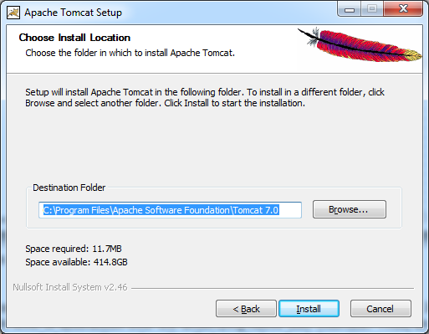
Instalação do Tomcat (Cont.)
Na tela abaixo, escolha o local de instalação
Notes:
Focus: Java EE UI Technologies – An Overview
Content:
AWT is part of the Java Front Controller (JFC). It provides a standard API for developing GUIs for Java programs. AWT initially provided a very thin level of abstraction over the underlying native user interface. Thus, an AWT check box would allow AWT to directly call the underlying native subroutine that created a check box. However, a check box on Microsoft® Windows® is not exactly the same as a check box on Macintosh Operating System (MAC OS) or on the various types of UNIX.
Swing is also a part of JFC. Swing widgets provide more sophisticated GUI components. Swing components can change their appearance based on the current 'look-and-feel' library that is being used. Lightweight components have slower execution, but the advantage is their uniformity across all platforms.
Note to Instructor: Click to reveal the description of the Java EE UI technology (Swing).
Explain the content on the slide in reference to the information in the Content row above.
List out the packages to the participants:
java.awt.*;
javax.swing.*;
Share following references with participants (also provided in the topic ‘References’ for this module):
AWT: http://java.sun.com/developer/onlineTraining/awt/contents.html
Swing: http://java.sun.com/docs/books/tutorial/uiswing/start/index.html
Reference(s): http://en.wikipedia.org/wiki/Abstract_Windowing_Toolkit & SWING
Transition: Let’s look at the comparison between AWT and Swing.

Slide 10
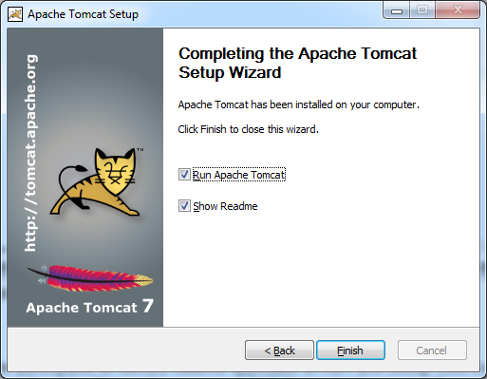
Instalação do Tomcat (Cont.)
Tela final
Notes:
Focus: Comparison between AWT and Swing in Java EE UI Technologies
Content: N/A
Note to Instructor: Prompt the participants to identify features applicable to AWT and Swing. Click to reveal the answers. Explain the content in the table on the slide. Discuss the process of AWT/Swing development with examples of tools.
Transition: Now that we have come to the end of this topic, we'll complete a checkpoint question to test your understanding of the content covered here.

Slide 11
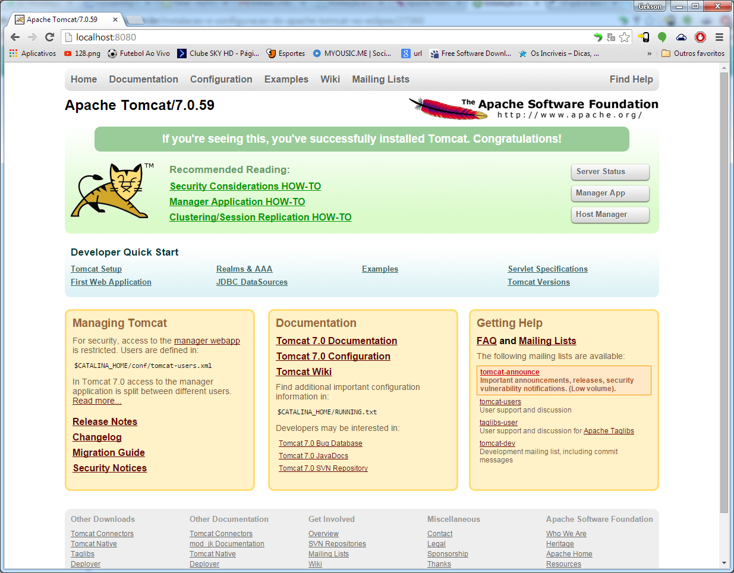
Instalação do Tomcat (Cont.)
Testando a instalação: http://localhost:8080/
Notes:
Focus: Checkpoint Question
Content: N/A
Note to Instructor: N/A
Transition: Let’s look at the answer.

Slide 12
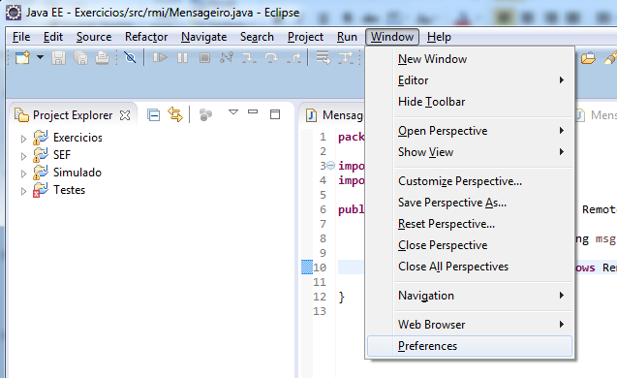
Integração do Tomcat com o Eclipse
No Eclipse, acesse o menu Window -> Preferences
Notes:
Focus: Questions and Comments
Content: N/A
Note to Instructor: Ask participants for any questions or comments they may have.
Transition: Let’s review the agenda for the next topic in this module.

Slide 13
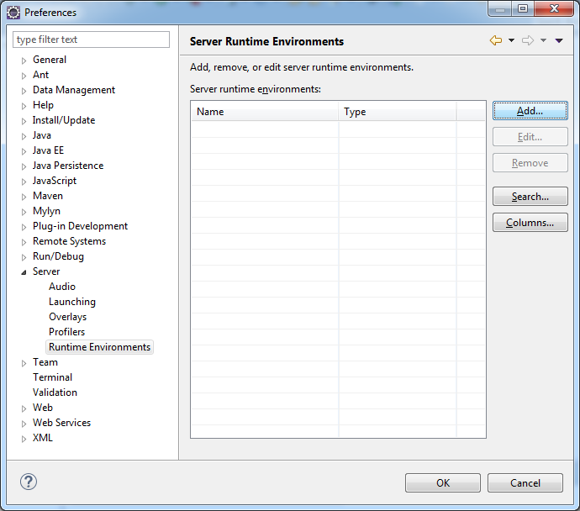
Integração do Tomcat com o Eclipse (Cont.)
Notes:
Topic Duration: 55 minutes
Focus: Agenda
Content: N/A
Note to Instructor: N/A
Transition: Let’s now take an overview of Web Tier.

Slide 14
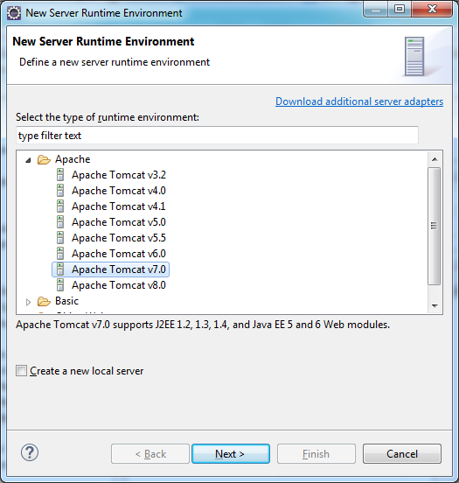
Integração do Tomcat com o Eclipse (Cont.)
Notes:
Focus: Overview of Web Tier
Content: N/A
Note to Instructor: Mention Intercepting Filter and Front Controller patterns in relation to request handling.
Transition: Let’s look at the challenges of the Web Tier.

Slide 15
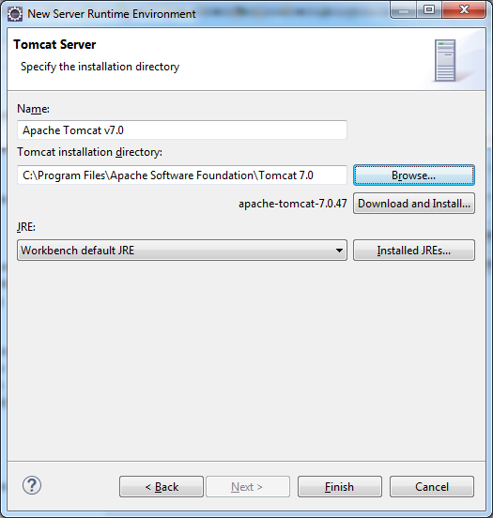
Integração do Tomcat com o Eclipse (Cont.)
Aponte para o diretório onde o tomcat foi instalado.
Notes:
Focus: Challenges of Web Tier
Content: Web interfaces involve complex markup consisting of HTML, JavaScript, Cascading Style Sheet (CSS), and Scriptlets making it clumsy and unreadable.
Note to Instructor: Walkthrough the slide explaining each point.
Tell participants that in creating a Web-based presentation layer, it is important for developers to know the difference between the different browsers and to test accordingly. Internet Explorer (IE) and Firefox, for instance, support different elements and methods. Some browsers offer more robust Application Program Interfaces (APIs)/tools for these technologies compared to others.
Participants may ask about the number of request parameters allowed in an HTTP request.
Facilitate a group discussion on the common challenges faced on a project. Share some of your experiences and ask the participants to share their experiences.
Transition: Let’s take an overview of Java EE UI technologies.

Slide 16
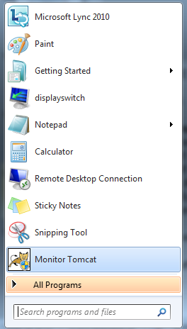
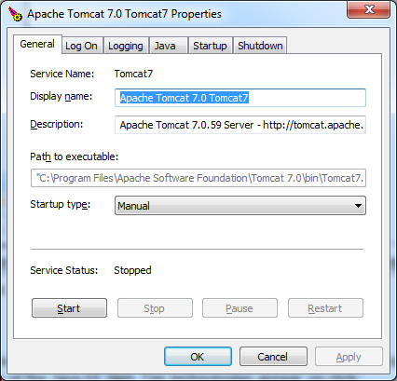
Integração do Tomcat com o Eclipse (Cont.)
Para testar a instalação, primeiro é necessário parar o serviço que esta rodando no windows, caso contrário, dará um erro informando que a porta já esta sendo utilizada.
Rode o Monitor Tomcat, e verifique se o serviço esta parado
Notes:
Focus: Java EE Web Tier Technologies
Content: N/A
Note to Instructor: Click to reveal the descriptions of each of the Java EE Web Tier technologies.
Explain the following points. Each of the Java EE Web Tier technologies appear on click:
Applet – ‘Java environment’ is a Java Virtual Machine (JVM).
Servlet – It is a server-side Java module that processes Web-based client requests.
JSP – Although JSP looks like HTML, the complete file gets compiled to create a Servlet and it is the Servlet that actually handles the requests.
JavaServer Faces – It is a server-side user interface component framework.
Each of these will be discussed in detail on the following slides.
Transition: Let’s discuss each technology in detail. To begin with, we will first discuss Applets.

Slide 17
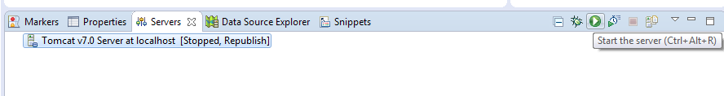
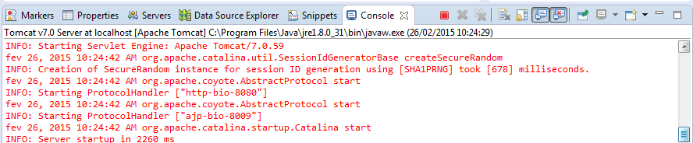
Integração do Tomcat com o Eclipse (Cont.)
Para testar a instalação, na aba Servers, clique no start
O tomcat será executado
Notes:
Focus: Java EE Web Tier Technologies
Content: N/A
Note to Instructor: Click to reveal the descriptions of each of the Java EE Web Tier technologies.
Explain the following points. Each of the Java EE Web Tier technologies appear on click:
Applet – ‘Java environment’ is a Java Virtual Machine (JVM).
Servlet – It is a server-side Java module that processes Web-based client requests.
JSP – Although JSP looks like HTML, the complete file gets compiled to create a Servlet and it is the Servlet that actually handles the requests.
JavaServer Faces – It is a server-side user interface component framework.
Each of these will be discussed in detail on the following slides.
Transition: Let’s discuss each technology in detail. To begin with, we will first discuss Applets.

