Slide 1


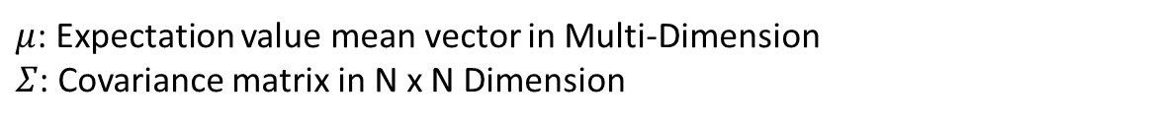
Probability Density Function of Gaussian Mixture Model
Single Dimension
Multi-Dimension
$μ$: Expectation value mean vector in Multi-Dimension
$Σ$: Covariance matrix in N x N Dimension

Slide 2


Gaussian Mixture Model
Gaussian Mixture Model is a model that conclude multiple Gaussian Distribution, its density function is the weighted sum of each Gaussian Distribution function
$π_{j}$: weighted coefficient of J-th Gaussian Distribution, which $≥$ 0 and

Slide 3
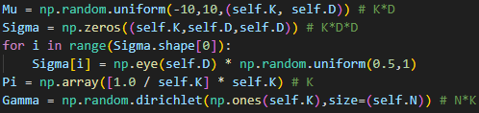
Step 1: Initialize mean, covariance and weight parameter
Mu (μ): cluster mean
Sigma (Σ): cluster covariance
Pi (mixing coefficients) (π): ratio of number of data point belongs to the cluster
Gamma (likelihood) (γ): ratio of data point belongs to the cluster

Slide 4


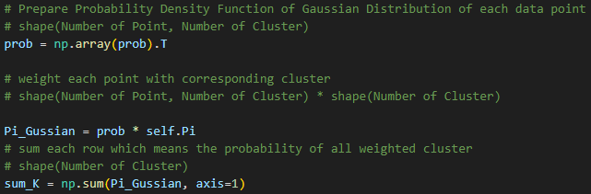


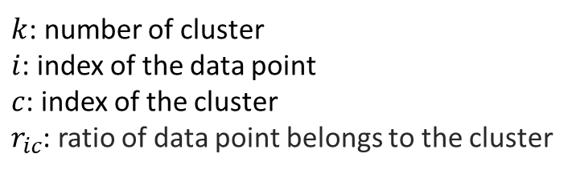
Step 2: Expectation
Calculate the probability that each data point belongs to cluster(c)
$k$: number of cluster
$i$: index of the data point
$c$: index of the cluster
$r_{ic}$: ratio of data point belongs to the cluster
Sum up log likelihood to determine when GMM converged
The above equation show the probability of 20th data point belongs to 1-th Gaussian Distribution

Slide 5
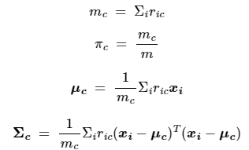
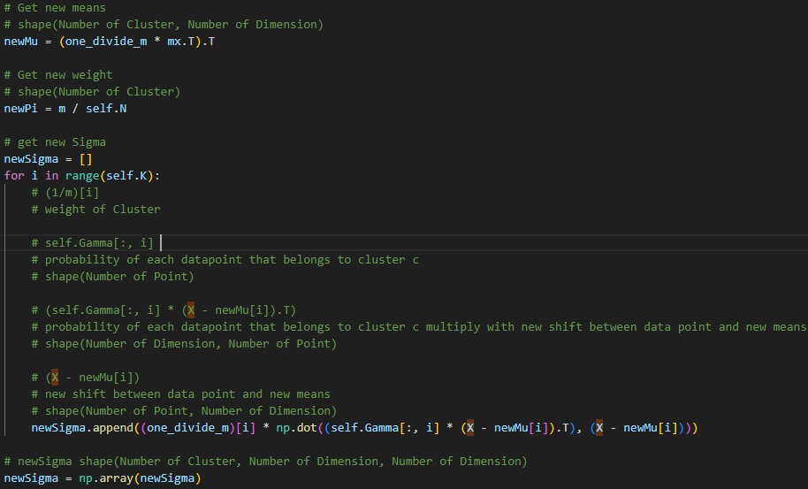
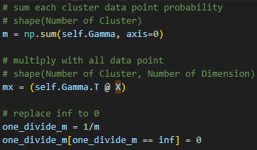
Step 3: Maximization
The Maximization updates the estimates of the parameters as follows:
These parameters will convergence during the process

