Slide 1
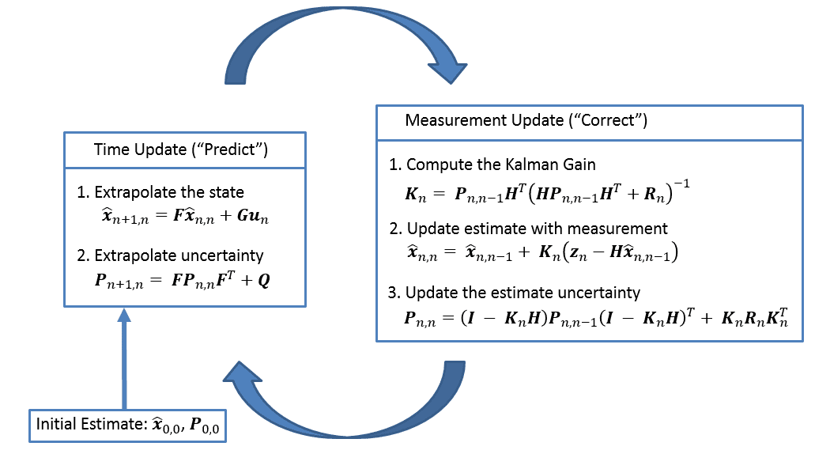
Kalman Filter step overview

Slide 2








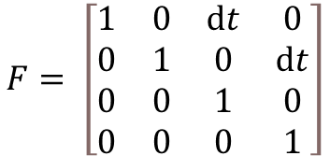

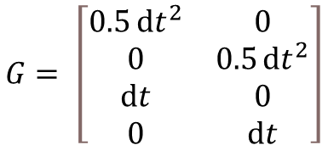

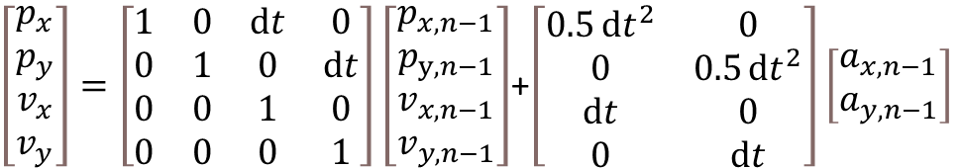
Extrapolate the state
F: state transition matrix shape:
x: state vector shape:
G: control matrix shape:
u: control input vector shape:
w: process noise vector shape:
$$p_{x}=p_{x,n−1}+v_{x,n−1}ⅆt+0.5a_{x,n−1}ⅆt^{2}$$
$$p_{y}=p_{y,n−1}+v_{y,n−1}ⅆt+0.5a_{y,n−1}ⅆt^{2}$$
$v_{x}=v_{x}ⅆt+$ $0.5a_{x,n−1}ⅆt^{2}$
$v_{y}=v_{y}$ $ⅆt+0.5a_{y,n−1}ⅆt^{2}$
$$F= \left[\begin{matrix}1 & 0 & ⅆt & 0 \\ 0 & 1 & 0 & ⅆt \\ 0 & 0 & 1 & 0 \\ 0 & 0 & 0 & 1\end{matrix}\right]$$
$$G= \left[\begin{matrix}0.5ⅆt^{2} & 0 \\ 0 & 0.5ⅆt^{2} \\ ⅆt & 0 \\ 0 & ⅆt\end{matrix}\right]$$
$\left[\begin{matrix}p_{x} \\ p_{y} \\ v_{x} \\ v_{y}\end{matrix}\right]=\left[\begin{matrix}1 & 0 & ⅆt & 0 \\ 0 & 1 & 0 & ⅆt \\ 0 & 0 & 1 & 0 \\ 0 & 0 & 0 & 1\end{matrix}\right]\left[\begin{matrix}p_{x,n−1} \\ p_{y,n−1} \\ v_{x,n−1} \\ v_{y,n−1}\end{matrix}\right]$+$\left[\begin{matrix}0.5ⅆt^{2} & 0 \\ 0 & 0.5ⅆt^{2} \\ ⅆt & 0 \\ 0 & ⅆt\end{matrix}\right]\left[\begin{matrix}a_{x,n−1} \\ a_{y,n−1}\end{matrix}\right]$

Slide 3




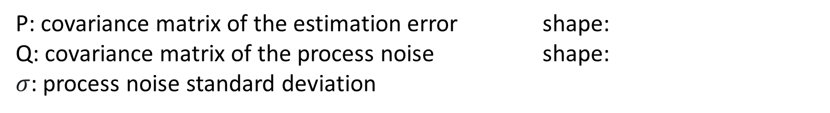
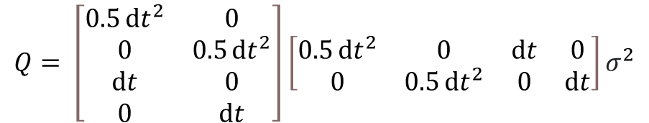
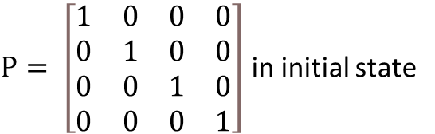
Extrapolate uncertainty
P: covariance matrix of the estimation error shape:
Q: covariance matrix of the process noise shape:
$σ$: process noise standard deviation
$P= \left[\begin{matrix}1 & 0 & 0 & 0 \\ 0 & 1 & 0 & 0 \\ 0 & 0 & 1 & 0 \\ 0 & 0 & 0 & 1\end{matrix}\right]$ in initial state
$$Q= \left[\begin{matrix}0.5ⅆt^{2} & 0 \\ 0 & 0.5ⅆt^{2} \\ ⅆt & 0 \\ 0 & ⅆt\end{matrix}\right]\left[\begin{matrix}0.5ⅆt^{2} & 0 & ⅆt & 0 \\ 0 & 0.5ⅆt^{2} & 0 & ⅆt\end{matrix}\right]σ^{2}$$

Slide 4






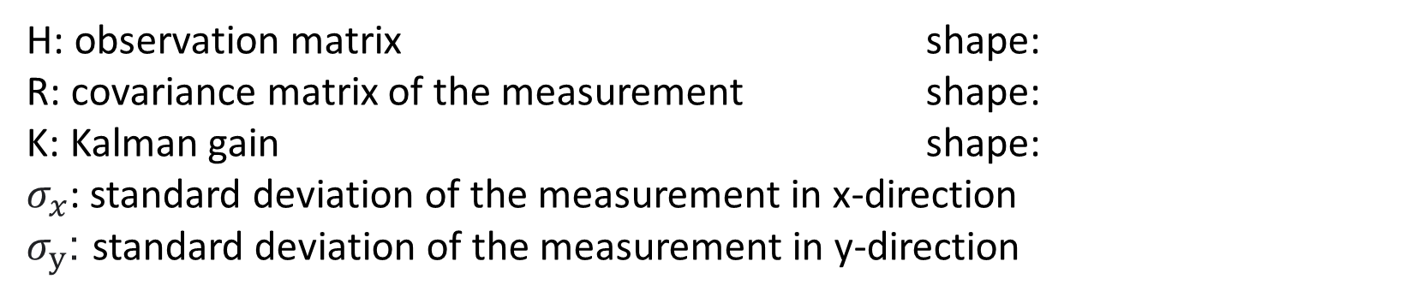
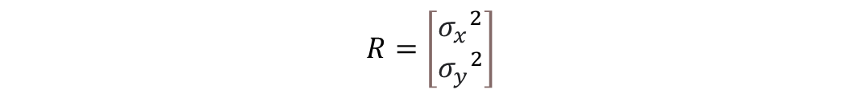
Compute the Kalman Gain
H: observation matrix shape:
R: covariance matrix of the measurement shape:
K: Kalman gain shape:
$σ_{x}$: standard deviation of the measurement in x-direction
$σ_{y}$: standard deviation of the measurement in y-direction
$$R=\left[\begin{matrix}{σ_{x}}^{2} \\ {σ_{y}}^{2}\end{matrix}\right]$$
$$H= \left[\begin{matrix}1 & 0 & 0 & 0 \\ 0 & 1 & 0 & 0\end{matrix}\right]$$

Slide 5





Update estimate with measurement
z: measurement vector shape:
v: measurement noise vector shape:
$$v=\left[\begin{matrix}random noise \\ random noise\end{matrix}\right]$$

Slide 6
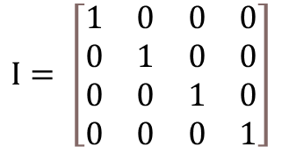
Update the estimate uncertainty
I: identity matrix shape:
$$I= \left[\begin{matrix}1 & 0 & 0 & 0 \\ 0 & 1 & 0 & 0 \\ 0 & 0 & 1 & 0 \\ 0 & 0 & 0 & 1\end{matrix}\right]$$

