Slide 1
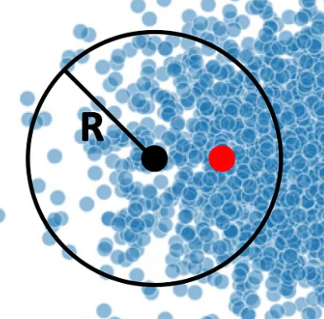
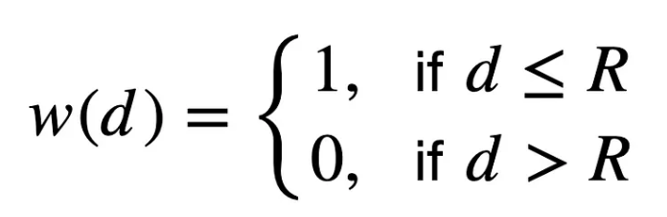
Flat filter
Algorithm:
d: Euclidean distance between one point to each point of the dataset
R: radius from the current point

Slide 2

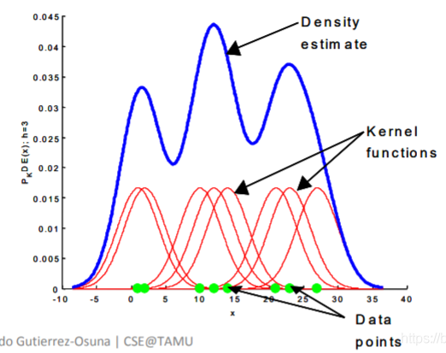
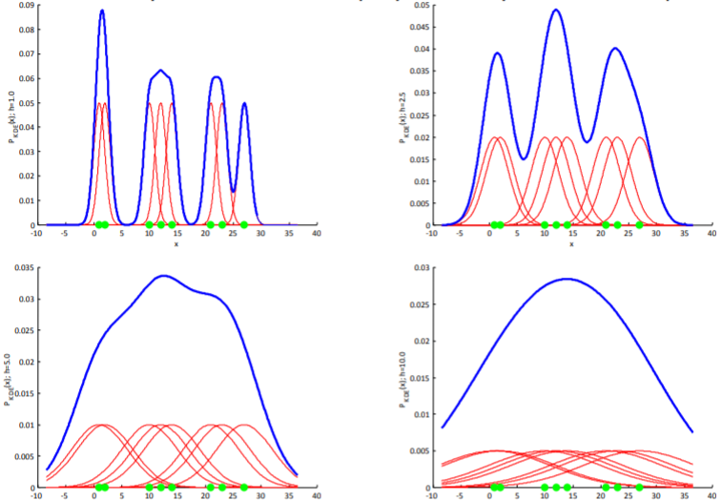
Gaussian filter
Algorithm:
h: bandwidth
(x1-x2)^2: Euclidean distance between one point to each point of the dataset

Slide 3

Mean Shift algorithm step
Step 1:
Calculate the Euclidean Distance from current point to other points of the dataset
Step 2:
Calculate the weight of each point in the dataset after passing through the Gaussian kernel

Slide 4

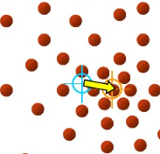


Mean Shift algorithm step
Step 3
Calculate total weight of the weight of each point in the dataset
Step 4
Calculate new position of the point after the below equation
$$x=\frac{w_{1}x_{1}+w_{2}x_{2}+…}{\sum{w}}$$
$$y=\frac{w_{1}y_{1}+w_{2}y_{2}+…}{\sum{w}}$$

Slide 5


Mean Shift algorithm step
Step 5
Calculate Euclidean Distance between new point position and old point position
Step 6
If step 5 distance larger than init maximum shifted distance, update it
Step 7
If step 5 distance smaller than threshold, label it and don’t shift this point as it already converge to the final position

