Slide 1
Research Question – Tutorial Presentation for Feedback Date:
Group Name: A12 Name of Student Presenting: Leslie Fernandes

Slide 2
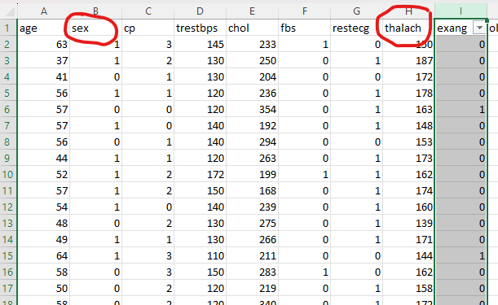
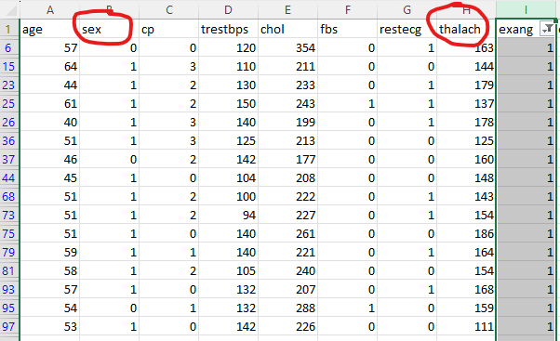
.
Original dataset 303 rows
Filtered dataset 99 rows. Will be done in R script

Slide 3
This dataset is interesting to us because (one sentence): Our Independent variable is: sex (1= male; 0 = female) This Independent variable datatype is : Nominal Our Dependent variable is: thalach (maximum heart rate) This Dependent variable datatype is : Interval
Dataset ID: (DS148, heart.csv)
Notes:
Before specifying your Research Question you must define the type of data you are analysing. Are the variables you select interval data (measurement data you can divide, multiple, etc), OR are they ordinal (there is a definite order but the intervals between each variable are not necessarily equal, or the terms might be subjective like in a likert scale); OR are they just categorical/nominal (Items such as film names, cities, etc., that you can count numbers of occurrences? You also need to understand whether the variable is either dependent or independent and this will vary according to the context. Independent variables may cause an effect, whereas the dependent variable might be effected by the independent variable. Check the lecture notes on the RQ for more information and examples.
You will get only one opportunity to present your Research Question ahead of the submission date. Have your questions ready, and be ready to take notes on feedback.

Slide 4
Template² :Interval vs Nominal. data “Is there a difference in the mean of maximum heart rate between males and females who experience exercise-induced angina?”
Our Research Question is

Slide 5
1) Null hypothesis (H₀):
There is no difference in the mean of the maximum heart rate between males and females who experience exercise-induced angina.
2) Alternative hypothesis (H₁):
There is a difference in the mean of the maximum heart rate between males and females who experience exercise-induced angina.

