Slide 1

Visualization
Data Analysis
Tutorial Presentation for Feedback
7COM1079-2022 Student Group No:A12 Names of Student Attendees :Lipi, Lai,Leslie, Khurram
1
Group Id: A12 Name of Student Presenting: Hafiza Ayesha Saddiqa

Slide 2
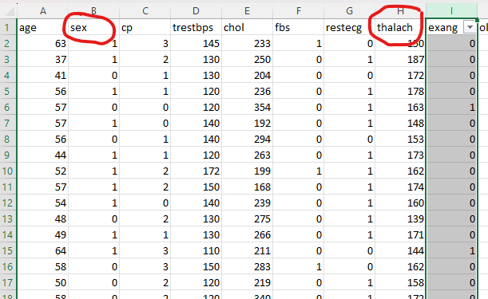
7COM1079-2022 Student Group ID:
We are using the dataset DS148 (heart.csv) to answer our Research question “Is there a difference in the mean of maximum heart rate between males and females who experience exercise-induced angina?” ¹
2
The dataset has 303 rows
The dependent variable is sex
The independent variable is thalach
Notes:
‹#›

Slide 3
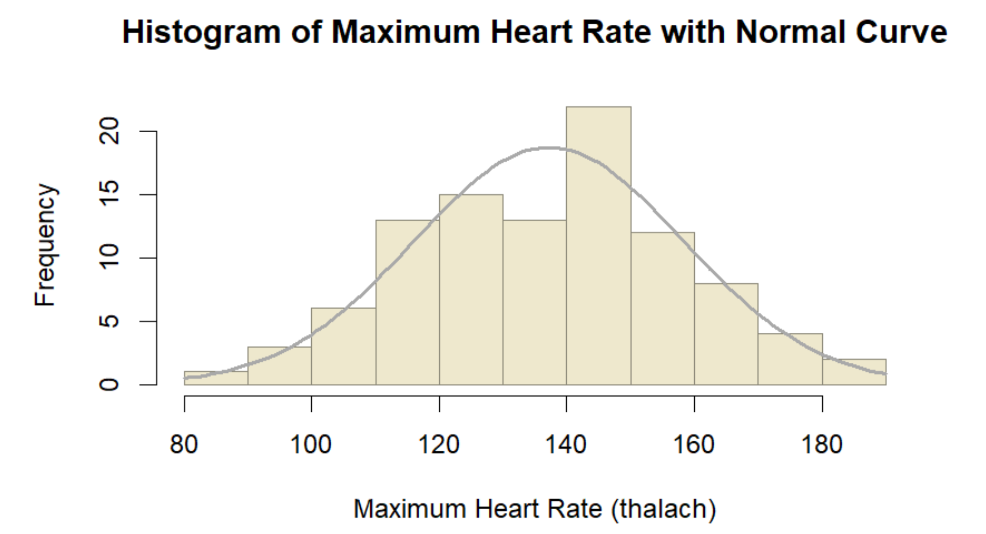
Histogram
3
Our RQ asks about differences in means/ medians
For example:
Most people's maximum heart rates are between 130 and 150 beats per minute (bpm). Overall, the data seems to be evenly spread out in a way that matches this normal bell shape, meaning it’s distributed fairly predictably.
3

Slide 4
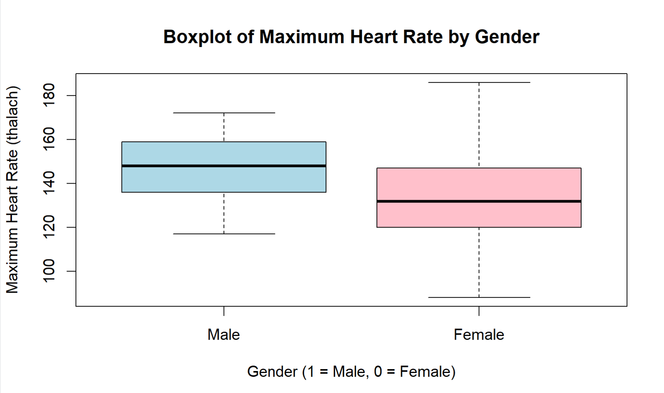
Boxplot
4
Our RQ asks about means/ medians
For example:
This boxplot shows a comparison of maximum heart rate (thalach) between males and females. It highlights that males tend to have a slightly higher means maximum heart rate than females, though the overall spread and variability are similar for both genders.
4
Notes:
‹#›

Slide 5
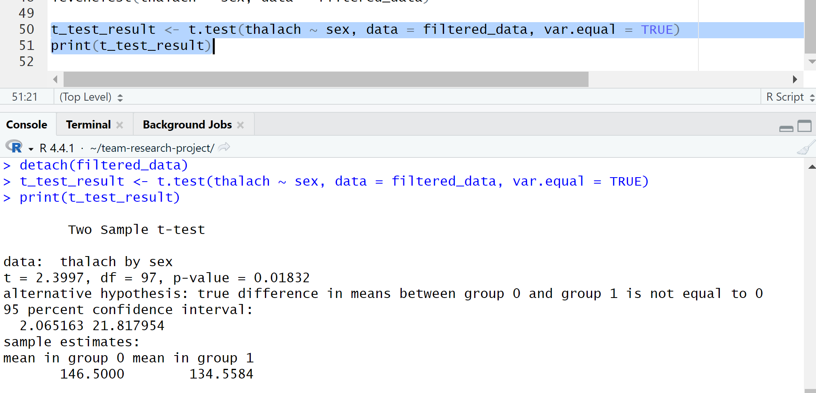
R Script and Results (For ALL types of test) – The Analysis
5
p-value = 0.01832
Null Hypothesis (H₀): There is no difference in the mean of the maximum heart rate between males and females who experience exercise-induced angina.
Alternative Hypothesis (H₁): There is a difference in the mean of the maximum heart rate between males and females who experience exercise-induced angina.

Slide 6
R Script and Results (For ALL types of test) – The Analysis
6
Because p-value <0.05, we reject the null hypothesis (𝐻0).
This indicates there is strong evidence that the mean maximum heart rates (thalach) are different between males and females.
Moreover, the 95% confidence interval suggests that the difference in means is between 2.07 and 21.82, with females (group 0) having a higher mean heart rate 146.5) compared to males (134.56).

Slide 7
R Script and Results (For ALL types of test) – The Analysis
Standard t-Test:
p-value = 0.01832 (< 0.05): Indicates a statistically significant difference in mean maximum heart rate between males and females.
Mean Maximum Heart Rates:
Females (sex = 0): Mean = 134.6.
Males (sex = 1): Mean = 146.5.

Slide 8
R Script and Results (For ALL types of test) – The Analysis
Conclusion:
This analysis has a statistically significant difference in the average maximum heart rates between males and females, assuming equal variances.
The 95% confidence interval (ranging from 2.07 to 21.82) indicates that, on average, males tend to have a higher maximum heart rate than females.
These results highlight important gender-related physiological differences that may impact cardiovascular health evaluations and the design of related health interventions.

