Slide 1
SQL Natural Language Interface
Yujing Ke, Ziming Sheng, Lai Wei
CS 516 Final Project

Slide 2
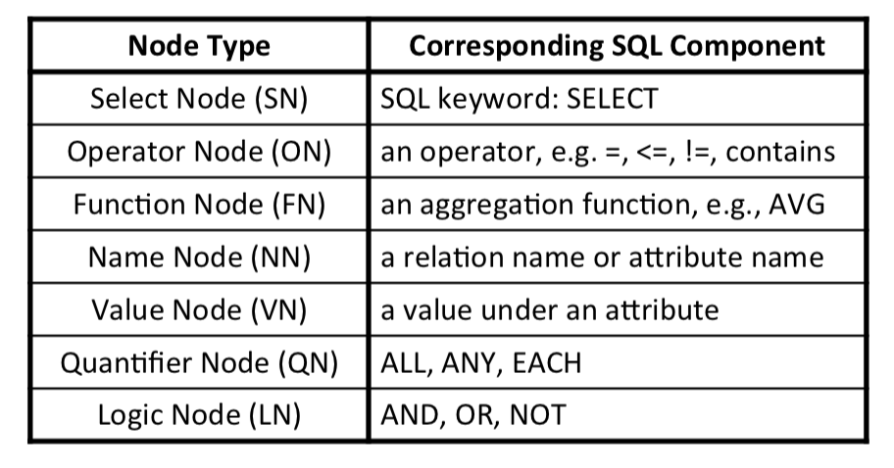
Step 1. Node Mapping
We use the WordNet WUP similarity score and Jaccord similarity score to map the words to node type and DB attributes.

Slide 3
Sample DB Attribute:
author, age, publication, gender, field
Get the authors whose name equals to BOB
Node Type:
SN NN NN ON VN
SQL Keyword:
Select author author = Bob

Slide 4
Step 2. SQL Generation
Generate SQL based on pre-defined templates from the mapping result
We propose 2 scoring functions:
The order similarity of mapping results and original sentence
The distance between two nodes separated by ON node

Slide 5
Demo
get the authors whose name equals to BOB or age is greater than 38
get the average age of author whose gender equals to male

