Slide 1
A Five-Dimensional Evaluation of
Machine Learning and Deep Learning Techniques
Driver Distraction Image Classification
- James Lai, Lingling Zhang, Iman Lau, L. Yang

Slide 2
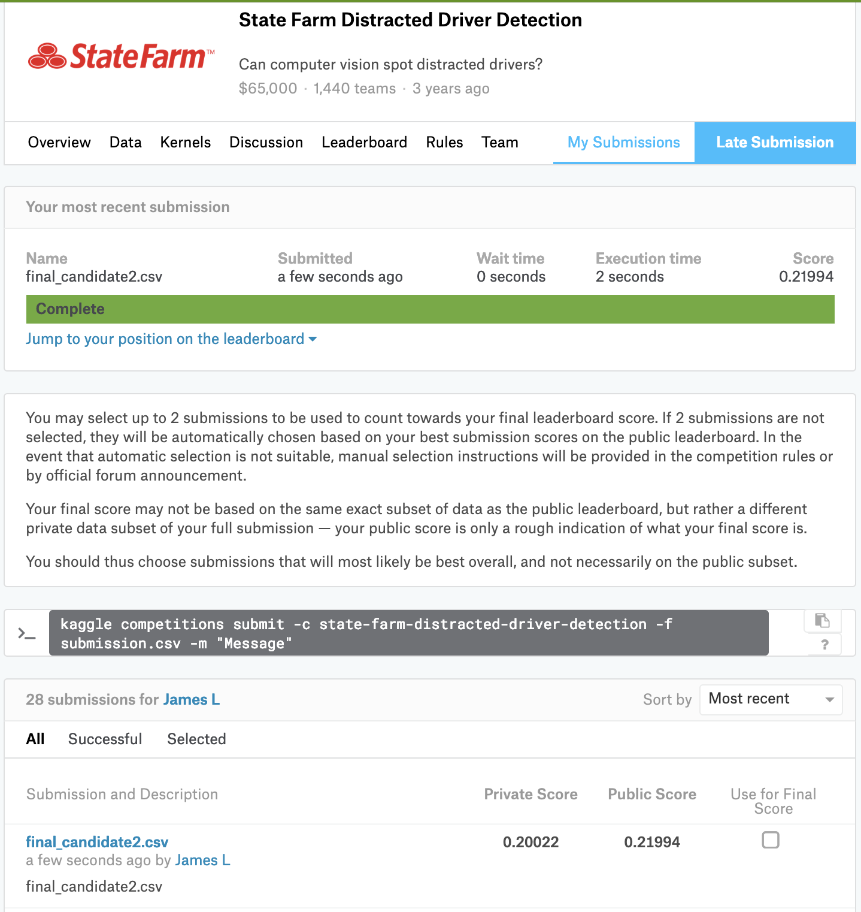
Final standing
Ensemble of
12 models by SGD + 2 models by Adam
Private Leaderboard score 0.20022
63 out of 1440 teams (Top 4.4%)
Public Leaderboard score 0.21994
103 out of 1440 teams (Top 7.2%)

Slide 3
Outline
Problem Statement
Machine Learning Pipeline
Results and Discussion
Summary
Bonus

Slide 4
Problem Statement
Distracted driving is a major concern for road safety. Distracted drivers are less likely to see potential issues on the road, and they can become issues themselves, leading to accidents.

Slide 5
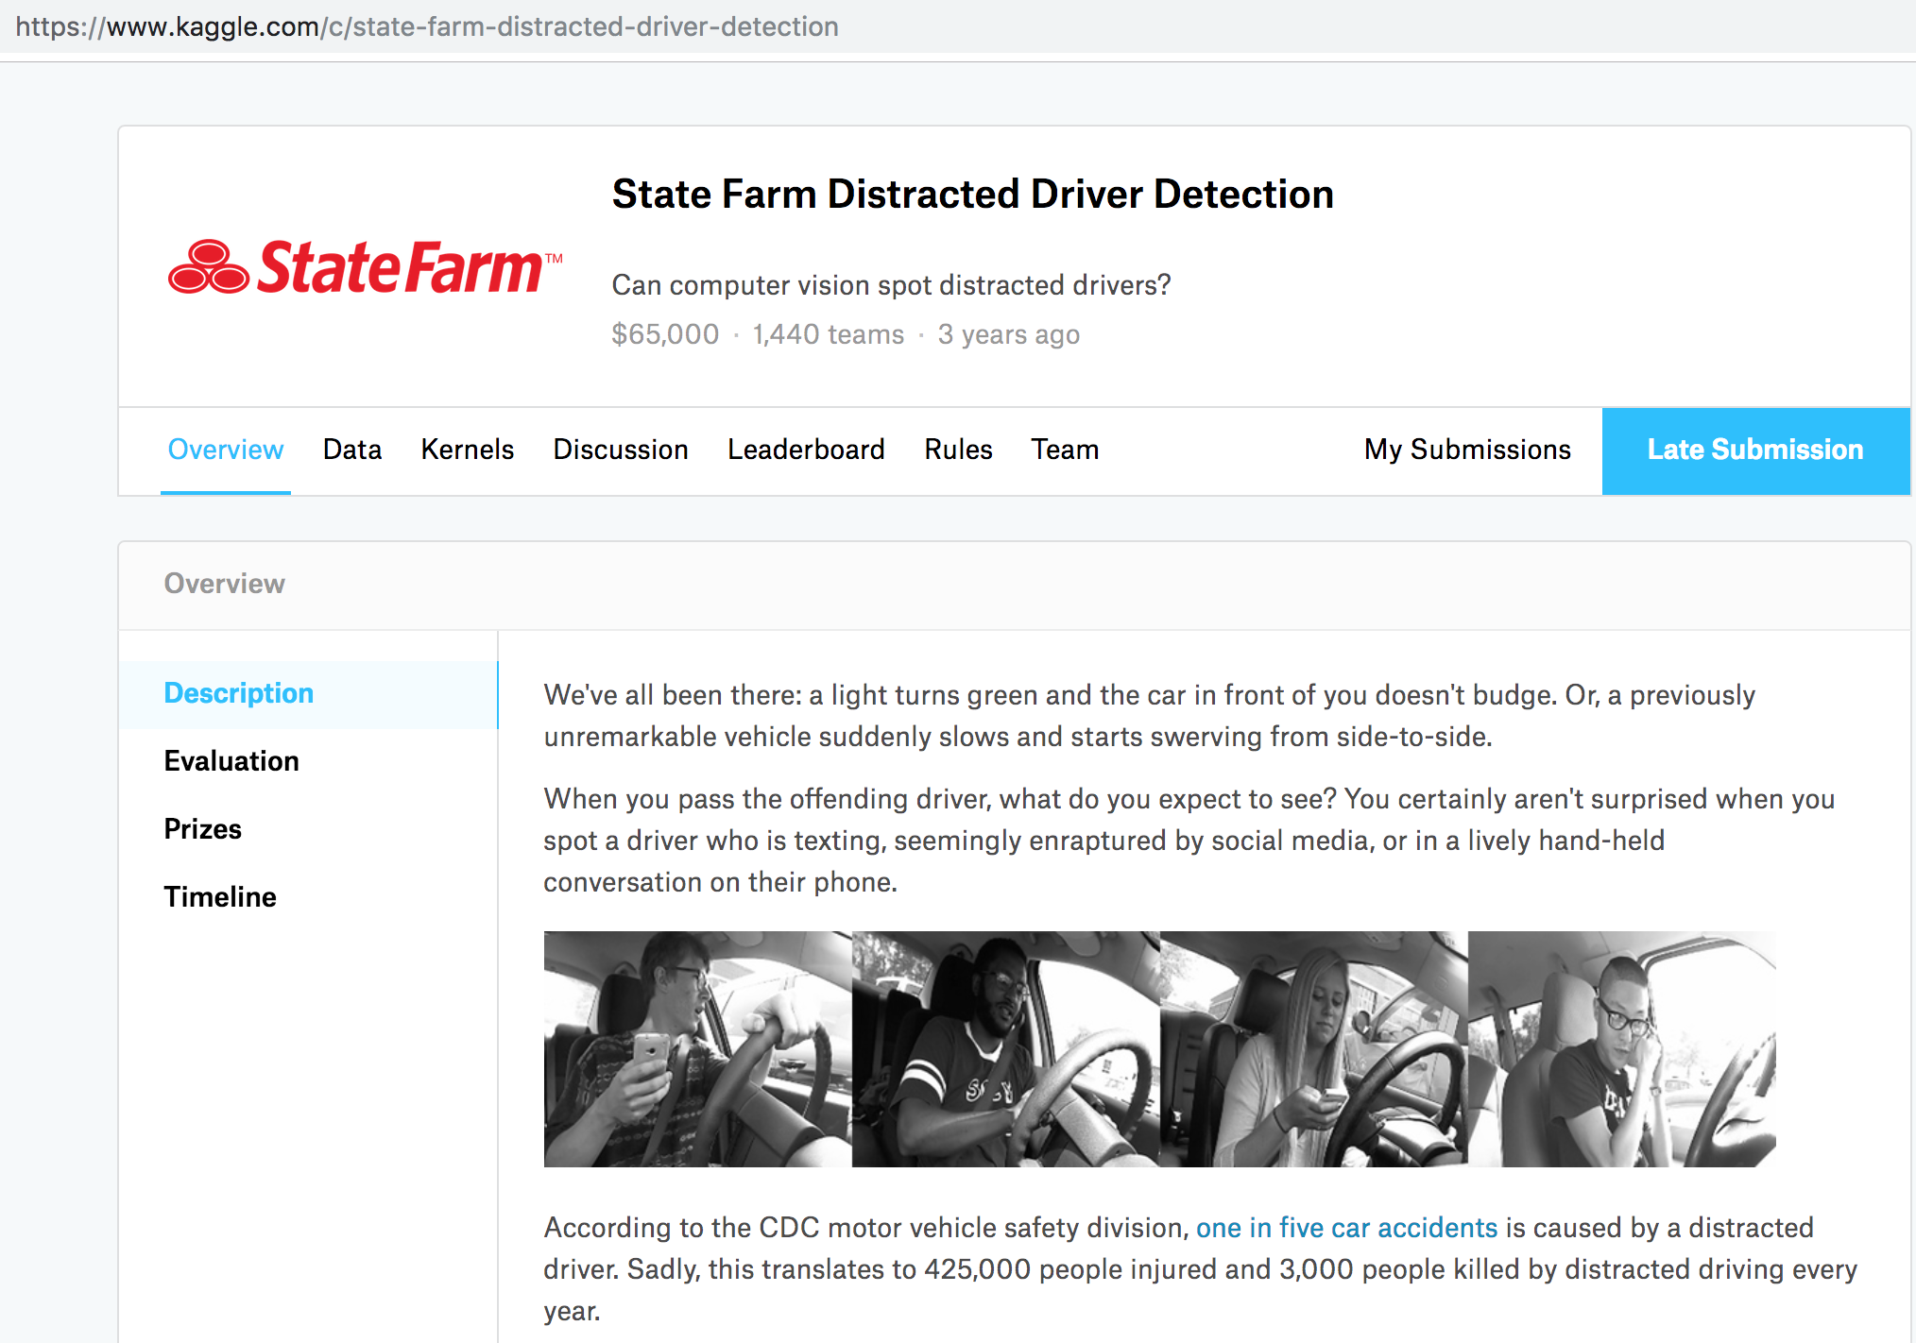
Kaggle Competition
The data set was obtained from a Kaggle competition called State Farm Distracted Driver Detection.
Training dataset contained 22,424 images where 79,726 images in the test set.

Slide 6
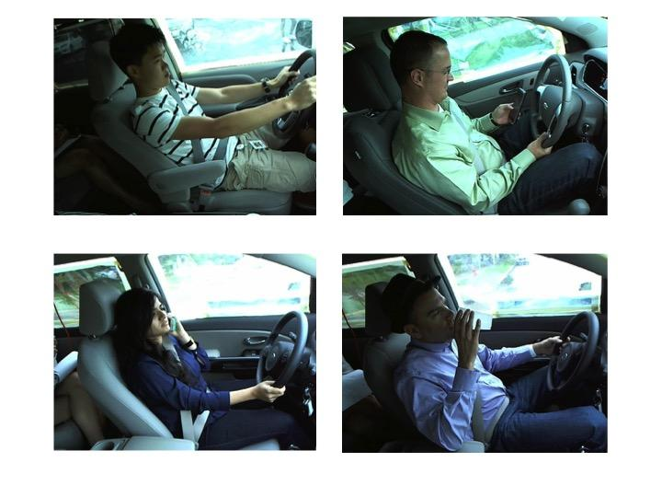
10 Classes
The training set was labeled into 10 classes and relatively evenly distributed,
Therefore, no Downsampling or Upsampling treatment was needed in the training process.
Index | Class
c0 | safe driving
c1 | texting - right
c2 | talking on the phone - right
c3 | texting - left
c4 | talking on the phone - left
c5 | operating the radio
c6 | drinking
c7 | reaching behind
c8 | hair and makeup
c9 | talking to passenger

Slide 7
Data
Training: 22,424 images, 1 csv file
subject | classname | img
p002 | c0 | img_44733.jpg
p002 | c0 | img_72999.jpg
…........ | …........ | …........
p012 | c1 | img_45632.jpg
p012 | c1 | img_26825.jpg
…..... | …..... | ….....
p014 | c9 | img_73160.jpg
p014 | c9 | img_17772.jpg
…........ | …........ | …........
Test: 79,726 images

Slide 8
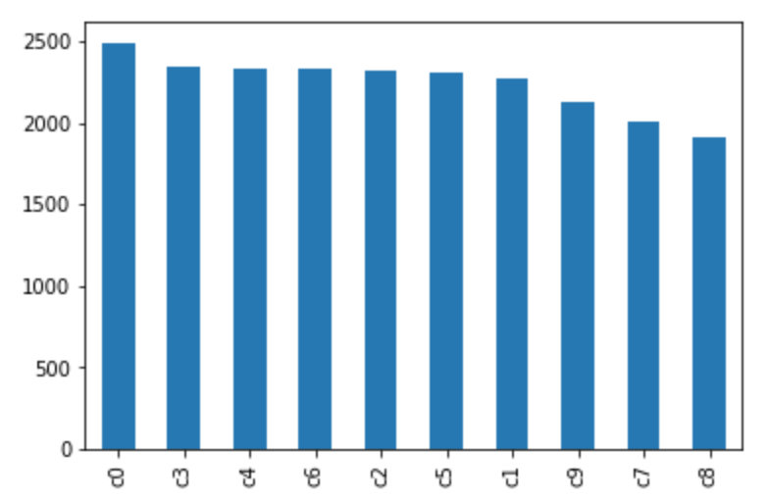
Data
Training: Classes
10 classes relatively evenly distributed

Slide 9
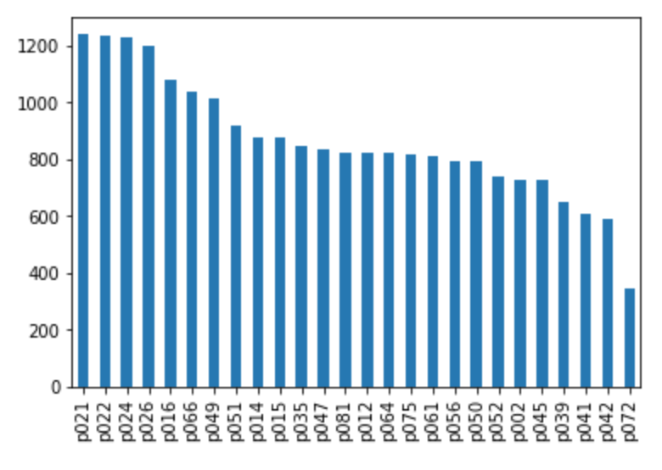
Data
Training: Drivers
26 drivers, whose images ranged from 346 to 1237

Slide 10
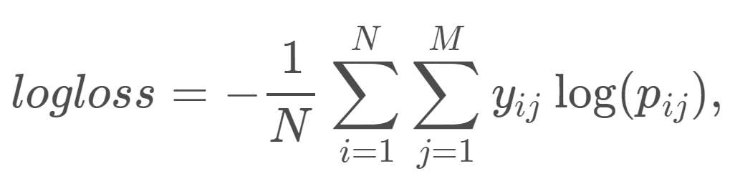
Loss Function
Where:
N is the number of images in the test set
M is the number of image class labels
y_{ij} is 1 if an observation i belongs to class j
p_{ij} is the predicted probability that an observation i belongs to class j

Slide 11
Machine Learning Pipeline

Slide 12
Machine Learning Pipeline
Fine-tune pretrained models - InceptionV3 and ResNet50 - on the training set.
Train K models from K-fold cross-validation, plus one additional model trained on whole dataset. Images in the training set is randomly augmented during training. Adam optimizer is also evaluated with ResNet50.
Compare cross-validation loss and accuracy
Apply various ensembling technique to reduce overfit.
Ensemble K+1 models trained on 1st step.
Ensemble predictions generated from randomly augmented images.
Ensemble predictions from K nearest neighbours.
Ensemble the two group of models - InceptionV3 and ResNet50.
The “ensembling” mentioned here is simple averaging, giving equal weights to predictions from all kinds.

Slide 13
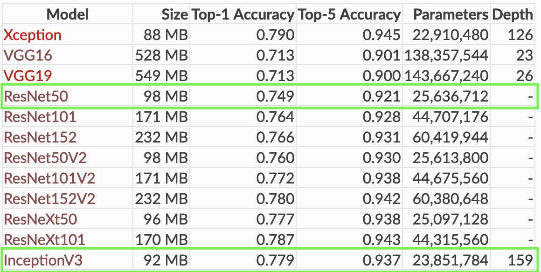
Pre-trained Weights & Models
We choose ResNet50 and InceptionV3. These two models have relatively small amount of parameters and high score on image-net competition.
*This table is taken from Keras’s website.

Slide 14
Cross-Validations
We use 5-fold cross validations to compare the performance between InceptionV3 and ResNet50.
However, we keep the 5 models resulting from the 5-fold cross validations. They are treated as slightly different models and we will ensemble their outputs.
An additional model is trained on the whole dataset for both InceptionV3 and ResNet50.

Slide 15
Image Augmentation
The following augmentations are used in this project: rescale, shear, zoom, rotation, width Shift, height Shift, horizontal Flip
During the models’ training phase, image augmentations are randomly applied to the image in training set.
When generating predictions for the test set, 5 augmented images are generated from a single test image. Predictions for the 5 images are averaged out as an ensembling method.
We also compare the performance without augmentation for test set, see later discussion.

Slide 16
K Nearest Neighbor
For a single image in the test set, we used KNN to find K nearest neighbours from within the test set.
The image are first converted to a (40x30x3) image. Then a KNN model based on L2 distance is fit on the test dataset.
We also tried using the output from the second-to-last layers of InceptionV3, but we ran out of CPU memory when fitting the dataset using KNN (KNN is an in-memory algorithm).
Predictions for the K nearest neighbours are averaged to produce a single prediction, as an ensembling technique.
The underlying assumptions are the test images are taken continuously. And the ones that are adjacent in time domain can help remove the noise from the model overfitting the training set.

Slide 17
K Nearest Neighbor
KNN Accuracy on Training Set by Neighbors
We also evaluate how accurate the KNN algorithm based on 40x30x3 images would be.
Accuracy is defined as the percentage of rows where both the subject and class match with target image.
For example, for “first 2” (nearest neighbors)’s accuracy, the accuracy is the percentage of rows where both the 1st and 2nd nearest neighbors belong to the same subject (a subject is the person) and the same class (the class is the person’s behaviour in the image, driving safe/looking at phones, etc.)
The first neighbor always matches with target image. The accuracy drops to 93% when we look at 11 nearest neighbors.
Nearest Neighbors | Accuracy of All Neighbors Predicted Correctly
first 1 | 1.000000
first 2 | 0.996878
first 3 | 0.992062
first 4 | 0.986577
first 5 | 0.980200
first 6 | 0.973065
first 7 | 0.965305
first 8 | 0.956029
first 9 | 0.947021
first 10 | 0.939083
first 11 | 0.931056

Slide 18
K Nearest Neighbor
In this project we evaluated using either 5 nearest neighbors or 10 nearest neighbors, and choose based on the results’ private and public leaderboard score.

Slide 19
Ensembling Workflow
“Ensembling” is simple averaging in this project.
1st level: 6 models * 5 augmented images = 30 predictions. We can opt to use portions or all 30 predictions, based on cross-validation scores.
2nd level: 5 nearest neighbors
3rd level: Averaging different groups of models (InceptionV3, ResNet50)
All predictions are given the same weight.
The 2nd and 3rd level need not perform forward propagation using the model. For a single image, forward propagation needs to carry on for 6*5*3=150 times.
Inference may be too slow for real time application.
InceptionV3
SGD
ResNet
SGD
ResNet
ADAM
cv0 , cv1, cv2, cv3, cv4, full data = 6 models
cv0 , cv1, cv2, cv3, cv4, full data = 6 models
cv0 , cv1, cv2, cv3, cv4, full data = 6 models
Inference with Image Augmentation
Inference with Image Augmentation
Inference with Image Augmentation
Select part or all 6 models
Select part or all 6 models
Select part or all 6 models
Averaging
Averaging
Averaging
KNN
KNN
KNN
Averaging Ensemble
Final Model

Slide 20
Results and Discussion

Slide 21
Cross-Validation Results on Training set
 | Model Optimizer | Result | CV0 | CV1 | CV2 | CV3 | CV4 | mean | std
Pair 1 | InceptionV3 SGD | train_loss | 0.004741 | 0.004954 | 0.006126 | 0.004986 | 0.004745 | 0.005110 | 0.000518
 |  | train_acc | 0.999219 | 0.999275 | 0.998885 | 0.999275 | 0.999108 | 0.999153 | 0.000147
 |  | val-loss | 0.021353 | 0.022775 | 0.019593 | 0.026735 | 0.021053 | 0.022302 | 0.002436
 |  | val-acc | 0.993541 | 0.995097 | 0.993977 | 0.993531 | 0.993528 | 0.993935 | 0.000606
Pair 2 | ResNet50 SGD | train_loss | 0.007156 | 0.006682 | 0.006466 | 0.006349 | 0.005758 | 0.006482 | 0.000455
 |  | train_acc | 0.998439 | 0.998327 | 0.998662 | 0.998718 | 0.998830 | 0.998595 | 0.000185
 |  | val-loss | 0.019599 | 0.022456 | 0.021639 | 0.026064 | 0.022333 | 0.022418 | 0.002091
 |  | val-acc | 0.994209 | 0.994428 | 0.994200 | 0.993977 | 0.994421 | 0.994247 | 0.000167
Overfitting: Validation loss was around 4 times higher than training loss.
Ensembling may reduce overfitting

Slide 22
Kaggle Scores on Test Set
Measuring Results in Five Dimensions
InceptionV3 vs. ResNet50
Single model vs. Ensembled models
Augmentation vs. No augmentation
KNN vs. No KNN
SGD vs. Adam

Slide 23
Model Optimizer |  | Ensemble |  | Test Data Preprocessing |  | InceptionV3 SGD |  | ResNet50 SGD
Grp | Index | Training set | # of Model | Augmentation | KNN | Private Board | Public Board | Private Board | Public Board
1 | 1 - A | cv0 | 1 | N | N | 0.48396 | 0.65042 | 0.44329 | 0.55615
 | 1 - B | cv0 | 1 | Y | N | 0.40052 | 0.52621 | 0.35607 | 0.46736
2 | 2 - A | full | 1 | N | N | 0.43700 | 0.59318 | 0.47368 | 0.45343
 | 2 - B | full | 1 | Y | N | 0.36239 | 0.44067 | 0.36663 | 0.39720
3 | 3 - A | cv0, cv1, cv2, cv3, cv4 | 5 | N | N | 0.34215 | 0.47330 | 0.35722 | 0.40510
 | 3 - B | cv0, cv1, cv2, cv3, cv4 | 5 | Y | N | 0.32889 | 0.43142 | 0.31650 | 0.36871
4 | 4 - A | cv0, cv1, cv2, cv3, cv4, full | 6 | N | N | 0.33477 | 0.46454 | 0.35183 | 0.39345
 | 4 - B | cv0, cv1, cv2, cv3, cv4, full | 6 | Y | N | 0.32322 | 0.42092 | 0.31386 | 0.36483
 | 4 - C | cv0, cv1, cv2, cv3, cv4, full | 6 | Y | Y | 0.28109 | 0.37298 | 0.27728 | 0.32967

Slide 24
 |  | Ensemble |  | Test Data Preprocessing |  | InceptionV3 SGD + ResNet50 SGD
Grp | Index | Training set | No. of Model | Augmentation | KNN | Private Board Score Ranking (Top%) |  | Public Board Score Ranking (Top%)
5 | 5 - A | cv0, cv1, cv2, cv3, cv4, full | 12 | Y | Y | 0.26251 152 10.6% |  | 0.32938 216 15.0%

Slide 25
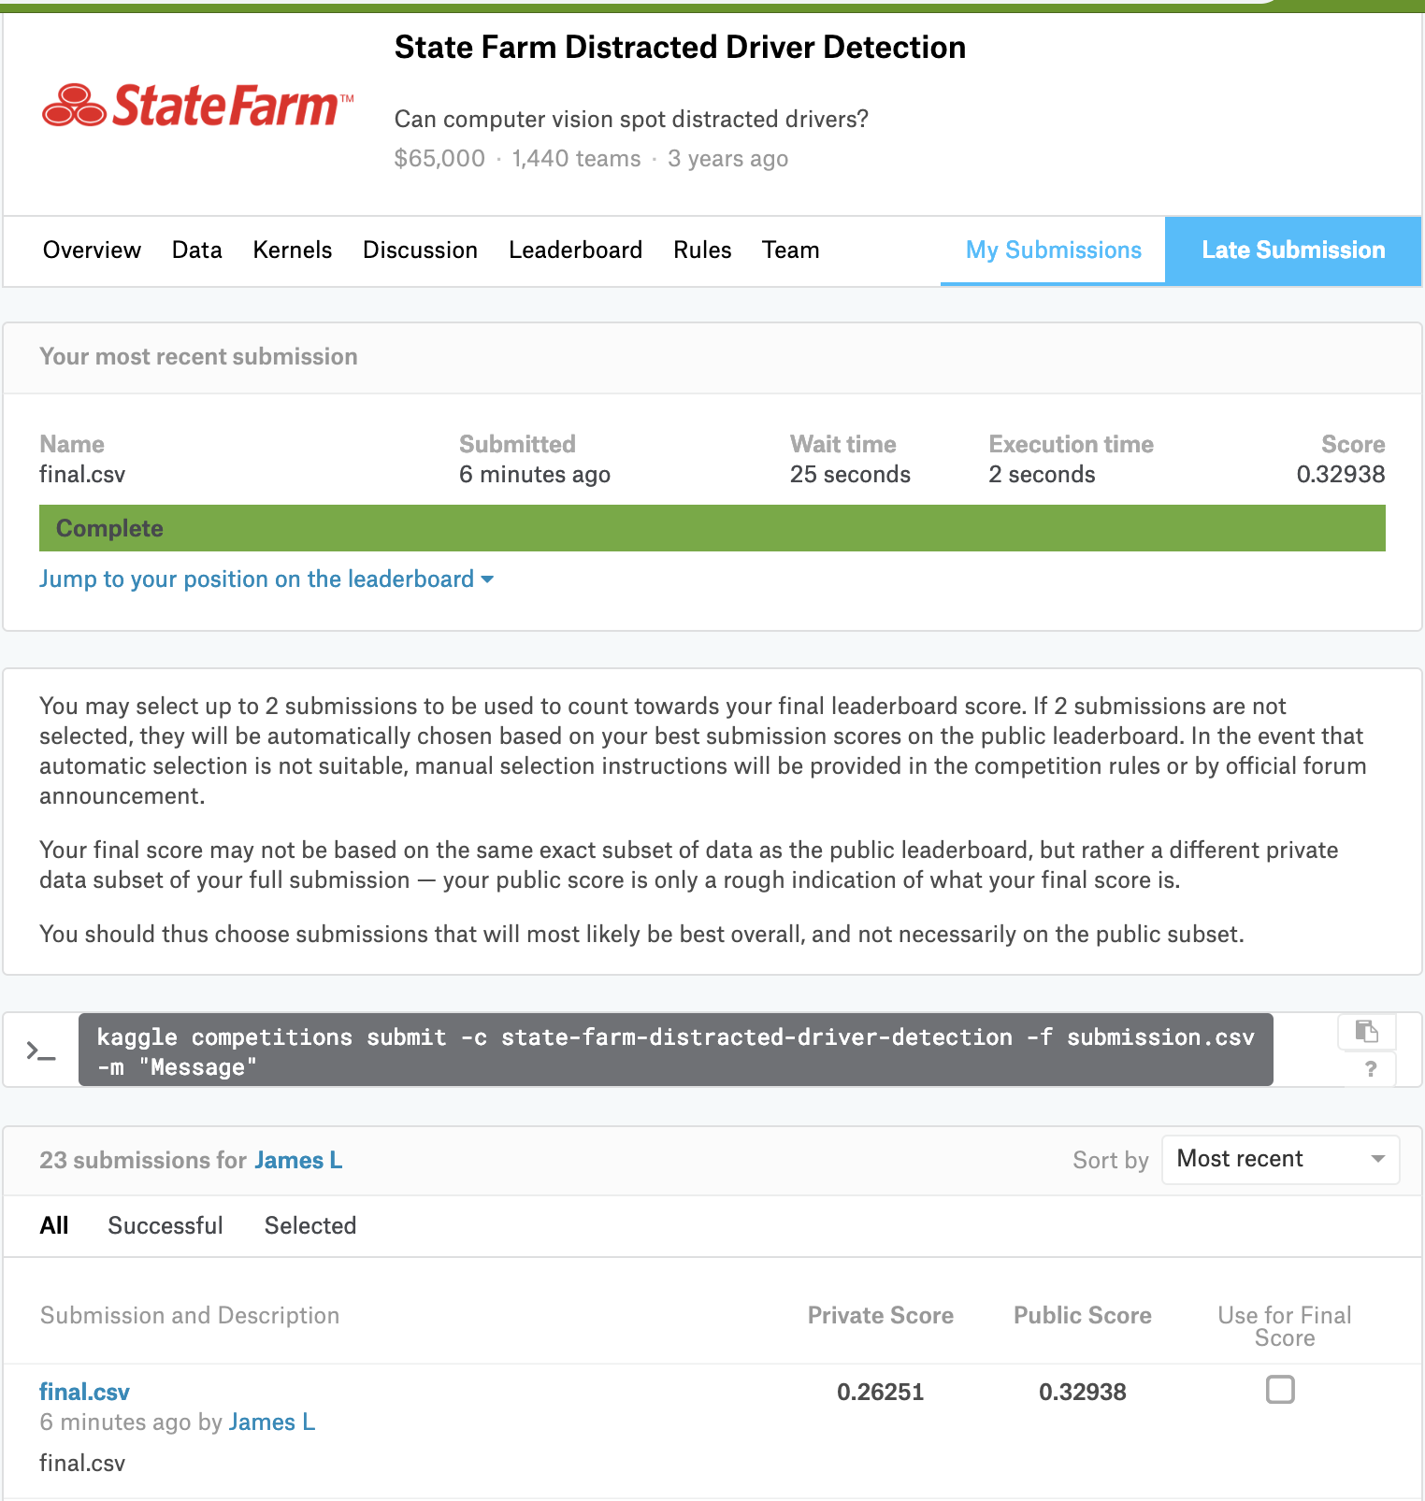
Candidate 1
12 models
Private Leaderboard score 0.26251
152 out of 1440 teams (Top 10.6%)
Public Leaderboard score 0.32938
216 out of 1440 teams (Top 15.0%)

Slide 26
Optimizer Comparison: SGD vs. Adam
1

Slide 27
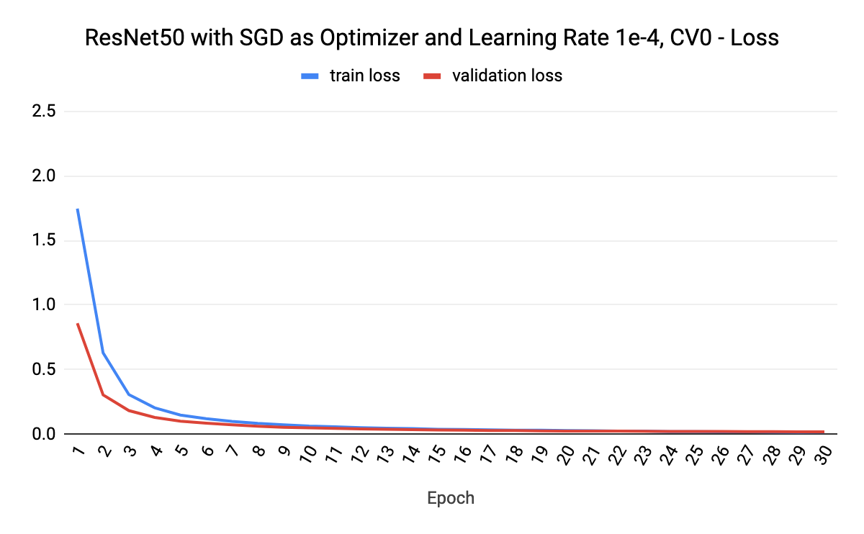
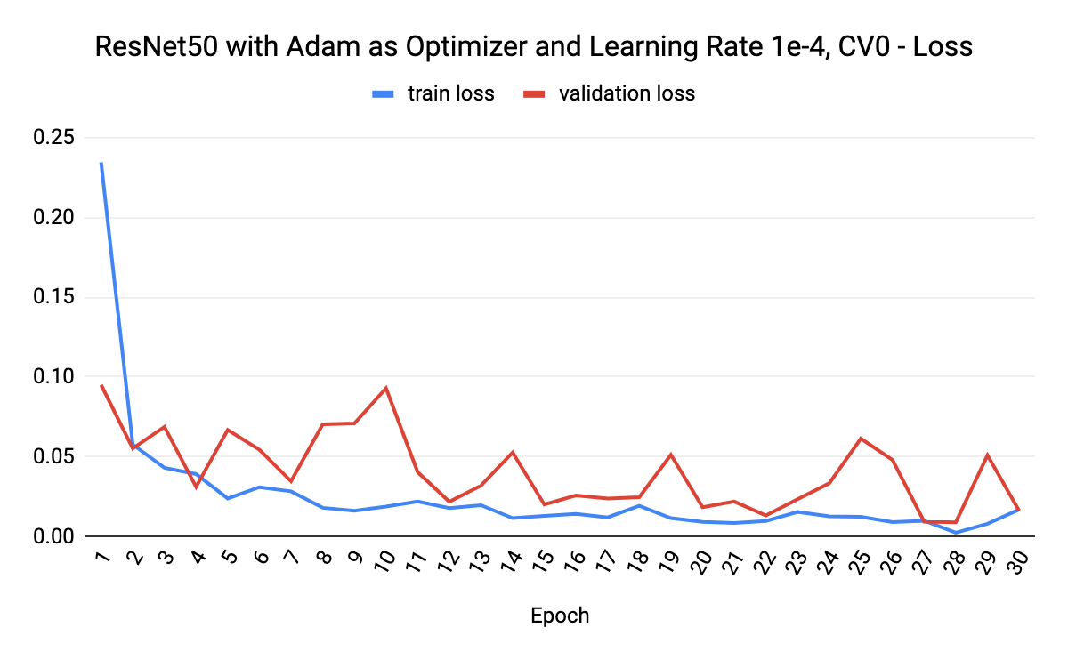
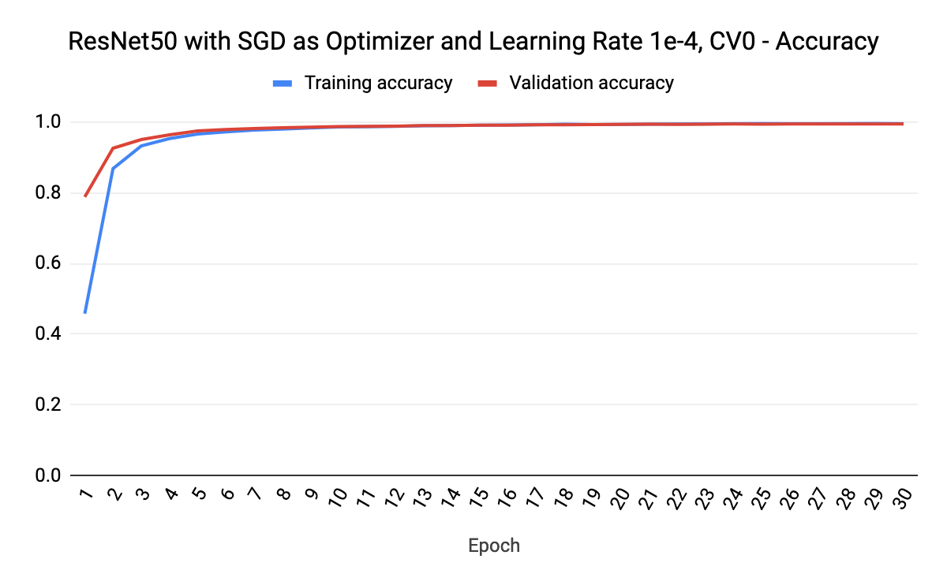
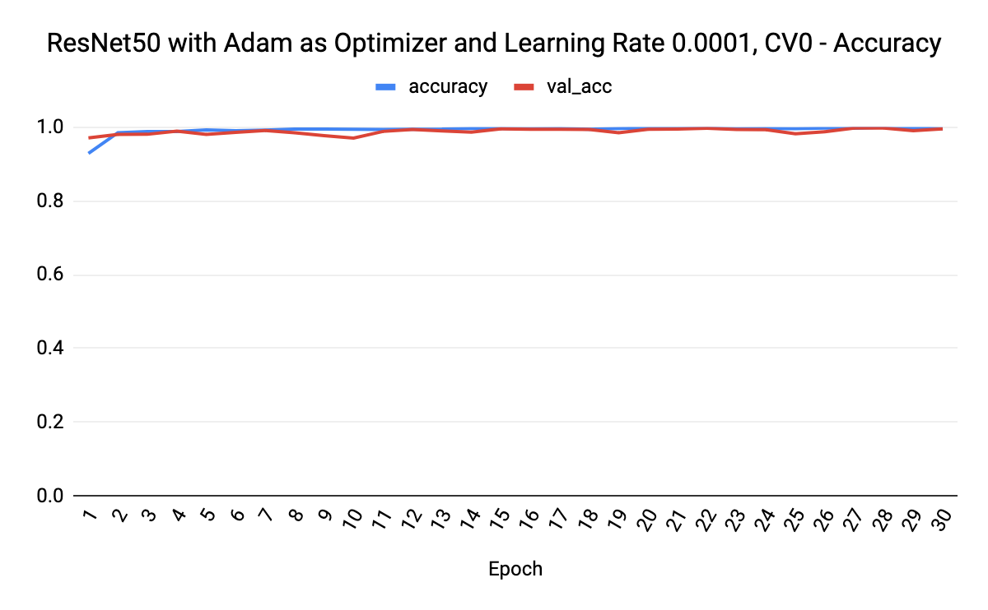
SGD
Adam

Slide 28
Adam produced some super good models during cross validation
Pair Index | Model Optimizer | Result | CV0 | CV1 | CV2 | CV3 | CV4 | mean | std
Pair 3 Run 1 | ResNet50 Adam | train_loss | 0.002614 | 0.162013 | 0.009556 | 0.006231 | 0.028656 | 0.041814 | 0.060769
 |  | train_acc | 0.999052 | 0.967442 | 0.995931 | 0.998328 | 0.991194 | 0.990389 | 0.011798
 |  | val-loss | 0.016337 | 0.253276 | 0.026917 | 0.024897 | 0.046944 | 0.073674 | 0.090360
 |  | val-acc | 0.995100 | 0.953644 | 0.993308 | 0.995539 | 0.987280 | 0.984974 | 0.015941

Slide 29
Adam produced some super good models during cross validation
Pair Index | Model Optimizer | Result | CV0 | CV1 | CV2 | CV3 | CV4 | mean | std
Pair 3 Run 1 | ResNet50 Adam | train_loss | 0.002614 | 0.162013 | 0.009556 | 0.006231 | 0.028656 | 0.041814 | 0.060769
 |  | train_acc | 0.999052 | 0.967442 | 0.995931 | 0.998328 | 0.991194 | 0.990389 | 0.011798
 |  | val-loss | 0.016337 | 0.253276 | 0.026917 | 0.024897 | 0.046944 | 0.073674 | 0.090360
 |  | val-acc | 0.995100 | 0.953644 | 0.993308 | 0.995539 | 0.987280 | 0.984974 | 0.015941
Pair 3 Run 2 | ResNet50 Adam | train_loss | 0.013737 | 0.015116 | 0.001446 | 0.005611 | 0.010234 | 0.009229 | 0.005092
 |  | train_acc | 0.996208 | 0.996934 | 0.999554 | 0.997993 | 0.997269 | 0.997592 | 0.001137
 |  | val-loss | 0.023318 | 0.027315 | 0.017609 | 0.025737 | 0.017620 | 0.022320 | 0.004048
 |  | val-acc | 0.993764 | 0.993314 | 0.996877 | 0.993308 | 0.995983 | 0.994649 | 0.001490

Slide 30
Model Optimizer |  | Ensemble | Test Data Preprocessing |  | ResNet50 Adam Try 1 CV0 |  | ResNet50 Adam Try 2 CV2 |  | ResNet50 Adam Try 2 CV4
Grp | Index | # of Model | Augmentation | KNN | Private Board | Public Board | Private Board | Public Board | Private Board | Public Board
6 | 6 - A | 1 | Y | First 5 | 0.22537 | 0.22082 | 0.23779 | 0.24154 | 0.30331 | 0.29786
 | 6 - B | 1 | Y | First 10 | 0.22006 | 0.21145 | 0.22799 | 0.23202 | 0.29710 | 0.28737
 |  |  |  |  | CV0 + Candidate 1 |  | CV2 + Candidate 1 |  | CV4 + Candidate 1
7 | 7 - A | 13 | Y | First 10 | 0.21654 | 0.24366 | 0.21798 | 0.25559 | 0.25535 | 0.27775
 |  | 14 |  |  | CV0 + CV2 + Candidate 1 |  |  |  | NA
 |  |  |  |  | Private Board Score Ranking (Top%) |  | Public Board Score Ranking (Top%)
8 | 8 - A |  | Y | First 10 | 0.20022 63 (4.4%) |  | 0.21994 103 (7.2%)
 |  |  |  |  | CV0 + CV2 + CV 4 + Candidate 1
9 | 9 - A |  |  |  | Private Board Score: 0.23013 | Public Board Score: 0.23067

Slide 31
Candidate 2
12 models by SGD +
2 models by Adam
Model Optimizer |  | Ensemble | Test Data Preprocessing |  | ResNet50 Adam Try 1 CV0 |  | ResNet50 Adam Try 2 CV2 |  | ResNet50 Adam Try 2 CV4
Grp | Index | # of Model | Augmentation | KNN | Private Board | Public Board | Private Board | Public Board | Private Board | Public Board
6 | 6 - A | 1 | Y | First 5 | 0.22537 | 0.22082 | 0.23779 | 0.24154 | 0.30331 | 0.29786
 | 6 - B | 1 | Y | First 10 | 0.22006 | 0.21145 | 0.22799 | 0.23202 | 0.29710 | 0.28737
 |  |  |  |  | CV0 + Candidate 1 |  | CV2 + Candidate 1 |  | CV4 + Candidate 1
7 | 7 - A | 13 | Y | First 10 | 0.21654 | 0.24366 | 0.21798 | 0.25559 | 0.25535 | 0.27775
 |  | 14 |  |  | CV0 + CV2 + Candidate 1 |  |  |  | NA
 |  |  |  |  | Private Board Score Ranking (Top%) |  | Public Board Score Ranking (Top%)
8 | 8 - A |  | Y | First 10 | 0.20022 63 (4.4%) |  | 0.21994 103 (7.2%)
 |  |  |  |  | CV0 + CV2 + CV 4 + 12 Models*
9 | 9 - A |  |  |  | 0.23013 Private ; 0.23067 Public

Slide 32
Candidate 2
12 models by SGD + 2 models by Adam
Private Leaderboard score 0.20022
63 out of 1440 teams (Top 4.4%)
Public Leaderboard score 0.21994
103 out of 1440 teams (Top 7.2%)

Slide 33
Summary

Slide 34
What Matters in Improving Performance
Transfer Learning using Pre-trained models
ResNet50 performs a little better than InceptionV3 in terms of loss and accuracy based on cross-validation
Ensembling
Ensemble k models from k-fold cross-validation
Ensemble predictions on randomly augmented images
Ensemble based on KNN
Ensemble two groups of models - InceptionV3 and ResNet50

Slide 35
Future Work
Averaging predictions to ensemble → Examine each class in each model and manually assign a weight to predictions
2 pre-trained models → More models to further reduced overfitting
For the 12 models trained with SGD, select the best performing models based on cross-validation score and use them to ensemble, instead of ensemble them all

Slide 36
Bonus

Slide 37
Google Cloud Cluster
A Dataproc cluster cannot train one model faster, but we could have used it to train multiple models at a time
PySpark could be used to create the submission, but...
Dataproc cluster with GPU on master and slaves is expensive!! Very easy to spend over $700 in 5 days
Google Cloud Platform provides a one-time “courtesy goodwill credit” if you make the same mistake and spend too much

Slide 38
DenseNet121 Memory Requirement
DenseNet is composed of multiple densely connected blocks
It is extremely memory hungry and consumes more memory than a ResNet because of the number of connections and the backpropagation
When attempting to train it, had to reduce batch size and increase learning rate to not run out of memory
1

Slide 39
Conclusion

Slide 40
Key Points
Distracted drivers cause problems
Reached top 4.4% of Kaggle competition!
Transfer learning is a great way to start off
There’s always room for improvement - lots of things we could try in the future
We can also look more into why the model is doing so well

Slide 41
Questions?

