Slide 1
PIZZA SALES DASHBOARD
ABC Pizzas is one of famous pizza store in New York.
Management wanted to make changes in their menu to offer new deals and combs to do so management made an ad-hoc request for insights
to make quick and smart data-informed decisions

Slide 2

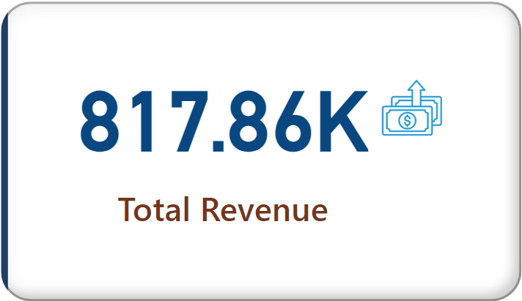

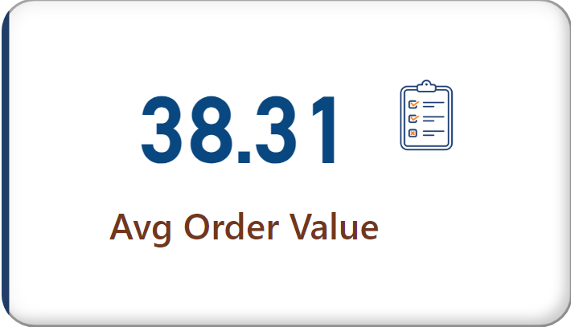
KPI`s REQUIREMENT
Key indicators for pizza sales data to gain insights into business performance.
Following are metrics:
1.Total Revenue: $817.86K revenue had been generated from 1/1/2015 to 12/31/2015 period
2. Average Order Value: Average amount spent per order was $38.31

Slide 3
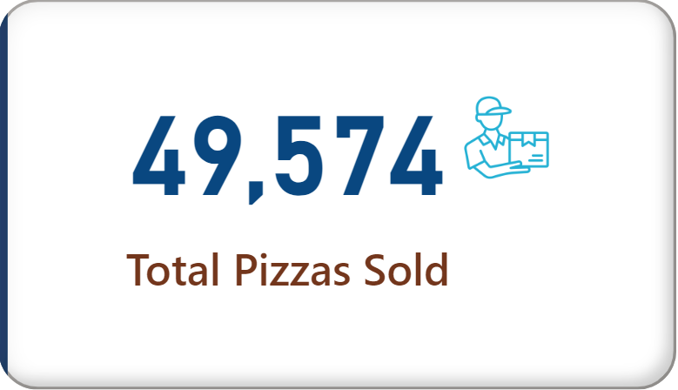

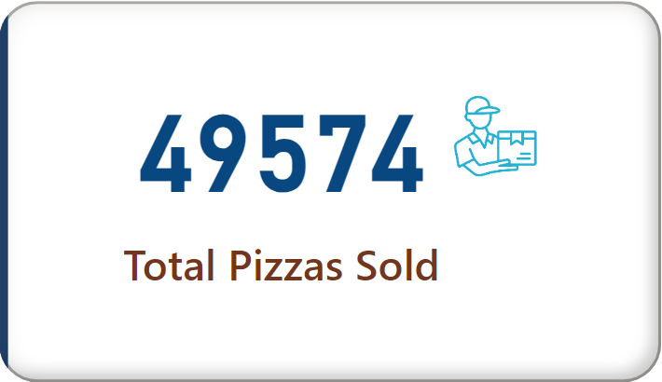
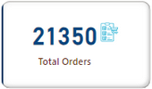
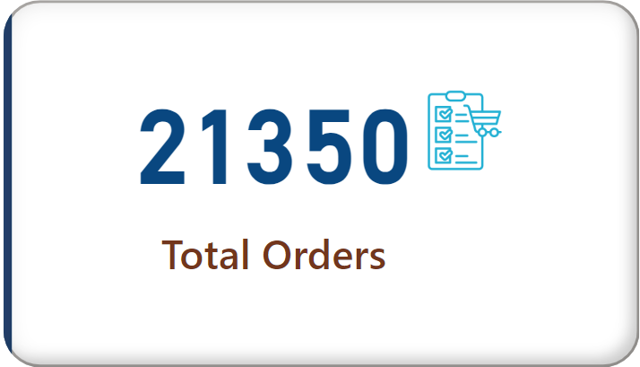
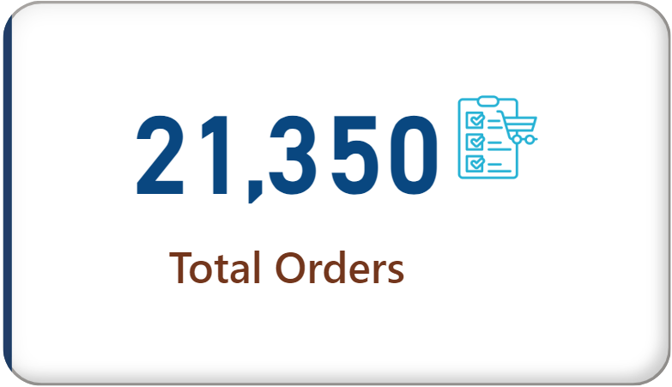
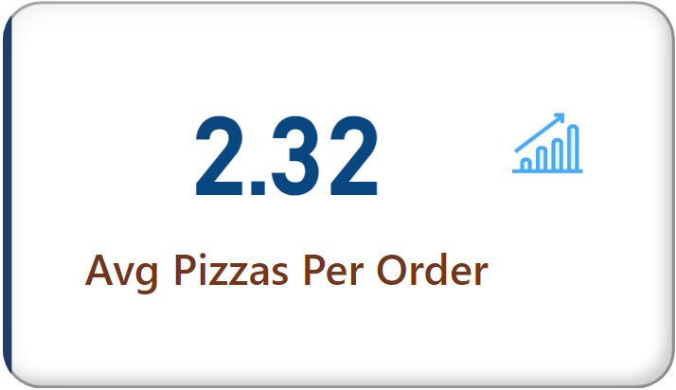

3. Total Pizzas Sold: 49,574 number of pizzas were sold from 1/1/2015 to 12/31/2015
4. Total Orders: 21,350 number of orders sold from 1/1/2015 - 12/31/2015.
5. Average Pizzas Per Order: On average 2.32 pizzas were sold per order.

Slide 4
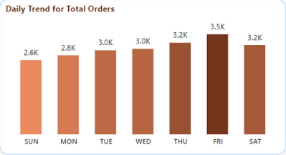

CHARTS
1. Daily Trend for Total Orders:
Orders were high on Tuesday, Friday and Saturday

Slide 5
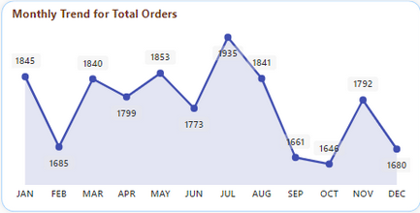
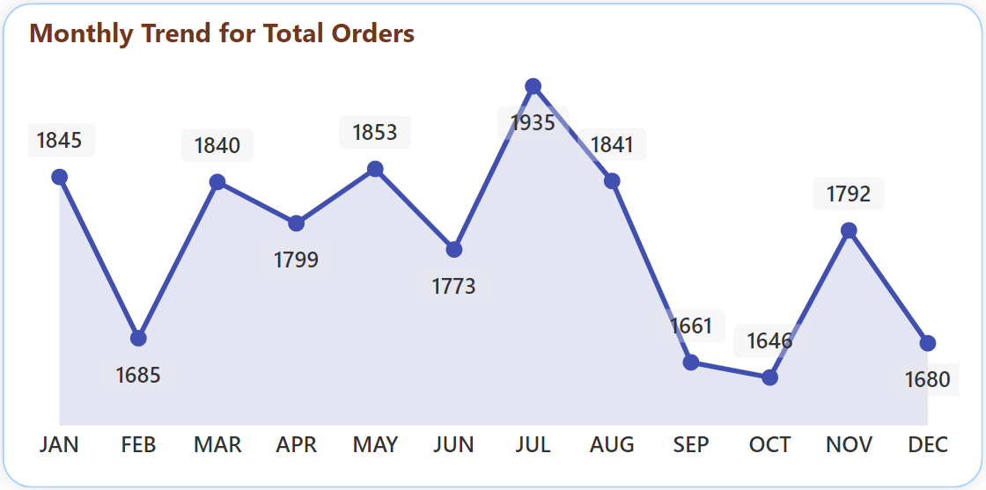
2. Monthly Trends for Total Orders:
The highest orders were from months July and January

Slide 6
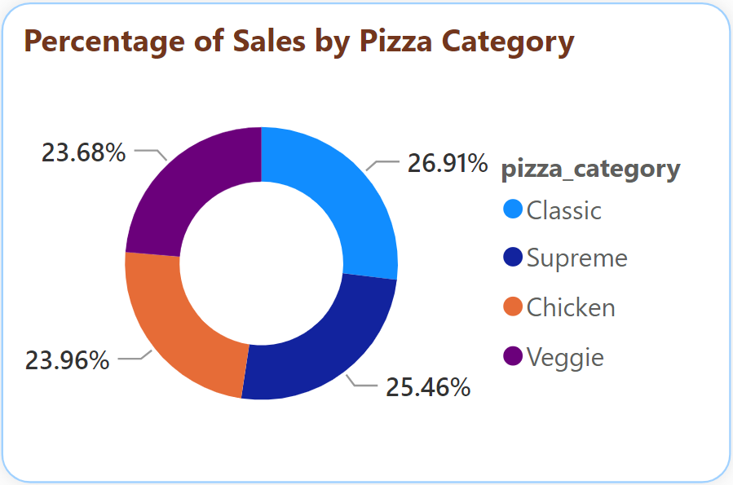

3. Percentage of Sales by Pizza Category:
Classic category contributed to maximum sales.

Slide 7
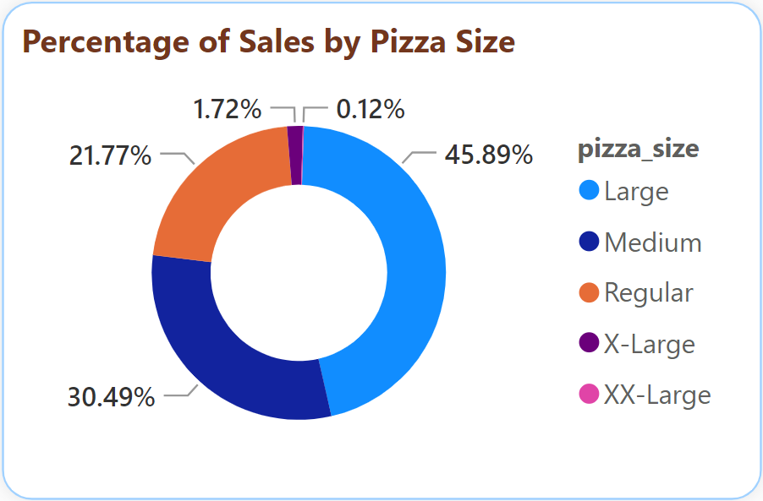
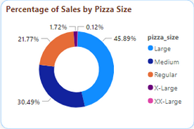
4. Percentage of Sales by Pizza Size:
Large size of pizza contributed to maximum sales

Slide 8
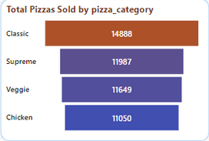
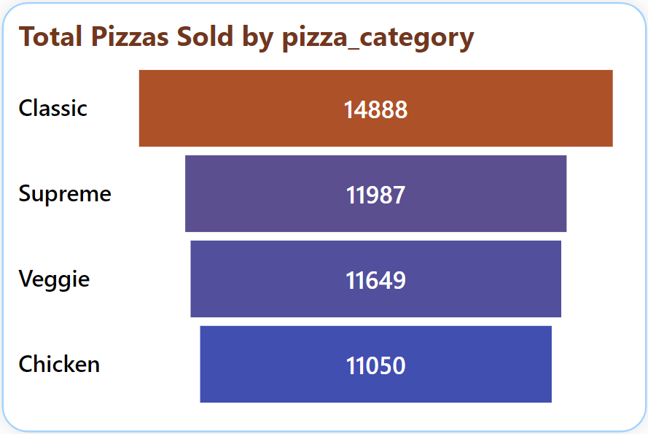
5. Total Pizzas Sold by Pizza Category:
Maximum pizzas sold were from Classic Category

Slide 9
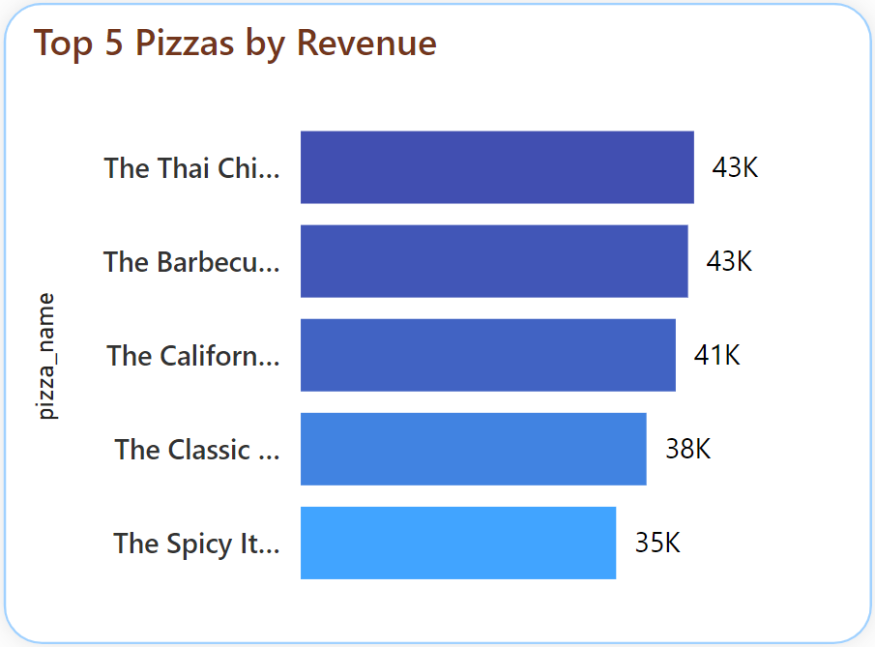
6. Top 5 Best Sellers by Revenue:
The Thai chicken pizza contributed to maximum Revenue

Slide 10
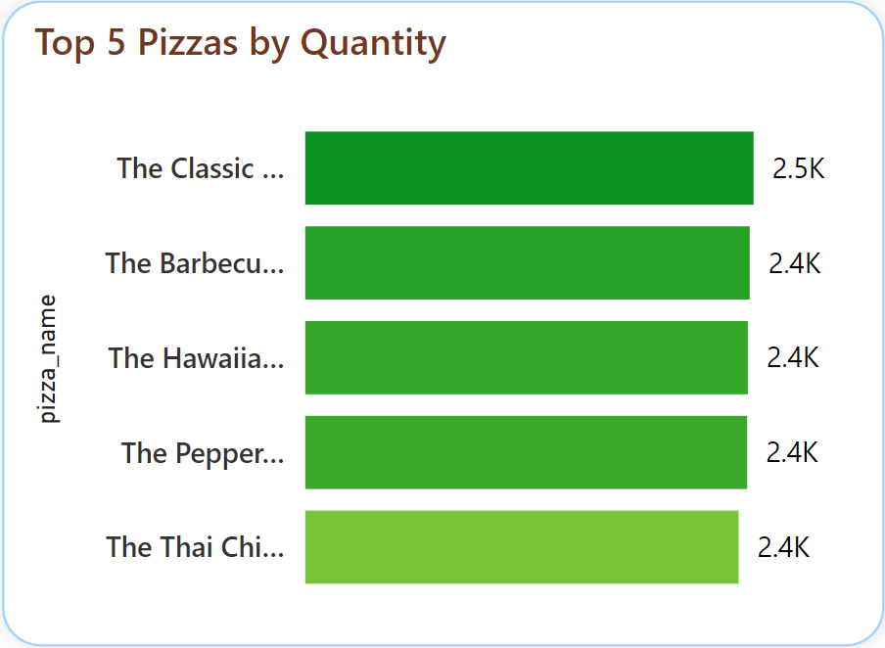
7. Top 5 Best Sellers by Total Quantity:
The Classic Deluxe Pizza contributed to maximum Total Quantities

Slide 11
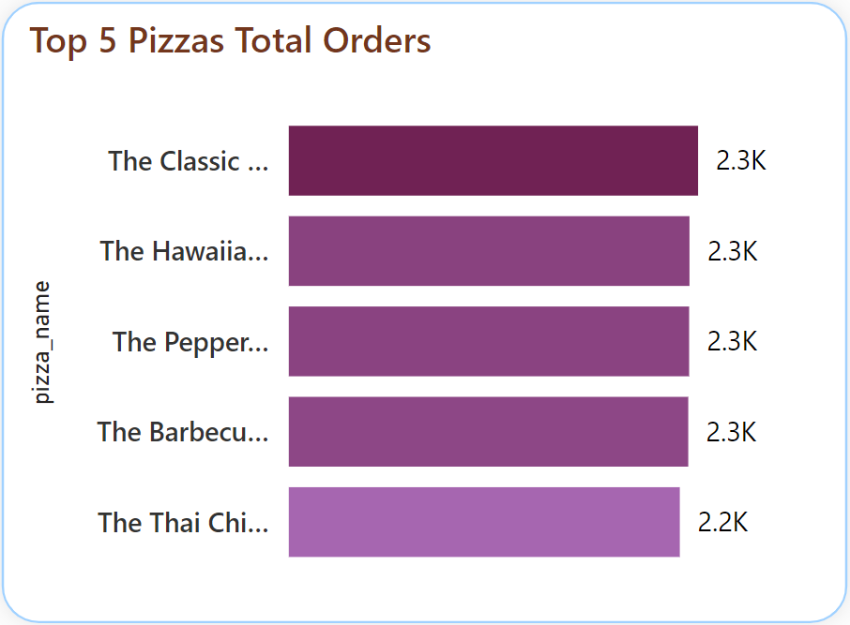
8. Top 5 Best Sellers by Total Orders:
The Classic Deluxe Pizza contributed to maximum Total Orders.

Slide 12
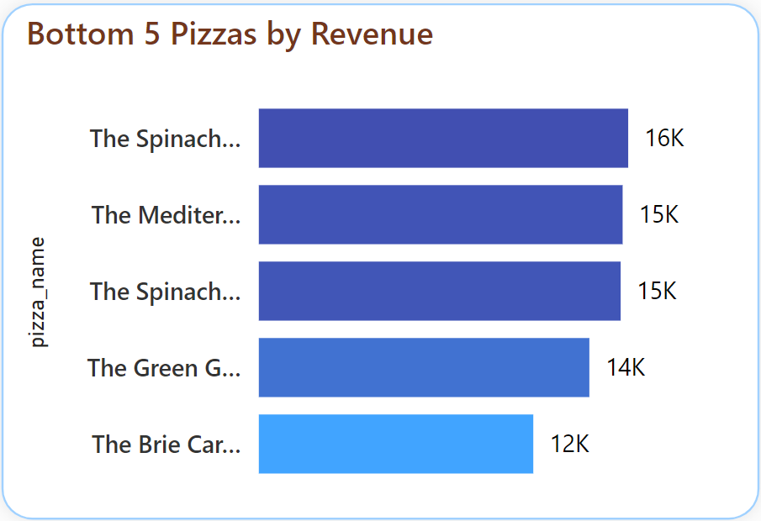
9. Bottom 5 Sellers by Revenue:
The Brie Carre Pizza contributed to least Revenue

Slide 13
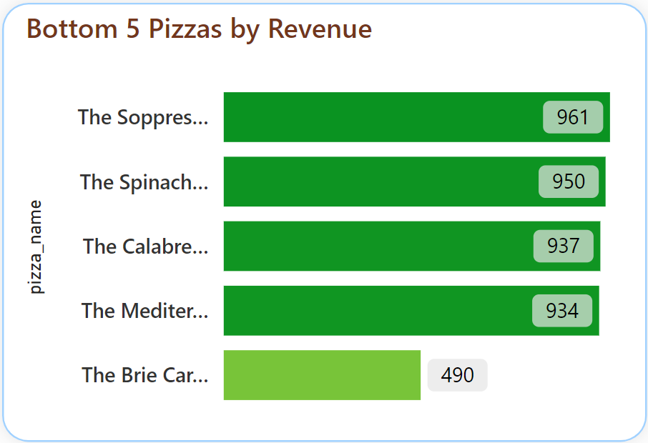
10. Bottom 5 Sellers by Total Quantity:
The Brie Carre Pizza contributed to least Total Quantities

Slide 14
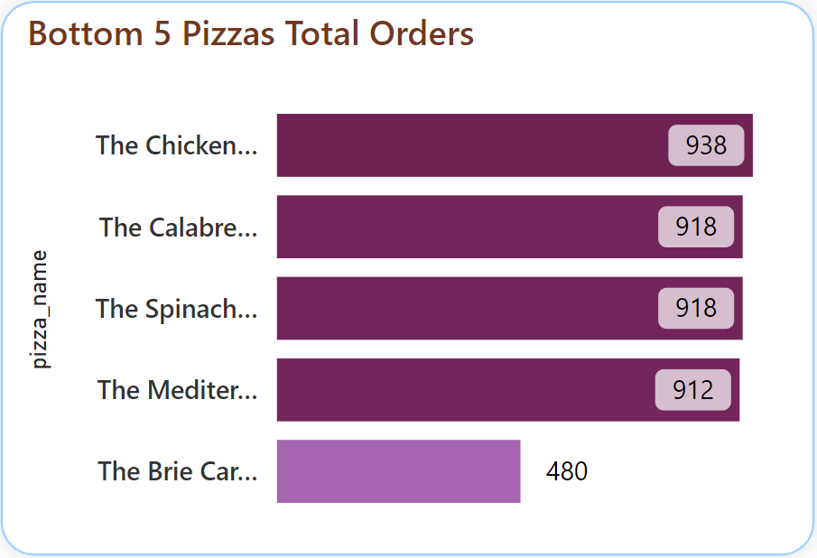
11. Bottom 5 Sellers by Total Orders:
The Brie Carre Pizza contributed to least total orders

Slide 15
SOFTWARE USED
GOOGLE SHEETS
POWER BI Version: 2.124.2028.0 64-bit (December 2023)

