Slide 1


CSci 6971: Image Registration
Lecture 9: Registration Components
February 10, 2004
Prof. Chuck Stewart, RPI
Dr. Luis Ibanez, Kitware

Slide 2
Registration Components
Basic
Registration Framework
Image Registration
Lecture 9

Slide 3
Image Registration Framework
Fixed
Image
Metric
Moving
Image
Interpolator
Optimizer
Transform
Parameters
Image Registration
Lecture 9

Slide 4
Other Image Metrics
Mean Reciprocal
Square Differences
Image Registration
Lecture 9

Slide 5
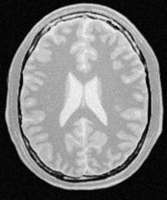
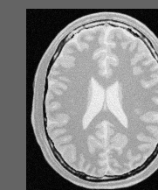
Mean Reciprocal Squared Differences
For each pixel in A
Image A
Image B
Difference( index ) = A( index ) – B( index )
1
Match( A , B ) +=
( 1 + λ ∙ Difference( index ) ² )
Image Registration
Lecture 9

Slide 6

For each pixel in the Fixed Image
j
j
i
i
Fixed Image Grid
Moving Image Grid
y
y’
Space Transform
x
x’
Fixed Image
Physical Coordinates
Moving Image
Physical Coordinates
Image Registration
Lecture 9

Slide 7
Mean Reciprocal Squared Differences
#include "itkImage.h"
#include "itkMeanReciprocalSquareDifferenceImageToImageMetric.h"
#include "itkLinearInterpolateImageFunction.h"
#include "itkTranslationTransform.h"
typedef itk::Image< char, 2 > ImageType;
ImageType::ConstPointer fixedImage = GetFixedImage();
ImageType::ConstPointer movingImage = GetMovingImage();
typedef itk::LinearInterpolateImageFunction<
ImageType,
double >
InterpolatorType;
InterpolatorType::Pointer interpolator = InterpolatorType::New();
typedef itk::TranslationTransform< double, 2 > TransformType;
TransformType::Pointer transform = TransformType::New();
Image Registration
Lecture 9

Slide 8
Mean Reciprocal Squared Differences
typedef
itk::MeanReciprocalSquareDifferenceImageToImageMetric<
ImageType,
ImageType
> MetricType;
MetricType::Pointer metric = MetricType::New();
metric->SetInterpolator( interpolator );
metric->SetTransform( transform );
metric->SetFixedImage( fixedImage );
metric->SetMovingImage( movingImage );
MetricType::TransformParametersType translation( Dimension );
translation[0] = 12;
translation[1] = 27;
double value = metric->GetValue( translation );
Image Registration
Lecture 9

Slide 9
Evaluating many matches
y
y
Transform
x
x
Fixed Image
Moving Image
Image Registration
Lecture 9

Slide 10
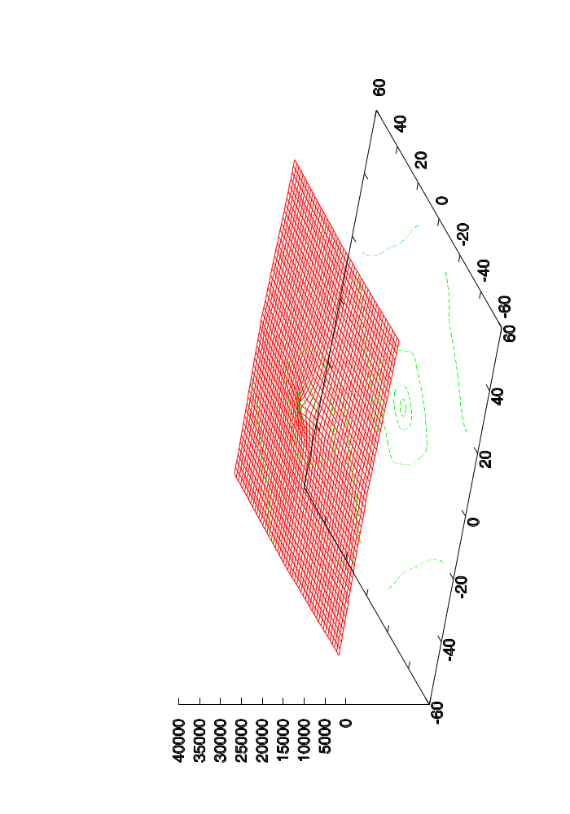
Plotting the Metric
Mean Reciprocal Squared Differences
Transform Parametric Space
Image Registration
Lecture 9

Slide 11
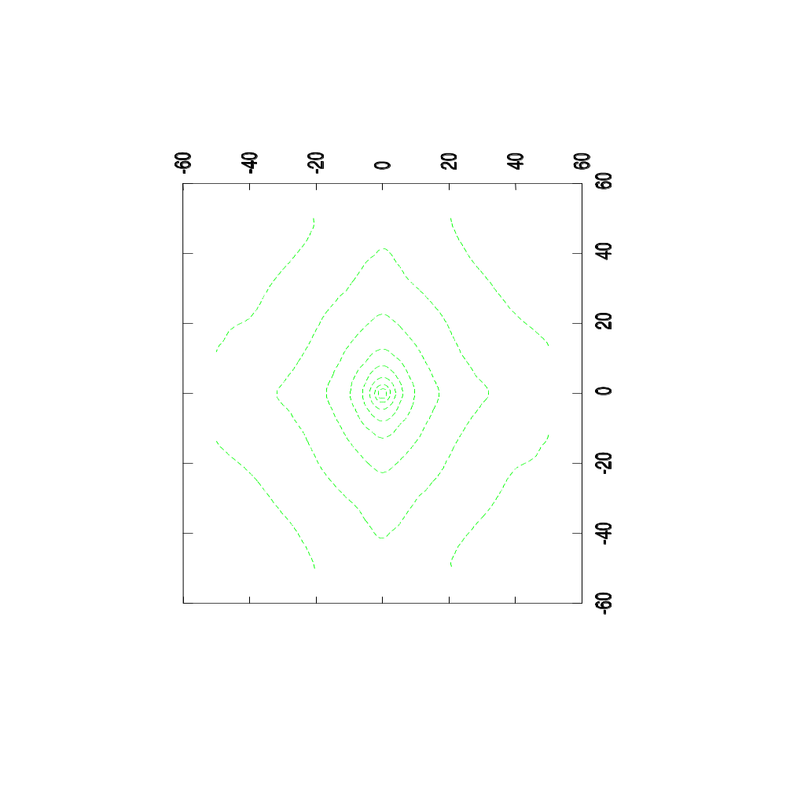
Plotting the Metric
Mean Reciprocal Squared Differences
Transform Parametric Space
Image Registration
Lecture 9

Slide 12
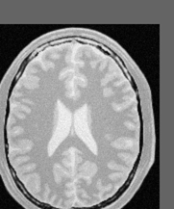
Evaluating many matches
y
y
Transform
(-15,-25) mm
x
x
Fixed Image
Moving Image
Image Registration
Lecture 9

Slide 13
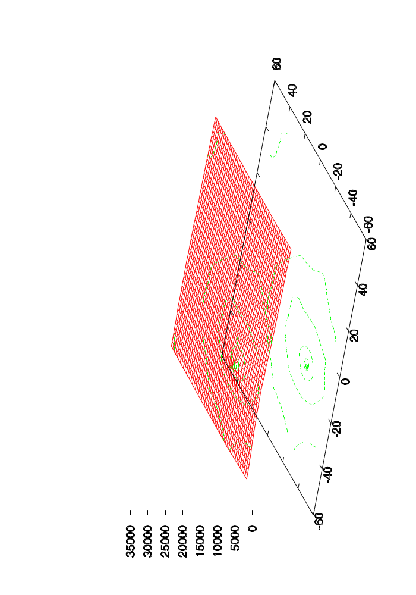
Plotting the Metric
Mean Reciprocal Squared Differences
Transform Parametric Space
Image Registration
Lecture 9

Slide 14
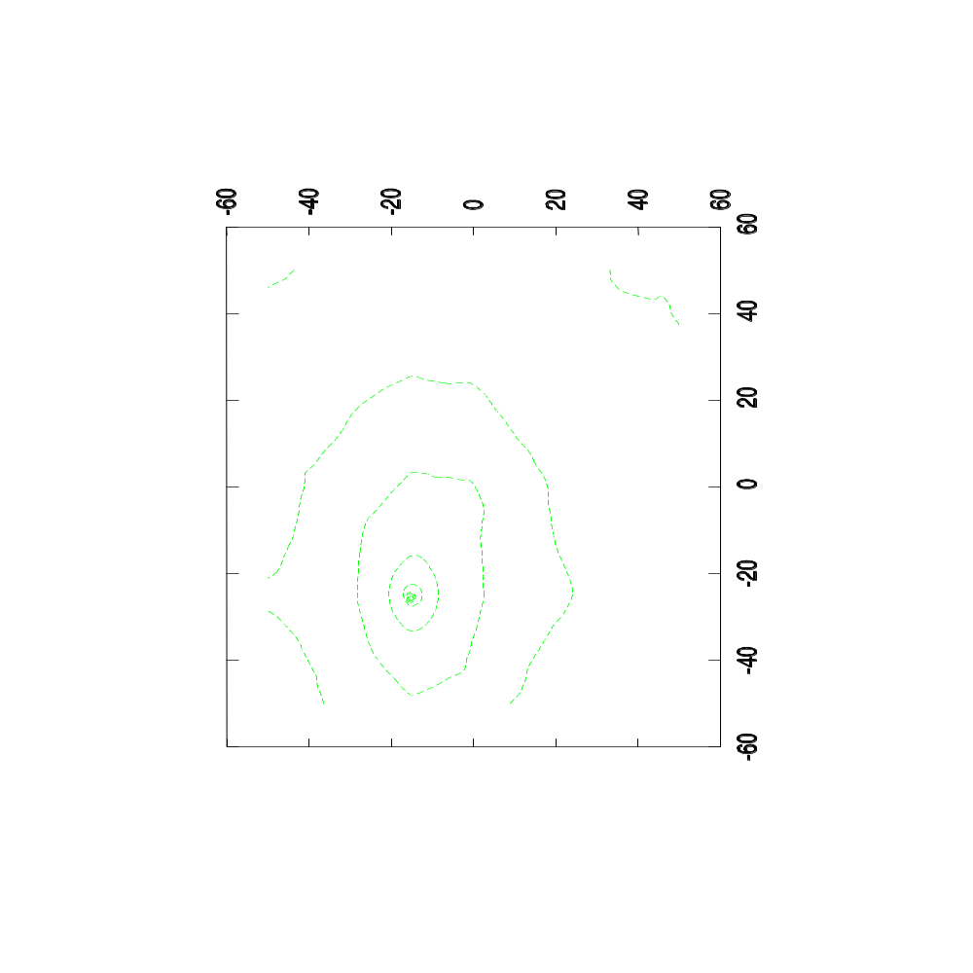
Plotting the Metric
Mean Reciprocal Squared Differences
Transform Parametric Space
Image Registration
Lecture 9

Slide 15
Watch over your optimizer
Example:
Optimizer registering an image with itself starting at (-15mm, -25mm)
Image Registration
Lecture 9

Slide 16
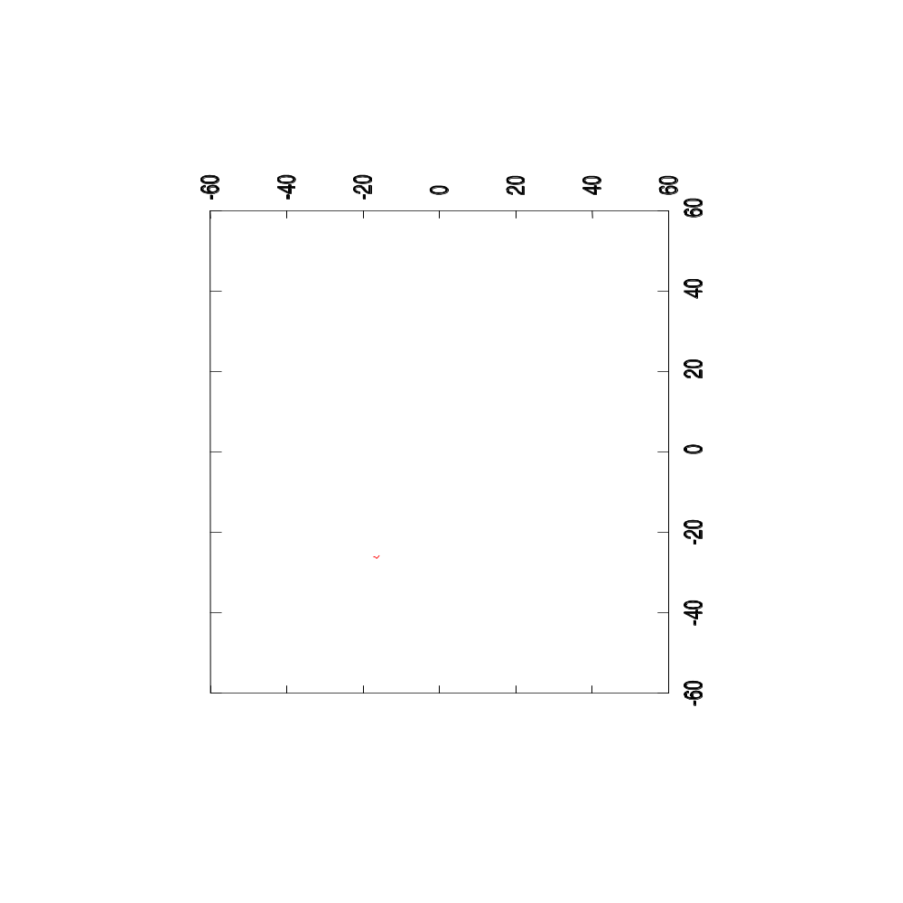
Plotting the Optimizer’s Path
Mean Reciprocal Squared Differences
Step Length = 1.0 mm
Image Registration
Lecture 9

Slide 17
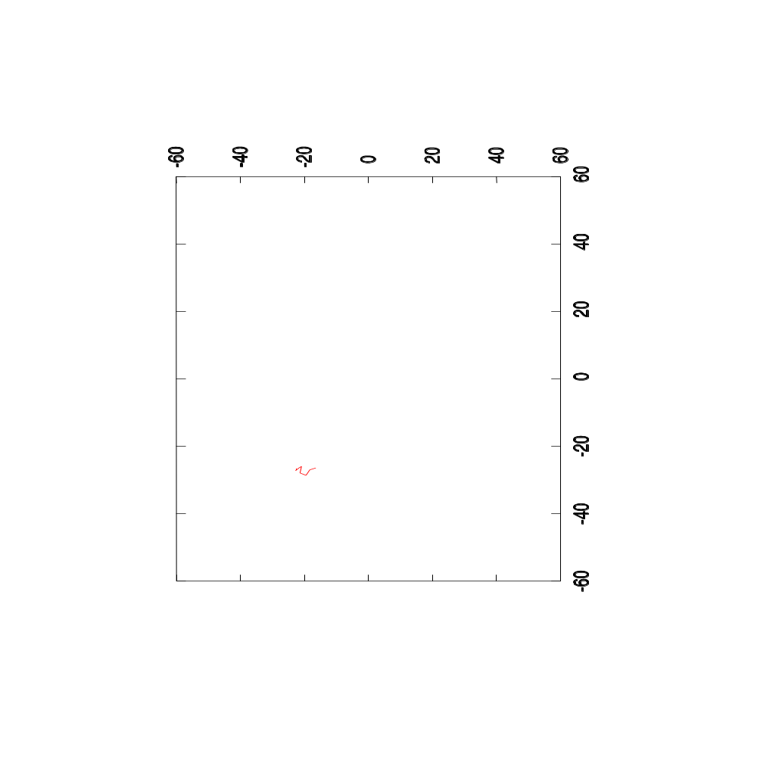
Plotting the Optimizer’s Path
Mean Reciprocal Squared Differences
Step Length = 2.0 mm
Image Registration
Lecture 9

Slide 18
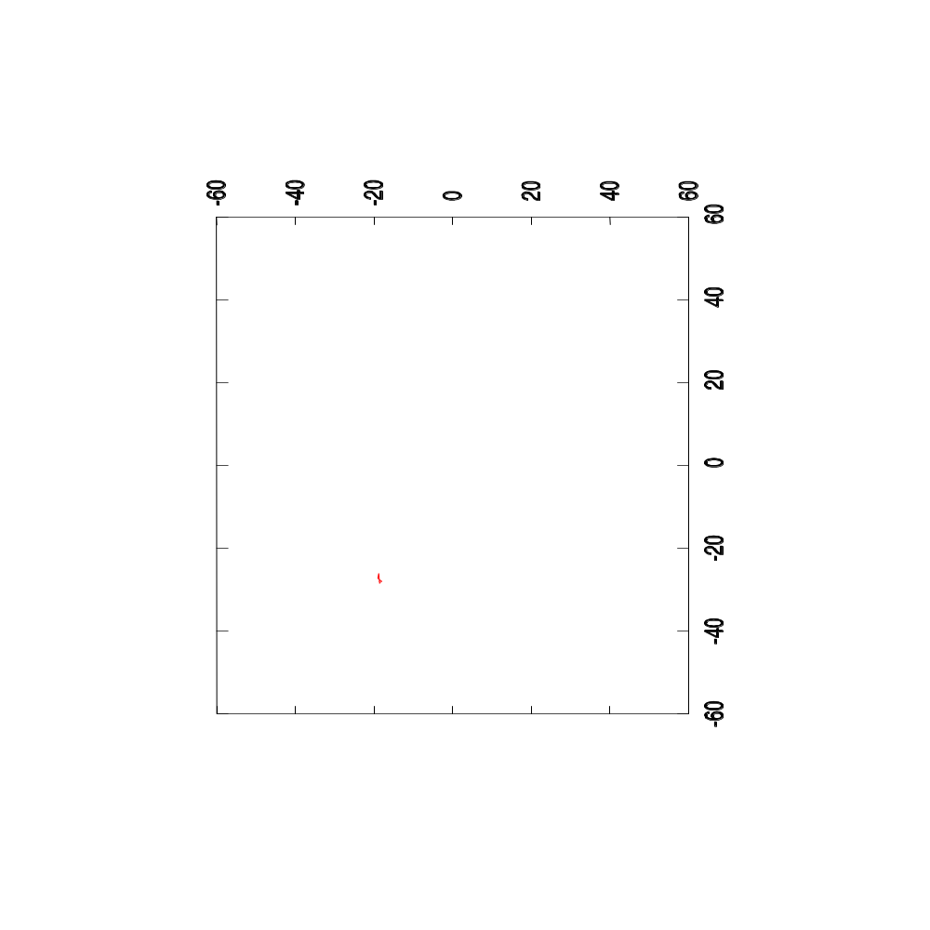
Plotting the Optimizer’s Path
Mean Reciprocal Squared Differences
Step Length = 5.0 mm
Image Registration
Lecture 9

Slide 19
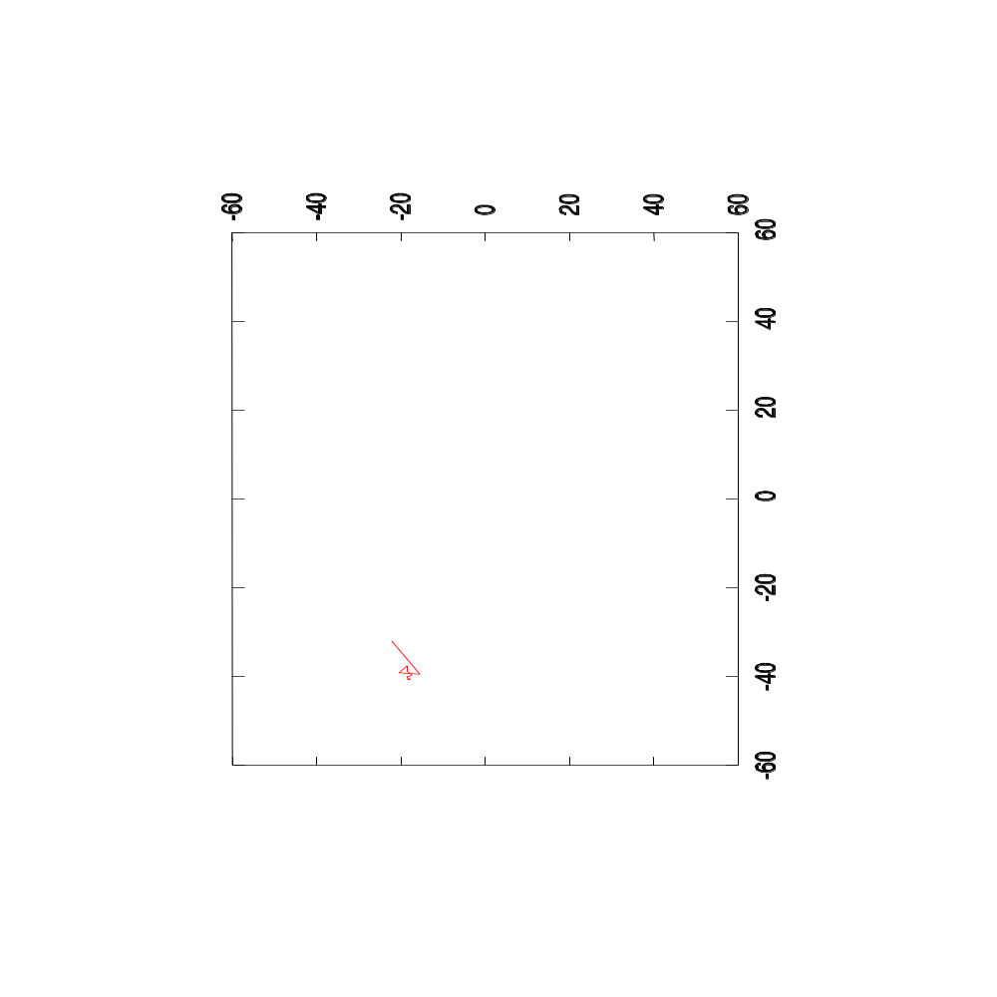
Plotting the Optimizer’s Path
Mean Reciprocal Squared Differences
Step Length = 10.0 mm
Image Registration
Lecture 9

Slide 20
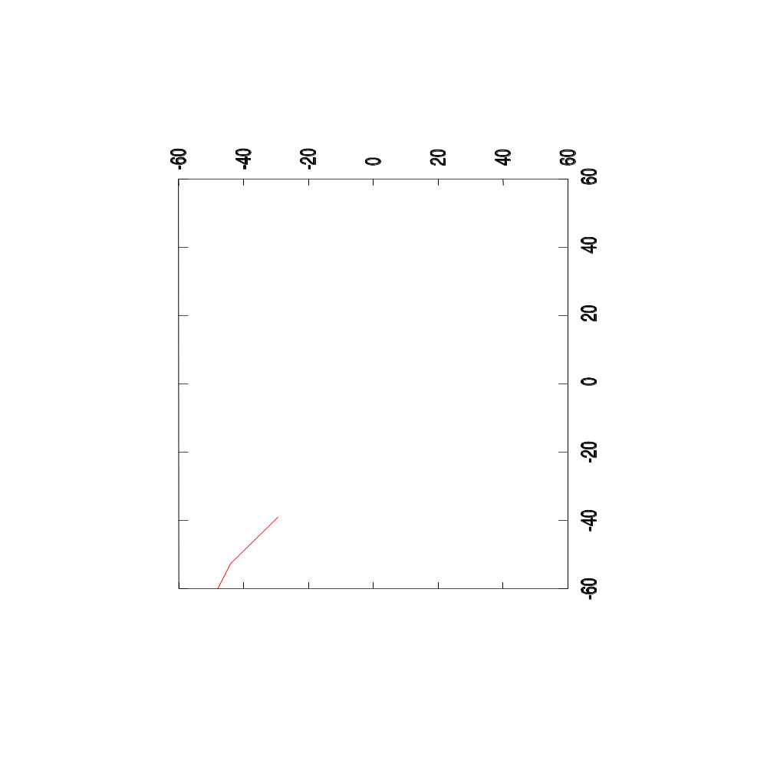
Plotting the Optimizer’s Path
Mean Reciprocal Squared Differences
Step Length = 20.0 mm
Image Registration
Lecture 9

Slide 21

Plotting the Optimizer’s Path
Mean Reciprocal Squared Differences
Step Length = 40.0 mm
Image Registration
Lecture 9

Slide 22
Quiz #1
If the Metric is Noisy
Where is the noise coming from ?
Image Registration
Lecture 9

Slide 23

Smoothing the Image
Image Registration
Lecture 9

Slide 24
Evaluating many matches
y
y
Transform
x
x
Fixed Image
Moving Image
Image Registration
Lecture 9

Slide 25
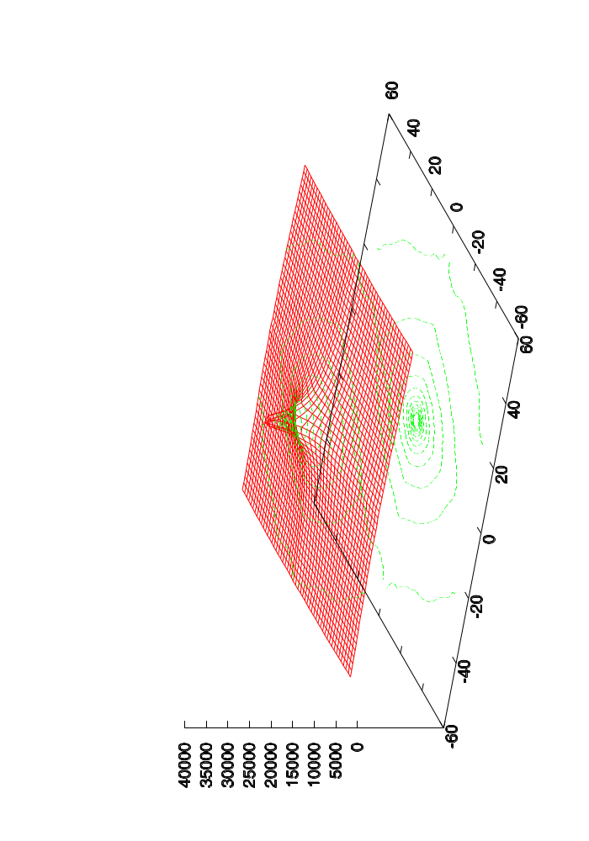
Plotting the Smoothed Metric
Mean Reciprocal Squared Differences
Transform Parametric Space
Image Registration
Lecture 9

Slide 26
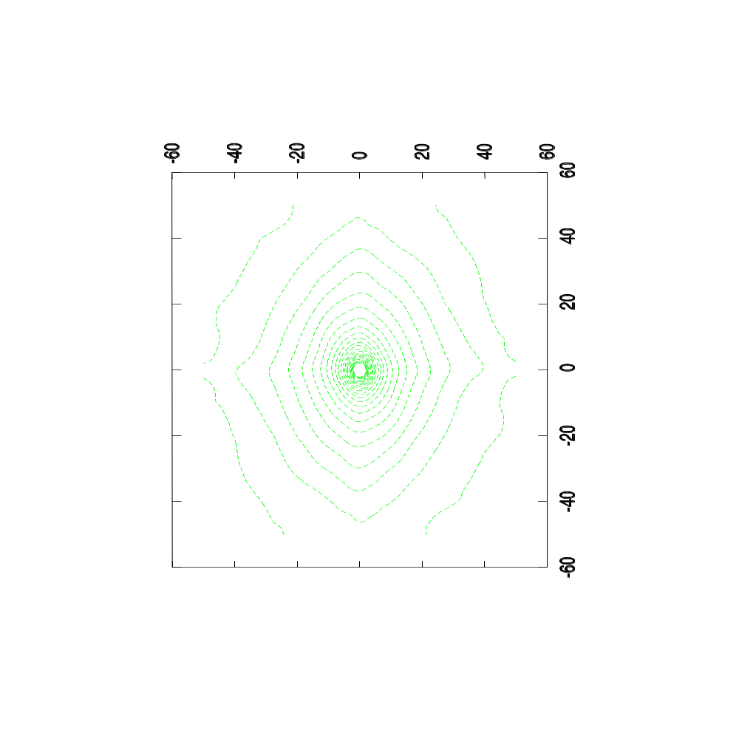
Plotting the Smoothed Metric
Mean Reciprocal Squared Differences
Transform Parametric Space
Image Registration
Lecture 9

Slide 27
Watch over your optimizer
Example:
Optimizer registering an image with itself starting at (-15mm, -25mm)
Image Registration
Lecture 9

Slide 28

Plotting the Optimizer’s Path
Mean Reciprocal Squared Differences
Step Length = 1.0 mm
Image Registration
Lecture 9

Slide 29

Plotting the Optimizer’s Path
Mean Reciprocal Squared Differences
Step Length = 2.0 mm
Image Registration
Lecture 9

Slide 30
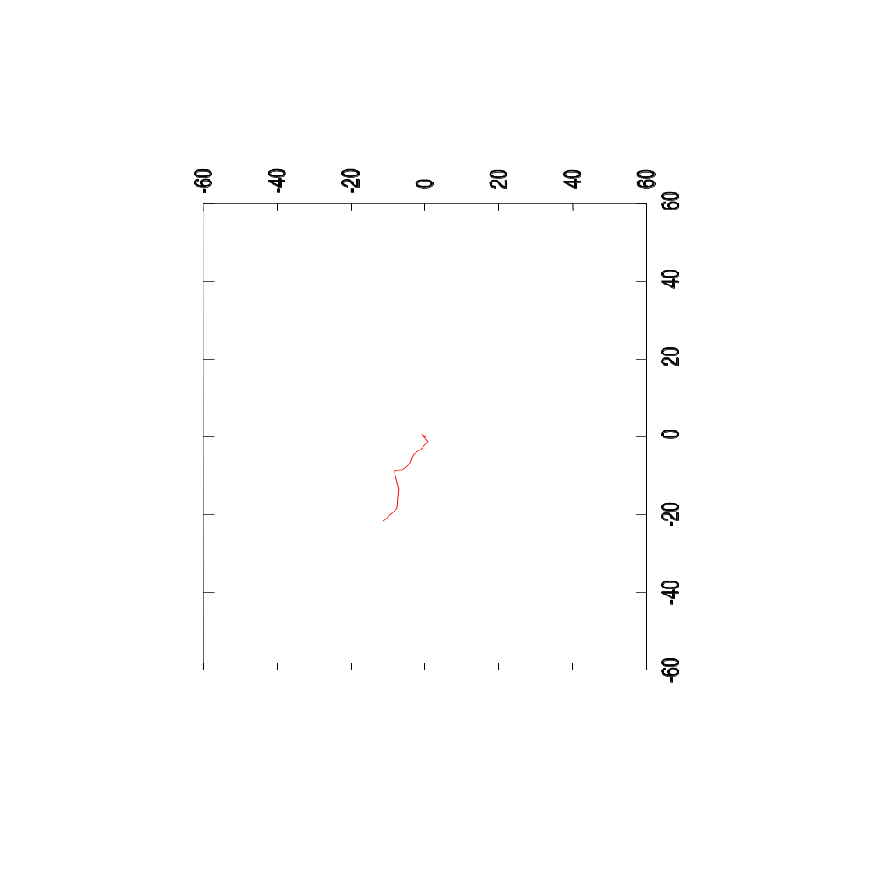
Plotting the Optimizer’s Path
Mean Reciprocal Squared Differences
Step Length = 5.0 mm
Image Registration
Lecture 9

Slide 31

Plotting the Optimizer’s Path
Mean Reciprocal Squared Differences
Step Length = 10.0 mm
Image Registration
Lecture 9

Slide 32
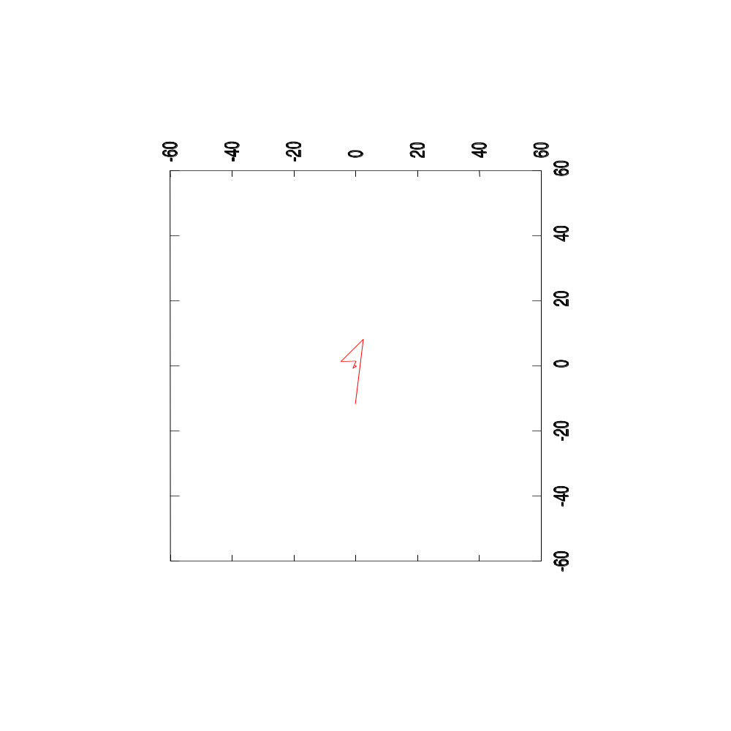
Plotting the Optimizer’s Path
Mean Reciprocal Squared Differences
Step Length = 20.0 mm
Image Registration
Lecture 9

Slide 33
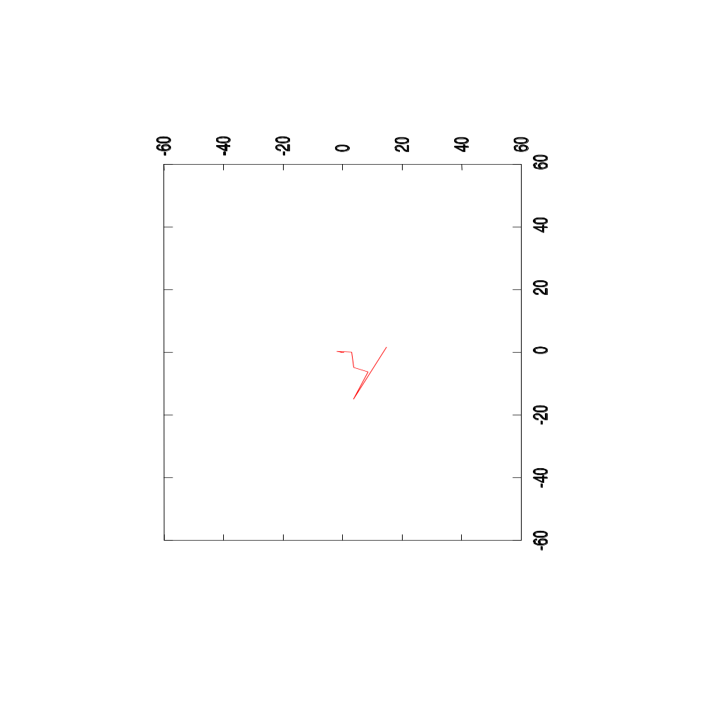
Plotting the Optimizer’s Path
Mean Reciprocal Squared Differences
Step Length = 40.0 mm
Image Registration
Lecture 9

Slide 34

Evaluating many matches
y
y
Transform
(-15,-25) mm
x
x
Fixed Image
Moving Image
Image Registration
Lecture 9

Slide 35
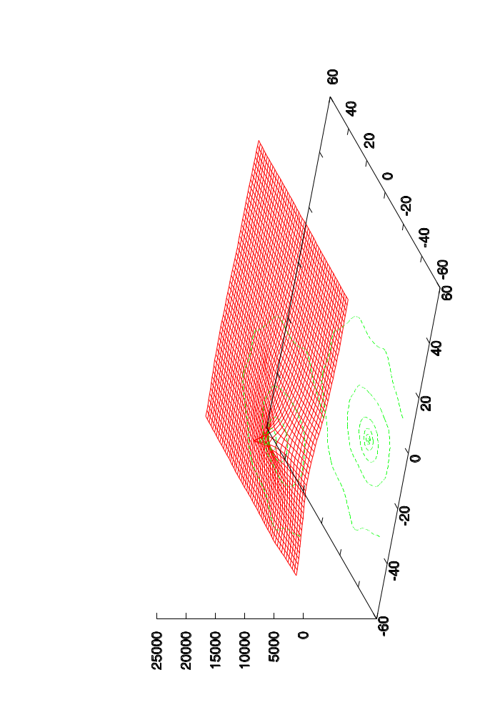
Plotting the Smoothed Metric
Mean Reciprocal Squared Differences
Transform Parametric Space
Image Registration
Lecture 9

Slide 36
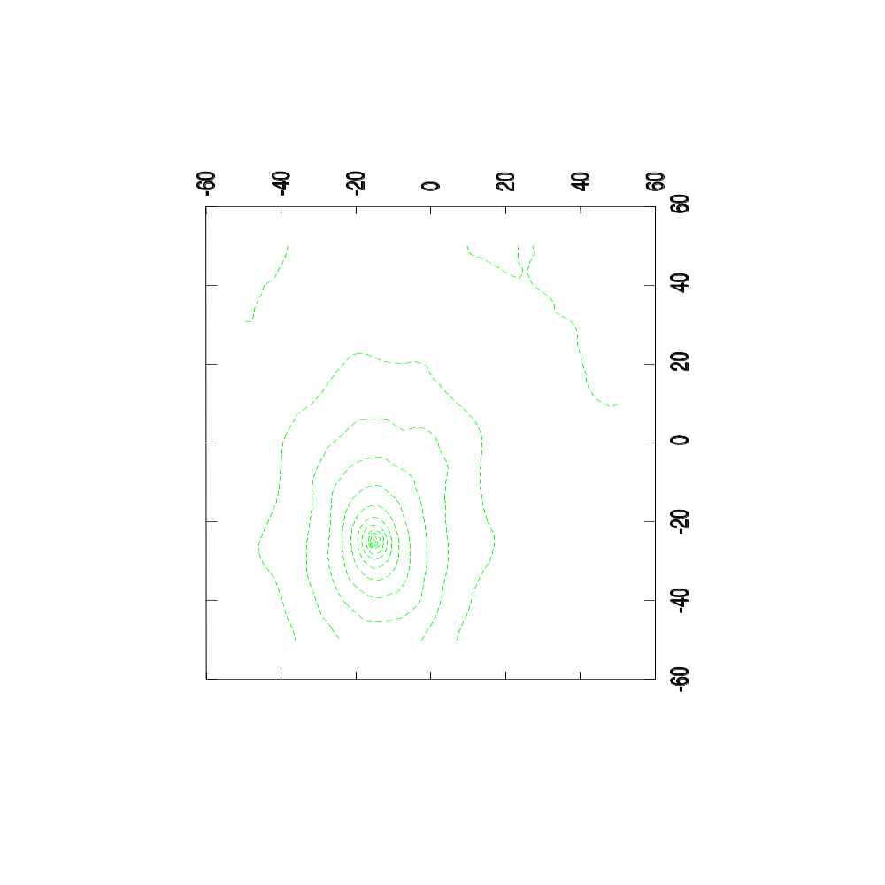
Plotting the Smoothed Metric
Mean Reciprocal Squared Differences
Transform Parametric Space
Image Registration
Lecture 9

Slide 37
Watch over your optimizer
Example:
Optimizer registering an image shifted by (-15mm, -25mm)
The optimizer starts at (0mm,0mm)
Image Registration
Lecture 9

Slide 38

Plotting the Optimizer’s Path
Mean Reciprocal Squared Differences
Step Length = 1.0 mm
Image Registration
Lecture 9

Slide 39
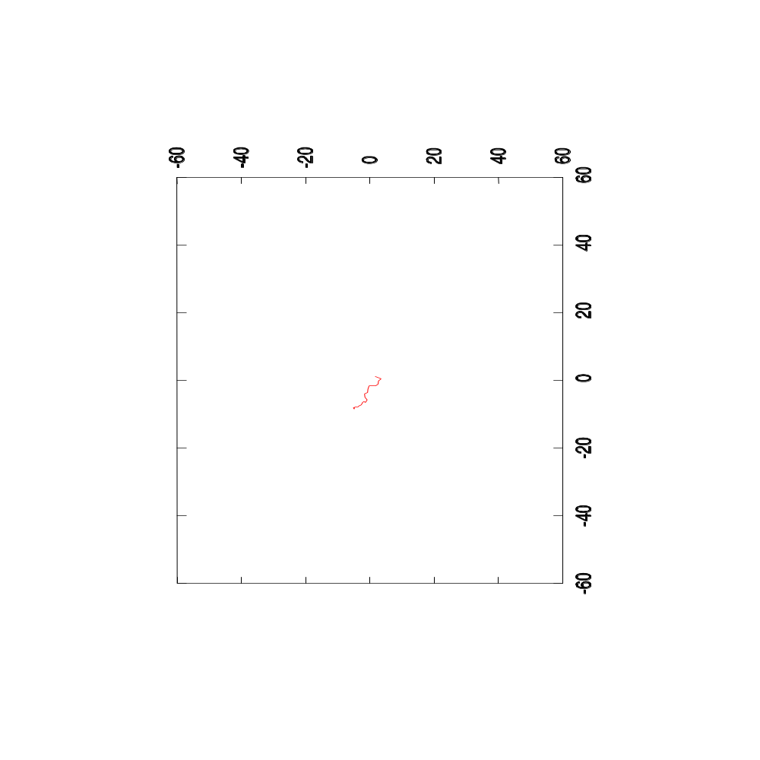
Plotting the Optimizer’s Path
Mean Reciprocal Squared Differences
Step Length = 2.0 mm
Image Registration
Lecture 9

Slide 40
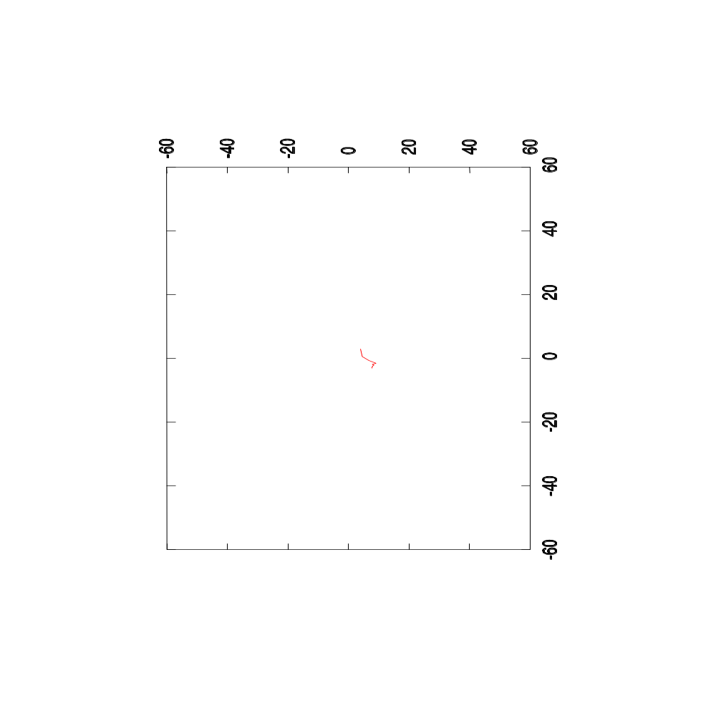
Plotting the Optimizer’s Path
Mean Reciprocal Squared Differences
Step Length = 5.0 mm
Image Registration
Lecture 9

Slide 41
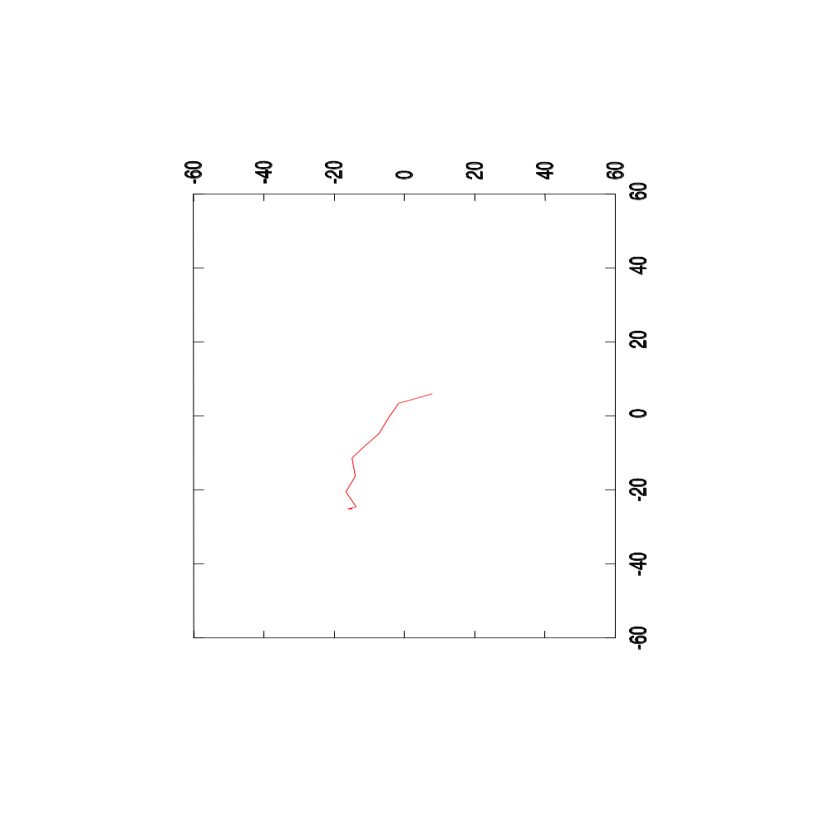
Plotting the Optimizer’s Path
Mean Reciprocal Squared Differences
Step Length = 10.0 mm
Image Registration
Lecture 9

Slide 42
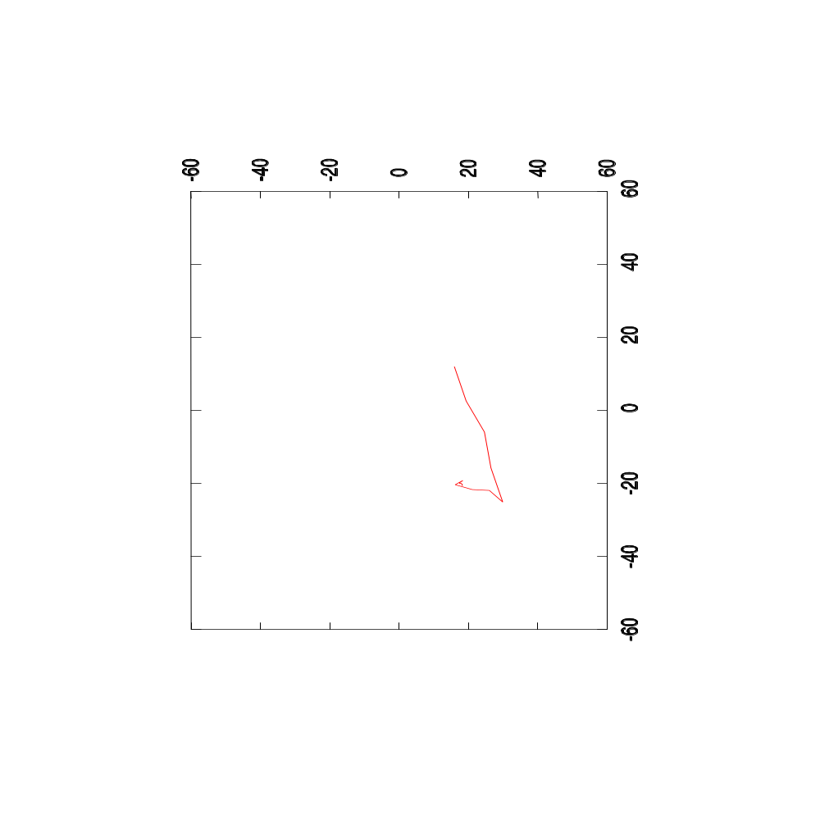
Plotting the Optimizer’s Path
Mean Reciprocal Squared Differences
Step Length = 20.0 mm
Image Registration
Lecture 9

Slide 43
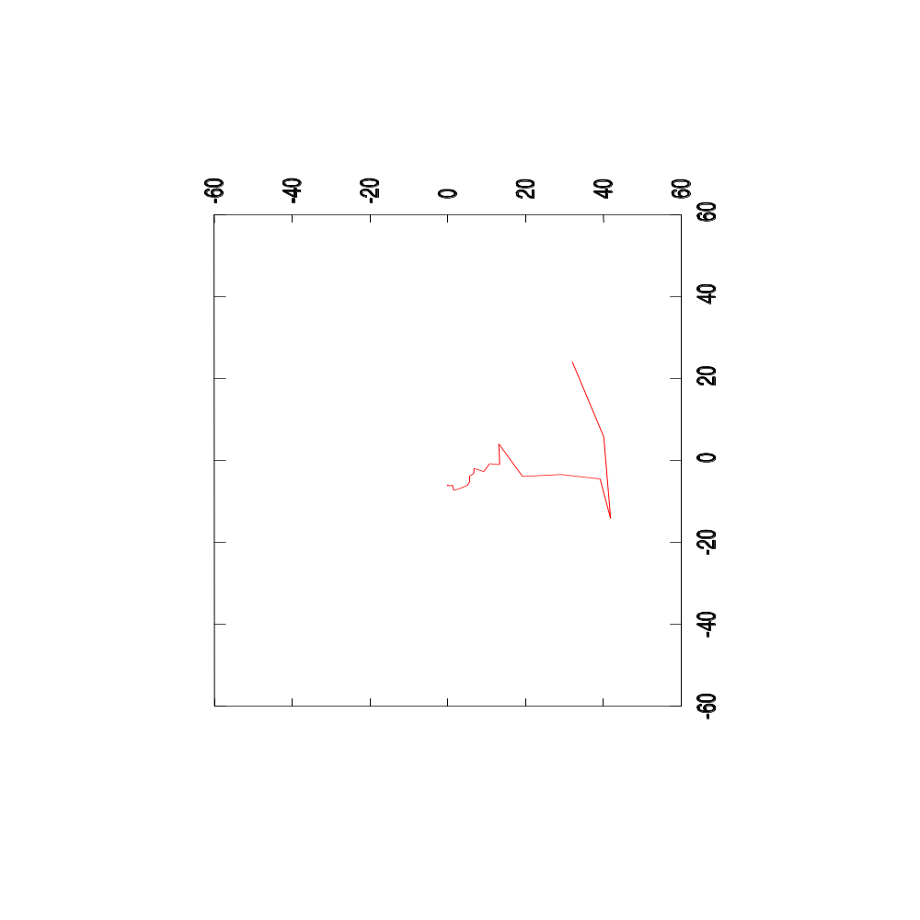
Plotting the Optimizer’s Path
Mean Reciprocal Squared Differences
Step Length = 40.0 mm
Image Registration
Lecture 9

Slide 44
Other Image Metrics
Multi – Modality
Registration
Image Registration
Lecture 9

Slide 45
Multiple Image Modalities
Number of pairs
Image Registration
Lecture 9

Slide 46
Multiple Image Modalities
More possible pairs
Image Registration
Lecture 9

Slide 47
Intuitive Notion of Joint Entropy
The More Pairs Exist
The Larger the Joint Entropy
Image Registration
Lecture 9

Slide 48
Mutual Information
Reduction of Number of Pairs
Reduction of Joint Entropy
Image Registration
Lecture 9

Slide 49
Mutual Information
Mutual Information =
Joint Entropy ( Image A, Image B )
- Entropy Image A
- Entropy Image B
Image Registration
Lecture 9

Slide 50
Mattes Mutual Information
#include "itkImage.h"
#include "itkMattesMutualInformationImageToImageMetric.h"
#include "itkLinearInterpolateImageFunction.h"
#include "itkTranslationTransform.h"
typedef itk::Image< char, 2 > ImageType;
ImageType::ConstPointer fixedImage = GetFixedImage();
ImageType::ConstPointer movingImage = GetMovingImage();
typedef itk::LinearInterpolateImageFunction<
ImageType,
double >
InterpolatorType;
InterpolatorType::Pointer interpolator = InterpolatorType::New();
typedef itk::TranslationTransform< double, 2 > TransformType;
TransformType::Pointer transform = TransformType::New();
Image Registration
Lecture 9

Slide 51
Mattes Mutual Information
typedef
itk::MattesMutualInformationImageToImageMetric<
ImageType,
ImageType
> MetricType;
MetricType::Pointer metric = MetricType::New();
metric->SetNumberOfHistogramBins( 20 );
metric->SetNumberOfSpatialSamples( 10000 );
metric->SetInterpolator( interpolator );
metric->SetTransform( transform );
metric->SetFixedImage( fixedImage );
metric->SetMovingImage( movingImage );
MetricType::TransformParametersType translation( Dimension );
translation[0] = 12;
translation[1] = 27;
double value = metric->GetValue( translation );
Image Registration
Lecture 9

Slide 52
Evaluating many matches
y
y
Transform
x
x
Fixed Image
Moving Image
Image Registration
Lecture 9

Slide 53
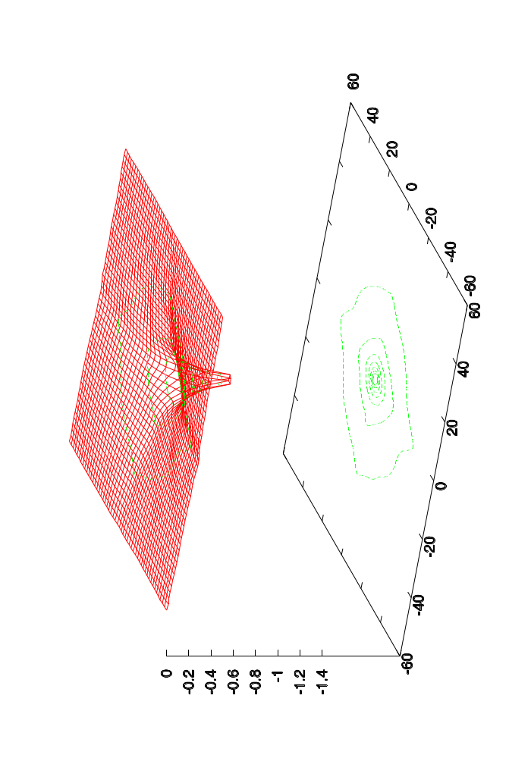
Plotting the Same Modality Metric
Mattes Mutual Information
Transform Parametric Space
Image Registration
Lecture 9

Slide 54
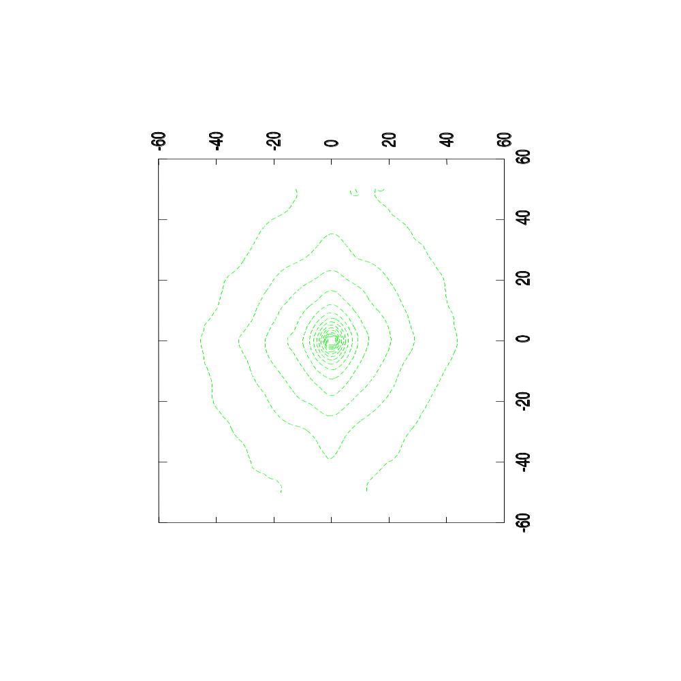
Plotting the Same Modality Metric
Mattes Mutual Information
Transform Parametric Space
Image Registration
Lecture 9

Slide 55
Evaluating many matches
y
y
Transform
(-15,-25) mm
x
x
Fixed Image
Moving Image
Image Registration
Lecture 9

Slide 56
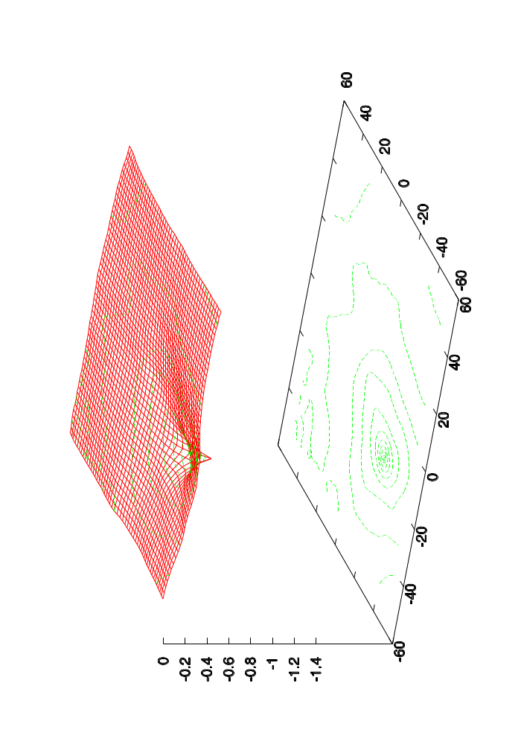
Plotting the Same Modality Metric
Mattes Mutual Information
Transform Parametric Space
Image Registration
Lecture 9

Slide 57
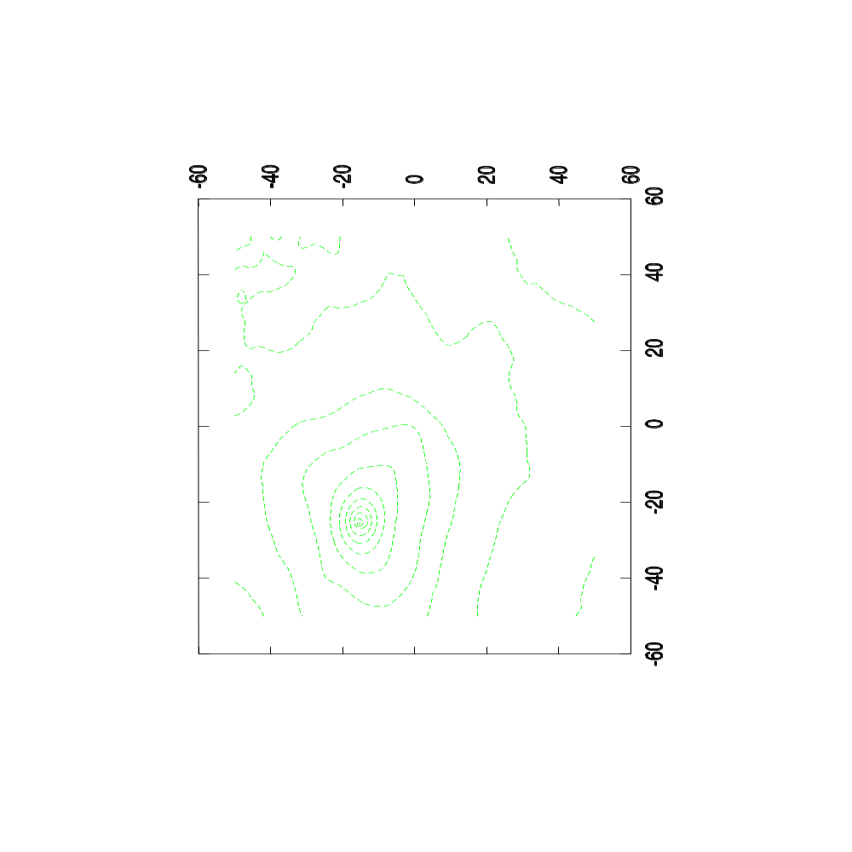
Plotting the Same Modality Metric
Mattes Mutual Information
Transform Parametric Space
Image Registration
Lecture 9

Slide 58
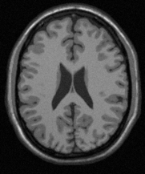
Evaluating many matches
y
y
Transform
x
x
Fixed Image
Moving Image
Image Registration
Lecture 9

Slide 59
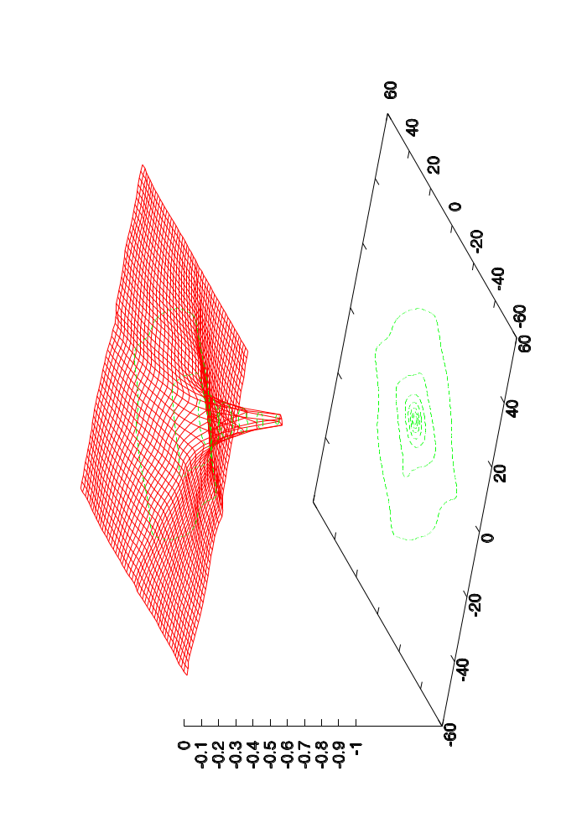
Plotting the Multi-Modality Metric
Mattes Mutual Information
Transform Parametric Space
Image Registration
Lecture 9

Slide 60
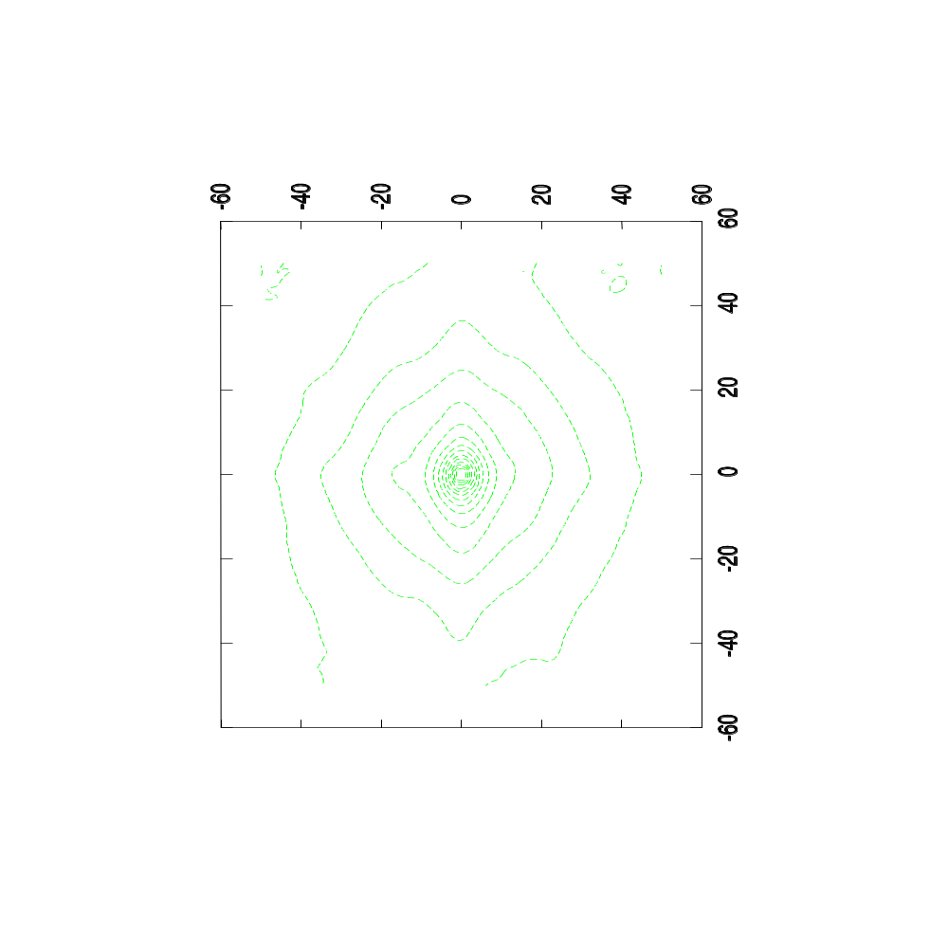
Plotting the Multi-Modality Metric
Mattes Mutual Information
Transform Parametric Space
Image Registration
Lecture 9

Slide 61
Evaluating many matches
y
y
Transform
x
x
Fixed Image
Moving Image
Image Registration
Lecture 9

Slide 62
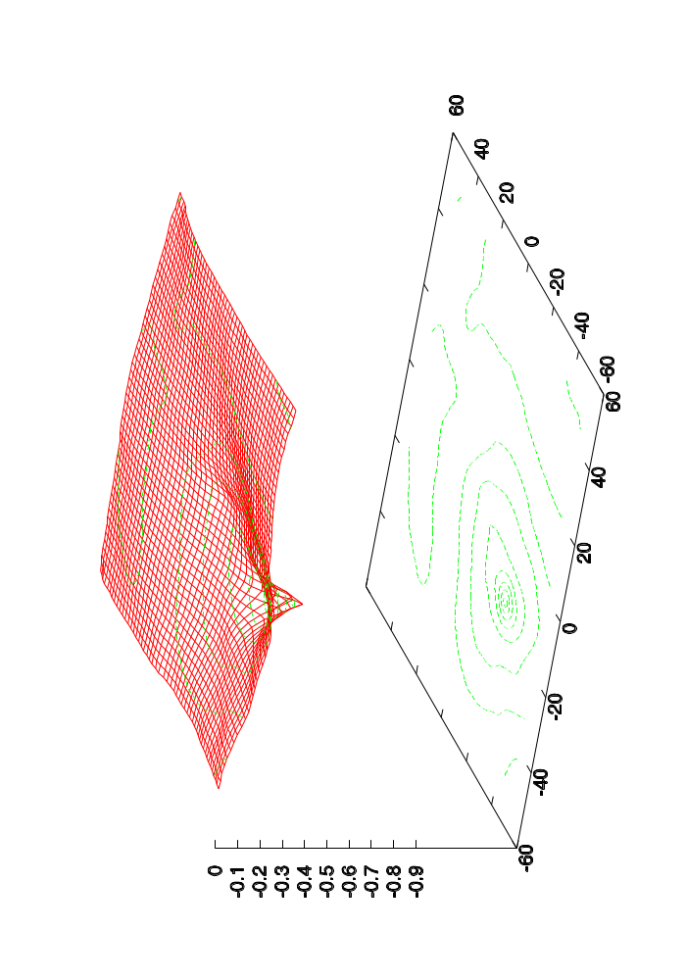
Plotting the Multi-Modality Metric
Mattes Mutual Information
Transform Parametric Space
Image Registration
Lecture 9

Slide 63
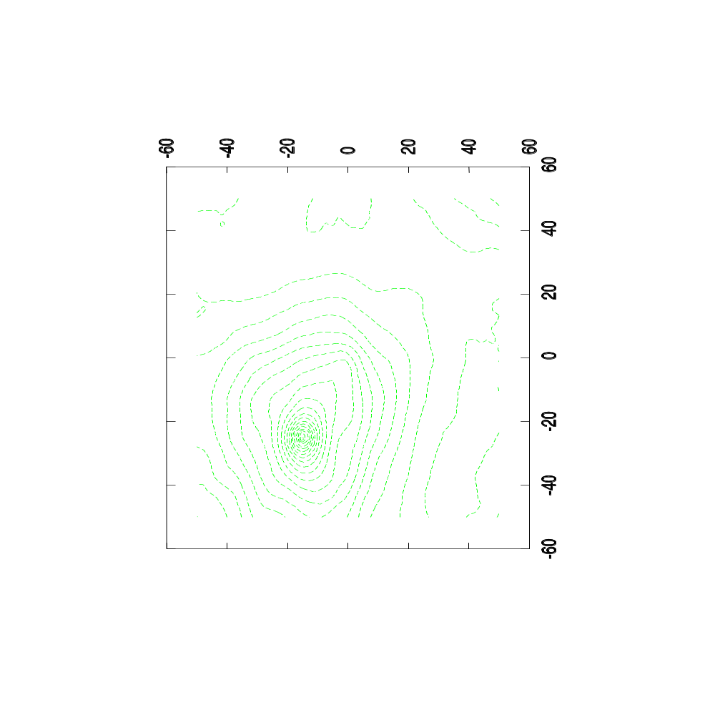
Plotting the Multi-Modality Metric
Mattes Mutual Information
Transform Parametric Space
Image Registration
Lecture 9

Slide 64
Watch over your optimizer
Example:
Optimizer registering two aligned
multi-modality images
starting at (-15mm, -25mm)
Image Registration
Lecture 9

Slide 65
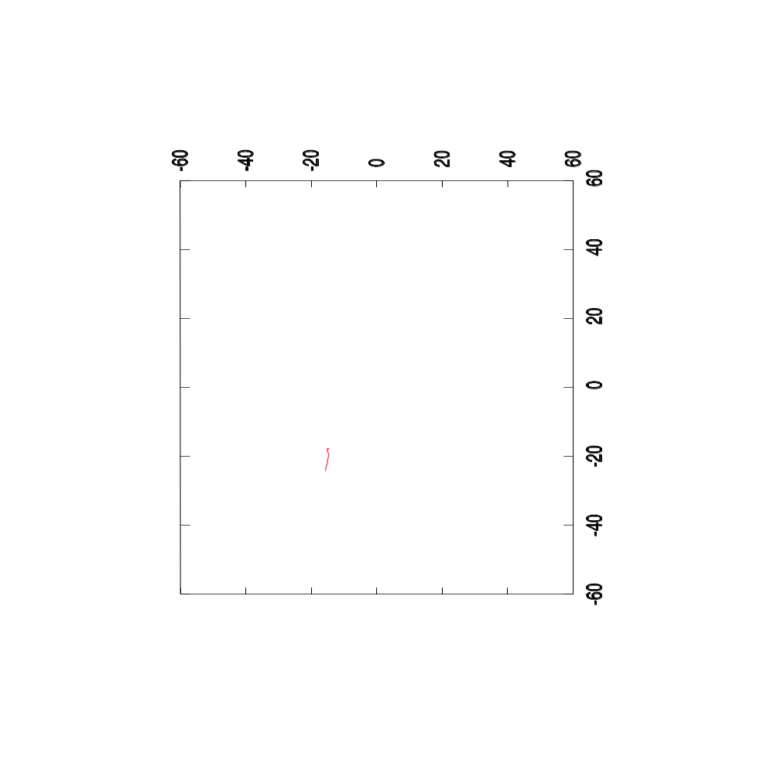
Plotting the Optimizer’s Path
Mattes Mutual Information
Step Length = 1.0 mm
Image Registration
Lecture 9

Slide 66

Plotting the Optimizer’s Path
Mattes Mutual Information
Step Length = 2.0 mm
Image Registration
Lecture 9

Slide 67

Plotting the Optimizer’s Path
Mattes Mutual Information
Step Length = 5.0 mm
Image Registration
Lecture 9

Slide 68

Plotting the Optimizer’s Path
Mattes Mutual Information
Step Length = 10.0 mm
Image Registration
Lecture 9

Slide 69
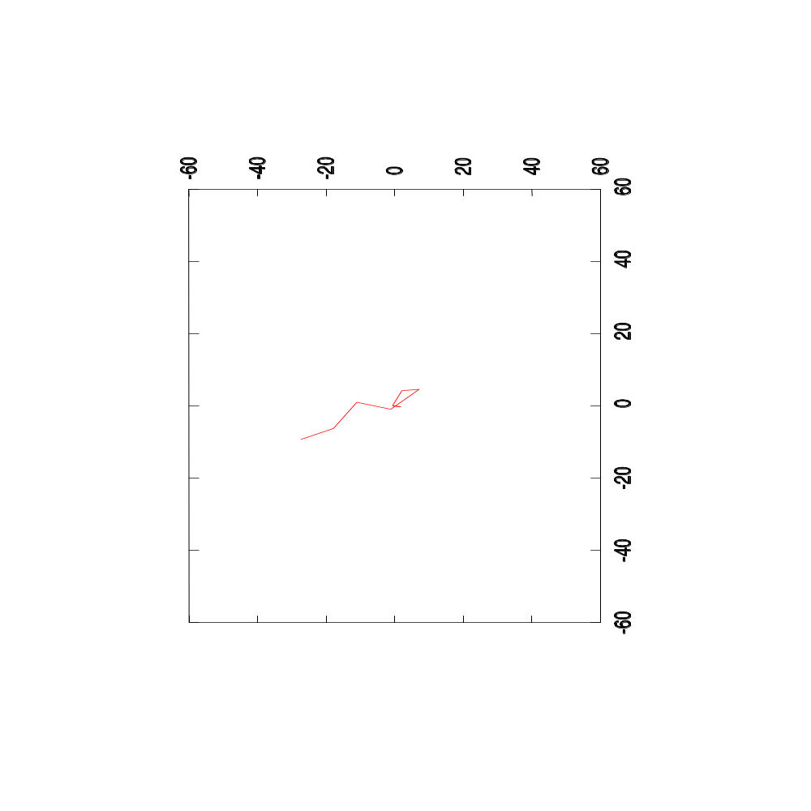
Plotting the Optimizer’s Path
Mattes Mutual Information
Step Length = 20.0 mm
Image Registration
Lecture 9

Slide 70
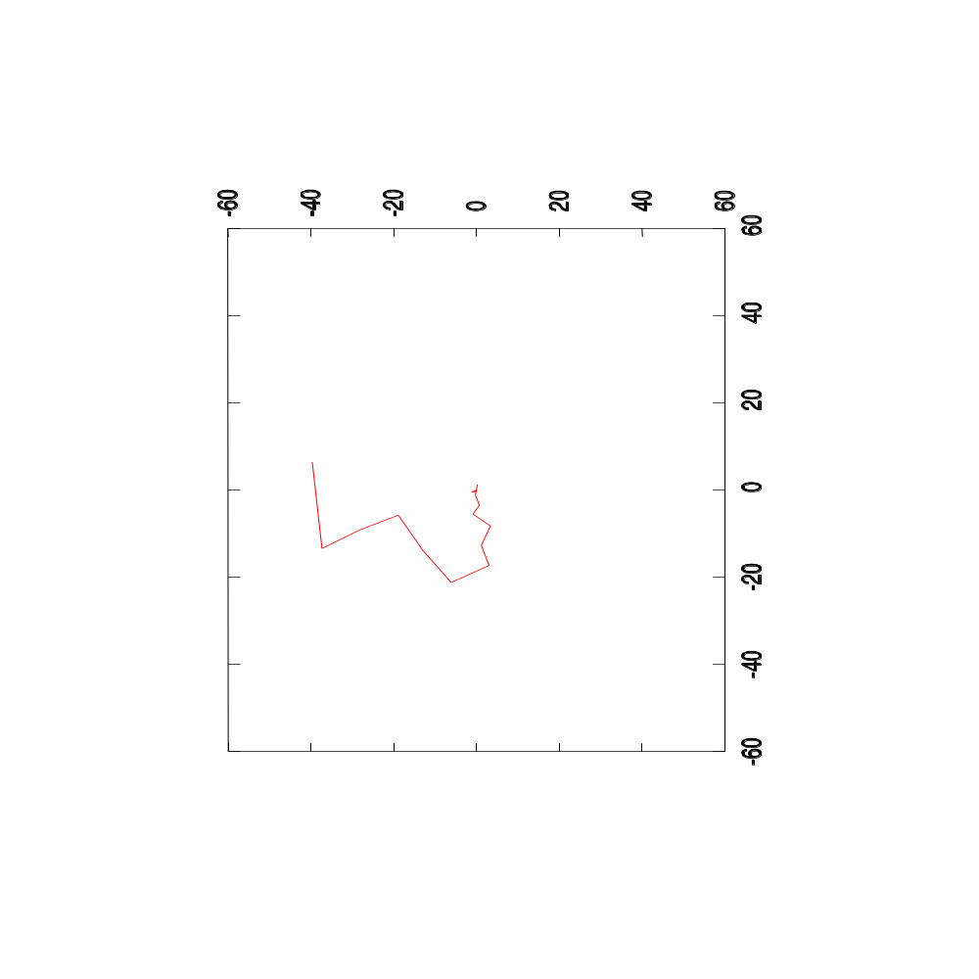
Plotting the Optimizer’s Path
Mattes Mutual Information
Step Length = 40.0 mm
Image Registration
Lecture 9

Slide 71
Watch over your optimizer
Example:
Optimizer registering two multi-modality
images shifted by (-15mm, -25mm)
The optimizer starts at (0mm,0mm)
Image Registration
Lecture 9

Slide 72

Plotting the Optimizer’s Path
Mattes Mutual Information
Step Length = 1.0 mm
Image Registration
Lecture 9

Slide 73

Plotting the Optimizer’s Path
Mattes Mutual Information
Step Length = 2.0 mm
Image Registration
Lecture 9

Slide 74

Plotting the Optimizer’s Path
Mattes Mutual Information
Step Length = 5.0 mm
Image Registration
Lecture 9

Slide 75
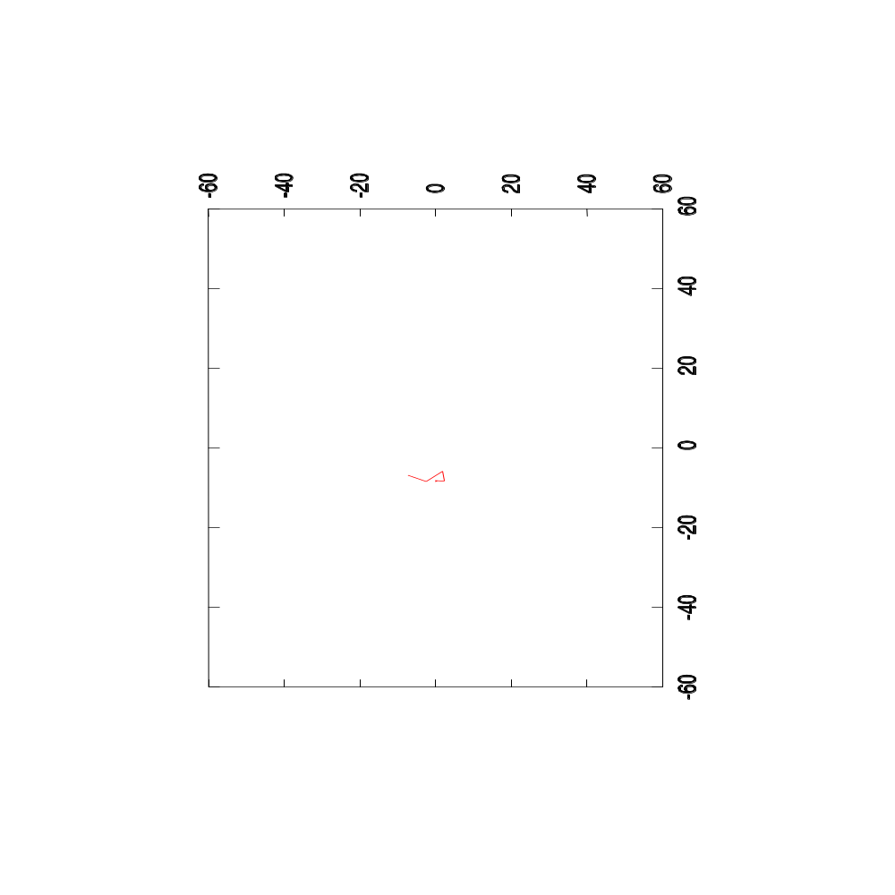
Plotting the Optimizer’s Path
Mattes Mutual Information
Step Length = 10.0 mm
Image Registration
Lecture 9

Slide 76
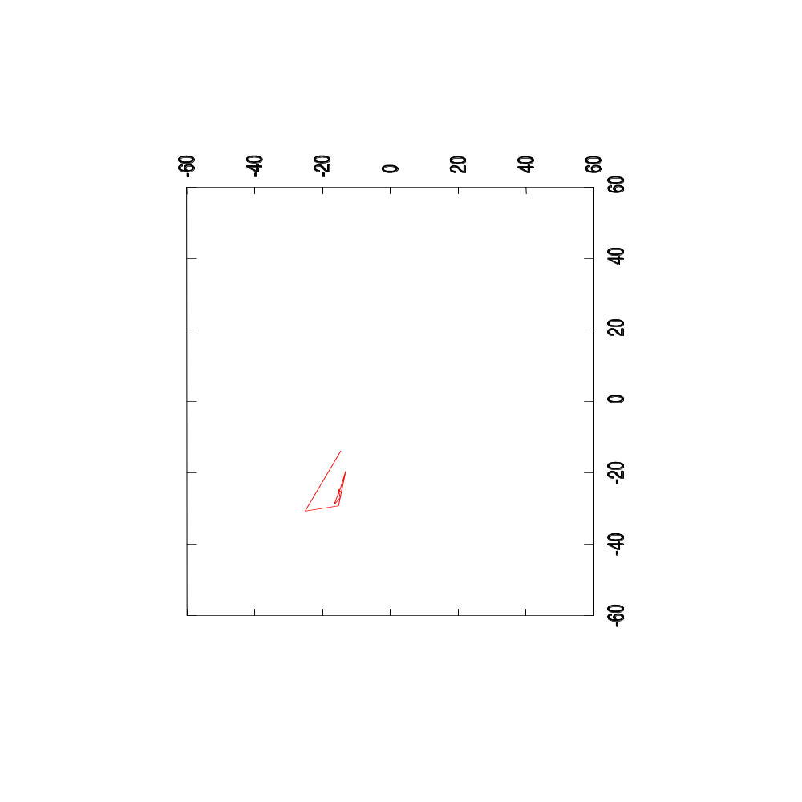
Plotting the Optimizer’s Path
Mattes Mutual Information
Step Length = 20.0 mm
Image Registration
Lecture 9

Slide 77
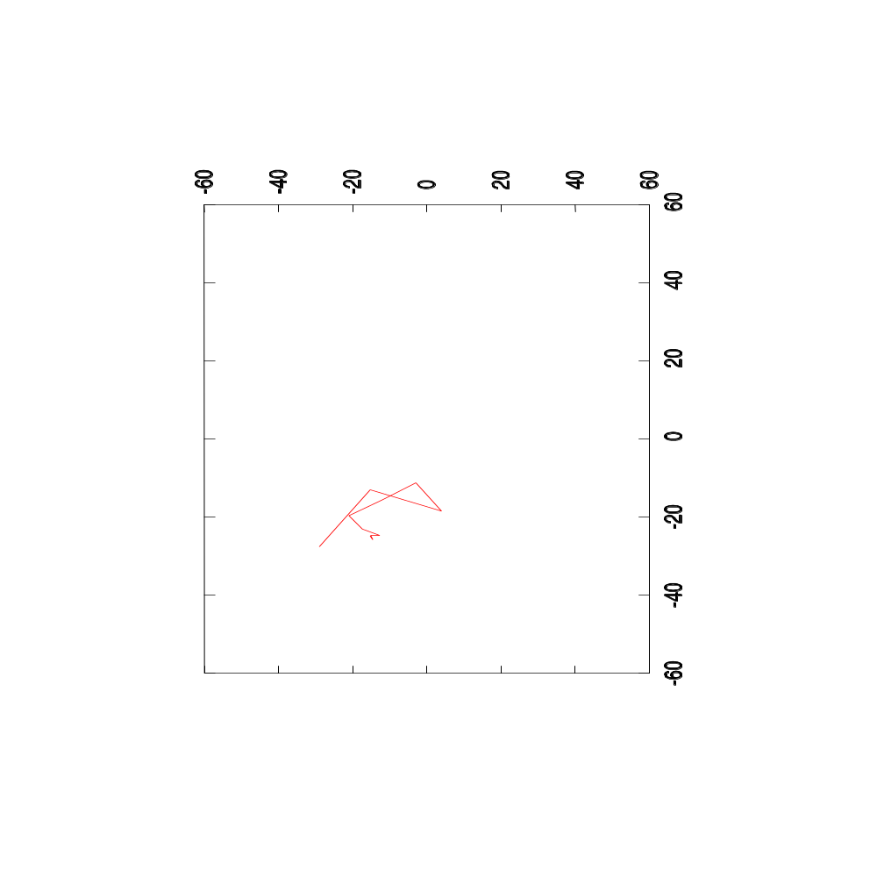
Plotting the Optimizer’s Path
Mattes Mutual Information
Step Length = 40.0 mm
Image Registration
Lecture 9

Slide 78
Mutual Information Variants in ITK
Viola – Wells
Mattes
Mutual Information Histogram
Image Registration
Lecture 9

Slide 79
End
Enjoy ITK !
Image Registration
Lecture 9

