Slide 1
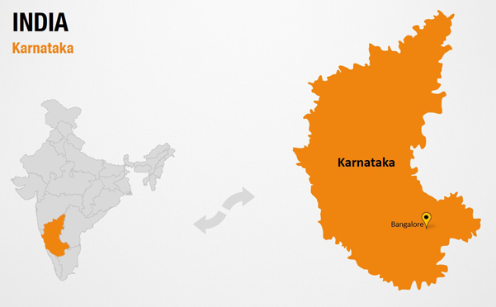
Exploration of education & employment in Karnataka
222BDA17- Lajiya Aleena Saji
222BDA06- Jaini Maria John
222BDA28- Keerthana P P
222BDA34- Anjali A Sunil

Slide 2
Objective
Analysing the total population over the years 2001 and 2011.
Analysing and comparing the illiterate and literate people of Karnataka over the years 2001 and 2011.
Getting insights about the overall literacy and employment distribution over the years.
Gender wise comparison of working and job seeking people.

Slide 3
We analyze census data of 2001 and 2011 in the areas of workers and education. The education census data(C-08) consists of 15 columns concerning the overall number of literate and illiterate individuals in various age categories. The 18 columns of the workers census(B-01) data contain information on the population, gender distribution, main workers, and non-workers.
Education and Workers Census Data Analysis

Slide 4
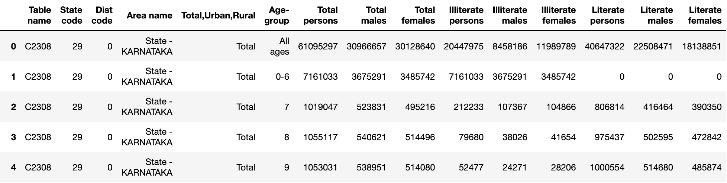
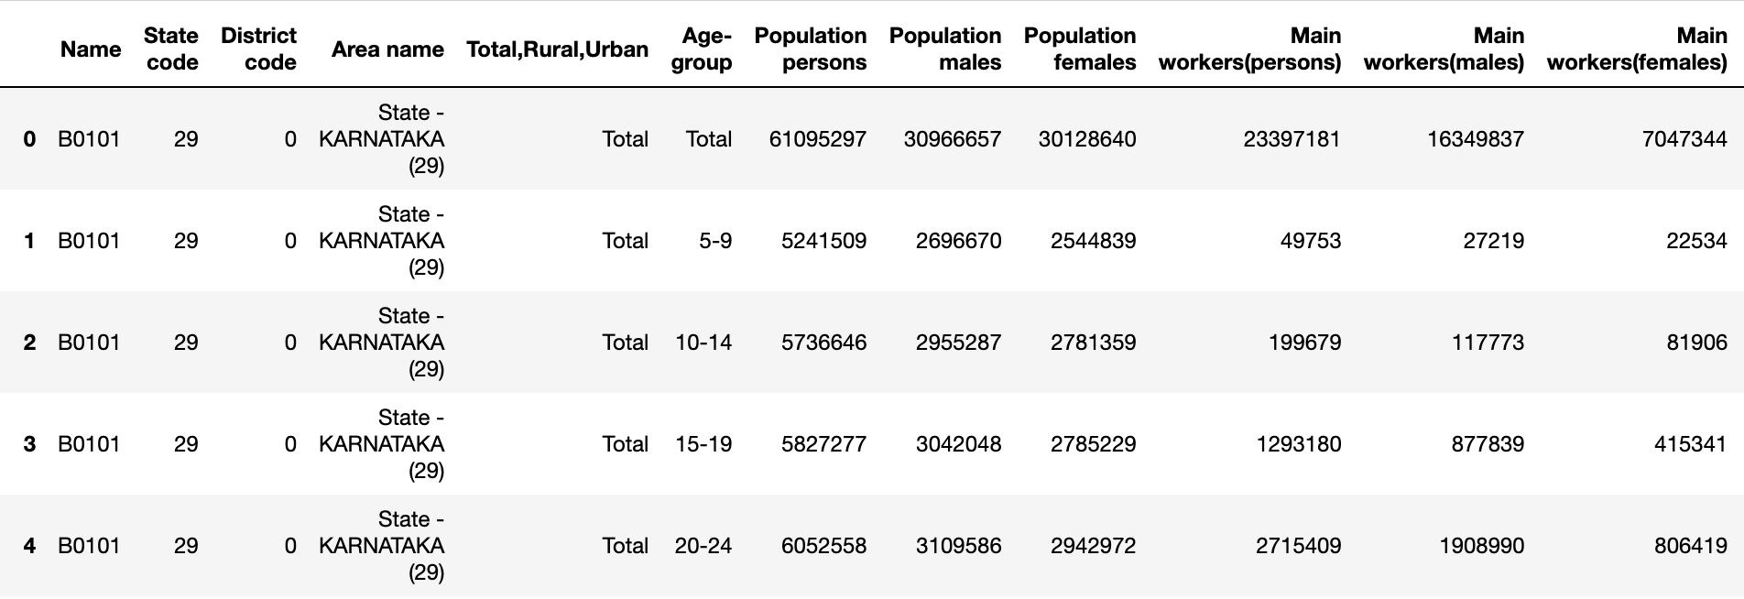
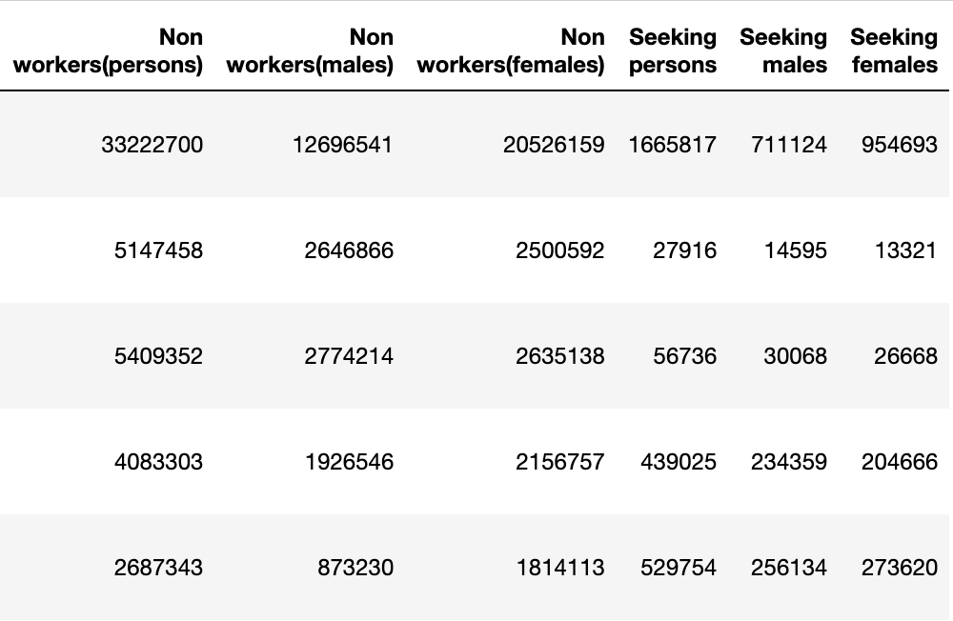
Dataset

Slide 5
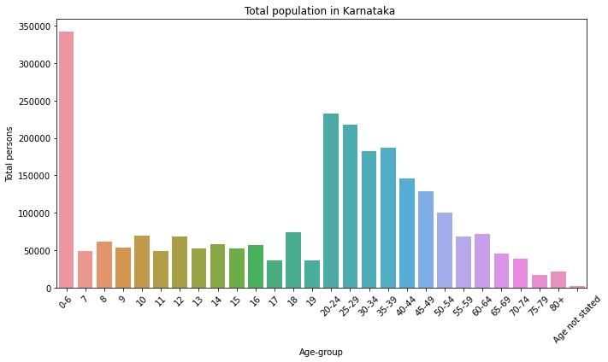
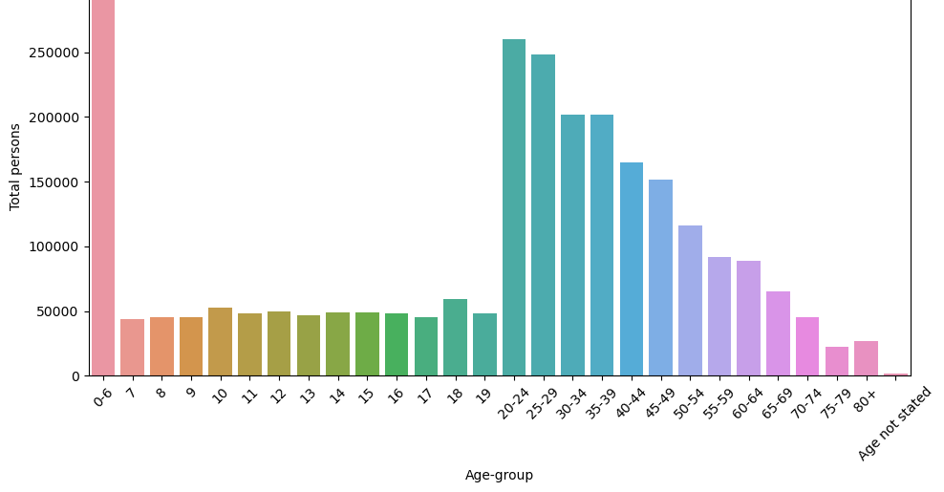
Age-group v/s Total population
2001
2011

Slide 6
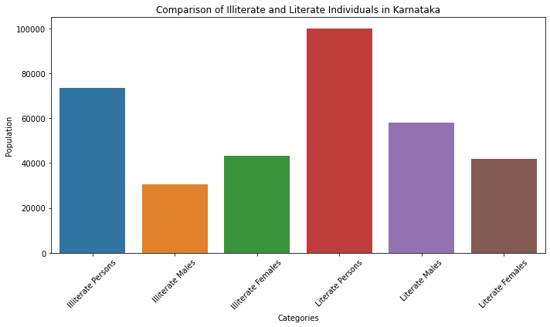
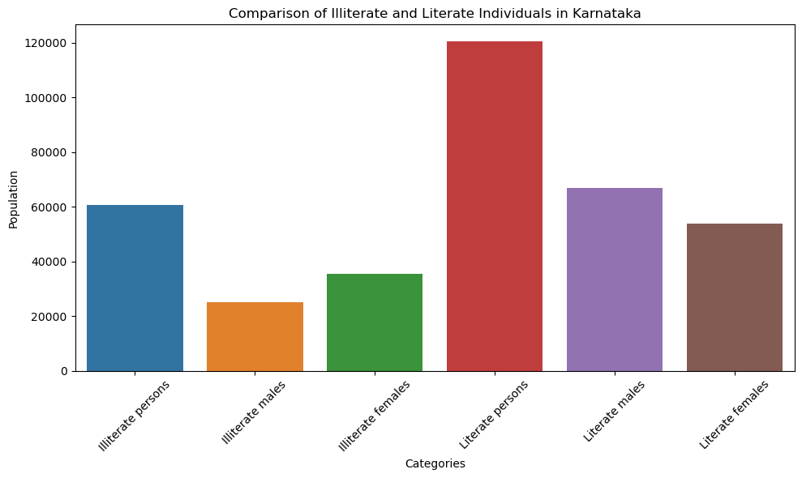
2001
2011

Slide 7
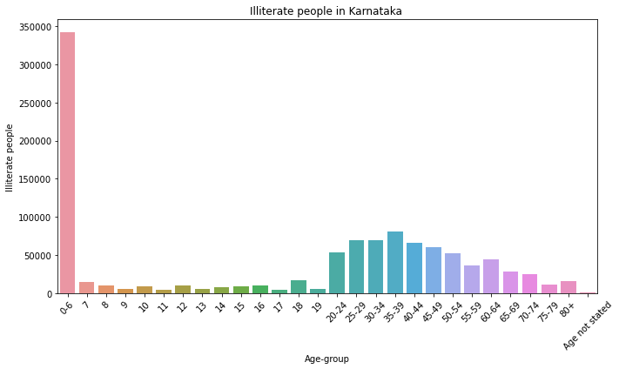
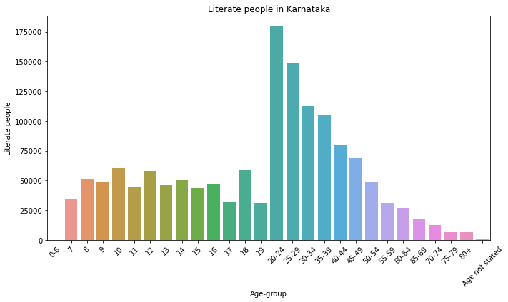
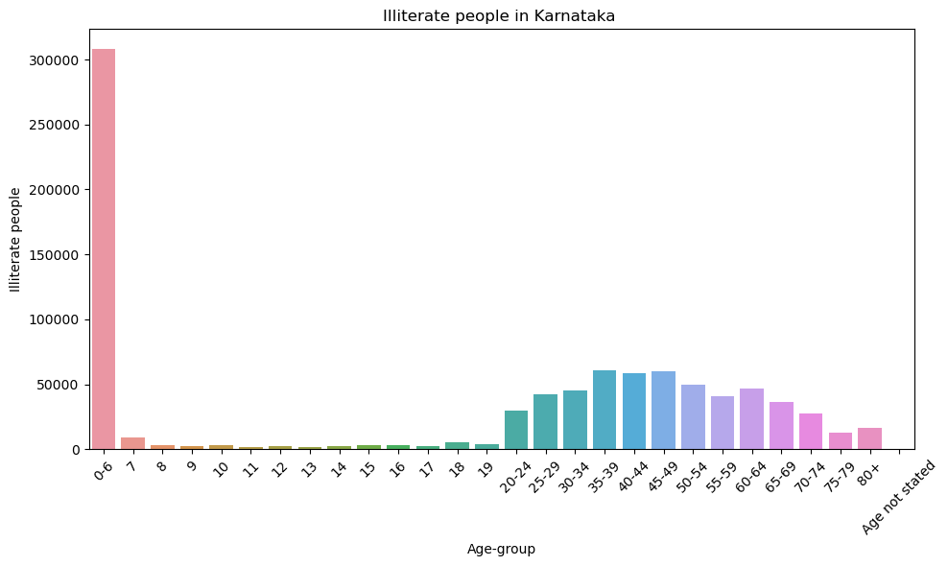
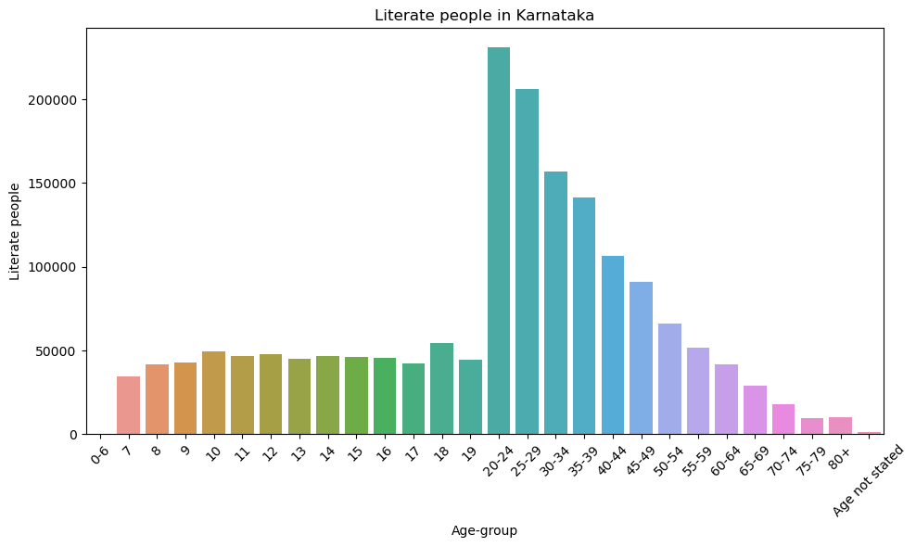
Literacy v/s Age-group
2001
2011

Slide 8
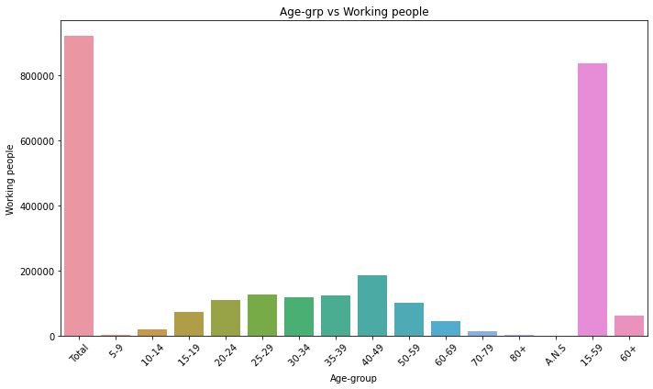
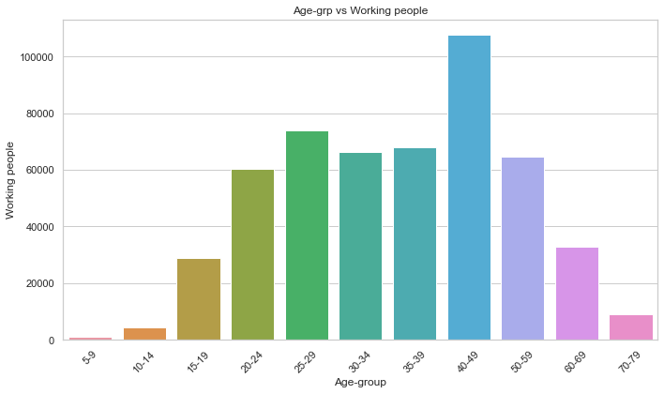
Age group v/s Working persons
2001
2011

Slide 9
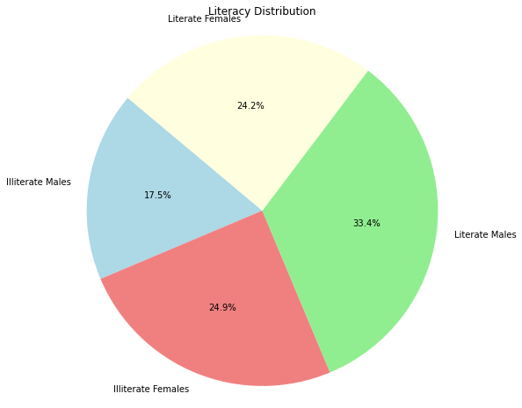
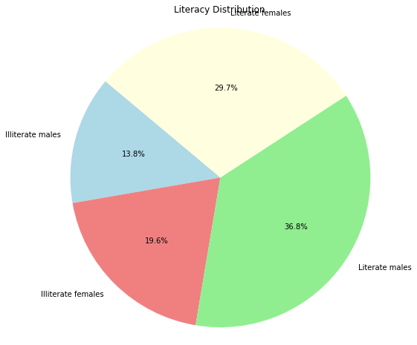
Pie chart of overall literacy distribution
2001
2011

Slide 10
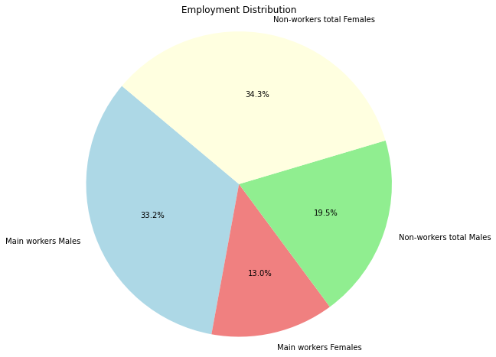
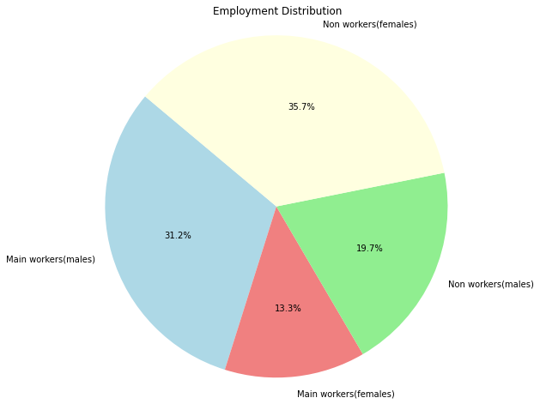
Pie chart of overall employment distribution
2001
2011

Slide 11
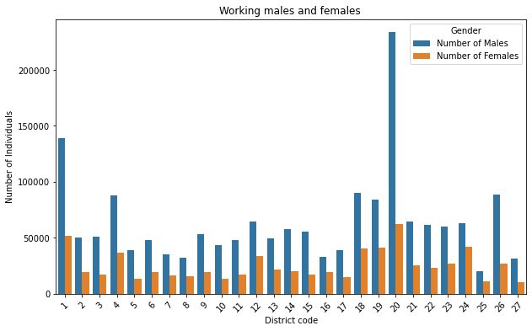
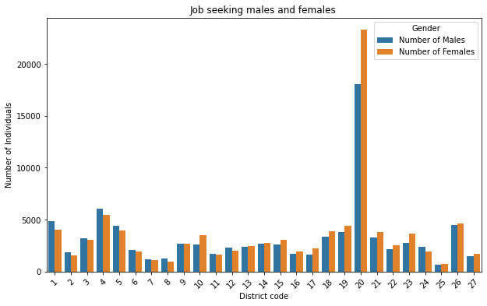
GENDERWISE COMPARISON OF WORKING AND JOBSEEKING PEOPLE (2001)

Slide 12
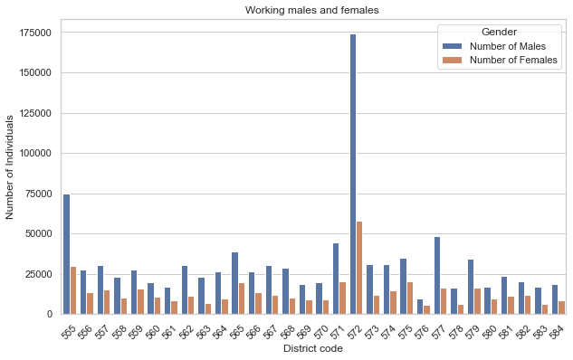
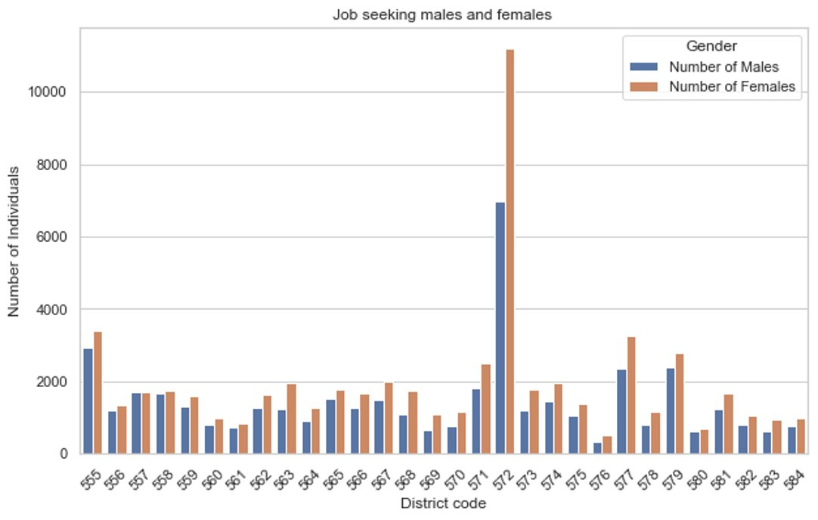
GENDERWISE COMPARISON OF WORKING AND JOBSEEKING PEOPLE (2011)

Slide 13
CONCLUSION
In conclusion, the 2001 and 2011 census data of education and workers show that there has been some progress in improving the educational and occupational status of the people of Karnataka. However, there is still a lot of work to be done. The literacy rate has increased over the years, gender gap in literacy has also narrowed. The unemployment rate has also decreased in 2011 as compared to 2001.This shows that the economy is creating more jobs.
However, there are still some challenges that need to be addressed. The dropout rate from school is still high, especially among girls. There is also a need to improve the quality of education, especially in rural areas.

Slide 14
Thankyou

