Slide 1
Microsoft
Excel:
Tips and
Tricks
Presented by: Inayah Rohimun & Saima Sookia

Slide 2

Introduction
Excel is a simple but powerful spreadsheet program for entering, managing and analyzing data using user-friendly menus, creating chart and performing calculations. It can be used for various purposes whether at work or for personal use. In this webinar, you will get the opportunity to learn about some basic Excel manipulations.

Slide 3
Outline
1
Basic features
Import CSV/TXT file to excel
Formulae and functions
What-if-analysis(Goal seek)
5
Optimisation(Solver)
PivotTable
Macros
Template
2
6
3
7
4
8

Slide 4
Basic features
1

Slide 5
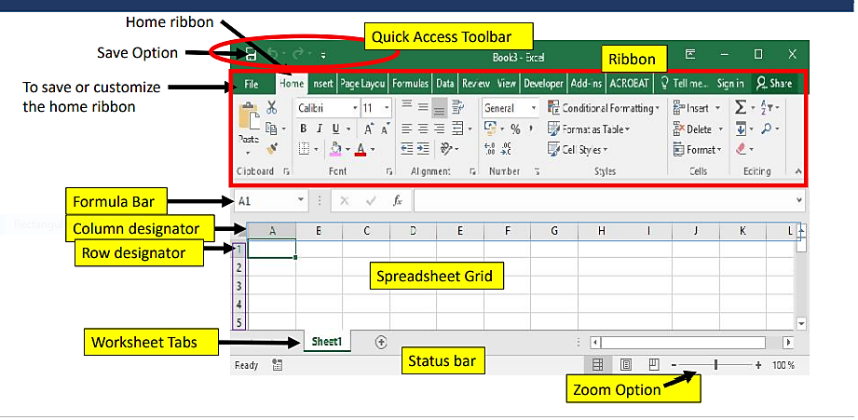
1
2
3
4
5
6
7
8
A Guide through the Excel interface

Slide 6
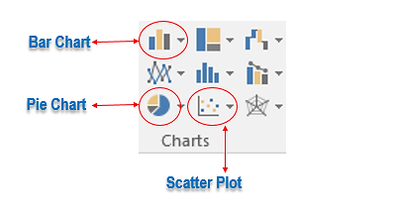
1
2
3
4
5
6
7
8
Shortcut Keys
Charts
Excel Shortcuts
F1 | Excel help
F2 | Enter cell and start typing
F4 | Fix a formula
F9 | Format random numbers
F11 | Insert a chart
F12 | Save
Ctrl + S | Save
Ctrl + Z | Undo
Ctrl + Y | Redo
Ctrl + N | New Sheet

Slide 7
Import TXT/CSV file to excel (XLS)
2

Slide 8
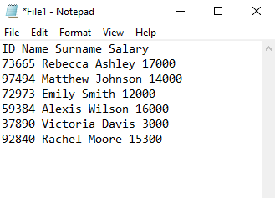
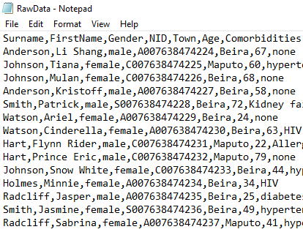
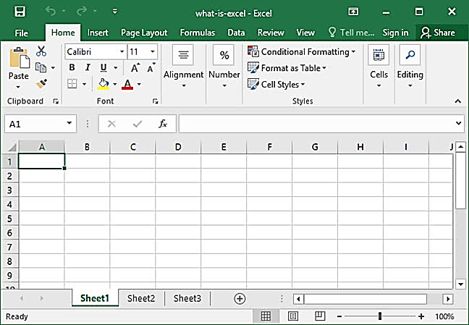
1
2
3
4
5
6
7
8
What is TXT, CSV and XLS file ?
TXT is a text file
CSV is a comma separated value file
XLS is an excel spreadsheet

Slide 9
1
2
3
4
5
6
7
8
Procedures
On Data tab > Get External Data group > From Text > Select the TXT or CSV file > click Import > Select "Delimited“ > Click Next.
Select the delimiter that groups your data into individual columns in the Data preview field. Look carefully at the Data preview to make sure your data is aligned with the intended column header!
Click Next > Select "General“ > Click Finish>Choose "Existing Worksheet“ > Add "=$A$1" to the field > Click OK > Click Save
  Note:
  A delimiter is just a fancy way of saying that your TXT file uses tabs or your CSV file uses commas to separate and group your data.
  Adding "=$A$1" to the field ensures your data begins in the Row 1, Column A cell of the spreadsheet.
  If there are any blank rows in the spreadsheet above your data, it can cause a file import error.

Slide 10
Formulae and Functions
3

Slide 11
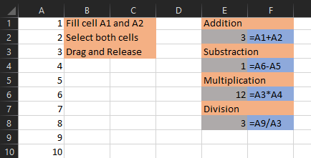
1
2
3
4
5
6
7
8
Formulae
Addition
Subtraction
Multiplication
Division

Slide 12
1
2
3
4
5
6
7
8
Referencing
Type | Description | Formula | Example(s)
Relative referencing | Formula adjust and change when it is copied or when using auto-fill | - | A1
Absolute referencing | Fixing a formula so that it does not change | $Col$Row F4 | $A$1
Mixed referencing | A reference where part of the reference is absolute and part is relative | $ColRow Col$Row | $A1 A$1
Referencing across worksheets | Copy formula from a worksheet to another worksheet | ‘Sheet_name’!Cell_address ‘Sheet_name’!First_cell:Last_cell | =‘Functions’!A6*10

Slide 13
1
2
3
4
5
6
7
8
Functions
=RAND() | Returns a random number greater than or equal to 0 and less than 1, evenly distributed
=SUM(number 1, [number 2],…) | Calculates the sum of specified values or cell range
=MAX(number 1, [number 2],…) | Finds the maximum number among specified values or cell range
=MIN(number 1, [number 2],…) | Finds the minimum number among specified values or cell range
=AVERAGE(number 1, [number 2],…) | Calculates the mean of specified values or cell range
=STDEV.S(number 1, [number 2],…) | Calculates the sample standard deviation of specified values or cell range
=VAR.S(number 1, [number 2],…) | Calculates the sample variance of specified values or cell range
=ROUND(number, num_digits) | Rounds up a value to the specified number of digits
=POWER(number, power) | Calculates the result of a number raised to a specific index
=CEILING(number, significance) | Rounds up a value to a given multiple
=FLOOR(number, significance) | Rounds down a value to a given multiple
=IF(logical_test, [value_if_true], [value_if_false] | Performs logical comparison between a value and what you expect
=SUMIF(range, criteria, [sum_range]) | Calculates the sum of corresponding values meeting the specified criteria in two ranges of values
=SUMPRODUCT(array,[array2],[array3],…) | Multiplies range of cells or arrays and returns the sum of products.

Slide 14
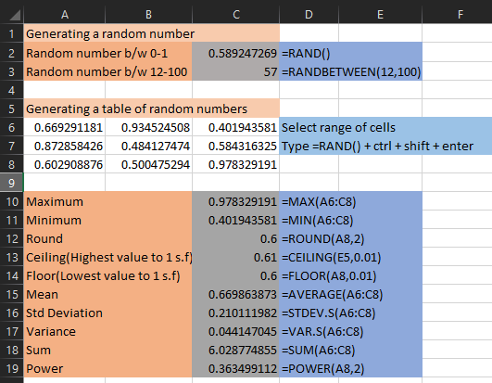
1
2
3
4
5
6
7
8
Examples

Slide 15
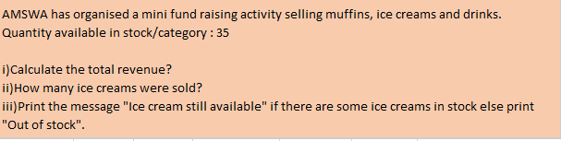
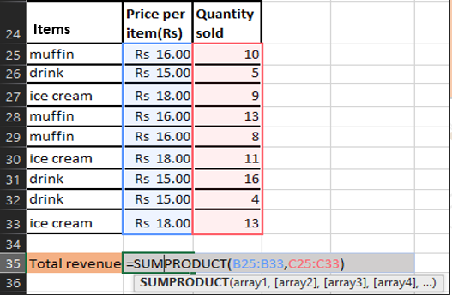
1
2
3
4
5
6
7
8
SUMPRODUCT()

Slide 16
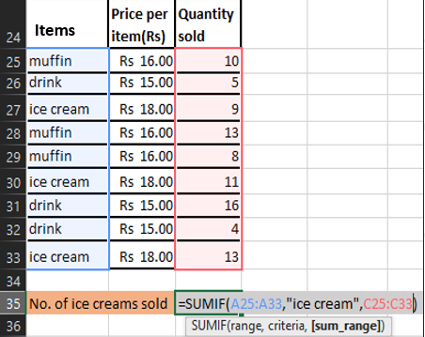
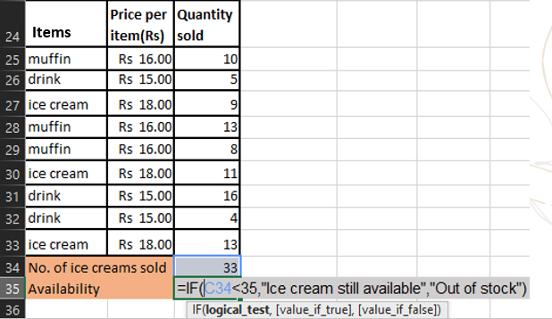
1
2
3
4
5
6
7
8
SUMIF()
IF()

Slide 17
What-if-analysis
4

Slide 18
1
2
3
4
5
6
7
8
What if analysis using goal seek
It allows us to find a specific value for a target cell by adjusting the value of another cell whose value
is allowed to vary.
Procedure
Input details > Link with formula
Data tab>What-if-Analysis>Goal Seek
  Set cell box: enter the reference for the cell that contains the formula you want to resolve.
  To value box: type the result you want.
  By changing cell box: enter the reference for the cell that contains the value you want to adjust.
Note:
While using this tool will save you time instead of doing trial and error to come up with the desired result, the disadvantage is that it returns only one value based on a formula and it is the closest number to the starting value. We can instead use graph or solver for more results and conditions as shown in the next two topics.

Slide 19
1
2
3
4
5
6
7
8
What if analysis using graph
When there are more than one solution it may be difficult to find them using goal seek only. Hence we may use graph to locate the solutions or find a number which is close to the solution and then apply goal seek more precisely.
Procedure
Make a table of values with a suitable range.
Select data > click on Insert > charts.
Select appropriate chart.
If the set of data is too small it may be adjusted at anytime.

Slide 20
Optimisation
5

Slide 21
1
2
3
4
5
6
7
8
Optimisation using solver
Solver is an optimization tool that can be used to determine how the desired outcome can be achieved by changing the assumptions in a model.
It is a type of What-if-Analysis and is particularly useful when trying to determine the best outcome given a set of more than 2 assumptions.
How to enable solver in excel
File
Options
Add-ins
Solver add-ins
Go
OK

Slide 22
1
2
3
4
5
6
7
8
Procedures
Data tab>Solver.
  Set Target Cell box: enter a cell reference or name for the target cell. The target cell must contain a formula.
  To have the value of the target cell be as large as possible, click Max.
  To have the value of the target cell be as small as possible, click Min.
  To have the target cell be a certain value, click Value of, and then type the value in the box.
  By Changing Cells box: enter a name or reference for each adjustable cell, separating nonadjacent references with commas.(The adjustable cells must be related directly or indirectly to the target cell)

Slide 23
1
2
3
4
5
6
7
8
In the Subject to the Constraints box, enter any constraints you want to apply.
  Click Add.
  Cell Reference box: enter the reference of the cell range for which you want to constrain the value.
  Select the relationship ( <=, =, >=, Int, or Bin ) that you want between the referenced cell and the constraint.
  Constraint box: type a number, a cell reference or name, or a formula.
  To accept the constraint and add another, click Add.
  To accept the constraint and return to the Solver Parameters dialog box, click OK
Click Solve.
To keep the solution values on the worksheet, click Keep Solver Solution in the Solver Results dialog box.
To restore the original data, click Restore Original Values.
Note: Microsoft Excel recalculates the worksheet with the last values found for the adjustable cells.

Slide 24
PivotTable
6

Slide 25
1
2
3
4
5
6
7
8
A PivotTable is a powerful tool to calculate, summarize, and analyse data that lets you see comparisons, patterns, and trends in your data. It classifies numeric data in a list based on other fields in the list.
Before proceeding in building the PivotTable, it is recommended that:
1.To check if the data is organized in a proper format:
Each column has headers
No empty column/rows
No total/subtotal rows
2.Tabulate the data set so that if new data are added, the pivotTable can reflect them by right click on the pivotTable and select refresh to update the PivotTable.

Slide 26
1
2
3
4
5
6
7
8
Procedure
Insert tab > PivotTable
Table/Range: Select the whole table
Existing Worksheet > select a blank cell > OK
PivotTable will be created
Adjust according to your preferences (Classify fields along row,columns,etc)
Note:
For New Worksheet -Automatically directed to new sheet, with PivotTable controls.
To sort data in PivotTable, select a cell in the PivotTable > Right click > Sort
Simple way to select all data set: Select header first, then on press Ctrl+Shift+down on keyboard

Slide 27
Macros
7

Slide 28
1
2
3
4
5
6
7
8
A macro is a set of rules that specifies a procedure.It is an interesting feature which eliminates or at-least minimize repetitive tasks to be able to capitalize your precious time in more productive & strategic activities.
Macro is found in the developer tab in excel.
Note: Always save the excel file as an excel macro-Enabled workbook!!!
How to enable Developer Tab in excel
File
Options
Customize
Ribbon
Tick developer
OK

Slide 29
1
2
3
4
5
6
7
8
Recording a macro.
Developer Tab > Record Macro
Carry out the steps then stop recording
Creating a macro button and assigning it a specific task
Developer tab>Insert> Form controls>button
Naming the macro button
Right click on Macro button>edit text>enter name
Name macro : Give a meaningful name to your macro
Click on ok to start recording
Draw your macro button
Assign Macro
Macro name: select the name of the specific task
Save from “this workbook only”>ok
Note: if a shortcut key is given, make sure it doesn’t conflict with an existing one.

Slide 30
Template
8

Slide 31
1
2
3
4
5
6
7
8
Excel templates offers a panoply of customizable spreadsheets which eases your collection and representation of data. These spreadsheets come with a wide array of built-in formulas that auto-complete after you fill out the first few rows. It may also be used to generate charts. They can be accessed when opening excel or on file options when creating a new sheet.
Budgeting the next fiscal year (e.g AMWSA budget)
Infographic chart data
Planners e.g meals, anniversaries, weddings
Examples
Time table– household schedule
Trackers e.g invitation list
Tutorials on excel features
USE TEMPLATES!!

Slide 32
Resources
https://www.excel-easy.com/examples.html
https://www.w3schools.com/excel/index.php

Slide 33
The End

