Slide 1
Pandemic Simulation
Matt Mitchell, Logan Jolicoeur, and Nick Vino

Slide 2
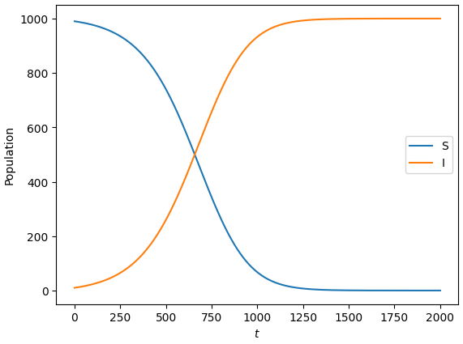
SI Model
No Recovery Rate
All Infected Eventually
R0 = 15
Each node is connected to an average of 5 people

Slide 3
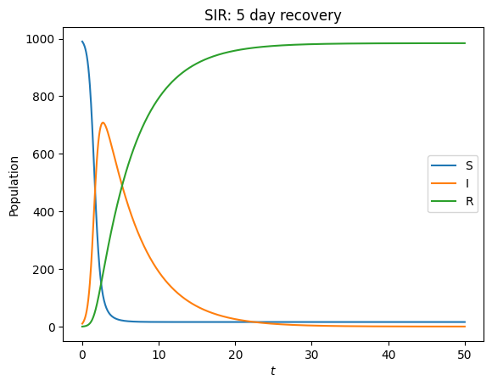
SIR Model
Transmission rate 0.65
R0 = (transmission / recovery)
R0 = 3.25

Slide 4
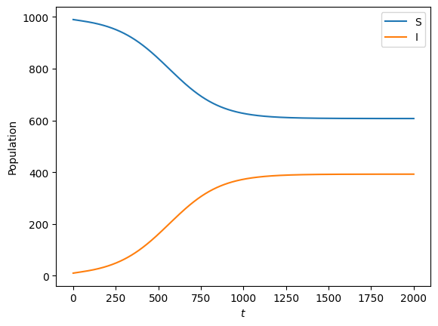
SIS Model
Recovery does not give immunity
Malaria
Meningitis
Venereal diseases
R0 = 2.5
1 - (1 / 2.5 ) = 40% infected

Slide 5
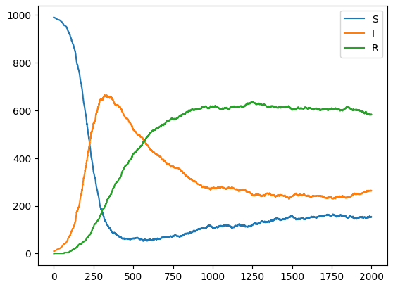
SIRS Model
Recovered can become susceptible again
After Infection Spike most Recover
R0 = 2.8

Slide 6
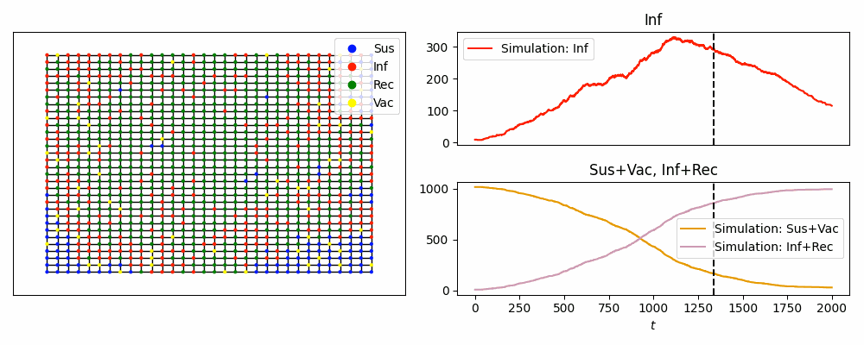
SIRV Model
Control: Vaccine rate
Vaccine rate increased 30%

Slide 7
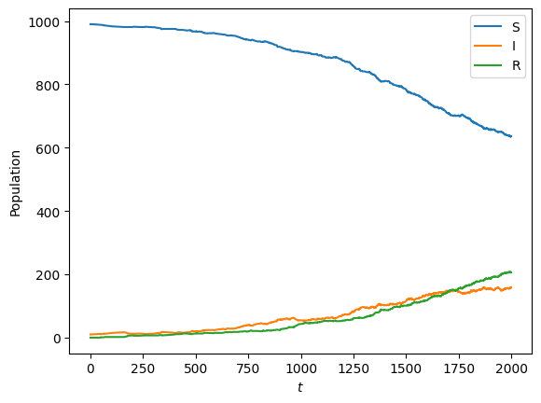
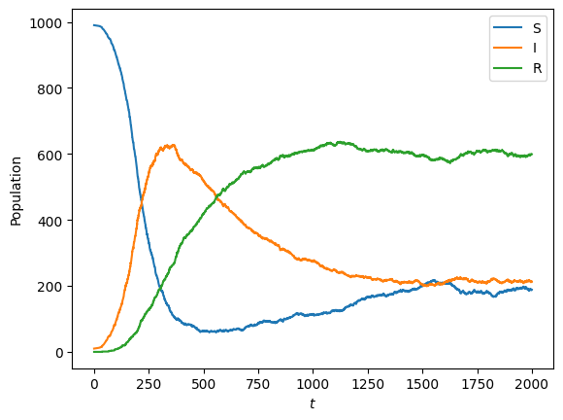
Mask Scenario
SIR Model showcasing masks
With Masks Without Masks

Slide 8
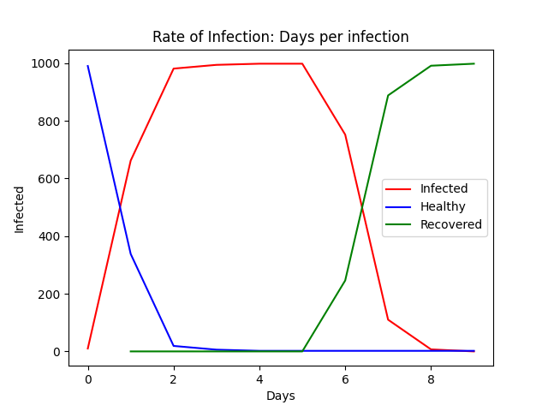
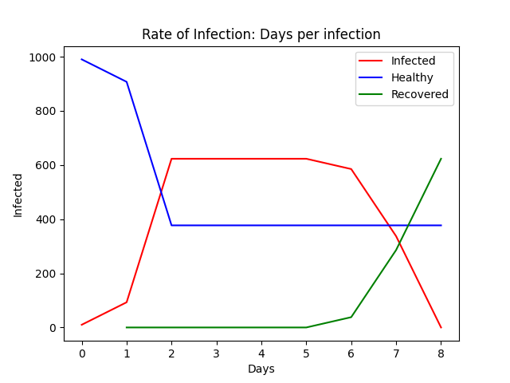
Lockdown Scenario
A SIRV Model with lockdown enabled
Without a lockdown (R0: 3.27) With a lockdown (R0: 4.75)

Slide 9
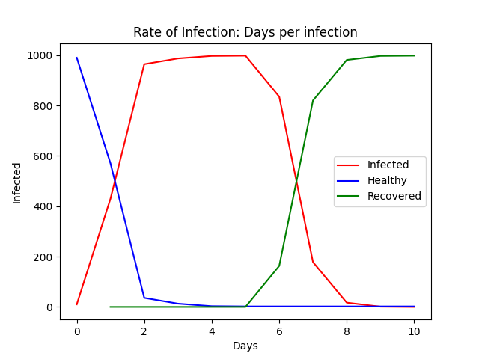
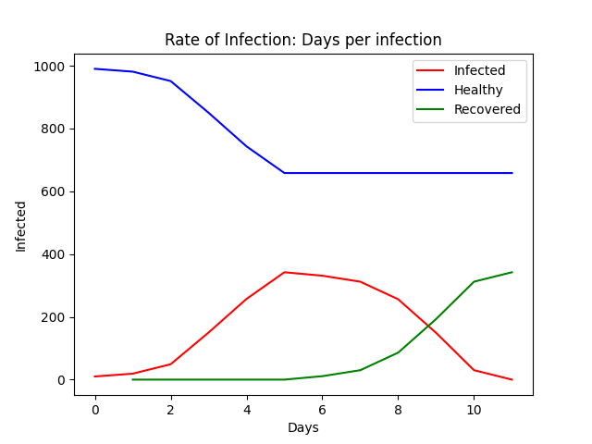
Lockdown and Mask Scenario
Scenario with both lockdown and masks
Without lock down or masks (R0: 4.32) With lockdown and masks (R0: 4.36)

