Slide 1
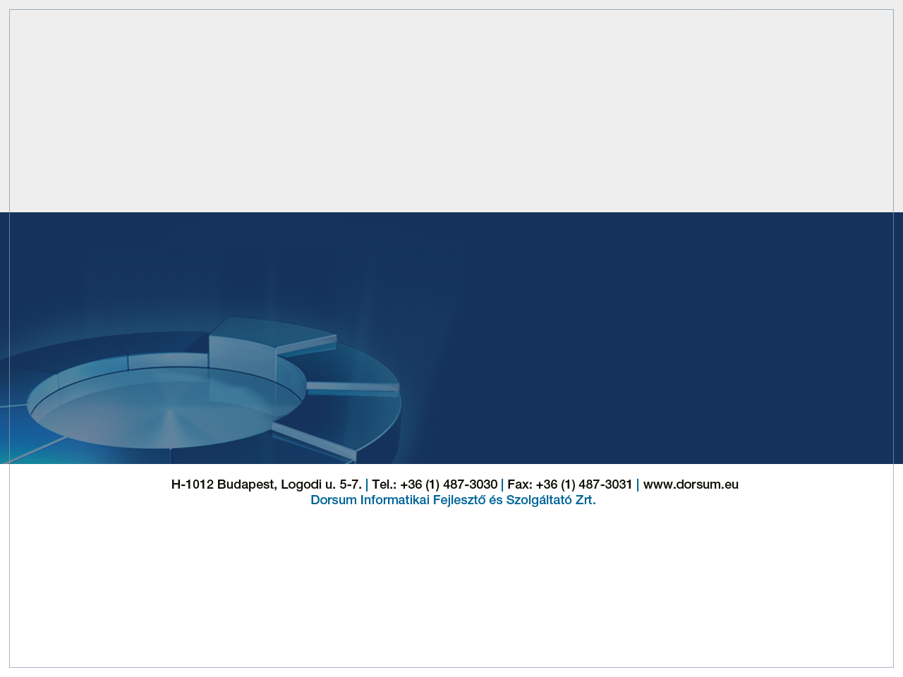

Java 8 SE
2018.01.17

Slide 2
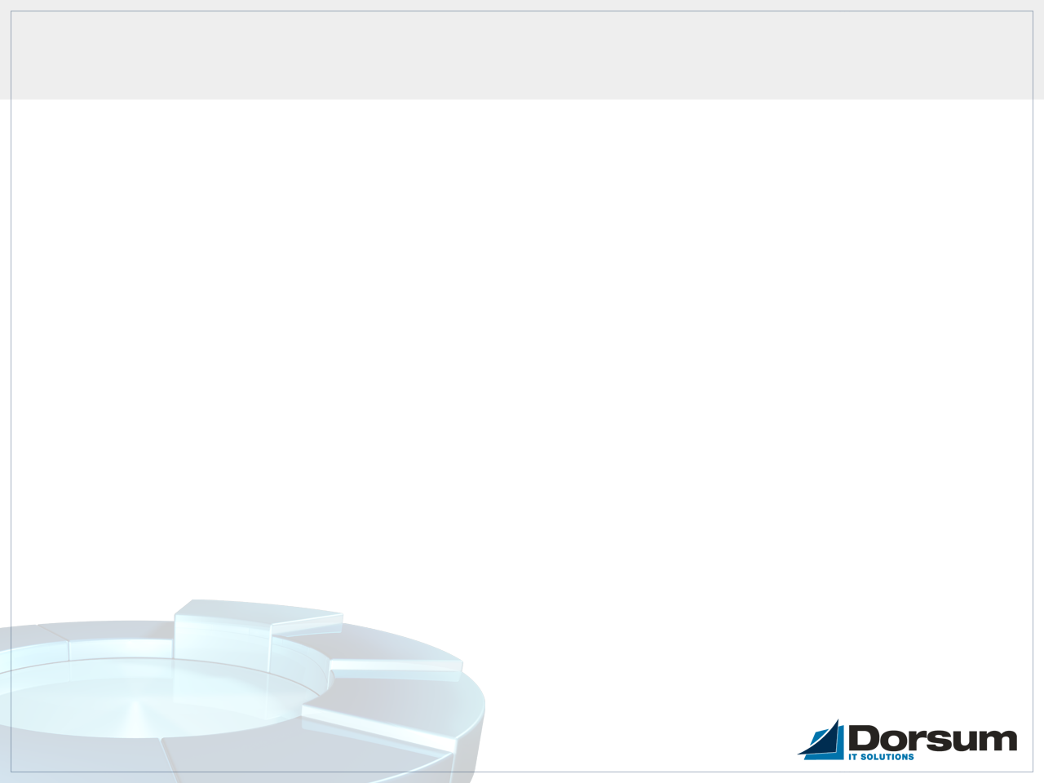
Introduction
• Default and static methods of interfaces
• Lambda expressions
• Functional interfaces
• Stream API
• Date Time API

Slide 3
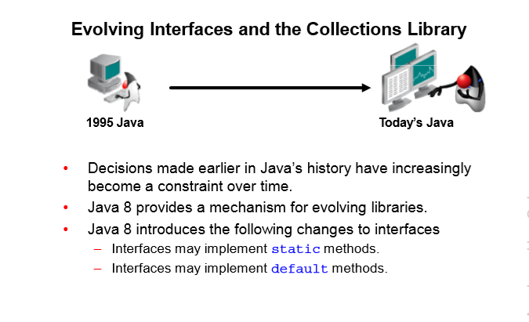
Chapter 1 – Method enhancements

Slide 4
Default methods in Interfaces
public interface IVehicle {
default int getNumberOfWheels() {
return 4;
}
}
//Example of calling getNumberOfWheels
int numberOfWheels = IVehicle.getNumberOfWheels();
It's not equivalent to abstract methods because it's not required to be implemented. With default methods it's possible to create new functionality without modify older implementations
Declared using the keyword default
Are fully implemented methods within an interface
Provide useful inheritance mechanics

Slide 5
Static methods in Interfaces
Static methods makes easier for you to organize methods in your libraries, you can keep static methods specific to an interface rather than in a separate class
public interface IVehicle {
default void print(Person owner) {
if(!isNull(owner)) {
System.out.print(owner.toString());
}
}
static boolean isNull(Person owner) {
return owner == null;
}
}

Slide 6
Multiple inheritance in Java
Multiple Inheritance of: | Using this mechanic: | Is Possible
Type | A class implements multiple interfaces | Yes
Behaviour | A class implements interfaces containing multiple default methods | Yes
State | A call to a variable cannot have multiple potential values | No*
* This is why multiple inheritance is problematic in C++

Slide 7
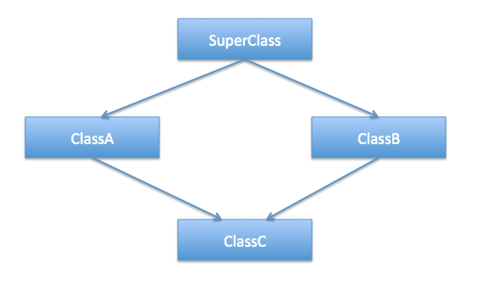
Multiple inheritance in C++ and the Diamond problem

Slide 8
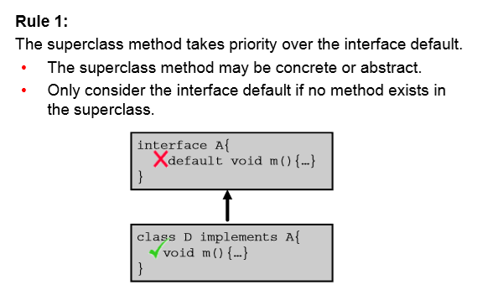
Inheritance rules of default methods

Slide 9
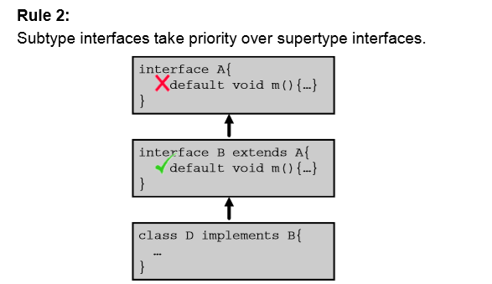
Inheritance rules of default methods

Slide 10
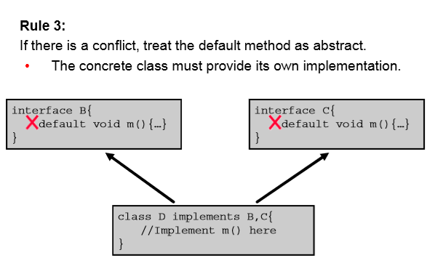
Inheritance rules of default methods

Slide 11
Chapter 2 – Lambda expressions
Lambda Introduction
Cases for lambda expressions
Filtering Collections with Lambdas
Using built-in lambda types
Collection Operations with lambdas
Parallel streams
Lambda cookbook

Slide 12
Inner Classes
public class OuterClass {
class InnerClass {
void print() {
System.out.println("Print from inner class");
}
}
void print() {
System.out.println("Print from outer class");
InnerClass ic = new InnerClass();
ic.print();
}
public static void main(String[] args) {
OuterClass oc = new OuterClass();
oc.print();
}
}

Slide 13
Inner Classes
Why Would You Use an Inner Class?
• It is a way of logically grouping classes that are only used in one place: If a class is useful to only one other class, it is logical to embed it in that class and keep the two together. Nesting such "helper classes" makes their package more streamlined.
• It increases encapsulation: Consider two top-level classes, A and B, where B needs access to members of A that would otherwise be declared private. By hiding class B within class A, A's members can be declared private and B can access them. In addition, B itself can be hidden from the outside world.
• It can lead to more readable and maintainable code: Nesting small classes within top-level classes places the code closer to where it is used.

Slide 14
Anonymous Inner Classes
btn.setOnAction(new EventHandler<ActionEvent>(){
@Override
public void handle(ActionEvent event){
System.out.println("Click detected by Anon Class");
}
});
Are there any drawbacks to this?

Slide 15
Anonymous Inner Classes
btn.setOnAction(new EventHandler<ActionEvent>(){
@Override
public void handle(ActionEvent event){
System.out.println("Click detected by Anon Class");
}
});
• The vertical problem
• Tricky syntax
• Reuse not possible
• Generates separate class files

Slide 16
First lambda version
btn.setOnAction(
(ActionEvent e) -> {
System.out.println("Click detected");
}
);
• Vertical problem solved
• Cleaner syntax
• Reusable

Slide 17
First lambda version
btn.setOnAction(new EventHandler<ActionEvent>(){
@Override
public void handle(params){
body
}
});
Lambda Version:
btn.setOnAction(params -> body);

Slide 18
Lambda expressions
Argument List | Arrow Token | Body
(int x, int y) | -> | x + y
Basic Lambda examples
(int x, int y) -> {
int z = x + y;
System.out.println(z);
}
(int x, int y) -> x + y;
x, y -> x + y;

Slide 19
Functional Interfaces
How does lambda expressions fit into Java's type system? Each lambda corresponds to a given type, specified by an interface. A so called functional interface must contain exactly one abstract method declaration. Each lambda expression of that type will be matched to this abstract method. Since default methods are not abstract you're free to add default methods to your functional interface.
Because a functional interface contains only one abstract method, you can omit the name of that method when you implement it.
To do this, instead of using an anonymous class expression, you use a lambda expression.

Slide 20
Functional Interfaces
@FunctionalInterface
public interface Predicate<T> {
public boolean test(T t);
}
An Interface that performs a test and returns a boolean
Usage:
Boolean result = test(param -> body);
...
void callTest(String param, Predicate<String> predicate) {
predicate.test(param);
}

Slide 21
Functional Interfaces
Predicate<T> already exists
The java.util.function package contains interfaces for use with lambda expressions.
Predicate.java :
package java.util.function.Predicate;
public Predicate<T> {
public interface boolean test(T t);
}

Slide 22
java.util.function package
Predicate: An expression that returns a boolean
Consumer: An expression that performs operations on an object passed as argument and has a void return type
Function: Transforms a T to a U
Supplier: Provides an instance of a T (such as a factory)
Primitive variations
Binary variations
https://docs.oracle.com/javase/8/docs/api/java/util/function/package-summary.html
http://www.java2s.com/Tutorials/Java/java.util.function/BinaryOperator/index.htm

Slide 23
Predicate<T>
Functional Interface
boolean test(T t)
Represents a predicate (boolean-valued function) of one argument.

Slide 24
Predicate<T>
//lambda expression 1
boolean result = getResult(number,
new Predicate<Integer>() {
@Override
public boolean test(Integer i) {
if(i > 5) return true;
else return false;
}
}
);
//lambda expression 2
boolean result = getResult(number, i -> i > 5);
boolean getResult(int i, Predicate<Integer> predicate) {
return predicate.test(i);
}

Slide 25
Predicate<T>
//lambda expression 1
boolean result = getResult(number, i -> i > 5);
//lambda expression 2
boolean result = getResult(number, (i) -> i > 5);
//lambda expression 3
boolean result = getResult(number, (Integer i) -> i > 5);
//lambda expression 4
boolean result = getResult(number, i -> {
return i > 5;
});

Slide 26
Consumer<T>
Functional interface
void accept(T t)
Represents an operation that accepts a single input argument and returns no result.
//Lambda expression 1
print(„str", s -> System.out.println(s));
void print(String s, Consumer<String> consumer) {
consumer.accept(s);
}

Slide 27
Supplier<T>
Functional interface
T get()
Represents a supplier of results.
There is no requirement that a new or distinct result be returned each time the supplier is invoked.
//Creates a new int Supplier<String> stringSupplier = () -> "Hello world";
Supplier<Double> doubleSupplier = () -> Math.random();
String s = stringSupplier.get();
Double d = doubleSupplier.get();

Slide 28
Function<T, R>
Functional interface
R apply(T t)
Represents a function that accepts one argument and produces a result.
//Lambda expression
String parsedInteger = parse(10, i -> String.valueOf(i));
String parse(Integer i, Function<Integer, String> function) {
return function.apply(i);
}

Slide 29
Iterating over a Collection – Person.java
public class Person {
private String firstName;
private String lastName;
private int age;
private Set<String> favouriteBooks;
//Getters and setters
...

Slide 30
Iterating over Collections - before Java 8
List<Person> list = new ArrayList<>();
//Populate list
...
//For loop - 1
for(int i = 0; i < list.size(); i++) {
System.out.println(list.get(i));
}
//Advanced for loop - 2
for(Person p : personList) {
System.out.println(p);
}

Slide 31
Iterating over Collections - before Java 8
//Iterate via Iterator loop
Iterator<Person> iterator = personList.iterator();
while(iterator.hasNext()) {
System.out.println(iterator.next());
}
//Iterate via while loop
int i = 0;
while(i < personList.size()) {
System.out.println(personList.get(i));
i++;
}

Slide 32
Iteration in Java 8 - ForEach
Collections can be iterated with a Consumer argument
This makes iteration much easier and provides a number of benefits
The forEach method has been added to all collections
//forEach – 1
personList.forEach(p -> System.out.println(p));
//forEach - 2
Consumer<Person> printPerson = p -> System.out.println(p);
personList.forEach(printPerson);
//forEach – 3
personList.forEach(System.out::println);

Slide 33
Uses of method references
Java 8 enables you to pass references of methods or constructors via the :: keyword. A method reference is the shorthand syntax for a lambda expression that executes just ONE method. The general syntax of a method reference: Object :: methodName
Reference to a static method - ContainingClass::staticMethodName
Reference to an instance method
Reference to an instance method of an arbitrary object of a particular type (e.g., String::compareToIgnoreCase)
Reference to a constructor — ClassName::new

Slide 34
Stream API
java.util.Stream reperesents a sequence of elements of which one or more operations can be performed.
//Stream from a collection
List<Integer> list = new ArrayList<>();
Stream<Integer> stream = list.stream();
//Stream from an array (for primive datatypes)
int[] array = {1,2,3};
IntStream intStream = Arrays.stream(array);
//Stream from an array
Integer[] intArray = {1,2,3};
Stream<Integer> st = Stream.of(intArray);

Slide 35
Stream API
A stream represents a sequence of elements on which various methods can be chained.
No storage. A stream is not a data structure that stores elements; instead, it conveys elements from a source such as a data structure, an array, a generator function, or an I/O channel, through a pipeline of computational operations.
An operation on a stream produces a result, but does not modify its source. For example, filtering a Stream obtained from a collection produces a new Stream without the filtered elements, rather than removing elements from the source collection.
The elements of a stream are only visited once during the life of a stream. Like an Iterator, a new stream must be generated to revisit the same elements of the source.

Slide 36
Stream API
A stream pipeline consists of:
A source
0 or more intermediate operations
One terminal operation
Example:
Source: A Collection (could be a file, a stream, and so on)
Intermediate: Filter, Map
Terminal: forEach
Terminals can be: forEach(), count(), sum(), average(), min(), max(), collect()

Slide 37
Stream operations - forEach
//Lambda expression 1 –
//Source : List<Person>
//Intermediate : none
//Terminal : forEach
personList.stream()
.forEach(System.out::println);
Remember: Collections can be iterated with a Consumer argument

Slide 38
Stream operations - filter
List<Person> personList = new ArrayList<>();
//Populate list ...
//Lambda expression - 1
personList.stream()
.filter(p -> p.getAge() > 20);
//Lambda expressions can be stored in a variable, which
//make these reusable
Predicate<Person> filterPerson = p -> p.getAge() > 20;
personList.stream()
.filter(filterPerson);

Slide 39
Comparator<T>
Functional interface
int compare(T o1, T o2)
Compares its two arguments for order. Returns a negative integer, zero, or a positive integer as the first argument is less than, equal to, or greater than the second.

Slide 40
Stream operations - sorting
//Before Java 8
Collections.sort(personList, new Comparator<Person>() {
public int compare(Person p1, Person p2) {
return p1.getLastName().compareTo(p2.getLastName());
}
});
for(Person p : personList) {
System.out.println(p);
}
//Lambda expression
Comparator<Person> compareByName = (p1, p2) -> p1.getLastName().compareTo(p2.getLastName());
personList.stream()
.sorted(compareByName)
.forEach(System.out::println);

Slide 41
Stream operations – Method chaining
//Example of chaining methods
List<Person> result = personList.stream()
.filter(p -> p.getAge() > 20)
.filter(p -> p.getFirstName().equals(„asd”))
.collect(Collectors.toList());
//or
List<Person> result = personList.stream()
.filter(p -> p.getAge() > 20 && p.getFirstName().equals(„asd”))
.collect(Collectors.toList());

Slide 42
Stream operations – map
map(Function<? super T,? extends R> mapper)
A map takes one Function as an argument.
//Lambda expression
String result = personList.stream()
.filter(FILTER_BY_NAME)
.map(Person::toString)
.findAny()
.orElse("There isn’t any " + filteredName);

Slide 43
Stream operations – Flatmap
In Java 8, Stream can hold different data types, like:
Stream<String[]>, Stream<Set<String>>,
Stream<List<String>>, etc
But, the Stream operations (filter, sum, distinct…) and collectors do not support it, so, we need flatMap() to do the following conversion :
Stream<String[]>> -> flatMap -> Stream<String>
Stream<Set<String>> -> flatMap -> Stream<String>
Stream<List<String>> -> flatMap -> Stream<String>
Stream<List<Object>> -> flatMap -> Stream<Object>

Slide 44
Stream operations – Flatmap
map(Function<? super T,? extends R> mapper)
A flatmap takes one Function as an argument.
//Lambda expression
List<String> books = personList.stream()
.map(Person::getBooks)
.flatMap(Set::stream)
.distinct()
.collect(Collectors.toList());
books.forEach(System.out::println);

Slide 45
Parallel sort
It’s possible to change stream() to parallelStream(), which may provide better performance, but not always faster
Example:
long startTime = System.nanoTime();
long count = values.parallelStream()
.sorted()
.count();
long endTime = System.nanoTime();
long millis = TimeUnit.NANOSECONDS.toMillis(endTime - startTime);
System.out.println(String.format("Sequential sort took: %d ms", millis));

Slide 46
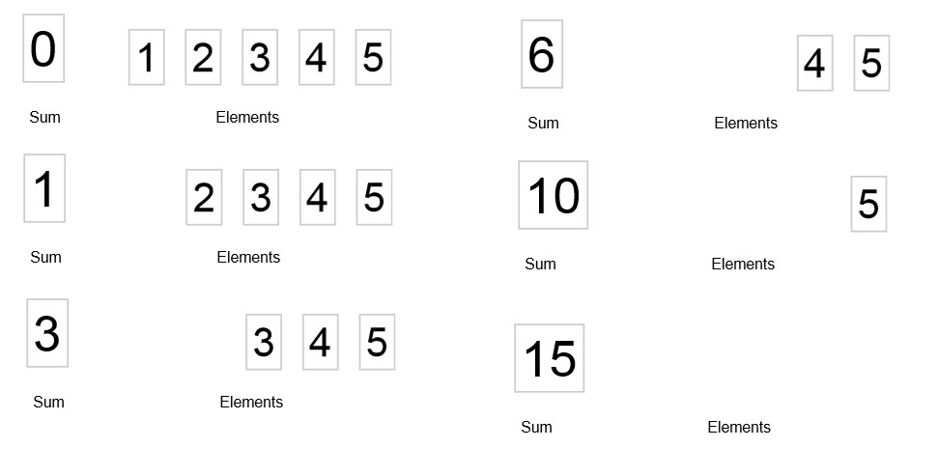
Sequential reduce

Slide 47
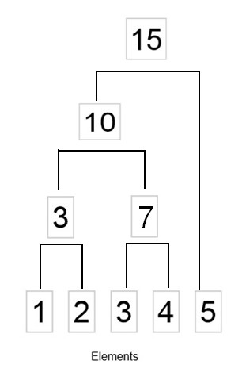
Parallel sort – 153.oldal

Slide 48
Lambda cookbook
file:///C:/dl/dorsum/java_se_8_tanfolyam/D80895GC10_sg.pdf
169. oldal

Slide 49
Chapter 3 - Working with Local Dates and Times
Previous Java Date and Time
What is wrong with java.util.Date (Calendar, TimeZone & DateFormat)?
Does not support fluent API approach
Instance are mutable - not compatible with lambda
Not thread safe
Weakly typed calendars
One size fits all

Slide 50
Local Date and Time API Goals
The classes and methods should be straight forward.
The API should support a fluent API approach.
Instances of time/date objects should be immutable - this is important for lambda operations.
Use ISO standards to define date and time.
Time and date operations should be thread safe.
Strong typing—makes it much easier to develop good code first (The compiler is your friend.)
toString will always return a human readable format.
Allow developers to extend the API easily.

Slide 51
Working with Local Date and Time
The java.time API defines two classes for working with local dates and times: (without a time zone)
LocalDate
Does not include time
A year-month-day representation
toString – ISO 8601 format (YYYY-MM-DD)
LocalTime
Does not include date
Stores hours-minutes-seconds-nanoseconds
toString – (HH:MM:SS)

Slide 54
Java 9 – New features
The JDK 8 HotSpot JVM is now using native memory for the representation of class metadata and is called Metaspace
Metaspace by default auto increases its size, while PermGen always has a fixed maximum size. You can set a fixed maximum for Metaspace with JVM parameters, but you cannot make PermGen auto increase.

Slide 55
Anonymous Inner Classes

Slide 56
Anonymous Inner Classes

