Slide 1
Java Advanced
Introduction to EE

Slide 2
Agenda
About the Enterprise Edition
Enterprise Java Beans
Annotations
Interceptors
Java Architecture for XML Binding
Log4j
JUnit

Slide 3
Enterprise Edition

Slide 4
Java SE -> EE
By 1996, Java had already become popular among developer for its friendly APIs and automated Garbage Collection and was starting to be widely used in back-end systems. One problem, however, was that most of these systems needed the same set of standard capabilities — such as persistence, transaction integrity, and concurrency control — which the JDK lacked at that time. That, naturally, led to many home-grown, closed implementations.
Notes:
The runtime environment is the so-called application server that fits into a layered software architecture.
Data Tier - Persistent storage of data
Business Tier – functionality, business domain tasks
Web Tier - serving thin clients – deployed to app server in EE
Presentation/Client Tier - UI

Slide 5
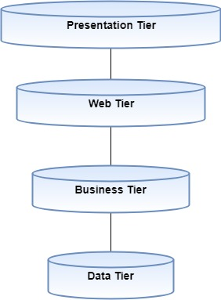
Java SE -> EE
multi-tier architecture
Web based
Enterprised applications
Distributed components
Notes:
The runtime environment is the so-called application server that fits into a layered software architecture.
Data Tier - Persistent storage of data
Business Tier – functionality, business domain tasks
Web Tier - serving thin clients – deployed to app server in EE
Presentation/Client Tier - UI

Slide 6
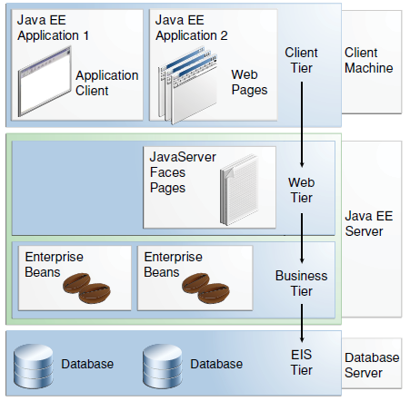
Java EE application server
Notes:
EJB contains the business logic.
- Remote access through RMI

Slide 7
What is business logic?
Prescribes how business objects interact with one another
Business logic is the portion of an enterprise system which determines how data is transformed or calculated, and how it is route to people or software (workflow)
For example for an eCommerce site: Allow visitors to add items to a shopping cart, specify a shipping address, and supply payment information
Notes:
The runtime environment is the so-called application server that fits into a layered software architecture.
Data Tier - Persistent storage of data
Business Tier – functionality, business domain tasks
Web Tier - serving thin clients – deployed to app server in EE
Presentation/Client Tier - UI

Slide 8
Example order workflow
1) Customer creates and order
2) Warehouse prepares order
3) Shipping puts the order on a truck
4) Confirm delivery at your door
The business logic of the website might include workflow such as: the sequence of events that happens during checkout, which first ask for the shipping address, then for the billing address, next page will contain the payments method, and last page will show congrats. Think workflow, what tasks, and what order.
Notes:
The runtime environment is the so-called application server that fits into a layered software architecture.
Data Tier - Persistent storage of data
Business Tier – functionality, business domain tasks
Web Tier - serving thin clients – deployed to app server in EE
Presentation/Client Tier - UI

Slide 9
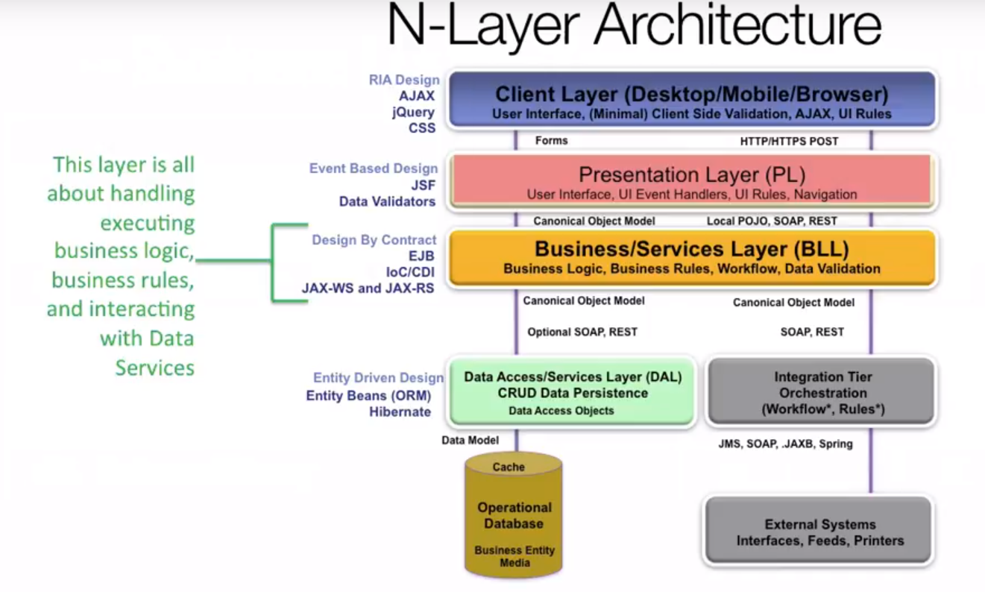
N Layer architechture
Notes:
The runtime environment is the so-called application server that fits into a layered software architecture.
Data Tier - Persistent storage of data
Business Tier – functionality, business domain tasks
Web Tier - serving thin clients – deployed to app server in EE
Presentation/Client Tier - UI

Slide 10
What is a business rule?
A business rule is a rule that defines or constraints some aspect of business and always resolves to either true or false
Business rules describe the operations, definitions and constrains that apply to an organization
Business rules can apply to people, processes, corporate behavior and computing system in an organization
For example:
Cannot withdraw more money from your account than your balance
Cannot buy items with a credit card if the card authorization fails
Notes:
The runtime environment is the so-called application server that fits into a layered software architecture.
Data Tier - Persistent storage of data
Business Tier – functionality, business domain tasks
Web Tier - serving thin clients – deployed to app server in EE
Presentation/Client Tier - UI

Slide 11
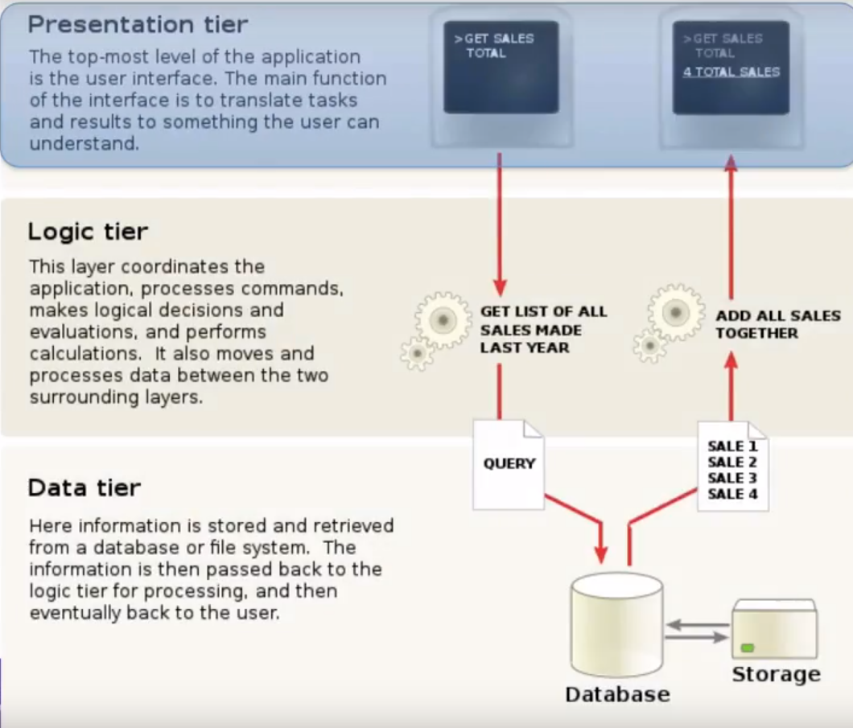
Main tiers
Notes:
The runtime environment is the so-called application server that fits into a layered software architecture.
Data Tier - Persistent storage of data
Business Tier – functionality, business domain tasks
Web Tier - serving thin clients – deployed to app server in EE
Presentation/Client Tier - UI

Slide 12
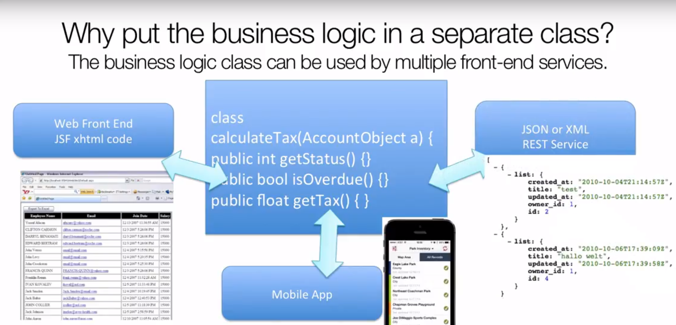
Business Logic
Notes:
The runtime environment is the so-called application server that fits into a layered software architecture.
Data Tier - Persistent storage of data
Business Tier – functionality, business domain tasks
Web Tier - serving thin clients – deployed to app server in EE
Presentation/Client Tier - UI

Slide 13
Enterprise Java Beans

Slide 14
EJB – overview
An enterprise bean (EJB) is a server-side component that encapsulates the business logic of an application. The business logic is the code that fulfills the purpose of the application.
It does not perform display of business data (presentation) or perform operations directly the database (persistence)
Notes:
the EJB container provides system-level services to enterprise beans
the EJB container, rather than the bean developer, is responsible for system-level- services, such as transaction management and security authorization
Controls transactions automatically. You can demarcate transactions explicitly

Slide 15
EJB – overview
To run EJB application, you need an application server (EJB Container) such as Jboss, Glassfish, Weblogic, Websphere etc. It performs:
life cycle management,
security,
transaction management, and
object pooling.
Notes:
the EJB container provides system-level services to enterprise beans
the EJB container, rather than the bean developer, is responsible for system-level- services, such as transaction management and security authorization
Controls transactions automatically. You can demarcate transactions explicitly

Slide 16
EJB – when to use
Application needs Remote Access. In other words, it is distributed.
Application needs to be scalable. EJB applications supports load balancing, clustering and fail-over.
Application needs encapsulated business logic. EJB application is separated from presentation and persistent layer.
Notes:
the EJB container provides system-level services to enterprise beans
the EJB container, rather than the bean developer, is responsible for system-level- services, such as transaction management and security authorization
Controls transactions automatically. You can demarcate transactions explicitly

Slide 17
EJB – overview
Server-side component
Business logic (no UI!)
Distributed
Transactional
Secure
Portable
Client can be JSPs, servlets, other EJBs and external applications
Clients see interfaces
Notes:
the EJB container provides system-level services to enterprise beans
the EJB container, rather than the bean developer, is responsible for system-level- services, such as transaction management and security authorization
Controls transactions automatically. You can demarcate transactions explicitly

Slide 18
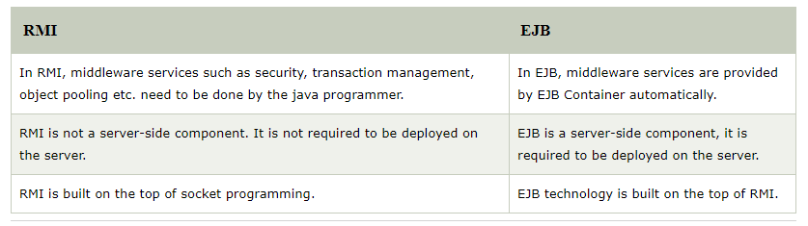
EJB or RMI
Both RMI and EJB, provides services to access an object running in another JVM (known as remote object) from another JVM. The differences between RMI and EJB are given below:
Notes:
the EJB container provides system-level services to enterprise beans
the EJB container, rather than the bean developer, is responsible for system-level- services, such as transaction management and security authorization
Controls transactions automatically. You can demarcate transactions explicitly

Slide 19
J2EE EJB Server or Container
An EJB container manages the enterprise beans contained within it
For each enterprise bean, the container is responsible for the registering the object, providing a remote interface for the object, creating and destroying object instances, checking security for the object, managing the active state for the object, and coordinating distributed transactions
Notes:
the EJB container provides system-level services to enterprise beans
the EJB container, rather than the bean developer, is responsible for system-level- services, such as transaction management and security authorization
Controls transactions automatically. You can demarcate transactions explicitly

Slide 20
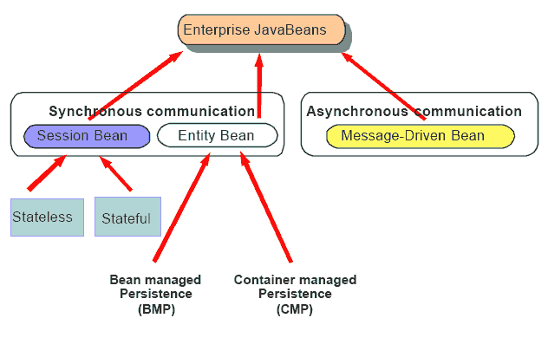
EJB – when to use, types
When to use
App must be scalable (Growing number of users, multiple machines)
Transactions (Concurrent access of shared objects)
Types
Session
Message-driven
(Entity)
Notes:
Session: Performs a task for a client; optionally, may implement a web service
Message-driven: Acts as a listener for a particular messaging type, such as the Java Message Service API

Slide 21
Session Bean
Business logic that can be invoked by a client over local, remote or web service client views.
JNDI api
Interfaces
Local
Remote
Notes:
Remote:
Business methods available to clients
acts as a proxy to the EJB instance
Stateful:
Each instance is bound to specific client session
shopping cart
Stateless:
no user specific data
shopping catalog

Slide 22
Types of Session Beans
1) Stateless Session Bean: It doesn't maintain state of a client between multiple method calls.
2) Stateful Session Bean: It maintains state of a client across multiple requests.
3) Singleton Session Bean: One instance per application, it is shared between clients and supports concurrent access.
Notes:
Remote:
Business methods available to clients
acts as a proxy to the EJB instance
Stateful:
Each instance is bound to specific client session
shopping cart
Stateless:
no user specific data
shopping catalog

Slide 23
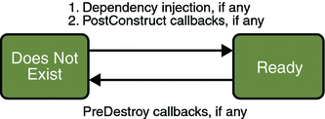
Stateless Session Beans
There are 3 important annotations used in stateless session bean:
@Stateless
@PostConstruct
@PreDestroy
Notes:
Remote:
Business methods available to clients
acts as a proxy to the EJB instance
Stateful:
Each instance is bound to specific client session
shopping cart
Stateless:
no user specific data
shopping catalog

Slide 24
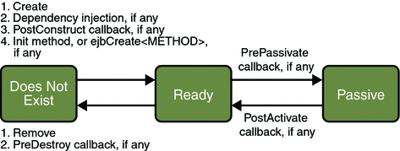
Stateful Session Beans
There are 5 important annotations used in stateful session bean:
@Stateful
@PostConstruct
@PreDestroy
@PrePassivate
@PostActivate
Notes:
Remote:
Business methods available to clients
acts as a proxy to the EJB instance
Stateful:
Each instance is bound to specific client session
shopping cart
Stateless:
no user specific data
shopping catalog

Slide 25
Singleton Session Beans
A Singleton Session Bean maintains the state of the bean for the complete lifecycle of the application.
Singleton Session Beans are similar to Stateless Session Beans but only one instance of the Singleton Session Bean is created in the whole application and does not terminates until the application is shut down.
The single instance of the bean is shared between multiple clients and can be concurrently accessed.
Notes:
Remote:
Business methods available to clients
acts as a proxy to the EJB instance
Stateful:
Each instance is bound to specific client session
shopping cart
Stateless:
no user specific data
shopping catalog

Slide 26
Session Bean - implementation
EJB2 – xml based
Home interface
Deployment descriptor: ejb-jar.xml
Spec deployment descriptor: weblogic-ejb-jar.xml
EJB3 – annotation based (xml is stronger)
@Remote, @Local
Dependency injection: @EJB, @Resource
Lifecycle methods: @PostConstruct, @PreDestroy, @PrePassivate, @PostActivate, @Remove
Notes:
@Remote, @Local – on ejb class or on interface, more interfaces
Stateless – postConstruct, preDestroy
Stateful :
postConstruct, preDestroy, prePassivate, postActivate
Remove

Slide 27
Session Bean – Example EJB3
@Local
public interface CalcServiceLocal {
long add(long i, long j);
}
@Remote
public interface CalcServiceRemote {
long add(long i, long j);
}
@Stateless(mappedName = "CalcService")
public class CalcService implements CalcServiceRemote, CalcServiceLocal {
public CalcService() {}
@Override
public long add(long i, long j) {
return i+j;
}
}

Slide 28
Session Bean – Example EJB3
public interface CalcServiceLocal {
long add(long i, long j);
}
public interface CalcServiceRemote {
long add(long i, long j);
}
@Local(CalcServiceLocal.class)
@Remote(CalcServiceRemote.class)
@Stateless(mappedName = "CalcService")
public class CalcService {
public CalcService() {}
public long add(long i, long j) {
return i+j;
}
}

Slide 29
Session Bean – Client example, local EJB3
public class CalcServiceClient {
public static void main(String[] args) throws NamingException {
CalcServiceLocal calcService = InitialContext. doLookup(“java:module/CalcService");
System.out.println(calcService.add(1, 2));
}
}

Slide 30
Session Bean – Client example, remote EJB3
public class CalcServiceClient {
public static void main(String[] args) throws NamingException {
Properties props = new Properties();
props.put(Context.INITIAL_CONTEXT_FACTORY, "weblogic.jndi.WLInitialContextFactory");
props.put(Context.PROVIDER_URL, "t3://localhost:17291");
props.put(Context.SECURITY_PRINCIPAL, "weblogic");
props.put(Context.SECURITY_CREDENTIALS, "12345678");
Context context = new InitialContext(props);
CalcServiceRemote calcService = (CalcServiceRemote) context.lookup("CalcService#eu.dorsum.ejb.session.CalcServiceRemote");
System.out.println(calcService.add(1, 2));
}
}

Slide 31
Session Bean – Example EJB2 ejb-jar.xml
<?xml version="1.0" encoding="UTF-8"?>
<!DOCTYPE ejb-jar PUBLIC "-//Sun Microsystems, Inc.//DTD Enterprise JavaBeans 2.0//EN" "http://java.sun.com/dtd/ejb-jar_2_0.dtd">
<ejb-jar id="ejb-jar_ID">
<display-name>ClavisMTIQ</display-name>
<enterprise-beans>
<session id="TransactionSession">
<display-name>TransactionSession</display-name>
<ejb-name>TransactionSession</ejb-name>
<home>hu.dorsum.clavis.ejb.transaction.TransactionSessionHome</home>
<remote>hu.dorsum.clavis.ejb.transaction.TransactionSession</remote>
<local-home>hu.dorsum.clavis.ejb.transaction.TransactionSessionLocalHome</local-home>
<local>hu.dorsum.clavis.ejb.transaction.TransactionSessionLocal</local>
<ejb-class>hu.dorsum.clavis.ejb.transaction.TransactionSessionBean</ejb-class>
<session-type>Stateless</session-type>
<transaction-type>Container</transaction-type>
<env-entry>
<env-entry-name>ejb/BeanFactoryPath</env-entry-name>
<env-entry-type>java.lang.String</env-entry-type>
<env-entry-value>spring-beans.xml</env-entry-value>
</env-entry>
<resource-env-ref>
<resource-env-ref-name>jdbc/ClavisDB</resource-env-ref-name>
<resource-env-ref-type>javax.sql.DataSource</resource-env-ref-type>
</resource-env-ref>
</session>
</enterprise-beans>
</ejb-jar>
Notes:
Home interface:
Factory
methods to create, remove or locate EJB objects

Slide 32
Session Bean – Example EJB2 weblogic-ejb-jar.xml
<?xml version="1.0" encoding="UTF-8"?>
<weblogic-ejb-jar xmlns="http://www.bea.com/ns/weblogic/10.0"
xmlns:xsi="http://www.w3.org/2001/XMLSchema-instance"
xsi:schemaLocation="http://www.bea.com/ns/weblogic/10.0 http://www.bea.com/ns/weblogic/10.0/weblogic-ejb-jar.xsd">
<weblogic-enterprise-bean>
<ejb-name>TransactionSession</ejb-name>
<resource-env-description>
<resource-env-ref-name>jdbc/ClavisDB</resource-env-ref-name>
<jndi-name>jdbc/ClavisDS</jndi-name>
</resource-env-description>
<enable-call-by-reference>true</enable-call-by-reference>
<jndi-name>ejb/clavis/TransactionSession</jndi-name>
<local-jndi-name>ejb/clavis/TransactionSessionLocal</local-jndi-name>
<dispatch-policy>ClavisWorkmanager</dispatch-policy>
</weblogic-enterprise-bean>
</weblogic-ejb-jar>

Slide 33
Message Driven Bean
allows Java EE applications to process messages asynchronously
Similar to an event listener but receives JMS messages instead of events
Stateless
Transaction aware
MessageListener interface
onMessage method
Notes:
Notes: JMS
point-to-point (queue)
Publish-subscribe (topic)

Slide 34
Message Driven Bean – Example EJB3
@MessageDriven(activationConfig = {
@ActivationConfigProperty(propertyName = "destinationType", propertyValue = "javax.jms.Queue"),
@ActivationConfigProperty(propertyName = "destination", propertyValue = “MY_QUEUE")}
, mappedName = “TestQueueMDB")
public class TestQueueMDB implements MessageListener {
public TestQueueMDB() {
}
public void onMessage(Message message) {
if (message instanceof TextMessage) {
try {
System.out.println("TextMessage, " + ((TextMessage) message).getText());
} catch (JMSException e) {
System.out.println(e);
}
} else {
System.out.println("No TextMessage");
}
}
}

Slide 35
MDB – Example EJB2 ejb-jar.xml
<?xml version="1.0" encoding="UTF-8"?>
<!DOCTYPE ejb-jar PUBLIC "-//Sun Microsystems, Inc.//DTD Enterprise JavaBeans 2.0//EN" "http://java.sun.com/dtd/ejb-jar_2_0.dtd">
<ejb-jar id="ejb-jar_ID">
<display-name>ClavisMTIQ</display-name>
<enterprise-beans>
<message-driven>
<display-name>MessageListener</display-name>
<ejb-name>MessageListener</ejb-name>
<ejb-class>hu.dorsum.clavis.modules.interfaces.ejb.listener.MessageListenerBean</ejb-class>
<transaction-type>Container</transaction-type>
<message-driven-destination>
<destination-type>javax.jms.Queue</destination-type>
</message-driven-destination>
</message-driven>
</enterprise-beans>
</ejb-jar>

Slide 36
MDB– Example EJB2 weblogic-ejb-jar.xml
<?xml version="1.0" encoding="UTF-8"?>
<weblogic-ejb-jar xmlns="http://www.bea.com/ns/weblogic/10.0"
xmlns:xsi="http://www.w3.org/2001/XMLSchema-instance"
xsi:schemaLocation="http://www.bea.com/ns/weblogic/10.0 http://www.bea.com/ns/weblogic/10.0/weblogic-ejb-jar.xsd">
<weblogic-enterprise-bean>
<ejb-name>MessageListener</ejb-name>
<message-driven-descriptor>
<pool>
<max-beans-in-free-pool>10</max-beans-in-free-pool>
</pool>
<destination-jndi-name>TO_CLAVIS</destination-jndi-name>
<connection-factory-jndi-name>weblogic.jws.jms.QueueConnectionFactory</connection-factory-jndi-name>
</message-driven-descriptor>
<enable-call-by-reference>true</enable-call-by-reference>
<dispatch-policy>MessageListenerWM</dispatch-policy>
</weblogic-enterprise-bean>
</weblogic-ejb-jar>

Slide 37
Annotations

Slide 38
Annotations
Annotations were introduced in Java 5.0. The purpose of having annotations is to attach additional information in the class or a meta-data of a class within its source code. In EJB 3.0, annotations are used to describe configuration meta-data in EJB classes. By this way, EJB 3.0 eliminates the need to describe configuration data in configuration XML file
Notes:
Meta-annotations to define an annotation
Target: milyen nyelvi elemekre alkalmazható
Retention: how to handle the annotation the compiler or The JVM
Documented: displayed in Javadoc
Inherited: inherited in subclasses

Slide 39
@Retention
This annotation specifies how the marked annotation is stored in java runtime. Whether it is limited to source code only, embedded into the generated class file, or it will be available at runtime through reflection as well.
import java.lang.annotation.Retention;
import java.lang.annotation.RetentionPolicy;
//@Retention(RetentionPolicy.CLASS)
@Retention(RetentionPolicy.RUNTIME)
//@Retention(RetentionPolicy.SOURCE)
public @interface MyCustomAnnotation {
//some code
}

Slide 40
RetentionPolicy
RetentionPolicy.SOURCE
Discard during the compile. These annotations don't make any sense after the compile has completed, so they aren't written to the bytecode.
Example: @Override, @SuppressWarnings
(annotation retained only in the source file and is discarded during compilation.)
RetentionPolicy.CLASS
Discard during class load. Useful when doing bytecode-level post-processing. Somewhat surprisingly, this is the default.
(annotation stored in the .class file during compilation, not available in the run time.)
RetentionPolicy.RUNTIME
Do not discard. The annotation should be available for reflection at runtime. Example: @Deprecated
(annotation stored in the .class file and available in the run time.)
}

Slide 41
RetentionPolicy
Default values to annotation members
@Retention(RetentionPolicy.RUNTIME)
@interface MyAnnot{
String key() default "site";
String value() default "java2novice.com";
}

Slide 42
@Documented
@Documented is a meta-annotation. You apply @Documented when defining an annotation, to ensure that classes using your annotation show this in their generated JavaDoc.
import java.lang.annotation.Documented;
@Documented
public @interface MyCustomAnnotation {
//Some other code
}

Slide 43
@Deprecated
The @Deprecated annotation will be used to inform the compiler to generate a warning whenever a program uses a method, class, or field with the @Deprecated annotation. It is good to document the reason with Javadoc @deprecated tag. Make a note of case difference with @Deprecated and @deprecated. @deprecated is for documentation purpose.
@Deprecated
public void showDeprecatedMessage(){
System.out.println("This method is marked as deprecated");
}

Slide 44
@Override
When we use @Override annotation to a method, it let compiler know that we are overriding it from super class. It is not mandatory to use @Override when you override a method. Incase you are using @Override annotation, and the method signature is not found at super class will results compilation error.
public class Animal {
public void makeSound(){}
}
class Cat extends Animal{
@Override
public void makeSound(){
System.out.println("myyyyyaaawwwwww");
}
}

Slide 45
@SupressWarnings
Incase if you don't want to get any warnings from compiler for the known things, then you can use @SuppressWarnings annotation. For example, you are calling deprecated method, and you know that it is deprecated, to avoid compiler warnings, user @SuppressWarnings annotation.
public class MyDeprecatedExmp {
@Deprecated
public void showDeprecatedMessage(){
System.out.println("This method is marked as deprecated");
}
@SuppressWarnings("deprecation")
public static void main(String a[]){
MyDeprecatedExmp mde = new MyDeprecatedExmp();
mde.showDeprecatedMessage();
}
}

Slide 46
@Target
Use @Target annotation to restrict the usage of new annotation on certain java elements such as class, interface or methods. After specifying the targets, you will be able to use the new annotation on given elements only.
@Target(value = {ElementType.TYPE, ElementType.METHOD, ElementType.CONSTRUCTOR, ElementType.ANNOTATION_TYPE,
ElementType.FIELD,
ElementType.LOCAL_VARIABLE,
ElementType.PACKAGE,
ElementType.PARAMETER})
public @interface MyCustomAnnotation {
//Some other code
}

Slide 47
Other Annotations
@Inherited
This is a annotation for annotations.It means that subclasses of annotated classes are considered having the same annotation as their superclass.
@Repeatable
By default, an annotation is applied on a java element only once. But, by any requirement, you have to apply a annotation more than once, then use @Repeatable annotation on your new annotation.
@Repeatable(Schedules.class)
public @interface Schedule { ... }
@Schedule(dayOfMonth="last")
@Schedule(dayOfWeek="Fri", hour="23")
public void doPeriodicCleanup() { ... }
@FunctionalInterface
public interface MyFirstFunctionalInterface {
public void doSomeWork();
}

Slide 48
EJB Annotations
https://www.tutorialspoint.com/ejb/ejb_annotations.htm

Slide 49
Interceptors

Slide 50
Interceptors
invoke methods on an associated target class, in conjunction with method invocations or lifecycle events
Any class with simple constructor (no params)
One interceptor method
Object <METHOD>(InvocationContext)
A life cycle event with the callback interceptor method
Associate the interceptor class with your EJB 3.0 session bean (@Interceptors)
Notes:
Interceptors are used in conjunction with Java EE managed classes to allow developers to invoke interceptor methods on an associated target class, in conjunction with method invocations or lifecycle events.
Common uses of interceptors are logging, auditing, and profiling.

Slide 51
Interceptor Metadata Annotation
@AroundInvoke
Designates the method as an interceptor method.
@AroundTimeout
Designates the method as a timeout interceptor, for interposing on timeout methods for enterprise bean timers
@PostConstruct
Designates the method as an interceptor method for post-construct lifecycle events.
@PreDestroy
Designates the method as an interceptor method for pre-destroy lifecycle events.

Slide 52
Interceptor declaration - Example
package eu.dorsum.interceptor;
import javax.interceptor.InvocationContext;
public class LoggerInterceptor {
@AroundInvoke
public Object logger(InvocationContext inv) throws Exception {
System.out.println("Following method was invoked: " + inv.getMethod().getName());
System.out.println("Parameters: " + inv.getParameters());
return inv.proceed();
}
}

Slide 53
Interceptor - Example
package eu.dorsum.interceptor;
import javax.ejb.Stateless;
import javax.interceptor.Interceptors;
@Stateless
public class CounterBean implements CounterBeanLocal {
private int val = 0;
public CounterBean() {}
@Override
@Interceptors({ LoggerInterceptor.class })
public void set(int val) {
this.val = val;
}
@Override
public int count() {
return ++val;
}
}

Slide 54
Java Architecture for XML Binding

Slide 55
JAXB vs. DOM
DOM
+ simple, general
- no types, no compile-time checking
https://www.tutorialspoint.com/java_xml/java_dom_parse_document.htm
JAXB
+ preserve types, compile-time checking
- complex, specific to a certain schema
Notes:
DOM – document object model
root.getChild("Address").getChild("Number").getText()

Slide 56
JAXB - features
Unmarshal: xml → objects
Marshal: objects → xml
Create / Read / Update / Delete objects
Validate objects
No roundtrip guarantees
Marshal( Unmarshal(xml) ) ≠ xml
order is not always preserved, but usually roundtrip holds

Slide 57
Example – xml descriptor
@XmlRootElement
public class Customer {
String name;
int id;
public String getName() {
return name;
}
@XmlElement
public void setName(String name) {
this.name = name;
}
public int getId() {
return id;
}
@XmlAttribute
public void setId(int id) {
this.id = id;
}
}

Slide 58
Example - marshalling
<?xml version="1.0" encoding="UTF-8" standalone="yes"?>
<customer id="100"> <name>dl</name>
</customer>
public class JaxbExample {
public static void main(String[] args) {
Customer customer = new Customer();
customer.setId(100);
customer.setName(“dl");
try {
JAXBContext jaxbContext = JAXBContext.newInstance(Customer.class);
Marshaller jaxbMarshaller = jaxbContext.createMarshaller();
jaxbMarshaller.setProperty(Marshaller.JAXB_FORMATTED_OUTPUT, true);
jaxbMarshaller.marshal(customer, System.out);
} catch (JAXBException e) {
e.printStackTrace();
}
}
}

Slide 59
Example - unmarshalling
public class JaxbExample {
public static void main(String[] args) {
try {
File file = new File("C:\\file.xml");
JAXBContext jaxbContext = JAXBContext.newInstance(Customer.class);
Unmarshaller jaxbUnmarshaller = jaxbContext.createUnmarshaller();
Customer customer = (Customer) jaxbUnmarshaller.unmarshal(file);
System.out.println(customer);
} catch (JAXBException e) {
e.printStackTrace();
}
}
}

Slide 60
Example – xml schema
Example.xml
<?xml version="1.0" encoding="utf-8"?>
<Person xmlns:xsi="http://www.w3.org/2001/XMLSchema-instance"
xsi:noNamespaceSchemaLocation="C:\JAXB Demo\demo.xsd">
<Name>kd</Name>
<Address>Test street 1</Address>
<Address>Test street 2</Address>
</Person>
Example.xsd
<?xml version="1.0" encoding="utf-8"?>
<xs:schema xmlns:xs="http://www.w3.org/2001/XMLSchema">
<xs:element name="Person" type="PersonType" />
<xs:complexType name="PersonType">
<xs:sequence>
<xs:element name="Name " type="xs:string" />
<xs:element name="Address" type="xs:string" minOccurs="1" maxOccurs="unbounded" />
</xs:sequence>
</xs:complexType>
</xs:schema>
"%JAVA_HOME%\bin\"xjc Example.xsd -d demo/ -p eu.dorsum.marshalling.example
Notes:
A package named eu.dorsum.marshalling.example is created
ObjectFactory.java
PersonType.java

Slide 61
Log4j

Slide 62
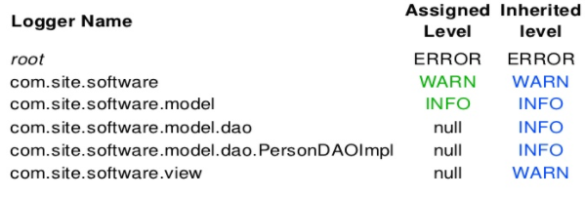
Log4j
Logger may be assigned to a level
TRACE<DEBUG<INFO<WARN<ERROR<FATAL
Configuration file
Properties, xml or java
Level inheritance
May be assigned to an appender
ConsoleAppender, FileAppender
Java.util.Logging, org.apache.log4j.Logger

Slide 63
Example – log4j.properties, log to file
log4j.rootLogger=warn, file
log4j.category.hu.dorsum.clavis=INFO
log4j.category.hu.dorsum.clavis.transaction=DEBUG
log4j.category.hu.dorsum.clavis.modules.interfaces=INFO
# Direct log messages to a log file
log4j.appender.file=org.apache.log4j.RollingFileAppender
log4j.appender.file.File=c:\\log\\wls.log
log4j.appender.file.MaxFileSize=10MB
log4j.appender.file.MaxBackupIndex=10
log4j.appender.file.layout=org.apache.log4j.PatternLayout
log4j.appender.file.layout.ConversionPattern=%d %5p %t %c{1} - %m%n

Slide 64
Example – log4j.xml, log to console
<?xml version="1.0" encoding="UTF-8" ?>
<!DOCTYPE log4j:configuration SYSTEM "log4j.dtd">
<log4j:configuration debug="true"
xmlns:log4j='http://jakarta.apache.org/log4j/'>
<appender name="console" class="org.apache.log4j.ConsoleAppender">
<layout class="org.apache.log4j.PatternLayout">
<param name="ConversionPattern"
value=“%d %5p %t %c{1} - %m%n" />
</layout>
</appender>
<root>
<level value="DEBUG" />
<appender-ref ref="console" />
</root>
</log4j:configuration>

Slide 65
Example - Log4j2.xml
<?xml version="1.0" encoding="UTF-8"?>
<Configuration status="WARN“ monitorInterval="30">
<Appenders>
<Console name="Console" target="SYSTEM_OUT">
<PatternLayout pattern=" %d %5p %t %c{1} - %m%n "/>
</Console>
</Appenders>
<Loggers>
<Logger name=“hu.dorsum" level="trace" additivity="false">
<AppenderRef ref="Console"/>
</Logger>
<Root level="error">
<AppenderRef ref="Console"/>
</Root>
</Loggers>
</Configuration>

Slide 66
Example – use of
public class LogExample {
private static final Logger logger = Logger.getLogger(LogExample.class);
public static void main(String[] args) {
logger.info("process started");
Customer customer = new Customer();
customer.setId(100);
customer.setName("kd");
if (logger.isDebugEnabled()) {
logger.debug("customer: " + customer);
}
}
}
Debug method also check log Level, duplicate check is unnecessary overhead. But if the external condition test is omitted, the customer.toString() method will be invoked!

Slide 67
JUnit

Slide 68
JUnit
Open source framework, writing and running test in java
Smallest part of the source code
Generally programmers created unit test
Test suites that can be run any time when you make any changes in your code
The modifications in the code will not break your system without your knowledge
Maven integration
running tests at compilation time
Notes:
Tests for a small part of the source code.

Slide 69
Why create a test suite?
Two option for testing your code
Ad hoc testing
Building a test suite
Pro:
Reduces total number of bugs in delivered code
Makes code much more maintainable and refactorable
Contra
lot of extra programming
no time for that extra work (BUT test suites reduce the debugging time!)

Slide 70
Assert methods
Each assert method has parameters like these: (message,) expected-value, actual-value
messages helps documents the tests
messages provide additional information when reading failure logs
Assert methods dealing with floating point numbers get an additional argument, a tolerance
assertTrue, assertFalse, assertNull, assertNotNull, assertEquals, assertNotEquals, …

Slide 71
public class TestPieceCalculator {
@Test
public void pieceCalc() throws Exception {
assertEquals(0.5, PieceCalculator.getPiece(50, 100), TestUtil.DELTA);
assertEquals(0.75, PieceCalculator.getPiece(75, 100), TestUtil.DELTA);
}
@Test
public void test_method_1() {
Assert.assertEquals(2, PieceCalculator.sum(1,1));
}
}

Slide 72
Setup and teardown methods
Setup methods
@BeforeClass
creates and initializes instance variables, etc
@Before
For example incrementing/decrementing, etc.
Teardown methods
@After
For example incrementing/decrementing, etc.
@AfterClass
Releases any system resources used by the testsuite

Slide 73
Example
public class TestExample {
// Run once, e.g. Database connection, connection pool
@BeforeClass
public static void runOnceBeforeClass() {
System.out.println("@BeforeClass - runOnceBeforeClass");
}
@AfterClass
public static void runOnceAfterClass() {
System.out.println("@AfterClass - runOnceAfterClass");
}
@Before
public void runBeforeTestMethod() {
System.out.println("@Before - runBeforeTestMethod");
}
@After
public void runAfterTestMethod() {
System.out.println("@After - runAfterTestMethod");
}
@Test
public void test_method_1() {
System.out.println("@Test - test_method_1");
Assert.assertEquals(2, 1 + 1);
}
@Test(expected = IndexOutOfBoundsException.class)
public void test_method_2() {
System.out.println("@Test - test_method_2");
new ArrayList<String>().get(0);
}
}
Notes:
@BeforeClass - runOnceBeforeClass
@Before - runBeforeTestMethod
@Test - test_method_1
@After – runAfterTestMethod
@Before – runBeforeTestMethod
@Test - test_method_2
@After - runAfterTestMethod
@AfterClass - runOnceAfterClass

Slide 74
Thank you

