Slide 1
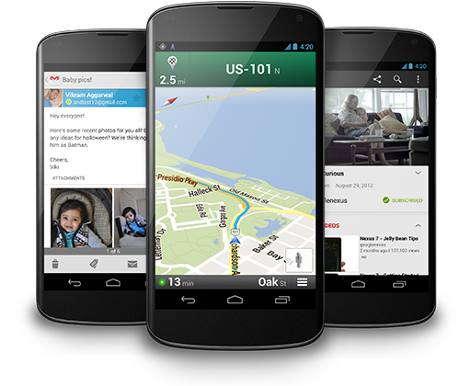
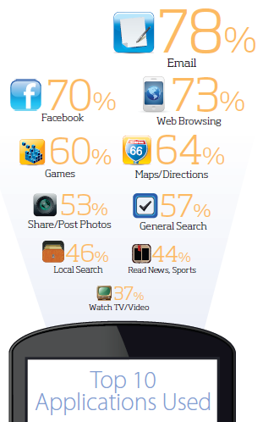
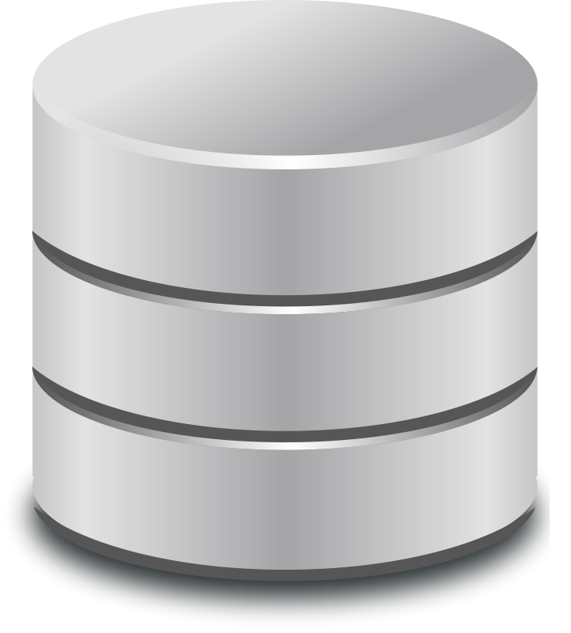
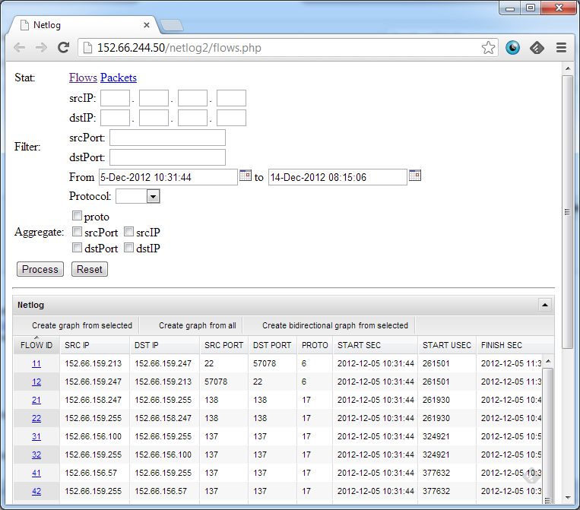
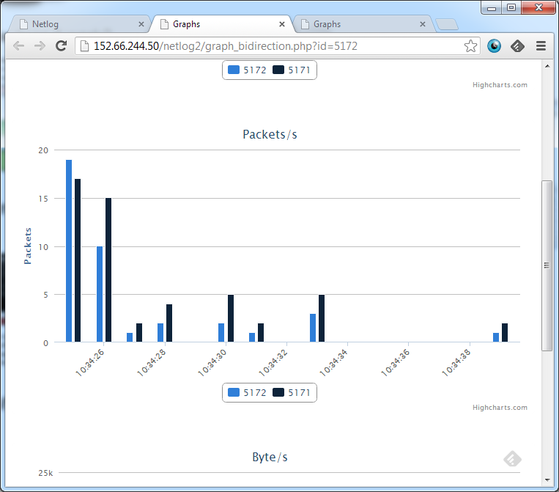
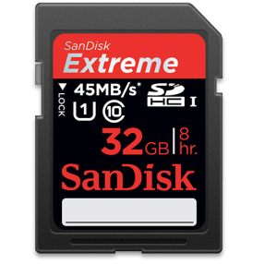
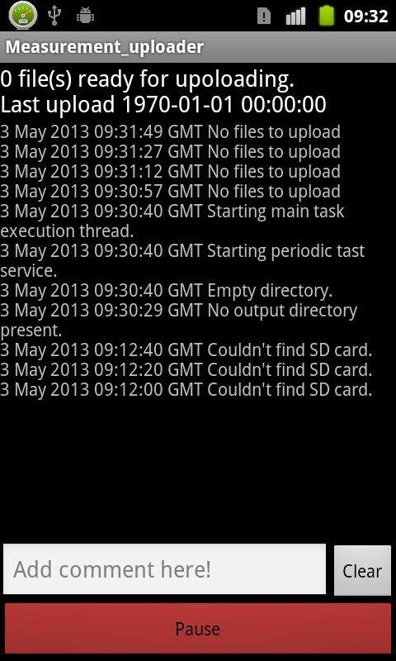
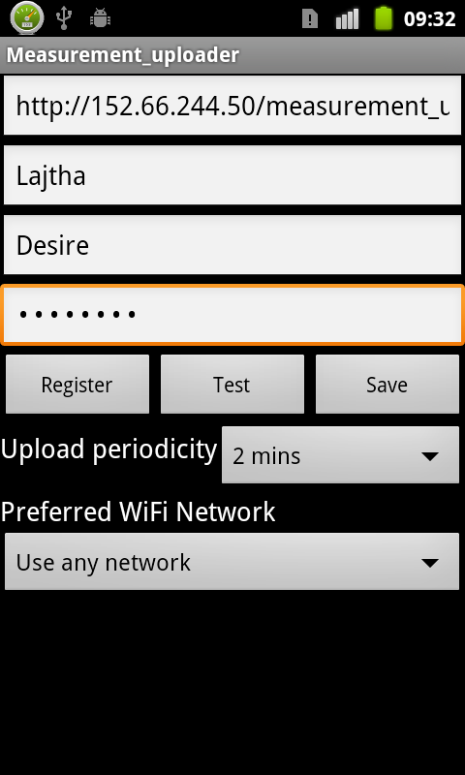
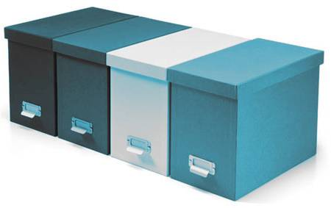

Network Capture and device statistics
On Android
Motivation
Mobile is the new way. In 2011 there were twice as many mobile broadband internet subscriptions than fixed ones. And it’s not only a question of access network technology. Twice as many touch screen devices are sold than traditional PCs and notebooks combined. This amplified the shift of content consumption that started with broader society gaining access to the Internet. And we know little of the way users and mobile devices use the internet. Most of the network models, content generators and network monitoring solutions are based on desktop applications and classical network usage. Our application is a first step in adopting network monitoring tools to current network usage.
Until now mobile app usage data mostly came from polls and download statistics, and didn’t reflect network usage. Our application aims at capturing both and furthermore linking the two sources to gain a deeper insight to the mobile experience.
How does it work?
It’s a multi layer Android application. Currently, requiring root access, but a newer version is already under development. Current version of the application uses firewall rules to redirect and capture traffic. The version under development will use a VPNService that creates a local VPN and captures traffic flowing through the virtual interface.
Data about running applications, front processes, screen and battery state are collected using the Android API. Data about memory and CPU usage is retrieved calling external scripts.
Our software combines the network traffic logs with the list of running applications. This provides unique input for teaching traffic classification algorithms.
Capture app
Apps
iptables
physical interface
Apps
tunnel interface
physical interface
Logs are parsed and processed
Firewall
softflow
VPN
softflow
Logs are uploaded periodically
User can set basic parameters and is notified of main events like successful log upload, and measurement results.
Where can I get it?
After finishing the VPN based solution, we’ll start a wider data collection involving students, teachers and volunteering Ericsson engineers. A main issue is data representation and visualization. We want to explore the correlation of the measured values. Application and flow associations will also be useful for training and validating flow based analysis tools.
Currently the log collection and processing is hosted on a BME TMIT virtual server. The Android application that requires root access is available at request. Ask the authors. When finished the VPN based solution will be downloadable from the Play Store. Backend code will be open source.
Future work
Gábor Fehér Markosz Maliosz
Balázs Lajtha TIBOR Vágó
Péter Máté

