Slide 1
📈
ML Stock Trading Backtest
Problem, approach, decisions, challenges, learning
A structured presentation based on a Python project that predicts next-day direction for Indian stocks using technical indicators and a Random Forest classifier.

Slide 2
Introduction
Stock markets generate large amounts of price data every day, which makes them a strong use case for data analysis and machine learning. Instead of depending only on intuition, this project explores whether technical indicators can support more systematic trading decisions.
The project focuses on Indian stocks, uses historical market data from Yahoo Finance, and converts model predictions into an actual backtesting process with buy, sell, stop-loss, and capital management rules.

Slide 3
Problem Statement
The main problem is to predict whether the next trading day will close higher or lower and then use that prediction to simulate profitable and controlled trades.
Input
Task
Output
Historical OHLC price data for RELIANCE.NS and INFY.NS.
Classify next-day movement as positive or negative using engineered indicators.
Trading actions and portfolio growth measured through backtesting metrics.

Slide 4
Advantages
Uses objective rules instead of emotional decision-making.
Combines technical indicators with machine learning classification.
Includes stop loss and position sizing for basic risk control.
Can be extended to more stocks and more features.
Produces measurable outputs like return, Sharpe ratio, and drawdown.
Helps understand the full workflow from data collection to evaluation.

Slide 5
Disadvantages
📉
💰
🧪
The strategy depends heavily on historical patterns, which may not repeat in future markets.
The current code does not include brokerage, taxes, slippage, or transaction costs.
Only a few indicators and two stocks are tested, so generalization is limited.

Slide 6
Problem Statement
What I chose
Why it matters
Build a rule-based backtesting workflow that uses machine learning predictions to decide when to buy or sell RELIANCE.NS and INFY.NS.
Manual trading decisions are often emotional and inconsistent. A backtest helps check whether a data-driven method could behave better than intuition.
The goal was not to guarantee profit, but to design a complete pipeline: collect data, engineer indicators, train a model, simulate trades, measure performance, and visualize results.

Slide 7
Why This Problem
🧠
⚙️
📊
Combines ML + Finance
Practical Pipeline
Measurable Outcome
It moves beyond model accuracy by testing actual trade execution, position sizing, stop loss, and capital tracking.
This project links classification, feature engineering, risk management, and evaluation in one real-world use case.
The strategy can be judged using return, Sharpe ratio, max drawdown, and equity curve behavior instead of vague claims.

Slide 8
System Workflow
1
2
3
4
5
Download stock data from Yahoo Finance from 2020 to today.
Create features: daily return, SMA 10, SMA 50, RSI.
Create binary target: whether next day's return is positive.
Train Random Forest on first 70% of samples and predict the remaining 30%.
Run backtest with position size, stop loss, and portfolio tracking.

Slide 9
Key Decisions
Model choice
Indicators
I used RandomForestClassifier because it handles nonlinear patterns better than a simple linear rule and works well without heavy feature scaling.
I selected SMA_10, SMA_50, and RSI because they are easy to interpret and represent short trend, longer trend, and momentum.
Risk design
Train/test split
Each trade uses 10% of current capital, with a 2% stop loss, so the backtest includes basic downside control instead of full-capital entries.
The split is chronological, not random, which is more realistic for time-series prediction because future data should not leak into training.

Slide 10
Challenges Faced
⏱️
🧹
💸
Time-series realism
Missing values
Strategy vs model
Indicators like moving averages and RSI create NaN values at the beginning, so the dataset must be cleaned before modeling.
In stock data, random shuffling breaks the sequence. I had to preserve time order while still making a train/test split.
A correct prediction does not always mean a good trading result. Execution rules, trade size, and exits affect final performance.
Another important challenge is that the current script does not include transaction costs, slippage, or benchmark comparison, so results may look better than live trading.

Slide 11
What I Learned
Feature engineering strongly shapes model usefulness.
Backtesting is more than prediction; it is also portfolio simulation.
Risk control can matter as much as model selection.
A profitable-looking strategy still needs realistic assumptions.
Finance problems require careful evaluation, not just high accuracy.
Reproducible code structure makes future improvement easier.

Slide 12
Code Highlights
def add_indicators(df):
df['Return'] = df['Close'].pct_change()
df['SMA_10'] = df['Close'].rolling(10).mean()
df['SMA_50'] = df['Close'].rolling(50).mean()
delta = df['Close'].diff()
gain = (delta.where(delta > 0, 0)).rolling(14).mean()
loss = (-delta.where(delta < 0, 0)).rolling(14).mean()
rs = gain / loss
df['RSI'] = 100 - (100 / (1 + rs))
df['Target'] = np.where(df['Return'].shift(-1) > 0, 1, 0)
return df.dropna()
model = RandomForestClassifier(
n_estimators=200,
max_depth=5
)
model.fit(X_train, y_train)
preds = model.predict(X_test)
if int(preds[i]) == 1 and shares == 0:
shares = position_size // price
elif shares > 0 and price < buy_price * (1 - stop_loss_pct):
balance += shares * price
elif int(preds[i]) == 0 and shares > 0:
balance += shares * price
These blocks show the core logic: technical indicator creation, target construction, model training, and trade execution rules.

Slide 13
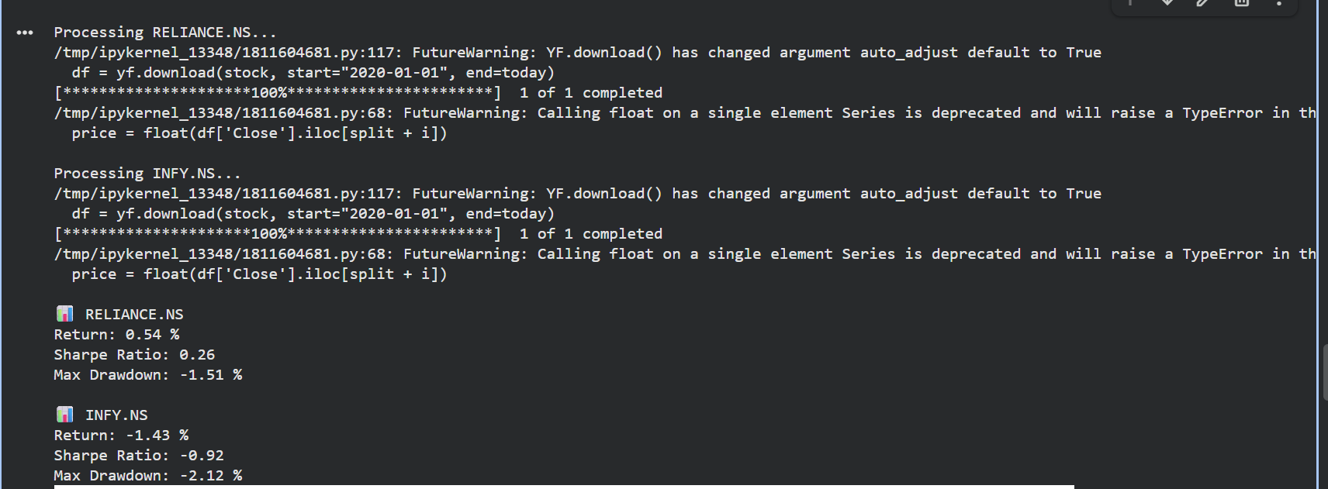
Result

Slide 14
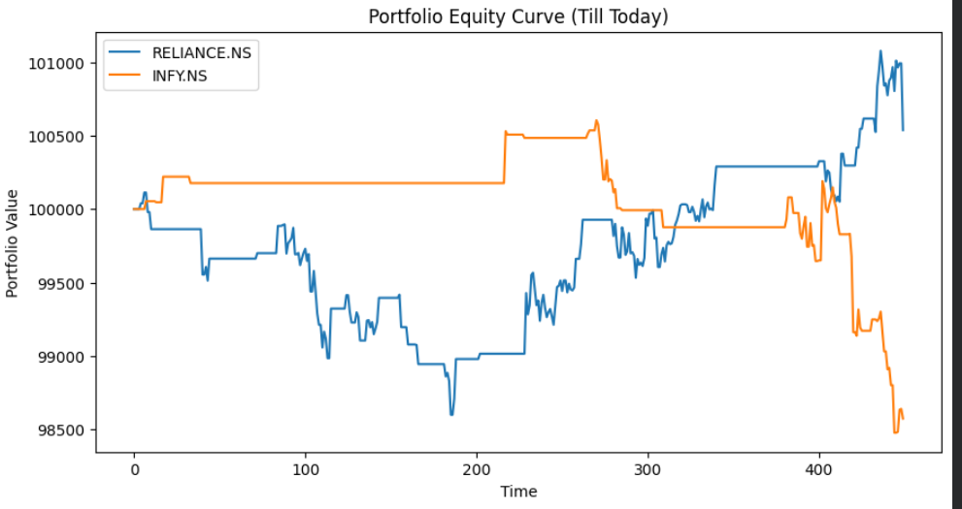

Slide 15
🚀
Next Improvements
Add transaction costs, slippage, and brokerage to make results more realistic.
Test more features such as MACD, volume-based indicators, and volatility measures.
Compare against buy-and-hold and try walk-forward validation instead of one fixed split.

