Slide 1
SUPERB-Prosody
최예린
서강대학교 인공지능학과
Email: lakahaga@u.sogang.ac.kr
2023.2.8
Notes:
어떤 분야인지, 현재 기술적 수준, 관련 논문 등
해당 분야에 대한 본인의 의견, 생각 등
다음 주 월요일에 교수님께 발표를 하고 각 주제에 대해서 이야기를 해볼 예정입니다. 작성은 github 이슈 게시판에 올려놓은 슬라이드 템플릿을 활용해서 해 주시기 바랍니다.

Slide 2
Overview
On the Utility of Self-supervised Models for Prosody-related Tasks
기존 speech SSL 모델이 prosody 정보를 encode하는지 알아보기 위함
Prosody intensive classification task
Prosody reconstruction
Future prosody prediction 에 대한 성능을 검증 해봄
대부분 wav2vec 2.0 / HuBERT / WavLM 이 좋은 성능을 보임
SOTA 보다 좋은 성능

Slide 3
Background
Speech Signal
Lexical + Prosodic
Prosodic: Paralinguistic, Phonological, Pragmatic
Paralinguistic
Speaker identity, Expressing emotion
Stable over the span of many utterances
Phonological
Marking the identity of syllables and words with tones and stress patterns
Pragmatic
Managing turn-taking, Marking topic structure and information structure, and expressing engagement, stance, attitude and intent
Especially important in dialog
Main interest: Pragmatic
Notes:
Pragmatics : 화자와 청자의 관계에 따라 언어 사용이 어떻게 바뀌는지, 화자의 의도와 발화의 의미는 어떻게 다를 수 있는지
Paralinguistics are the aspects of spoken communication that do not involve words.
Phonology is the study of the patterns of sounds in a language and across languages

Slide 4
Introduction
Whether pretrained models have utility for prosody-conveyed pragmatic support them
Prosody-intensive task
To measure how well pretrained models support them
Pitch and Energy Reconstruction pseudo-tasks
To measure how well pretrained models represent prosodic information
Future value prediction
Which layer in pretrained model has prosodic information

Slide 5
Tasks
Prosody-intensive Classification Tasks
Persuasiveness Prediction
detecting whether a presentation is likely to convincing to others
 | Sentiment analysis | Sarcasm Detection | Persuasiveness Prediction
Dataset | CMU-MOSEI | MUStARD | POM
label | -3 to 3 | Sarcastic or not | Persuasive or not
 | Binary classification [-3,0), (0,3] 7-category classification | Binary classification | Binary classification
Metrics | Accuracy | F1-score | Accuracy

Slide 6
Tasks
Pseudo Prosody tasks
A pseudo-task designed to test whether SSL models embed specific prosody features in their hidden representation
Target : Pitch / Energy
Pitch : pYAAPT를 이용해 log scale로 추출
Energy: Librosa toolkit을 이용해 log scale로 추출
For Future Value Prediction task, only test causal SSL models or attention-based SSL models
Attention-based 모델에는 attention mask를 적용하여 future information을 mask
 | Prosody reconstruction | Future Value Prediction
Task description | Input: SSL feature Output: predicted prosody features | Input: SSL feature from 0 to t step Output: predicted prosody features from t+1 steps
Dataset | LibriTTS
Target | Pitch / Energy
Evaluation | MSE

Slide 7
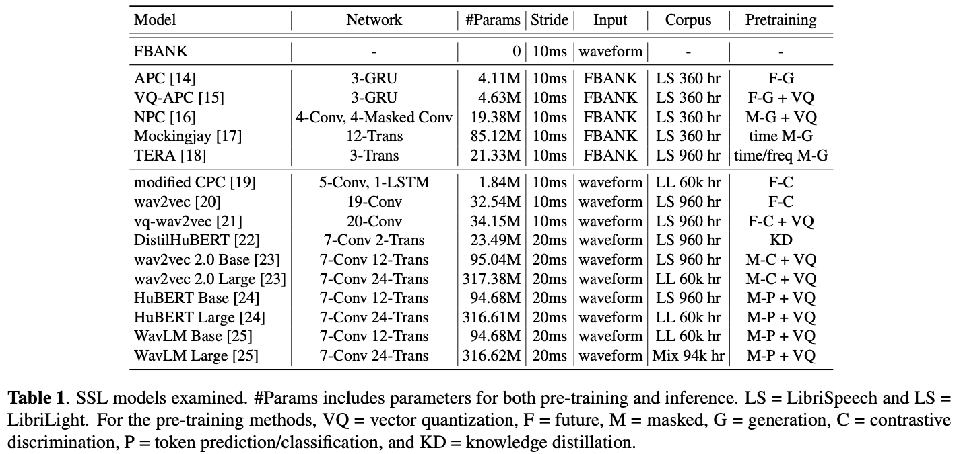
Models - Upstream SSL models

Slide 8
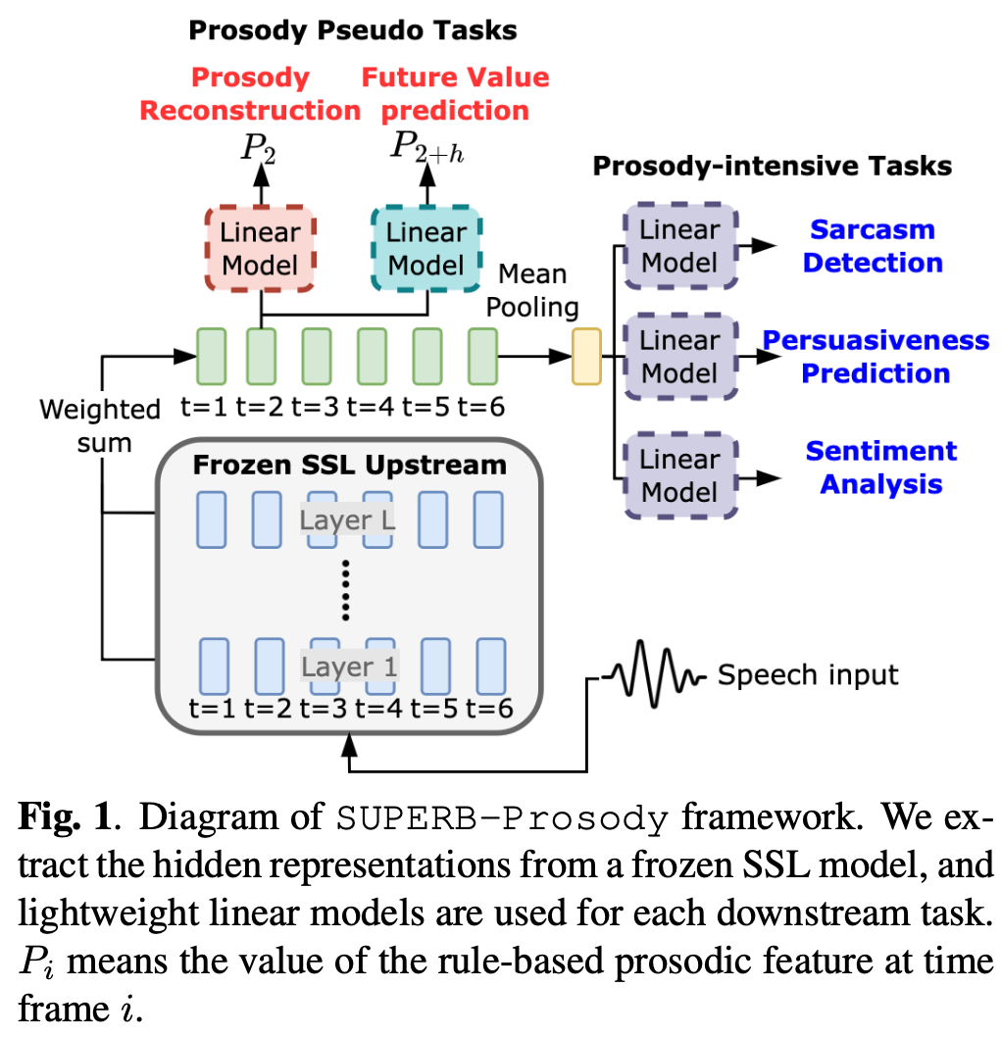
Models - Downstream model
Classification tasks
Last hidden state -> mean pooling along the time axis -> linear projection
Cross-Entropy Minimization
Prosody Reconstruction / Future Value Prediction
Frame-level representation -> linear projection to 1
MSE minimization

Slide 9
Models - baseline
FBANK
Baseline feature set
80 dim Log mel Filterbank features with delta and delta-delta
240 dimensional feature
Classification Tasks
Mean-pooled FBANK feature across utterance
Text-only performance
Fine-tuned RoBERTa for Sarcasm Detection, SA / Longformer for Persuasiveness Prediction
Prosody Reconstruction
Talkin’s REAPER (high quality off-the-shelf pitch extractor)
Future Value Prediction
FBANK + RNN
One-layer uni-directional RNN
Notes:
실험 베이스라인 설정
80 dimensional mel-spectrogram을 baseline feature set으로 사용
Delta : first derivative of signal / delta-delta : second derivative of signal
F0 같은 거는 absolute value 보다는 contour를 보기 때문
Classification task에는 mel –pectrogram

Slide 10
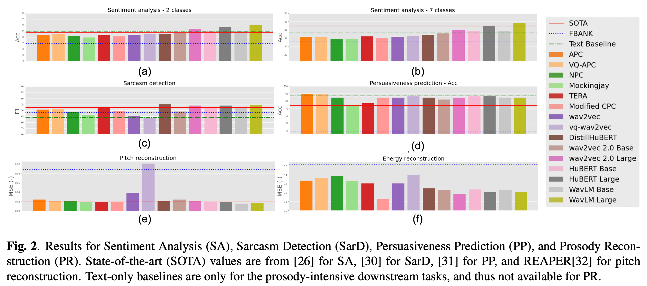
Results

Slide 11
Results
Sentiment Analysis
Better than FBANK
Binary classification
Large models 는 SOTA를 뛰어 넘음
SOTA : Multimodal language analysis in the wild: CMU-MOSEI dataset and interpretable dynamic fusion graph
7 class classification
WavLM Large 는 audio-only SOTA를 뛰어 넘음
W2v 2.0 large, Hubert base/large, WavLM base/Large는 Text-only performance 를 뛰어 넘음
Notes:
we can see that all SSL mod- els yield better SA performance than the baseline FBANK features in both 2-label and 7-label evaluations. The large SSL models, wav2vec 2.0, HuBERT, and WavLM, even im- prove on the state-of-the-art (SOTA) performance [26] in the 2-label setup. In the 7-label setup, WavLM Large outperforms audio-only SOTA performance. Around one-third of the SSL models show better performance than the text-only baseline, confirming the value of acoustic information for SA.

Slide 12
Results
Sarcasm Detection
Mockingjay, wav2vec, and vq-wav2vec 는 Baseline 보다 안 좋음
DistillHubert, HuBert, WavLM : audio only SOTA보다 좋음
모두 text –only performance보다 좋은 성능
SOTA : A multi- modal fusion method for sarcasm detection based on late fusion
Persuasiveness Prediction
모두 audio only SOTA / baseline 보다 좋음
다른 task와 달리 Text-only performance 의 성능이 대체로 audio SSL 모델 보다 좋음
SOTA: A multi- modal fusion method for sarcasm detection based on late fusion,” Multimedia Tools and Applications
Notes:
SD :
Figure 2 (c) shows the SarD result. Although Mockingjay, wav2vec, and vq-wav2vec show inferior performance to the baseline FBANK, the other SSL models do well, with Distil- HuBERT, HuBERT, and WavLM improving on the previous audio-only SOTA [30]. In SarD, all acoustic models, both SSL models and FBANK, outperform the text-only baseline, confirming that SarD requires acoustic information beyond content for prediction.
PP:
Lastly, for the PP results, Figure 2 (d), shows that all SSL models yield better performance than the FBANK features and the previous audio-only SOTA [31]. APC, VQ-APC, vq- wav2vec, and HuBERT obtains superior or equal accuracy to the text-only baseline.

Slide 13
Results
Pitch reconsturction
SOTA : REAPER
MSE (the lower the better)
대부분 SOTA 및 baseline 보다 성능이 좋고, WavLM 이 가장 좋음
예외 : VQ-Wav2vec
Energy Reconstruction
모든 SSL 모델이 FBANK 보다 좋음
=> SSL 모델이 prosodic information을 encode한다는 것을 알 수 있음
Notes:
Pitch :
In pitch reconstruction, Figure 2 (e), all the SSL models perform better than baseline FBANK ex- cept for vq-wav2vec. Several SSL models surpass REAPER performance, with the WavLM the best.
Energy :
Figure 2 (f) shows that all SSL models greatly improved over baseline FBANK. Although generation-based SSL models perform well on pitch reconstruction, they did relatively worse on energy reconstruction. On the other hand, the SSL models pre-trained by masked contrastive discrim- ination/token prediction show strong performance on both pitch and energy reconstruction. Overall, we observe that SSL models indeed encode prosodic information.

Slide 14
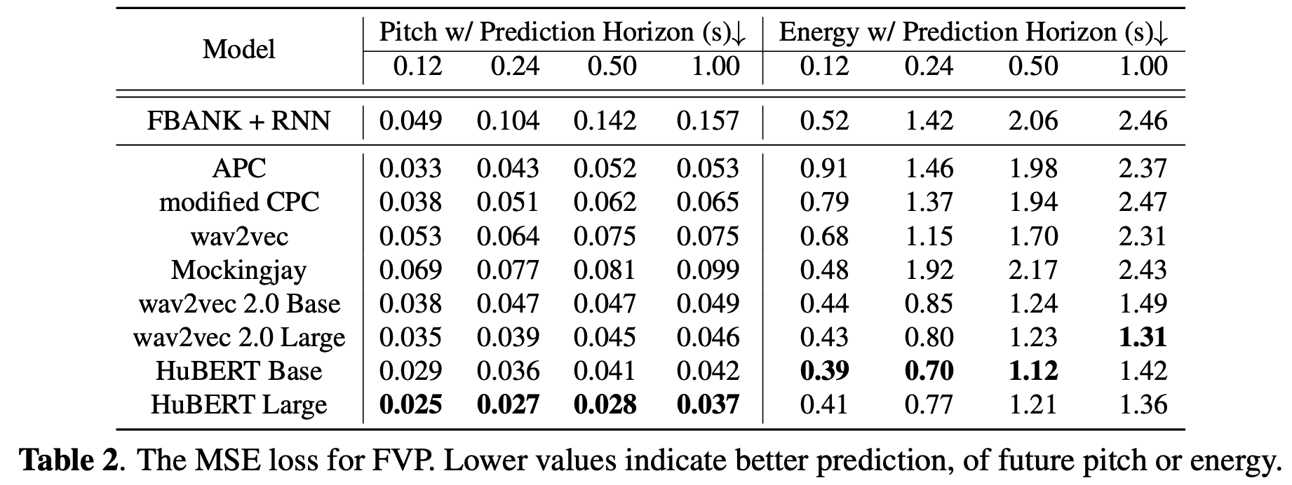
Results
Pitch : HuBERT 가 가장 좋은 성능
APC, modified CPC, wav2vec은 pretext task에 future generation을 포함하지만, 그러한 pretext task를 사용하지 않는 모델보다 안 좋은 성능을 보임
Energy : wav2vec 2.0 과 HuBERT 만 baseline 보다 좋음
Notes:
FVP is more challenging than ProR since it requires the model to capture both global and local prosodic information for successful future prediction. From Table 2, we see, unsur- prisingly, that the larger prediction horizons make prediction
harder. For pitch, HuBERT Large gets the best performance, outperforming other SSL models and baseline FBANK+RNN at all four horizons. Although the pre-training objectives of APC, modified CPC, and wav2vec involve future genera- tion/discrimination, they still result in inferior performance to wav2vec 2.0 and HuBERT. As for future energy prediction, only wav2vec 2.0 and HuBERT consistently outperform base- line FBANK. In general, we observe that some SSL models are not good at FVP, but wav2vec 2.0 and HuBERT outper- form FBANK by a large margin. This result suggests that wav2vec 2.0 and HuBERT do have the capability to encode and summarize relevant prosodic information.

Slide 15
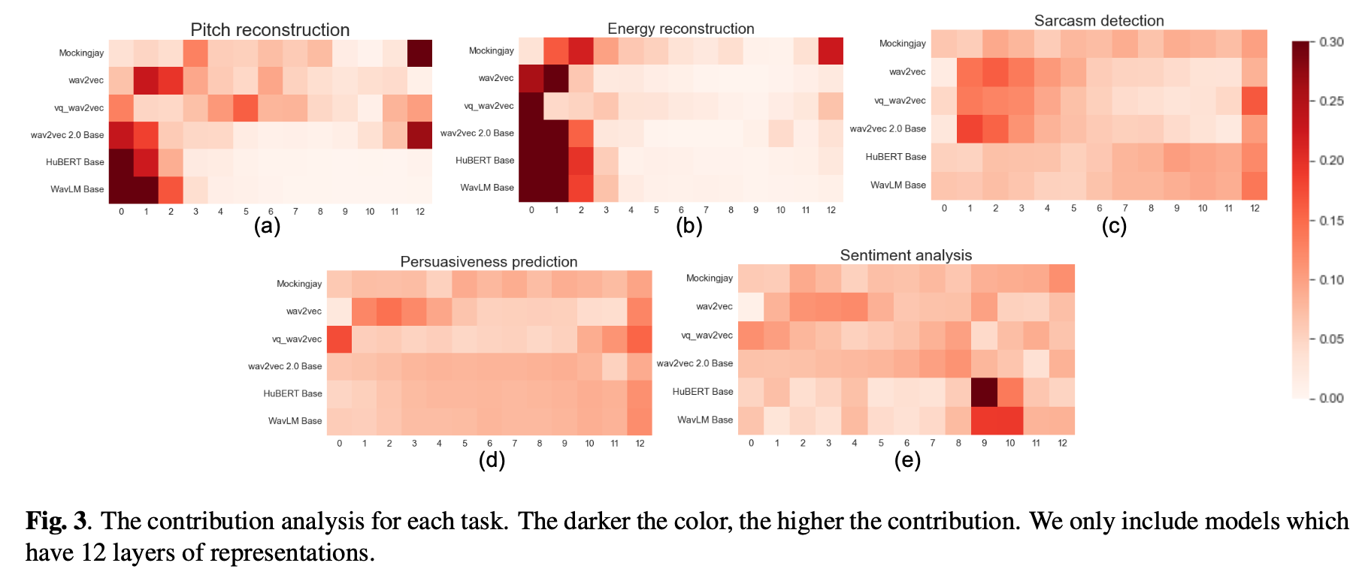
Results
각 layer 의 Weight를 관찰
Reconstruction task는 초반 Layer의 weight가 높음
Classification task는 layer간의 차이가 별로 없음
HuBERT, WavLM은 후반 layer에 집중 되는 경향
기존 연구에서 후반 layer에서 content 정보가 나타난다는 것을 보인 바 있음
Wavlm: Large-scale self-supervised pre-training for full stack speech processing
Layer-wise analysis of a self-supervised speech rep- resentation model
Notes:
Analysis 방법
n order to estimate the contribution of each layer, we con- sider two factors. First, we use the weight wi from each layer (through the weighted-sum mechanism) to the downstream model. Second, because typical feature magnitudes may vary, we also consider the values of the hidden representation x in each layer, as measured by the L2-norm of feature values for the testing data. After getting the whole L2-norm features for each layer for each sample, we take the mean across samples to get the feature magnitude estimation. The contribution for each layer is then defined as: ci = ||xi||2 ×wi, where i means the layer number.
결과
The results are shown in Figure 3. From Figure 3(a), we can see that for most SSL models, the contribution is strongest in the first few layers for both pitch and energy reconstruc- tion. This shows that SSL tends to best represent prosodic information in the front. One exception is Mockingjay, where the largest contribution is located in the last layer. Because Mockingjay’s pre-training objective is to reconstruct frame- wise features, it is unsurprising that the later layers contain a good representation of low-level prosody.
However, for the classification tasks SarD and PP, Figure 3 (c) and (d) shows that the distribution of layer contribu- tions is smooth, suggesting that both tasks need information across multiple layers. As previous work has shown that later layers represent more content information [11, 25], this sug- gests that both prosodic and content information are needed for SarD and PP. As for SA, in Figure 3(e), we observe a high contribution value in the latter layers for the high-performing models HuBERT and WavLM. This suggests that SA might only require content information to perform well.

Slide 16
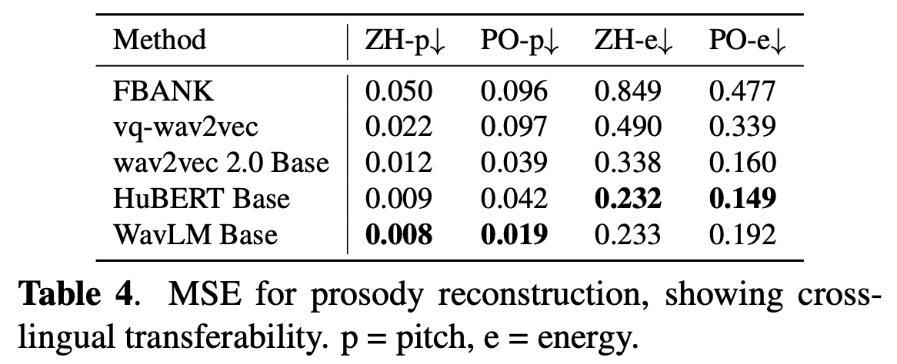
Results
Cross lingual transferability
Pitch / Energy reconstruction
영어에 pretrained 된 SSL 모델을 폴란드어와 중국어 음성으로 실험
Pitch는 WavLM이 좋은 성능을 보였고, Energy 는 HuBERT 가 좋은 성능을 보임
Notes:
Further, we did a preliminary investigation of whether SSL models may have cross-lingual transferability for prosodic information, using the ProR task as in previous experiments: specifically, attempting pitch and energy reconstruction. While the pitch of one frame is primarily a physical phe- nomenon, in context there may be language dependencies. All the SSL models being pre-trained in English, we try this for Mandarin and Polish, using data from AISHELL-3 [35] multilingual LibriSpeech (MLS) [36], respectively. Table 4 summarizes the results. We note that WavLM is good at pitch reconstruction, and HuBERT is superior at energy reconstruction.

Slide 17
Conclusion
SSL 모델이 prosody information 을 encode하는지 알아보기 위해
Prosody intensive classification task, Prosody reconstruction, Future prosody prediction 에 대한 성능을 검증 해봄
Wavform을 input으로 받는 large SSL 모델들 (HuBERT, WavLM) 이 대부분 좋은 성능을 보임.
결론적으로 SSL 모델은 prosody information 을 encode한다고 볼 수 있음

Slide 18
끝
감사합니다.

