Slide 1
Department of Computer Science & Engineering
A Mini Project Presentation
on
EVENT RECOMMENDATION SYSTEM
BY
D. Gnanpreeth Reddy (228R1A05D9)
G. Srikanth (228R1A05E3)
L. Aravind (228R1A05F6)
S. Bhavya (228R1A05H7)
Internal Guide
Mr. D. Uma Vishveshwar,
Assistant Professor,
Dept. of CSE.
Batch No: C9

Slide 2
TABLE OF CONTENTS
Abstract
Introduction
Literature Survey
Existing System
Existing System with limitations
Proposed System
Proposed System & Advantages
Software Requirements
Hardware Requirements
Techniques and algorithms used
Data Flow Diagram
UML Diagrams(Class Diagram, use case, sequence, etc)
System Architecture
System Testing
Output Screens
Conclusion
Future Enhancements
Bibliography

Slide 3
ABSTRACT
With the rapid growth of online platforms and digital events, users are often overwhelmed by the abundance of event choices. This has led to the need for intelligent recommendation systems that can filter and personalize event suggestions based on user-specific data. An Event Recommendation System is designed to analyze various inputs such as user preferences, historical behavior, location, social connections, and real-time context to provide relevant and engaging event recommendations.
The proposed system combines collaborative filtering, content-based filtering, and hybrid recommendation strategies to improve accuracy and relevance. Collaborative filtering identifies user similarities and suggests events based on peer preferences, while content-based filtering focuses on matching events to individual user profiles. A hybrid approach merges these techniques to address limitations such as cold start and data sparsity problems.

Slide 4
INTRODUCTION
With the rapid growth of online platforms and digital events, users are often overwhelmed by the abundance of event choices. This has led to the need for intelligent recommendation systems that can filter and personalize event suggestions based on user-specific data. An Event Recommendation System is designed to analyze various inputs such as user preferences, historical behavior, location, social connections, and real-time context to provide relevant and engaging event recommendations.
The proposed system combines collaborative filtering, content-based filtering, and hybrid recommendation strategies to improve accuracy and relevance. Collaborative filtering identifies user similarities and suggests events based on peer preferences, while content-based filtering focuses on matching events to individual user profiles. A hybrid approach merges these techniques to address limitations such as cold start and data sparsity problems.

Slide 5
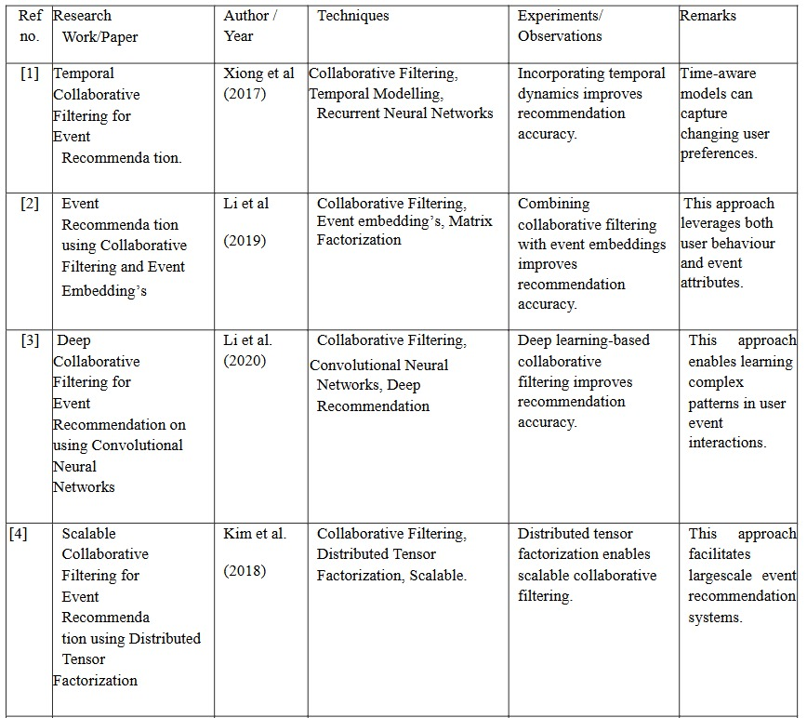
LITERATURE SURVEY

Slide 6
EXISTING SYSTEM
Content-Based Filtering - These systems use event attributes (genre, location, time, etc.) and user profiles (interests, past activity) to match preferences.
Tourism-Based Recommendation Systems - Platforms like TripAdvisor and Expedia suggest destinations and attractions based on user reviews and general popularity, but they do not dynamically adjust recommendations based on real-time conditions.
Collaborative Filtering-Based Systems - Some applications use collaborative filtering (e.g., recommending places visited by similar users), but these systems often rely on historical data and lack real-time adaptability.

Slide 7
EXISTING SYSTEM WITH LIMITATIONS
1.Data Handling & Persistence
Only supports static CSV files.
No live updates or admin panel to add/edit/delete events.
2.Recommendation Logic
Simple filtering and sorting — no machine learning, user behavior tracking, or collaborative filtering.
All users see the same "Top 10" list, regardless of history or preferences.

Slide 8
PROPOSED SYSTEM
Personalized Event Recommendations - based on user interests and popularity.
User Authentication for saving preferences and managing profiles.
Smart Filters & Search for city, type, levels.
Responsive UI Design compatible with both desktop and mobile devices.
Admin Dashboard for event management and performance tracking.

Slide 9
PROPOSED SYSTEM & ADVANTAGES
Personalization – Tailors recommendations to user interests for better engagement.
Updates – Uses a manual CSV updates.
Improved User Experience – Modern UI with mobile responsiveness and smart search.
Event Features – Enables preferences, city, and levels.
Cross-Platform Compatibility – Seamless access across desktops, tablets, and smartphones.

Slide 10
SOFTWARE REQUIREMENTS
Programming Technology : Python
Operating System : Linux/Windows/macOS
Frontend Development : CSS
Operating System : Windows 8/10/11

Slide 11
HARDWARE REQUIREMENTS
Processor : Dual Core/I3/I5/I7
RAM : 4GB(MIN)
Hard Disk : 100GB or above

Slide 12
TECHNIQUES AND ALGORITHMS USED
Content-Based Filtering
Content-based filtering recommends events by analyzing the features of each event, such as city, level, subtype, and popularity. The system builds a user profile based on past selections or preferences and compares it with the attributes of new events. For example, if a user often attends “Outdoor Music Festivals” in Mumbai, the system will prioritize similar events in future recommendations. This method is highly personalized but may lack diversity if user preferences don’t change.

Slide 13
CLUSTERING ALGORITHM (K-Means)
Clustering algorithms group users or events with similar characteristics into clusters. In the context of this system, events can be clustered by attributes like popularity, location, or type. This enables personalized recommendations within the same cluster as the user’s interest. For instance, if a user frequently attends events in a specific cluster (e.g., urban music festivals), they can be recommended other events from that group. Clustering helps in audience segmentation and targeted marketing.
Classification Algorithms
Classification algorithms predict whether a user will be interested in or attend a particular event. By training models like Decision Trees, Logistic Regression, or Random Forests on historical data (e.g., attendance history, demographics), the system can make predictions for new events. This predictive capability helps refine recommendations beyond simple matching and can assist in personalized notifications or targeted promotion.

Slide 14
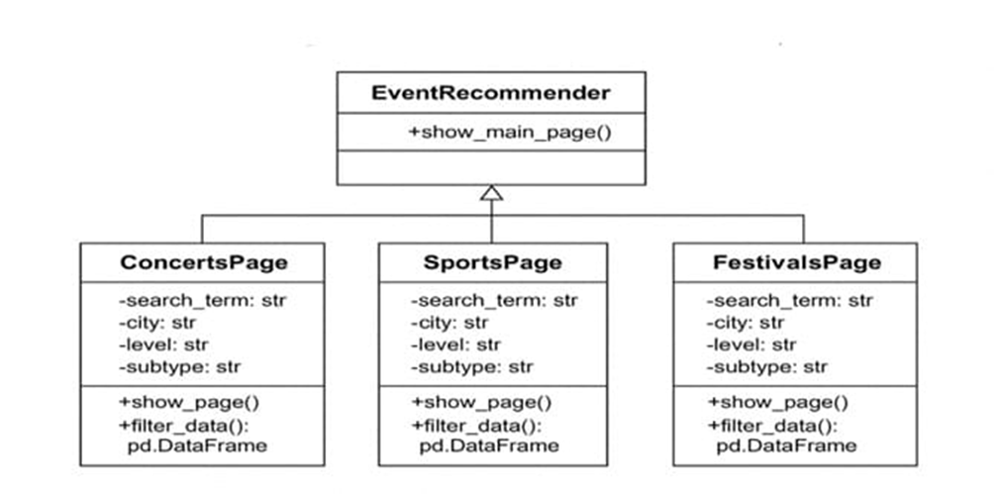
Class Diagram

Slide 15
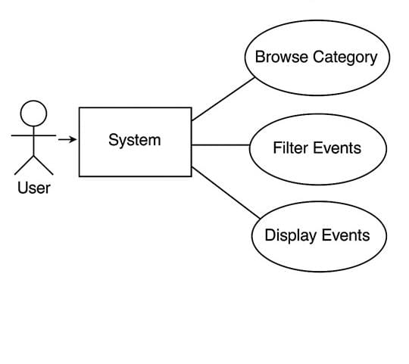
USE CASE DIAGRAM

Slide 16
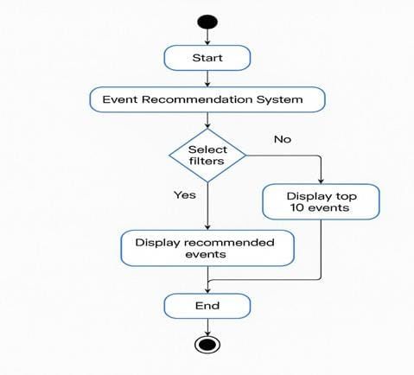
ACTIVITY DIAGRAM

Slide 17
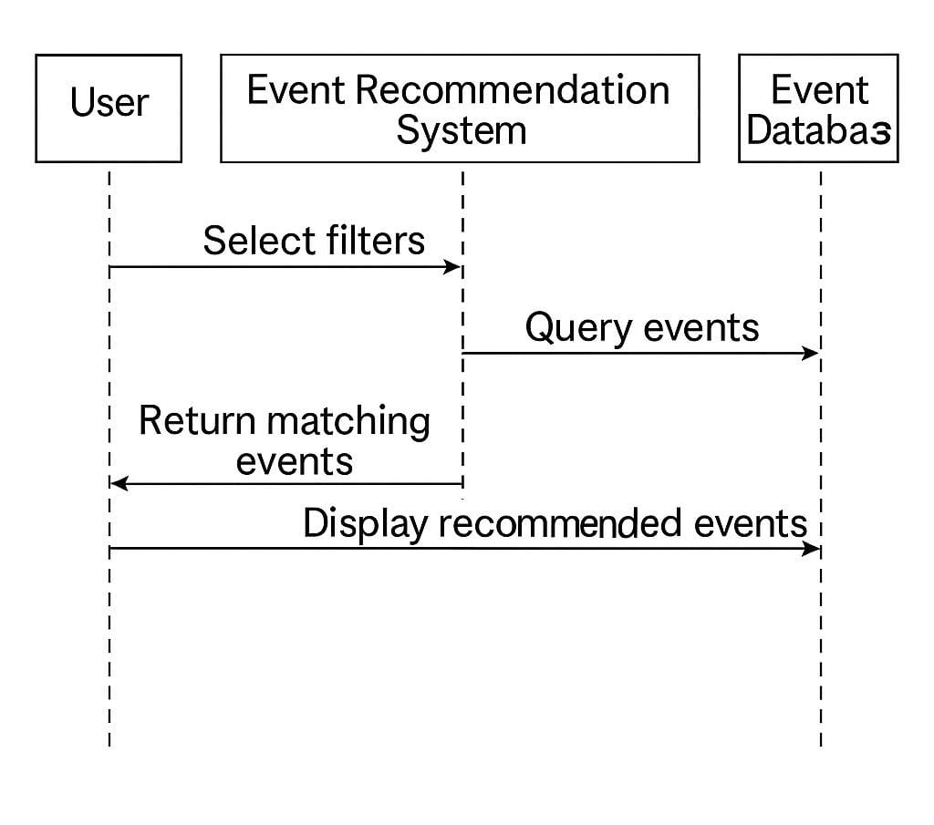
SEQUENCE DIAGRAM

Slide 18
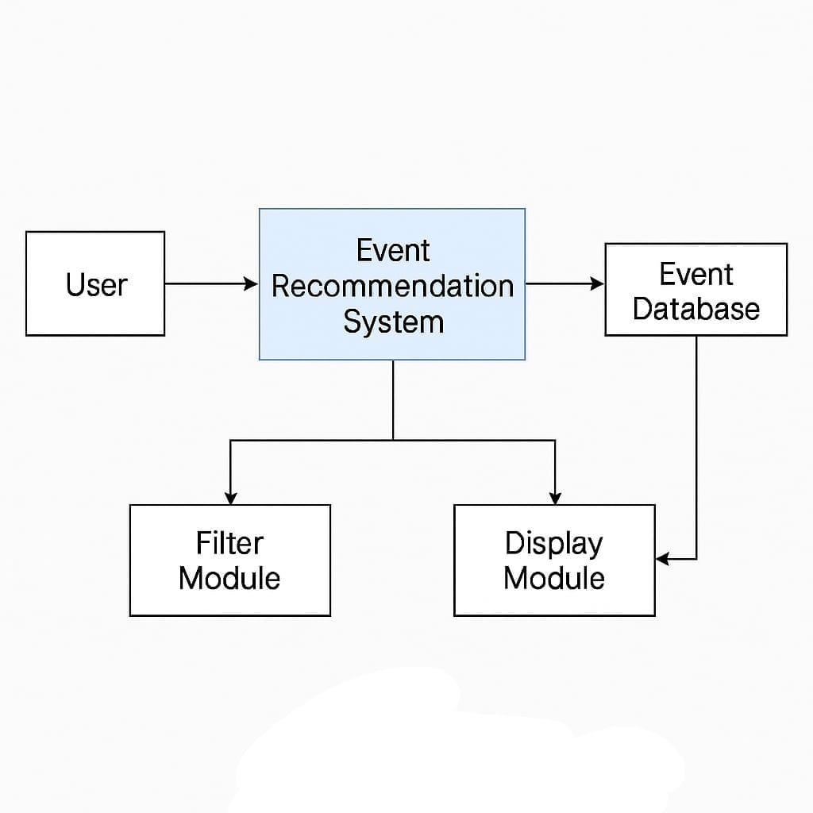

SYSTEM ARCHITECTURE

Slide 19
SYSTEM TESTING
Module Testing – Verifies modules like event filtering ensuring they work independently.
Unit Testing – Tests individual components (e.g., recommendation algorithm, user preference parser) to ensure each functions correctly.
System Testing – Evaluates the entire event recommendation system, ensuring end-to-end functionality, including input processing, recommendation generation, and output display.
Functional Testing – Checks if features like user queries, search filters, and personalized recommendations work as expected.
Acceptance Testing – Validates the system with real users or stakeholders to confirm it meets business needs and delivers useful recommendations.

Slide 20
OUTPUT SCREENS

Slide 21
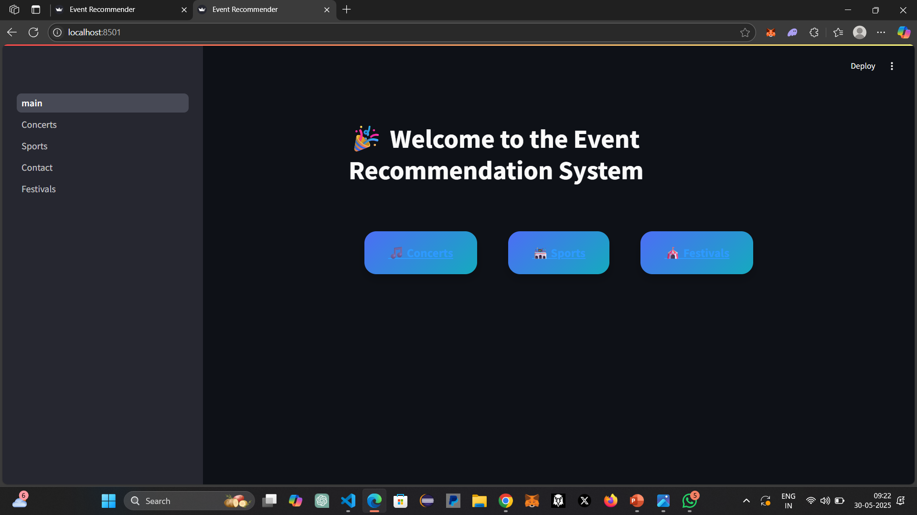
Figure i : Main Page
Figure i :Main Page

Slide 22
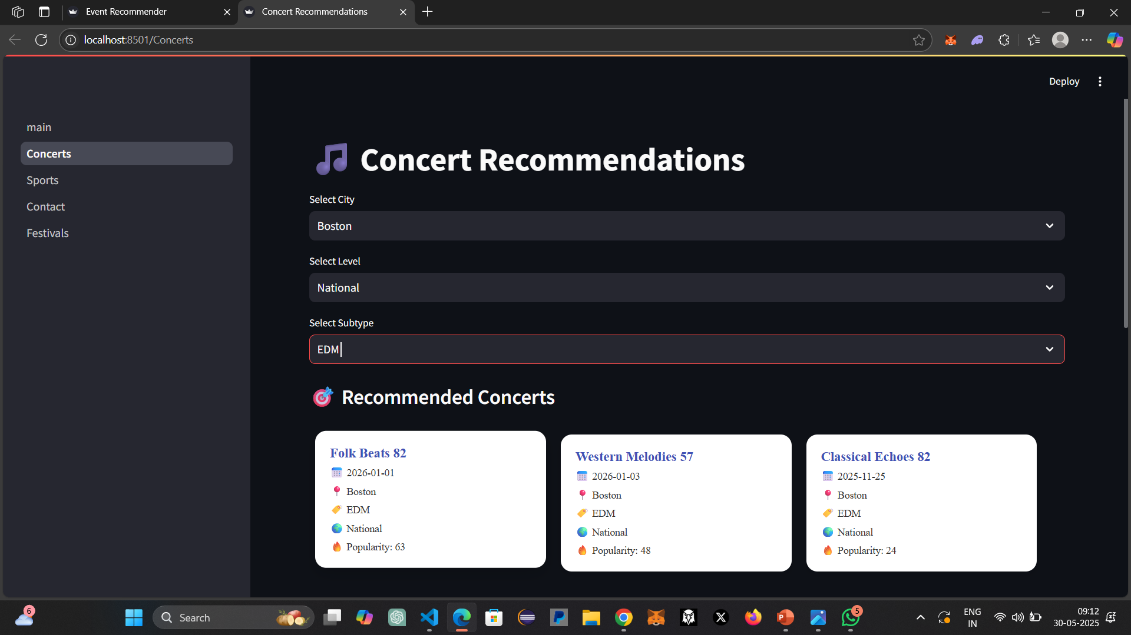
Figure ii : Concerts Page

Slide 23
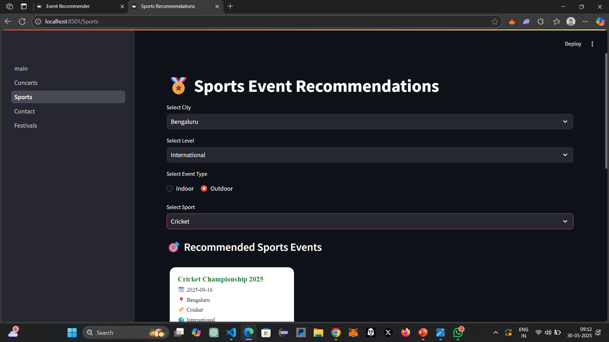
Figure iii : Sports Page

Slide 24
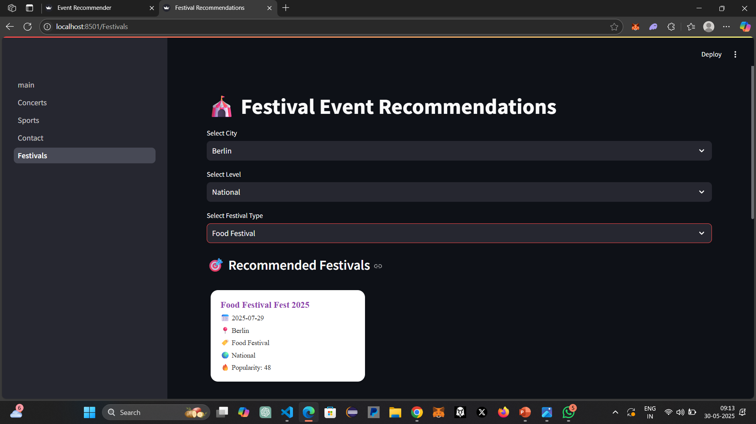
Figure iv : Festivals Page

Slide 25
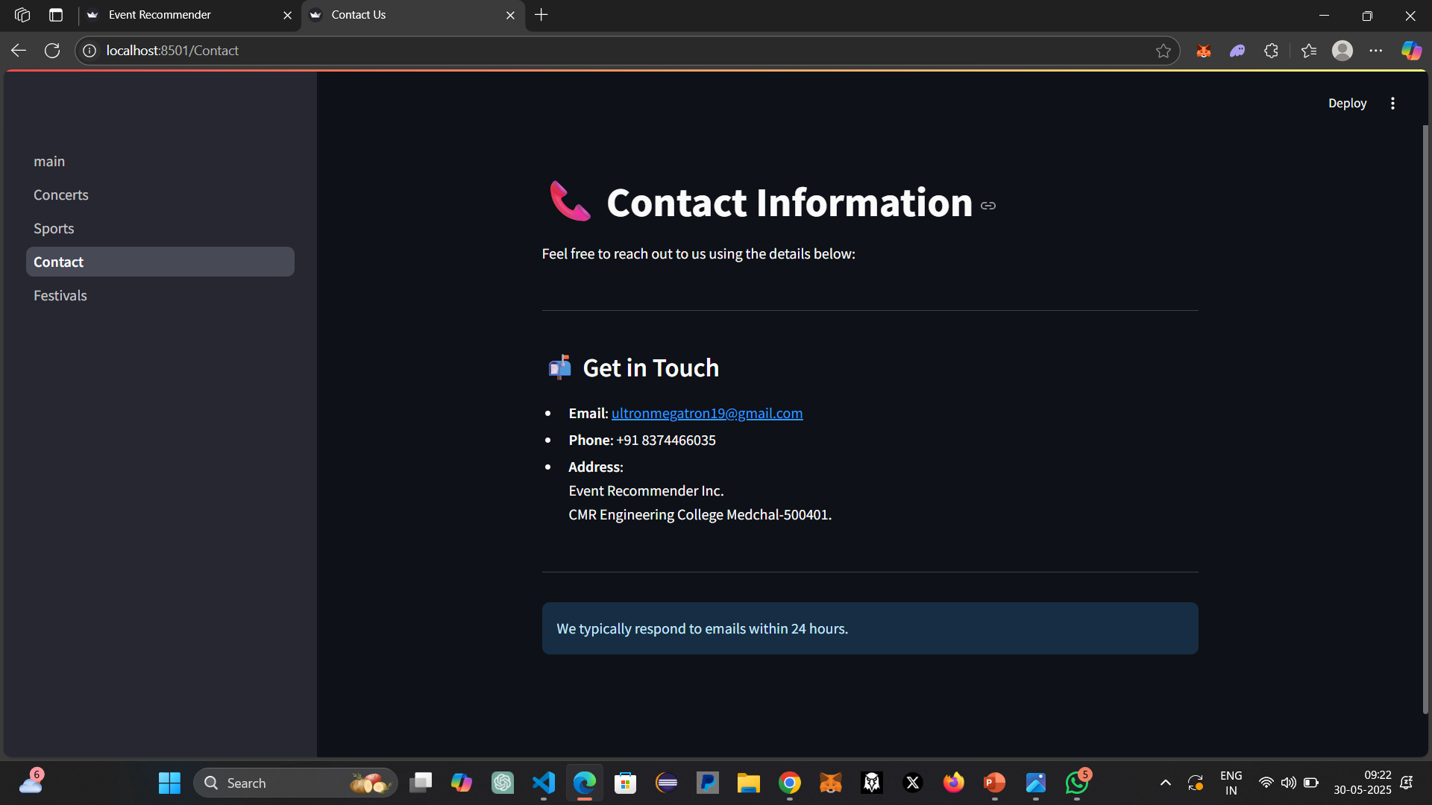
Figure v : Contact page

Slide 26
CONCLUSION
The Event Recommendation System is a user-friendly, dynamic web application built with Streamlit that successfully helps users discover and explore various events such as concerts, sports, and festivals. The platform provides a seamless experience by offering:
An intuitive homepage with category navigation
Interactive filtering options for location, event level, and type
A visually appealing card-based layout that displays recommended events
Default trending recommendations for new users
A clean and responsive contact page with support information
Through system testing and validation, the application has proven to be functionally robust, delivering accurate recommendations based on user-selected filters. Its modular structure makes it easy to expand with new event categories or connect to live databases in the future.
This project showcases how a simple yet powerful UI, backed by well-structured CSV data, can offer users a tailored and engaging way to explore public events.

Slide 27
FUTURE ENHANCEMENTS
The event recommendation system has exciting potential for future improvements:
Integration with Live Event APIs: Connect to real-time event sources like Ticketmaster API, Eventbrite, or Meetup to fetch up-to-date events automatically instead of using static CSV files.
User Authentication and Personalization
Allow users to sign up and log in.
Save user preferences (e.g., favorite cities or event types).
Provide personalized recommendations based on past activity.
Search by Date and Time
Include advanced filtering for event start/end dates, time ranges, and date pickers for more precise planning.

Slide 28
BIBILIOGRAPHY
[1]Streamlit Documentation
Streamlit Inc. (n.d.). Streamlit Docs. Retrieved from https://docs.streamlit.io/
[2] Xiong, L., et al. (2017). Temporal Collaborative Filtering with Graph Convolutional Neural Networks. https://arxiv.org/pdf/2010.06425
[3]Event Recommendation Concepts
Ricci, F., Rokach, L., & Shapira, B. (2015). Recommender Systems Handbook. Springer.
[4] Pandas Library
The pandas development team. (2023). pandas - Python Data Analysis Library. Retrieved from https://pandas.pydata.org/

Slide 29
THANK YOU

