Slide 1


Introduction to QGISS
Matthew McKitrick
Master’s Student
GIS Peer Facilitator

Slide 2
Workshop Outline
The workshop will include:
5% me rambling
95% hands-on experience
I’d rather talk with you than at you, so please ask questions!

Slide 3
Why are you here?

Slide 4
QGIS vs ArcGIS
QGIS
Open source
Free
Plugins, plugins, plugins!
Highly interoperable
Great cartography tools
Not quite as many analysis functions as ArcGIS
Windows, Linux, Mac, BSD, Android
ArcGIS
Closed source
Costs thousands of dollars
Custom Toolboxes
Limited interoperability
Cartography is a bit more cumbersome
Powerful analysis tools
ArcGIS Online
Windows only

Slide 5
File Types
QGIS can use a LOT of varied data sources
Shapefile (ESRI)
GeoJSON (web mapping)
PostGIS (spatial database)
Idrisi Vector (TerrSet)
GeoPackage (stores both vector & raster)
KML (Google Earth)
OpenStreetMap (OpenStreetMap….)
70+ Vector formats
100+ Raster formats

Slide 6
Vector vs Raster
Vector:
Imagine drawing points lines or polygons over the proportionate real world area.
In other words, vector data are spatially reference shapes and points.
Raster
Image a square covered with a grid, each cell of which has an RGB pixel value.
In other words, raster data are spatially referenced images.

Slide 7
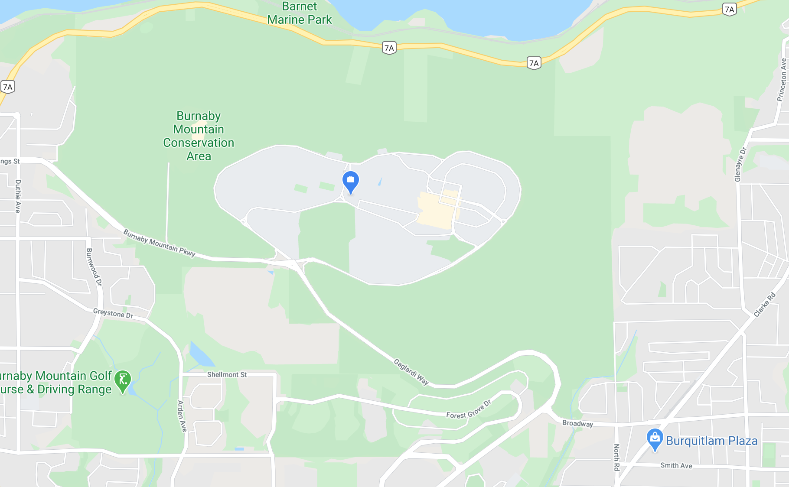
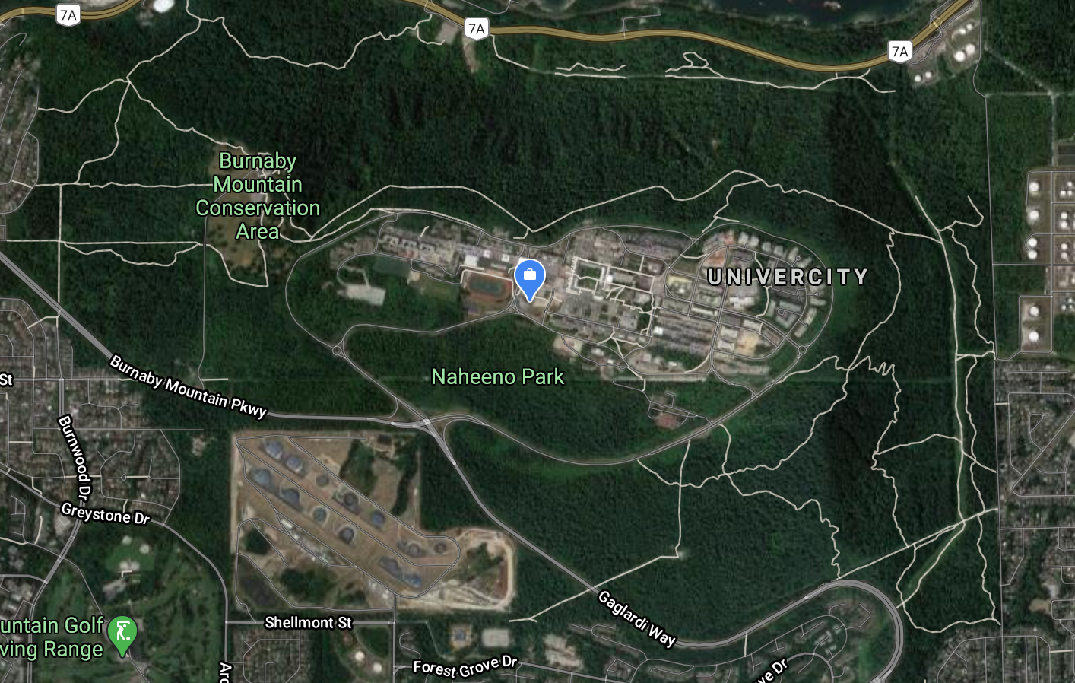
Think Google Maps vs Google Earth
Maps shows us drawn features proportionate to the real world (Vector)
Earth shows us the real ground imagery in a digital format (Raster)

Slide 8
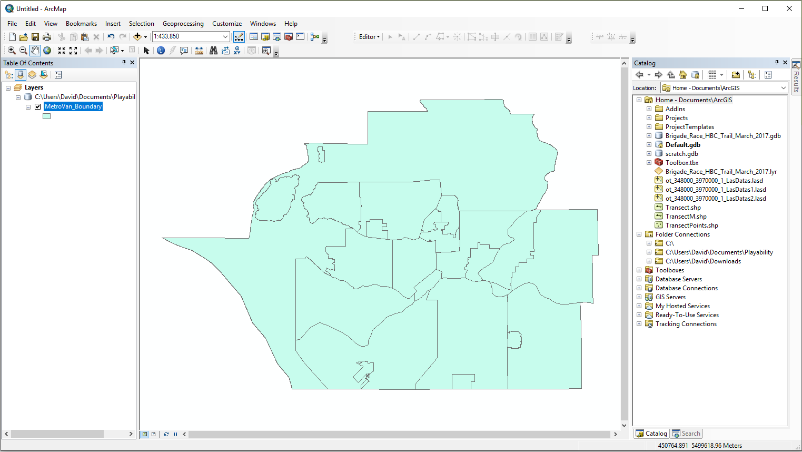
Analysis Tools
Your Map Area
Your data layers
Where you add data from

Slide 9
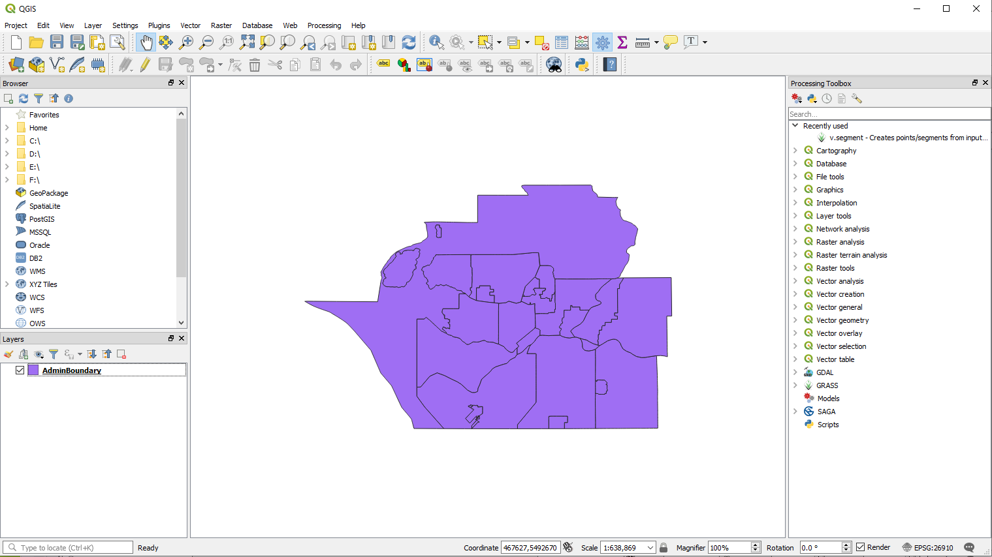
Your Map Area
Where you add data from
Analysis Tools
Your data layers

Slide 10
Mapping Bicycle Access to Free Food Community Gardens & Food Trees
Data from Vancouver Open Data Catalogue:
https://opendata.vancouver.ca/explore/
Download:
City Boundary (SHP)
Community Gardens and Food Trees (SHP)
Bikeways (SHP)

