Slide 1

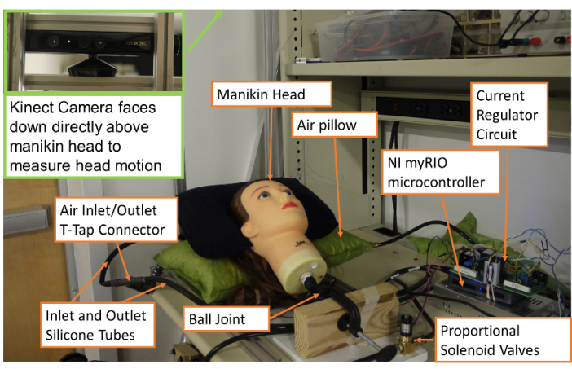
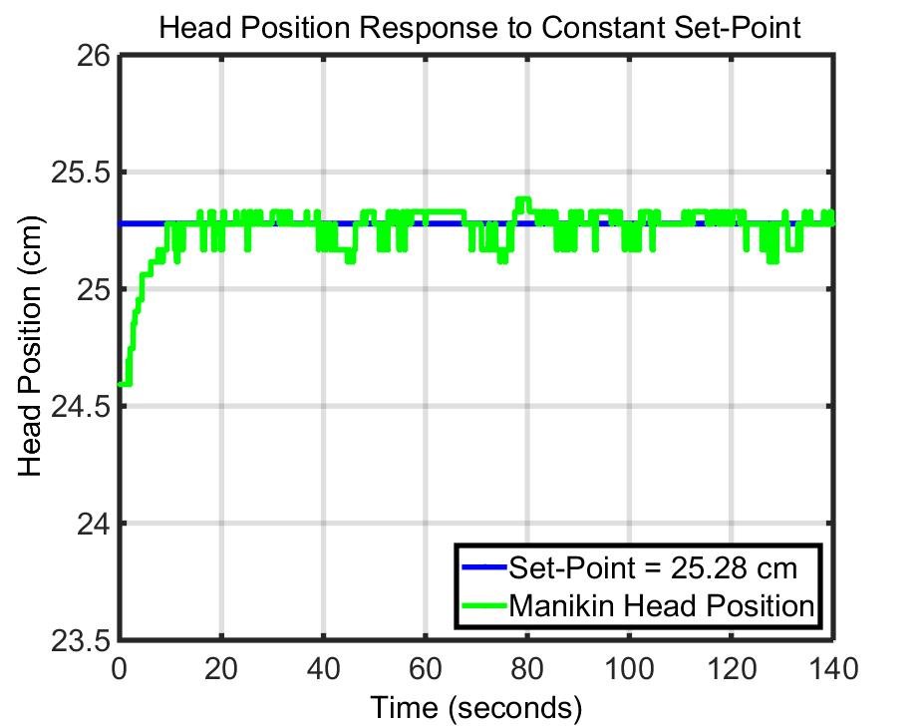
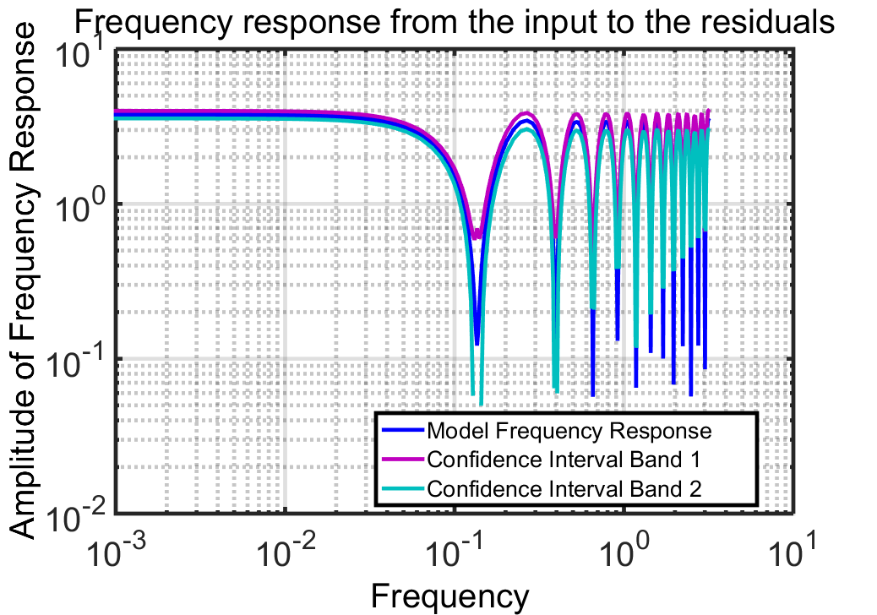
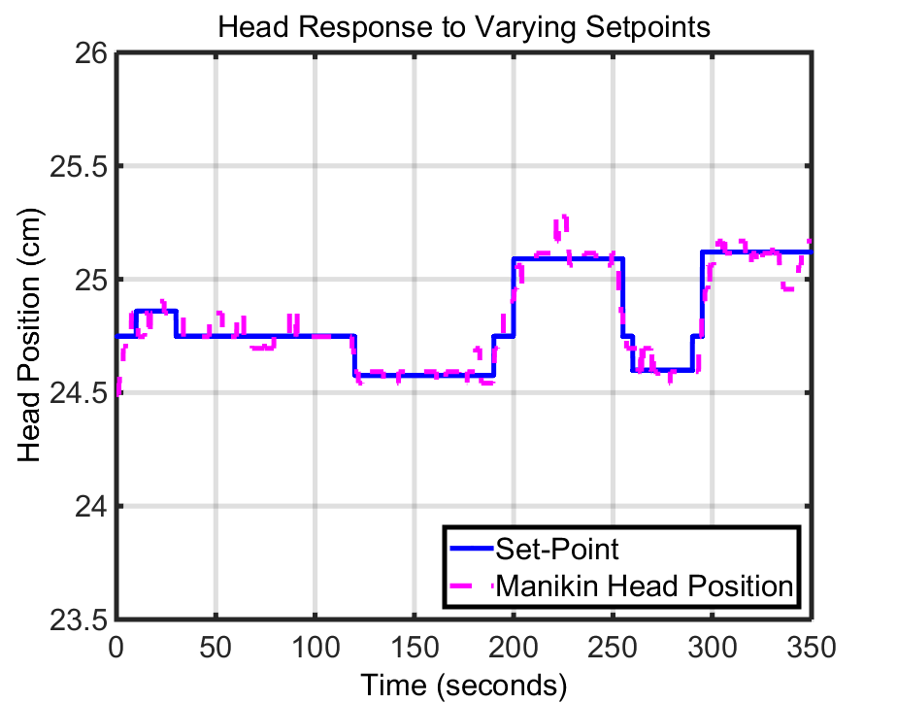

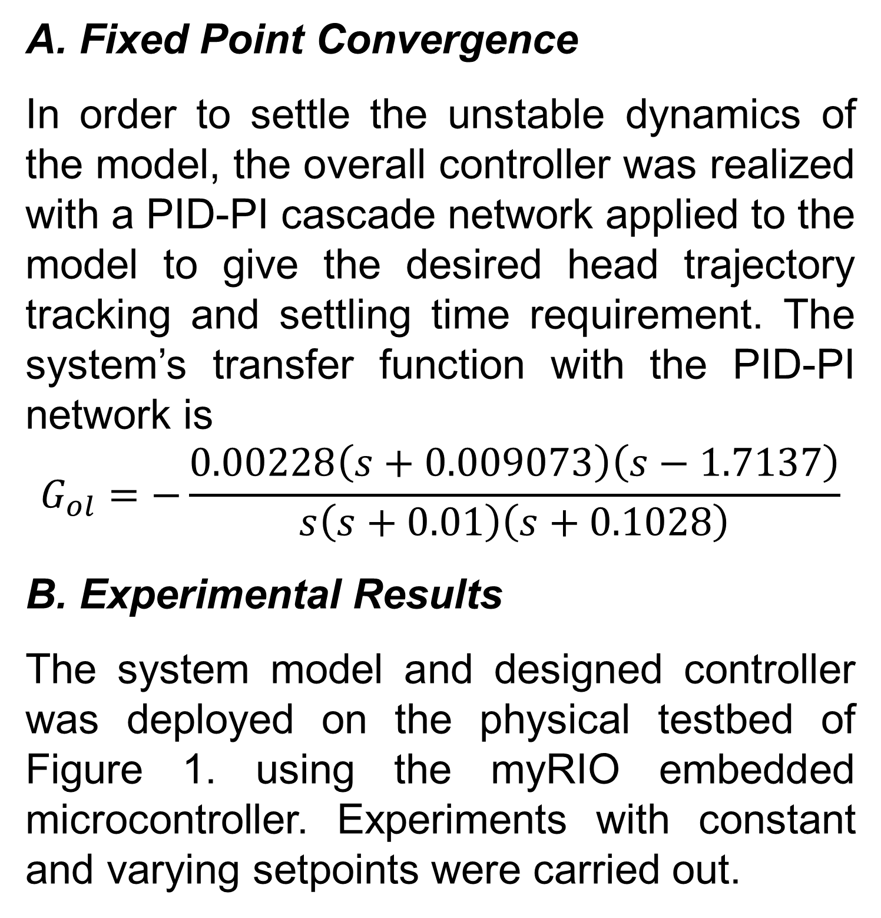
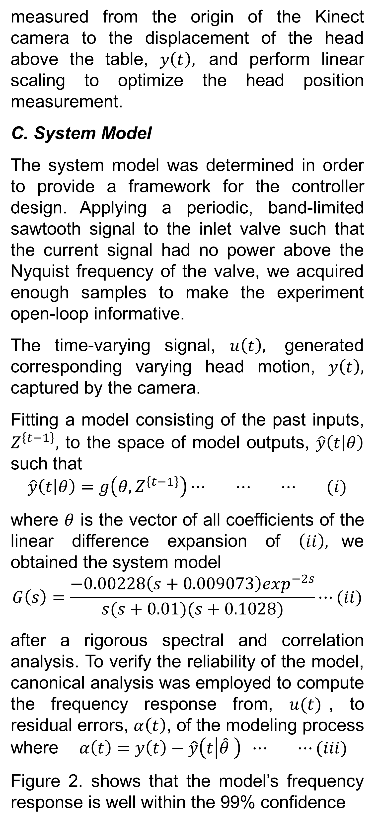
An Image Guided Soft Robotic Patient Positioning System for Maskless Head-and Neck Cancer Radiotherapy: A Proof of Concept Study
O. Ogunmolu¹, N. Gan¹, S. Jiang², X. Gu²
¹$Department of Electrical Enginnering, University of Texas at Dallas, Richardson, Texas$
$$2Department of Radiation Oncology, University of Texas Southwestern Medical Center, Dallas, Texas$$
Purpose
Figure 3 and 4 shows that the controller enables automated desired trajectory tracking with a deviation of no more than 2mm. The spikes in the tracking signal are a result of the noisy structure-from-motion based depth camera of the Vision System. The delay inherent in the system is due to the non-collocation of the sensor and actuator during the experiment.
To build a soft robot for automatic and accurate non-rigid patient positioning during head and neck (H&N) cancer radiotherapy.
Background
As H&N cancers are often treated with intensity modulated radiotherapy (IMRT), high accuracy in patient positioning is a necessity to ensure potent dose irradiation of the target and minimize exposure of surrounding organs at risk (OAR)¹. Employed positioning systems in image guided radiotherapy(RT) do not compensate for the neck curvature changes as state-of-the-art RT couches can only correct rigid motion leaving neck curvature changes in head or neck motion unaccounted for.
Recent advances in soft robots² manufacture have paved the way for easy and comfortable actuation and mimicry of complex human body motion. The customizable, deformable nature of soft robots make them compliant to biomedical actuation of human body motion and they are more suitable for compensating positioning errors in RT.
In this study, we design a one-dimensional motion control soft robot system to demonstrate the feasibility of our mechanical design and control theory to be used for head-and-neck patient positioning.
Figure 1. System Overview: manikin head in a supine position on an IAB. The Kinect RGBD camera above the head measures head displacement triggered by inflation/deflation of the bladder.
measured from the origin of the Kinect camera to the displacement of the head above the table, $y\left(t\right),$ and perform linear scaling to optimize the head position measurement.
C. System Model
The system model was determined in order to provide a framework for the controller design. Applying a periodic, band-limited sawtooth signal to the inlet valve such that the current signal had no power above the Nyquist frequency of the valve, we acquired enough samples to make the experiment open-loop informative.
The time-varying signal, $u\left(t\right),$ generated corresponding varying head motion, $y\left(t\right),$ captured by the camera.
Fitting a model consisting of the past inputs, $Z^{\left\{t−1\right\}},$ to the space of model outputs, $\hat{y}\left(t | θ\right)$ such that
$$\hat{y}\left(t | θ\right)=g\left(θ, Z^{\left\{t−1\right\}}\right)⋯ ⋯ ⋯ (i)$$
where $θ$ is the vector of all coefficients of the linear difference expansion of $\left(ii\right),$we obtained the system model
$$G\left(s\right)=\frac{−0.00228\left(s+0.009073\right)exp^{−2s}}{s(s+0.01)(s+0.1028)}⋯(ii)$$
after a rigorous spectral and correlation analysis. To verify the reliability of the model, canonical analysis was employed to compute the frequency response from, $u(t)$, to residual errors, $α\left(t\right)$, of the modeling process where $α\left(t\right)=y\left(t\right)−\hat{y}\left(t | \hat{θ} \right) ⋯ ⋯(iii)$
Figure 2. shows that the model’s frequency response is well within the 99% confidence
Figure 3. Constant setpoint experiment
Methods and Materials
A. Soft Robot System
This study is limited to the flexion and extension motion control of the H&N region during a simulated RT.
The soft robot system (Figure 1) includes a deformable inflatable air bladder (IAB) made of lightweight, durable polyester and PVC, and a pair of silicone rubber tubes. Each tube is locked onto each of the T-port connector orifices at the mouth the IAB and the other tube terminals convey air to and fro each current-controlled proportional solenoid valves. Air is sourced from a rechargeable 1HP pressurized air canister.
The proportional valves control the actuation of the IAB which in turn controls the motion of the head. A manikin head with ball joint neck was used as a patient phantom.
B. Vision System
A Kinect RGB-D camera was mounted above the couch while the manikin head lied in a supine position on the inflatable bladder. We mapped the displacement of the head as
Figure 2 Frequency analysis from past inputs to residuals
bands (pink and purple lines), leading to the conclusion that the model captures the input-output dynamics and is reliable.
Figure 4. Varying set-points experiment
Results
Conclusion
A. Fixed Point Convergence
In order to settle the unstable dynamics of the model, the overall controller was realized with a PID-PI cascade network applied to the model to give the desired head trajectory tracking and settling time requirement. The system’s transfer function with the PID-PI network is
$$G_{ol}=−\frac{0.00228\left(s+0.009073\right)\left(s−1.7137\right)}{s\left(s+0.01\right)\left(s+0.1028\right)}$$
B. Experimental Results
The system model and designed controller was deployed on the physical testbed of Figure 1. using the myRIO embedded microcontroller. Experiments with constant and varying setpoints were carried out.
This work demonstrates the developed surface image-guided soft robotic patient positioning system can achieve accurate manikin head flexion/extension motion. Given this promising initial result, we will extend the current one-dimensional soft robot control to multiple IABs for non-rigid positioning control. Clinically approved vision systems will help ensure accuracy to less than 0.5mm error.
References
1.L. Xing et al. "Dosimetric effects of patient displacement and collimator and gantry angle misalignment on intensity modulated radiation therapy," Radiother Oncol 56, 97-108 (2000).
2. C. Laschi, et al, "Soft robot arm inspired by the octopus," Advanced Robotics 26, 709-727 (2012).

