Slide 1
Analyze the Book Sales to target new areas of growth
Vilma Topuzi
Timeframe: 2021-03 to 2022-02
Analysis: Vilma.Topuzi; Timeframe: 2021-03 to 2022-02

Slide 2
Overview:
A concentration analysis: Lorenz curve and a Gini coefficient.
Graphic representations: histogram, boxplots, time series graph.
Bivariate analyses.
Is there a correlation between:
gender and categories of products purchased
age and total amount of purchases
age and purchase frequency (number of purchases per month)
age and average basket size (in number of items)
age and categories of purchased products
Analysis: Vilma.Topuzi; Timeframe: 2021-03 to 2022-02

Slide 3
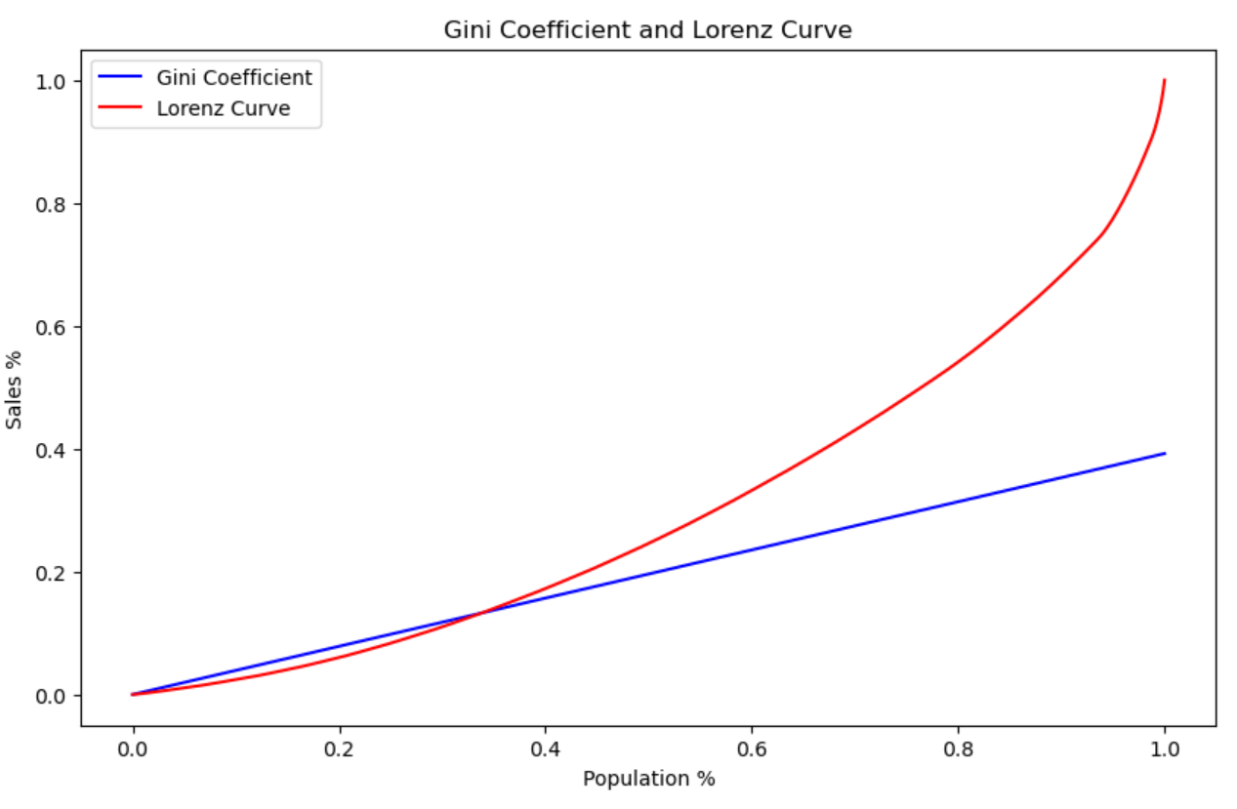
Lorenz curve and Gini Coefficient
About 35% of population counts for 15% of the sales.
Recommendation: Increase the percent of sales per population.
Analysis: Vilma.Topuzi; Timeframe: 2021-03 to 2022-02

Slide 4
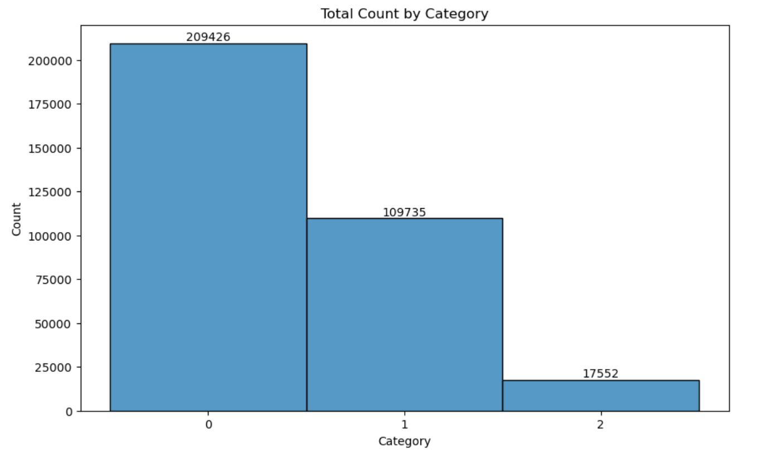
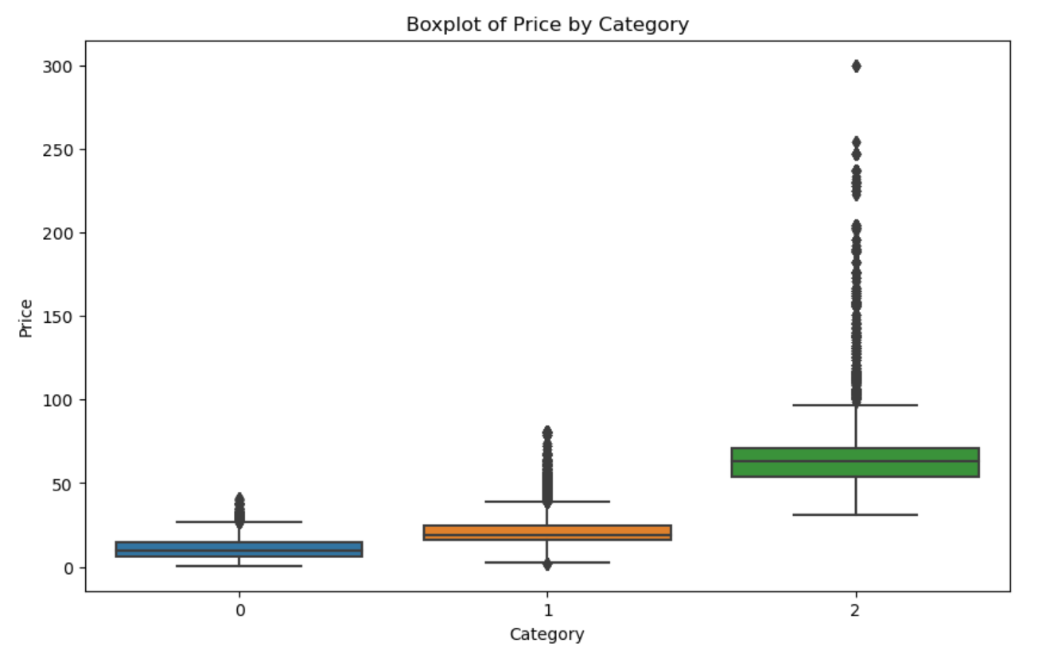
Histogram by Category
Category 0 has the highest number of books sold.
Category 2 has the highest AVG Price sold per book.
Recommendation: Increase sales on Category 1 and 2 but also maintain sales on category 0 as is.
Analysis: Vilma.Topuzi; Timeframe: 2021-03 to 2022-02

Slide 5
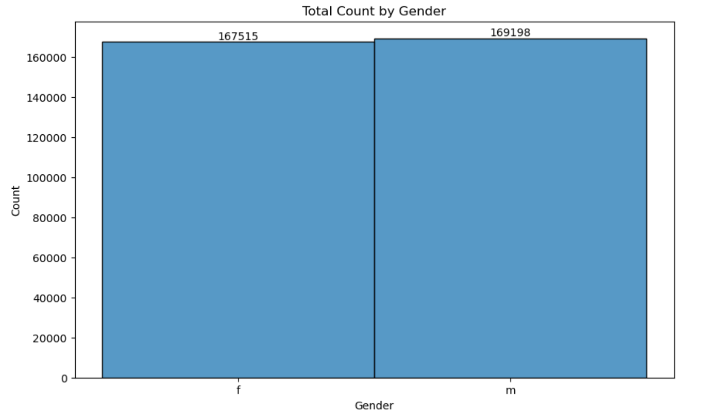
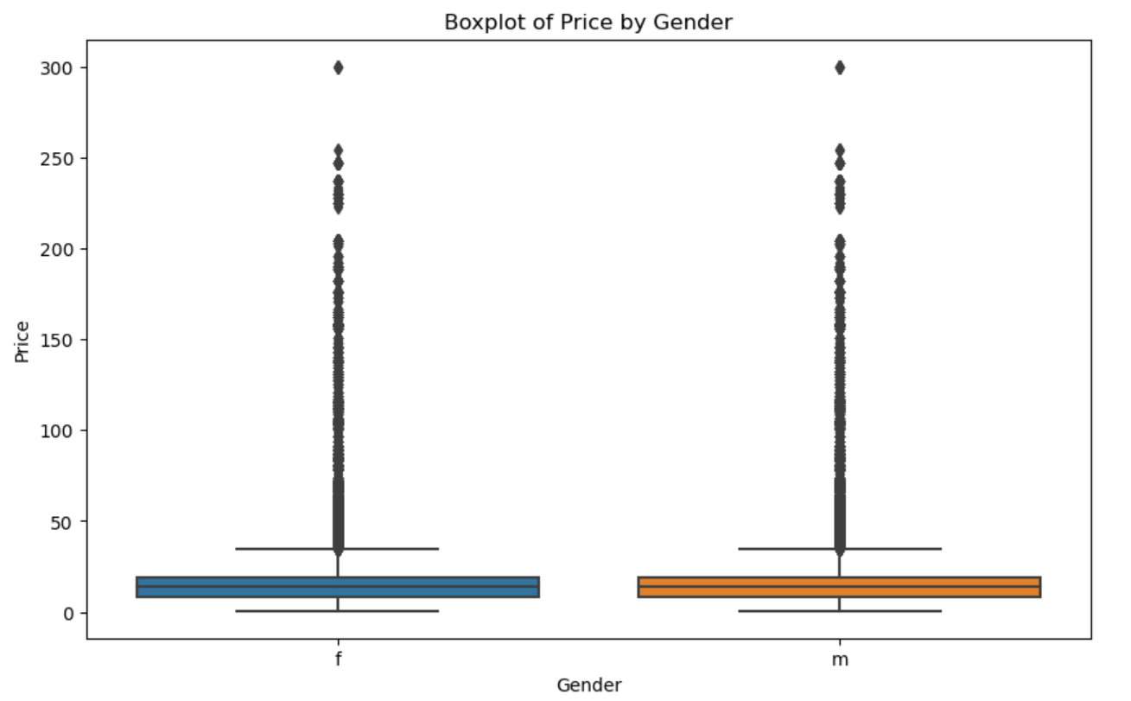
Histogram by Gender
Male has slightly higher number of books sold.
Male and female are spending similar on AVG. per book.
Recommendation: Continue to keep the trends for male and female customers.
Analysis: Vilma.Topuzi; Timeframe: 2021-03 to 2022-02

Slide 6
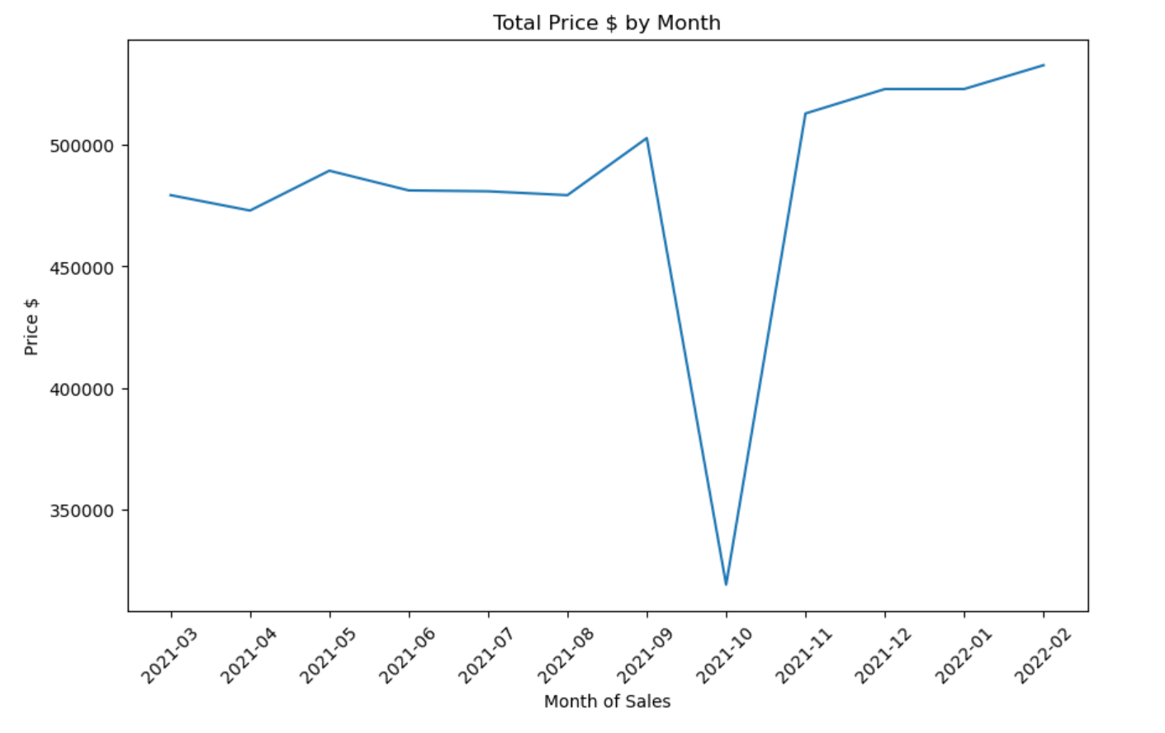
Monthly Sales Trendline
October has the least number of sales.
Recommendations: Increase sales strategy in October.
Analysis: Vilma.Topuzi; Timeframe: 2021-03 to 2022-02

Slide 7
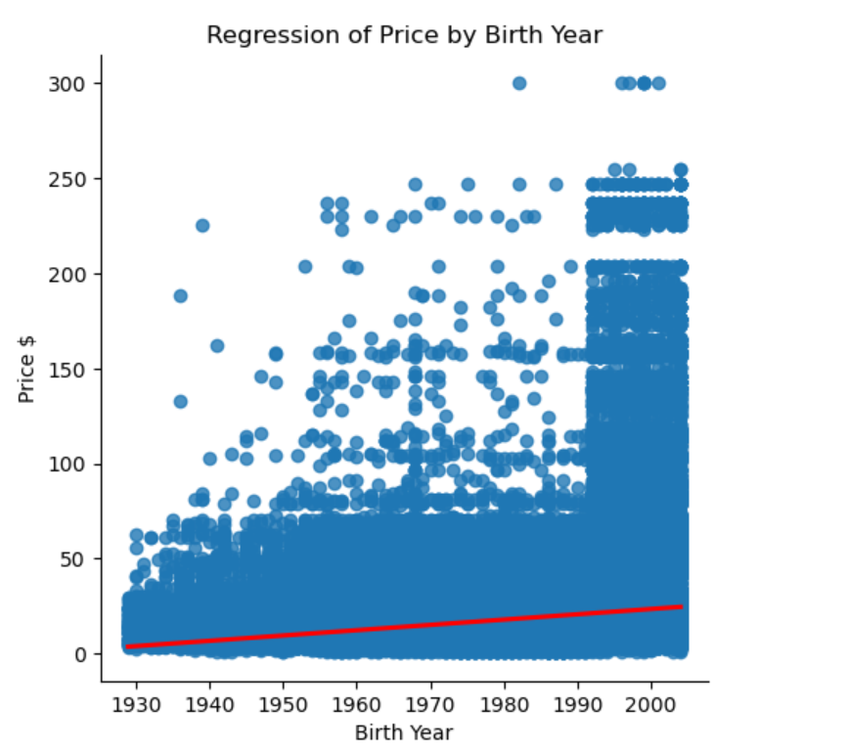
Linear Regression
As the birth year increases, total sales $ increases. Younger customers are purchasing more.
Recommendations: Adjust assortment to attract other group ages.
Analysis: Vilma.Topuzi; Timeframe: 2021-03 to 2022-02

Slide 8
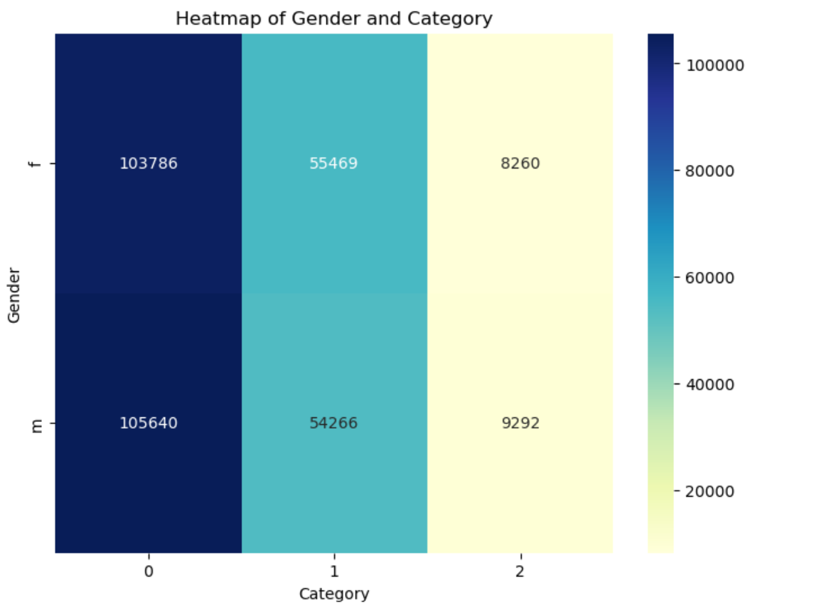

Correlation between Gender and Categories of Product
Chi-Square is high – There is a correlation between gender and categories purchased. They depend on each other.
Analysis: Vilma.Topuzi; Timeframe: 2021-03 to 2022-02

Slide 9




Correlation between Age and …
Total Amount Purchased: Eta-squared is large which indicates a strong relationship between Age and Total $ Purchased. Age has a notable influence on the Total $ Amount Purchased.
Purchase Frequency: Eta is large which indicates a strong relationship between Age and Number of purchases per month. Age has a notable influence on the Number of purchases per month.
Average Basket Size: Eta-squared is large indicates a strong relationship between Age and Average Basket Size. Age has a notable influence on the Average Basket Size.
Category of Purchased: Chi-Square is high – There is a correlation between Age and categories purchased. They depend on each other.
Analysis: Vilma.Topuzi; Timeframe: 2021-03 to 2022-02

Slide 10
Summary
About 35% of population counts for 15% of the sales.
Category 0 has the highest number of books sold.
Category 2 has the highest AVG Price sold per book.
Male has slightly higher number of books sold.
Male and female are spending similar on AVG. per book.
October has the least number of sales.
Younger customers are purchasing more books.
Correlation:
Gender and Categories of Product: There is a correlation between gender and categories purchased. They depend on each other.
Age and Total Amount Purchased: Age has a notable influence on the Total $ Amount Purchased.
Age and Purchase Frequency: Age has a notable influence on the Number of purchases per month.
Age and Average Basket Size: Age has a notable influence on the Average Basket Size.
Age and Category of Purchased: There is a correlation between Age and categories purchased. They depend on each other
Analysis: Vilma.Topuzi; Timeframe: 2021-03 to 2022-02

Slide 11
Recommendations:
Increase the percent of sales per population.
Increase sales on Category 1 and 2 but also maintain sales on category 0 as is.
Continue to keep the trends for male and female customers.
Increase sales in October.
Adjust assortment to attract other group ages than younger customers.
Analysis: Vilma.Topuzi; Timeframe: 2021-03 to 2022-02

