Slide 1
An Enhanced Ant Colony Optimization Metaheuristic for the Minimum Dominating Set Problem
By CK Ho, YP Singh & HT Ewe
CK Ho, YP Singh & HT Ewe, Feb 2006

Slide 2
Outline
Brief Overview of Ant Colony Optimization
Scope
Our contributions
Problem Formulation
The ACO Approach
The enhancement
Summary of results
CK Ho, YP Singh & HT Ewe, Feb 2006

Slide 3
Brief Overview of ACO
Stochastic, iterative, multi-agent (ants) approach to problem solving through search.
During each iteration, every ant construct complete solution.
Experience of each ant communicated to other ants via a global structure – the artificial pheromone.
Pheromone corresponding to promising solution components is reinforced.
CK Ho, YP Singh & HT Ewe, Feb 2006

Slide 4
Scope
The problem addressed: Minimum dominating set (MDS) problem inspired from node clustering in ad hoc networks.
Objective: To propose a better ACO approach for MDS problem, and evaluate its performance.
CK Ho, YP Singh & HT Ewe, Feb 2006

Slide 5
Our contributions
Application of ACO to attack the minimum dominating set problem.
Improving the ACO approach via incorporation of a tournament selection strategy for solution construction. We call our approach ACO-TS.
CK Ho, YP Singh & HT Ewe, Feb 2006

Slide 6
Problem formulation (1)
The model:
An ad hoc network with N nodes can be modeled as an undirected graph G = (V, E), where V is the set of vertices representing the nodes of the network and E is the set of edges.
An edge e_{ij} ∈ E exists between i and j if they can hear each other’s transmission, i.e. if ∥ij∥ ≤ R, where R is the transmission range of the nodes.
CK Ho, YP Singh & HT Ewe, Feb 2006

Slide 7
Problem formulation (2)
Motivation for the MDS problem:
To enhance manageability, nodes are organized into clusters.
Each node is either a cluster head or a normal cluster member.
Cluster heads form the dominating set.
Desirable: Have a minimum number of CHs – therefore minimum dominating set.
CK Ho, YP Singh & HT Ewe, Feb 2006

Slide 8
Problem formulation (3)
The Minimum Dominating Set Problem
A dominating set is a subset of vertices V ’⊆ V such that ∀x ∈ V, either x∈V ’ or ∃ e_{xy} such that y∈ V ’
A node is said to be covered if it is either in the dominating set, or is adjacent to any node in the dominating set.
Two CHs can be, but are not necessarily adjacent.
CK Ho, YP Singh & HT Ewe, Feb 2006

Slide 9
MDS – graphical illustration
Nodes in yellow are members of the DS
i.e. cluster heads
CK Ho, YP Singh & HT Ewe, Feb 2006

Slide 10
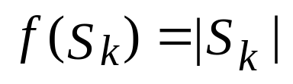
The ACO Approach (1)
Objective function:
Required to measure the quality of the dominating set produced by each ant.
The objective function:
The objective function assigns to each solution S_{k} generated by ant k, its cardinality.
CK Ho, YP Singh & HT Ewe, Feb 2006

Slide 11
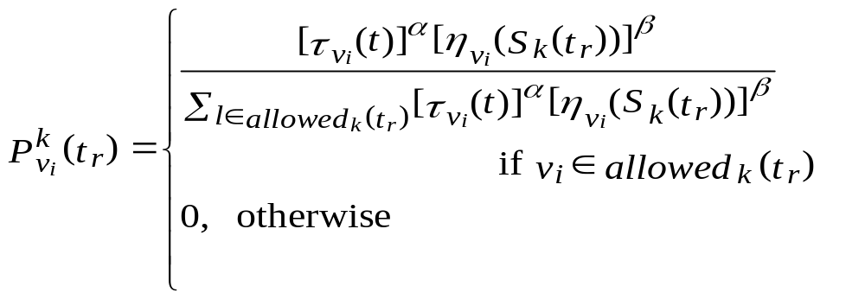
The ACO Approach (2)
Selecting a Solution Component:
At step r of iteration t, an ant k will select node v_{i} to be included in its partially constructed solution S_{k}(t_{r})={v₁,… vj} with probability:
Once a node v_{i} has been selected for inclusion into the solution, it is put on a tabu list so that the same node is never selected twice.
CK Ho, YP Singh & HT Ewe, Feb 2006

Slide 12
The ACO Approach (3)
Factors influencing solution construction:
Visibility measure
Pheromone trail intensity
CK Ho, YP Singh & HT Ewe, Feb 2006

Slide 13

The ACO Approach (4)
Visibility measure:
Given by the term .
Each node v_{i} has an associated weight, weight_{i} and is initialized as weight_{i} = degree(v_{i}) + 1.
The weight of a node v_{i} represents the number of uncovered nodes that will be covered if v_{i} is selected into the partial solution.
The visibility measure for a node is dynamic and depends on the current partial solution S_{k}(t_{r}).
Influence of visibility measure controlled using b.
CK Ho, YP Singh & HT Ewe, Feb 2006

Slide 14
The ACO Approach (5)
Once an ant has selected node v_{i} to be a dominating node, the following weight update procedure will be performed:
proc UpdateWeight(Node v_{i})
weight_{i} = 0
for each neighbor v_{j} of v_{i}
if weight_{j}>0
if covered_{i} = false
weight_{j}= weight_{j} - 1
if covered_{j} = false
covered_{j} = true
weight_{j} = weight_{j} – 1
for each neighbor v_{h} of v_{j}
if weight_{h} >0
weight_{h} = weight_{h} – 1
covered_{i} = true
CK Ho, YP Singh & HT Ewe, Feb 2006

Slide 15
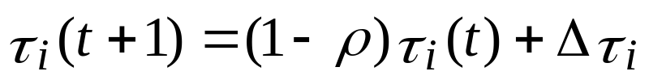

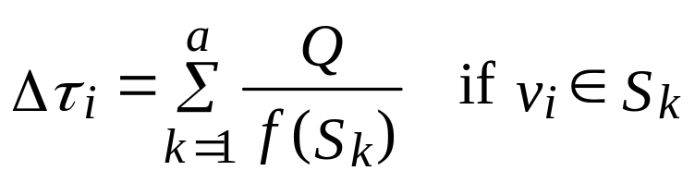
The ACO Approach (6)
Pheromone trail update
At the end of iteration t, the pheromone for node vi is updated for use in iteration t+1 using equation:
where is given by:
CK Ho, YP Singh & HT Ewe, Feb 2006

Slide 16
The Enhancement – Motivation (1)
Search mechanism:
Intensification – Process of identifying characteristics of good solutions that have been found. Then, use these to guide search to discover better solution.
In ACO, intensification achieved via the use of pheromone in solution construction.
CK Ho, YP Singh & HT Ewe, Feb 2006

Slide 17
The Enhancement – Motivation (2)
Search mechanism:
Diversification: Process of expanding the search to cove a larger area of the search space.
In ACO diversification is achieved via the probabilistic nature of solution construction.
CK Ho, YP Singh & HT Ewe, Feb 2006

Slide 18
Tournament Selection Concept
Tournament
Population
winner
Mating Pool
CK Ho, YP Singh & HT Ewe, Feb 2006

Slide 19
ACO-TS – Modifying ant behavior
First, generate a random number, rand in the range [0,1].
If rand ≤ pselect, then tournament selection will be performed.
Otherwise, select solution component as usual.
CK Ho, YP Singh & HT Ewe, Feb 2006

Slide 20
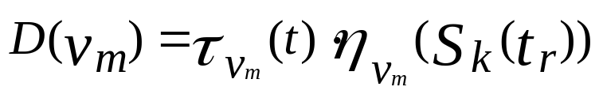
ACO-TS – performing the tournament selection
Select tsize number of allowable nodes to form the tournament pool.
Assign each node v_{m} in the tournament pool a desirability measure D(v_{m}) given as follows:
Tournament winner: node with highest value for D(v_{m}) .
CK Ho, YP Singh & HT Ewe, Feb 2006

Slide 21
Generating the problem instances
Ad hoc networks whose nodes are randomly (uniform distribution) placed in a square area.
Each network is generated in a way so that its topology graph is connected.
ID | Number of nodes | Area size | Trans. Ranges (m)
Net1 | 400 | 3000mx3000m | 210m-240m
Net2 | 350 | 2500mx2500m | 200m-230m
Net3 | 300 | 2000m x 2000m | 180m – 220m
Net4 | 200 | 1000m x 1000m | 100m – 160m
Net5 | 200 | 700m x 700m | 70m – 120m
Net6 | 100 | 600m x 600m | 80m – 120m
Net7 | 100 | 700m x 700m | 90m – 130m
Net8 | 80 | 400m x 400m | 60m – 120m
CK Ho, YP Singh & HT Ewe, Feb 2006

Slide 22
Parameter setting
Determined via randomized complete block design.
ACO parameter | Value
α | 1
β | 4
ρ | 0.1
Q | 5.0
Number of ants | 30
Tournament size | 10
Pheromone update | Iteration best
Probability of performing tournament selection | 0.05
CK Ho, YP Singh & HT Ewe, Feb 2006

Slide 23
Performance measures
Best solution (Min)
Number of times best solution is found (Hits)
Average solution quality (Avg)
Average number of iterations.
CK Ho, YP Singh & HT Ewe, Feb 2006

Slide 24
Compared methods
ACO in the original form
ACO-TS (tournament size = 1, 10)
Genetic Algorithm
50 runs for each method on each problem instance.
CK Ho, YP Singh & HT Ewe, Feb 2006

Slide 25
Results ACO-TS10 vs. ACO
Min: ACO-TS10 produced best solutions for 14 instances.
Avg: ACO-TS10 performed better for 20 instances.
Both methods found best solutions of equal quality for 28 instances. ACO-TS10 gave considerably larger hits for 7 instances.
ACO-TS10 took on average fewer iterations to find solution with desired quality.
Most improvements were found in graphs with >= 200 nodes.
CK Ho, YP Singh & HT Ewe, Feb 2006

Slide 26
Results ACO-TS10 vs. GA
Small number of nodes (80 and 100), best solutions produced are identical in quality.
ACO-TS10 outperformed GA on all 48 instances on the average solution quality measure.
Cases with identical best solution quality, ACO-TS10 gave higher hits.
CK Ho, YP Singh & HT Ewe, Feb 2006

Slide 27
Results ACO-TS10 vs ACO-TS1
Best solutions found are equal in quality for all graphs.
In terms of average solution quality, ACO-TS1 performed better on 5 instances, while ACO-TS10 on 2 instances.
Main advantage of ACO-TS10: significantly fewer iterations on 25 problem instances.
CK Ho, YP Singh & HT Ewe, Feb 2006

Slide 28
Testing for statistical significance
Non-parametric Wilcoxon rank-sum test applied on: Solution quality and number of iterations.
Level of significance α = 0.05.
CK Ho, YP Singh & HT Ewe, Feb 2006

Slide 29
Publication
Applied Artificial Intelligence, Vol. 20, 2006 (in press)
CK Ho, YP Singh & HT Ewe, Feb 2006

Slide 30
Thank you…
CK Ho, YP Singh & HT Ewe, Feb 2006

